Slide 1
Relational Algebra × θ-Join
⨝_{θ}, θ-join, is product (×) of relations followed by selection (σ)
R1 ⨝_{θ} R2 = σ_{θ} (R1 × R2)
Notes:
In theta join, the join operatin is done over a condition.
In product operation, you don’t have to specify the condition, but theta-join you should.

Slide 2


Advanced SQL × FROM × INNER JOIN
3
SELECT Columns
FROM Table1, Table2
WHERE $θ$
1
σ_{θ} (R1 × R2)
2
---------------------------- SAME AS ----------------------------------
3
SELECT Columns
FROM Table1
INNER JOIN Table2 ON $θ$
1
R1 ⨝_{θ} R2
2
Notes:
Theta join is implemented as INNER join in SQL…
The same notation for theta join is inner join..
Preferably DB users, writh the product in 2nd format.

Slide 3
Advanced SQL × FROM × INNER JOIN
Movie |  |  |  | MovieGenre |  | Genre
Id | Title | Language | RunningTime | MovieId | GenreId | Id | Title
1 | 2001: A Space Odyssey | English | 142 | 1 | 1 | 1 | Sci-fi
1 | 2001: A Space Odyssey | English | 142 | 1 | 3 | 3 | Adventure
σ_{Title='2001: A Space Odyssey’}((Movie ⨝_{Movie.Id=MovieId} MovieGenre) ⨝_{Genre.Id=GenreId} Genre)
SELECT *
FROM Movie
INNER JOIN MovieGenre ON Movie.Id = MovieId
INNER JOIN Genre ON Genre.Id = GenreId
WHERE Movie.Title='2001: A Space Odyssey'
Notes:
First, from is executate, then inner joins and then condition and then SELECT.

Slide 4
Advanced SQL × FROM × INNER JOIN
Director
Id | FirstName | LastName | DateOfBirth | PlaceOfBirth | BestMovieId | MovieCount
1 | Stanley | Kubrick | Jul. 26, 1928 | USA | 1 | 13
2 | Alfred | Hitchcock | Aug. 13, 1899 | England | NULL | 47
3 | Clint | Eastwood | May 31, 1930 | USA | NULL | 35
Movie
Id | Title | Language | RunningTime
1 | 2001: A Space Odyssey | English | 142
2 | Rosemary's Baby | English | NULL
What are directors’ best movie name?
SELECT D.Id, FirstName, LastName, BestMovieId, M.Id, Title
FROM Director AS D, Movie AS M
WHERE M.Id = BestMovieId
Notes:
1-From
2-Where
3-Select

Slide 5
Advanced SQL × FROM × INNER JOIN
Director
Id | FirstName | LastName | DateOfBirth | PlaceOfBirth | BestMovieId | MovieCount
1 | Stanley | Kubrick | Jul. 26, 1928 | USA | 1 | 13
2 | Alfred | Hitchcock | Aug. 13, 1899 | England | NULL | 47
3 | Clint | Eastwood | May 31, 1930 | USA | NULL | 35
Movie
Id | Title | Language | RunningTime
1 | 2001: A Space Odyssey | English | 142
2 | Rosemary's Baby | English | NULL
What are directors’ best movie name?
SELECT D.Id, FirstName, LastName, BestMovieId, M.Id, Title
FROM Director AS D
INNER JOIN Movie AS M ON M.Id = BestMovieId

Slide 6
Advanced SQL × FROM × INNER JOIN
Id | FirstName | LastName | BestMovieId | Id | Title
1 | Stanley | Kubrick | 1 | 1 | 2001: A Space Odyssey
What are directors’ best movie name?
SELECT D.Id, FirstName, LastName, BestMovieId, M.Id, Title
FROM Director AS D
INNER JOIN Movie AS M ON M.Id = BestMovieId

Slide 7
Advanced SQL × FROM × LEFT JOIN
FirstName | LastName | BestMovieId | Id | Title
Stanley | Kubrick | 1 | 1 | 2001: A Space Odyssey
Alfred | Hitchcock | NULL | NULL | NULL
Clint | Eastwood | NULL | NULL | NULL
What are directors’ best movie name if any?
Director ⟕_{BestMovieId=Movie.Id} Movie
SELECT D.Id, FirstName, LastName, BestMovieId, M.Id, Title
FROM Director AS D
LEFT [OUTER] JOIN Movie AS M ON M.Id = BestMovieId
Notes:
Left join: we are doing inner join but include all the columns in left table, even if there is no match… if there is no value for the left table, we got null…

Slide 8
Advanced SQL × FROM × RIGHT JOIN
FirstName | LastName | BestMovieId | Id | Title
Stanley | Kubrick | 1 | 1 | 2001: A Space Odyssey
NULL | NULL | NULL | 2 | Rosemary's Baby
List all movies and identify whether each one is the best of its director?
Director ⟖_{BestMovieId=Movie.Id} Movie
SELECT D.Id, FirstName, LastName, BestMovieId, M.Id, Title
FROM Director AS D
RIGHT [OUTER] JOIN Movie AS M ON M.Id = BestMovieId
Notes:
Right join: inner join on a condition with all the columns in right table.
R

Slide 9
Advanced SQL × FROM × FULL JOIN
FirstName | LastName | BestMovieId | Id | Title
Stanley | Kubrick | 1 | 1 | 2001: A Space Odyssey
Alfred | Hitchcock | NULL | NULL | NULL
Clint | Eastwood | NULL | NULL | NULL
NULL | NULL | NULL | 2 | Rosemary's Baby
Director ⟗_{BestMovieId=Movie.Id} Movie
SELECT D.Id, FirstName, LastName, BestMovieId, M.Id, Title
FROM Director AS D
FULL [OUTER] JOIN Movie AS M ON M.Id = BestMovieId
Notes:
All the columns in both table. If there is match, there is value, if no match, NULL values…
Include all rows from both sides.

Slide 10
Advanced SQL × FROM × RIGHT JOIN
Advanced SQL × FROM × FULL JOIN
NOT currently supported in SQLite!

Slide 11

Advanced SQL × SELECT
5
SELECT DISTINCT Columns
FROM Tables
[WHERE $θ$]
[GROUP BY Columns]
[HAVING $θ′\text{]}$
1
2
3
4
Notes:
Another extension to SELECT is a Groupby keyword.

Slide 12
Advanced SQL × GROUP BY
To categorize tuples/ rows based on values on columns.
Group by clause return one row for each group. In other words, reduce the number of rows in the result set.
Group by often is used with aggregate functions such as SUM, AVG, MIN, MAX and COUNT.
Aggregation functions that appears in the SELECT clause provide information about each group
Notes:
Sometime we want to categorise rows to different set and do processing on each set.

Slide 13
Advanced SQL × SELECT x GROUP BY
SELECT
c1, c2,..., cn, AGG(ci)
FROM
table
WHERE
where_conditions
GROUP BY c1 , c2,...,cn;
Notes:
The GROUP BY clause must appear after the FROM and WHERE clauses. Following the GROUP BY keywords is a list of comma-separated columns.
MySQL evaluates the GROUP BY clause after the FROM, WHERE and SELECT clauses

Slide 14
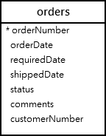

Advanced SQL × SELECT x GROUP BY
What are the status of the orders?
SELECT status
FROM orders
GROUP BY status;
Notes:
Suppose we have order table…
the GROUP BY clause returns unique occurrences of status values.
What is the other way of writing the same query?? It works like the DISTINCT operator as shown in the following query:

Slide 15
Advanced SQL × SELECT x GROUP BY
What are the status of the orders?
SELECT DISTINCT status
FROM orders;
Notes:
What is the other way of writing the same query?? It works like the DISTINCT operator as shown in the following query:

Slide 16
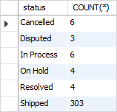
Advanced SQL x GROUP BY x AGG
What are the number of orders in each status?
SELECT status, COUNT(*)
FROM orders
GROUP BY status;

Slide 17
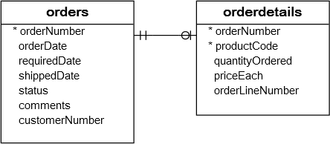
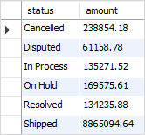
Advanced SQL x GROUP BY x AGG
What are the total amount of all orders per status?
SELECT status, SUM(quantityOrdered * priceEach) AS amount
FROM orders, orderdetails
WHERE orders.orderNumber = orderdetails.orderNumber
GROUP BY status;
Notes:
See the following orders and orderdetails table.

Slide 18
Advanced SQL × GROUP BY
Movie
Id | Title | Language | ReleaseDate | RunningTime
1 | 2001: A Space Odyssey | English | 1968 | 142
2 | Rosemary's Baby | English | 1968 | NULL
3 | The Birds | English | 1963 | 119
4 | Planet of the Apes | English | 1968 | 112
How many movies have been made in each year?
ReleaseDate | COUNT(*)
1968 | 3
1963 | 1
Notes:
e.g., we want to know how many movie released in each year….we need to categorize them..
We need to categorize them based on releaseDate…. We apply GROUPBY on Column (ReleaseDate) and then apply COUNT on columns in each group..
This is a very common practice in DB.. We want to know how many students enroll for each course in a department?? How many students are in each department?? And etc. we apply groupby on different course title and do a counting…

Slide 19
Advanced SQL × GROUP BY
Movie
Id | Title | Language | ReleaseDate | RunningTime
1 | 2001: A Space Odyssey | English | 1968 | 142
2 | Rosemary's Baby | English | 1968 | NULL
3 | The Birds | English | 1963 | 119
4 | Planet of the Apes | English | 1968 | 112
How many movies have been made in each year?
SELECT ReleaseDate, COUNT(*)
FROM Movie
GROUP BY ReleaseDate
ReleaseDate | COUNT(*)
1968 | 3
1963 | 1
Notes:
e.g., we want to know how many movie released in each year….we need to categorize them..
We need to categorize them based on releaseDate…. We apply GROUPBY on Column (ReleaseDate) and then apply COUNT on columns in each group..
This is a very common practice in DB.. We want to know how many students enroll for each course in a department?? How many students are in each department?? And etc. we apply groupby on different course title and do a counting…

Slide 20
Advanced SQL × GROUP BY
Movie
Id | Title | Language | ReleaseDate | RunningTime
1 | 2001: A Space Odyssey | English | 1968 | 142
2 | Rosemary's Baby | English | 1968 | NULL
3 | The Birds | English | 1963 | 119
4 | Planet of the Apes | French | 1968 | 112
How many movies have been made in each year per language?
ReleaseDate | Language | COUNT(*)
1968 | English | 2
1968 | French | 1
1963 | English | 1
Notes:
If we have multiple columns after GROUPBY: the table will be categorized based on the combination of these columns. Then the count function will be applied on the columns on each category.
e.g., not we have three releaseDates. The result is different with the last statement.

Slide 21
Advanced SQL × GROUP BY
Movie
Id | Title | Language | ReleaseDate | RunningTime
1 | 2001: A Space Odyssey | English | 1968 | 142
2 | Rosemary's Baby | English | 1968 | NULL
3 | The Birds | English | 1963 | 119
4 | Planet of the Apes | EN | 1968 | 112
How many movies have been made in each year per language?
SELECT ReleaseDate, Language, COUNT(*)
FROM Movie
GROUP BY ReleaseDate, Language
ReleaseDate | Language | COUNT(*)
1968 | English | 2
1968 | EN | 1
1963 | English | 1
Notes:
If we have multiple columns after GROUPBY: the table will be categorized based on the combination of these columns. Then the count function will be applied on the columns on each category.
e.g., not we have three releaseDates. The result is different with the last statement.

Slide 22
Advanced SQL × GROUP BY
Movie
Id | Title | Language | ReleaseDate | RunningTime
1 | 2001: A Space Odyssey | English | 1968 | 142
2 | Rosemary's Baby | English | 1968 | NULL
3 | The Birds | English | 1963 | 119
4 | Planet of the Apes | EN | 1968 | 112
How many movies have been made in each year per language?
SELECT Title, ReleaseDate, Language, COUNT(*)
FROM Movie
GROUP BY ReleaseDate, Language
SELECT clause only accepts AGG or columns in GROUP BY list.
ReleaseDate | Language | COUNT(*)
1968 | English | 2
1968 | EN | 1
1963 | English | 1
Notes:
If we want to know how many movie has been made each year and include the title of the movie, this query cannot be run…because the grouping is based on the groupby columns.. We don’t have the TITLE for the output of groupby columns.
When we use GROUPBY statement, in the select clause we can only have the same columns as in a GROUPBY statement AND AGG function.

Slide 23
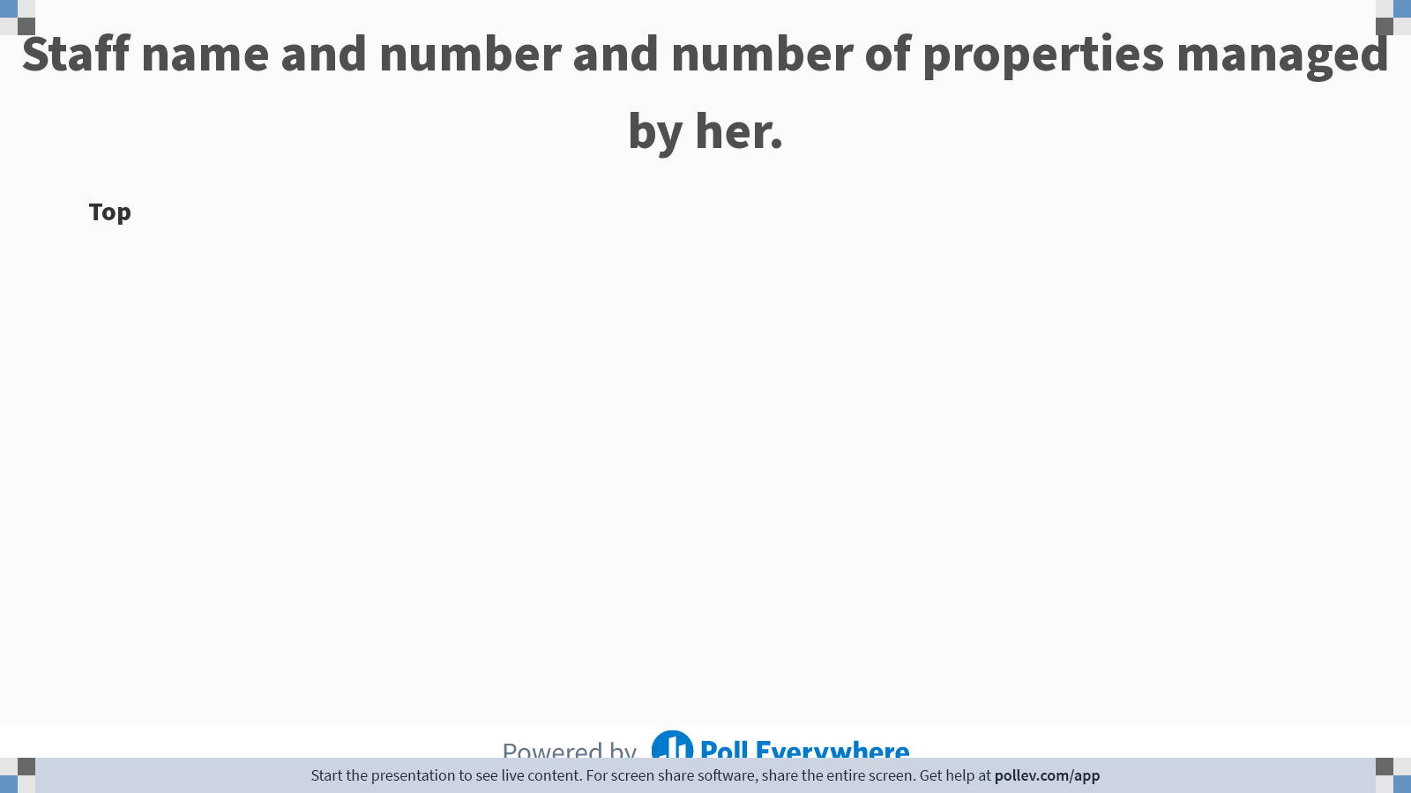
PROPERTYFORRENT (pno, street, area, city, pcode, type, rooms, rent, sno)
STAFF (sno, fname, lname, position, sex, DOB, salary, bno)
BRANCH (bno, street, city, postcode)
Notes:
Poll Title: Do not modify the notes in this section to avoid tampering with the Poll Everywhere activity. More info at polleverywhere.com/support Staff name and number and number of properties managed by her. https://www.polleverywhere.com/discourses/psnTPe5aqqisdpjhxo746

Slide 24
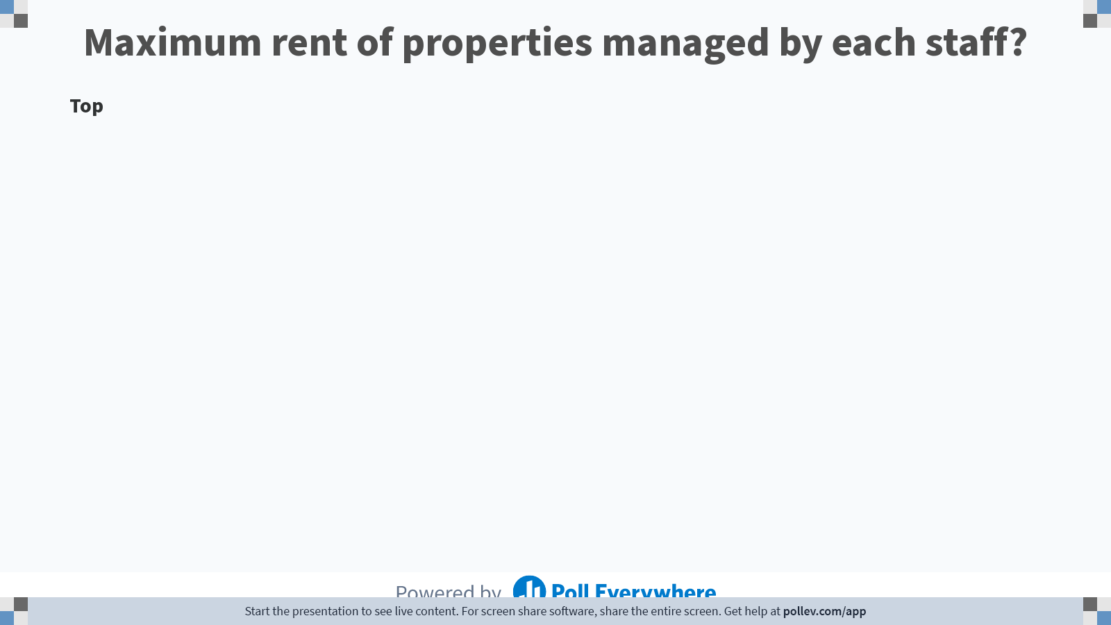
PROPERTYFORRENT (pno, street, area, city, pcode, type, rooms, rent, sno)
STAFF (sno, fname, lname, position, sex, DOB, salary, bno)
BRANCH (bno, street, city, postcode)
Notes:
Poll Title: Do not modify the notes in this section to avoid tampering with the Poll Everywhere activity. More info at polleverywhere.com/support Maximum rent of properties managed by each staff? https://www.polleverywhere.com/discourses/9dZkjgjklQ6urSeDeehQr

Slide 25
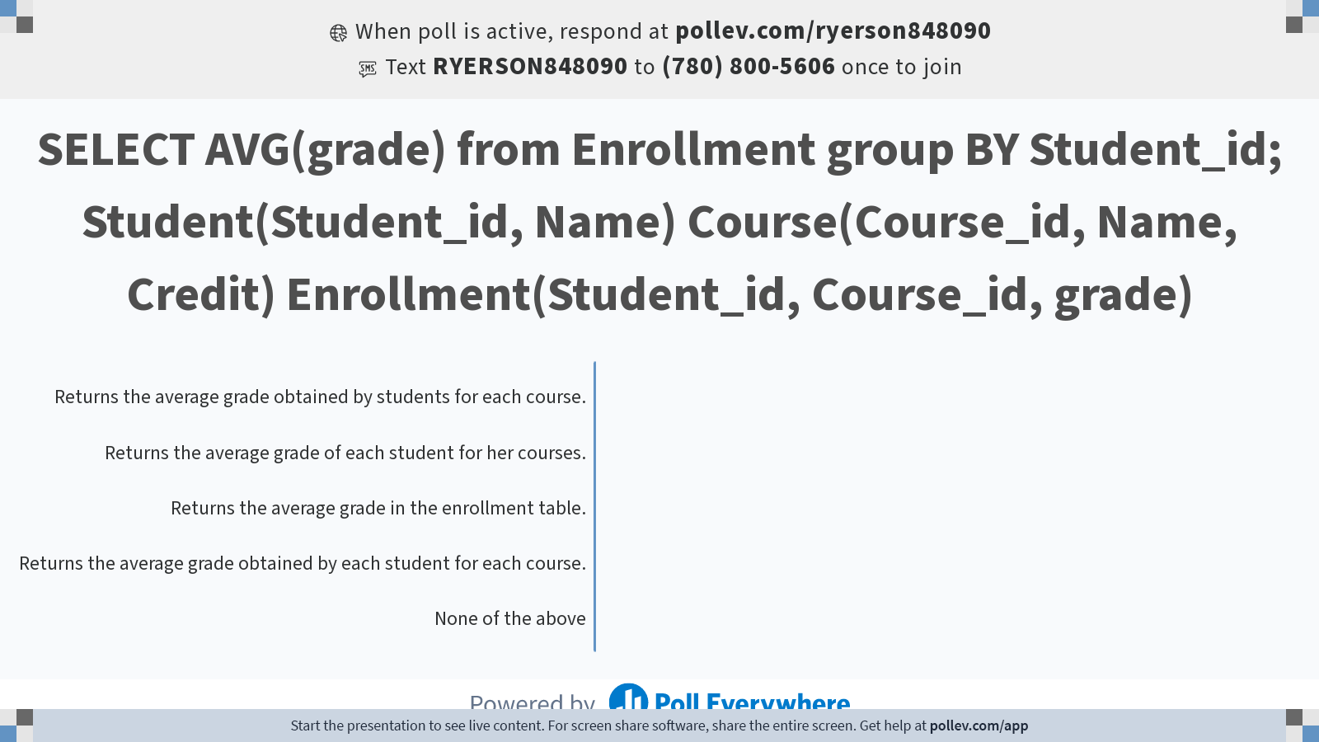
Notes:
Poll Title: Do not modify the notes in this section to avoid tampering with the Poll Everywhere activity. More info at polleverywhere.com/support SELECT AVG(grade) from Enrollment group BY Student_id; Student(Student_id, Name) Course(Course_id, Name, Credit) Enrollment(Student_id, Course_id, grade) https://www.polleverywhere.com/multiple_choice_polls/mWcVETAf7KFHMBkPjJofj?state=opened&flow=Default&onscreen=persist

Slide 26
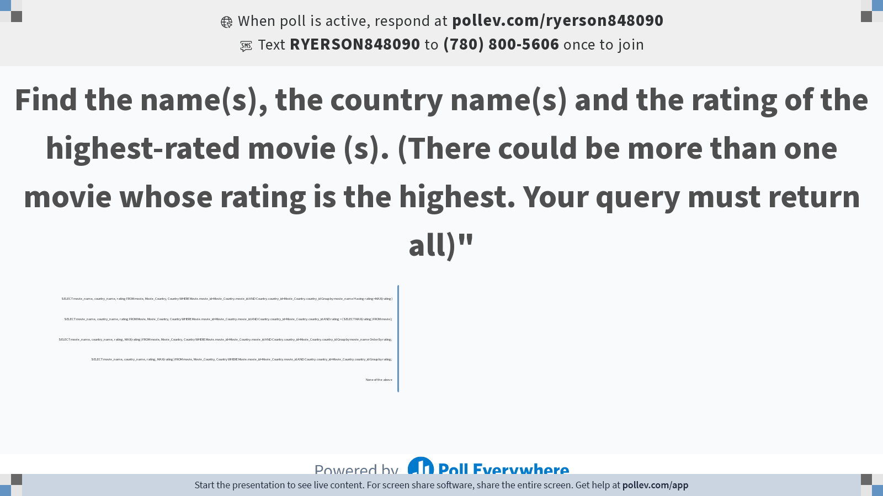
Movie (movie_id, movie_name, rating)
Country(country_id, country_name)
Movie_Country (movie_id, country_id)
Notes:
Poll Title: Do not modify the notes in this section to avoid tampering with the Poll Everywhere activity. More info at polleverywhere.com/support Find the name(s), the country name(s) and the rating of the highest-rated movie (s). (There could be more than one movie whose rating is the highest. Your query must return all)" https://www.polleverywhere.com/multiple_choice_polls/IqmUjvq5LHxInO2agix5v?state=opened&flow=Default&onscreen=persist

