Slide 1

JK Grader
Grade Performance Analyzer
A.Y Dissanayake
120126K

Slide 2
System Details
standalone
Python
Publishing the Grades of other students are illegal
Since this is the analysing system accuracy and efficiency is the main concern. Python is the best scientific language.

Slide 3
Main Capabilities of The System
Student Performance Representation
Prediction
Lecture Performance Representation
Based On Previous Subjects He has taken
Based On Student obtained in CA

Slide 4
Prediction Based On Previous Subjects He has taken
Using Hidden Markov Model
Can Model Relation Up to 3 Subjects
Probabilities are calculates analyzing one previous batch result pattern and write them presently in configuration files
Eg: Here I used OOP and OOSD result to Predict Software architecture result using 40 student result of 11 Batch. Count all patterns (ex: count all student OOP-A,OOSD-B, Software Architecture –B and take percentage and assign that value to branch of that model) . Those values are write in text files at the configuration level for increase the performance

Slide 5
Reason of choosing Hidden Markov Model ..
Comparing 2 students marks(previous batch student with current batch) is not a good in accuracy since they are not identical in manner.
Here we take a mean value by studying all student patterns

Slide 6
Example Model for 1 subject
Hidden States: Software Architecture Marks
Use Only A ,B, C and F levels for out put increase performance
Transition Probabilities
A
B
C
F
Emission Probabilities
A+
A
A-
B+
B
B-
C+
C
C-
F
Observation: Previous Subject Marks
How I assign Probabilities

Slide 7
How Probabilities are Assigned
Emission Probabilities
Data:
Sub1(Hidden State) | Sub2(Observed State)
A | A
A | A
A | B
A | A
A | C
A
0.6
0.2
0.2
A
B
C
Probabilities:
AA:3/5=0.6
AB:1/5=0.2
AC:1/5=0.2
Like this all values are calculated and saved in a text file at the configuration level for all states. Since no need to run every time.

Slide 8
How Probabilities are Assigned
Transitions Probabilities
Starting Probabilities
A
B
C
F
All states are assigned a same probabilities
Ex:
[0.25, 0.25, 0.25, 0.25]
For 1 subject model this probability has no effect. But if there is a 2 subjects then more probability should have most closes grade since output is for same subject.
Example in A’s and C’s transition probabilities should be [0.4,0.3,0.2,0.1] and [0.1,0.3,0.4,0.2]

Slide 9
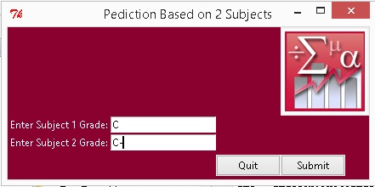
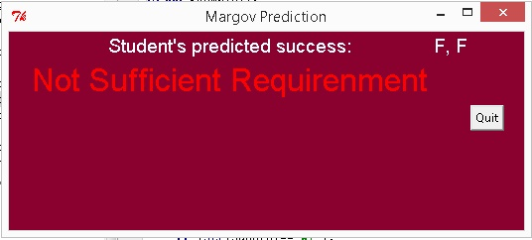
How Probabilities are Assigned
Input
Out Put

Slide 10
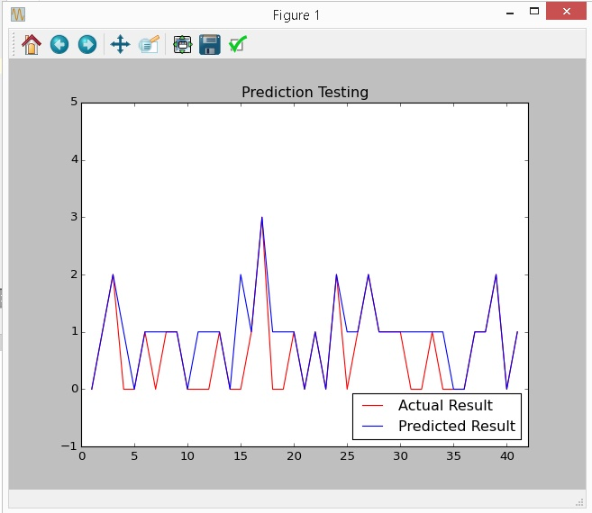
Accuracy Testing By Unit Testing in OOP module Related to Software Engineering module
Here I include grades and have a lower bound of result since I need a worst case scenario of 41 students in 11 Batch.

Slide 11
Prediction Based On CA marks achieved
Can Model Relation Up to 15 assignments marks by assuming maximum 14 weeks in one academic semester
Algorithms Used
Curve Fitting
Exponential Weighted Average Regression
Exponential Moving Average Regression
Weighted Regression
Weights are assign by analyzing actual data

Slide 12
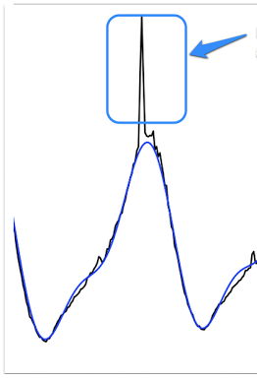
Reason of choosing 3 algorithms instead one..
Since here we are consider CA marks there can have more deviation sin data points.
Here we reduce such deviations.

Slide 13
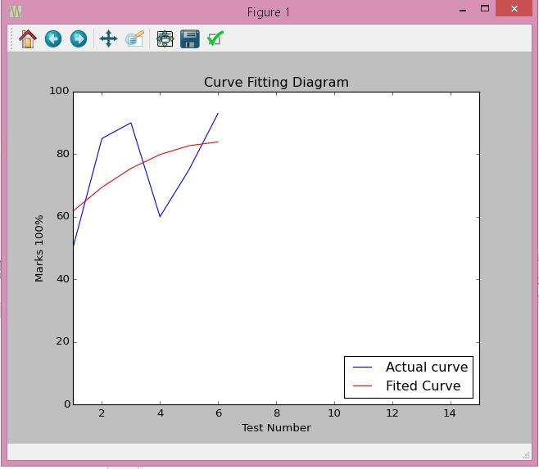
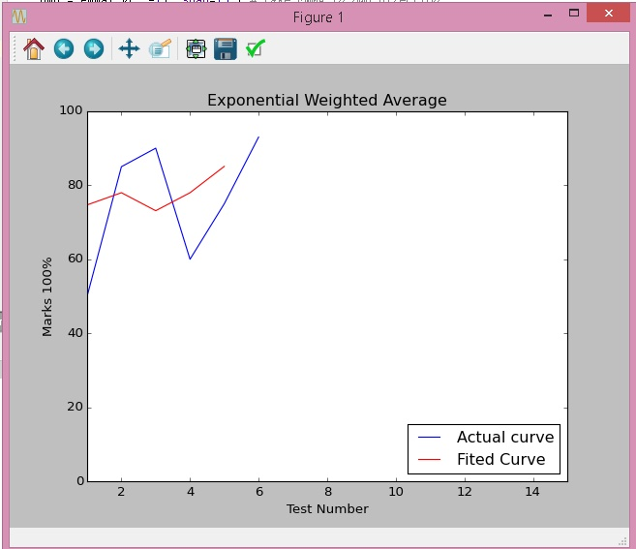
Unit Testing of algorithms
(Eg: Data Structure Module result of a 120006T)
Curve Fitting
Exponential Weighted Average Regression

Slide 14
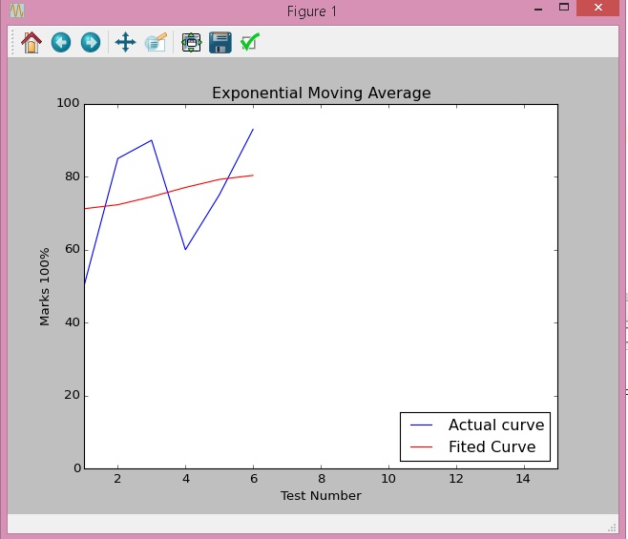
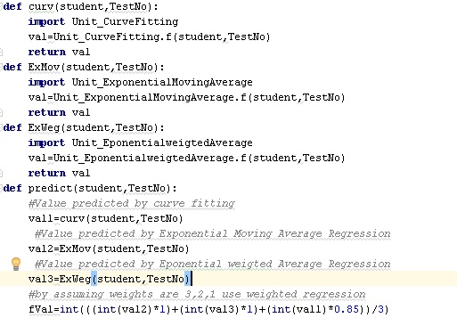
Unit Testing of algorithms
(Eg: Data Structure Module result of a 120006T)
Finally These algorithms predicted values are combined using weighted regression
Exponential Moving Average Regression

Slide 15
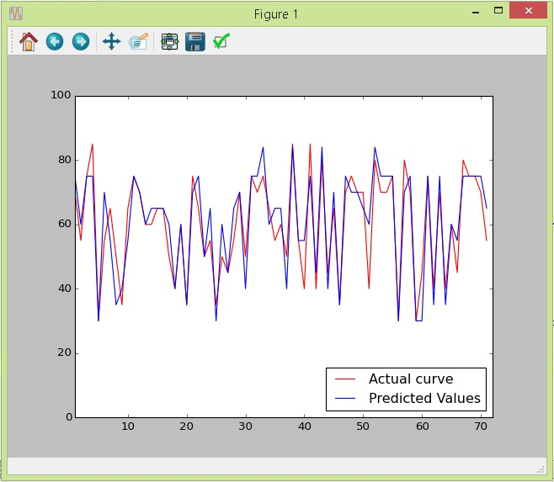
Accuracy Testing By Unit Testing
(in Data Structure module of a 12th Batch using 71 students results)

Slide 16
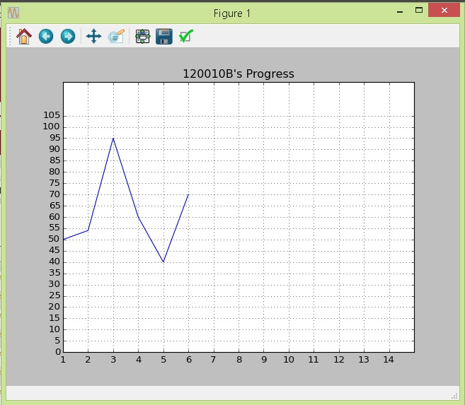
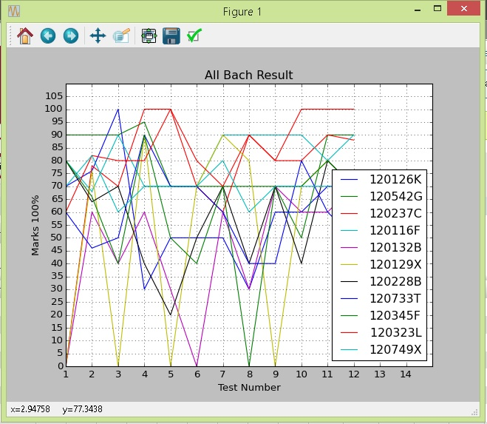
Student/s Performance Representation
Graphical representation of weekly CA marks %
Compared to whole batch
individual Student

Slide 17
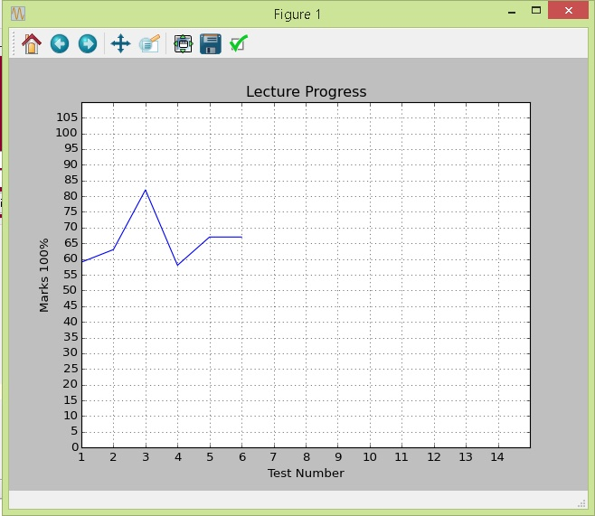
Lecture Performance Representation
Using Average value of a students display the which assignment is the most difficult to students.
This is data structure and algorithms assignments marks

Slide 18
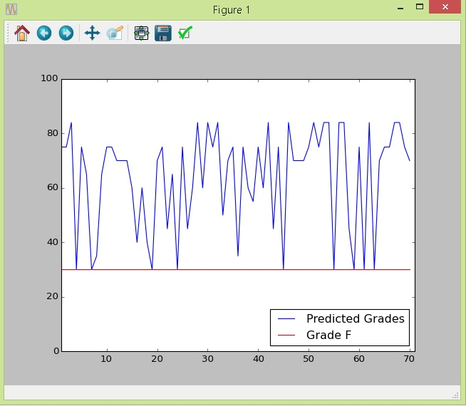
Lecture Performance Representation
Using predicted value display the final result of a whole batch.
This is data structure and algorithms assignments marks

Slide 19
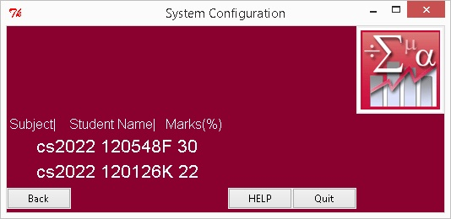
Warnings Representation
View the students who has predicted value lower than 35

Slide 20
Other Feature of The System
Backups System
Use database and text files to keep passwords and other configuration files
Encryption System
Use 64Base Encryption method for keep passwords and usernames
User Friendly GUI
Use Help option each and every main windows

Slide 21
Design Patterns
Singleton
Memento
Since this is the single user standalone system when creating user system use this design patter.
Provide the Roll back feature of the passwords and username.

Slide 22
Database System of the System
Event Handling
Entries of warning table are deleted when after the year
Triggers handling
Each insertion of the new test mark current predicted value of a student update and if it is <35 it goes to the warnings table
Encryption
Use Encryption when store passwords and user name backups.
SQL injections
Prepared Statements

Slide 23
System Testing
Unit Testing->> PySuit Test Runner
Accuracy Testing->>PyUnit frame work using graphs
UI Testing ->> mock pach test framework
Performance Testing ->> Manual testing using pyUnit testing

Slide 24
Scope of the System
Personnel usage of lecturer.
Goal
Goal is increase the marks of user’s student’s and make easy to have over view about batch.
Objectives
To Provide more accurate prediction for result at examination, which is useful for student to improve the work before examination.
To design and implement the tool which can analysing trends in an individual student’s grades over a number of weeks, comparing one student’s performance against another’s over a course module ,predicting a student’s likely grade in an exam, view the student performance graphically over a time period
To provide lecture progress based on assignment marks

Slide 25
Deliverables
Graphical comparison (chart) of result of student’s work over a particular period of time (GUI).
Graphical representation of the final result of a whole batch to identify no of students which have more probability to fail.
Stand alone application.
Main Functional Requirement
Accuracy of the prediction
Main Non Functional Requirements
High performance and less resource consumption

Slide 26
Thank You !

