Slide 1
Hopfield Net Based Neural Processor
Kamalakkannan Kamalavasan
Yasas Seneviratne
Dr. Ajith Pasqual

Slide 2
Introduction
Neural net processing in a single core processor takes a considerable amount of time.
To overcome this using the Graphics Processing Unit(GPU) is a commonly used alternative in general purpose applications.
But in the field of embedded processing and Application Specific Integrated Circuits(ASICs) GPUs are rarely or not at all used which makes the processing of neural net based computations inefficient and time consuming.
Hopfield net is a Recurrent Neural Network(RNN) which is capable of identifying a pre trained pattern and uses minimum number of multiplications as compared to Convolutional Neural Networks(CNN).
This is why Hopfield net was used as the base for the development of the Neural net processor which is capable of working alongside a conventional embedded or ASIC processor.

Slide 3
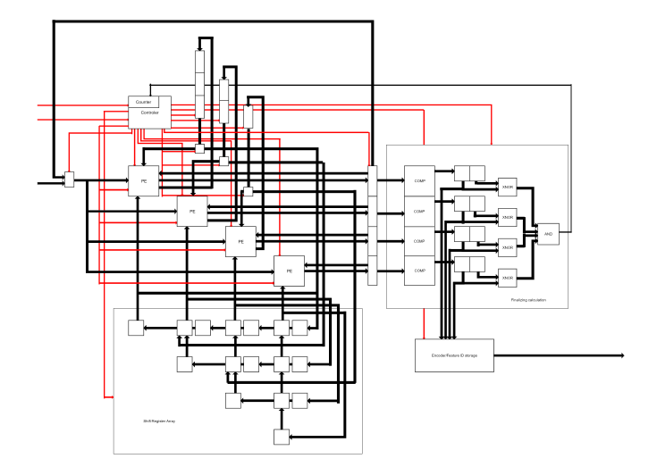
Architecture : Overview
The figure shows a processor which is miniaturized for the simplicity of explanation.
Processor consists of the following main components.
The Processing Elements
The FIFO Array
The Weight matrix
The Final Calculator
Controller

Slide 4
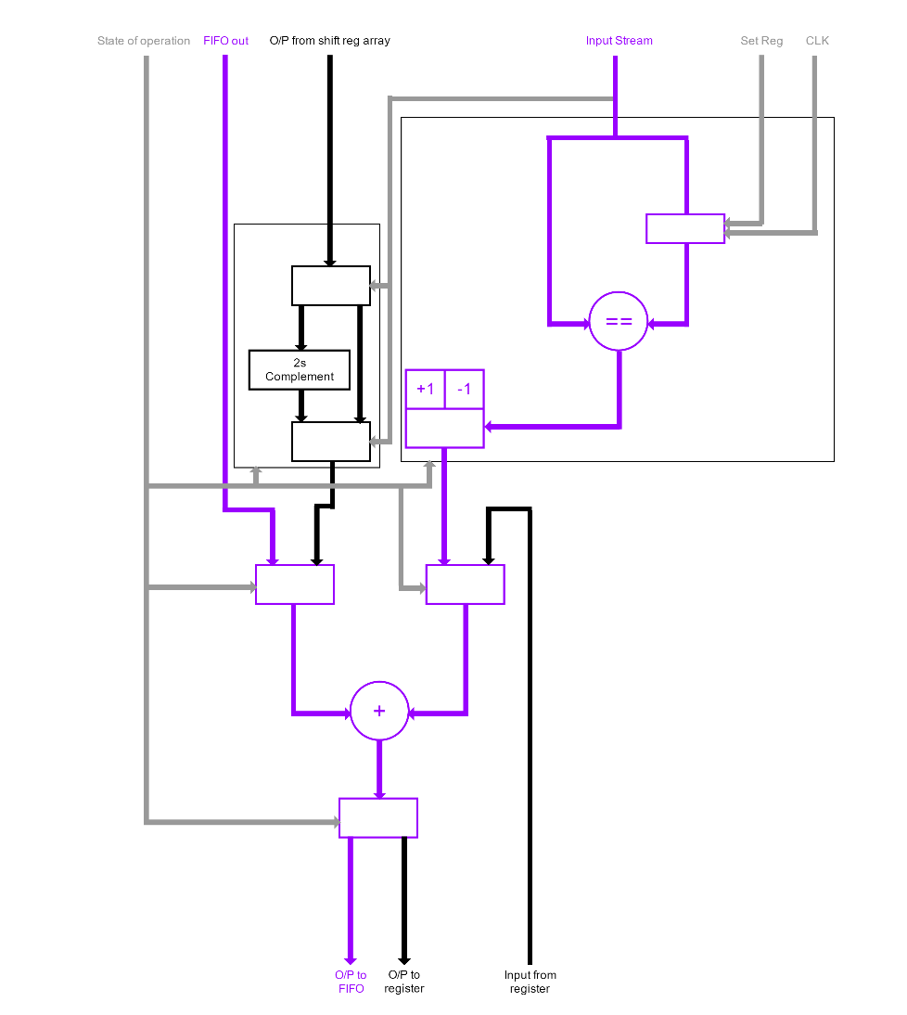
Architecture : Processing Element
The Processing Element(PE) has two different states of operation in the training and recognition stages.
In the PE only addition and comparison operations are used.

Slide 5
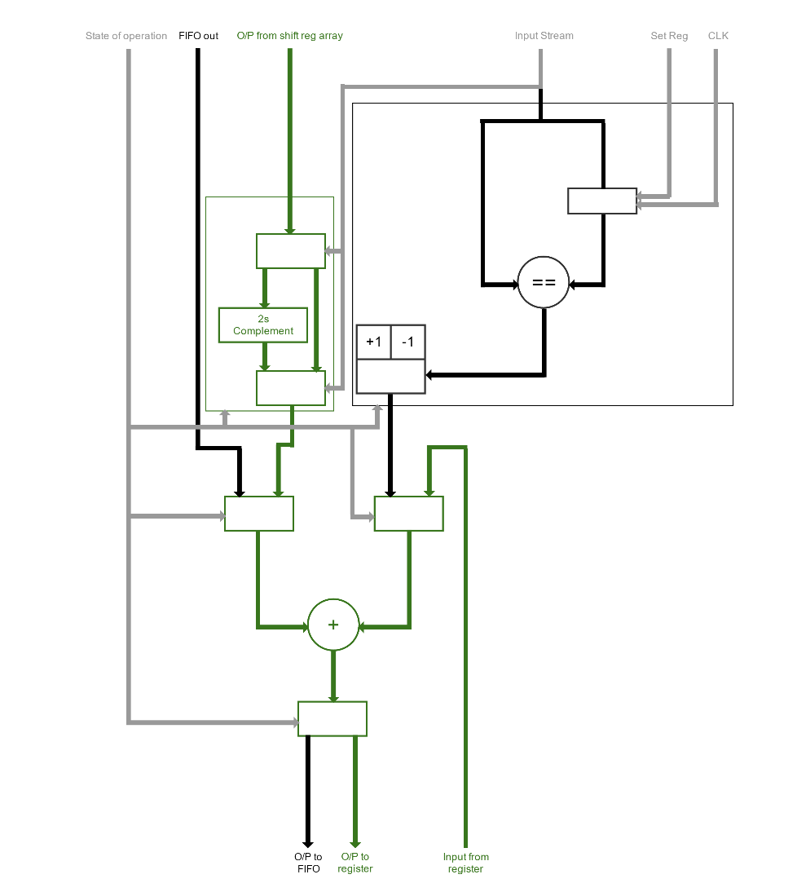
Architecture : Processing Element
The Processing Element(PE) has two different states of operation in the training and recognition stages.
In the PE only addition and comparison operations are used.
Multiplication by 1 and -1 are achieved by addition and 2’s complement addition.

Slide 6
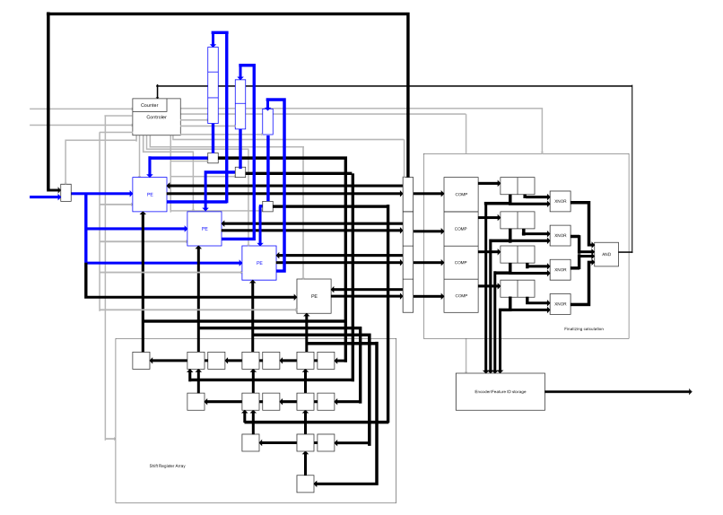
Stages of Operation: Training Stage 1
The 1st stage of training is generation of the weight matrix.
This process is fully parallelized.
The final generated values in the FIFOs are equivalent to the upper triangular sector values in the weight matrix.

Slide 7
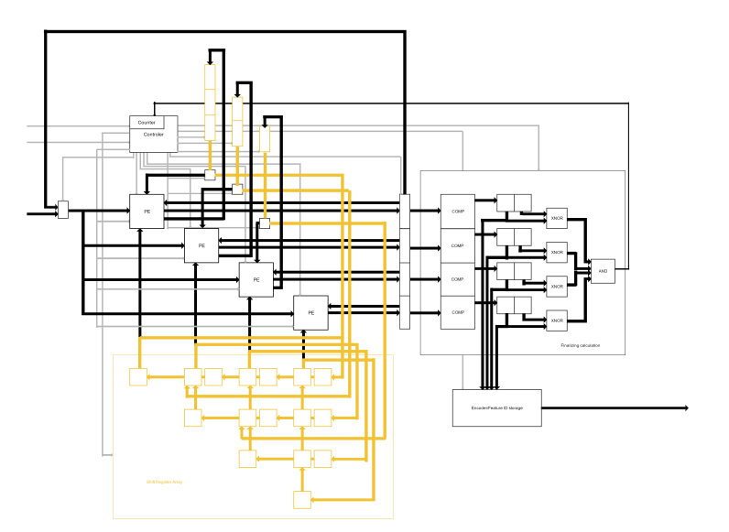
Stages of Operation: Training Stage 2
Moving the upper triangular sector of the weight matrix in to the shift register array and completion of the matrix

Slide 8
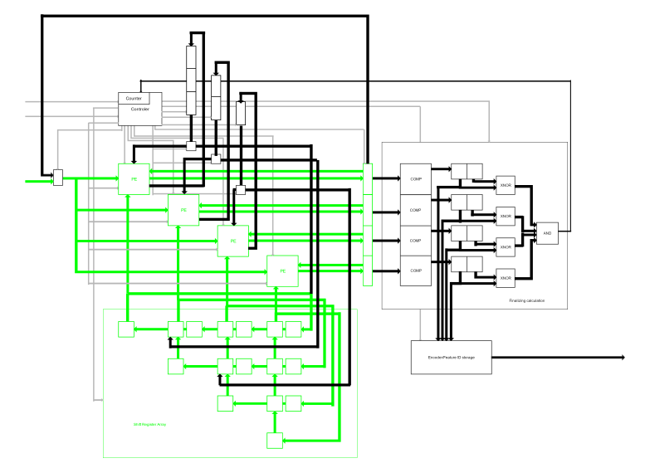
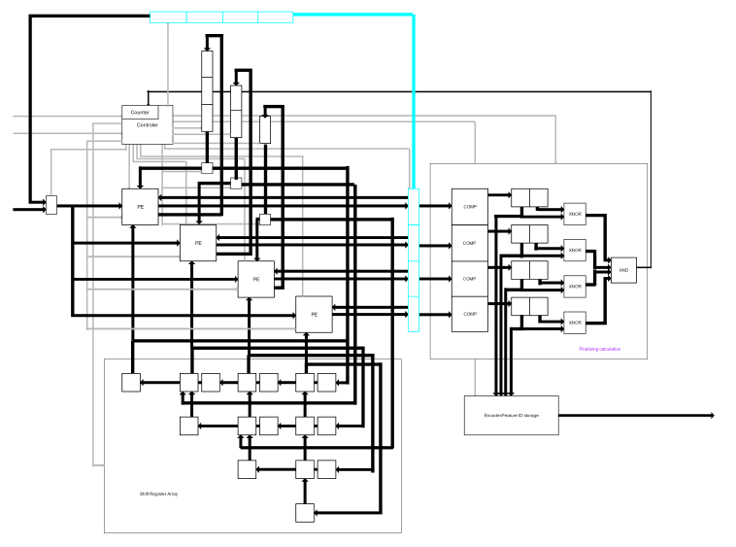
Stages of Operation: Detection

Slide 9
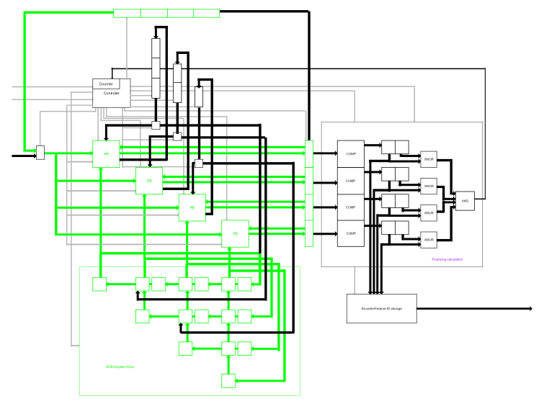
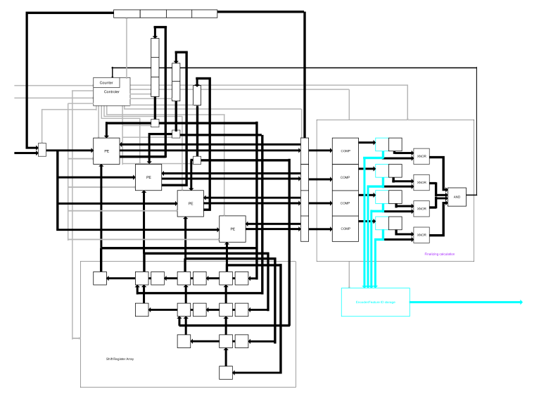
Stages of Operation: Detection

Slide 10
Fields of Application
Handwriting recognition
Feature detection in images
License plate identification
Road sign detection

Slide 11
Simulation Specifications
Catagory | Neural Net Processor | Microblaze Processor | NNEP
Development Board | Xilinx Zybo (xc7z010clq400-1) | Xilinx Zybo (xc7z010clq400-1) | Custom Chip
Operating frequency | 100MHz | 1200MHz | 400MHz
The Neural net processor is also capable of running at 200MHz
Simulation Methodology
Simulation was done using a test bench which used text files as inputs.
One input files contained the pattern to be taught to the Neural net processor and the other contained the pattern to be recognized.
The test bench reads the files accordingly in each state of operation.

Slide 12
Results : Performance vs Microblaze

Slide 13
Results : Performance vs NNEP

Slide 14
Results : Resource Utilization
Site Type | Used | Fixed | Available | Utilization%
Slice LUTs | 1026 | 0 | 17600 | 5.83%
LUT as Logic | 948 | 0 | 17600 | 5.39%
LUT as Memory | 78 | 0 | 6000 | 1.30%
Slice Registers | 2074 | 0 | 35200 | 5.89%
Register as Flip Flop | 2074 | 0 | 35200 | 5.89%

Slide 15
Results : Power
Results were generated at 30 degree Celsius.
Total on chip power | 0.111W
Dynamic | 0.005W
Signal | 0.002W
Logic | 0.002W
IO | <0.001W
Static | 0.106W
Junction Temperature | 31.3 Celsius

Slide 16
Shortcomings
Limitation of the Hopfield algorithm which made it only possible to train a limited number of patterns to a given number of nodes. If the number of nodes were N number of patterns that can be taught equaled 0.15*N.
Weight matrix size increases with additional number of nodes with this the number of processing elements and other resource utilization increase.

Slide 17
Further Improvements
Usage of the same processing elements to compute a larger weight matrix based Hopfield computation(Access sharing).
Development of a NOC or a bus architecture for reducing the number of connections required.
Use of a memory to store multiple Weight matrices making it possible to detect additional patterns.
Making the core capable of storing any number of patterns trained to it.

