Slide 1
Design for Hardware Memory Model Verification
Yao Hsiao, Yasas Seneviratne*, Tommy Tracy*, Kevin Skadron*, Caroline Trippel
Stanford University, *University of Virginia
Notes:
Hello, my name is Yao Hsiao. I’m a PhD student at Stanford University working with Prof. Caroline Trippel. I’m excited to tell you about our work on design for hardware memory model verification. This is joint work with our collaborators at university of Virginia.

Slide 2





Memory Consistency Model (MCM): Restricts the ordering and visibility of shared memory accesses on a multiprocessor
Core 0
Core 1
if (y == 1)
print(“hello”);
Initially
x, y = 0
0
2
x = 1;
if (x == 1)
print(“world”);
1
3
y = 1;
Print “world” only?
Yes.
0
2
3
1
Print “hello” only?
Depends on MCM!
1
2
3
0
✓
SC
❌
How do we verify that a microarchitecture complies with
ordering rules defined in its ISA MCM specification?
Notes:
Let’s consider a concurrent program where two cores share memory at address x and y. Core 0 writes 1 to x and then 1 to y. Core 1 prints conditionally depending on the values it reads for y and x respectively.
Depending on the interleavings of threads, we may see different results, such as only world is printed.
==========================================
More importantly, the results also depends on the memory consistency model or MCM of the hardware on which this program is run.
For example, the result of only “hello” printed is permitted on Arm machines but forbidden on intel processors, as ARM memory model permits reordering of store instruction whereas x86-TSO disallow reordering.
That is, MCMs restrict the ordering and visibility of shared memory accesses on a multiprocessor, and therefore the outcome of program.
==========================================
Since microarchitectures must correctly implement the MCMs specified by their ISAs to correctly execute parallel programs, a question is: how do we verify that a specific microarchitecture indeed implements a given MCM?

Slide 3








Top-down verification lacks robustness and scalability
Linear Temporal Logic (LTL) properties
Instruction-level order:
Store instructions update memory in program order
ISA-level Memory Consistency Model (MCM)
Assertions involving low-level signals: ((STB_update_in_order) &
((cache_hit & cache_update_in_order) |
(!cache_hit & mem_update_in_order))....
C0
C1
...
Cn
memory
Model Checker
Gen 2
Gen 3
Verilog design
....
....
Notes:
One could try to construct individual proofs for every microarchitecture.
=====
Prior works adopt a top-down approach that tries to maps
high-level ordering rules to
====
sets of signals and properties in Verilog
Such approach lacks scalability and completeness
====
Verifying an industry design for its MCM implementation takes a whole team of engineers months or more and typically requires resorting to bounded proofs.
====
Not to mention you need to do so for every generation

Slide 4

Synthesizing Formal Models of Hardware from RTL to support MCM verification
ISA-level Memory Consistency Model (MCM)
C0
C1
...
Cn
Abstraction of MCM implementation
memory
Axiom Ld_exe_path: forall microops i, IsAnyRead i ⇒ AddEdges [ ((i, IF), (i, DX))
((i, DX), (i, WB))
....]
...
Verilog design
Notes:
In our work, we take a different approach and ask if we can instead synthesize an abstract model of hardware for MCM verification
// that only retains information relevant for MCM verification and thrwo away the reset.

Slide 5





Synthesizing Formal Models of Hardware from RTL to support MCM verification
✓
ISA-level Memory Consistency Model (MCM)
Check Tools¹
❌
Upheld or not?
Multiple execution paths
C0
C1
...
Cn
μspec models: Axiomatic models of MCM implementation of the microarchitecture
Restricted instruction interaction
...
Coherence support
memory
...
...
Axiom Ld_exe_path: forall microops i, IsAnyRead i ⇒ AddEdges [ ((i, IF), (i, DX))
((i, DX), (i, WB))
....]
...
Undetermined proof outcomes
Scalable via incremental construction of axiomatic model from many localized properties referring to signals close to each others
rtlμspec²
Verilog design
¹http://check.cs.princeton.edu
²Hsiao et al. “Synthesizing Formal Models of Hardware from RTL for Efficient Verification of Memory Model Implementations.” MICRO’21
Notes:
Specifically, prior work propose a suite of tools called check tools that verify hardware MCM implementation.
It takes in as input an axiomatic model of MCM implementation of the microarchitecture, called uspec model, to prove copmliance to ISA-level MCM.
The check tools has been demonstrated effective in identifying real bugs in processors, compilers, and MCM specifications.
analysis on uspec model is efficient because it abstracts aways combinational logics from uarch and retains only information between state updates and their ordering behaviors, which are necessary and sufficient condition to ensure MCM to be correct
However uspec model had been manually written and uspec is not proven upheld by the actual implementation
=========
therefore our prior work of rtl2uspec took the first step in synthesizing a proven correct uspec model from RTL design.
================
Unfortunately, there are limitation to applying rtl2uspec on complex processor// , including limited support for designs with certain features such as coherence protocol, complex instruction interaction.
We have either addressed or in progress to solve them.
So this talk I will focus on some of these limitation and how we plan to address them.
Before I do so, i’ll introduce the uspec model in more details and how rtl2psuec works.

Slide 6
Microarchitectural happens-before analysis
C0
C1
Initially x, y = 0
Core 0 | Core 1
(i0) W[x] = 1; (i1) W[y] = 1; | (i2) R[y] = 1; (i3) R[x] = 0;
i0
i1
i2
i3
PO
PO
IF
Litmus test
DX
IF
IF
IF
IF
mem_WB
μspec models
Check Tools¹
μhb graph
DX
DX
DX
DX
regfile_WB
WB
WB
WB
WB
1 Axiom Ld_exe_path: 2 forall microops i, 3 IsAnyWrite i ⇒ AddEdges [ 4 ((i, IF), (i, DX))
5 ((i, DX), (i, WB))
6 ....]
7 ...
arbiter
mem
RISC-V multi-V-scale³
³Albert Magyar. 2016. A Verilog implementation of the RISC-V Z-scale microprocessor. https://github.com/ucb-bar/vscale.
Notes:
Specifically, a uspec model encodes ordering behaviors of the design using a set of axioms written in a first-order logic DSL.
For example the uspec model shown in the middle represents the processor on the left.
It enables an analysis call microarchitectural happens-before analysis that models hardware-specific program execution as directed graph called uhb graph.
=====
Given a litmus test that is small program that encodes ordering behaviors of a given MCM, such as the one shown on the top, where// core 0 writes to 1 to x and y and core 1 reads y first and x second.
=====
according to the uspec model, we can instantiate a uhb graph on the right which represents a specific microarchitectural execution of the litmus test program
=====
with this particular outcome running on the targeted hardware

Slide 7
Microarchitectural happens-before analysis
C0
C1
Initially x, y = 0
Core 0 | Core 1
(i0) W[x] = 1; (i1) W[y] = 1; | (i2) R[y] = 1; (i3) R[x] = 0;
i0
i1
i2
i3
PO
PO
IF
Litmus test
DX
IF
IF
IF
IF
mem_WB
μspec models
Check Tools¹
DX
DX
DX
DX
regfile_WB
WB
WB
WB
WB
1 Axiom Ld_exe_path: 2 forall microops i, 3 IsAnyWrite i ⇒ AddEdges [ 4 ((i, IF), (i, DX))
5 ((i, DX), (i, WB))
6 ....]
7 ...
arbiter
Hardware state elements
mem
RISC-V multi-V-scale³
³Albert Magyar. 2016. A Verilog implementation of the RISC-V Z-scale microprocessor. https://github.com/ucb-bar/vscale.
Notes:
Within the graph, row labels are sets of state elements in the cores
For example, the IF row label represents pipeline registers in IF stage on the left

Slide 8
Microarchitectural happens-before analysis
C0
C1
Initially x, y = 0
Core 0 | Core 1
(i0) W[x] = 1; (i1) W[y] = 1; | (i2) R[y] = 1; (i3) R[x] = 0;
i0
i1
i2
i3
PO
PO
IF
Litmus test
DX
IF
IF
IF
IF
mem_WB
μspec models
Check Tools¹
DX
DX
DX
DX
regfile_WB
WB
WB
WB
WB
1 Axiom Ld_exe_path: 2 forall microops i, 3 IsAnyWrite i ⇒ AddEdges [ 4 ((i, IF), (i, DX))
5 ((i, DX), (i, WB))
6 ....]
7 ...
arbiter
Execution path
mem
RISC-V multi-V-scale³
³Albert Magyar. 2016. A Verilog implementation of the RISC-V Z-scale microprocessor. https://github.com/ucb-bar/vscale.
Notes:
a column of nodes represent instruction execution through the design
Say this highlighted column represents i0 in the program

Slide 9
Microarchitectural happens-before analysis
C0
C1
Initially x, y = 0
Core 0 | Core 1
(i0) W[x] = 1; (i1) W[y] = 1; | (i2) R[y] = 1; (i3) R[x] = 0;
i0
i1
i2
i3
PO
PO
IF
Litmus test
DX
Microarchitectural events,
<instruction, state element(s)> pair
IF
IF
IF
IF
mem_WB
μspec models
Check Tools¹
DX
DX
DX
DX
regfile_WB
WB
WB
WB
WB
1 Axiom Ld_exe_path: 2 forall microops i, 3 IsAnyWrite i ⇒ AddEdges [ 4 ((i, IF), (i, DX))
5 ((i, DX), (i, WB))
6 ....]
7 ...
arbiter
mem
RISC-V multi-V-scale³
³Albert Magyar. 2016. A Verilog implementation of the RISC-V Z-scale microprocessor. https://github.com/ucb-bar/vscale.
Notes:
Within a column, a node represents a hardware event which corresponds to an instruction updating a particular set of state elements.

Slide 10
Microarchitectural happens-before analysis
C0
C1
Initially x, y = 0
Core 0 | Core 1
(i0) W[x] = 1; (i1) W[y] = 1; | (i2) R[y] = 1; (i3) R[x] = 0;
i0
i1
i2
i3
PO
PO
IF
Litmus test
DX
μspec edges: happens-before relationships between nodes
IF
IF
IF
IF
mem_WB
μspec models
Check Tools¹
DX
DX
DX
DX
regfile_WB
WB
WB
WB
WB
1 Axiom Ld_exe_path: 2 forall microops i, 3 IsAnyWrite i ⇒ AddEdges [ 4 ((i, IF), (i, DX))
5 ((i, DX), (i, WB))
6 ....]
7 ...
arbiter
mem
RISC-V multi-V-scale³
³Albert Magyar. 2016. A Verilog implementation of the RISC-V Z-scale microprocessor. https://github.com/ucb-bar/vscale.
Notes:
The directed edge indicates happens-before relation between events.
=======
And it is the uspec decides these nodes and edges
=======
The example axioms uses “AddEdge” constructs to describe a set of happens before relations for all write operations
=======
One of them in the red box indicate the store updates IF stage happens-before it updates DX stage. Which instantiates the two nodes for i0 and the highlighted edge between the node.

Slide 11
Microarchitectural happens-before analysis
C0
C1
Initially x, y = 0
Core 0 | Core 1
(i0) W[x] = 1; (i1) W[y] = 1; | (i2) R[y] = 1; (i3) R[x] = 0;
i0
i1
i2
i3
PO
PO
IF
Litmus test
DX
IF
IF
IF
IF
mem_WB
μspec models
Check Tools¹
DX
DX
DX
DX
regfile_WB
WB
WB
WB
WB
arbiter
A cycle ⟷ An execution described by the graph is not possible on the target hardware
μarch exe 1
μarch exe N
Check Tools: searches all microarchitectural executions of the program on the hardware
mem
RISC-V multi-V-scale³
...
...
...
...
...
All graphs corresponding to illegal outcomes should be cyclic
Outcome w.r.t ISA MCM:
Illegal
...
Legal
Cyclic:
Cyclic
...
acyclic/cyclic
Notes:
Finally a cycle in a uhb graph indicates an impossible sequencing of events, where one event must have happened before itself and imply this particular execution is not possible
==========
Thus, to verify a litmus test always executes correctly on a microarchitecture,
the check tools searches all microarchitectural executions of an input program on the hardware design and
=========
make sure corresponding uhb graphs corresponding to illegal outcomes are cyclic, meaning forbidden outcomes are not observable.

Slide 12
Microarchitectural happens-before analysis
C0
C1
Initially x, y = 0
Core 0 | Core 1
(i0) W[x] = 1; (i1) W[y] = 1; | (i2) R[y] = 1; (i3) R[x] = 0;
i0
i1
i2
i3
PO
PO
IF
Litmus test
DX
IF
IF
IF
IF
mem_WB
DX
DX
DX
DX
μspec models
Check Tools
regfile_WB
WB
WB
WB
WB
1 Axiom Ld_exe_path: 2 forall microops i, 3 IsAnyWrite i ⇒ AddEdges [ 4 ((i, IF), (i, DX))
5 ((i, DX), (i, WB))
6 ....]
7 ...
arbiter
rtlμspec¹
mem
RISC-V multi-V-scale³
¹Hsiao et al. “Synthesizing Formal Models of Hardware from RTL for Efficient Verification of Memory Model Implementations.” MICRO’21
Notes:
uspec models are what enable the Check Tools to conduct such a search, since it determines how to construct uhb graph //place nodes and edges to be instantiated as uhb graph.
Therefore, the correctness proof of check tool depends on the fidelity of uspec model
=====
As mentioned, prior to our work, uspec model had been manually written
And thus to extend the guarantee down to RTL level, we proposed rtl2uspec to synthesize proven correct uspec model

Slide 13

Flow of rtl2μspec: Automatic synthesis of μspec models
Control-flow dataflow graph of a design enables generation of over-approximation of all axioms
User annotation
+
C0
C1
i0
i1
i2
i3
IF
IF
IF
IF
___
___
__
___
___
__
___
___
__
___
___
__
___
___
__
___
___
__
PO
PO
IF
DX
DX
DX
DX
Over-approximation of all μspec axioms (i.e., all state updates and ordering invariants)
WB
WB
WB
WB
DX
arbiter
Embedded in SystemVerilog Assertion (SVA)
mem
mem_WB
RISC-V multi-V-scale
assert (SW ops. update DX stage in program order)
regfile_WB
Inst. Execution
Inst. Interaction
✓
✓
✓
❌
❌
❌
___
___
__
___
___
__
___
___
__
___
___
__
___
___
__
___
___
__
......
multi-V-scale: complete proof v.s. incomplete proof in RTLCheck¹
JasperGold
Proven set of μspec axioms
¹Manerkar, Yatin A., et al. "RTLCheck: Verifying the memory consistency of RTL designs." MICRO’17
Notes:
rtl2uspec leverages the insights that static analysis on the netlist or control-data-flow grpah of a design can produce an over-approximation of all axioms that could be included
======
The over approximation is embedded in SystemVerilog assertion or SVA to be evaluated against the design using JasperGold, a commercial model checker.
======
Based on the evaluation result, which proves or disproves the properties
======
rtl2uspec select those proven ones to have correct-by construction uspec model.
======
These synthesized axioms are proven ordering rules about per instruction execution paths and instruction interaction, which specify the blue and red edges respectively in the uhb graph on the right.
=======
Say one rules specify store instruction update execution stage in program order and hence the red edge on the right.
======
We conducted a case study on multi-v-scale that implements sequential consistency.
rtl2uspec synthesizes a model with all properties completed (either proven or disproven) and proves it indeeds complies with sequential consistency using Check tool, whereas prior work of RTL check takes a top-down approach and gave incomplete proof.
The completeness arises from this bottom up approach where properties generated is localized in the sense that it refers to very small footprint of design and generally reference hardware state elements that are directly connected through combinational logic in the netlist.
While this improves over prior work, rtl2uspec can only handle simple processor, due to several assumption.
// ***What is nice about this approach is that it is amendable to modularization, and is efficient as the these properties generated are localized. That is these properties refer to very small footprint of design and generally reference hardware state elements that are directly connected through combinational logic in the netlist.

Slide 14

Extending rtl2μspec to support advanced processors
User annotation
Multiple execution paths
Coherence support
Tomorrow OSCAR workshop
+
Restricted instruction interaction
IF
IF
IF
IF
___
___
__
___
___
__
___
___
__
___
___
__
___
___
__
___
___
__
miss
ld y
hit
ld y
DX
DX
DX
DX
ld y
Over-approximation of all μspec axioms (i.e., all state updates and ordering invariants)
IF
WB
WB
WB
WB
arbiter
...
......
......
mem
Embedded in SystemVerilog Assertion (SVA)
L1_write
RTL design
rob_wb
✓
✓
✓
regfile
......
JasperGold
Proven set of μspec axioms
Notes:
Several limitation is related to features of input designs.
One is on limited support for designs where instruction exhibits multiple execution paths.
An example is design featuring cache, where memory operation exhibits cache hit or miss path as shown in graphs on the right. Previous rtl2uspec cannot synthesize complete axioms capturing both paths, because it assumes if an instruction ever updates a state element, it always updates it. // each instruction updates a fixed set of state elements exactly once over the execution in the pipeline
=======
Some other limitation includes no support for coherence and assumption on instruction interaction.
=======
We are in the process of resolving these but due to time limit I will not go into details. As a sidenote, i’ll talk about them in tomorrow’s OSCAR workshop and their relevance for hardware security verification

Slide 15




Extending rtl2μspec to support advanced processors
User annotation
Multiple execution paths
Coherence support
+
Restricted instruction interaction
IF
IF
IF
IF
___
___
__
___
___
__
___
___
__
___
___
__
___
___
__
___
___
__
DX
DX
DX
DX
Common Techniques
Modularization
Induction: Prove on scaled-down design
Q: Still difficult-to-prove properties?
Over-approximation of all μspec axioms (i.e., all state updates and ordering invariants)
WB
WB
WB
WB
arbiter
mem
Embedded in SystemVerilog Assertion (SVA)
RTL design
Disproven: False with a counterexample
Undetermined: True up to a bound (bounded proof)
✓
✓
❌
❌
___
___
__
___
___
__
___
___
__
___
___
__
___
___
__
___
___
__
JasperGold
Proven: True for all hardware traces (unbound proof)
Notes:
For the remaining of the talk, I’d like to focus on the scalability of this property-driven approach.
specifically, this approach relies on evaluation of SVA properties.
Previously all properties completes in our case study of multi-v-scale.
===========
Namely, for each property, the model checker, can either prove a property to be true for all hardware traces
===========
or disprove a property with a counterexample
===========
However, as we scale to larger design, the model checker may produce incomplete or undetermined result. That is, due to complexity, it cannot say if a property is always true or false within the time limit budge. It can only say property is true up to certain bound on the number of execution cycles from a reset state.
===========
While common techniques such as modularization or induction can address some of these undetermined results, not all undetermined properties can be resolved due to being too complex from multiple data dependencies.
Therefore, for the remaining of the talk, I’ll motivate the case for addressing undetermined outcomes and how we plan to resolve these undetermined outcomes with design for verification.
// An example is one where ordering between committing and entering of committed store buffer on CVA6.

Slide 16

MCM violation due to undetermined outcomes
IF
stb
stb
IF
ID
ID
ISSUE
ISSUE
EX
EX
COM
arbiter
COM
mem
assert (SW ops update MEM in program order)
RTL design
✓
✓
❌
❌
___
___
__
___
___
__
___
___
__
___
___
__
___
___
__
___
___
__
JasperGold
Undetermined (bounded proof)
Notes:
As a concrete example, consider this processor that features store buffer and implements TSO
We run rtl2uspec on the processor. // to generate overapproximation of axioms.
Different from previous examples, there are now axioms whose corresponding SVA properties return undetermined outcomes by model checker.
Say memory has large amount of fan-in, model checker can’t say for sure that SW always updates memory in program order.
// stage before store buffer
Since we cannot prove them, rtl2uspec cannot include them in the synthesized uspec model

Slide 17
MCM violation due to undetermined outcomes
C1
Acyclic ⟷ Observable execution
C0
C1
C0
i3
i1
i2
i3
i0
i1
i2
Initially x, y = 0
Core 0 | Core 1
(i0) W[x] = 1; (i1) W[y] = 1; | (i2) R[y] = 1; (i3) R[x] = 0;
i0
Forbidden on TSO
PO
PO
PO
PO
IF
IF
ID
ID
Issue
IF
IF
Issue
stb
stb
Check Tools
ID
ID
EX
EX
Undetermined ordering rules
ISSUE
ISSUE
Commit
EX
EX
Commit
arbiter
in-order update on MEM by SW?
COM
COM
μspec models
STB
mem
STB
True bug?
1
True bug?
RTL design
1
Proven ordering rules
Mem
Mem
False positive bug due to model being partial?
2
False positive bug due to model being partial!
2
✓
✓
Challenge: Guarantee ordering when it cannot be proven statically by model checker
❌
❌
___
___
__
___
___
__
___
___
__
___
___
__
___
___
__
___
___
__
JasperGold
Undetermined (bounded proof)
Notes:
Therefore we hand this partial uspec model after discarding the undetermined ordering rule to check tool to verify MCM implementation.
==========
In the unfortunate case, Check tool shows this partial uspec that represent this processor now doesn’t satisfy TSO memory model.
Namely, Checktool can find a MCM violation where say a forbidden litmus test, one shown on the left, can be observable on the machine, as shown on this acyclic uhb graph.
// construct an acyclic uhb graph for this litmus test that implies forbidden result to be observable on the machine
=========
There are two possibilities, either this is a real bug in processor design. Or it is likely due to uspec model being partial by missing some ordering relation that are discarded because of undetermined proof outcomes
=========
We can determine the case by taking a look at the axioms discarded earlier.
That is say we can add back undetermined edges and see if we can correct MCM violation. // make MCM correct.
For this litmus test, this indeed make the graph cyclic and can make the MCM correct.
=========
Therefore, to restore the MCM compliance, the axioms corresponding to undetermined properties needs a way to be proven.
But how can we address this hard-to-prove properties when it is too complex to be proven statically by jaspergold? // we don’t have enough time to evaluate the property for a long time?

Slide 18

Guarantee difficult-to-prove-statically ordering relation
Acyclic ⟷ Observable execution
C0
C1
Initially x, y = 0
Core 0 | Core 1
(i0) W[x] = 1; (i1) W[y] = 1; | (i2) R[y] = 1; (i3) R[x] = 0;
i0
i1
i2
i3
Forbidden on TSO
PO
PO
IF
ID
IF
IF
Issue
stb
stb
Check Tools
ID
ID
EX
ISSUE
ISSUE
Undetermined ordering rules
EX
EX
Commit
COM
arbiter
COM
μspec models
Monitors events and flushes the processor or raises an alert when reordering is detected
Amenable to verification
mem
STB
RTL design
Proven ordering rules
Mem
✓
✓
❌
❌
___
___
__
___
___
__
___
___
__
___
___
__
___
___
__
___
___
__
Verifiable hardware monitor¹ that checks for ordering violation at runtime
JasperGold
Undetermined (bounded proof)
¹Tracy et al. “Runtime verification on fpgas with ltlf specifications”. FMCAD 2020.
Notes:
We propose here to make the use of verifiable monitor that checks for difficult-to-prove properties at runtime.
Specifically, for an undetermined ordering relation, we modify the design by adding a small finite machine that preserves the ordering between two events, by raising a flag or flushing the processor when it detects ordering violation during runtime.
=====
Together, in pre-silicon design phase, we can statically and separately verify the monitor to always correctly monitor ordering between two events using model checker.
And thus the undermined rules can be used to construct uspec model, on which Check tool can verify the processor complies with ISA-level .
Hence, such a design-for-verification could be a potential solution to the bounded proof to which the industry has been stuck with.
// In the runtime, that is post-silicon, these undetermined edges are now guarantee to be preserved by the monitors.

Slide 19

Verifiable and performant hardware monitor synthesized from LTL_{f.} specification
C1
C3
Acyclic ⟷ Observable execution
C0
C1
i0
i1
i2
i3
...
Tracy et al. [1] (Collaborators at UVA): Automated generation of runtime monitor given formula expressed in linear temporal logic
Monitor has low overhead in power/area
Preliminary result: Average 6.6 flip-flop bits per ordering relation
[1] Tracy et al. “Runtime verification on FPGAs with ltlf specifications”. FMCAD 2020.
PO
PO
EX
EX
IF
ID
mem
Issue
EX
Commit
Monitoring localized events → low overhead in wiring for events monitoring
STB
event A
state transition logics
report logic
alert
EX
Mem
event B
ff1
comb. logic
ff2
state bit
Undetermined ordering rules
19
Notes:
So now we need a verifiable runtime monitor that has low overhead in area/power/performanc.
Prior work has already proposed a framework that is able to generate correct-by-construction runtime monitor that checks for a given formula expressed in linear temporal logic.
Their case study shows a good results in area and power.
=====
Another potential issue is whether the events we are monitoring are far away from each other, and thus we have to instantiate the monitor on module that is highest in hierarchy, and mointor two events at two cores and thus requires long wires comming out of cores.
=====
In rtl2uspec, the ordering relation it generates are localized, meaning every ordering relation are concerened with update events on state elements that are at most one flip-flop away and thus the monitor should be instantites locally in a module or within a pipeline statge only. And therefore we should will not have such issue thanks to the design of rtl2uspec and the ordering relation.

Slide 20
Statistics [for instance "Automata_Stage0"]
---------------------------
# Flops: 56 (61) (0 property flop bits)
# Latches: 0 (0)
# Gates: 3322 (27617)
# Nets: 4171
# Ports: 42
# RTL Lines: 3519
# RTL Instances: 118
# Embedded Assumptions: 0
# Embedded Assertions: 0
# Embedded Covers: 0
61
Statistics [for instance "Automata_ltl0"]
---------------------------
# Flops: 6 (6) (0 property flop bits)
# Latches: 0 (0)
# Gates: 198 (1444)
# Nets: 294
# Ports: 8
# RTL Lines: 465
# RTL Instances: 13
# Embedded Assumptions: 0
# Embedded Assertions: 0
# Embedded Covers: 0
6

Slide 21
Preliminary result of verification on hardware monitor
unbound!
time!
reusable
overhead
(wires, will not have two wire between two cores) worst case is the longest wire in the design
increase the STA??.....
Number of concurrent instructions.....
¹Tracy et al. “Runtime verification on fpgas with ltlf specifications”. FMCAD 2020.

Slide 22
Overhead on design-for-verification
C1
C0
C1
C0
i3
i1
i2
i3
i0
i1
i2
i0
Forbidden on TSO
PO
PO
PO
Core 0 | Core 1
(i0) W[x] = 1; (i1) W[y] = 1; | (i2) R[y] = 1; (i3) R[x] = 0;
PO
Undetermined ordering rules
IF
IF
ID
ID
Issue
IF
IF
Issue
stb
stb
Check Tools
ID
ID
EX
EX
ISSUE
ISSUE
Not all ordering relations generated by rtl2μspec are necessary to uphold ISA-level MCM
Commit
EX
EX
Commit
COM
arbiter
COM
μspec models
STB
mem
STB
How many monitors needs to be added? ☹
RTL design
Proven ordering rules
Mem
Mem
✓
✓
❌
❌
___
___
__
___
___
__
___
___
__
___
___
__
___
___
__
___
___
__
Counterexample-guided abstraction refinement (CEGAR)
JasperGold
Undetermined (bounded proof)
¹Tracy et al. “Runtime verification on fpgas with ltlf specifications”. FMCAD 2020.
Notes:
However one obvious how many such monitors should we add to the design.
As mention, original rtl2uspec takes a rather brute force way by generating and proving all ordering relations between pairs of state updates it derives from the netlist
=========
That is, there may be some ordering relations regarding instruction execution not necessarily required to have MCM ordering rule s to be upheld.
Such as the ones highlighted in red circles are not necessary to make the graph cyclic again.
=========
Therefore, we plan to leverage counterexample guided abstraction refinement techniques to find the minimal set of ordering relations that are required to uphold the MCM.
Essentially we will develop search procedure to find minimal set of undetermined edges that achieve MCM compliance and use such a result to direct insertion of runtime monitors.
// iteratively add edges from the set of all undetermined edges, and ask Check tool if the addition of an edge may results in an MCM compliance.
// --------------------

Slide 23
Conclusion & Next steps
rtl2μspec
Control-flow dataflow graph of a design enables generation of over-approximation of all axioms
Multi-V-scale: Complete proof v.s. prior work of bounded proof
Notes:
In conclusion,
Our prior work of rtl2uspec is the first to synthesize a uspec model from RTL for efficient memory consistency verification.
However, it can only handle simple processor, and have several limitation

Slide 24
Conclusion & Next steps
rtl2μspec
Control-flow dataflow graph of a design enables generation of over-approximation of all axioms
Multi-V-scale: Complete proof v.s. prior work of bounded proof
Challenges in applying to advanced processor
Design features to be supported
Multiple execution paths
Coherence support
Restricted Instruction interaction
Undetermined proof outcomes
Verifiable hardware monitor that checks for ordering violation at runtime
Scalability of properties
Overhead in added hardware
Counterexample-guided abstraction refinement (CEGAR)
Notes:
In conclusion,
Our prior work of rtl2uspec is the first to synthesize a uspec model from RTL for efficient memory consistency verification.
However, it can only handle simple processor, and we have two direction to improve upon.
=========
On one hand, we need support on design with various features say instruction exhibiting multiple execution behavior, various data-dependent interaction or coherence. We have had some progress int resolving some of these limitation.
=========
On the other hand, orthogonal but a common issue is scalability of properties as rtlu2spec depends on the evaluation results to synthesize the uspec model.
=========
The major issue is undetermined proof outcome arising from the complexity of hardware design, and we propose to leverage these verifiable hardware monitor to address, in doing so, we also identify the overhead in such design-for-verification approach, and we plan to leverage the counterexample guided abstraction refinement when integrating the monitor.
=========
Our next step is to evaluate the effectiveness and efficiency of these monitors and CEGAR approaches.
Here ends my talk thanks for listening

Slide 25
Readability of synthesized μspec models
RTLCheck:
- Line: 94
- Stages are more corase grained than rtl2uspec with only3 stages
rtl2uspec:
- Line: 98
- Stages are slightly more fine-grained with 6 stages
StageName 0 "IF_".
StageName 1 "mgnode_1".
StageName 2 "mgnode_0".
StageName 3 "hasti_mem_mem".
StageName 4 "mgnode_3".
StageName 5 "mgnode_2".
% ProgramOrder
Axiom "PO_man": forall microop "i1", forall microop "i2",
SameCore i1 i2 => ProgramOrder i1 i2 => AddEdge ((i1, IF_), (i2, IF_), "PO", "orange").
Axiom "intra_Write":
forall microop "i", IsAnyWrite i => AddEdges [((i, IF_), (i, mgnode_1), "path_Write");
((i, IF_), (i, mgnode_0), "path_Write");
((i, mgnode_1), (i, (0, hasti_mem_mem)), "path_Write");
((i, mgnode_1), (i, mgnode_3), "path_Write");
((i, mgnode_0), (i, (0, hasti_mem_mem)), "path_Write");
((i, mgnode_0), (i, mgnode_3), "path_Write")].
Axiom "intra_Read":
forall microop "i", IsAnyRead i => AddEdges [((i, IF_), (i, mgnode_0), "path_Read");
((i, mgnode_0), (i, mgnode_2), "path_Read");
((i, mgnode_0), (i, mgnode_3), "path_Read")].
%core_gen_block[0].vscale.pipeline.csr.htif_resp_data,mgnode_3
%core_gen_block[0].vscale.pipeline.regfile.data,mgnode_2
%hasti_mem.p0_waddr,mgnode_1
%core_gen_block[0].vscale.pipeline.store_data_WB,mgnode_0
%core_gen_block[0].vscale.pipeline.inst_DX,IF_
StageName 0 "Fetch".
StageName 1 "DecodeExecute".
StageName 2 "Writeback".
Axiom "Reads":
forall microops "i",
OnCore c i =>
IsAnyRead i =>
AddEdges [((i, (c, Fetch)), (i, (c, DecodeExecute)), "path");
((i, (c, DecodeExecute)), (i, (c, Writeback)), "path")].
Axiom "Writes":
forall microops "i",
OnCore c i =>
IsAnyWrite i =>
AddEdges [((i, (c, Fetch)), (i, (c, DecodeExecute)), "path");
((i, (c, DecodeExecute)), (i, (c, Writeback)), "path")
].
We can mapp directly back to RTL signals for design to debug
Notes:
* For this question, I think you can have at least 1 backup slide that shows side-by-side of rtl2uspec-generated and ha ndwritten (from RTLCheck) mutli-V-scale models. For answering this question, I think we can emphasize that uspec models def ine relative orderings between specific instructions’ updates to specific state elements. Thus, a counterexample that arise s when verifying an rtl2uspec-generated uspec model for ISC MCM compliance with the Check Tools will indicate something lik e: loads’ updates to register A are not ordered before po-later stores’ updates to register B. Such a counterexample can b e mapped directly back to the RTL for the designer to debug. In contrast, handwritten uspec models have no direct connectio n to the RTL.

Slide 26
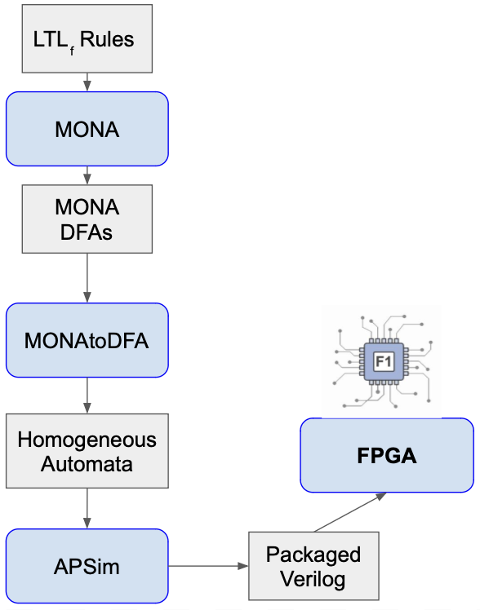
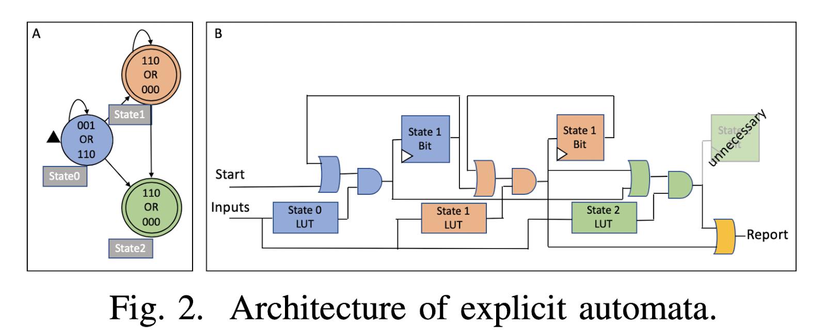
LTLf Backup Slide
Notes:
The figure on the left, from the LTLfAutomata work by Tracy et al, shows how we represent NFAs as a combination of registers and gates on the FPGA. The authors showed that this lightweight approach resulted in less hardware utilization and higher performance than a symbolic, lookup table-based approach.
On the right is the toolflow from the same work that generates FPGA-synthesizable hardware from LTLf specifications

Slide 27
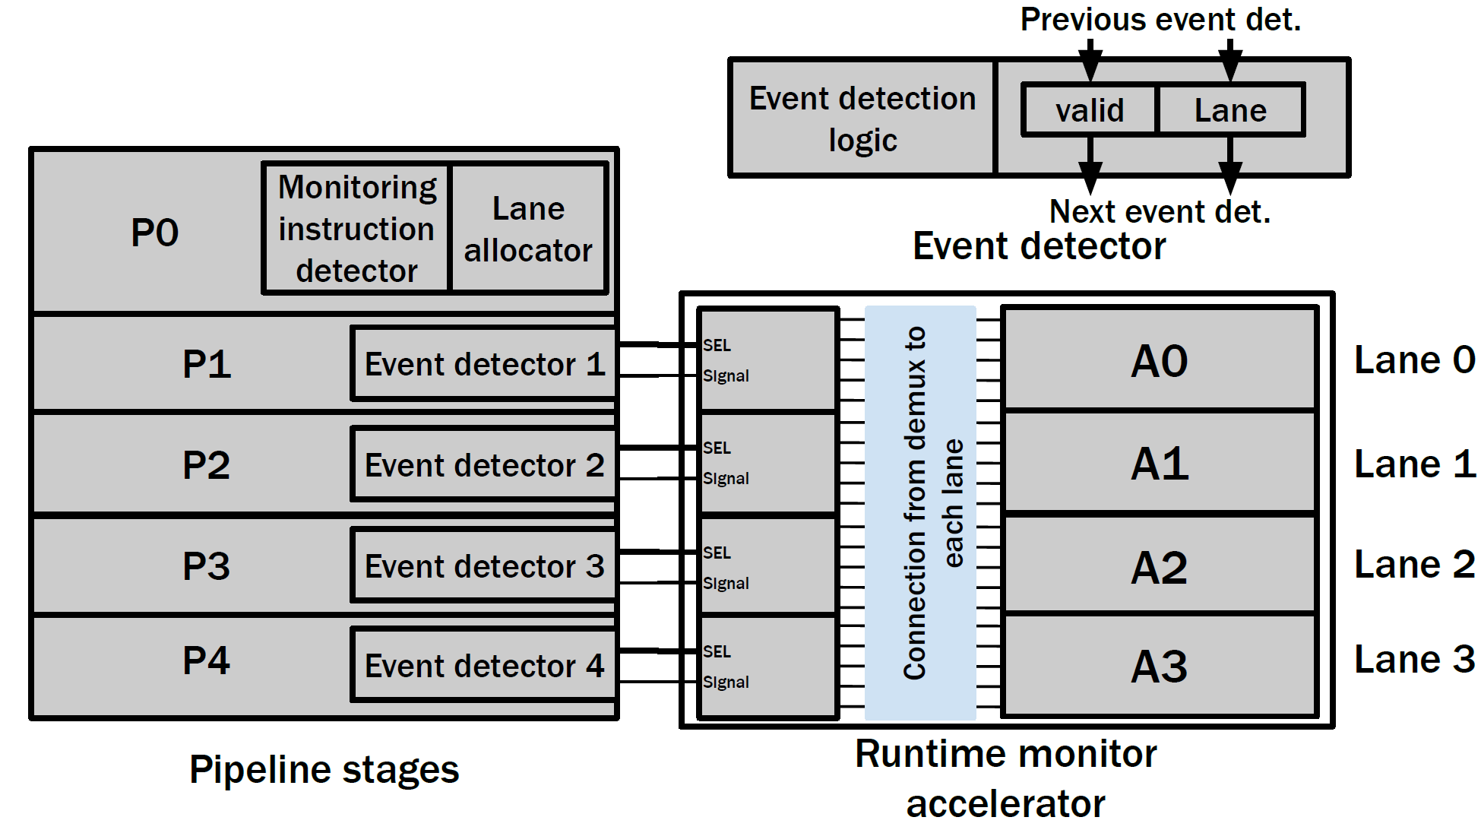
Detailed architecture
Notes:
We deploy event doctors at each stage that need to be monitored. At the stage the monitoring need to start we have the monitoring instruction detector and lane allocator.
Event detectors forward detected events to the runtime monitor if a monitored instruction is in the pipeline stage.
The runtime monitor has lanes capable of validating the order in which events take place.
In the current architecture a single lane is capable of monitoring a single instruction at a given time. We plan on extending this in our future iterations.

Slide 28
MCM violation from undetermined outcomes
C0
C1
Core 0 | Core 1
(i0) W[x] = 1; (i1) W[y] = 1; | (i2) R[y] = 1; (i3) R[x] = 0;
i0
i1
i2
i3
User annotation
PO
PO
ID
+
Issue
IF
IF
IF
IF
___
___
__
___
___
__
___
___
__
___
___
__
___
___
__
___
___
__
IF
ID
DX
DX
DX
Over-approximation of all μspec axioms (a.k.a ordering of state updates)
ISSUE
WB
WB
WB
EX
EX
arbiter
Commit
COMM
Embedded in SystemVerilog Assertion (SVA)
mem
RTL design
STB
Check Tools
Undetermined ordering rules
Mem
✓
✓
❌
❌
___
___
__
___
___
__
___
___
__
___
___
__
___
___
__
___
___
__
Verifiable hardware monitor that checks for ordering violation at runtime
JasperGold
Undetermined (bounded proof)
Notes:
As a concrete example, consider this processor that features store buffer and implements TSO
Opposed to the previous examples, there are now axioms discarded because the corresponding SVA properties return undetermined outcomes.
Now if we handed this incomplete uspec model to check tool to verify MCM implementation, MCM violation can be found as shown on the right the forbidden result is observable with concret acyclic uhb graph.
=========
Therefore, to restore the MCM compliance, the axioms corresponding to undetermined properties needs a way to be proven.
But how?
==========
We propose here to make the use of verifiable monitor that checks for difficult-to-prove properties at runtime and thus gives ordering guarantee during runtime.
As mentioned, since these
The problem is thus what is the minimal set of axioms that corersopnd to undetermined properties we should add back to satisfy MCM requirement? can find counterexample wher a forbidden litmus test is render observable with acyclic uhb graph.
, and thus the results for this litmus test program should be forbidden.
That is we should not have any acyclic uhb graph corresponding to this particular program outcome.
As a reminder rtl2uspec collects only those axioms corresponding to proven SVA properties to construct uspec model.
For this example we use solide edges to represent them, realize this is actually an acyclic graph, which indicates an MCM violation.
let’s say we are unable to get unbound proof for properties corresponding to multiple happens-before relations as highlighted in red.
However, we may not need all of the orderings to verify MCM compliance.
That is, some of these undetermined edges may not be that important to verify MCM. By using a counterexample guided abstraciton synthesis along with the check tool we can identify a subset of ordering relaitonship as important and spend our efforst on them for MCM compliance.

Slide 29
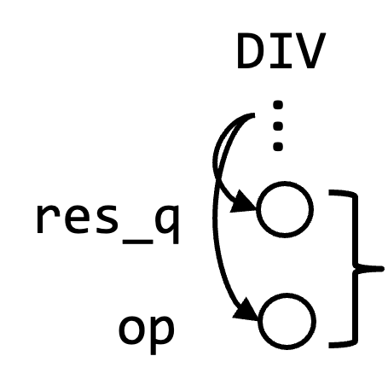
Insight 2: μFSM Orchestrate Instruction Execution from Fetch to Final State Updates
issue
EX
DIV
DIV
DIV
score-board
Mult/Serial_Div
Both during state_q is in sDIV
...
res_q
op
state_q
txn_id
reg file
(txn_id == pc0 & state_q == sDIV)
sIDLE
Each control state summarizes instruction update behavior
sDIV
sFIN
The set of control states visited by instruction and the partial of visit forms an execution path
Notes:
To facilitate execution path discovery, our second insight is that a subset of finite state machines (FSMs) from the DUV’s control-path, called micro-op FMS (μFSMs), orchestrate the execution of instructions from the time they are fetched to the time they project their final state updates onto the DUV.
=======
An instruction claims a set of μFSMs by occupying itheir associated dentifier registers during its execution and progresses through a series of control states in each.
=========
Each control state and the identifier registers represents an execution phase which summarizes a set of state updates that the instruction projects onto the DUV in a given cycle. Thus, τSYNTH can discover an IUV’s execution paths by exploring all realizable partial orders on visited μFSM states.
// we shouldn’t use DIV to refer to both the instruction and a state

Slide 30
τSYNTH Path Discovery Procedure
Instruction encodings & User annotation
– ––
–
– ––
–
– ––
–
...
– ––
–
– ––
–
+
IF
ID
issue
muldiv.DIV
STB
rob.enq
...
IF
ID
issue
EX
score-board
Mult/ Ser_Div
I$
PC Mux
LSU
mem
SVA property embedding
reg file
ALU
CSR buffer
branch unit
...
...
...
...
...
(System)Verilog design
Over-approximation of all possible execution paths
✓
✓
✓
❌
❌
......
❌
– ––
–
– ––
–
– ––
–
– ––
–
– ––
–
– ––
–
JasperGold
All realizable execution paths per instruction
Notes:
τSYNTH conducts path exploration using a combination of modest design metadata, static netlist analysis, linear temporal logic (LTL) property generation, and model checking. It implements several optimizations to exhaustively explore IUV execution behavior on a DUV with reasonable runtimes. In general, τSYNTH benefits from evaluating many simple and localized LTL properties on the DUV, which are each evaluated on the order of a few seconds to a few minutes for the RISC-V CVA6 CPU [3] in our case study.

Slide 31
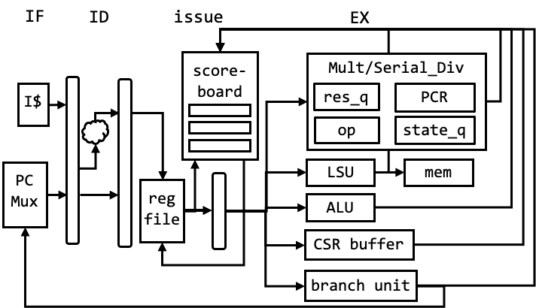
Case Study: Transmitter Discovery on CVA6
CVA6: 64-bit, 6-stage, single-issue RISC-V core
Speculation, limited out-of-order write-back with diversified functional units
Evaluate all 72 instruction in RV64I base ISA and M extension (RV64IM)
Evaluate in separtion cache-subsystem:
4-way 128B write-through cache with coalescing write-buffer
Notes:
We deployed a proof-of-concept implementation of τSYNTH on the open-source RISC-V CVA6 processor [3], a 64-bit, 6-stage, single-issue RISC-V core featuring speculation, limited out-of-order write-back, diversified functional units, and a data cache. We evaluated all 72 instructions across the RV64I ISA and M extension. τ SYNTH classified 32 as transmitters.

Slide 32
Synthesizing Formal Models of Hardware from RTL to support MCM verification
Multiple execution paths
✓
ISA-level Memory Consistency Model (MCM)
Check Tools¹
❌
Restricted instruction interaction
...
Upheld or not?
Coherence support
...
...
C0
C1
...
Cn
μspec models: Axiomatic models of MCM implementation of the microarchitecture
Undetermined proof outcomes
memory
Scalable via incremental construction of axiomatic model from many easy-to-prove properties referring to localized set of signals
Axiom Ld_exe_path: forall microops i, IsAnyRead i ⇒ AddEdges [ ((i, IF), (i, DX))
((i, DX), (i, WB))
....]
...
rtlμspec²
Verilog design
¹http://check.cs.princeton.edu
²Hsiao et al. “Synthesizing Formal Models of Hardware from RTL for Efficient Verification of Memory Model Implementations.” MICRO’21
Notes:
In our work, we take a different approach and ask if we can instead synthesize an abstract model of hardware that retains information relevant for MCM verification and thrwo away the reset.
==========
Specifically, prior work propose a suite of tools called check tools that verify hardware MCM implementation.
It takes in as input an axiomatic model of MCM implementation of the microarchitecture, called uspec model, to prove copmliance to ISA-level MCM.
The check tools has been demonstrated effective and efficient in identifying real bugs in processors, compilers, and MCM specifications.
But
Essentially uspec model is axiomatic model of MCM implementation of the microarchitecture.
======
It encodes the ordering behaviors of hardware events using a set of axioms written in first-order logic DSL, such as one shown on the right.
I’ll give a bit more details later but essentially it serves as input to a suite of tools called the check tools that verify hardware MCM implementation.
The check tools has been demonstrated effective and efficient in identifying real bugs in processors, compilers, and MCM specifications.
Analysis on uspec model is efficient because it abstracts aways combinational logics from uarch and retains only information between state updates and their ordering behaviors, which are necessary and sufficient condition to ensure MCM to be correct.
**** In this way the Check tool consume this uspec and reason exclusively about microarchitectu’res state update and ordering behavior, whereas prior work requires reasoning about complex combinational logic on top of all state updates.
================
However uspec model had been manually written and therefore our prior work of rtl2uspec took the first step in synthesizing a proven correct uspec model from RTL design.
================
Unfortunately, there are limitation to applying rtl2uspec on complex processor, including limited support for designs with certain features such as coherence protocol, complex instruction interaction.
We have either addressed or in progress to solve them.
So this talk I will focus on some of these limitation and how we plan to address them.
Before I do so, i’ll briefly introduce the uspec model, and how rtl2psuec works.
// --------------------------------------------------------

