Slide 1
❤️Heart Failure Risk & Readmission Analysis
Presented By Team 3
Yasasmini V
Pavani G
Deepthi K
Ramyakrishna Y

Slide 2



Project Overview
This project analyzes clinical data from 2,008 hospitalized heart-failure patients treated at Zigong Fourth People’s Hospital, China, between December 2016 and June 2019.
The dataset contains 168 clinical variables, covering demographics, vital signs, comorbidities, laboratory findings, cardiac characteristics, medications, and follow-up outcomes.
Patient outcomes were tracked at 28 days, 3 months, and 6 months, focusing on readmission and mortality.

Slide 3
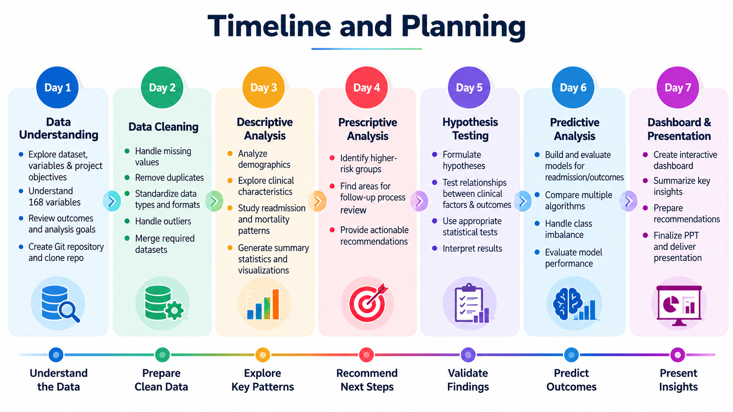

Slide 4
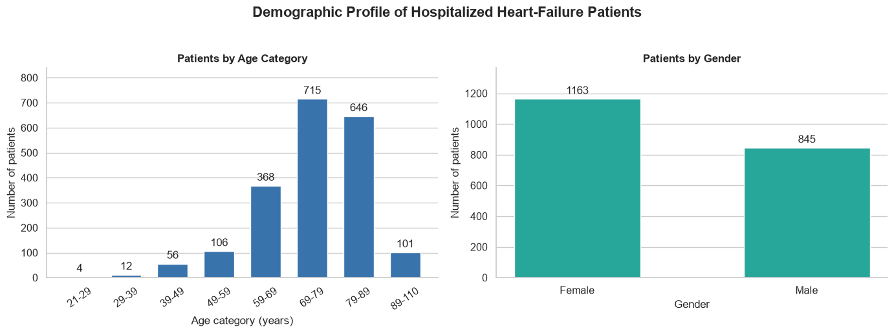
Descriptive Analysis
We performed descriptive analysis to understand the basic characteristics of the patient population. Descriptive analysis summarizes what is present in the dataset, such as the number of patients, their age distribution, gender distribution, and other clinical characteristics.
It gives us an overall picture of the population before moving into risk-factor and predictive analysis.”
Heart Failure Patient Outcome Analysis

Slide 5
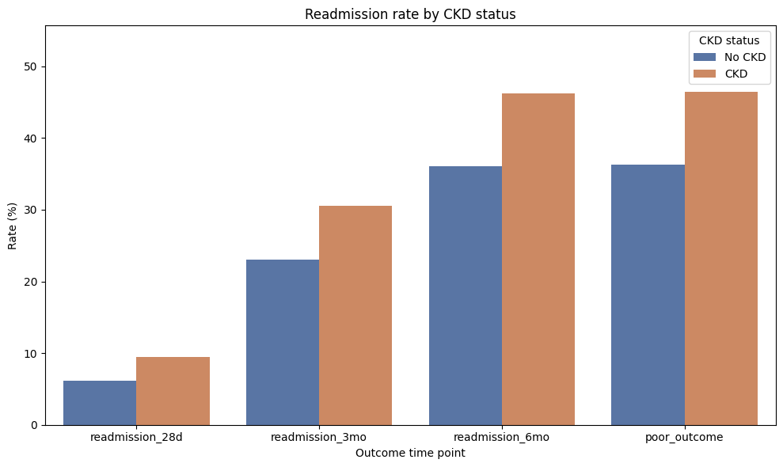
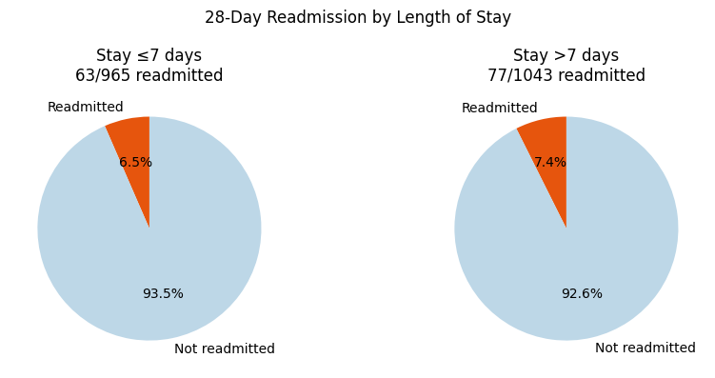
Prescriptive Analysis
We performed prescriptive analysis to identify which patient groups and care areas may need more attention based on the patterns observed in the data.
Prescriptive analysis uses factors such as readmission rates by chronic kidney disease, comorbidities, NYHA class, Killip grade, length of stay, repeat visits, and ED returns to identify priorities for review.
It helps us suggest areas for closer monitoring, discharge planning, and post-discharge follow-up based on observed associations, rather than proving that a specific intervention will reduce readmission.

Slide 6
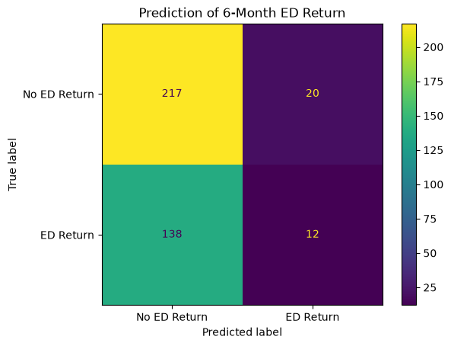
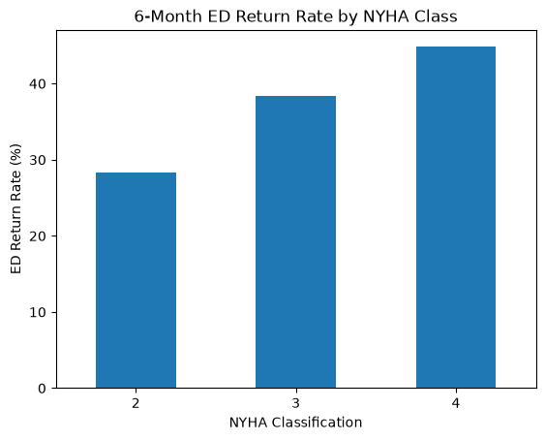
Predictive Analysis
We performed predictive analysis to estimate the likelihood of future patient outcomes, such as readmission or emergency department return, using available clinical characteristics.
Higher NYHA classes were associated with increased 6-month ED return risk, indicating greater heart failure severity.
Predictive modeling showed that severity, kidney function, and comorbidity burden contain useful risk signals for 6-month ED return.
However, the model’s discrimination was limited, suggesting that additional clinical variables are needed to improve prediction accuracy.

Slide 7
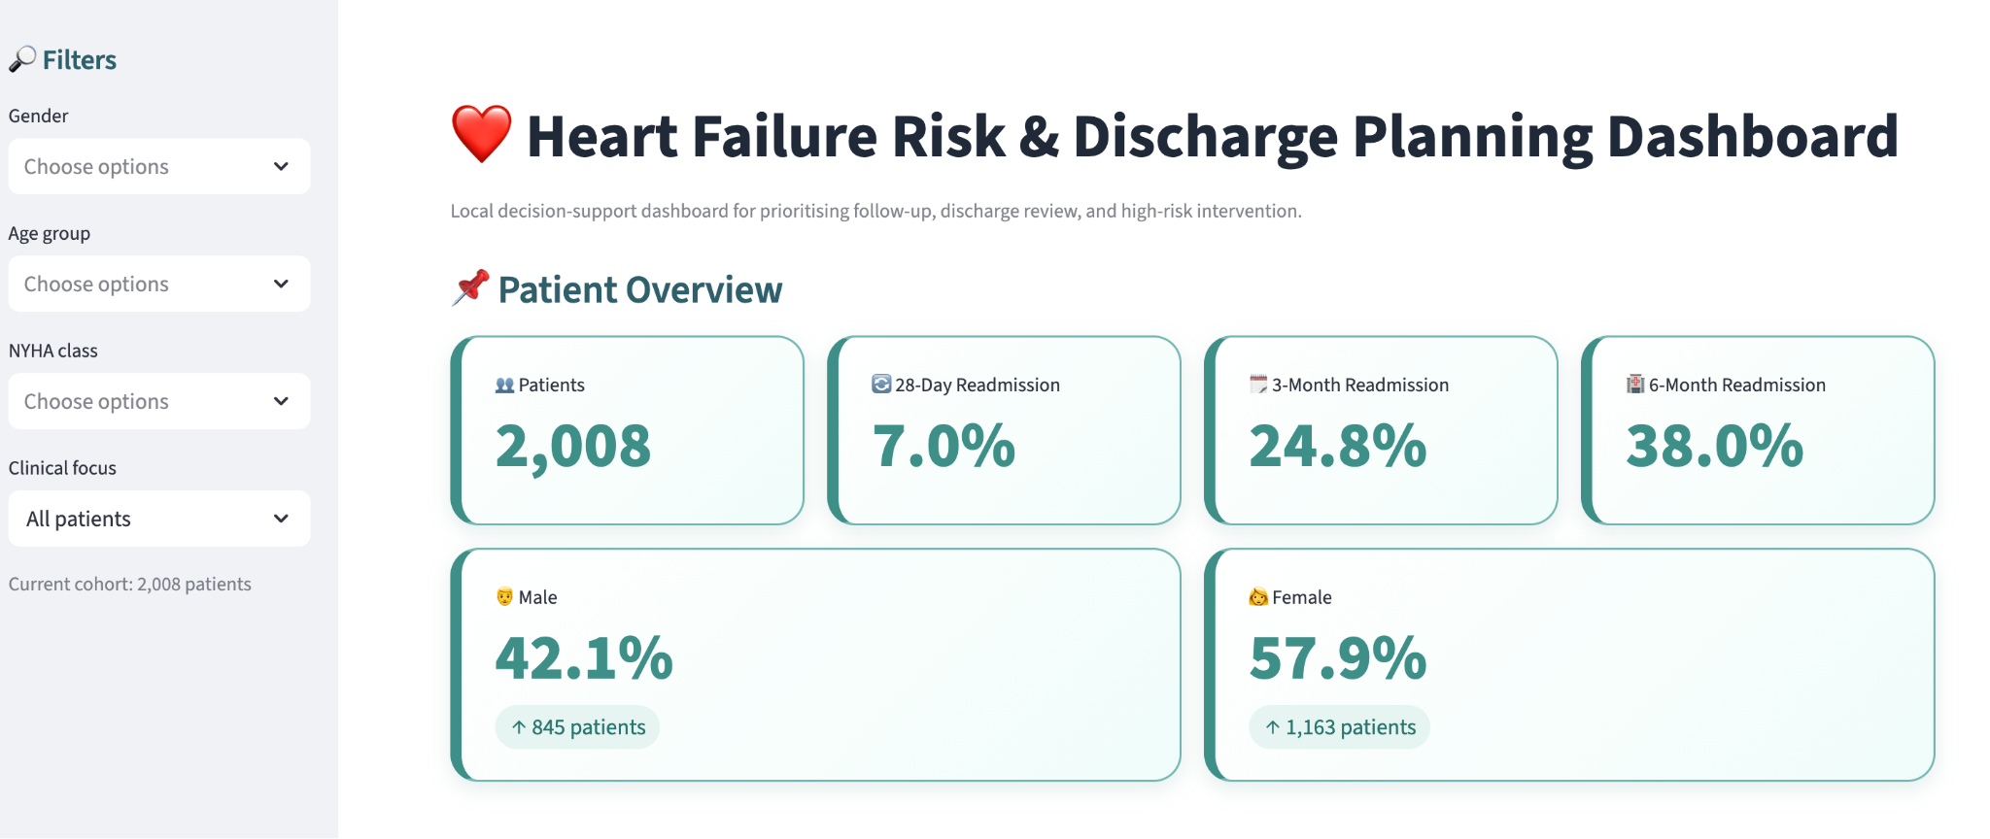
Heart Failure Analysis Dashboard
Dashboard Link

Slide 8
Key Insights
The dataset represents an older hospitalized heart-failure population with substantial clinical complexity.
Readmission and ED-return risk are not explained by one variable; demographic, clinical and comorbidity factors should be considered together.
Some patient subgroups show higher observed adverse-outcome rates and provide useful starting points for follow-up review.
Statistical testing helps separate visible differences from differences that may be due to sampling variation.
Predictive modeling can identify useful patterns, but model performance and external validation determine how confidently predictions can be used.

Slide 9
Conclusion
This project combined descriptive, prescriptive, statistical and predictive methods to study heart-failure outcomes.
The analysis moved beyond reporting counts by comparing patient groups, testing relationships and exploring prediction.
The strongest value of the project is the connection between clinical questions, statistical evidence, visual storytelling and practical follow-up considerations.
Thank You

