Slide 1

Project Title - Seasonal Agriculture Performance Analysis
Student Name : Nune Venkata Yasasvi
College Name : Vignan University
AICTE STU ID : STU6a528cb0ab8321783794864
Seasonal_Agriculture_Performance_Analysis_GitHub_Link

Slide 2

PROBLEM STATEMENT
Problem Statement:
Agricultural performance varies across seasons due to changes in environmental conditions, crop selection, resource usage, and input management. It is difficult to clearly identify the factors affecting yield, profitability, and overall farm performance from raw agricultural data.
This project aims to analyze seasonal agricultural data, identify important patterns and relationships, compare performance across crops, states and seasons, and use data-driven techniques to support better agricultural decision-making.
Key Challenges :
Seasonal Variation: Agricultural performance changes across different seasons and needs systematic comparison.
Identifying Key Factors: Environmental conditions, crop selection, irrigation, inputs, and other factors may influence yield and profitability.
Performance Comparison: It is necessary to compare crops, states, districts, and seasons to identify high- and low-performing groups.
Data-Driven Decisions: Raw agricultural data should be transformed into meaningful insights and recommendations for better planning and resource management.

Slide 3
PROJECT DESCRIPTION
Seasonal Agriculture Performance Analysis is a data analytics project that analyzes agricultural data across different seasons to understand variations in crop performance, yield, resource usage, and profitability. The project uses data cleaning, exploratory data analysis, statistical analysis, and visualization techniques to identify meaningful patterns, trends, relationships, and differences across crops, states, districts, and seasons.
The project also includes Machine Learning enhancements for yield prediction and agricultural performance classification. Different regression and classification models are compared and evaluated to identify useful predictive approaches. Feature importance analysis is used to understand which agricultural factors contribute to prediction.
A dashboard enhancement presents important agricultural indicators through interactive visualizations, making the analytical results easier to understand and use for decision-making.
Overall, the project converts raw agricultural data into meaningful insights, predictive results, and evidence-based recommendations for better seasonal planning, resource management, and agricultural performance analysis

Slide 4

WHO ARE THE END USERS?
Farmers & Agricultural Producers – To understand seasonal crop performance, yield, profitability, and resource usage.
Agricultural Planners & Officers – To compare crop, state, district, and seasonal performance for better planning.
Researchers & Agricultural Analysts – To study trends, relationships, and factors influencing agricultural outcomes.
Policy Makers & Decision Makers – To use data-driven insights for agricultural planning and resource management.
Students & Data Analysts – To learn and apply data analytics, statistical analysis, visualization, and machine learning techniques to agricultural data.
End Users: Farmers & Agricultural Producers, Agricultural Planners & Officers, Researchers & Agricultural Analysts, Policy Makers & Decision Makers, Students & Data Analysts.

Slide 5

TECHNOLOGY USED
Programming Language: Python
Data Analytics: Pandas, NumPy
Data Visualization: Matplotlib, Seaborn
Statistical Analysis: SciPy
Machine Learning: Scikit-learn
Development Environment: Jupyter Notebook
Dashboard & Reporting: Interactive data visualizations and analytical dashboard
Technologies:
Python | Pandas | NumPy | Matplotlib | Seaborn | SciPy | Scikit-learn | Jupyter Notebook

Slide 6
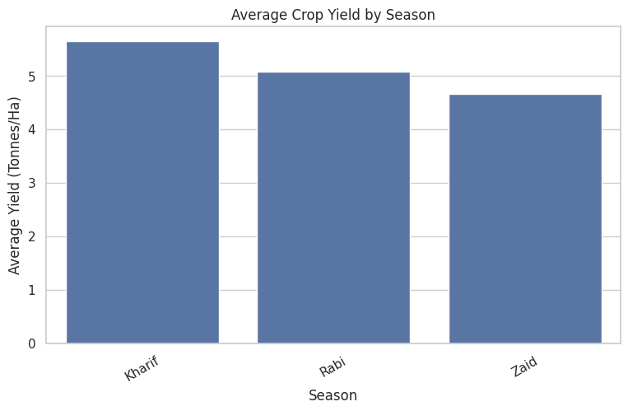
RESULTS
# ------------------------------------------------------------ # 15. AVERAGE YIELD BY SEASON # ------------------------------------------------------------ yield_by_season = ( df.groupby("Season")["Yield_Tonnes_Ha"] .mean() .sort_values(ascending=False) ) display(yield_by_season) plt.figure(figsize=(9, 5)) sns.barplot( x=yield_by_season.index, y=yield_by_season.values ) plt.title("Average Crop Yield by Season") plt.xlabel("Season") plt.ylabel("Average Yield (Tonnes/Ha)") plt.xticks(rotation=30) plt.show()

Slide 7
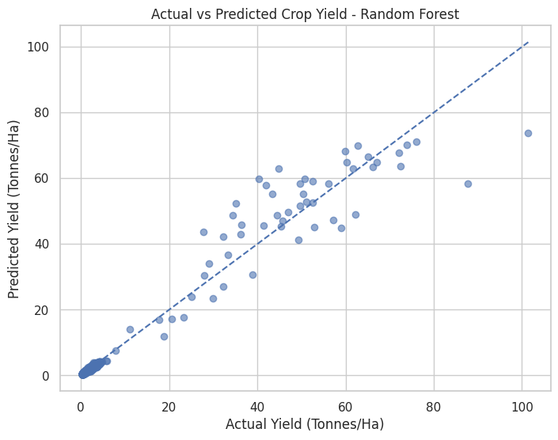
RESULTS
# ------------------------------------------------------------ # 74. ACTUAL VS PREDICTED YIELD # ------------------------------------------------------------ ​ plt.figure(figsize=(8, 6)) ​ plt.scatter( y_test, rf_predictions, alpha=0.6 ) ​ plt.xlabel("Actual Yield (Tonnes/Ha)") plt.ylabel("Predicted Yield (Tonnes/Ha)") ​ plt.title( "Actual vs Predicted Crop Yield - Random Forest" ) ​ # Perfect prediction line minimum = min( y_test.min(), rf_predictions.min() ) ​ maximum = max( y_test.max(), rf_predictions.max() ) ​ plt.plot( [minimum, maximum], [minimum, maximum], linestyle="--" ) ​ plt.show()

Slide 8
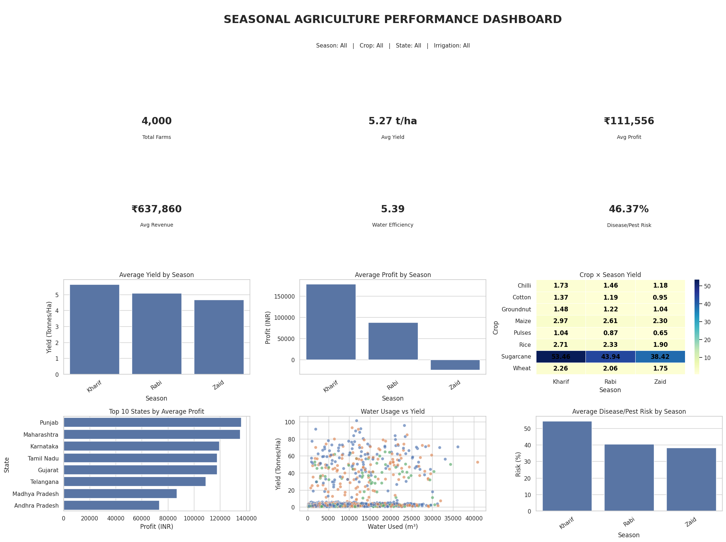
RESULTS
# ------------------------------------------------------------ # 105. INTERACTIVE DASHBOARD FILTERS # ------------------------------------------------------------ ​ try: import ipywidgets as widgets from IPython.display import display ​ season_options = ["All"] + sorted(df["Season"].dropna().astype(str).unique().tolist()) crop_options = ["All"] + sorted(df["Crop"].dropna().astype(str).unique().tolist()) state_options = ["All"] + sorted(df["State"].dropna().astype(str).unique().tolist()) irrigation_options = ["All"] + sorted( df["Irrigation_Method"].dropna().astype(str).unique().tolist() ) ​ season_widget = widgets.Dropdown(options=season_options, description="Season:") crop_widget = widgets.Dropdown(options=crop_options, description="Crop:") state_widget = widgets.Dropdown(options=state_options, description="State:") irrigation_widget = widgets.Dropdown(options=irrigation_options, description="Irrigation:") ​ dashboard_output = widgets.interactive_output( show_agriculture_dashboard, { "season": season_widget, "crop": crop_widget, "state": state_widget, "irrigation_method": irrigation_widget } ) ​ display( widgets.HBox([season_widget, crop_widget]), widgets.HBox([state_widget, irrigation_widget]), dashboard_output ) ​ except ImportError: print( "ipywidgets is not installed. The static dashboard above is available. " "Install with: pip install ipywidgets" ) ​

Slide 9
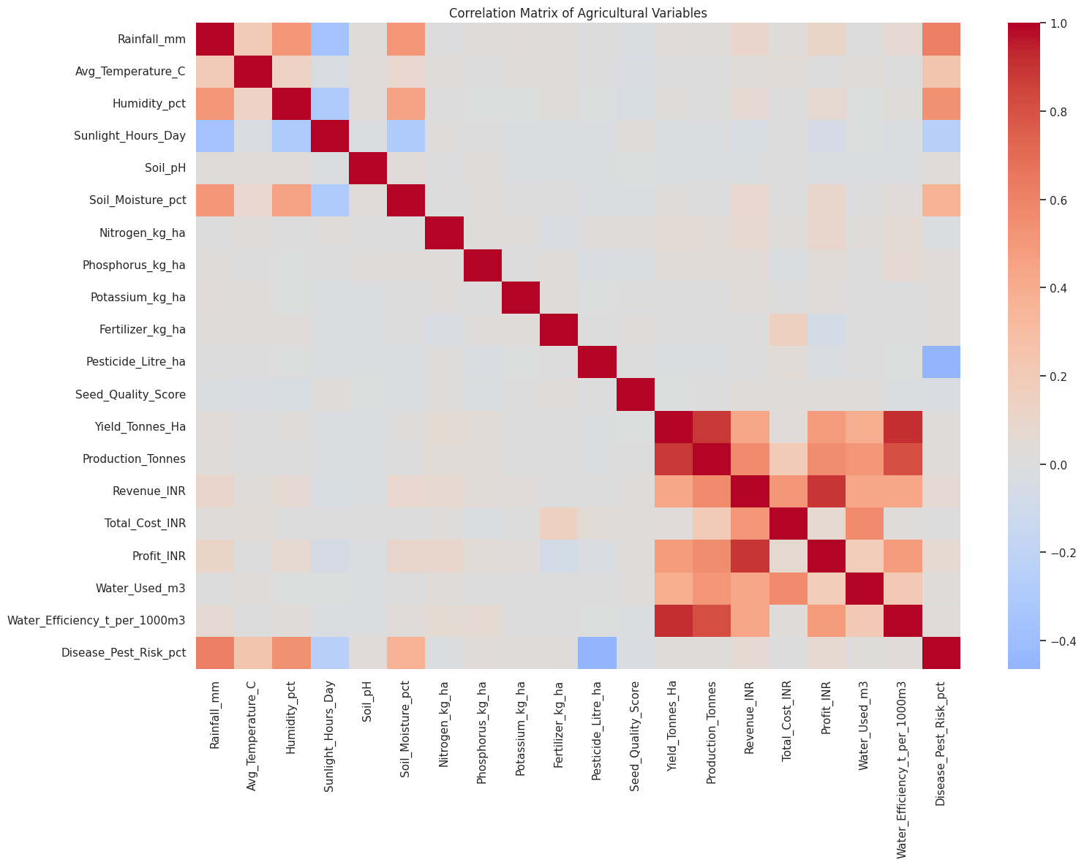
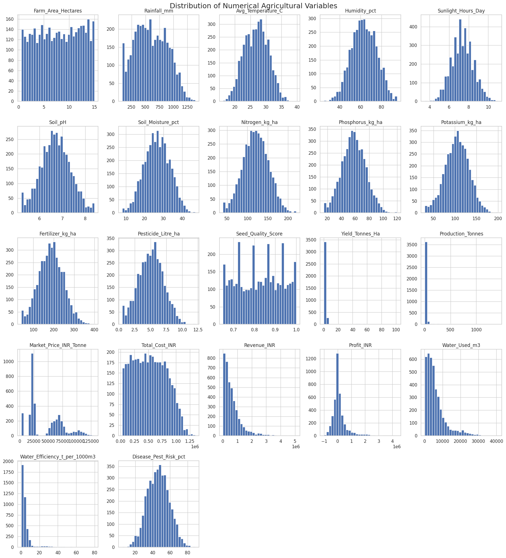
RESULTS

Slide 10
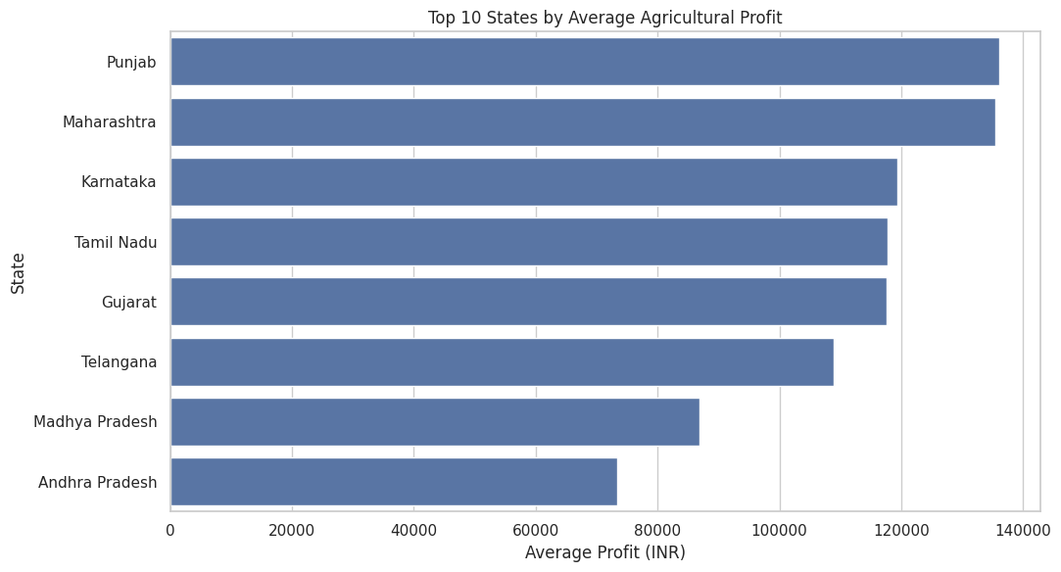
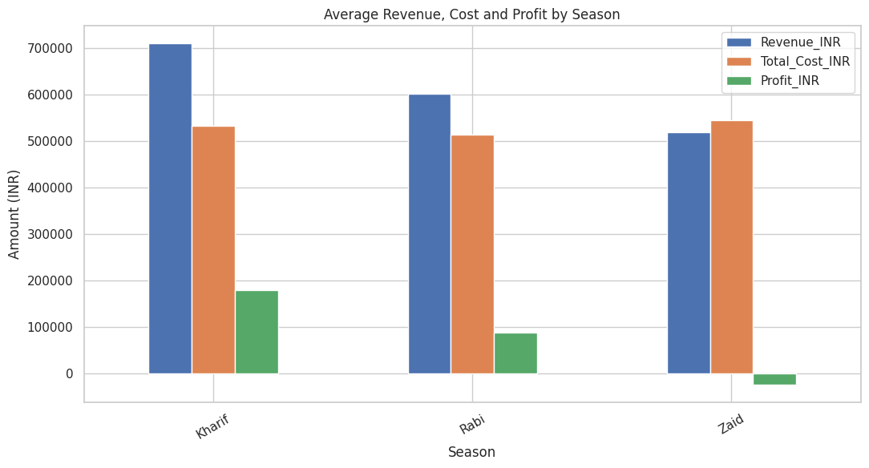
RESULTS

Slide 11
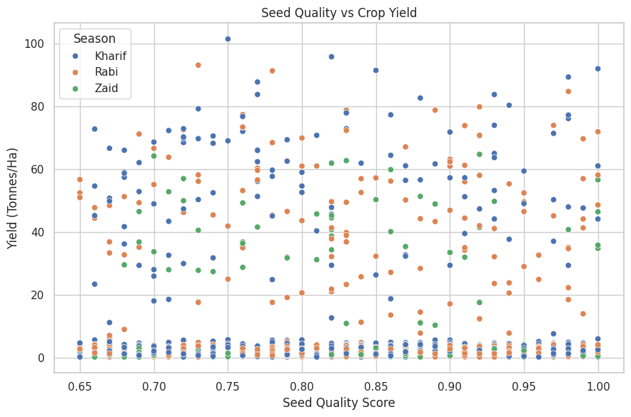
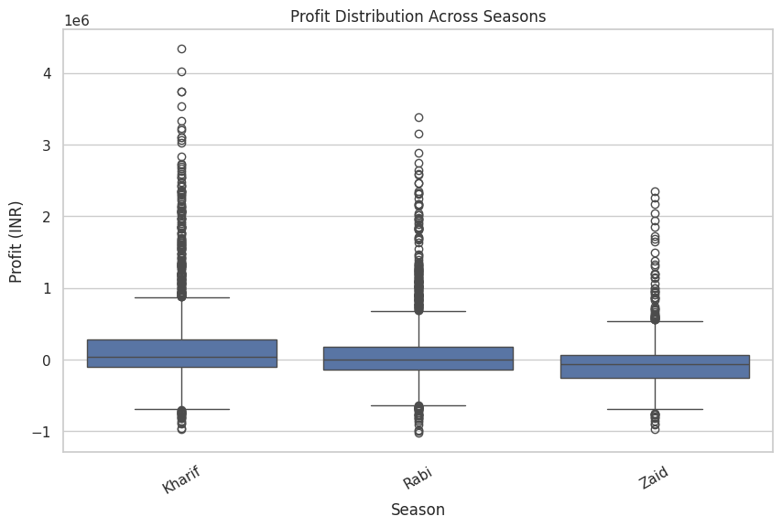
RESULTS

Slide 12
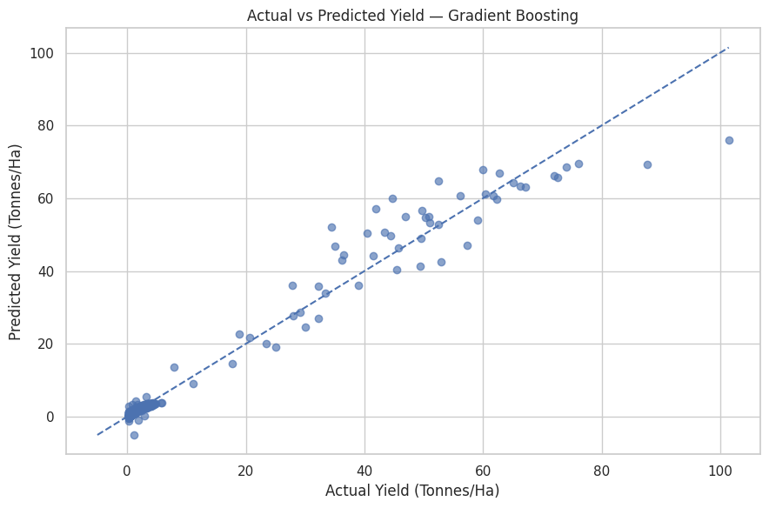
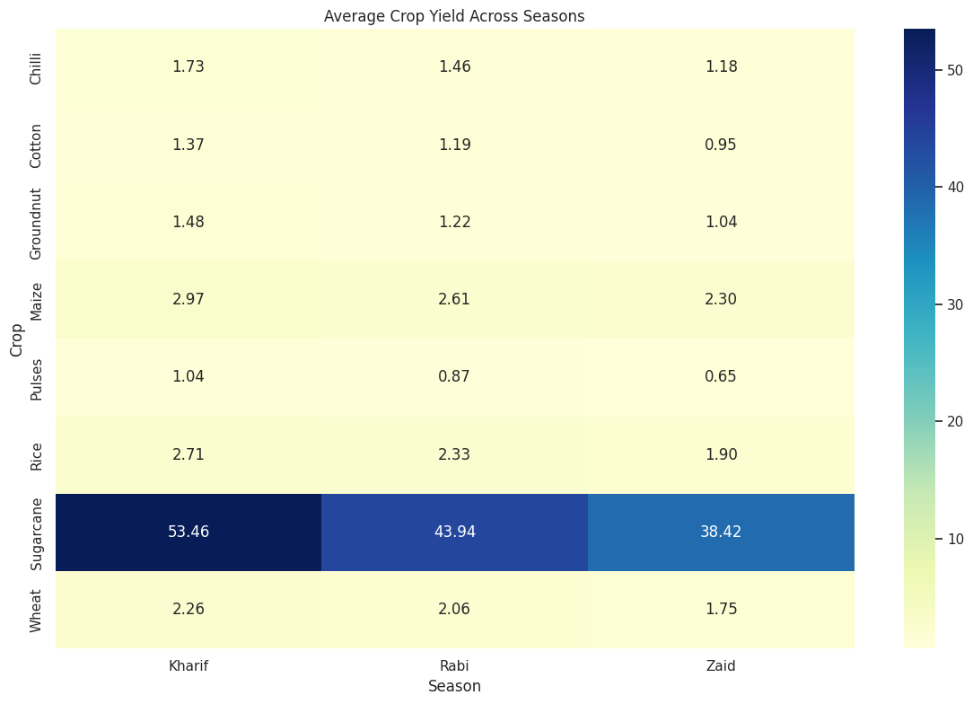
RESULTS

Slide 13
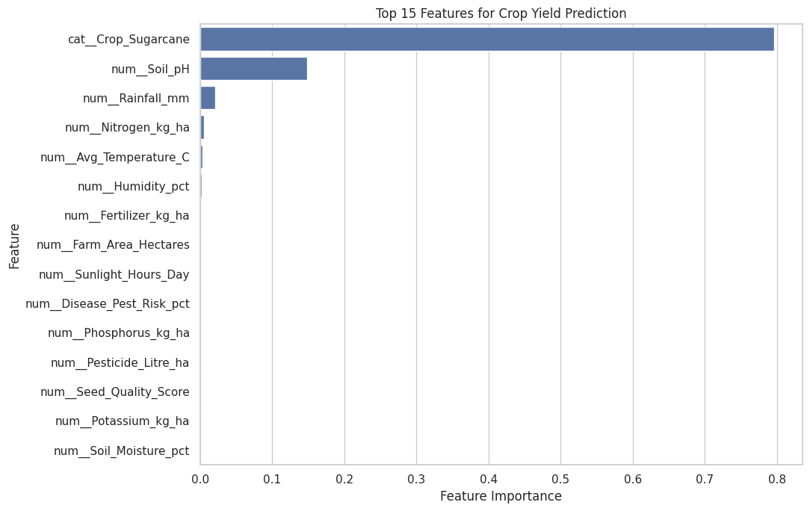
RESULTS

Slide 14
FUTURE SCOPE
Real-Time Data Integration: Integrate live weather, soil, market price, and agricultural data for continuous monitoring.
Advanced Machine Learning: Use advanced models such as XGBoost, neural networks, and time-series models for improved prediction.
Crop Recommendation System: Develop a system that recommends suitable crops based on season, soil, weather, and resource conditions.
Early Risk Prediction: Predict potential disease, pest, water, and yield risks before they significantly affect production.
Mobile/Web Application: Convert the dashboard into a user-friendly application for farmers and agricultural officers.
Scalable Regional Analysis: Extend the project to larger datasets and more regions for broader agricultural insights.
Real-time data integration | Advanced ML prediction | Crop recommendation | Risk prediction | Mobile/Web application | Regional scalability

Slide 15
GITHUB LINK
Seasonal_Agriculture_Performance_Analysis_GitHub_Link
🔗 GITHUB REPOSITORY
Seasonal Agriculture Performance Analysis
Project Repository: N.V. Yasasvi — Seasonal Agriculture Performance Analysis
GitHub:
Seasonal_Agriculture_Performance_Analysis_GitHub_Link
📂 Repository Includes
📓 Jupyter Notebook 📊 Agriculture Dataset 📄 README Documentation 📈 Data Analytics & ML Screenshots 📁 Project Outputs & Results

Slide 16

VOIS Course completion certificate - Course name - Data Visualization

Slide 17
THANK YOU
“Thank You for Your Time and Attention!”
Seasonal Agriculture Performance Analysis Data Analytics with Machine Learning & Dashboard Enhancements
🌾 “Turning Agricultural Data into Meaningful Insights for Better Decisions.”
.
Presented by : Nune Venkata Yasasvi
Student ID : STU6a528cb0ab8321783794864
Seasonal_Agriculture_Performance_Analysis_GitHub_Link

