Slide 1
GUI for Underwater Robotics
Yasasvi Peruvemba
Ashwini Jha
Devansh shah
Amanpreet Singh
CS 258 project under
Dr. i.a. palani

Slide 2
Introduction

Slide 3
Project Objectives
Develop a Graphic User Interface to:
Remotely switch the robot on/off.
Display the sensor data

Slide 4
Technologies Used
JavaScript
WebSockets
NodeJS
Arduino
DHT Sensors
HTML/CSS/Bootstrap

Slide 5
Arduino

Slide 6
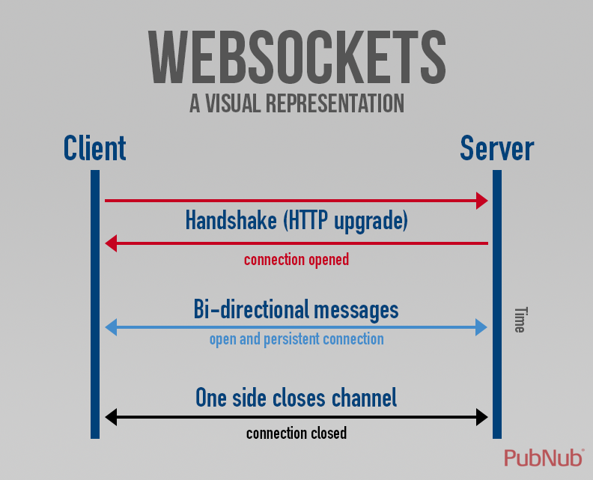
WebSockets
WebSockets provide a persistent connection between a client and server that both parties can use to start sending data at any time.
The client establishes a WebSocket connection through a process known as the WebSocket handshake. This process starts with the client sending a regular HTTP request to the server.

Slide 7
NodeJS

Slide 8
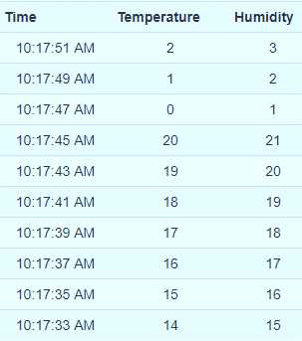
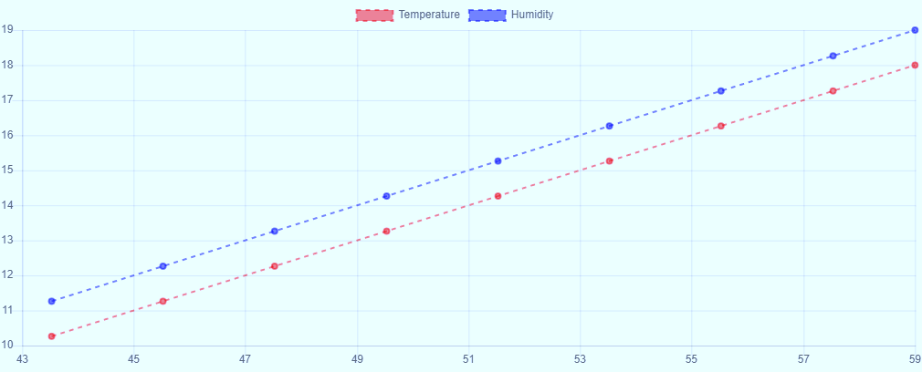

JavaScript
Bootstrap used for designing responsive webpage
JavaScript used to add features to the webpage which include:
Switch functionality of the button
Taking data from the node server and pushing into JavaScript array object.
Displaying the data in form of a graph and table.

Slide 9
GUI contents
LOGIN page
SWITCH button
Graph for Temperature SENSOR data
Graph for Humidity SENSOR data
Table for Temperature SENSOR data
Table for Humidity SENSOR data

Slide 10
Pre-Requirements
NodeJS
Command Prompt / Terminal / Git

Slide 11
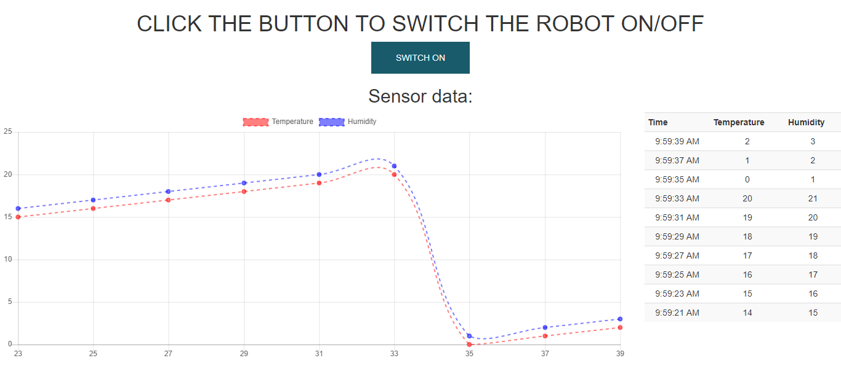
HOW TO USE?
Supply voltage to ESP8266 connected Arduino
Start Node Server
Open localhost on browser
LOGIN

