Slide 1

CSI 436/536
Introduction to Machine Learning
Project Ideas
Professor Ming-Ching Chang Computer Science
University at Albany, State University of New York
Slides adapted from Prof. Siwei Lyu, University at Albany - SUNY

Slide 2
Guideline
Start with a research paper with code available
Leverage online resources
Cannot just copy/paste code, you need to understand what is going on in the code
Write your project proposal
Persistence:
Regular/weekly progress or discussions.
Enrich your presentation slides:
Use it as your road map to brainstorm
Use it to store results

Slide 3
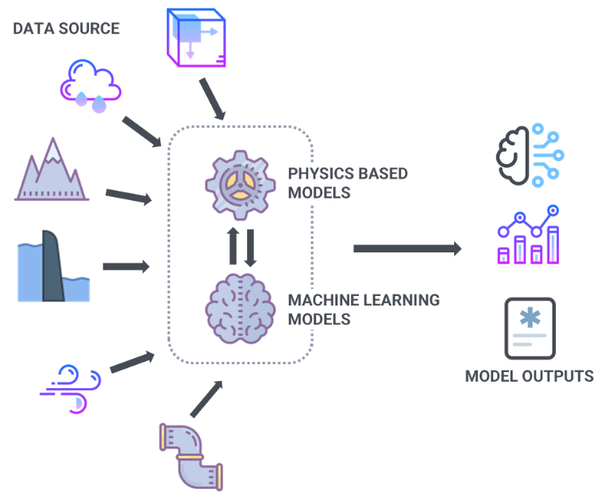
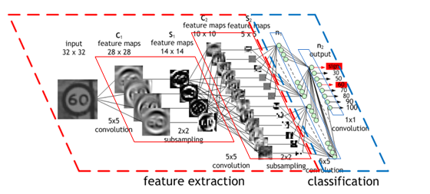
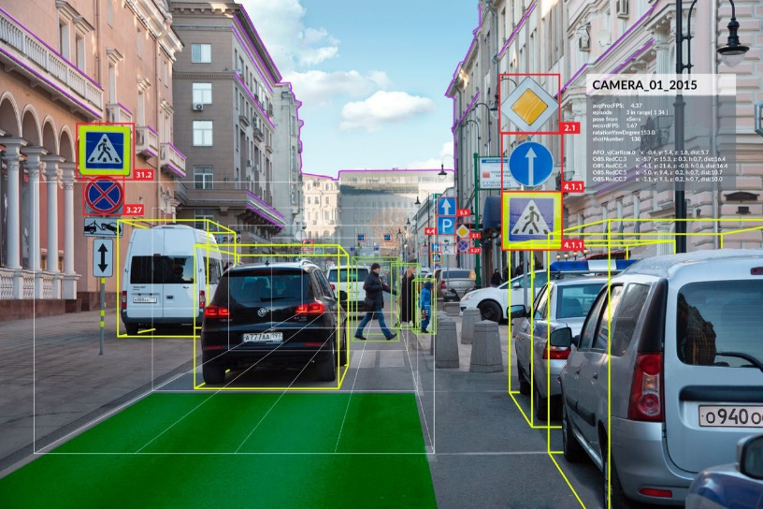
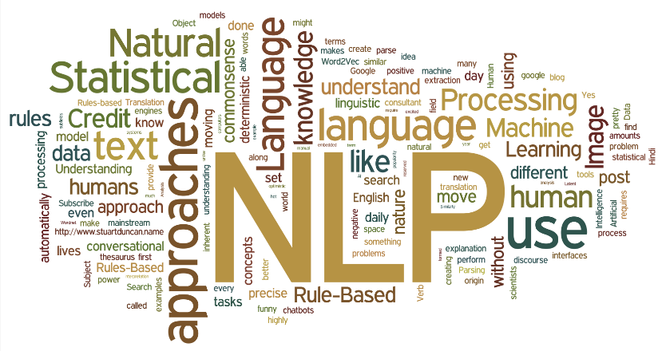
Project Ideas
Machine Learning, Data Mining
Deep Learning
Computer Vision
Others: NLP, ...

Slide 4
Project Ideas
Machine Learning Course Project Ideas
https://data-flair.training/blogs/machine-learning-project-ideas/
Kaggle
Top 10 Machine Learning Projects for Beginners:
https://www.kaggle.com/getting-started/150260
Machine Learning Project Ideas for Beginners
https://www.upgrad.com/blog/machine-learning-project-ideas-for-beginners/

Slide 5
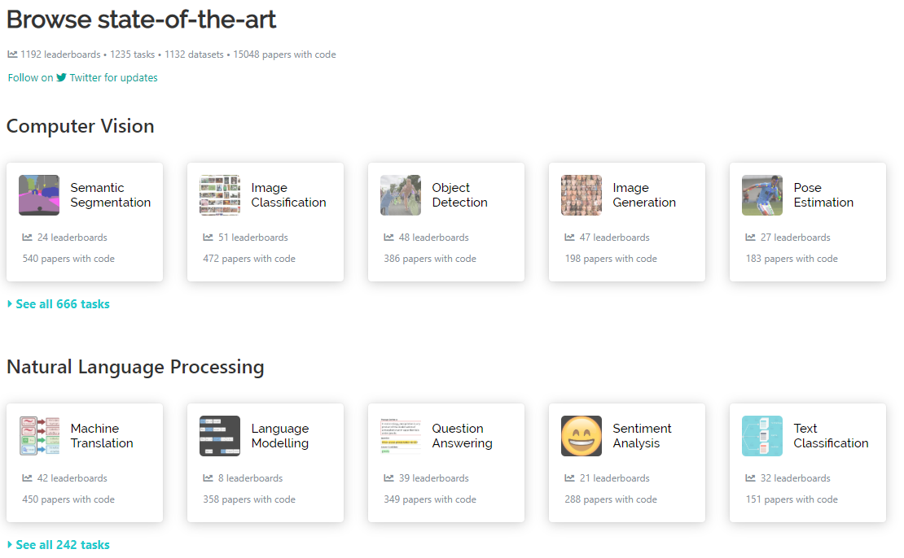
Papers with Code
paperswithcode.com

Slide 6
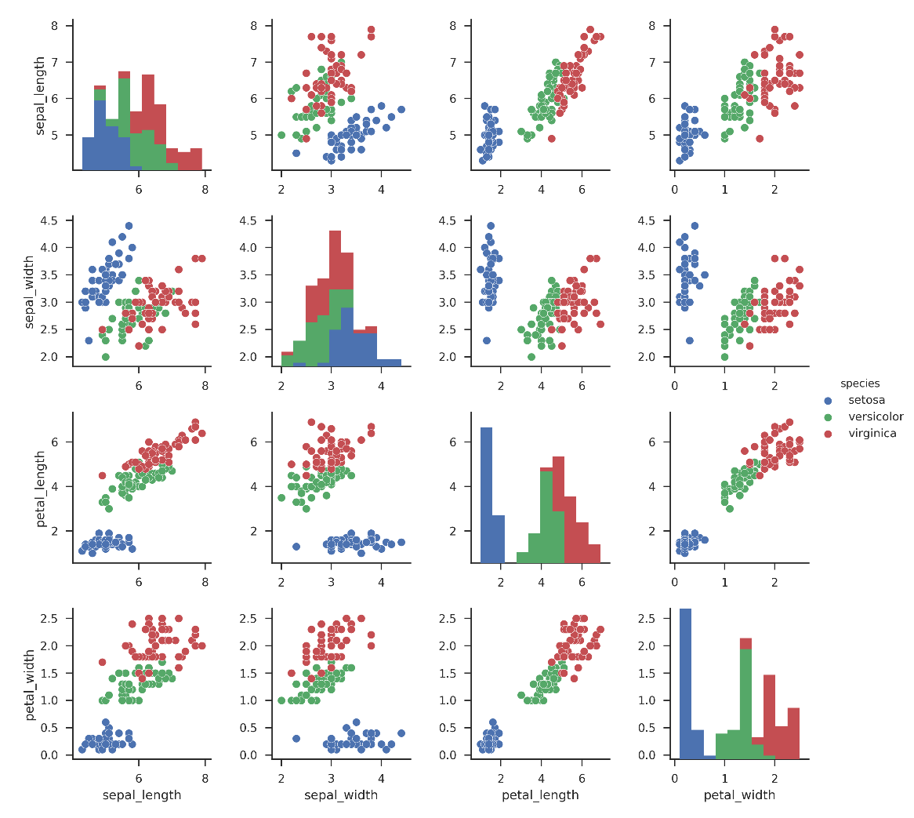
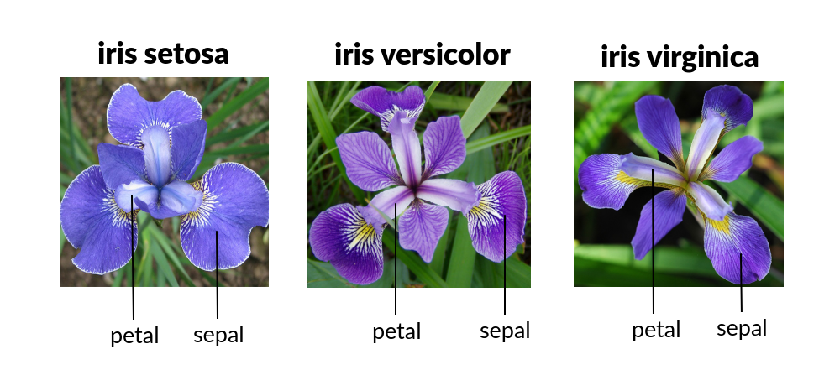
Iris Flowers Classification
https://deeplearning.cms.waikato.ac.nz/examples/classifying-iris/

Slide 7
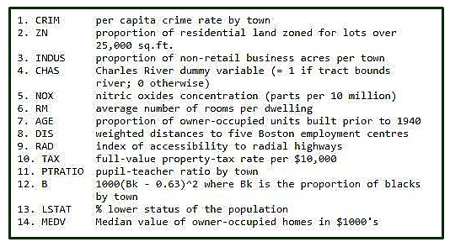
Housing Prices Prediction
The Boston Housing Dataset
https://www.cs.toronto.edu/~delve/data/boston/bostonDetail.html
https://www.geeksforgeeks.org/ml-boston-housing-kaggle-challenge-with-linear-regression/

Slide 8
Stock Price Prediction
Code: https://data-flair.training/blogs/stock-price-prediction-machine-learning-project-in-python/
Dataset: https://www.kaggle.com/c/two-sigma-financial-news/data

Slide 9
Fake News Detection Project
Code: https://data-flair.training/blogs/advanced-python-project-detecting-fake-news/
Data: https://drive.google.com/file/d/1er9NJTLUA3qnRuyhfzuN0XUsoIC4a-_q/view

Slide 10
Natural Language Processing (NLP)
Name-Entity Analysis
Sentiment Analysis
Click-Bait Detection

