Slide 1


Department of Information Technology
V R Siddhartha Engineering College
AI-Powered Automated Database Schema Design Agent
B.Tech in Information Technology
Major Project Review Presentation
Presented by
Yasaswi Gorantla (228W1A1221)
Sai Charan Yaragorala (228W1A1265)
Under the guidance of
Dr. Y. Sandeep, Assistant Professor

Slide 2
Agenda
Introduction and Problem Statement
Objectives and Outcomes of the Project
Literature Survey and Summary
Datasets and Requirements
Algorithms used in the Project
Architecture/Project flow diagram
Implementation steps and Execution
Complete Results obtained
Result analysis with charts
Conclusion and Future work
References

Slide 3
Introduction
Database schema design is a critical step in application development.
Developers manually identify entities, relationships, and constraints.
Manual design leads to redundancy and poor normalization.
Beginners struggle with ER modeling and SQL generation. There is no simple tool that converts project description into database schema automatically.
Hence, an AI-powered automation system is needed

Slide 4
Problem Statement
Manual database schema design is time-consuming and requires expertise.
Developers often face difficulty in identifying entities and relationships from requirements.
Existing tools lack the ability to automatically convert natural language into structured schemas.
Inconsistent designs may lead to poor normalization and scalability issues.
There is a need for an intelligent system to automate schema generation with accuracy and validation.

Slide 5
Objectives
Outcomes
Develop an AI-based system to convert natural language requirements into database schema.
Automatically generate entities, relationships, SQL, and ER diagrams.
Validate generated schema using dataset-based accuracy evaluation
Reduced time and effort in database design process.
Generated structured, consistent, and scalable database schemas.
Achieved measurable accuracy through dataset-based validation.

Slide 6
Literature Review
Publication Details | Description | Model Used | Dataset | Result | Limitations
Year: 2025 Title: Text2Schema: Filling the Gap in Designing Database Schemas | Proposes automatic generation of relational database schemas from natural language descriptions and introduces evaluation benchmarks. | Large Language Models (LLMs), Error Detection & Correction Pipeline | Text2Schema Benchmark Dataset (synthetic + structured schema samples) | Achieved improved schema accuracy using multi-stage correction framework. | Requires high-quality prompts; performance varies with domain complexity.
Year: 2025 Title: SchemaAgent: A Multi-Agent Framework for Generating Relational Database Schema | Introduces a role-based multi-agent system that mimics manual database design process using reasoning agents. | Multi-Agent LLM Framework (Planner, Designer, Evaluator Agents) | RSchema Dataset (Requirement-to-Schema mapping) | Improved structural correctness through agent collaboration and reflection. | High computational cost; complex orchestration of agents.
Year: 2024 Title: Generating Database Schema from Requirement Specifications using NLP and LLM | Uses NLP techniques combined with LLM to extract entities and generate ER diagrams and SQL DDL scripts. | NLP + LLM Hybrid Model | Requirement documents and synthetic project descriptions | Successfully generated ER diagrams and SQL statements automatically. | Limited handling of ambiguous requirements; needs human validation.
Year: 2024 Title: A Survey of Text-to-SQL Systems in the Era of LLMs | Reviews advancements in converting natural language into structured SQL queries. | GPT-based Models, Fine-Tuned Transformers | Spider Dataset, WikiSQL | LLM-based systems significantly improved query accuracy. | Focuses on query generation, not schema design.
Year: 2025 Title: Gen-SQL: Generate-Ground-Regenerate Framework | Proposes iterative refinement of SQL queries using pseudo-schema grounding for accuracy. | LLM with Generate-Ground-Regenerate Strategy | Spider & Complex SQL Benchmarks | Reduced syntax and logical errors in SQL generation. | Designed for query correction, not full schema generation.

Slide 7
Datasets and Requirements
Dataset
Custom dataset containing:
System description
Expected entities
Example:
Description: Students enroll in courses
Expected Entities: Student | Course | Enrollment
Requirements
Python (FastAPI, Streamlit)
Ollama (LLM)
CSV dataset
Graphviz (for ER diagrams)

Slide 8
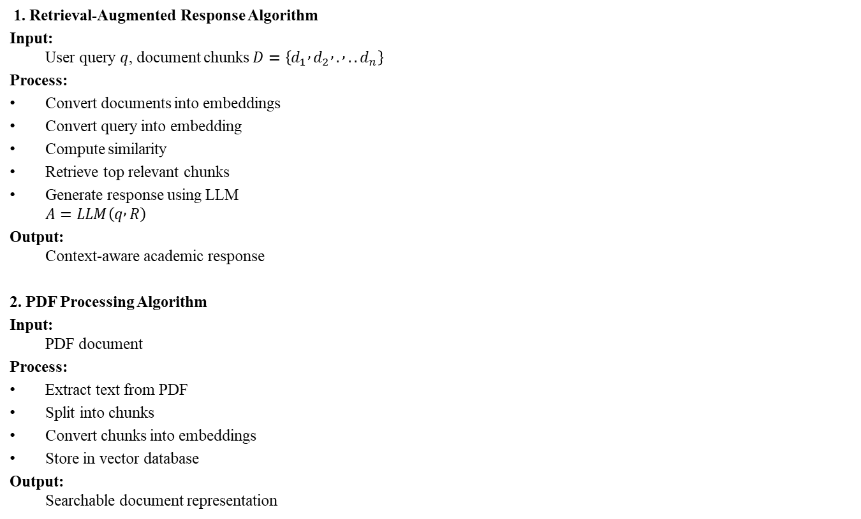
Aglorithms
1. Retrieval-Augmented Response Algorithm
Input: User query $q$, document chunks $D=\left\{d_{1} , d_{2} , . , ..d_{n}\right\}$
Process:
Convert documents into embeddings
Convert query into embedding
Compute similarity
Retrieve top relevant chunks
Generate response using LLM
$$A=LLM\left(q , R\right)$$
Output: Context-aware academic response
2. PDF Processing Algorithm
Input: PDF document
Process:
Extract text from PDF
Split into chunks
Convert chunks into embeddings
Store in vector database
Output: Searchable document representation

Slide 9
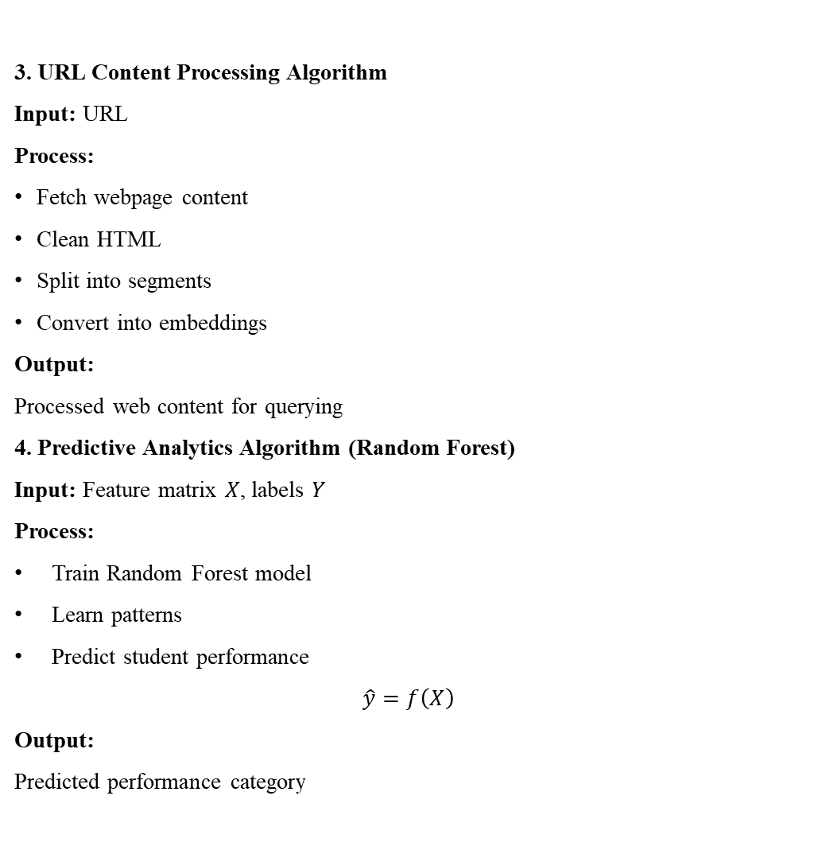
3. URL Content Processing Algorithm
Input: URL
Process:
Fetch webpage content
Clean HTML
Split into segments
Convert into embeddings
Output: Processed web content for querying
4. Predictive Analytics Algorithm (Random Forest)
Input: Feature matrix $X$, labels $Y$
Process:
Train Random Forest model
Learn patterns
Predict student performance
$$\hat{y}=f\left(X\right)$$
Output: Predicted performance category

Slide 10

5. Model Comparison Algorithm
Process:
Train Logistic Regression
Train Random Forest
Compare accuracy, precision, recall
$${\hat{y}}_{LR},{\hat{y}}_{RF}$$
Output: Best performing model
6. Multilingual Query Processing Algorithm
Input: User query $q$
Process:
Detect language
Translate to English
Pass to retrieval system
$$q^{′}=Translate\left(q , L→EN\right)$$
Output: Language-independent response

Slide 11
7. Entity Extraction Algorithm
Input: Natural language requirement text 𝑇
Process:
(1) Perform tokenization on 𝑇. (2) Apply Part-of-Speech tagging on tokens. (3) Extract noun terms as candidate entities (4) Remove stop words and duplicate entities. (5) Identify attribute terms linked to each entity.
Output: Set of extracted entities 𝐸 and attributes 𝐴.
8. Relationship Detection Algorithm
Input: Set of entities 𝐸 = {e₁, e₂, …, eₙ}
Process:
(1) Analyze verbs connecting entities in text. (2) For each pair (eᵢ, eⱼ), determine relationship rᵢⱼ. (3) Determine relationship type (1:1, 1:N, M:N). (4) Form relationship set 𝑅 = {(eᵢ, eⱼ, type)}.
Output: Set of relationships 𝑅.

Slide 12
9. Schema Generation Algorithm
Input: Entities 𝐸 and relationships 𝑅
Process: (1) For each entity e ∈ 𝐸, create a table. (2) Add attributes as columns for each table. (3) Assign primary key (id) for each table. (4) For each relationship: (a) If 1:N → add foreign key in N-side table. (b) If M:N → create a junction table. (5) Add constraints (PRIMARY KEY, FOREIGN KEY).
Output: SQL schema statements
10. ER Diagram Generation Algorithm
Input: Entities 𝐸 and relationships 𝑅
Process: (1) Create nodes for each entity. (2) Add attributes to corresponding entities. (3) Draw edges between entities based on relationships. (4) Label edges with relationship types.
Output: ER diagram representation

Slide 13
11. Schema Validation Algorithm (Dataset-Based)
Input: Generated entities 𝐸₍g₎, expected entities 𝐸₍e₎
Process: (1) Convert both entity sets to comparable format. (2) Compute intersection:
(3) Count correct entities |𝐶| (4) Compute total expected entities (5) Calculate accuracy:
Output: Validation score (Accuracy %)

Slide 14
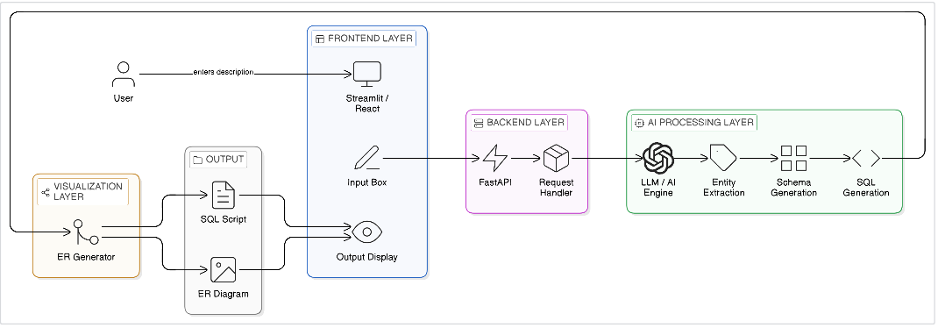
Architecture Diagram
Fig 1: Architecture Diagram

Slide 15
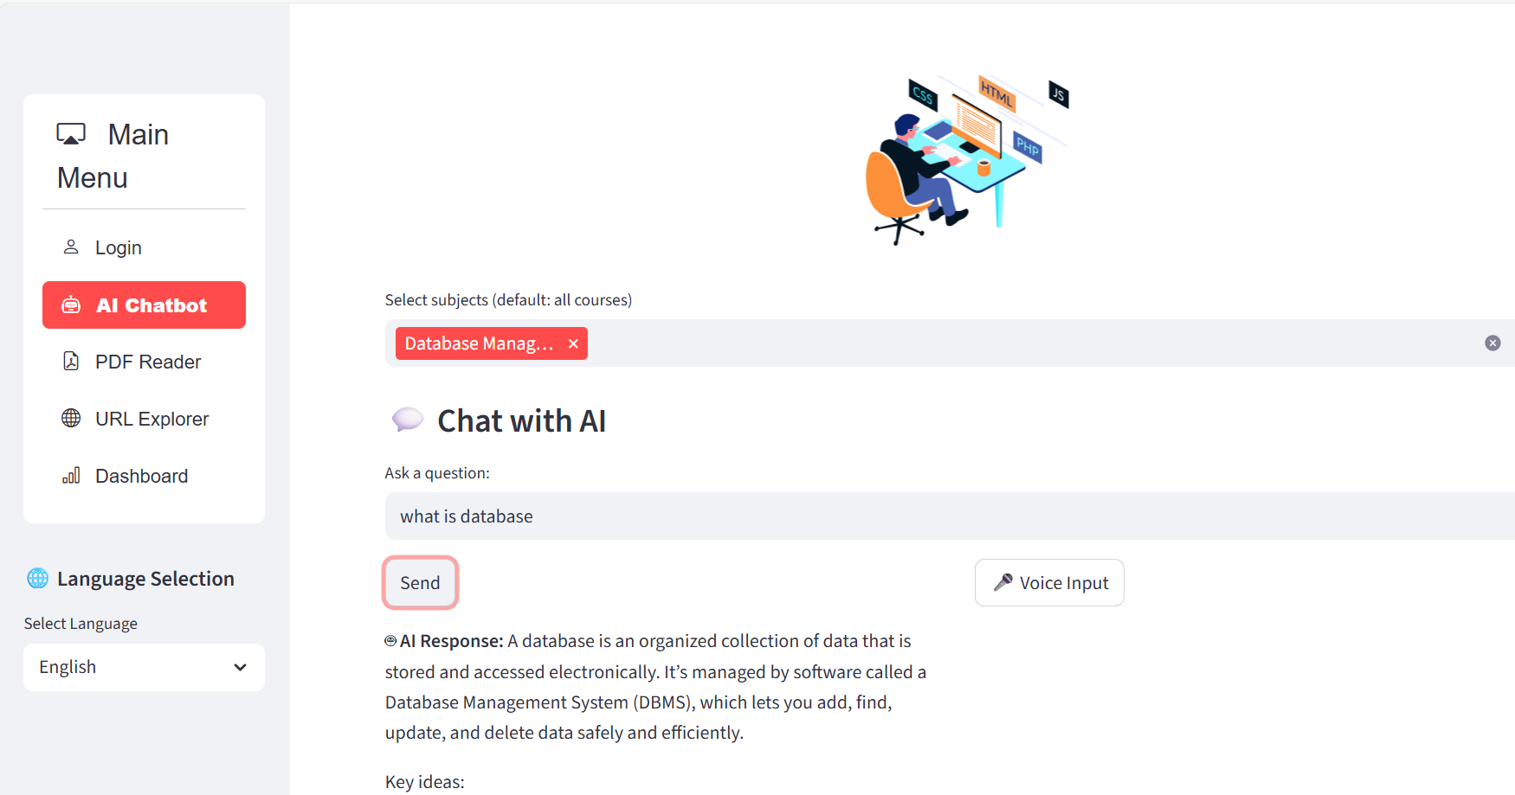
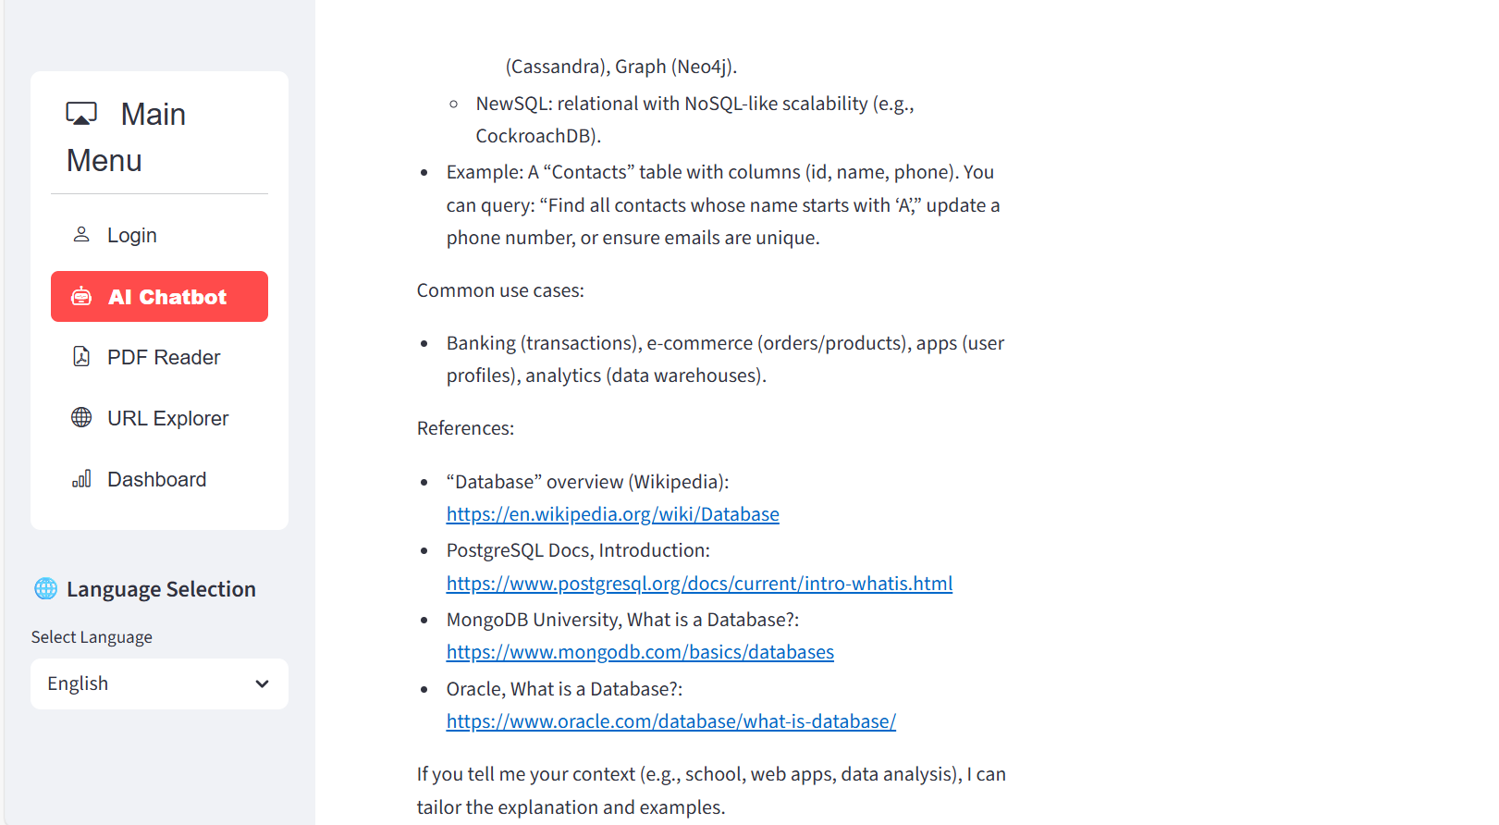
Results obtained in IPLA
Fig 2: Chatbot responses:

Slide 16
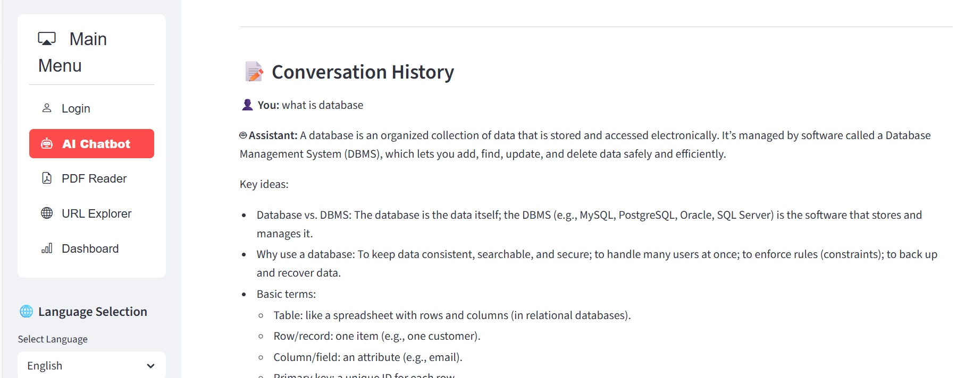
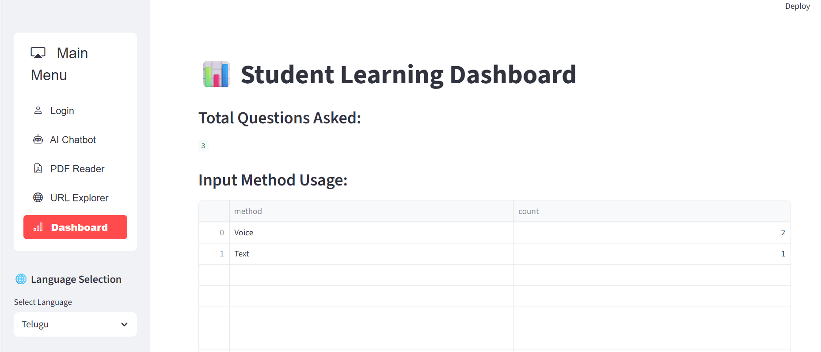
Fig 3. History
Fig 4. Dashboard

Slide 17
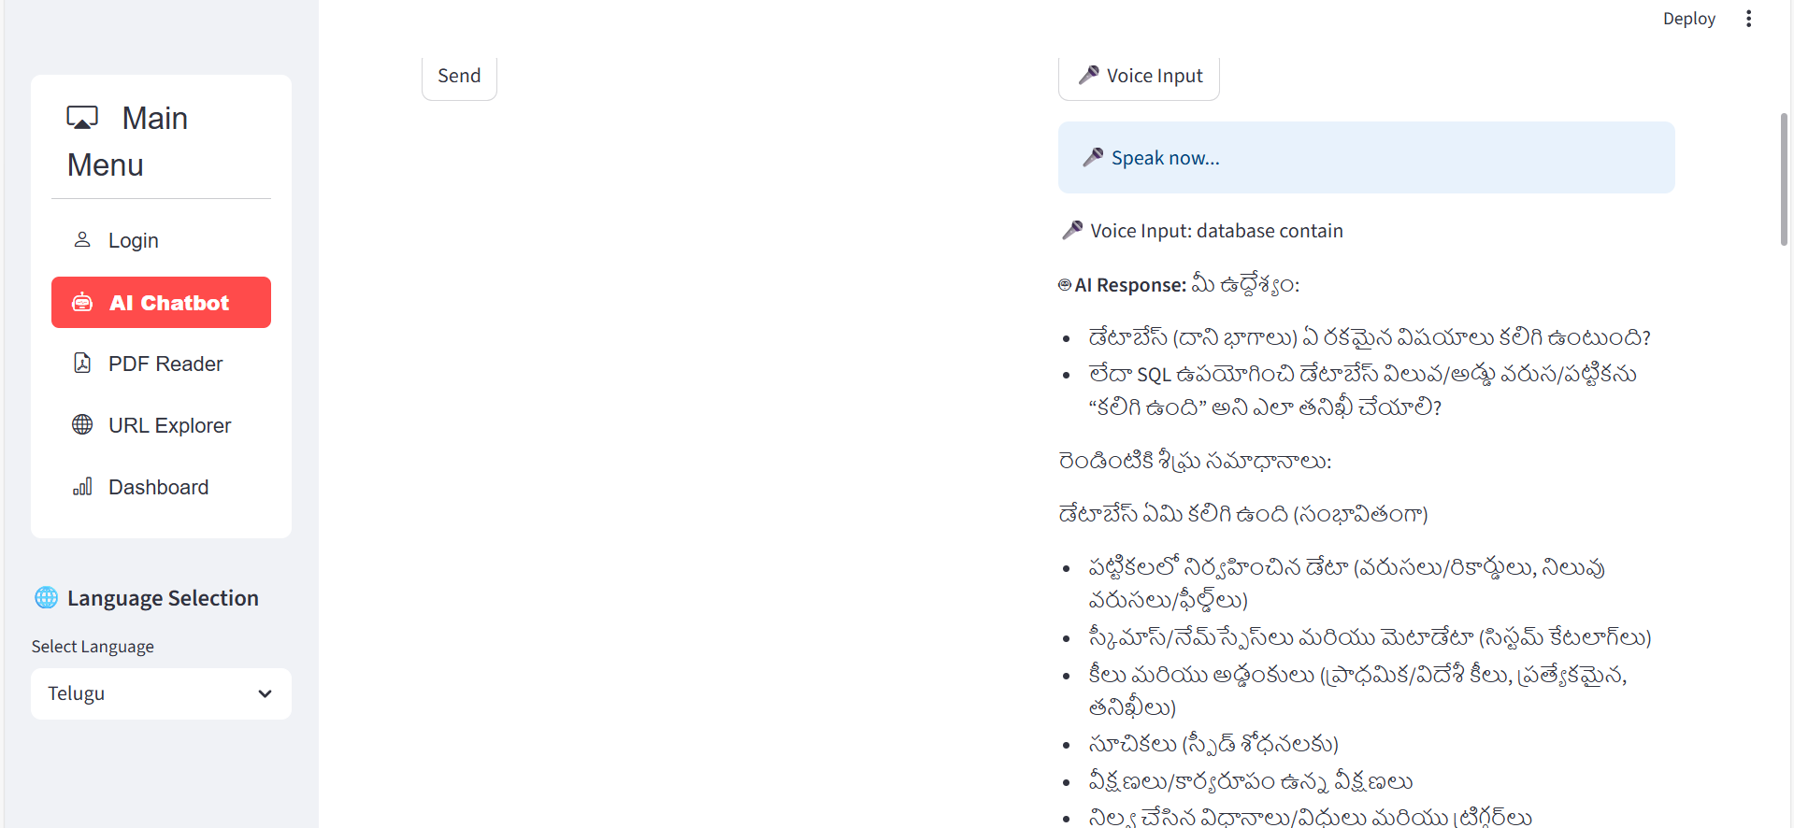
Fig 5: Multilingual support

Slide 18
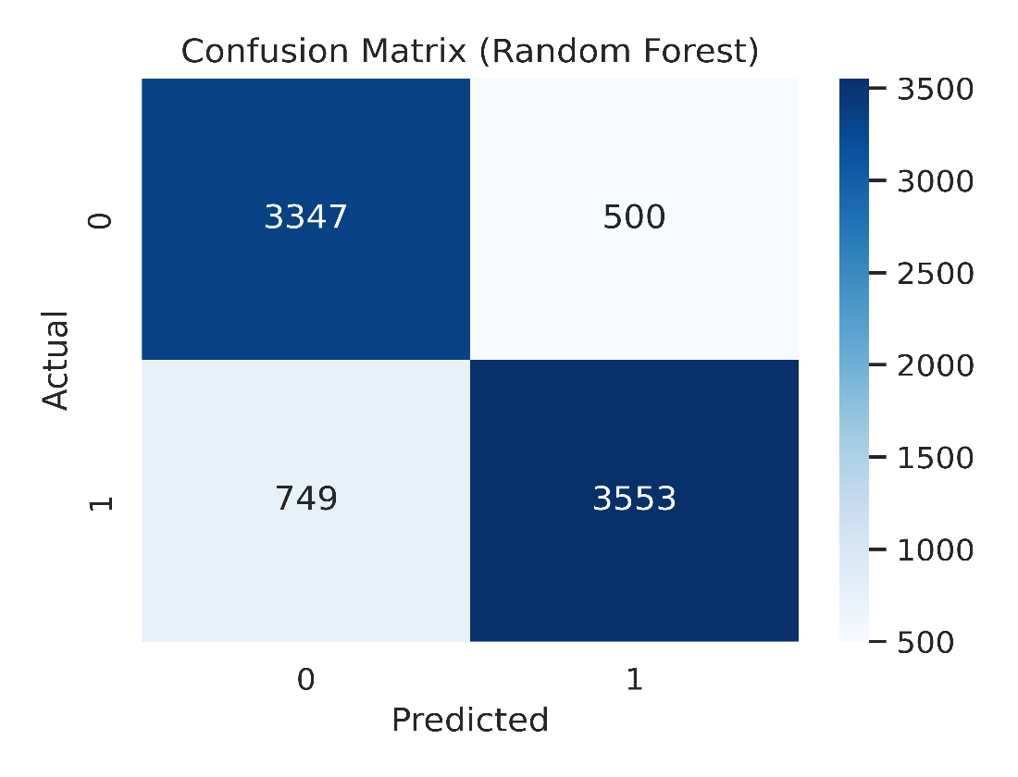
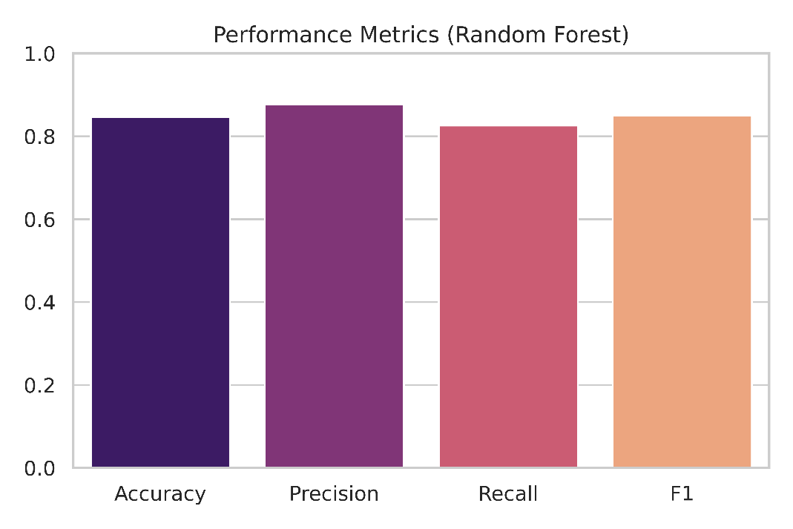
Fig 6: Performance Metrics
Fig 7: Confusion Matrix
Table-1: Model comparision
Model | Accuracy | Precision | Recall | F1-score
Logistic Regression | 0.832 | 0.870 | 0.802 | 0.835
Random Forest | 0.844 | 0.869 | 0.830 | 0.849

Slide 19
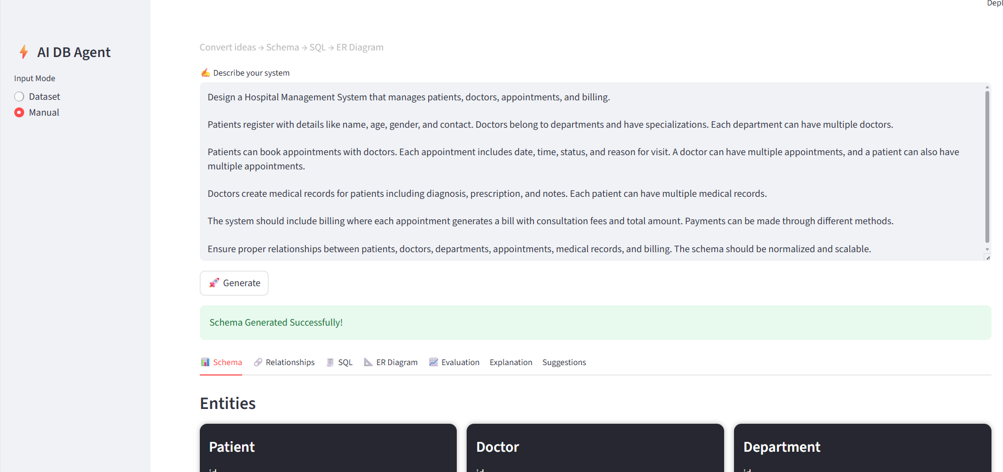
Complete Results obtained in Schema design Agent:
Fig 8. Schema Generation Interface

Slide 20
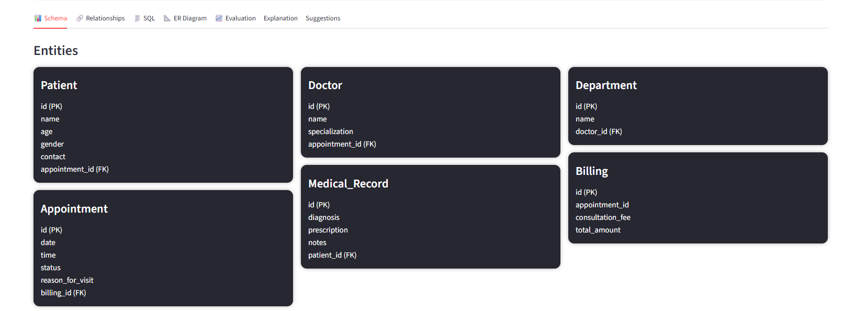
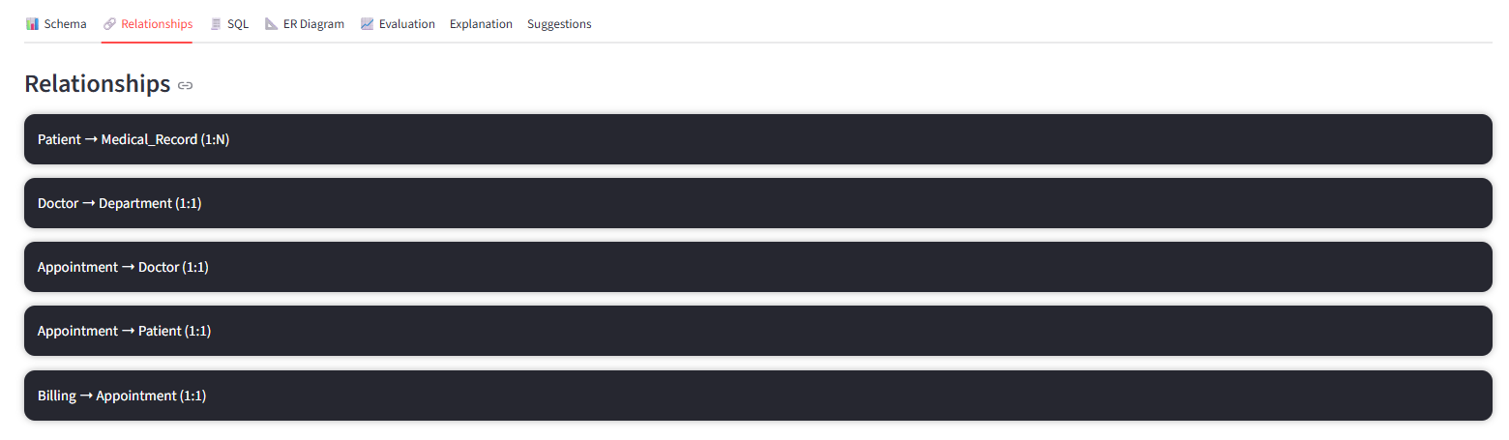
Fig 9. Extracted Entities and Attributes
Fig 10. Relationship Detection Output

Slide 21
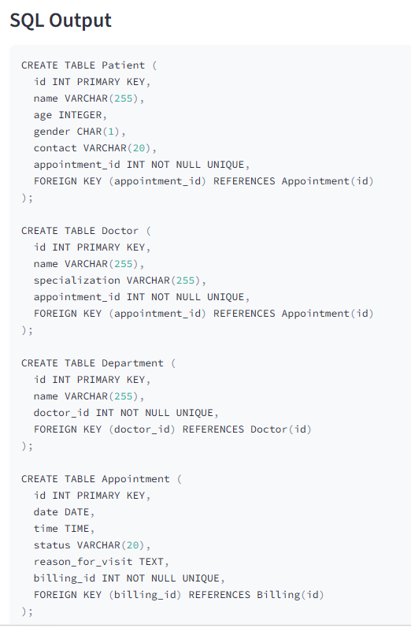
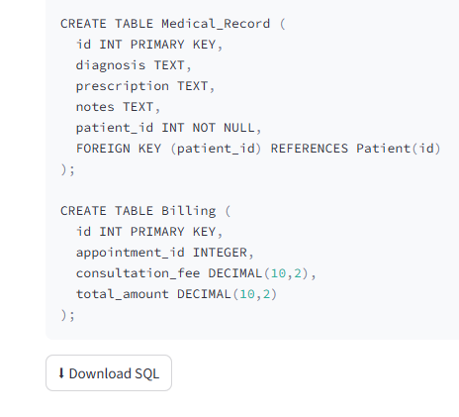
Fig 11. SQL DDL Generation

Slide 22
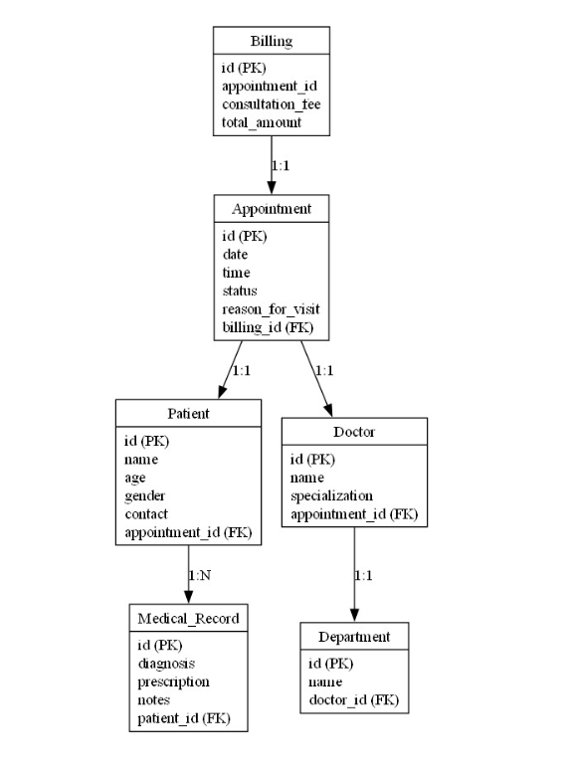
Fig 12. ER Diagram Output

Slide 23
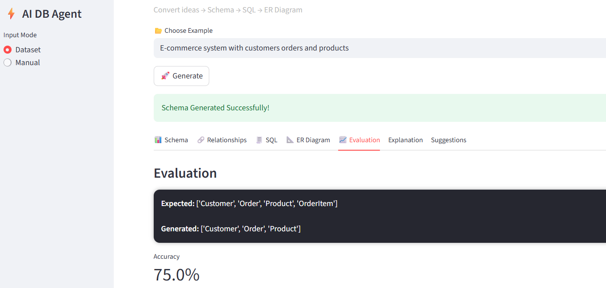
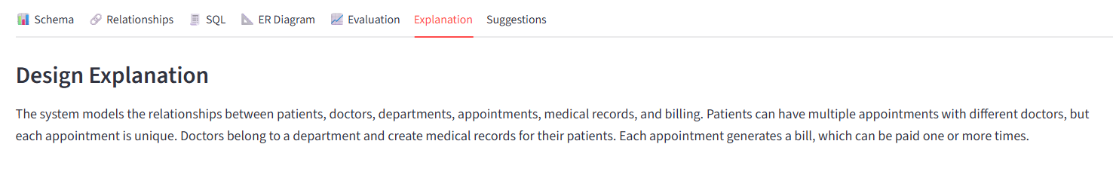
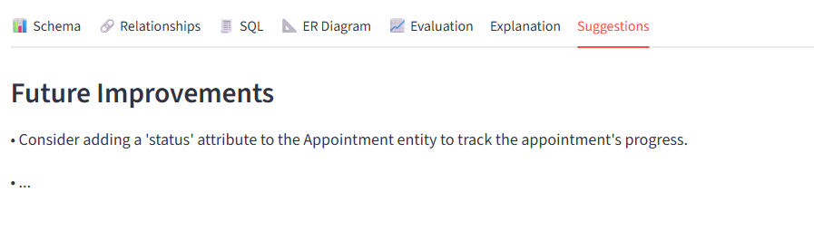
Result Analysis
Fig 13. Validation Output

Slide 24
Conclusion
Developed an AI-Powered Automated Database Schema Design Agent.
Converts natural-language software requirements into entities, relationships, SQL DDL, and ER diagrams.
Reduces manual effort in early-stage database design.
Provides a useful starting point for students and developers.
Validation results show effective identification of major schema components.
Future Work
Improve implicit entity and relationship detection.
Add normalization checks for better schema quality.
Support multiple SQL dialects such as MySQL and PostgreSQL.
Enable interactive schema refinement by users.

Slide 25
References
[1] Li, X., Chen, Y., Zhang, H. et al. Text2Schema: Filling the Gap in Designing Database Schemas from Natural Language. arXiv preprint arXiv:2503.23886, 2025.
[2] Wang, Z., Liu, Q., and Sun, T. SchemaAgent: A Multi-Agent Framework for Generating Relational Database Schema. arXiv preprint arXiv:2503.23886v1, 2025.
[3] Kumar, R., Sharma, P., and Verma, S. Generating Database Schema from Requirement Specifications Based on Natural Language Processing and Large Language Models. International Journal of Intelligent Systems, 2025.
[4] Deng, N., Chen, Y., and Zhang, X. Recent Advances in Text-to-SQL Generation: A Survey in the Era of Large Language Models. arXiv preprint arXiv:2408.05109, 2024.
[5] Gao, L., Xu, J., and Huang, K. Gen-SQL: Generate-Ground-Regenerate Framework for Text-to-SQL Generation. Proceedings of COLING 2025, pp. 256–267, 2025.
[6] Yu, T., Zhang, R., Yang, K. et al. Spider: A Large-Scale Human-Labeled Dataset for Complex and Cross-Domain Semantic Parsing and Text-to-SQL Task. Proceedings of EMNLP 2018, pp. 3911–3921, 2018.

