Slide 1
TEAM 5 PYTHON RECAP QUESTIONS

Slide 2
QUESTIONS

Slide 3

CODE 1

Slide 4
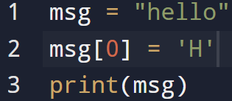
CODE 2

Slide 5
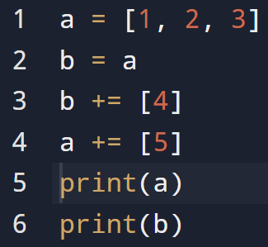
CODE 3

Slide 6
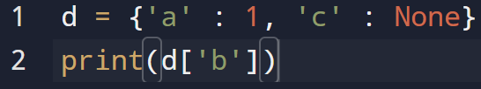
CODE 4

Slide 7
CODE 5

Slide 8
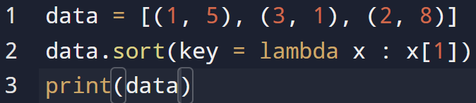
CODE 6

Slide 9
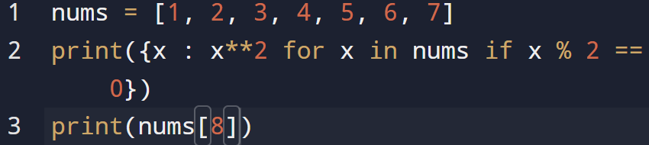
CODE 7

Slide 10

CODE 8A

Slide 11

CODE 8B

Slide 12
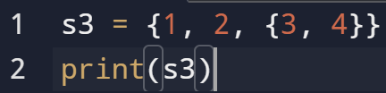
CODE 8C

Slide 13

CODE 8D

Slide 14
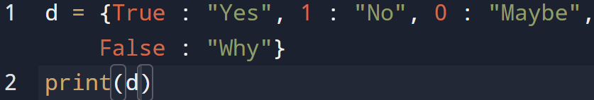
CODE 9

Slide 15
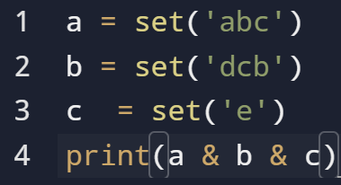
CODE 10

Slide 16
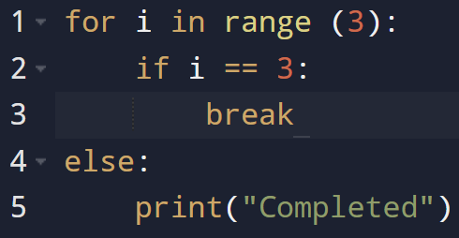
CODE 11

Slide 17

CODE 12

Slide 18
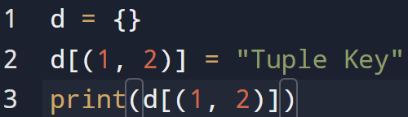
CODE 13

Slide 19

CODE 14

Slide 20

CODE 15A

Slide 21
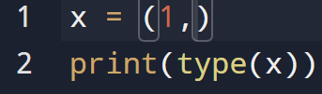
CODE 15B

Slide 22
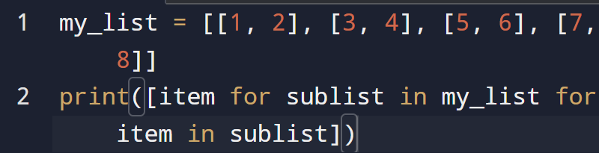
CODE 16

Slide 23
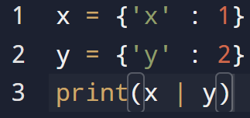
CODE 17

Slide 24
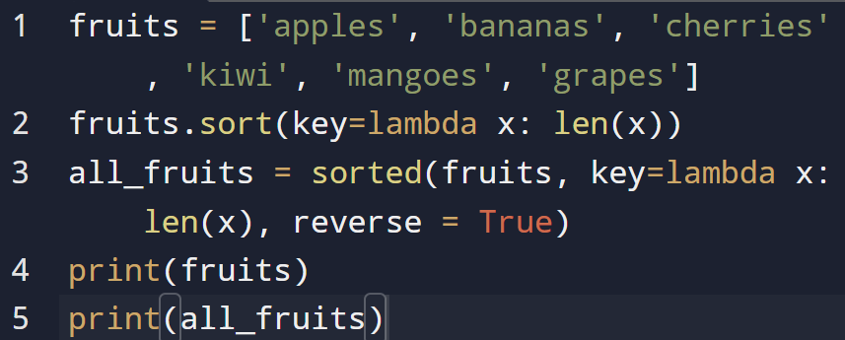
CODE 18

Slide 25
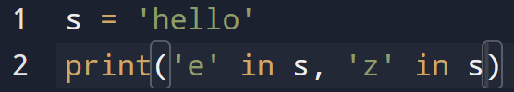
CODE 19

Slide 26
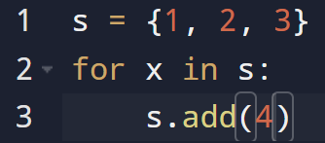
CODE 20

Slide 27
ANSWERS

Slide 28
CODE 1

Slide 29
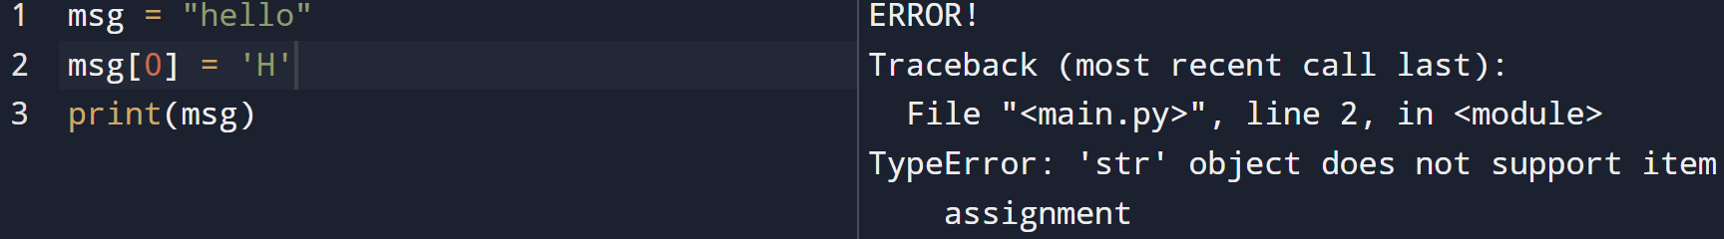
CODE 2

Slide 30
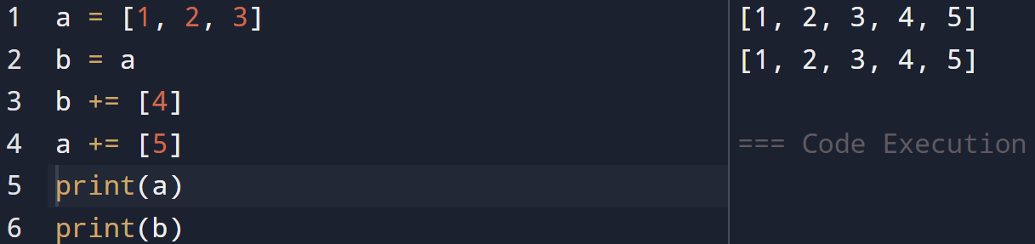
CODE 3

Slide 31
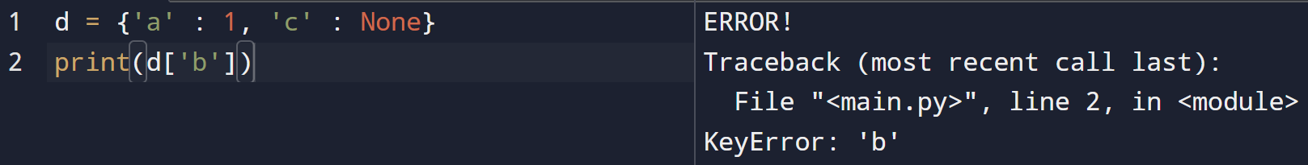
CODE 4

Slide 32
CODE 5

Slide 33
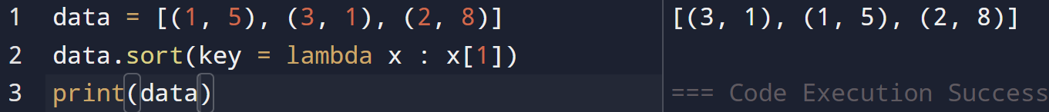
CODE 6

Slide 34
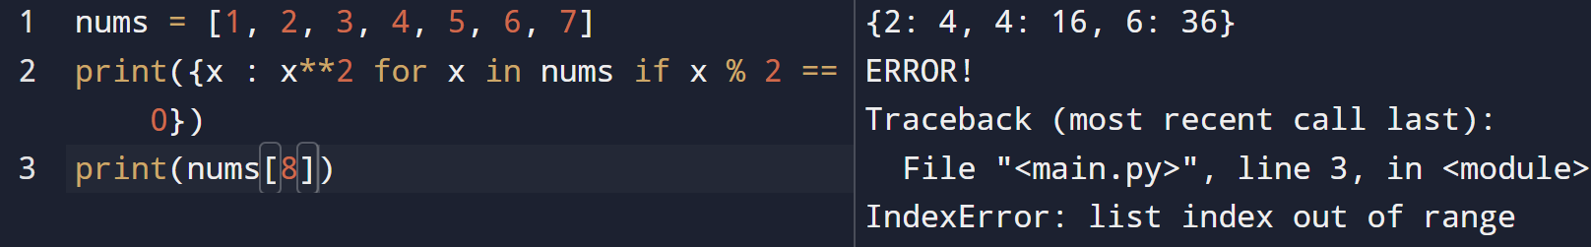
CODE 7

Slide 35
CODE 8A

Slide 36
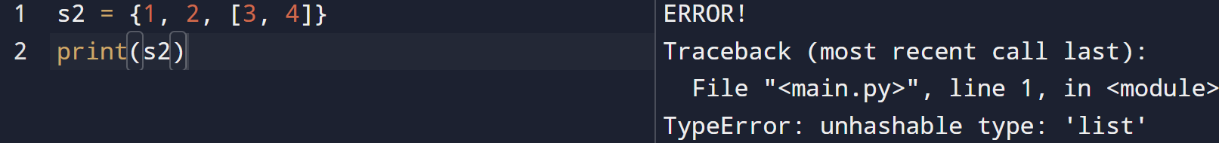
CODE 8B

Slide 37
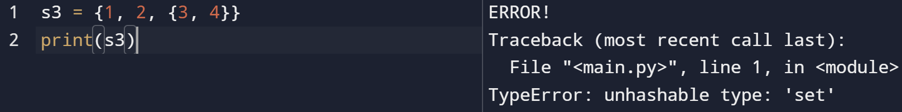
CODE 8C

Slide 38
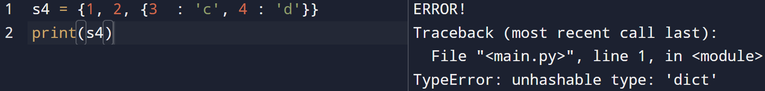
CODE 8D

Slide 39
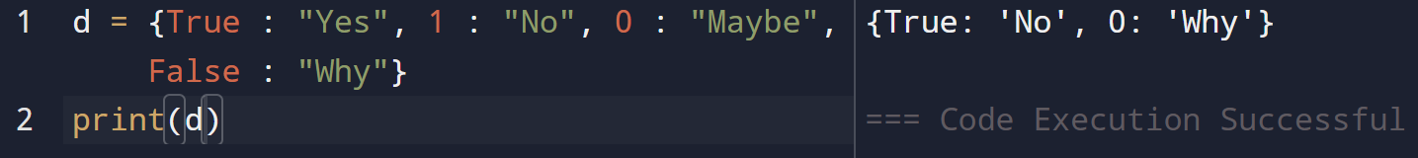
CODE 9

Slide 40
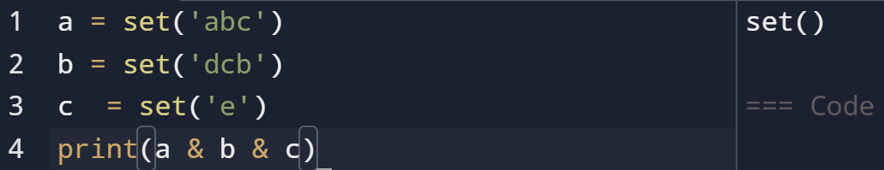
CODE 10

Slide 41
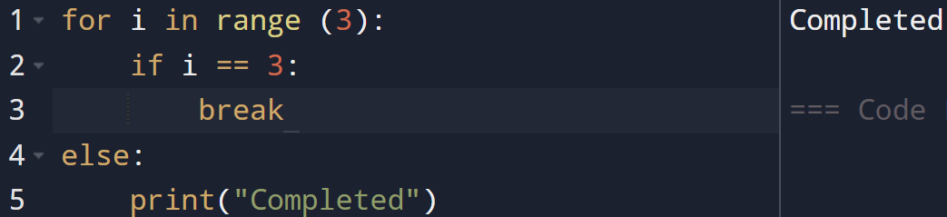
CODE 11

Slide 42
CODE 12

Slide 43
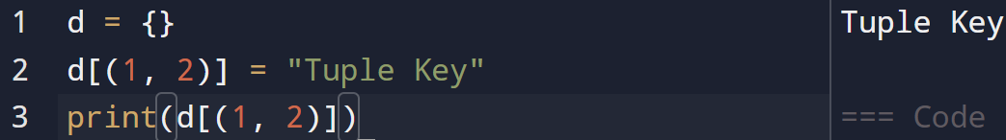
CODE 13

Slide 44

CODE 14

Slide 45
CODE 15A

Slide 46
CODE 15B

Slide 47
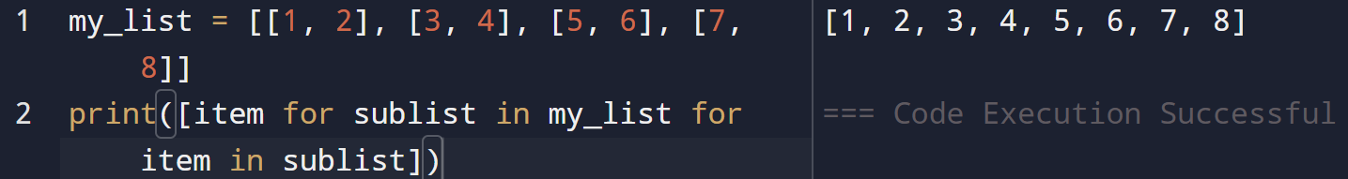
CODE 16

Slide 48
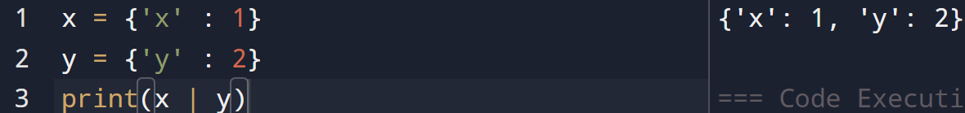
CODE 17

Slide 49
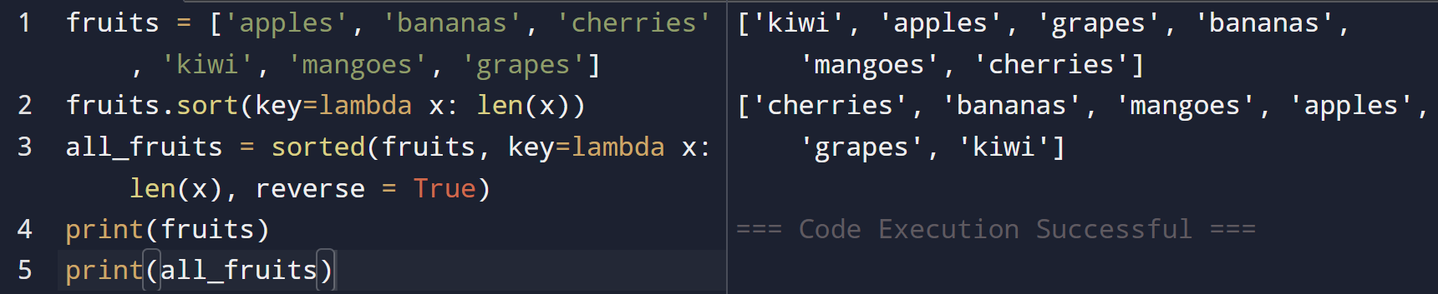
CODE 18

Slide 50
CODE 19

Slide 51
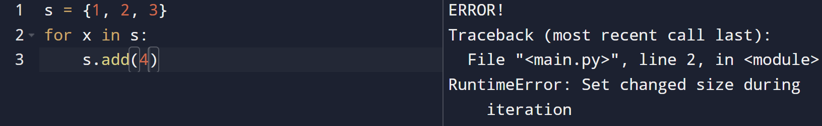
CODE 20

Slide 52
THANK YOU
By
Yasaswini
Sowmya
Harshitha
Yukthakshary
Supriya

