Slide 1
ADHD Classification Significance using Neural Networks
Varaprasad Kurra
Professor Dr. Yanqing Zhang Yasawini Kandru

Slide 2

ADHD Classification
Motivation behind the Project
Introduction
Dataset
Neural Network Model
LSTM Model
Results and Hypothesis Testing

Slide 3
Motivation - ADHD Classification
Traditional Machine Learning Models lack understanding the patterns behind the Dynamic Brain.
Neural Networks resemble the neurons in the human brain. The message passing between the neurons is similar to layers in the neural networks.
The basic idea behind a neural network is to simulate lots of densely interconnected brain cells inside a computer so we can get it to learn things.

Slide 4
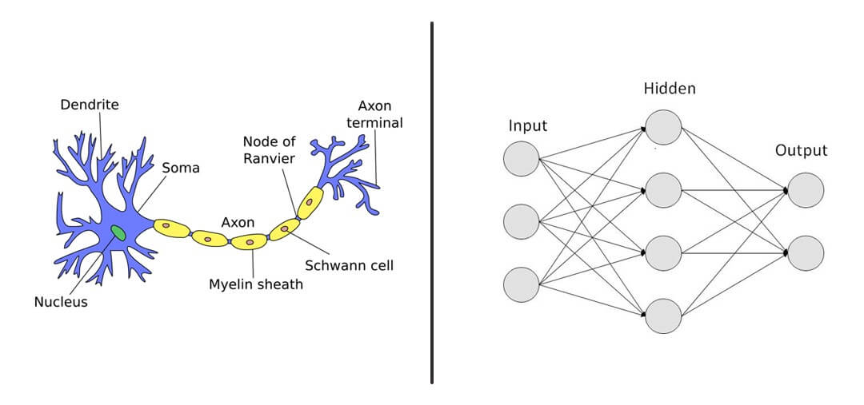
Brain Cell | NN

Slide 5
Introduction:
We aim to implement Neural Networks on rs-fMRI data and identify its classification significance. We emit the regions in the resting state network and consider the regions that have impact on ADHD classification.
We get the resting state network [rsn-70] which is nothing but that demonstrate 70 region’s connectivity in the brain. We use these state networks to implement ADHD classification.
Lastly, we compare the results doing a Hypothesis Testing.

Slide 6
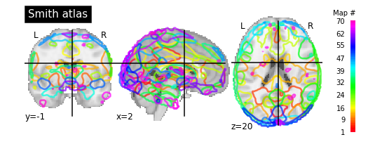
Data Analysis
In this step we first get the masker from the neuroimaging package. We can select the required networks depending upon the requirement.
We can select the networks as 10, 20, 70 depending the requirement.
We selected 70 resting state networks in our model.

Slide 7
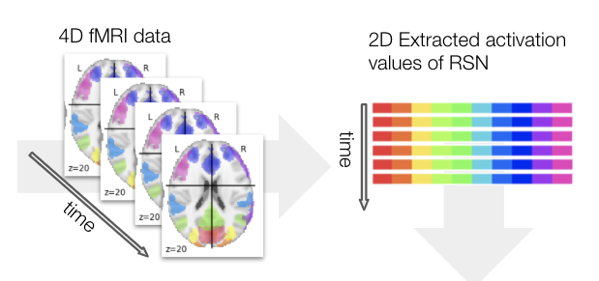
Data Preparation
We use train/test split paradigm to make sure the model is tested.
We define a function that randomly split data into train and test and reshape each according to model’s requirement.
We extract the resting state networks from 4D time series fMRI data.

Slide 8
Data Preparation
We initially fetch the ADHD dataset from nilearn package.
ADHD data consists of
CONFOUNDS i.e csv files that describe representing fluctuations with a potential non-neuronal origin.
FUNC files contain images of the resting-state data.
PHENOTYPIC contains description about preprocessing steps
We get the SMITH_ATLAS_RS_NETWORK masker that we will use to get only the required resting state networks from rs-fMRI. The sole purpose of this is to form a time series data from existing dataset.
We apply this masker to func_file using confounds and transform it to get time series data.

Slide 9
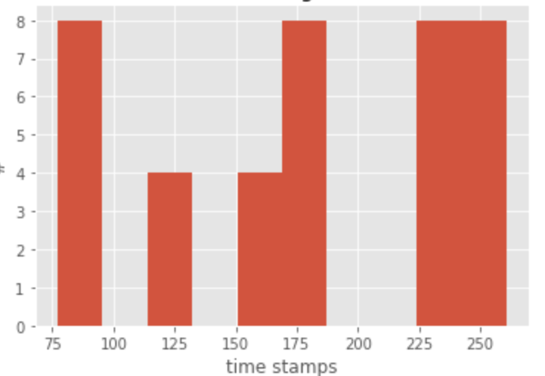
Data Preparation
fMRI dataset length variation.
We identify the longest image first.
We reshape every image to that longest image.
From the observation 261 is the highest timestamp.
With 40 subjects and 261 timestamp and 70 resting state networks. We reshape the entire data into [(40,261,70)].
We split the training and testing datasets from the above reshaped values.

Slide 10
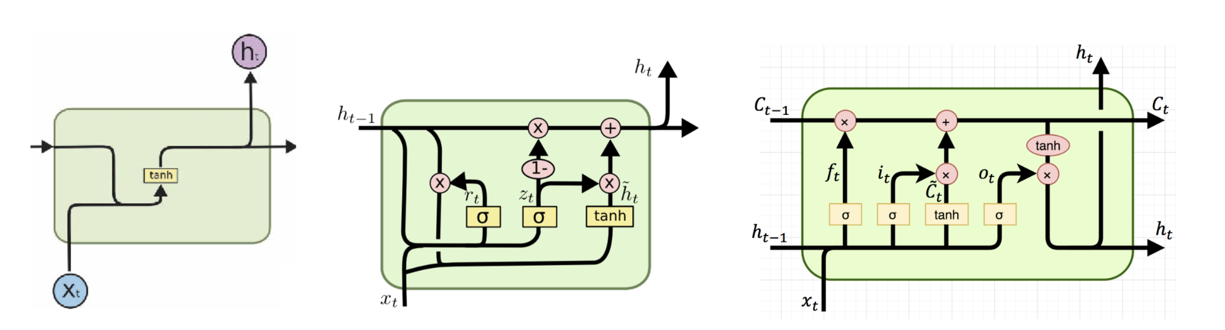
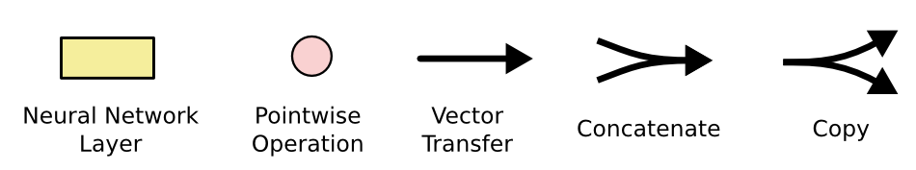
Neural Network Models
Neural network models differ from traditional machine learning models by keeping the track of previous results. Hence, to improve the efficiency we use Neural Network
We have different types of models. We focus on RNN , GRU and LSTM.

Slide 11
LSTM Model
A common LSTM unit is composed of a cell, an input gate, an output gate and a forget gate. The cell remembers values over arbitrary time intervals and the three gates regulate the flow of information in and out of the cell.
The advantage of an LSTM cell compared to a common recurrent unit is its cell memory unit. The cell vector has the ability to encapsulate the notion of forgetting part of its previously stored memory as well as to add part of new information.

Slide 12
Building the LSTM Model
We build a LSTM Model by adding upto 5 layers with initially 70 units [ Dimensionality of output space], and with a dropout of 0.4 and recurrent dropout of 0.15 in each layer.
We are likely to get the in addition to the output, so we make return the last state as true.
We keep decreasing the units at each layer, finally arriving at 2.

Slide 13
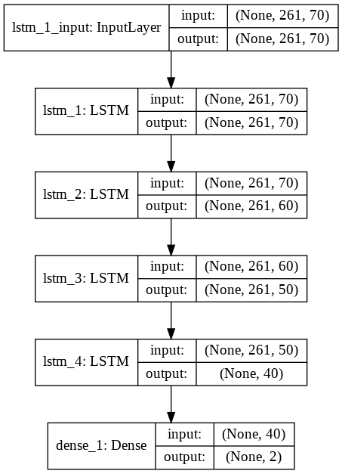
LSTM Model

Slide 14
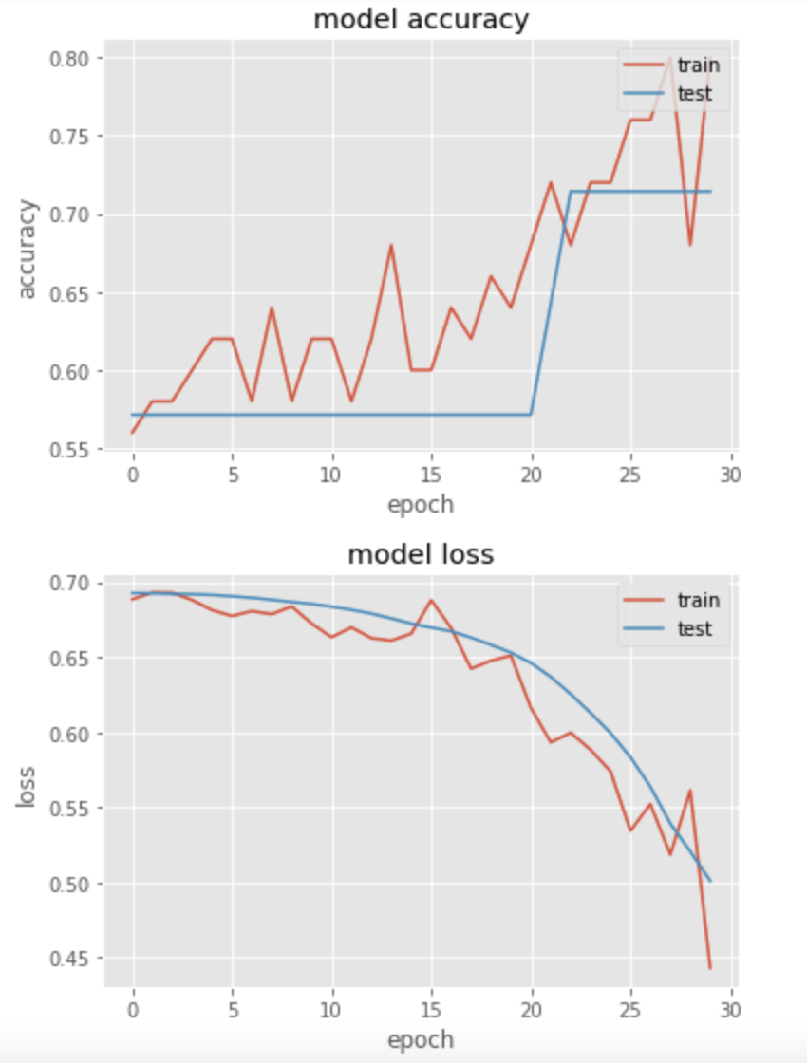
Model Accuracy and Loss

Slide 15
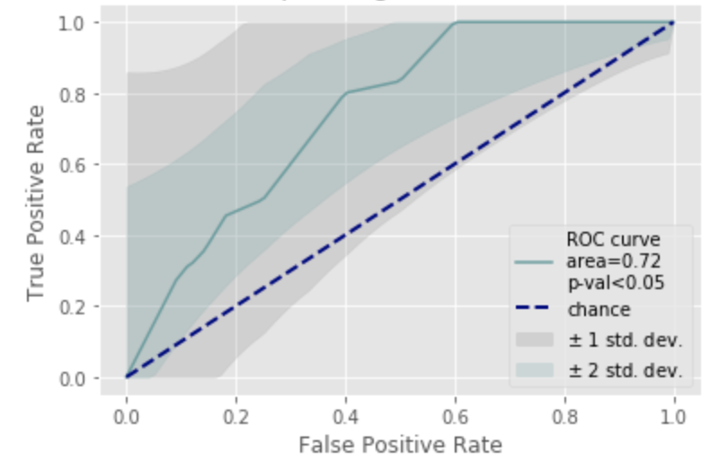
Hypothesis Testing- ROC curve
Specificity : Sensitivity

Slide 16
Future Work

Slide 17
Thank you

