Slide 1
Lecture 2 Text Processing: Regular Expressions, Text Normalization, Edit Distance
Adapted from the Recommended textbook’s slides

Slide 2
Basic Text Processing
Regular Expressions

Slide 3
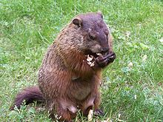
Regular expressions
A formal language for specifying text strings
A sequence of characters representing a search pattern
The RE is used to check a body of text for the search pattern
How can we search for any of these?
woodchuck
woodchucks
Woodchuck
Woodchucks
WOODCHUCK
WoodChuck
…

Slide 4
Why REs?
Regular expressions play a surprisingly large role
Sophisticated sequences of regular expressions are often the first model for any text processing task
For hard tasks, we use machine learning classifiers
But regular expressions are still used for pre-processing, or as features in the classifiers
Can be very useful in capturing generalizations

Slide 5
Note
There are slight differences in the way REs are represented and used in different languages and applications.
The regular expressions from the textbook follow the Perl syntax, but for this class we’ll be using the syntax for RE in the Python programming language.

Slide 6
Lecture continues on Jupyter Notebooks (Lab)
You can first read up on REs in python (if you are not familiar with them).
You’ll practice them in the labs this week (today).

Slide 7
Basic Text Processing
Regular Expressions
Notes:
In the last class and lab session, we started our discussion on basic text processing using REs. We looked at how REs can be used to search, find and replace strings in a body of text, we also looked at how REs can be used for pre-processing our text.

Slide 8
Week 2
Outline
Words and Corpora
Text Normalization
Word tokenization
Word normalization
Sentence segmentation
Starts here

Slide 9
Basic Text Processing
Words and Corpora
Notes:
Let's continue our study of basic text processing methods. In this lecture we'll talk about some basic properties of words. How many words are there? And what are the properties of corpora, that's the plural of corpus, meaning bodies of text?

Slide 10
How many words in a sentence?
"I do uh main- mainly business data processing"
Fragments, filled pauses
"Seuss’s cat in the hat is different from other cats!"
Lemma: same stem, part of speech, same word sense (meaning)
cat and cats = same lemma
Wordform: the full inflected surface form
cat and cats = different wordforms
Notes:
Let's start by asking how many words are in just one sentence? Here's a sentence: "I do uh main- mainly business data processing". How many words are in that sentence? It's a complicated question. Is "uh" a word? What about the cutoff "main" the first time I started to say "mainly". We call things like "main" here a fragment, and we call "uh" and "um" filled pauses. So for certain applications, like speech applications, we might want to be counting these. Or how about "cat" and "cats" in this Dr. Seuss sentence? It will help to introduce the distinction between "lemma" and "wordform". Two words have the same lemma if they have the same stem, the same part of speech, the same sense. Whereas wordform is the exact surface form of the word, with all its inflections or endings. So if we're counting lemmas, "cat" and "cats" count as the same lemma. If we're counting wordforms, "cat" and "cats" are different.

Slide 11
How many words in a sentence?
they lay back on the San Francisco grass and looked at the stars and their
Types: number of distinct words in a corpus
Type: an element of the vocabulary.
Tokens: the total number of running words in the text
Token: an instance of that type in running text.
How many?
15 tokens (or 14)
13 types (or 12) (or 11?)
Notes:
Let's look at a part of another sentence. How many words are in this sentence? Pause the video and count for yourself. Again, it depends how you count. We could count word types, the number of unique words that occur in the sentence. By that count we only count "the" once, even though it appears twice. Word tokens we're counting every word token on the page, so the two "the"s count twice. And what about San Francisco? One word or two? And how about "they and their". Different wordforms, same lemma. Again, it depends on our goals, and it's important to make that clear whenever you report word counts

Slide 12
How many words in a corpus?
Punctuations?
Capitalizations: US vs us
Needed in part-of-speech tagging and named entity recognition
Notes:
Punctuation is critical for finding boundaries of things
(commas, periods, colons) and for identifying some aspects of meaning (question
marks, exclamation marks, quotation marks). For some tasks, like part-of-speech
tagging or parsing or speech synthesis, we sometimes treat punctuation marks as if
they were separate words.

Slide 13
How many words in a corpus?
N = number of tokens
V = vocabulary = set of types, |V| is size of vocabulary
Heaps Law = Herdan's Law = where often .67 < β < .75
i.e., vocabulary size grows faster than the square root of the number of word tokens
 | Tokens = N | Types = |V|
Switchboard phone conversations | 2.4 million | 20 thousand
Shakespeare | 884,000 | 31 thousand
COCA | 440 million | 2 million
Google N-grams | 1 trillion | 13+ million
Notes:
In general, we'll refer to the number of tokens with capital N. And we'll use capital V to mean the vocabulary, the set of all words. So the cardinality of V is the size of vocabulary, the number of word types. although sometimes for simplification, we'll just use capital V to mean the vocabulary size when it's not ambiguous. There's a relationship between these two in running text, called Heaps Law or Herdan's Law, which is that the size of the vocabulary grows with something over the square root of the number of word tokens. So a large corpus of N words tokens, you can expect to see N to the .7 word types. Here are the numbers for some common corpora,… The switchboard corpus of phone conversations has 2.4 million word tokens. And there's 20,000 word types in those 2.4
millions words. Shakespeare has just under a million word tokens. Shakespeare is
quite a small corpus. He wrote, 800,000 words in his lifetime. And in that less
than a million words, he actually used 31,000 distinct words. So he had a very,
very broad vocabulary famously. And if you look at a very huge corpus, the Google
N-grams corpus that has a trillion different tokens, a very large number of
words, there's. Thirteen million types, so how many words are there in English? Well,
if you look at conversation, 20,000 different words. If you look at
Shakespeare, 30,000 words. And if you combine the two, probably somewhere, not
quite the sum of the two, but some larger number. But if you look at the Google
engrams, we have thirteen million. And of course, some of those are probably urls,
and. And email addresses, but even if you eliminate all of those, the number of
words in a language is very large, maybe there's a million words of English.

Slide 14
Heaps/Herdans Law
Suggests that
the dictionary size continues to increase with more documents in the collection, rather than a maximum vocabulary size being reached
the size of the dictionary is quite large for large collections.
It can be used to estimate the vocabulary size as a function of the size of the corpus

Slide 15
Corpora
Words don't appear out of nowhere!
A text is produced by
a specific writer(s),
at a specific time,
in a specific variety,
of a specific language,
for a specific function.
Notes:
Where did these corpora come from? …. These characteristics of a text influence properties of the text.

Slide 16
Corpora vary along dimension like
Language: 7097 languages in the world (2018)
Variety, like African American Language varieties.
AAE Twitter posts might include forms like "iont" (I don't)
Code switching, e.g., Spanish/English, Hindi/English:
S/E: Por primera vez veo a @username actually being hateful! It was beautiful:)
[For the first time I get to see @username actually being hateful! it was beautiful:) ]
H/E: dost tha or ra- hega ... dont wory ... but dherya rakhe
[“he was and will remain a friend ... don’t worry ... but have faith”]
Genre: newswire, fiction, scientific articles, Wikipedia
Author Demographics: writer's age, gender, ethnicity, SES
Notes:
For example, what language is the text in? As we'll see when we get to talking about word tokenization, what counts as a word can be different in different languages.

Slide 17
Corpus datasheets
Gebru et al (2020), Bender and Friedman (2018)
Motivation:
Why was the corpus collected?
By whom?
Who funded it?
Situation: In what situation was the text written?
Collection process: If it is a subsample how was it sampled? Was there consent? Pre-processing?
+Annotation process, language variety, demographics, etc.
Notes:
You'll need to make sure you consider all those properties of a text when you are using it for processing purposes. And there are even more properties of corpora that it's important to consider. Who collected this corpus?
Whenever you build a corpus, you should be documenting these decisions in a datasheet for the corpus.
In summary, when you study text in corpora it's important to be explicit about what you mean by word (type or token, lemma or wordform) and what are the properties of the corpora; their genre, their language variety, who wrote them and how they were collected.

Slide 18
Basic Text Processing
Text Normalization
Notes:
In the next few lectures we'll introduce text normalization, the process of turning a text into standard formatting of words or sentences. We'll start by thinking about how to break up a text into word tokens.

Slide 19
Text Normalization
Every NLP task requires text normalization:
Tokenizing (segmenting) words
Normalizing word formats
Segmenting sentences
Notes:
When we normalize text, we attempt to reduce its randomness, bringing it closer to a predefined “standard”. This helps us to reduce the amount of different information that the computer has to deal with, and therefore improves efficiency. (https://towardsdatascience.com/text-normalization-for-natural-language-processing-nlp-70a314bfa646)

Slide 20
Basic Text Processing
Word tokenization
Notes:
tokenization, the task of segmenting running text into words.
Different considerations
Will punctuations be a different token
We often want to break off punctuation as a separate token; commas are a useful piece of
information for parsers, periods help indicate sentence boundaries. But we’ll often
want to keep the punctuation that occurs word internally, in examples like m.p.h.,
Ph.D., AT&T, and cap’n. Special characters and numbers will need to be kept in
prices ($45.55) and dates (01/02/06); we don’t want to segment that price into separate
tokens of “45” and “55”. And there are URLs (http://www.wits.ac.za),
Twitter hashtags (#nlproc), or email addresses (someone@students.ac.za).
Expand clitics: we’re – we are
New York as two tokens or one

Slide 21
Space-based tokenization
A very simple way to tokenize
For languages that use space characters between words
Arabic, Cyrillic, Greek, Latin, etc., based writing systems
Segment off a token between instances of spaces

Slide 22
Issues in Tokenization
Can't just blindly remove punctuation:
m.p.h., Ph.D., AT&T, cap’n
prices ($45.55)
dates (01/02/06)
URLs (http://www.wits.ac.za)
hashtags (#nlproc)
email addresses (someone@students.ac.za)
Clitic: a word that doesn't stand on its own
"are" in we're, French "je" in j'ai, "le" in l'honneur
When should multiword expressions (MWE) be words?
New York, rock ’n’ roll
Notes:
Of course, tokenization in most real situations isn't as simple as I've suggested with the simple UNIX tools.

Slide 23
Tokenization in NLTK
Bird, Loper and Klein (2009), Natural Language Processing with Python. O’Reilly
Notes:
So most standard tokenization programs for English or languages with similar writing systems need to deal with each of these issues. Here's a simple python tokenizer in the Natural Language Toolkit that has little regular expressions for dealing with hypthens, and currency, and whatnot

Slide 24
Tokenization in languages without spaces
Many languages (like Chinese, Japanese, Thai) don't use spaces to separate words!
How do we decide where the token boundaries should be?
Notes:
But wait, what about all the languages that don't have spaces!

Slide 25
Word tokenization in Chinese
Chinese words are composed of characters called "hanzi" (or sometimes just "zi")
Each one represents a meaning unit called a morpheme.
Each word has on average 2.4 of them.
But deciding what counts as a word is complex and not agreed upon.

Slide 26
How to do word tokenization in Chinese?
姚明进入总决赛 “Yao Ming reaches the finals”
3 words?
姚明 进入 总决赛
YaoMing reaches finals
5 words?
姚 明 进入 总 决赛
Yao Ming reaches overall finals
7 characters? (don't use words at all):
姚 明 进 入 总 决 赛
Yao Ming enter enter overall decision game

Slide 27
How to do word tokenization in Chinese?
姚明进入总决赛 “Yao Ming reaches the finals”
3 words?
姚明 进入 总决赛
YaoMing reaches finals
5 words?
姚 明 进入 总 决赛
Yao Ming reaches overall finals
7 characters? (don't use words at all):
姚 明 进 入 总 决 赛
Yao Ming enter enter overall decision game

Slide 28
How to do word tokenization in Chinese?
姚明进入总决赛 “Yao Ming reaches the finals”
3 words?
姚明 进入 总决赛
YaoMing reaches finals
5 words?
姚 明 进入 总 决赛
Yao Ming reaches overall finals
7 characters? (don't use words at all):
姚 明 进 入 总 决 赛
Yao Ming enter enter overall decision game

Slide 29
How to do word tokenization in Chinese?
姚明进入总决赛 “Yao Ming reaches the finals”
3 words?
姚明 进入 总决赛
YaoMing reaches finals
5 words?
姚 明 进入 总 决赛
Yao Ming reaches overall finals
7 characters? (don't use words at all):
姚 明 进 入 总 决 赛
Yao Ming enter enter overall decision game

Slide 30
Word tokenization / segmentation
So in Chinese it's common to just treat each character (zi) as a token.
So the segmentation step is very simple
In other languages (like Thai and Japanese), more complex word segmentation is required.
The standard algorithms are neural sequence models trained by supervised machine learning.

Slide 31
Basic Text Processing
Word tokenization
Notes:
Word tokenization is an important step in text normalization. Here we introduced some common baseline methods, space-based and character-based tokenization.

Slide 32
Basic Text Processing
Byte Pair Encoding
Notes:
In this lecture, we introduce the Byte Pair Encoding or BPE algorithm that uses corpus statistics to decide how to segment a text into tokens.

Slide 33
Another option for text tokenization
Instead of
white-space segmentation
single-character segmentation
Use the data to tell us how to tokenize.
Subword tokenization (because tokens can be parts of words as well as whole words)
Notes:
To deal with this unknown word problem, modern tokenizers often automatically induce sets of tokens that include tokens smaller than words, called subwords
Subwords can be arbitrary substrings, or they can be meaning-bearing units like the
morphemes -est or -er. (A morpheme is the smallest meaning-bearing unit of a language;
for example the word unlikeliest has the morphemes un-, likely, and -est.)
In modern tokenization schemes, most tokens are words, but some tokens are frequently
occurring morphemes or other subwords like -er. Every unseen word like
lower can thus be represented by some sequence of known subword units, such as
low and er, or even as a sequence of individual letters if necessary.

Slide 34
Subword tokenization
Three common algorithms:
Byte-Pair Encoding (BPE) (Sennrich et al., 2016)
Unigram language modeling tokenization (Kudo, 2018)
WordPiece (Schuster and Nakajima, 2012)
All have 2 parts:
A token learner that takes a raw training corpus and induces a vocabulary (a set of tokens).
A token segmenter that takes a raw test sentence and tokenizes it according to that vocabulary

Slide 35
Byte Pair Encoding (BPE) token learner
Let vocabulary be the set of all individual characters
= {A, B, C, D,…, a, b, c, d….}
Repeat:
Choose the two symbols that are most frequently adjacent in the training corpus (say 'A', 'B')
Add a new merged symbol 'AB' to the vocabulary
Replace every adjacent 'A' 'B' in the corpus with 'AB'.
Until k merges have been done.

Slide 36
BPE token learner algorithm

Slide 37
Byte Pair Encoding (BPE) Addendum
Most subword algorithms are run inside space-separated tokens.
So we commonly first add a special end-of-word symbol '__' before space in training corpus
Next, separate into letters.

Slide 38
BPE token learner
Original (very fascinating🙄) corpus:
low low low low low lowest lowest newer newer newer newer newer newer wider wider wider new new
Add end-of-word tokens, resulting in this vocabulary:
representation

Slide 39
BPE token learner
Merge e r to er

Slide 40
BPE
Merge er _ to er_

Slide 41
BPE
Merge n e to ne

Slide 42
Work it out

Slide 43
BPE
The next merges are:

Slide 44
BPE token segmenter algorithm
On the test data, run each merge learned from the training data:
Greedily
In the order we learned them
(test frequencies don't play a role)
So: merge every e r to er, then merge er _ to er_, etc.
Result:
Test set "n e w e r _" would be tokenized as a full word
Test set "l o w e r _" would be two tokens: "low er_"

Slide 45
Properties of BPE tokens
Usually include frequent words
And frequent subwords
Which are often morphemes like -est or –er
A morpheme is the smallest meaning-bearing unit of a language
unlikeliest has 3 morphemes un-, likely, and -est

Slide 46
Basic Text Processing
Byte Pair Encoding
Notes:
The Byte Pair Encoding algorithm we've described is one of a set of corpus-based tokenizers that together are now extremely commonly used throughout NLP

Slide 47
What are the three tokenization techniques we learnt?
Notes:
Character tokenization, space tokenization, subword tokenization

Slide 48
Basic Text Processing
Word Normalization and other issues
Notes:
Now let's discuss how to put all words in a standard format, a process called Word Normalization. choosing
a single normal form for words with multiple forms. Normalizing words, and segmenting off sentences or other larger discourse units, are important initial steps in text processing.

Slide 49
Word Normalization
Putting words/tokens in a standard format
U.S.A. or USA
uhhuh or uh-huh
Fed or fed
am, is, be, are

Slide 50
Case folding
Applications like IR: reduce all letters to lower case
Since users tend to use lower case
Possible exception: upper case in mid-sentence?
e.g., General Motors
Fed vs. fed
SAIL vs. sail
For sentiment analysis, MT, Information extraction
Case is helpful (US versus us is important)

Slide 51
Lemmatization
Represent all words as their lemma, their shared root
= dictionary headword form:
am, are, is → be
car, cars, car's, cars' → car
Spanish quiero (‘I want’), quieres (‘you want’)
→ querer ‘want'
He is reading detective stories
→ He be read detective story
Notes:
Lemmatization is the task of determining that two words have the same root,
despite their surface differences.

Slide 52
Lemmatization is done by Morphological Parsing
Morphemes:
The small meaningful units that make up words
Stems: The core meaning-bearing units
Affixes: Parts that adhere to stems, often with grammatical functions
Morphological Parsers:
Parse cats into two morphemes cat and s

Slide 53
Stemming
Reduce terms to stems, chopping off affixes crudely
This was not the map we found in Billy Bones’s chest, but an accurate copy, complete in all things-names and heights and soundings-with the single exception of the red crosses and the written notes.
Thi wa not the map we found in Billi Bone s chest but an accur copi complet in all thing name and height and sound with the singl except of the red cross and the written note
.

Slide 54
Porter Stemmer
Based on a series of rewrite rules run in series
A cascade, in which output of each pass fed to next pass
Some sample rules:

Slide 55
Sentence Segmentation
!, ? mostly unambiguous but period “.” is very ambiguous
Sentence boundary
Abbreviations like Inc. or Dr.
Numbers like .02% or 4.3
Common algorithm: Tokenize first: use rules or ML to classify a period as either (a) part of the word or (b) a sentence-boundary.
An abbreviation dictionary can help
Sentence segmentation can then often be done by rules based on this tokenization.

Slide 56
Minimum Edit Distance
Definition of Minimum Edit Distance

Slide 57
How similar are two strings?
Computational Biology
Align two sequences of nucleotides
Resulting alignment:
Spell correction
The user typed “graffe”
Which is closest?
graf
graft
grail
giraffe
AGGCTATCACCTGACCTCCAGGCCGATGCCC
TAGCTATCACGACCGCGGTCGATTTGCCCGAC
-AGGCTATCACCTGACCTCCAGGCCGA--TGCCC---
TAG-CTATCAC--GACCGC--GGTCGATTTGCCCGAC

Slide 58
How similar are two strings?
Coreference
the task of deciding whether two strings such as the following refer to the same entity:
Wits Chancellor, Dr Judy Dlamini
Wits Chancellor, Judy Dlamini
Wits University Chancellor, Dr Judy Dlamini

Slide 59
Edit Distance
The minimum edit distance between two strings
Is the minimum number of editing operations
Insertion
Deletion
Substitution
Needed to transform one into the other

Slide 60

Minimum Edit Distance
Two strings and their alignment:

Slide 61
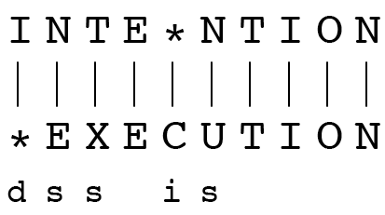
Minimum Edit Distance
If each operation has cost of 1
Distance between these is 5
If substitutions cost 2 (Levenshtein)
Distance between them is 8

Slide 62
Alignment in Computational Biology
Given a sequence of bases
An alignment:
Given two sequences, align each letter to a letter or gap
AGGCTATCACCTGACCTCCAGGCCGATGCCC
TAGCTATCACGACCGCGGTCGATTTGCCCGAC
-AGGCTATCACCTGACCTCCAGGCCGA--TGCCC---
TAG-CTATCAC--GACCGC--GGTCGATTTGCCCGAC

Slide 63
Other uses of Edit Distance in NLP
Evaluating Machine Translation and speech recognition
R Spokesman confirms senior government adviser was appointed
H Spokesman said the senior adviser was appointed
S I D I
Named Entity Extraction and Entity Coreference
IBM Inc. announced today
IBM profits
Notes:
Machine translation vs human translation

Slide 64
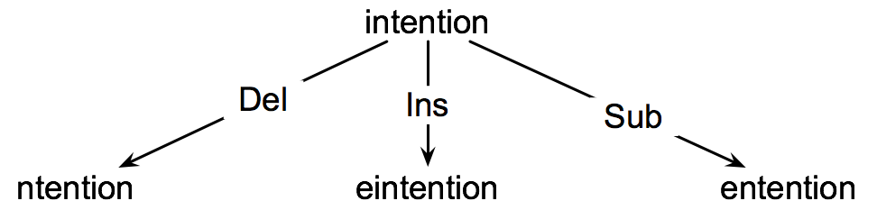
How to find the Min Edit Distance?
Searching for a path (sequence of edits) from the start string to the final string:
Initial state: the word we’re transforming
Operators: insert, delete, substitute
Goal state: the word we’re trying to get to
Path cost: what we want to minimize: the number of edits

Slide 65
Minimum Edit as Search
But the space of all edit sequences is huge!
We can’t afford to navigate naïvely
Lots of distinct paths wind up at the same state.
We don’t have to keep track of all of them
Just the shortest path to each of those revisted states.

Slide 66
Defining Min Edit Distance
For two strings
X of length n
Y of length m
We define D(i,j)
the edit distance between X[1..i] and Y[1..j]
i.e., the first i characters of X and the first j characters of Y
The edit distance between X and Y is thus D(n,m)

Slide 67
Dynamic Programming for Minimum Edit Distance
Dynamic programming: A tabular computation of D(n,m)
Solving problems by combining solutions to subproblems.
Bottom-up
We compute D(i,j) for small i,j
And compute larger D(i,j) based on previously computed smaller values
i.e., compute D(i,j) for all i (0 < i < n) and j (0 < j < m)

Slide 68
Defining Min Edit Distance (Levenshtein)
Initialization
D(i,0) = i
D(0,j) = j
Recurrence Relation:
For each i = 1…M
For each j = 1…N
D(i-1,j) + 1
D(i,j)= min D(i,j-1) + 1
D(i-1,j-1) + 2; if X(i) ≠ Y(j)
0; if X(i) = Y(j)
Termination:
D(N,M) is distance
Notes:
We’ll use dynamic programming to compute D[n;m] bottom up, combining solutions
to subproblems. In the base case, with a source substring of length i but an
empty target string, going from i characters to 0 requires i deletes. With a target
substring of length j but an empty source going from 0 characters to j characters
requires j inserts. Having computed D[i; j] for small i; j we then compute larger
D[i; j] based on previously computed smaller values. The value of D[i; j] is computed
by taking the minimum of the three possible paths through the matrix which arrive there

Slide 69
The Edit Distance Table
N | 9
O | 8
I | 7
T | 6
N | 5
E | 4
T | 3
N | 2
I | 1
# | 0 | 1 | 2 | 3 | 4 | 5 | 6 | 7 | 8 | 9
 | # | E | X | E | C | U | T | I | O | N
Notes:
Column – from intention to empty string, deleting all characters
Row – empty string to execution, inserting all characters

Slide 70
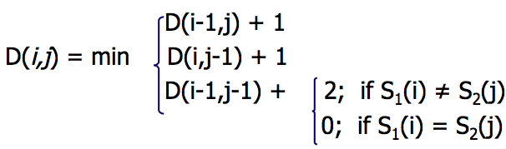
The Edit Distance Table
N | 9
O | 8
I | 7
T | 6
N | 5
E | 4
T | 3
N | 2
I | 1
# | 0 | 1 | 2 | 3 | 4 | 5 | 6 | 7 | 8 | 9
 | # | E | X | E | C | U | T | I | O | N

Slide 71
Edit Distance
N | 9
O | 8
I | 7
T | 6
N | 5
E | 4
T | 3
N | 2
I | 1
# | 0 | 1 | 2 | 3 | 4 | 5 | 6 | 7 | 8 | 9
 | # | E | X | E | C | U | T | I | O | N

Slide 72
The Edit Distance Table
N | 9 | 8 | 9 | 10 | 11 | 12 | 11 | 10 | 9 | 8
O | 8 | 7 | 8 | 9 | 10 | 11 | 10 | 9 | 8 | 9
I | 7 | 6 | 7 | 8 | 9 | 10 | 9 | 8 | 9 | 10
T | 6 | 5 | 6 | 7 | 8 | 9 | 8 | 9 | 10 | 11
N | 5 | 4 | 5 | 6 | 7 | 8 | 9 | 10 | 11 | 10
E | 4 | 3 | 4 | 5 | 6 | 7 | 8 | 9 | 10 | 9
T | 3 | 4 | 5 | 6 | 7 | 8 | 7 | 8 | 9 | 8
N | 2 | 3 | 4 | 5 | 6 | 7 | 8 | 7 | 8 | 7
I | 1 | 2 | 3 | 4 | 5 | 6 | 7 | 6 | 7 | 8
# | 0 | 1 | 2 | 3 | 4 | 5 | 6 | 7 | 8 | 9
 | # | E | X | E | C | U | T | I | O | N

Slide 73
Minimum Edit Distance
Computing Minimum Edit Distance

Slide 74
Minimum Edit Distance
Backtrace for Computing Alignments

Slide 75
Computing alignments
Edit distance isn’t sufficient
We often need to align each character of the two strings to each other
We do this by keeping a “backtrace”
Every time we enter a cell, remember where we came from
When we reach the end,
Trace back the path from the upper right corner to read off the alignment

Slide 76
Edit Distance
N | 9
O | 8
I | 7
T | 6
N | 5
E | 4
T | 3
N | 2
I | 1
# | 0 | 1 | 2 | 3 | 4 | 5 | 6 | 7 | 8 | 9
 | # | E | X | E | C | U | T | I | O | N

Slide 77
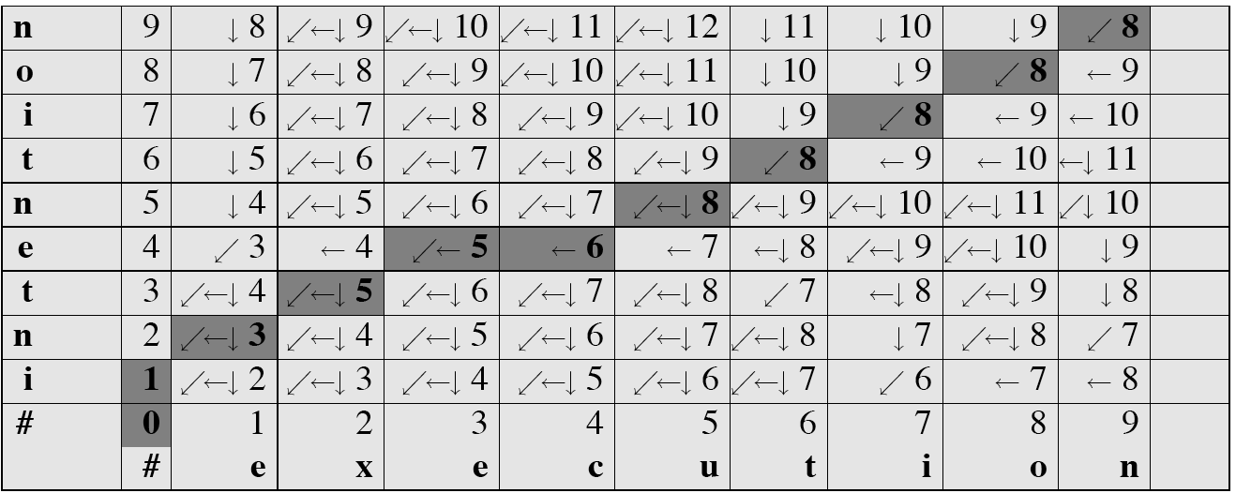
MinEdit with Backtrace

Slide 78
Adding Backtrace to Minimum Edit Distance
Base conditions: Termination:
D(i,0) = i D(0,j) = j D(N,M) is distance
Recurrence Relation:
For each i = 1…M
For each j = 1…N
D(i-1,j) + 1
D(i,j)= min D(i,j-1) + 1
D(i-1,j-1) + 2; if X(i) ≠ Y(j)
0; if X(i) = Y(j)
LEFT
ptr(i,j)= DOWN
DIAG
deletion
insertion
substitution
insertion
deletion
substitution

Slide 79
Result of Backtrace
Two strings and their alignment:

Slide 80
Minimum Edit Distance
Weighted Minimum Edit Distance

Slide 81
Weighted Edit Distance
Why would we add weights to the computation?
Spell Correction: some letters are more likely to be mistyped than others
Biology: certain kinds of deletions or insertions are more likely than others

Slide 82
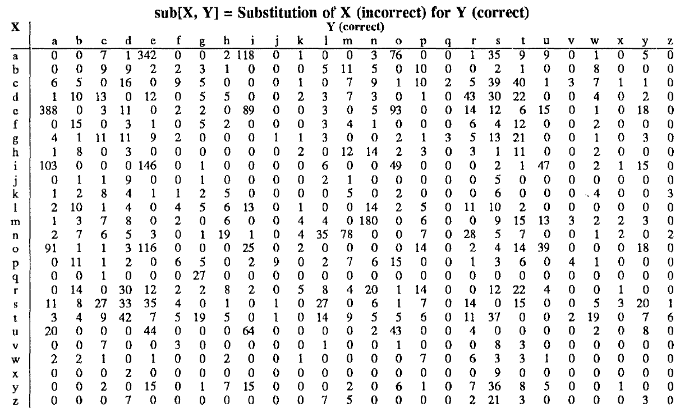
Confusion matrix for spelling errors

Slide 83
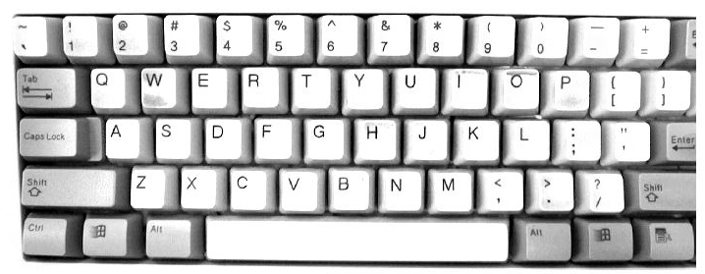

Slide 84
Recommended Reading
- Chapter 2 of the recommended text.

Slide 85
Lab Session 2 Review

