Slide 1
Lecture 3 N-gram Language Models
Adapted from the Recommended textbook’s slides

Slide 2
What are Language Models?
Models that assign probabilities to sequences of words.
N-grams
The simplest model
An n-gram is a sequence of n-words.
Example: ‘Please turn your assignment over’
Unigrams..
Bigrams..
Trigrams..
Type all the bigrams and Trigrams of this sentence in the chat
Models that assign probabilities to sequences of words
We’ll see how to use n-gram models to
estimate the probability of the last word of an n-gram given the previous words,
and also to assign probabilities to entire sequences
Notes:
Models that assign a probability to each possible next word or assign a probability to an entire sentence.

Slide 3
Trigrams…
Models that assign probabilities to sequences of words

Slide 4
Language Modeling
Introduction to N-grams

Slide 5
Probabilistic Language Models
Today’s goal: assign a probability to a sentence
Machine Translation:
P(high winds tonite) > P(large winds tonite)
Spell Correction
The office is about fifteen minuets from my house
P(about fifteen minutes from) > P(about fifteen minuets from)
Speech Recognition
P(I saw a van) >> P(eyes awe of an)
+ Summarization, question-answering, etc., etc.!!
Why?

Slide 6
Probabilistic Language Modeling
Goal: compute the probability of a sentence or sequence of words:
P(W) = P(w₁,w₂,w₃,w₄,w₅…w_{n})
Related task: probability of an upcoming word:
P(w₅|w₁,w₂,w₃,w₄)
A model that computes either of these:
P(W) or P(w_{n}|w₁,w₂…w_{n-1}) is called a language model.
Better: the grammar But language model or LM is standard

Slide 7
How to compute P(W)
How to compute this joint probability:
P(its, water, is, so, transparent, that)
Intuition: let’s rely on the Chain Rule of Probability

Slide 8
Reminder: The Chain Rule
Recall the definition of conditional probabilities
p(B|A) = P(A,B)/P(A) Rewriting: P(A,B) = P(A)P(B|A)
More variables:
P(A,B,C,D) = P(A)P(B|A)P(C|A,B)P(D|A,B,C)
The Chain Rule in General
P(x₁,x₂,x₃,…,x_{n}) = P(x₁)P(x₂|x₁)P(x₃|x₁,x₂)…P(x_{n}|x₁,…,x_{n-1})

Slide 9
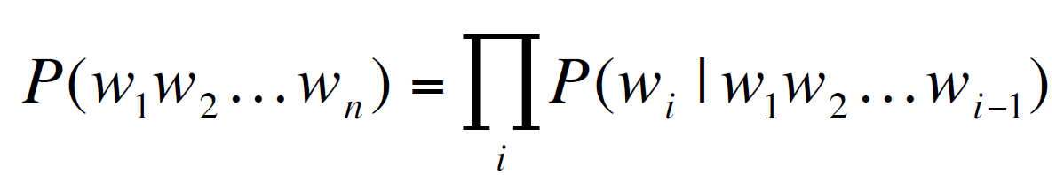
The Chain Rule applied to compute joint probability of words in sentence
P(“its water is so transparent”) =
P(its) × P(water|its) × P(is|its water)
× P(so|its water is) × P(transparent|its water is so)

Slide 10
Notes:
Courtesy: Lena Voita

Slide 11
How to estimate these probabilities
Could we just count and divide?
No! Too many possible sentences!
We’ll never see enough data for estimating these
Notes:
Language is creative. new sentences are created all the
time, and we won’t always be able to count entire sentences.

Slide 12
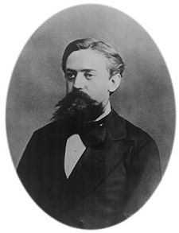
Markov Assumption
Simplifying assumption:
Or maybe
Andrei Markov
Notes:
The intuition of the n-gram model is that instead of computing the probability of
a word given its entire history, we can approximate the history by just the last few
words.
The assumption that the probability of a word depends only on the previous word is
called a Markov assumption Markov

Slide 13
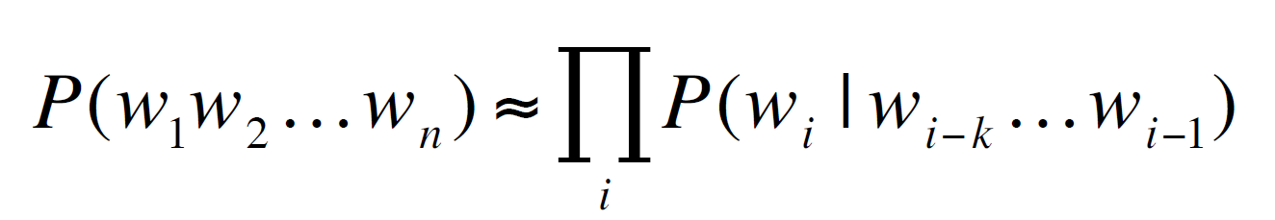
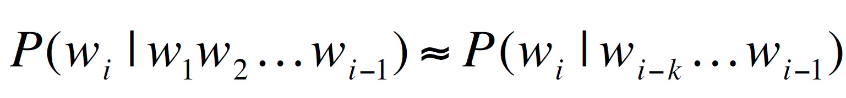
Markov Assumption
In other words, we approximate each component in the product
Notes:
Markov models are the class of probabilistic models that assume we can predict the probability of some future unit without looking too far into the past.

Slide 14
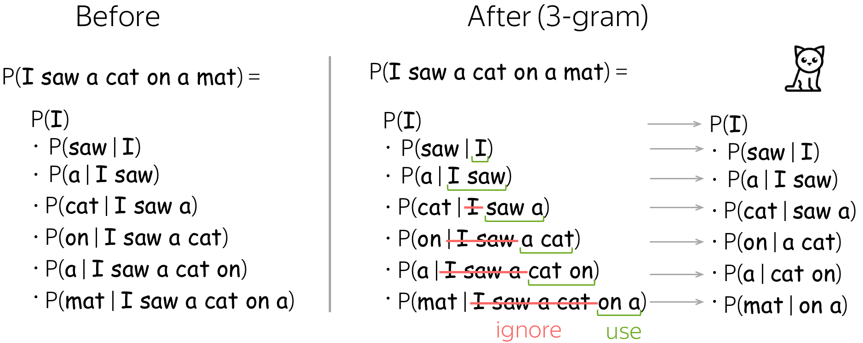

Slide 15
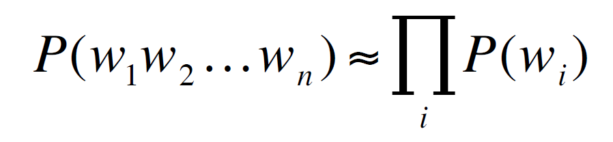
Simplest case: Unigram model
Some automatically generated sentences from a unigram model
fifth, an, of, futures, the, an, incorporated, a, a, the, inflation, most, dollars, quarter, in, is, mass
thrift, did, eighty, said, hard, 'm, july, bullish
that, or, limited, the

Slide 16
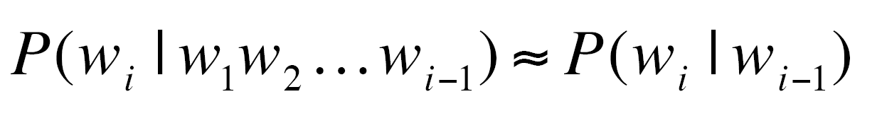
Bigram model
Condition on the previous word:
texaco, rose, one, in, this, issue, is, pursuing, growth, in, a, boiler, house, said, mr., gurria, mexico, 's, motion, control, proposal, without, permission, from, five, hundred, fifty, five, yen
outside, new, car, parking, lot, of, the, agreement, reached
this, would, be, a, record, november
Notes:
We can generalize the bigram (which looks one word into the past)

Slide 17
N-gram models
We can extend to trigrams, 4-grams, 5-grams
In general this is an insufficient model of language
because language has long-distance dependencies:
“The computer which I had just put into the machine room on the fifth floor crashed.”
But we can often get away with N-gram models
Notes:
to the trigram (which looks two words into the past)
the n-gram (which looks n-1 words into the past).

Slide 18
Language Modeling
Introduction to N-grams

Slide 19
Language Modeling
Estimating N-gram Probabilities

Slide 20
Estimating bigram probabilities
The Maximum Likelihood Estimate
Notes:
We get Maximum likelihood estimation the MLE estimate for the parameters of an n-gram model by getting counts from a
corpus, and normalizing the counts so that they lie between 0 and 1.
For example, to compute a particular bigram probability of a word wn given a previous word wn-1, we’ll compute the count of the bigram C(wn-1,wn) and normalize by the sum of all the bigrams that share the same first word wn-1:

Slide 21
Estimating bigram probabilities
The Maximum Likelihood Estimate
Example: I am Sam
am Sam
Sam
am
am

Slide 22
Note…
How do we calculate the bigram probability of the first word? Or the last word?
Example: I am Sam
We’ll first need to augment each sentence with a special symbol <s> at the beginning of the sentence, to give us the bigram context of the first word. We’ll also need a special end-symbol. </s>
Generalization
N-gram models: Add N-1 start tokens <s>
Add a single end token </s>
Notes:
For probabilistic models, normalizing means dividing by some total count so that the resulting probabilities
fall legally between 0 and 1.
2 We need the end-symbol to make the bigram grammar a true probability distribution. Without an endsymbol,
instead of the sentence probabilities of all sentences summing to one, the sentence probabilities
for all sentences of a given length would sum to one (all prob of sentences of length 2 sum to 1, of length 3 sum to 1 etc…) . This model would define an infinite set of probability
distributions, with one distribution per sentence length. We want the probability of all sentences in the corpus to sum to 1. The addition of the start and end tokens fixes this.

Slide 23

An example
<s> I am Sam </s>
<s> Sam I am </s>
<s> I do not like green eggs and ham </s>
Notes:
<s> I, <s> Sam, I am, Sam </s>, am Sam, I do

Slide 24
More examples: Berkeley Restaurant Project sentences
can you tell me about any good cantonese restaurants close by
mid priced thai food is what i’m looking for
tell me about chez panisse
can you give me a listing of the kinds of food that are available
i’m looking for a good place to eat breakfast
when is caffe venezia open during the day

Slide 25
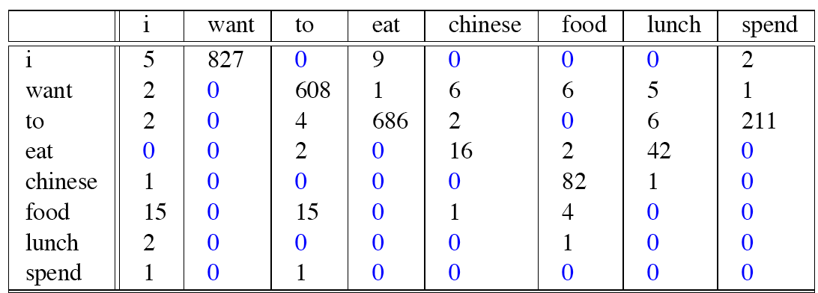
Raw bigram counts
Out of 9222 sentences

Slide 26
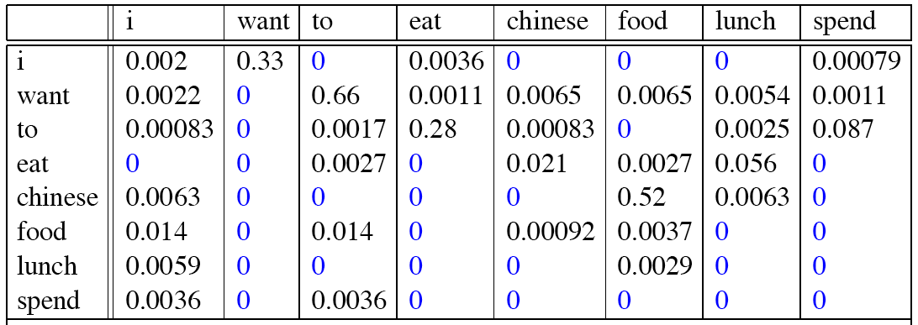
Raw bigram probabilities
Normalize by unigrams:
Result:

Slide 27
Raw bigram probabilities
Normalize by unigrams:
Result:

Slide 28
What kinds of knowledge?
P(english|want) = .0011
P(chinese|want) = .0065
P(to|want) = .66
P(eat | to) = .28
P(food | to) = 0
P(want | spend) = 0
P (i | <s>) = .25
P(food |english) = 0.5
P(</s> | food) = 0.68

Slide 29
Bigram estimates of sentence probabilities
P(<s> I want english food </s>) = ?
Calculate this and put your answer in the chat.
P(english|want) = .0011
P(chinese|want) = .0065
P(to|want) = .66
P(eat | to) = .28
P(food | to) = 0
P(want | spend) = 0
P (i | <s>) = .25
P(food |english) = 0.5
P(</s> | food) = 0.68

Slide 30
Bigram estimates of sentence probabilities
P(<s> I want english food </s>) =
P(I|<s>)
× P(want|I)
× P(english|want)
× P(food|english)
× P(</s>|food)
= .000031

Slide 31
Practical Issues
We do everything in log space
Avoid underflow
(also adding is faster than multiplying)
Notes:
By using log probabilities instead of raw probabilities, we get numbers that are not as small. Adding in log space is equivalent to multiplying in linear space, so we combine log probabilities by adding them. The result of doing all computation and storage in log space is that we only need to convert back into probabilities if we need to report them at the end; then we can just take the exp of the logprob:

Slide 32
Language Modeling Toolkits
SRILM
http://www.speech.sri.com/projects/srilm/
KenLM
https://kheafield.com/code/kenlm/

Slide 33
Google N-Gram Release, August 2006
…

Slide 34
Google N-Gram Release
serve as the incoming 92
serve as the incubator 99
serve as the independent 794
serve as the index 223
serve as the indication 72
serve as the indicator 120
serve as the indicators 45
serve as the indispensable 111
serve as the indispensible 40
serve as the individual 234
http://googleresearch.blogspot.com/2006/08/all-our-n-gram-are-belong-to-you.html

Slide 35
Google Book N-grams
http://ngrams.googlelabs.com/

Slide 36
Language Modeling
Estimating N-gram Probabilities

Slide 37
Language Modeling
Evaluation and Perplexity

Slide 38
Extrinsic vs Intrinsic Evaluation
Extrinsic
End-to-end
Test the models in an actual application
Intrinsic
Measures model quality independent of any application
Training set vs test set…
Ex. Perplexity

Slide 39
Extrinsic evaluation of N-gram models
Best evaluation for comparing models A and B
Put each model in a task
spelling corrector, speech recognizer, MT system
Run the task, get an accuracy for A and for B
How many misspelled words corrected properly
How many words translated correctly
Compare accuracy for A and B

Slide 40
Intrinsic Evaluation: How good is our model?
Does our language model prefer good sentences to bad ones?
Assign higher probability to “real” or “frequently observed” sentences
Than “ungrammatical” or “rarely observed” sentences?
We train parameters of our model on a training set.
We test the model’s performance on data we haven’t seen.
A test set is an unseen dataset that is different from our training set, totally unused.
An evaluation metric tells us how well our model does on the test set.

Slide 41
Difficulty of extrinsic (in-vivo) evaluation of N-gram models
Extrinsic evaluation
Time-consuming; can take days or weeks
So
Sometimes use intrinsic evaluation: perplexity
Bad approximation
unless the test data looks just like the training data
So generally only useful in pilot experiments
But is helpful to think about.

Slide 42
Perplexity: Intuition
The Shannon Game:
How well can we predict the next word?
Unigrams are terrible at this game. (Why?)
A better model of a text
is one which assigns a higher probability to the word that actually occurs
mushrooms 0.1
pepperoni 0.1
anchovies 0.01
….
fried rice 0.0001
….
and 1e-100
I always order pizza with cheese and ____
The 33rd President of the US was ____
I saw a ____

Slide 43
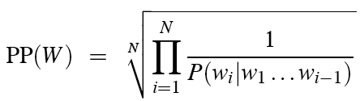
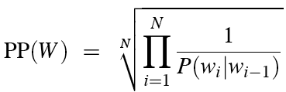
Perplexity
The best language model is one that best predicts an unseen test set
Gives the highest P(sentence)
Perplexity is the inverse probability of the test set, normalized by the number of words:
Chain rule:
For bigrams:
Minimizing perplexity is the same as maximizing probability

Slide 44
Lower perplexity = better model
Training 38 million words, test 1.5 million words, WSJ
N-gram Order | Unigram | Bigram | Trigram
Perplexity | 962 | 170 | 109
Notes:
WSJ – World Street Journal

Slide 45
Perplexity Calculation
See the lab…

Slide 46
Language Modeling
Evaluation and Perplexity

Slide 47
Language Modeling
Generation

Slide 48
Generation
The generation procedure for a n-gram language model
given current context (history),
generate a probability distribution for the next token (over all tokens in the vocabulary),
sample a token, add this token to the sequence, and
repeat all steps again.
Notes:
Courtesy: Lena Voita

Slide 49
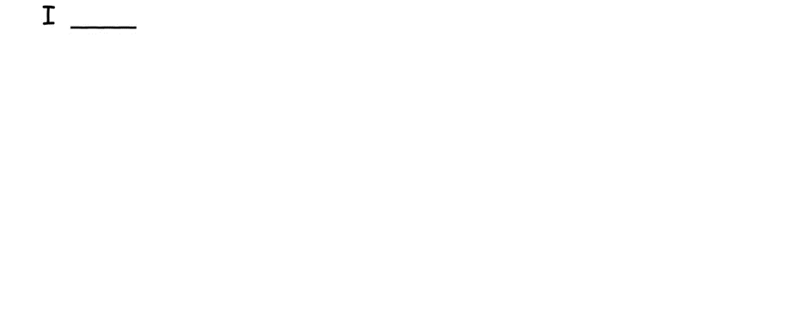
The general idea…
Notes:
Courtesy: Lena Voita

Slide 50
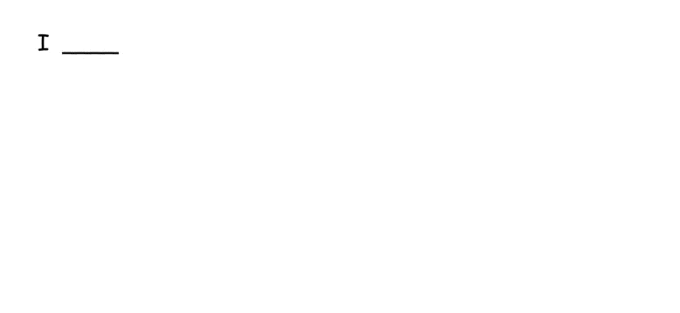
Using a tri-gram
Notes:
Courtesy: Lena Voita

Slide 51
Language Modeling
Generation

Slide 52
Language Modeling
Generalization and zeros

Slide 53
Approximating Shakespeare

Slide 54
The Wall Street Journal is not Shakespeare (no offense)

Slide 55
What is wrong with the generated text?
not fluent:
it can be clearly seen that the model does not use long context, and relies only on a couple of tokens.
The inability to use long contexts is the main shortcoming of n-gram models.
To overcome the main flaw of n-gram LMs, fixed context size,
neural models are used

Slide 56
Shakespeare as corpus
N=884,647 tokens, V=29,066
Shakespeare produced 300,000 bigram types out of V²= 844 million possible bigrams.
So 99.96% of the possible bigrams were never seen (have zero entries in the table)
Quadrigrams worse: What's coming out looks like Shakespeare because it is Shakespeare

Slide 57
The perils of overfitting
N-grams only work well for word prediction if the test corpus looks like the training corpus
In real life, it often doesn’t
We need to train robust models that generalize!
One kind of generalization: Zeros!
Things that don’t ever occur in the training set
But occur in the test set

Slide 58
Zeros
Training set:
… denied the allegations
… denied the reports
… denied the claims
… denied the request
P(“offer” | denied the) = 0
Test set
… denied the offer
… denied the loan

Slide 59
Zero probability bigrams
Bigrams with zero probability
mean that we will assign 0 probability to the test set!
And hence we cannot compute perplexity (can’t divide by 0)!

Slide 60
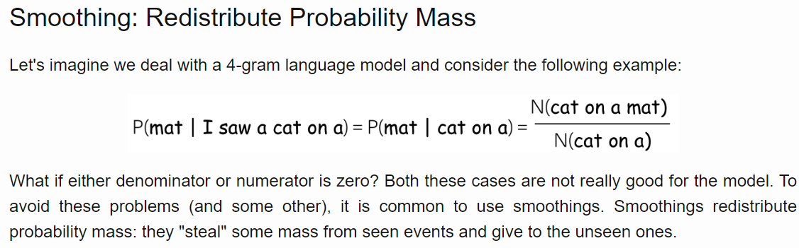

Slide 61
Language Modeling
Generalization and zeros

Slide 62
Language Modeling
Smoothing: Add-one (Laplace) smoothing

Slide 63
The intuition of smoothing (from Dan Klein)
When we have sparse statistics:
Steal probability mass to generalize better
P(w | denied the)
3 allegations
2 reports
1 claims
1 request
7 total
allegations
attack
man
reports
outcome
…
claims
request
P(w | denied the)
2.5 allegations
1.5 reports
0.5 claims
0.5 request
2 other
7 total
allegations
allegations
attack
man
outcome
reports
…
claims
request

Slide 64
Add-one estimation
Also called Laplace smoothing
Pretend we saw each word one more time than we did
Just add one to all the counts!
MLE estimate:
Add-1 estimate:

Slide 65
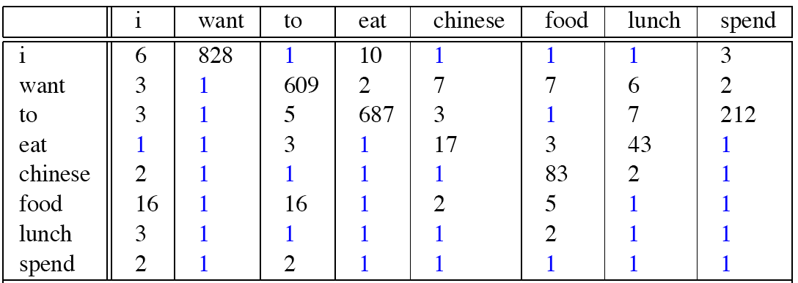
Berkeley Restaurant Corpus: Laplace smoothed bigram counts

Slide 66
Berkeley Restaurant Corpus: Laplace smoothed bigram counts

Slide 67

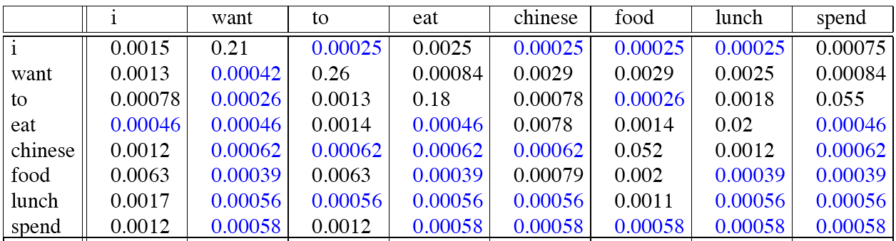
Laplace-smoothed bigrams

Slide 68
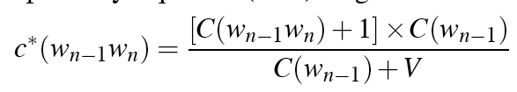
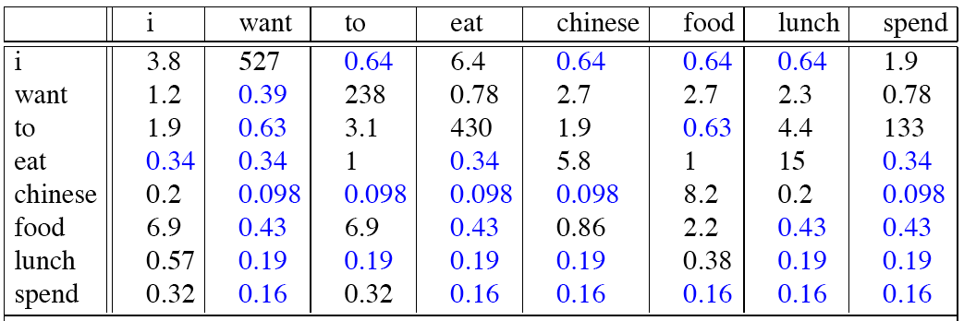
Reconstituted counts

Slide 69
Compare with raw bigram counts
Notes:
C(want to) went from 608 to 238, P(to|want) from .66 to .26!
Discount d= c*/c
d for “chinese food” =.10!!! A 10x reduction

Slide 70
Add-1 estimation is a blunt instrument
So add-1 isn’t used for N-grams:
We’ll see better methods
But add-1 is used to smooth other NLP models
For text classification
In domains where the number of zeros isn’t so huge.

Slide 71
Language Modeling
Smoothing: Add-one (Laplace) smoothing

Slide 72
Language Modeling
Interpolation and Backoff

Slide 73
Backoff and Interpolation
Sometimes it helps to use less context
Condition on less context for contexts you haven’t learned much about
Backoff:
use trigram if you have good evidence,
otherwise bigram, otherwise unigram
Interpolation:
mix unigram, bigram, trigram
Interpolation works better

Slide 74
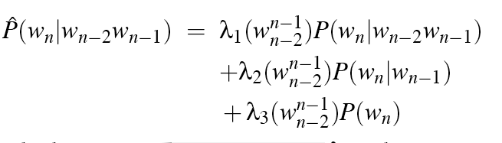
Linear Interpolation
Simple interpolation
Lambdas conditional on context:
Notes:
A more clever solution is to mix all probabilities: unigram, bigram, trigram, etc. For this, we need scalar positive weights.
The coefficients λi can be picked by cross-validation on the development set.

Slide 75
How to set the lambdas?
Use a held-out corpus
Choose λs to maximize the probability of held-out data:
Fix the N-gram probabilities (on the training data)
Then search for λs that give largest probability to held-out set:
Training Data
Held-Out Data
Test
Data

Slide 76
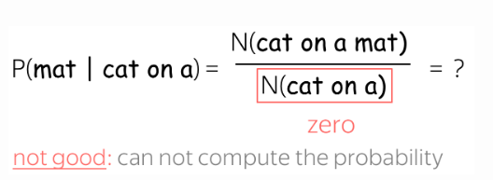
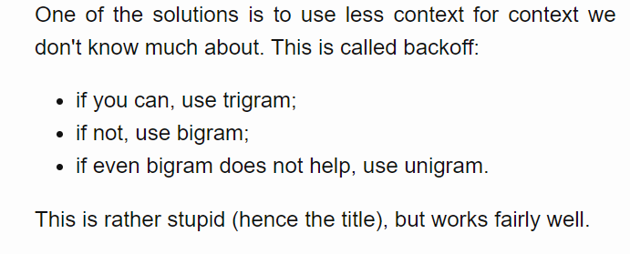
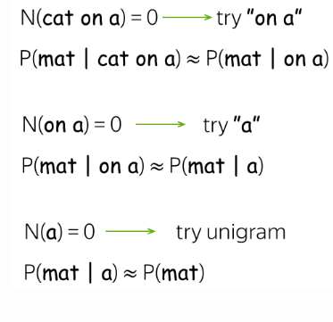
Stupid Back-off

Slide 77
N-gram Smoothing Summary
Add-1 smoothing:
OK for text categorization, not for language modeling
The most commonly used method:
Extended Interpolated Kneser-Ney
For very large N-grams like the Web:
Stupid backoff

Slide 78
Unknown words: Open versus closed vocabulary tasks
If we know all the words in advanced
Vocabulary V is fixed
Closed vocabulary task
Often we don’t know this
Out Of Vocabulary = OOV words
Open vocabulary task
Instead: create an unknown word token <UNK>
Training of <UNK> probabilities
Create a fixed lexicon L of size V
At text normalization phase, any training word not in L changed to <UNK>
Now we train its probabilities like a normal word
At decoding time
If text input: Use UNK probabilities for any word not in training

Slide 79
Language Modeling
Interpolation and Backoff

Slide 80
Language Modeling
Advanced:
Kneser-Ney Smoothing

Slide 81
Recommended Reading
Advanced:
Kneser-Ney Smoothing

