Slide 1



University of Baghdad · College of Medicine
Health Anxiety, AI Chatbot Use and Cyberchondria Among Adults in Baghdad
An online cross-sectional survey
Presented by
[Student 1] · [Student 2] · [Student 3]
Supervisor
[Title and name]
Notes:
[STUDENT 1 · Introduction & Methods]
Good morning. We are [names], supervised by [supervisor]. Our research looks at what happens when people search their symptoms online, and now ask AI chatbots like ChatGPT, before they see a doctor; and how this relates to health anxiety and cyberchondria.

Slide 2

BACKGROUND
Why this study matters
> 80%
of Iraqis are online: symptoms are searched before they reach a doctor
AI
chatbots now answer health questions conversationally and without limit
0
studies of health anxiety and cyberchondria in Baghdad before ours
Health anxiety, AI chatbots & cyberchondria · Baghdad
2
Notes:
[STUDENT 1 · Introduction & Methods]
Looking up symptoms online is now ordinary, and in Iraq more than four in five people are online. AI chatbots now answer health questions in fluent, personal language. For some people searching relieves worry; for others it makes it worse: that is cyberchondria. Nobody had studied this in Baghdad, and AI chatbots had hardly been studied next to search engines.

Slide 3

KEY CONCEPTS
Health anxiety and cyberchondria
Health anxiety
Cyberchondria
Persistent worry about having a serious illness, kept going by misreading normal sensations and seeking reassurance.
Measured with the SHAI-14 (14 items, 0–42).
Excessive or repeated online health searching that increases distress instead of relieving it.
Measured with the CSS-12 (12 items, 12–60): excessiveness · compulsion · distress · reassurance.
Health anxiety, AI chatbots & cyberchondria · Baghdad
3
Notes:
[STUDENT 1 · Introduction & Methods]
Health anxiety is persistent worry about having a serious illness, kept going by misreading normal sensations and seeking reassurance. We measured it with the SHAI-14, scored 0 to 42. Cyberchondria is excessive or repeated online searching that increases distress rather than relieving it. We measured it with the CSS-12, which has four facets: excessiveness, compulsion, distress and reassurance seeking.

Slide 4
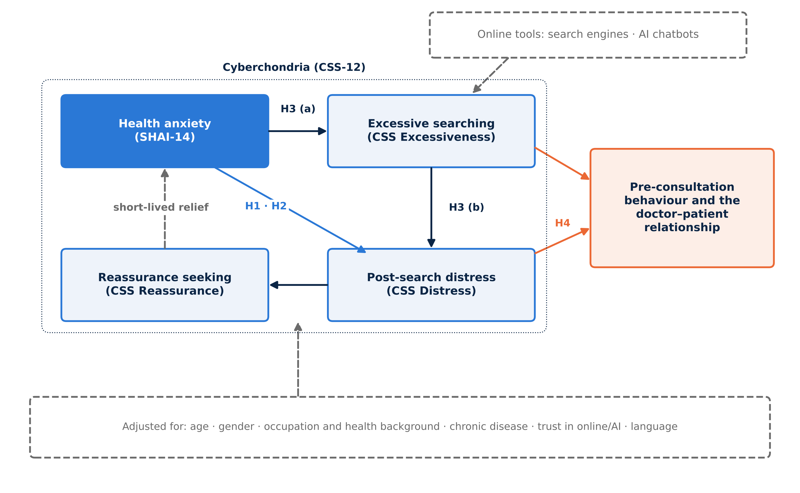
OUR MODEL
A vicious cycle, and four hypotheses
H1
Health anxiety ↔ cyberchondria
H2
Independent of other factors
H3
Excessive searching is a step to distress
H4
Cyberchondria ↔ care-seeking & doctor relationship
Health anxiety, AI chatbots & cyberchondria · Baghdad
4
Notes:
[STUDENT 1 · Introduction & Methods]
This is our conceptual framework. Health anxiety leads to excessive searching, which leads to post-search distress, which leads to reassurance seeking; reassurance gives short relief, so the cycle repeats. Our four hypotheses sit on this model. H1: health anxiety is linked to cyberchondria. H2: this holds after adjusting for other factors. H3: excessive searching is a step between health anxiety and distress. H4: cyberchondria goes with care-seeking and a strained relationship with doctors.

Slide 5

METHODS
How we did it
1
Design
2
Setting
Analytical cross-sectional online survey (STROBE, CHERRIES)
Baghdad · 17 July 2026 – 11 September 2026
3
Sampling
4
Participants
Convenience + snowball via Baghdad-based online groups
n = 300 adults ≥ 18 · consent · Arabic or English
5
Questionnaire
6
Ethics
Bilingual Google Form · 5 parts · SHAI-14 · CSS-12
Anonymous · e-consent first · [approval no.]
Health anxiety, AI chatbots & cyberchondria · Baghdad
5
Notes:
[STUDENT 1 · Introduction & Methods]
An analytical cross-sectional online survey, reported with the STROBE and CHERRIES checklists. Data were collected in Baghdad from 17 July 2026 to 11 September 2026, through Baghdad-based social-media and messaging groups, using convenience and snowball sampling. Adults aged 18 or older who could read Arabic or English and gave consent were included. 300 people answered, with no missing data. The form was bilingual, and the analysis used Python with correction for multiple testing.

Slide 6
METHODS
Sample size and analysis
194 → 300
Psychometrics
Cronbach α, McDonald ω, CFA; Arabic vs English invariance
needed (r = 0.20, α 0.05, 80% power) → collected
Associations
Pearson / Spearman, Mann–Whitney, Kruskal–Wallis, χ²
±5.7%
Models
Hierarchical robust regression; logistic regression (AUC)
margin of error for percentages
Pathways
Bootstrapped mediation (5000 resamples); moderation
≈ 0.62
Rigour
FDR correction for many tests; sensitivity analyses
expected r from meta-analyses: our target is conservative
Health anxiety, AI chatbots & cyberchondria · Baghdad
6
Notes:
[STUDENT 1 · Introduction & Methods]
Our main question is a correlation. With alpha 0.05 and 80% power we needed 194 people to detect a correlation of 0.20; we collected 300. For percentages that gives a margin of error of plus or minus 5.7 percent. We checked reliability and structure, including whether the scales work the same in Arabic and English, then used correlations, group comparisons, regression and mediation, with false discovery rate correction and sensitivity analyses. Now my colleague will present the results.

Slide 7

02
Results
Who took part · how they search · how anxious they are · the main link · who is at risk · behaviour · AI
Notes:
[STUDENT 2 · Results]
Thank you. I will present our results: who took part, how they search, how anxious they are, the main link, who is at risk, behaviour after searching, and finally AI chatbots.

Slide 8
PARTICIPANTS
A young, educated, digitally active sample
300
62.3%
56.3%
participants · no missing data
aged 20–29
female
44.0%
63.3%
21.7%
medical students
health-related background
chronic condition
Percentages describe this sample; the associations, however, held in every subgroup.
Health anxiety, AI chatbots & cyberchondria · Baghdad
8
Notes:
[STUDENT 2 · Results]
Table 1: 300 adults answered. 62.3% were aged 20 to 29, 56.3% were women, and 44.0% were medical students; 63.3% had a health-related background and 21.7% a chronic condition. In summary: a young, educated sample, which we keep in mind when reading percentages; the associations, however, were consistent across all subgroups.

Slide 9
HOW PEOPLE SEARCH
AI chatbots are now the first stop
88.7%
41.0%
59.3%
use AI incl. those who named a chatbot
use AI without any search engine
use ChatGPT
Health anxiety, AI chatbots & cyberchondria · Baghdad
9
Notes:
[STUDENT 2 · Results]
Figure 3: 78.0% ticked AI chatbots, 88.7% if we include those who named a chatbot, ahead of search engines at 56.3%. 41.0% used AI without any search engine, and ChatGPT alone was used by 59.3%. The top motives were convenience, deciding whether a doctor is needed, and instant reassurance. In summary: for many people the first "doctor" is now an AI chatbot.

Slide 10
HEALTH ANXIETY AND THE SCALES
One in five scored in the elevated range
19%
α 0.81
α 0.86
SHAI-14 reliability
CSS-12 reliability
elevated health anxiety (SHAI ≥ 18) · 95% CI 15.0–23.8%
CFI 0.95
Same
SHAI-14 cut-off | %
≥ 15 | 32.7
≥ 18 (used) | 19.0
≥ 22 | 7.3
≥ 29 | 0.7
CSS-12 four-factor structure confirmed
CSS-12 in Arabic and English (full invariance)
SHAI mean 12.3 / 42 · CSS mean 28.9 / 60 · excessiveness highest, compulsion lowest
Health anxiety, AI chatbots & cyberchondria · Baghdad
10
Notes:
[STUDENT 2 · Results]
Table 4: 19% scored 18 or more on the SHAI-14, our threshold for elevated health anxiety, 95% CI 15.0–23.8%. This is a screening threshold, not a diagnosis, and the estimate depends on the cut-off: 33% at 15 down to 0.7% at 29. Both scales were reliable, alpha 0.81 and 0.86, and the CSS-12 worked identically in Arabic and English. In summary: our tools measured well.

Slide 11
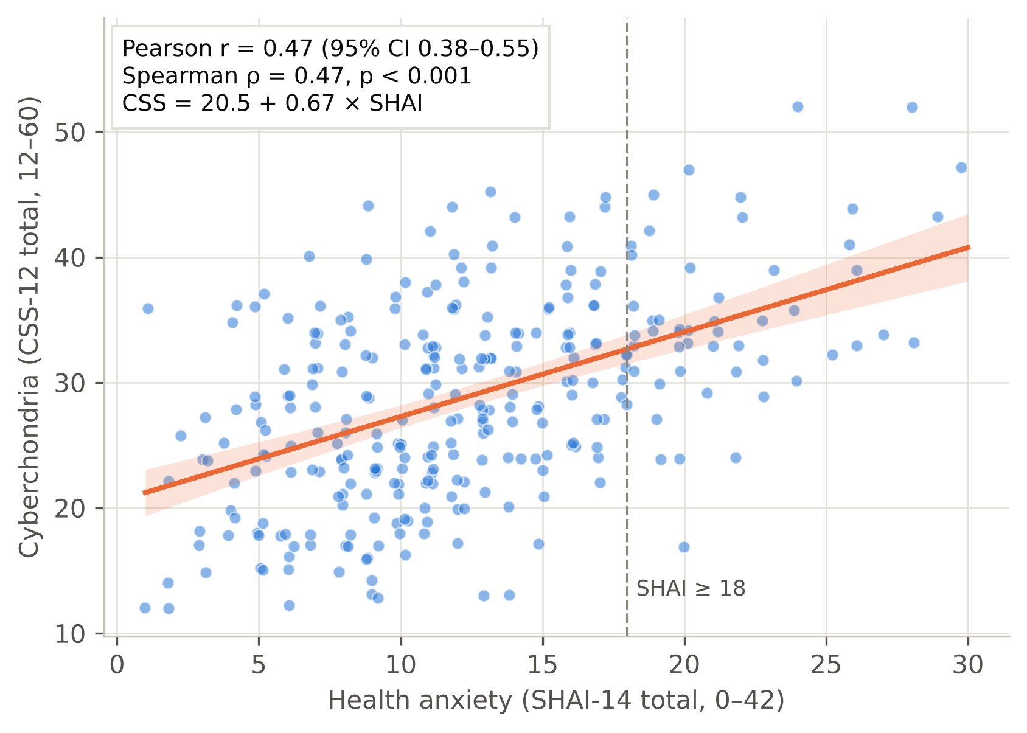
MAIN RESULT
Health anxiety and cyberchondria rise together
r = 0.47
95% CI 0.38–0.55 · p < 0.001 · partial r = 0.48
H1 and H2 supported
Health anxiety, AI chatbots & cyberchondria · Baghdad
11
Notes:
[STUDENT 2 · Results]
Figure 5 is our main result. Each dot is a participant; the line rises clearly: r = 0.47, 95% CI 0.38–0.55. After adjusting for age, gender, background, chronic disease, trust and AI use, it is still 0.48. The link is strongest for excessive searching and post-search distress. In summary: hypotheses 1 and 2 are supported.

Slide 12
WHAT PREDICTS CYBERCHONDRIA
How anxious you are matters more than who you are
+18.4%
extra variance explained by health anxiety
β = 0.48
strongest predictor · B = 0.68 CSS points per SHAI point
Not robust
AI use: +5.3 (inclusive) but +1.5, p = 0.31 (strict)
Health anxiety, AI chatbots & cyberchondria · Baghdad
12
Notes:
[STUDENT 2 · Results]
Table 9, hierarchical regression. Demographics alone explain about 3% of cyberchondria; adding digital use brings it to 13%; adding health anxiety brings it to 32%, an extra 18.4%. Health anxiety is by far the strongest predictor, beta 0.48: each extra SHAI point adds about 0.68 CSS points. In summary: health anxiety, not demographics, explains cyberchondria.

Slide 13
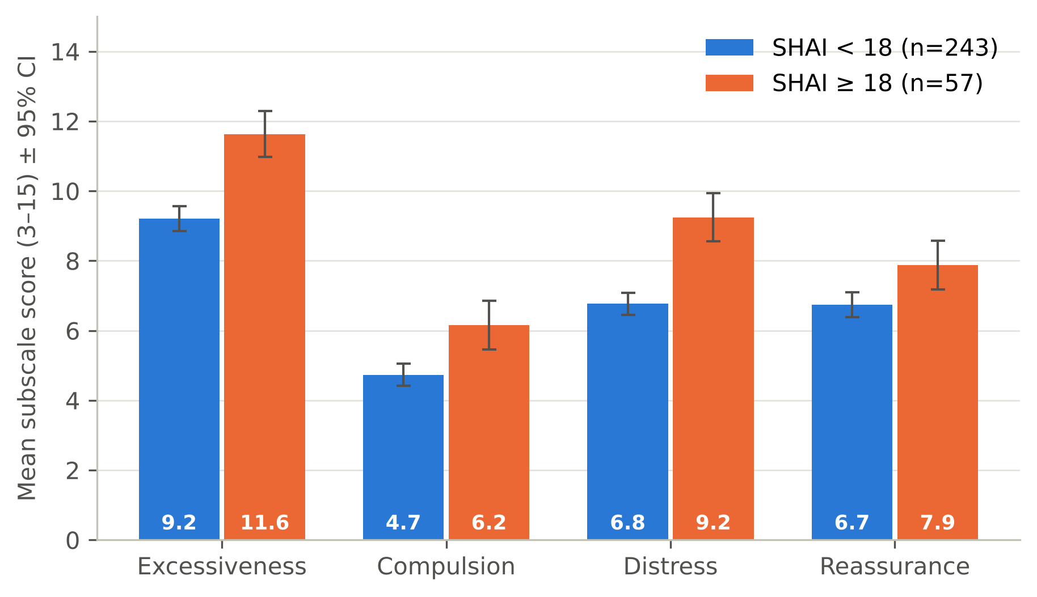
WHAT DRIVES SEARCHING
Fear and interpretation, not noticing
ρ 0.43
Fear of serious illness ↔ panic on reading of a rare condition
ρ 0.42
Interpreting sensations ↔ searching every sensation
≈ 0
Merely noticing aches or sensations
Figure 10: CSS facets by health-anxiety status (mean ± 95% CI)
111 of 168 item pairs significant after FDR
Health anxiety, AI chatbots & cyberchondria · Baghdad
13
Notes:
[STUDENT 2 · Results]
Figure 10 compares the four facets between people with and without elevated health anxiety: the biggest gaps are in excessive searching and distress. At item level, Figure 11, the strongest links are fear of serious illness with panicking when reading about a rare condition, rho 0.43, and interpreting body sensations with searching every sensation, 0.42. Simply noticing aches is almost unrelated. In summary: fear drives searching, not noticing.

Slide 14
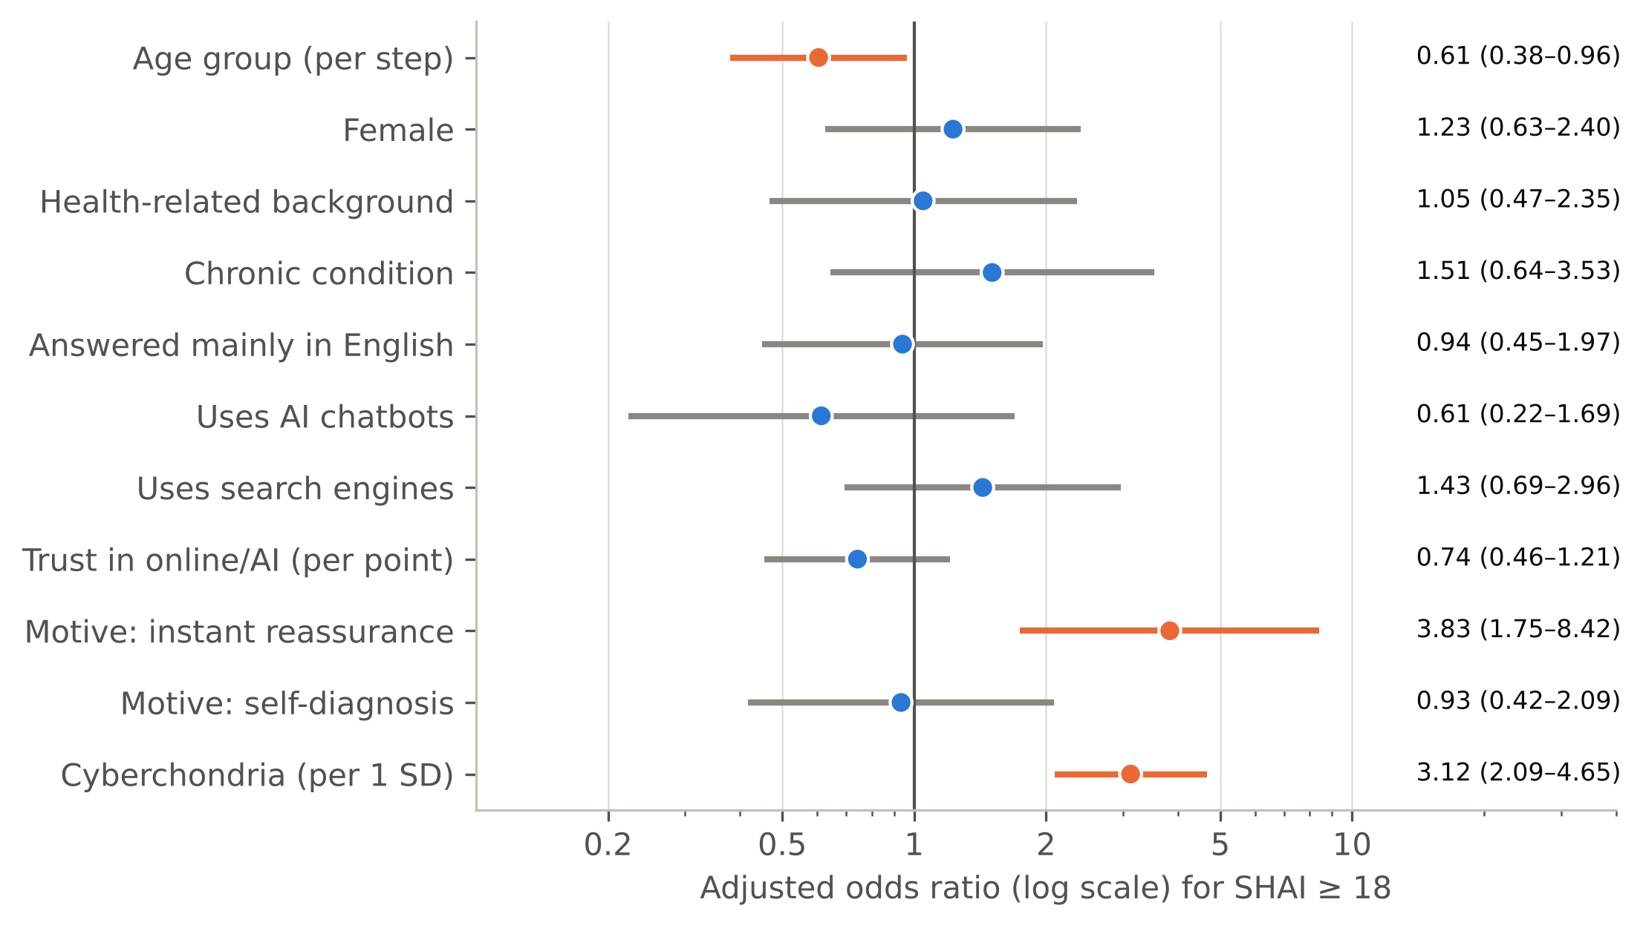
WHO IS AT RISK
Young people who search for reassurance
3.12×
odds per SD of cyberchondria
3.83×
if searching for instant reassurance
0.61×
per older age group (protective)
AUC 0.79
Figure 8: adjusted odds ratios; orange = p < 0.05
after optimism correction (apparent 0.83)
Health anxiety, AI chatbots & cyberchondria · Baghdad
14
Notes:
[STUDENT 2 · Results]
Figure 8 shows the logistic model for elevated health anxiety. Each standard deviation of cyberchondria triples the odds, adjusted odds ratio 3.12; searching for instant reassurance almost quadruples them, 3.83; older age is protective, 0.61. The model discriminates well: AUC 0.83, 0.79 after correcting for optimism. In summary: the person most at risk is young and searches to feel reassured.

Slide 15
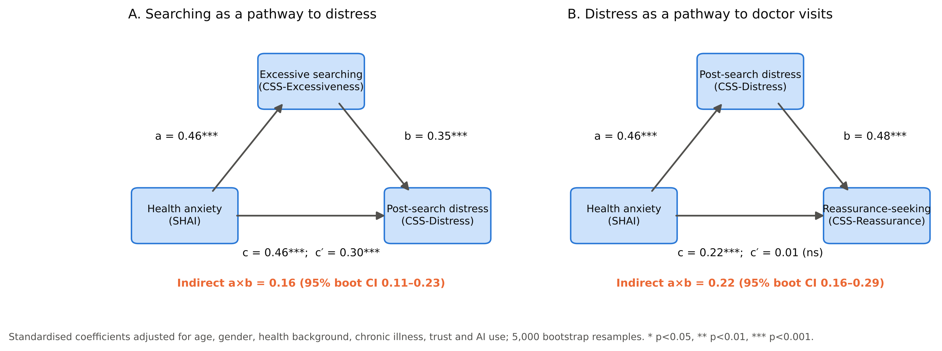
PATHWAYS
Compatible with a cycle, not proof of one
Figure 9: mediation models (standardised; 5000 bootstrap resamples)
0.16
0.01
0.15
indirect via excessive searching (CI 0.11–0.23)
direct effect left after distress (not significant)
reverse direction also significant
Health anxiety, AI chatbots & cyberchondria · Baghdad
15
Notes:
[STUDENT 2 · Results]
Figure 9, mediation. Part of the link from health anxiety to distress runs through excessive searching, indirect effect 0.16. Almost all of the link from health anxiety to reassurance-seeking visits runs through distress: the direct effect falls to 0.01. But the reverse direction also fits, 0.15. In summary: our data are compatible with a vicious cycle, but one survey at one time point cannot prove the direction. Hypothesis 3 is supported statistically, not causally.

Slide 16
BEHAVIOUR AFTER SEARCHING
Searching shapes the consultation
31.7%
never tell their doctor (fear of judgement)
34.7%
say searching strained their relationship with doctors
OR 0.57
higher cyberchondria → less hiding (q = 0.012, robust)
Health anxiety, AI chatbots & cyberchondria · Baghdad
16
Notes:
[STUDENT 2 · Results]
Figure 4: after searching, 34.7% delayed or skipped care because they felt reassured; others escalated, consulting several doctors or seeking urgent care. Only 27.0% always tell their doctor, and 31.7% never do, citing fear of being judged. Higher cyberchondria went with more disclosure, and this was the only behavioural result that survived correction. In summary: searching changes the consultation before it begins.

Slide 17

AI CHATBOTS
No reliable independent effect of AI
+5.3
+1.5
CSS points · inclusive definition
strict definition · p = 0.31
1
32 respondents named a chatbot but did not tick “AI”; they scored highest
2
Only 34 true non-users: a small comparison group
3
AI use did not change the health anxiety ↔ cyberchondria link
Absence of evidence, not evidence of absence.
Health anxiety, AI chatbots & cyberchondria · Baghdad
17
Notes:
[STUDENT 2 · Results]
Did AI itself matter? Under the inclusive definition AI users scored 5.3 points higher. But 32 people named a chatbot without ticking the AI option, and they had the highest scores. With the strict definition the difference is only 1.5, p = 0.31; and only 34 people were true non-users. AI also did not change the strength of the anxiety–cyberchondria link. In summary: no reliable independent effect of AI; absence of evidence, not evidence of absence. I now hand over to my colleague.

Slide 18

03
Discussion
How we compare · why · AI and the consultation · medical students · limitations · recommendations
Notes:
[STUDENT 3 · Discussion & Conclusions]
Thank you. I will discuss what these results mean, how they compare with other studies, our limitations and our recommendations.

Slide 19
COMPARED WITH THE WORLD
Same direction, weaker link: four reasons
1
Measurement error
corrected for reliability, r ≈ 0.56
2
Narrow range
low health anxiety (mean 12.3) weakens r
3
Who answered
online recruitment favours confident users
4
Short form
most studies used the 33-item CSS
Health anxiety, AI chatbots & cyberchondria · Baghdad
19
Notes:
[STUDENT 3 · Discussion & Conclusions]
To our knowledge, this is the first CSS-12 study in Baghdad. Our correlation of 0.47 is weaker than the meta-analytic 0.62 and 0.63. Four reasons: measurement error, since corrected for reliability it would be about 0.56; our sample had low and narrow health anxiety; online recruitment favours confident internet users; and most earlier studies used the longer 33-item scale.

Slide 20
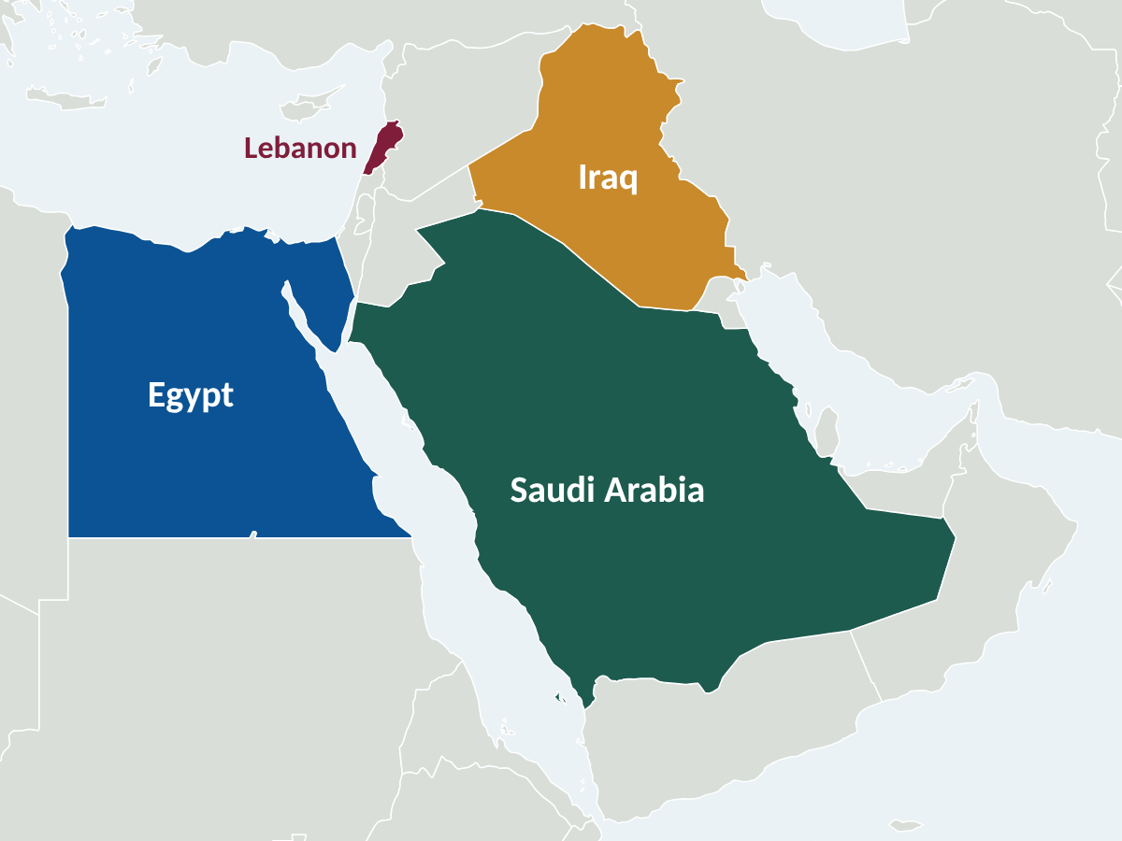
COMPARED WITH THE ARAB REGION
Consistent with regional studies
Saudi Arabia · Jeddah
Common; linked with smartphone addiction
Saudi Arabia · primary care
Linked with health anxiety
Lebanon
Arabic CSS-12: same four-factor structure
Egypt · 1435 medical students
85.8% moderate cyberchondria
Health anxiety, AI chatbots & cyberchondria · Baghdad
20
Notes:
[STUDENT 3 · Discussion & Conclusions]
Our findings agree with the Arab region: in Jeddah cyberchondria was common and linked with smartphone addiction; in Saudi primary care it was linked with health anxiety; in Lebanon the Arabic CSS-12 had the same structure as ours; and among 1435 Egyptian medical students, 85.8% had moderate cyberchondria.

Slide 21

TWO GROUPS WORTH DISCUSSING
AI users and medical students
AI chatbots
Medical students
Our use 78.0%–88.7% vs ≈ 20% (US 2024) and 21% (2025).
Young sample: 96% at 18–19 y vs 72% at ≥ 40 y.
Conversational AI may invite “one more question”.
44.0% of our sample.
Higher health anxiety disappeared after adjustment (younger age).
Same cyberchondria as others: knowledge did not protect.
Health anxiety, AI chatbots & cyberchondria · Baghdad
21
Notes:
[STUDENT 3 · Discussion & Conclusions]
AI use here, 78.0% to 88.7%, is far higher than about one in five in a 2024 US survey and 21% in a 2025 survey; our sample is young, and AI use fell from 96% at 18 to 19 years to 72% at 40 or older. 44.0% of our sample were medical students: their higher unadjusted health anxiety disappeared after adjustment for age, and their cyberchondria was the same as everyone else's. Medical knowledge did not protect them. A Palestinian study using the same SHAI cut-off even found medical students had the lowest health anxiety.

Slide 22

WHAT IT MEANS FOR THE CONSULTATION
Ask every patient what they searched
34.7%
delay care when reassured: saves visits, but risks delayed diagnosis
31.7%
never tell the doctor: hidden information in the consultation
H4
only partially supported: disclosure was the robust finding
Clinical message: ask, without judgement, what patients searched or asked an AI.
Health anxiety, AI chatbots & cyberchondria · Baghdad
22
Notes:
[STUDENT 3 · Discussion & Conclusions]
Delaying care because of reassurance, 34.7%, is double-edged: it can save unnecessary visits for minor symptoms but risks delayed diagnosis for serious ones, and it happened at all levels of anxiety. Almost a third never tell their doctor what they searched. Higher cyberchondria went with more disclosure, while health anxiety tended towards concealment, which is exploratory. So the practical message is simple: ask, without judgement.

Slide 23
LIMITATIONS
What limits our conclusions, and what we did
Cross-sectional design
No causal direction
→ Reverse models tested; “compatible with”
1
Convenience sample
Young, 44% medical students
→ Percentages not generalised; associations consistent
2
Arabic wording
No back-translation
→ Equal reliability; CSS-12 fully invariant
3
Single-item measures
Behaviour, disclosure, trust
→ Reported descriptively; labelled exploratory
4
Many tests
Risk of false positives
→ FDR correction; robust vs exploratory
5
Health anxiety, AI chatbots & cyberchondria · Baghdad
23
Notes:
[STUDENT 3 · Discussion & Conclusions]
Our main limitations. The design is cross-sectional, so we cannot prove direction. The sample is an online convenience sample, young and heavy in medical students, so percentages cannot be generalised; but associations were consistent across subgroups. The Arabic wording was ours, without formal back-translation; but reliability was equal and the CSS-12 was fully invariant. Behaviour questions were single, non-validated items. And we ran many tests, so we used FDR correction.

Slide 24
RECOMMENDATIONS
From findings to action
Clinicians
Ministry of Health
Ask non-judgementally; treat repeated searching as a sign of health anxiety; teach AI literacy
May consider Arabic digital & AI health-literacy campaigns and reliable triage sources
AI developers
Researchers
May consider anxiety-aware answers that do not escalate rare diagnoses
Longitudinal studies; probability samples; trials: only 9 registered, none in Iraq
Health anxiety, AI chatbots & cyberchondria · Baghdad
24
Notes:
[STUDENT 3 · Discussion & Conclusions]
For clinicians: ask without judgement, recognise repeated searching and reassurance seeking as signs of health anxiety, and teach digital and AI literacy in medical school. The Ministry of Health may consider Arabic digital and AI health-literacy campaigns and reliable Arabic triage sources. AI developers may consider anxiety-aware answers. And researchers should run longitudinal studies and intervention trials: ClinicalTrials.gov lists only nine cyberchondria studies, none in Iraq.

Slide 25
CONCLUSION
Three things to remember
1
2
3
AI chatbots are the first stop
Health anxiety ↔ cyberchondria, r = 0.47
Searching shapes the consultation
78.0% ticked them (88.7% incl. named), more than search engines.
Robust, compatible with a cycle; no reliable independent AI effect.
34.7% delay care when reassured; 31.7% never tell the doctor.
Ask every patient, without judgement, what they searched or asked an AI.
Health anxiety, AI chatbots & cyberchondria · Baghdad
25
Notes:
[STUDENT 3 · Discussion & Conclusions]
To conclude. One: AI chatbots, mainly ChatGPT, are now the main source of health information before seeing a doctor in our sample. Two: health anxiety and cyberchondria are moderately and robustly linked, r = 0.47, compatible with a vicious cycle, with no reliable independent effect of AI. Three: searching shapes the consultation, so doctors should ask. Thank you.

Slide 26
r = 0.47
Health anxiety and cyberchondria travel together.
Thank you · questions are welcome
Photos: StockSnap (CC0) · maps: Natural Earth (public domain)
Notes:
[ALL] Leave this slide up during questions. Each student answers on their own part; Student 2 takes statistics questions.

