Slide 1
Artificial Intelligence, Search Engines, and Cyberchondria
A Study of Patient Pre-Consultation Behavior in Baghdad
[Student names] · Supervisor: [name] · [College], [Year]
Notes:
Introduce the title and the team. 'Today we present our study on how people in Baghdad use search engines and AI chatbots before seeing a doctor, and how this relates to health anxiety and cyberchondria.'

Slide 2
Why this study matters
1
2
3
4
Everyone searches
AI now answers
Searching can backfire
No data from Iraq
Looking up symptoms before seeing a doctor is now routine; more than 80% of Iraqis are online.
ChatGPT and Gemini give fluent, personal, endlessly available answers about symptoms.
For some, searching escalates worry instead of relieving it: cyberchondria.
No study had linked health anxiety, cyberchondria and AI use in Baghdad.
Notes:
Everyone searches symptoms online; now AI chatbots answer them conversationally. For some people searching makes worry worse: cyberchondria. Health anxiety increases healthcare use and costs. Iraq has over 80% Internet penetration but no data on this, and AI chatbots had not been studied next to search engines.

Slide 3
Key concepts: health anxiety and cyberchondria
Health anxiety
Health anxiety
Persistent worry about having a serious illness, maintained by misreading normal sensations and by reassurance seeking. Measured with SHAI-14 (0–42).
Reassurance seeking
Excessive searching
Cyberchondria
Excessive or repeated online health searching that increases distress. Measured with CSS-12 (12–60): excessiveness, compulsion, distress, reassurance.
Post-search distress
The proposed cycle we tested
Notes:
Health anxiety: persistent worry about having a serious illness, kept going by misinterpreting sensations and seeking reassurance. Cyberchondria: excessive online searching that increases distress. Theory: a cycle in which anxiety drives searching, searching drives distress, and distress drives reassurance seeking. Our question was whether our data fit this cycle.

Slide 4
Aim and hypotheses
H1
Health anxiety is positively associated with cyberchondria, most with distress and excessiveness
Aim
To study the relationship between health anxiety and cyberchondria, and their correlates, among adults in Baghdad who search for health information online, with attention to AI chatbots and pre-consultation behaviour.
H2
The association is independent of demographic and digital-use factors
H3
Excessive searching mediates the link between health anxiety and post-search distress
H4
Higher cyberchondria goes with care-seeking and a strained doctor relationship
Notes:
State the aim, then the four hypotheses briefly. Mention we also described tools, motives and behaviours.

Slide 5
Methods
Design, sample, instruments and analysis

Slide 6
How we did it
Design
Setting & time
Sample
Analytical cross-sectional online survey (STROBE, CHERRIES)
Baghdad · 17 July 2026 – 11 September 2026
n = 300, convenience + snowball; a priori 194 needed to detect r = 0.20
Instruments
Analysis
Ethics
Bilingual Google Form · SHAI-14 (health anxiety) · CSS-12 (cyberchondria, 4 subscales)
Reliability & CFA · correlations · FDR-corrected tests · robust and logistic regression · bootstrapped mediation
Anonymous, voluntary, e-consent before any question · [approval no.]
Notes:
Cross-sectional online survey in Baghdad, 17 July 2026 to 11 September 2026. Convenience and snowball sampling, n = 300. Sample size: 194 needed to detect r = 0.20 with 80% power; our sample of 300 exceeds this. Bilingual Google Form with SHAI-14 and CSS-12. Analysis: reliability and CFA, correlations, non-parametric tests with FDR correction, robust regression, logistic models, bootstrapped mediation and moderation, sensitivity analyses.

Slide 7
Results
What we found

Slide 8
Participants: young, mostly students
300
62.3%
56.3%
44.0%
21.7%
participants
aged 20–29
female
medical students
chronic condition
Health-related background: 63.3% · Answered mainly in Arabic: 70.7%
Interpret percentages with care: the sample over-represents young people and medical students. Associations, however, were consistent across every subgroup.
Notes:
300 adults. 62.3% aged 20–29, 56.3% female, 44.0% medical students, 21.7% with a chronic condition. Acknowledge that the sample is young and heavy in medical students: this limits generalisation of percentages, but associations were the same across groups.

Slide 9
AI chatbots are now the main gateway
ChatGPT is the main chatbot for 59.3% of all participants · 41.0% use AI without any search engine
Notes:
88.7% use AI chatbots versus 56.3% search engines; 41.0% use AI without any search engine. ChatGPT dominates. Main motives: convenience, deciding whether a doctor is needed, and instant reassurance.

Slide 10
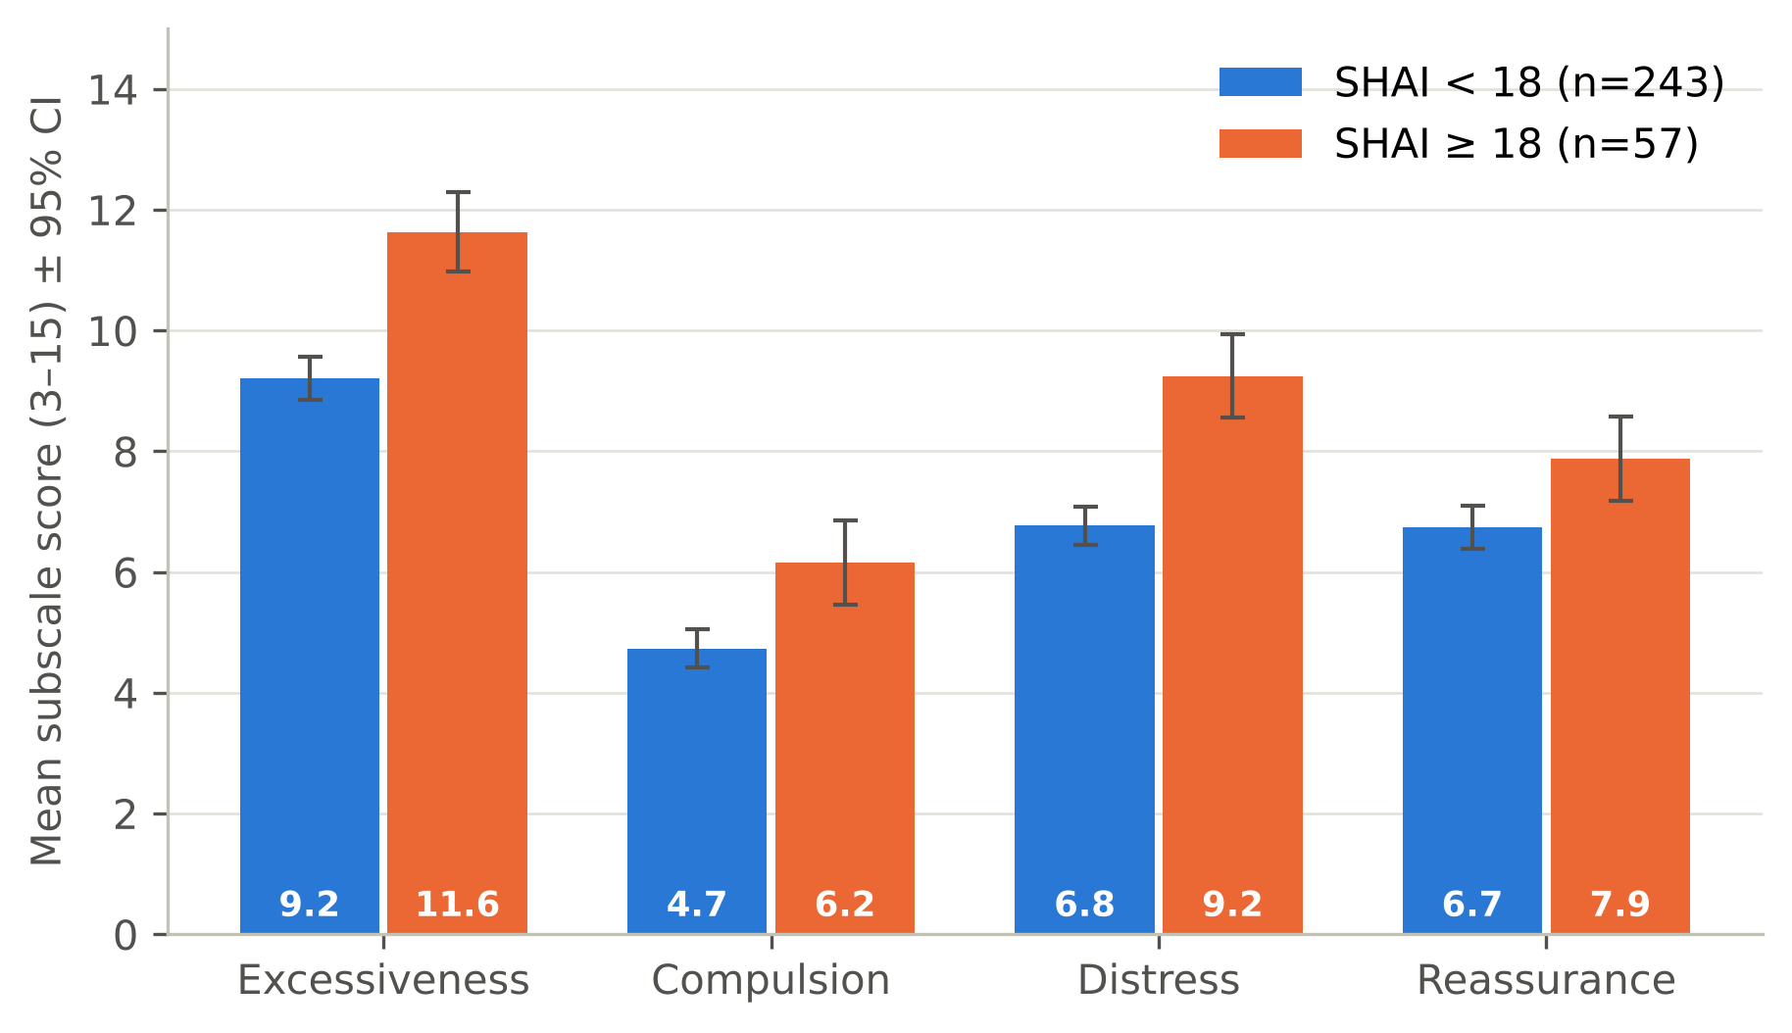
One in five has elevated health anxiety
12.3
19%
28.9
0.81 / 0.86
mean SHAI-14 (0–42)
elevated (SHAI ≥ 18)
mean CSS-12 (12–60)
reliability α (SHAI / CSS)
Notes:
SHAI mean 12.3; 19% scored 18 or more (95% CI 15.0–23.8%). CSS mean 28.9. People search a lot (excessiveness highest) but it rarely disrupts daily life (compulsion lowest). Both scales reliable.

Slide 11
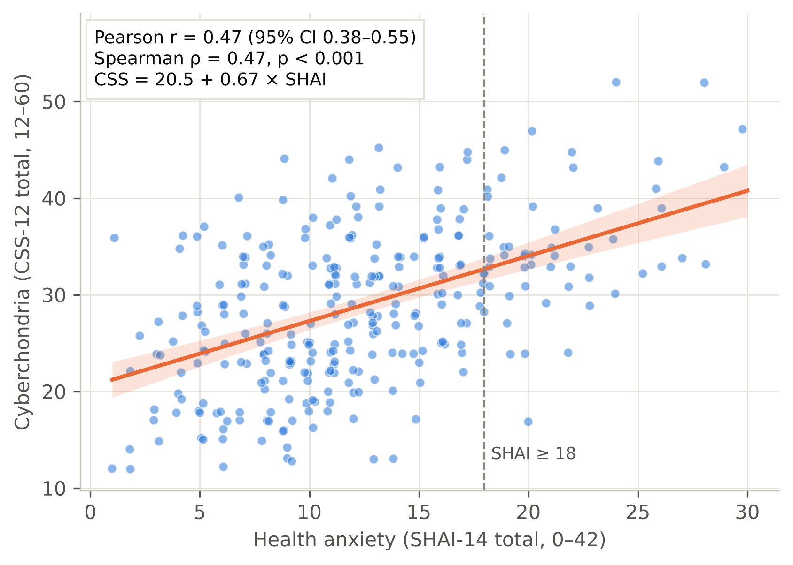
Health anxiety and cyberchondria travel together
r = 0.47
0.48
overall correlation
partial r (adjusted)
Notes:
Main result. r = 0.47 (95% CI 0.38–0.55); partial r = 0.48 after adjusting for all covariates. Strongest for excessive searching (0.46) and post-search distress (0.45). In regression, health anxiety is the strongest predictor (beta 0.48); R-squared rises from 0.133 to 0.317 when health anxiety is added.

Slide 12
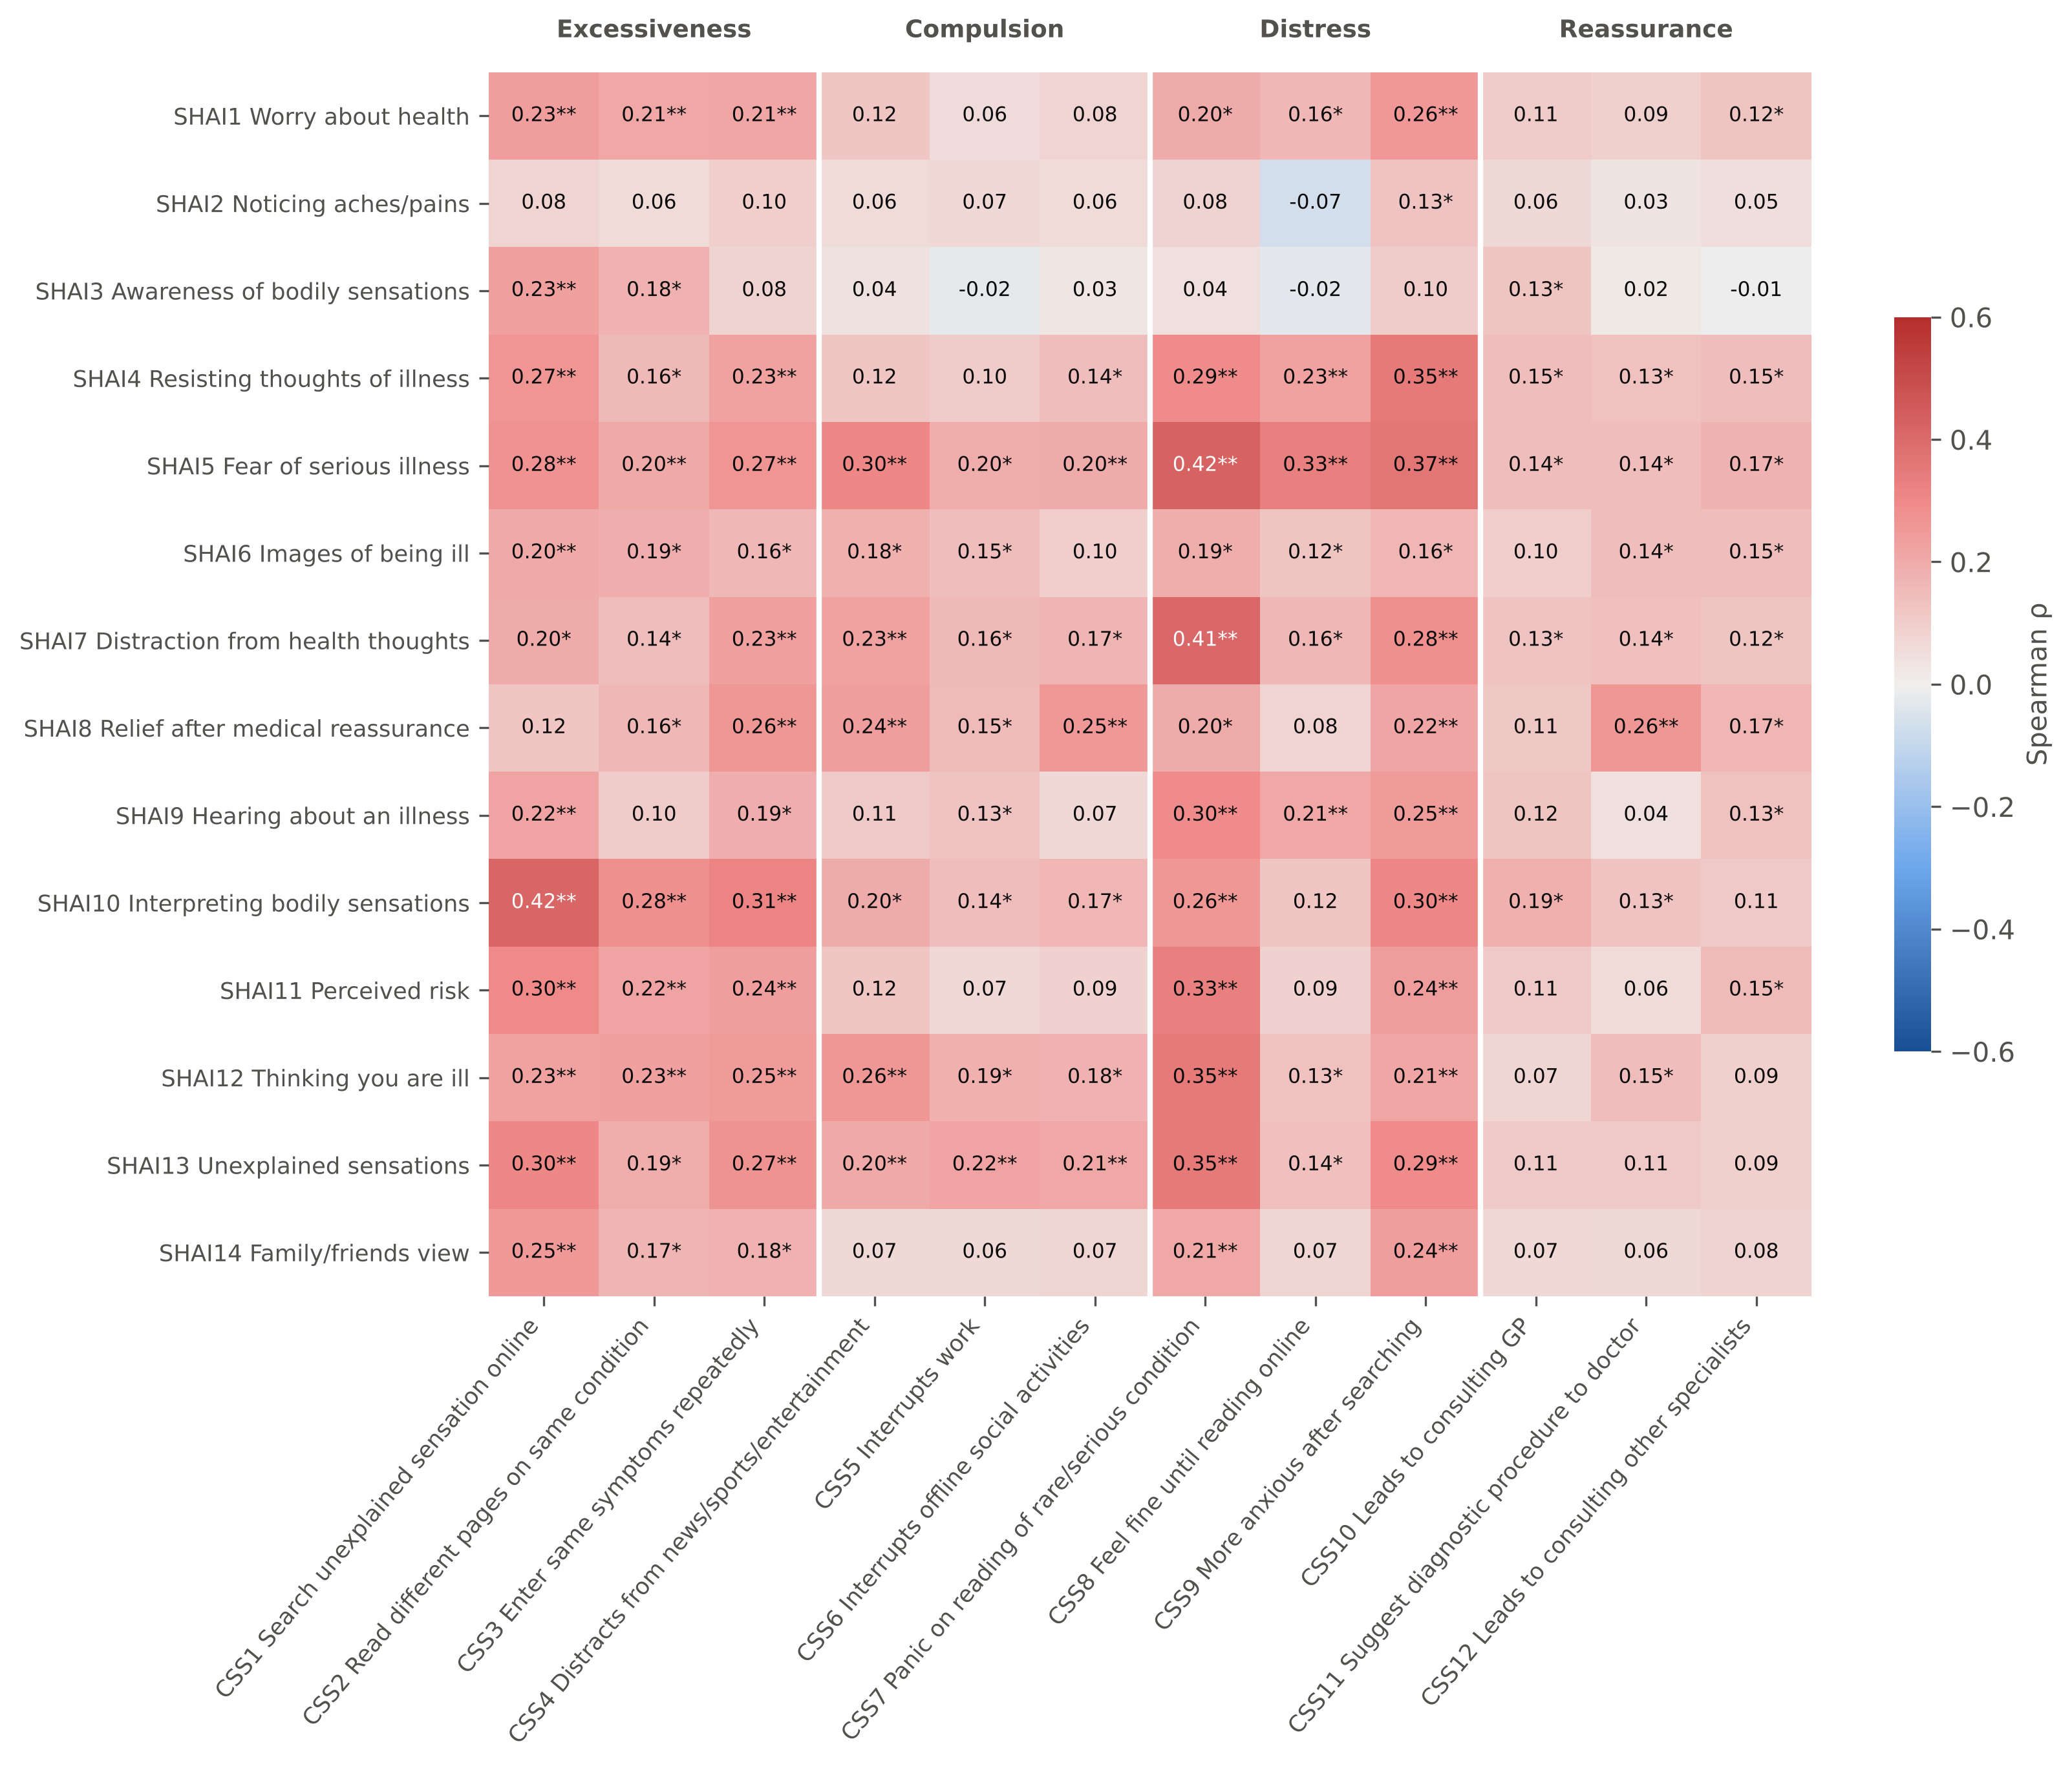
What drives searching is fear, not noticing
ρ = 0.43
Fear of serious illness ↔ panic on reading a rare condition
ρ = 0.42
Interpreting sensations ↔ searching every sensation
≈ unrelated
Mere awareness of aches and sensations
111/168 item pairs significant after FDR
Notes:
Item by item, 111 of 168 pairs were significant after FDR correction. The strongest links involve fear of serious illness and interpreting sensations, for example fear of illness with panic when reading about a rare condition. Simply noticing aches and sensations was not linked. This fits the cognitive model.

Slide 13
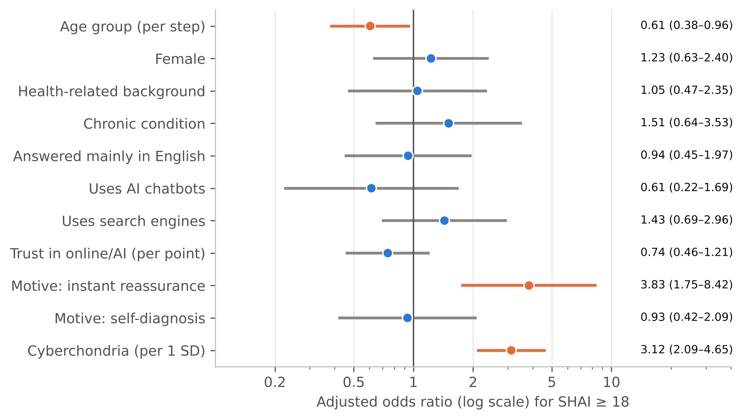
Who is most affected
3.12×
odds per SD of cyberchondria
3.83×
odds if searching for instant reassurance
0.83
AUC: good discrimination
Notes:
Elevated health anxiety is independently associated with higher cyberchondria (AOR 3.12 per SD), searching for instant reassurance (AOR 3.83) and younger age (AOR 0.61 per age step). AUC 0.83. Chronic illness predicts SHAI in linear models. Demographics explain almost none of cyberchondria (R-squared 0.030).

Slide 14
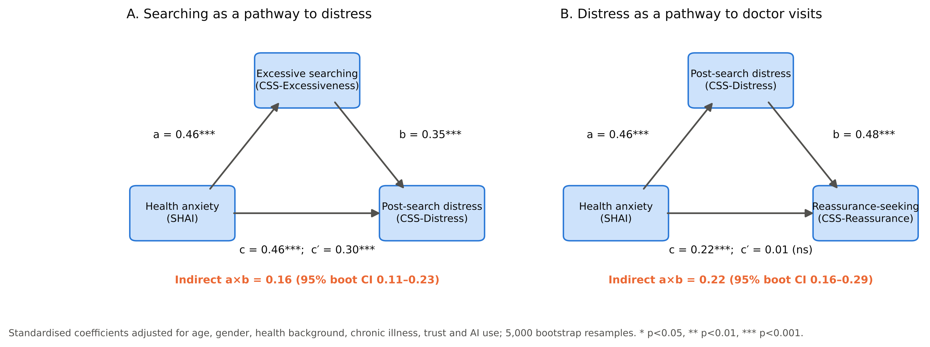
A pattern consistent with a cycle
Reverse path also significant (indirect 0.15): compatible with mutual reinforcement, but cross-sectional data cannot prove direction.
Notes:
Excessive searching carries part of the link from health anxiety to distress (indirect 0.16, CI 0.11–0.23). Post-search distress carries almost all of the link from health anxiety to reassurance-seeking visits (direct effect drops to 0.01). The reverse path is also significant (0.15). Say clearly: consistent with a two-way cycle, but one-time data cannot prove direction.

Slide 15
Searching shapes the consultation
31.7%
never tell their doctor about searches (fear of being judged)
The concealment paradox
Higher health anxiety → more hiding (AOR 1.47)
Higher cyberchondria → more sharing (AOR 0.57)
34.7% say searching strained their trust in doctors
Notes:
Most common response: delay or skip care because reassured (34.7%). Others escalate: urgent care 22.0%, multiple doctors 25.3%. Only 27.0% always tell their doctor; 31.7% never do. Paradox: higher health anxiety means more hiding (AOR 1.47); higher cyberchondria means less (AOR 0.57). Clinicians should ask.

Slide 16
AI chatbots: a new channel, not a proven cause
+5.3
1.5
34
CSS points in AI users (adjusted)
with strict definition (p = 0.31)
true non-users: a small comparison group
32 respondents named a chatbot without ticking "AI chatbots"; how they are classified decides the result
Effect concentrated in excessiveness and reassurance seeking: conversational AI may invite "one more question"
AI use did not change the strength of the health anxiety–cyberchondria link
Notes:
AI users had higher cyberchondria (+5.3 points, adjusted), mainly excessiveness and reassurance seeking. But with the strict definition (only those who ticked AI), the effect disappears (B = 1.5, p = 0.31). 32 people named a chatbot without ticking it, and they had the highest scores; only 34 were non-users. AI did not change the strength of the anxiety-cyberchondria link.

Slide 17
Limitations and how we addressed them
Cross-sectional
Convenience sample
Arabic wording
No causal claims; reverse paths tested; longitudinal work recommended
Young, 44% medical students; associations consistent across all subgroups
Not back-translated; equal reliability and loadings across Arabic and English responders
Single-item measures
Many tests
Self-report online
Behaviour and trust items are descriptive; their associations labelled exploratory
FDR correction applied; robust vs exploratory findings separated
Anonymous; careless responders checked; excluding them changed nothing
Notes:
Go through each briefly; emphasise what was done to mitigate it.

Slide 18
Conclusions and recommendations
Conclusions
1
Clinicians
Ask every patient, without judgement, what they searched or asked an AI
AI chatbots are now the main source of pre-consultation health information (88.7%)
Health anxiety and cyberchondria are linked (r = 0.47), via excessive searching and distress
Searching shapes the consultation: false reassurance, over-use, and hidden searches
2
Public health
Arabic digital and AI health-literacy campaigns; warn about false reassurance
3
AI developers
Anxiety-aware answers that do not escalate rare diagnoses
4
Research
Longitudinal studies; formal Arabic validation; random sampling
Notes:
Three conclusions, then recommendations for clinicians, public health, AI developers and researchers.

Slide 19
Thank you
Questions are welcome
Health anxiety ↔ cyberchondria: r = 0.47 · AI chatbots used by 88.7% · 31.7% never tell their doctor
Notes:
Keep this slide up during questions.

