Slide 1




Ministry of Higher Education and Scientific Research
University of Baghdad – College of Medicine
Health Anxiety, AI Chatbot Use and Cyberchondria Among Adults in Baghdad
An online cross-sectional survey
Prepared by:
[Student 1 full name]
[Student 2 full name]
[Student 3 full name]
Supervisor:
[Title and full name]
headache for 3 days causes brain tumour
Could my headache be serious?
Notes:
[STUDENT 1 — Introduction & Methods]
Good morning. We are [names], supervised by [supervisor]. Our research is titled: Health anxiety, AI chatbot use and cyberchondria among adults in Baghdad. In simple words: what happens when worried people search their symptoms online, and now ask AI chatbots like ChatGPT, before they see a doctor.

Slide 2


is my chest pain a heart attack?
مَا أَنْزَلَ اللَّهُ دَاءً إِلَّا أَنْزَلَ لَهُ شِفَاءً
صحيح البخاري
“He who fears he shall suffer, already suffers what he fears.”
Michel de Montaigne
…but what if it is?
Notes:
[STUDENT 1 — Introduction & Methods]
We open with two lines. The hadith reminds us that every illness has a cure, so seeking knowledge about health is good. The second line, from Montaigne, describes health anxiety exactly: the fear of illness is itself a kind of suffering. Our study sits between these two ideas: looking for information can help, or it can feed fear.

Slide 3

Objectives
Describe online and AI-chatbot health-information seeking and pre-consultation behaviour among adults in Baghdad.
Estimate levels of health anxiety and cyberchondria and the strength of their association, independent of other factors.
Examine pathways consistent with a mutually reinforcing cycle between the two.
Relate both to pre-consultation behaviour, disclosure of searches to doctors and trust in physicians.
Primary hypothesis (H1–H2): health anxiety is positively associated with cyberchondria, independently of socio-demographic and digital-use factors.
Notes:
[STUDENT 1 — Introduction & Methods]
Our aim was to study the relationship between health anxiety and cyberchondria among adults in Baghdad who search for health information online. We had four objectives. First, describe how people search, including AI chatbots. Second, measure health anxiety and cyberchondria and how strongly they are linked. Third, look for pathways that fit a vicious cycle. Fourth, see how all this affects what people do before and during the consultation.

Slide 4

Introduction
Health anxiety
Cyberchondria
The vicious cycle
From search engines to AI chatbots
Rationale
rash on arm meaning skin cancer
Notes:
[STUDENT 1 — Introduction & Methods]
We will start with the background: what health anxiety is, what cyberchondria is, how they may feed each other, and why AI chatbots change the picture.

Slide 5
Health Anxiety
Definition & model
Burden
Persistent preoccupation with having or acquiring a serious illness.
A continuum: everyday worry → illness anxiety disorder / somatic symptom disorder (DSM-5).
Cognitive model: misreading normal sensations → anxiety → checking & reassurance seeking → short relief → worry returns.
Lifetime prevalence ≈ 6% in the population, up to 20% in hospital outpatients.
Costly: unnecessary medical contacts; scores rising over three decades.
Iraq (COVID-19 online survey, n = 1591): about half reported health anxiety.
How we measured it
SHAI-14 (Short Health Anxiety Inventory): 14 items scored 0–3, total 0–42. Validated in clinical and non-clinical samples; Arabic version validated in Saudi Arabia.
We used ≥ 18 to mark elevated health anxiety (a screening threshold, not a diagnosis).
Notes:
[STUDENT 1 — Introduction & Methods]
Health anxiety is a persistent worry about having a serious illness. It is a spectrum: most people have some health worry; at the far end it becomes illness anxiety disorder or somatic symptom disorder in DSM-5. The cognitive-behavioural model says normal sensations are misread as signs of disease, and safety behaviours such as checking and reassurance seeking give short relief but keep the worry going. It is common and costly. In Iraq, about half of online respondents reported health anxiety during COVID. We measured it with the Short Health Anxiety Inventory, SHAI-14.

Slide 6
Cyberchondria
Definition: excessive or repeated online searching for health information that increases, rather than relieves, distress or anxiety (Starcevic & Berle).
Search logs showed benign-symptom searches often escalate to rare, serious diagnoses (White & Horvitz). Searching is normal; it becomes cyberchondria when it is excessive, compulsive and distressing.
CSS-12: four facets (3 items each, total 12–60)
Excessiveness
Compulsion
Distress
Reassurance
Searching the same symptom again and again
Searching interrupts work and social life
Feeling worse, panicking after reading
Searching leads to consulting a doctor
Arabic CSS-12 versions show the same four-factor structure (Lebanon, Saudi Arabia).
Notes:
[STUDENT 1 — Introduction & Methods]
The word cyberchondria comes from White and Horvitz, who analysed search logs and found that searches for common, benign symptoms often escalated to rare and serious diagnoses. Starcevic and Berle defined it as excessive or repeated online health searching that increases rather than relieves distress. Searching itself is normal; it becomes cyberchondria when it is excessive, compulsive and distressing. We measured it with the CSS-12, which has four parts: excessiveness, compulsion, distress and reassurance seeking.

Slide 7
The Vicious Cycle
Meta-analyses: health anxiety ↔ cyberchondria r ≈ 0.62–0.63.
High-anxiety users feel worse after searching; low-anxiety users feel relieved.
Dutch 4-wave panel (n = 5322): evidence of a reciprocal relationship.
Reassurance gives short relief, so the cycle repeats.
Health anxiety
Reassurance seeking
Excessive searching
Post-search distress
Proposed cycle (cognitive-behavioural model)
Notes:
[STUDENT 1 — Introduction & Methods]
Why study these together? Meta-analyses show health anxiety correlates strongly with cyberchondria, around r = 0.62. Health-anxious people feel worse after searching, while people with low anxiety feel relieved. A Dutch study of 5322 adults over four waves suggested the relationship goes both ways. This is the cycle on the slide: anxiety drives searching, searching drives distress, distress drives reassurance seeking, and reassurance does not last. We tested whether our data fit this cycle.

Slide 8

From “Dr Google” to “Dr ChatGPT”
What changes with AI chatbots?
Fluent, personalised, conversational answers.
Can be questioned again and again: “one more question”.
Answers may seem more empathetic than physicians’.
US survey: ~1 in 5 used ChatGPT for health; ~1/3 of them changed medication or asked for referrals.
I feel tired and my hands shake. Is it serious?
Rationale: first CSS-12 data from Baghdad · AI chatbots studied separately from search engines · psychology linked to real behaviour before the consultation. More than 80% of Iraqis are online.
Notes:
[STUDENT 1 — Introduction & Methods]
Almost all the evidence comes from the search-engine era. AI chatbots are different: they answer fluently and personally, can be asked again and again, and can sound more empathetic than doctors. In a US survey about one in five people used ChatGPT for health information, and about a third changed medications or asked for referrals based on its answers. No study had compared AI chatbots with search engines in Iraq.

Slide 9
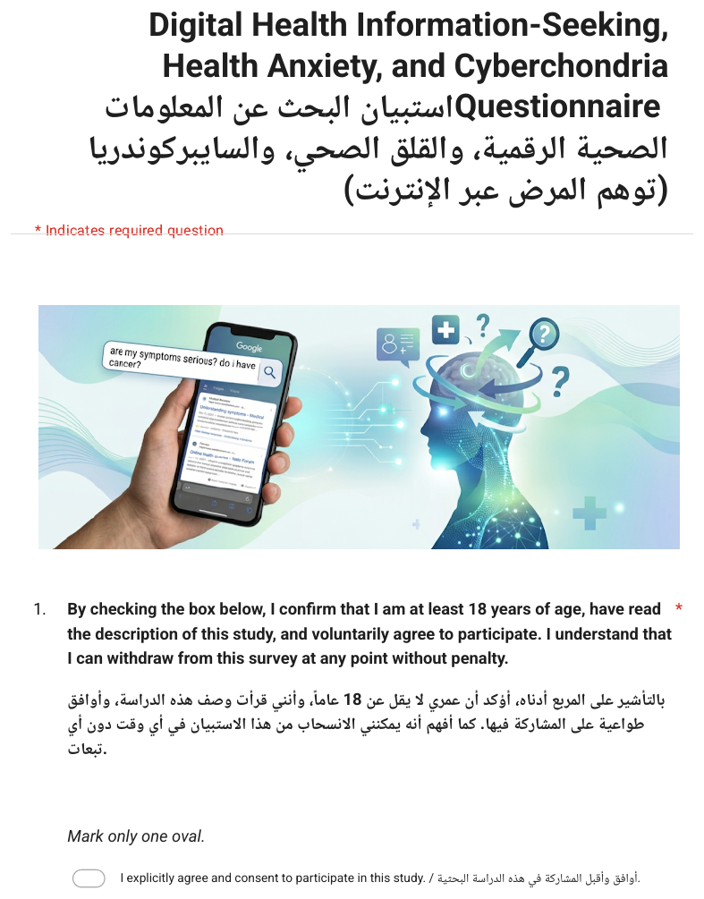
Methodology
Study design & setting
Participants & sampling
Sample size
Questionnaire
Statistical analysis
Notes:
[STUDENT 1 — Introduction & Methods]
Now the methodology: design, participants, sample size, the questionnaire and the analysis.

Slide 10
Study Design & Settings
Study design & settings
Criteria
Basis
Analytical cross-sectional online survey (STROBE, CHERRIES).
Baghdad, Iraq: 17 July 2026 – 11 September 2026.
Convenience + snowball sampling via Baghdad-based social-media and messaging groups.
1. Age ≥ 18 years
Adult population; SHAI & CSS validated in adults
2. Reads Arabic or English
Bilingual questionnaire
Ethics
3. Gave informed consent
Ethical requirement (e-consent page)
Anonymous & voluntary; no names or contacts collected.
Electronic consent (and age ≥ 18) required before any question.
Approval: [committee, number, date].
4. Reached through Baghdad channels
Defines the study setting
Notes:
[STUDENT 1 — Introduction & Methods]
This was an analytical cross-sectional study, reported using the STROBE and CHERRIES checklists. Data were collected online in Baghdad from 17 July 2026 to 11 September 2026. We used convenience and snowball sampling through social media and messaging groups based in Baghdad. Inclusion: 18 or older, able to read Arabic or English, and gave consent. Participation was anonymous and voluntary, with electronic consent before any question.

Slide 11
Sample Size & Questionnaire
Sample size
Consent & socio-demographics
age, gender, education, study/work, chronic disease
1
Primary outcome: correlation SHAI ↔ CSS
Fisher’s z, two-sided α = 0.05, 80% power
To detect r = 0.20 → 194 needed
Collected: n = 300
Margin of error for %: ±5.7%
Meta-analytic r ≈ 0.62, so the target is conservative.
Digital health seeking
tools (search engines, AI chatbots…), motives, trust
2
SHAI-14
health anxiety, 0–42
3
CSS-12
cyberchondria, 12–60, four facets
4
Before the consultation
behaviour after searching, disclosure to doctor, trust
5
Bilingual Arabic–English Google Form · Arabic wording by the research team
Notes:
[STUDENT 1 — Introduction & Methods]
Sample size. Our main question is a correlation. With alpha 0.05 and 80% power we need 194 people to detect a small-to-moderate correlation of 0.20. We collected 300, and the expected correlation from meta-analyses is much bigger, so the study is well powered (power about 94%). The questionnaire was a bilingual Google Form with five parts: consent and demographics; digital health seeking including AI chatbots; the SHAI-14; the CSS-12; and behaviour before the consultation and the relationship with the doctor. Every item was shown in Arabic and English.

Slide 12
Statistical Analysis
Describe
Psychometrics
Associations
Frequencies, mean ± SD, median (IQR); normality by Shapiro–Wilk
Cronbach α, McDonald ω, confirmatory factor analysis (CFI, TLI, RMSEA, SRMR)
Pearson / Spearman (bootstrap CI), partial r; Mann–Whitney, Kruskal–Wallis; χ²
Multivariable
Pathways
Rigour
Hierarchical robust (HC3) regression; logistic & ordinal logistic; AUC
Bootstrapped mediation (5000 resamples); moderation by interaction terms
Benjamini–Hochberg FDR for multiple testing; sensitivity analyses
Software: Python 3 (pandas, SciPy, statsmodels, pingouin, semopy), fully scripted · SPSS dataset & syntax provided · α = 0.05, two-sided
Notes:
[STUDENT 1 — Introduction & Methods]
For the analysis we used Python, with every step scripted so it can be reproduced, and we also prepared an SPSS file. We checked reliability and factor structure, then correlations, group comparisons, multivariable regression, and mediation with bootstrapping. Because we ran many tests, we corrected p-values with the false discovery rate method, and we labelled anything that did not survive as exploratory. Now my colleague will present the results.

Slide 13

Results
Participants
How people search
Levels & reliability
Health anxiety ↔ cyberchondria
Predictors & pathways
Behaviour & AI chatbots
Notes:
[STUDENT 2 — Results]
Thank you. I will present the results in six steps: who took part, how they search, the levels of health anxiety and cyberchondria, the main association, the predictors and pathways, and finally behaviour and AI chatbots.

Slide 14
Participants
Table 1: Socio-demographic characteristics of the participants (n = 300)
Variable | Category | n (%)
Age group (years) | 18–19 / 20–29 / 30–39 / ≥ 40 | 56 (18.7) / 187 (62.3) / 21 (7.0) / 36 (12.0)
Gender | Female / Male | 169 (56.3) / 131 (43.7)
Education | Currently a student | 189 (63.0)
Study / work | Medical student | 132 (44.0)
 | Other health-science student / healthcare worker | 43 (14.3) / 15 (5.0)
 | Non-health student / non-health employee or other | 46 (15.3) / 64 (21.3)
Health-related background | Yes | 190 (63.3)
Chronic medical condition | Yes | 65 (21.7)
Language relied on | Arabic / English | 212 (70.7) / 88 (29.3)
Health-related background = medical students, other health-science students and healthcare workers.
Notes:
[STUDENT 2 — Results]
Opening: Table 1 shows our 300 participants. Main finding: the sample is young, 62.3% aged 20 to 29, slightly more women at 56.3%, and 44.0% are medical students; 63.3% have a health-related background, and 21.7% reported a chronic condition. 70.7% answered mainly in Arabic. Closing: so this is a young, educated, digitally active sample, and that matters when we interpret percentages.

Slide 15
How People Search
Figure 2: Tools used and motivations for searching for health information online (n = 300; multiple answers)
78.0% ticked AI chatbots
56.3% search engines
41.0% AI without search engine
59.3% use ChatGPT
Notes:
[STUDENT 2 — Results]
Opening: Figure 2 shows the tools people use and why. Main finding: AI chatbots are now the main gateway. 78.0% ticked AI chatbots, 88.7% if we include those who named one, compared with 56.3% for search engines. 41.0% use AI with no search engine at all, and ChatGPT alone is used by 59.3%. The top motives are convenience at 80.0%, checking whether a doctor is needed at 57.7%, and instant reassurance at 51.0%. Closing: in summary, for this sample, the first doctor is often an AI chatbot.

Slide 16
Levels & Reliability
Table 3: Descriptive statistics, reliability and language equivalence of the SHAI-14 and CSS-12 (n = 300)
Scale (range) | Mean ± SD | Median (IQR) | α (95% CI) | ω | α Arabic / English
SHAI-14 (0–42) | 12.35 ± 5.83 | 12 (8–16) | 0.81 (0.78–0.84) | 0.82 | 0.81 / 0.81
CSS-12 (12–60) | 28.86 ± 8.36 | 29 (23–34) | 0.86 (0.84–0.89) | 0.87 | 0.86 / 0.88
Excessiveness (3–15) | 9.66 ± 2.94 | 10 (8–12) | 0.77 (0.72–0.81) | 0.77
Compulsion (3–15) | 5.00 ± 2.58 | 4 (3–6) | 0.88 (0.86–0.90) | 0.89
Distress (3–15) | 7.24 ± 2.74 | 7 (5–9) | 0.76 (0.71–0.81) | 0.77
Reassurance (3–15) | 6.96 ± 2.81 | 7 (5–9) | 0.76 (0.71–0.81) | 0.77
CSS-12 four-factor CFA (ML): CFI 0.95, RMSEA 0.070, SRMR 0.053. Arabic vs English: means equal; CSS-12 scalar-invariant, SHAI-14 metric-invariant (multi-group CFA); no item DIF after FDR.
19% elevated health anxiety (SHAI ≥ 18)
15.0–23.8% 95% CI
Notes:
[STUDENT 2 — Results]
Opening: Table 3 shows the scores and reliability. Main finding: mean SHAI was 12.3 out of 42 and 19% scored 18 or more, our threshold for elevated health anxiety, with a 95% confidence interval of 15.0–23.8%. Mean CSS was 28.9 out of 60. Excessiveness was the highest facet and compulsion the lowest: people search a lot, but it rarely disrupts their lives. Both scales were reliable, alpha 0.81 and 0.86, and reliability was the same in Arabic and English responders. Formal invariance testing showed the CSS-12 works the same way in both languages, and no single item behaved differently. Closing: our tools measured well in this population.

Slide 17
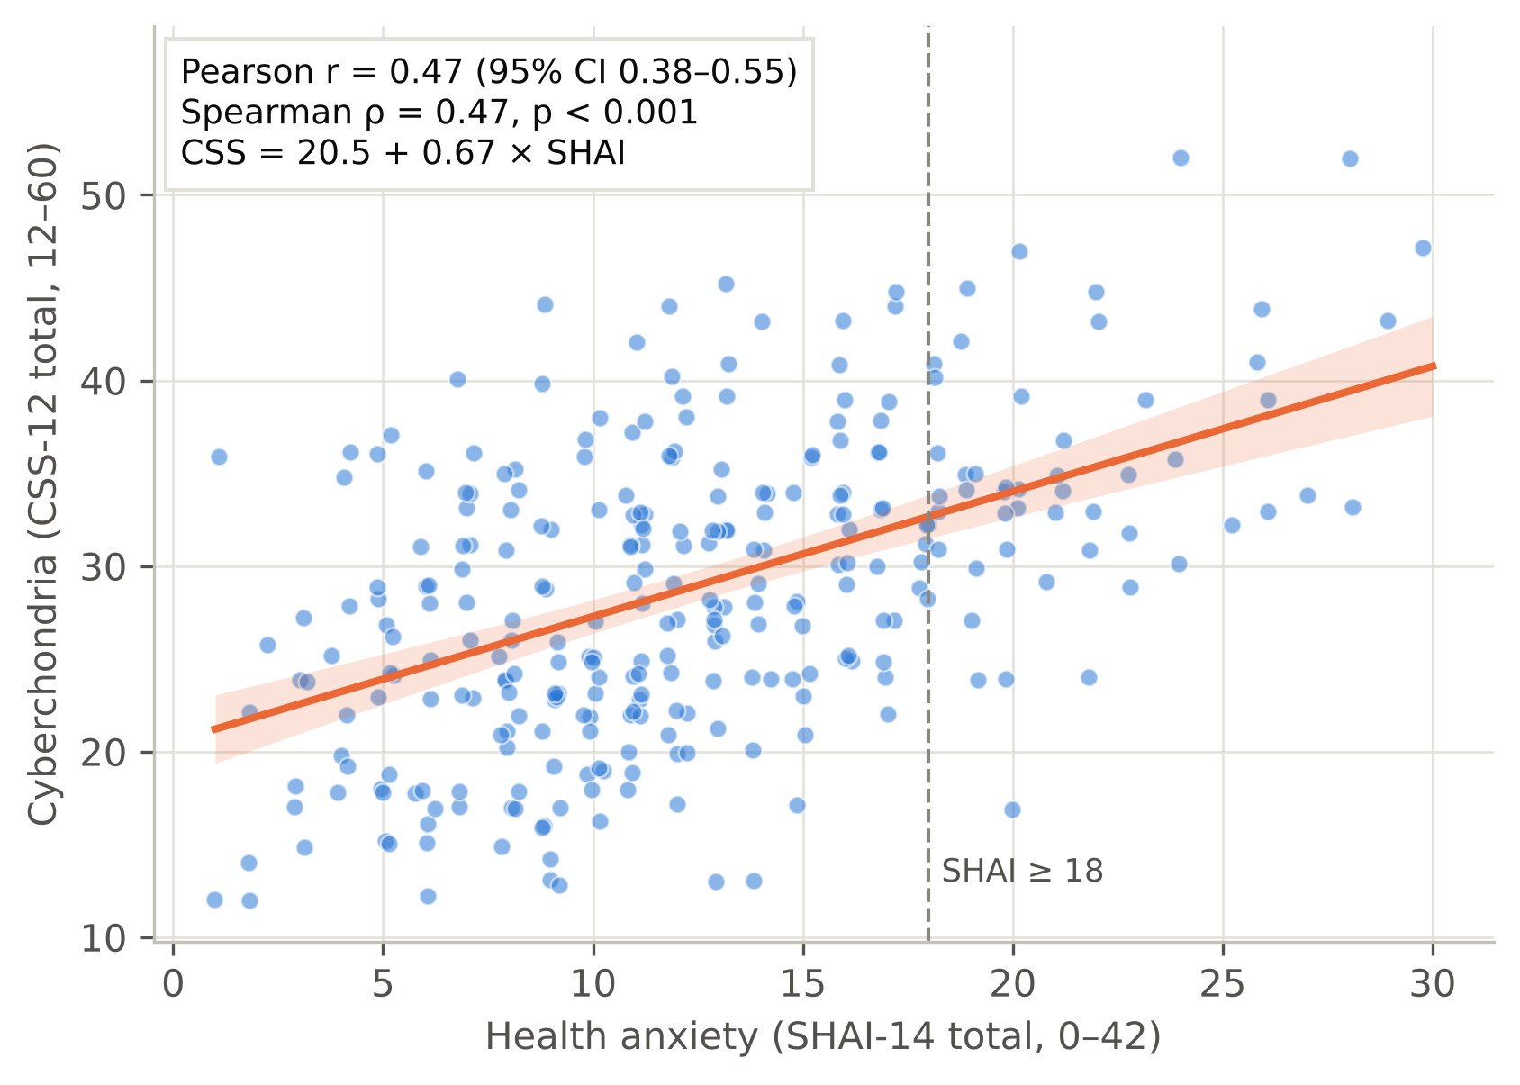
Health Anxiety ↔ Cyberchondria
r = 0.47
95% CI 0.38–0.55 · p < 0.001
Partial r (all covariates): 0.48
By CSS facet:
Excessiveness 0.46
Distress 0.45
Compulsion 0.25
Reassurance 0.24
H1 & H2 supported
Figure 4: Health anxiety (SHAI-14) against cyberchondria (CSS-12), least-squares line and 95% band
Notes:
[STUDENT 2 — Results]
Opening: this is our main result, Figure 4. Main finding: health anxiety and cyberchondria rise together, r = 0.47, 95% CI 0.38–0.55, so health anxiety explains about 22% of the variation in cyberchondria. After adjusting for every other variable, the partial correlation is still 0.48. The link is strongest for excessive searching, 0.46, and distress, 0.45, and weaker for compulsion and reassurance. Closing: in summary, hypotheses 1 and 2 are supported.

Slide 18
What Predicts Cyberchondria?
Table 8: Hierarchical robust (HC3) linear regression of cyberchondria (CSS-12 total)
Block | R² | ΔR² | p (change)
1. Socio-demographics | 0.030 | 0.030 | —
2. + Digital-use variables | 0.133 | 0.103 | < 0.001
3. + Health anxiety (SHAI-14) | 0.317 | 0.184 | < 0.001
Final model: key predictors
Predictor | B (95% CI) | β | p
SHAI-14 (per point) | 0.68 (0.53–0.84) | 0.48 | < 0.001
AI-chatbot user* | 5.33 (2.34–8.32) | 0.20 | < 0.001
Age 30–39 (vs 20–29) | 6.27 (0.19–12.34) | 0.19 | 0.043
Gender, chronic, language, job | n.s. |  | > 0.5
*Inclusive definition; with the strict definition the AI effect is not significant (slide 23).
+18.4% added by health anxiety
Notes:
[STUDENT 2 — Results]
Opening: Table 8 is the hierarchical regression for cyberchondria. Main finding: demographics alone explain only about 3% of cyberchondria. Adding digital-use variables brings it to 13%. Adding health anxiety adds another 18.4%, to about 32%. Health anxiety is the strongest predictor, standardised beta 0.48: each extra SHAI point adds about 0.68 CSS points. Closing: who you are matters little; how anxious you are matters most.

Slide 19
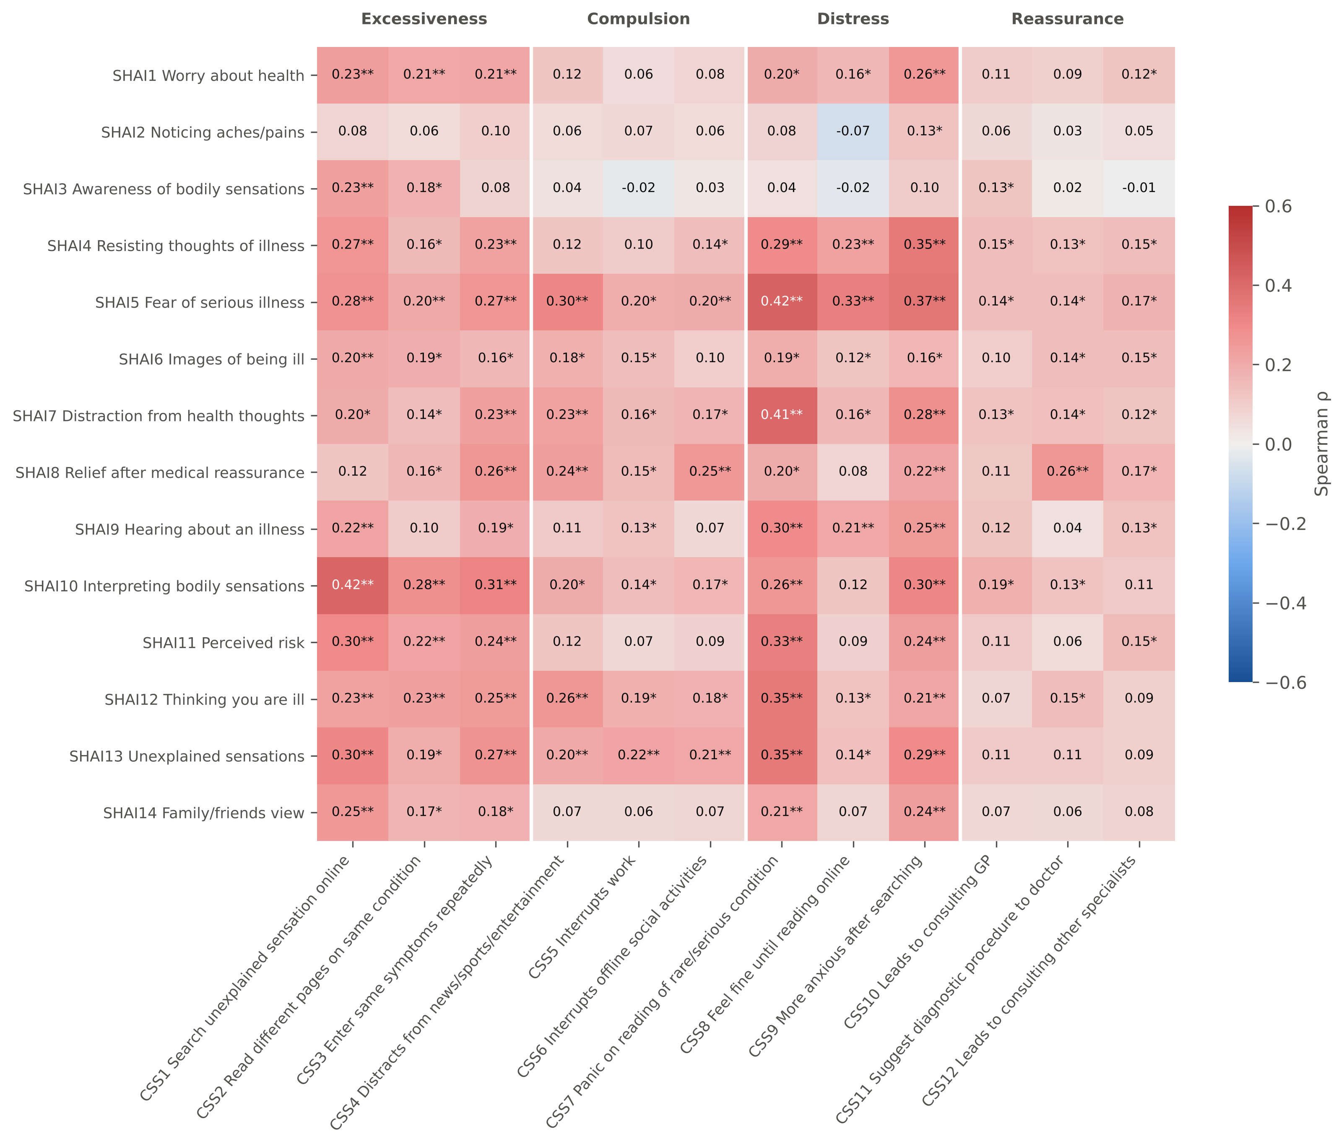
Item by Item: What Drives Searching?
ρ = 0.43
Fear of serious illness ↔ panic on reading of a rare condition
ρ = 0.42
Interpreting sensations ↔ searching every sensation
≈ 0
Merely noticing aches / sensations
Supplementary figure: Item-by-item Spearman correlations, SHAI-14 × CSS-12 (* FDR, ** Holm)
111/168 pairs significant after FDR
Notes:
[STUDENT 2 — Results]
Opening: this supplementary figure breaks the association down item by item, all 168 pairs. Main finding: 111 pairs remained significant after FDR correction. The strongest links involve fear of serious illness and interpreting body sensations; for example fear of illness with panicking when reading about a rare condition. Simply noticing aches and pains was almost unrelated. Closing: what drives searching is fear and interpretation, not just noticing symptoms, exactly what the cognitive model predicts.

Slide 20
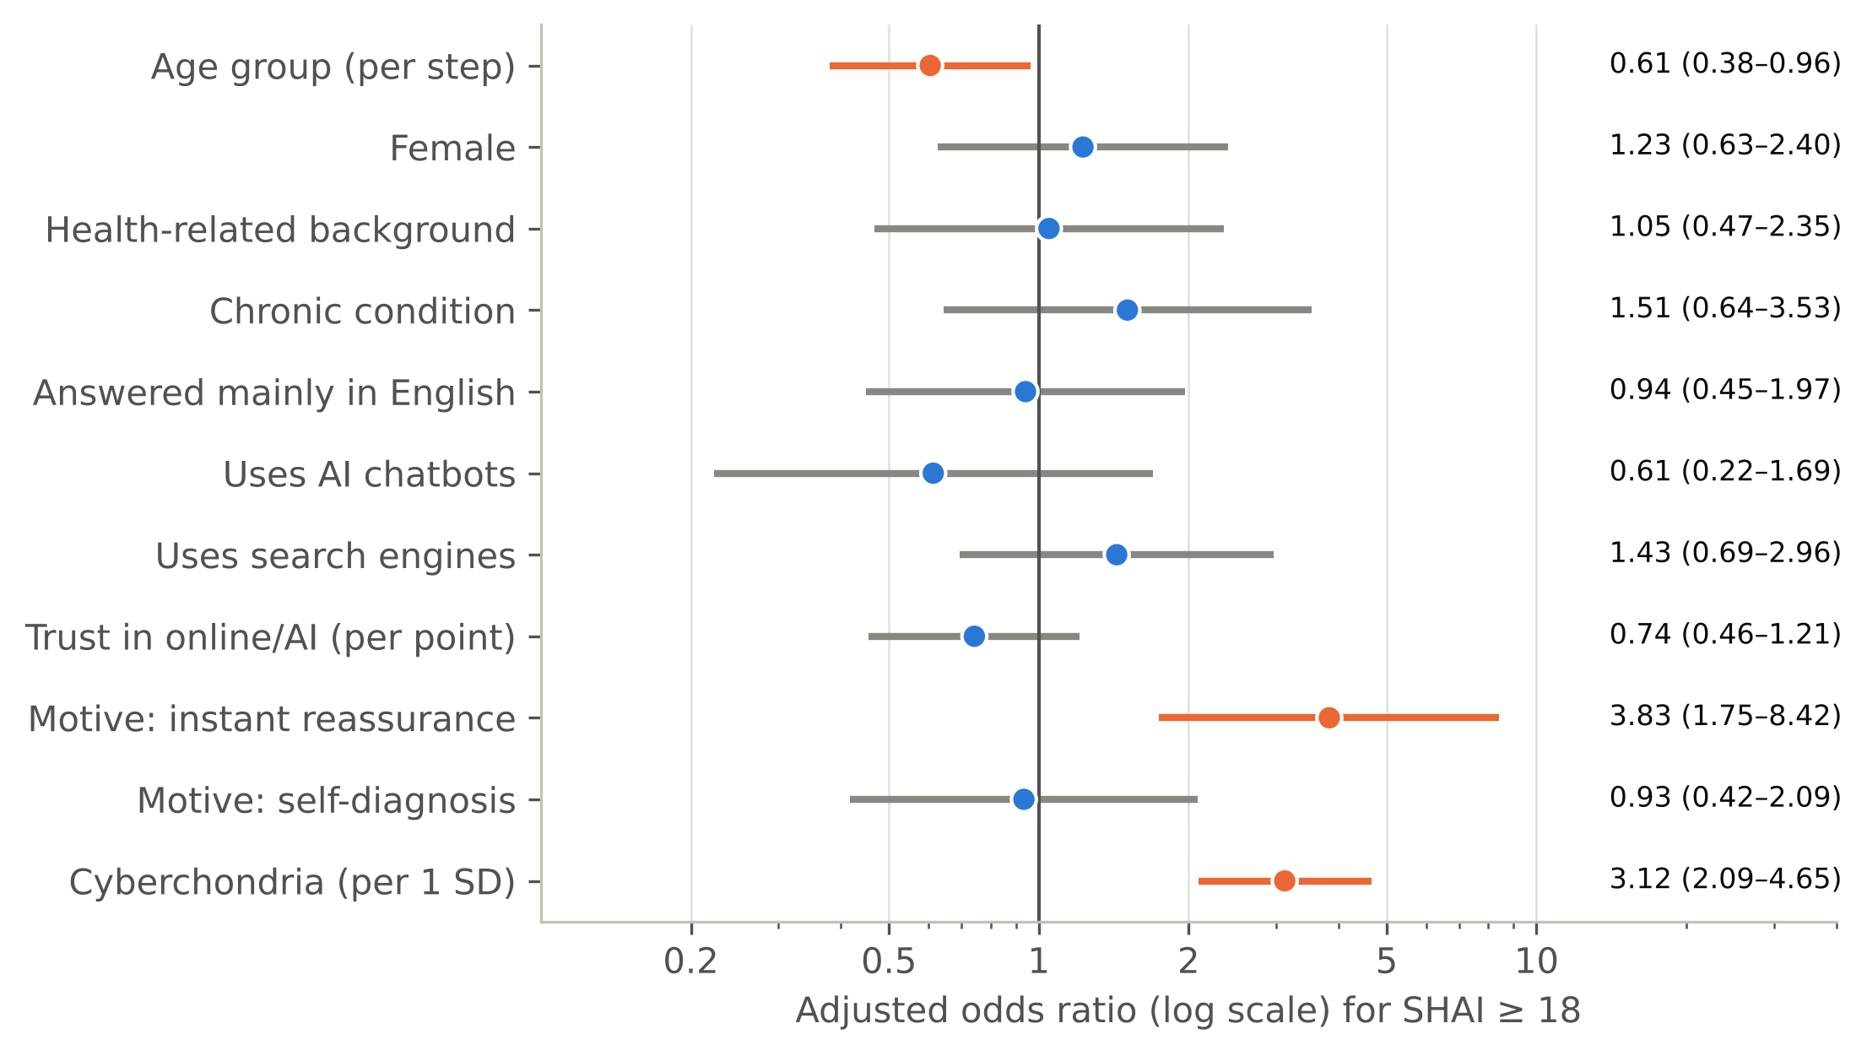
Who Has Elevated Health Anxiety?
3.12×
odds per SD of cyberchondria
3.83×
if searching for instant reassurance
0.61×
per older age group (protective)
Figure 6: Adjusted odds ratios for elevated health anxiety (SHAI ≥ 18). Orange: p < 0.05
0.83 → 0.79
AUC (apparent → optimism-corrected)
Notes:
[STUDENT 2 — Results]
Opening: Figure 6 shows who has elevated health anxiety, in a multivariable logistic model. Main finding: three factors are independent. Each standard deviation of cyberchondria triples the odds, adjusted odds ratio 3.12. Searching for instant reassurance almost quadruples them, 3.83. Older age is protective, 0.61 per age step. The model discriminates well: AUC 0.83, 0.79 after correcting for optimism. Closing: the person most at risk is young and searches to feel reassured.

Slide 21
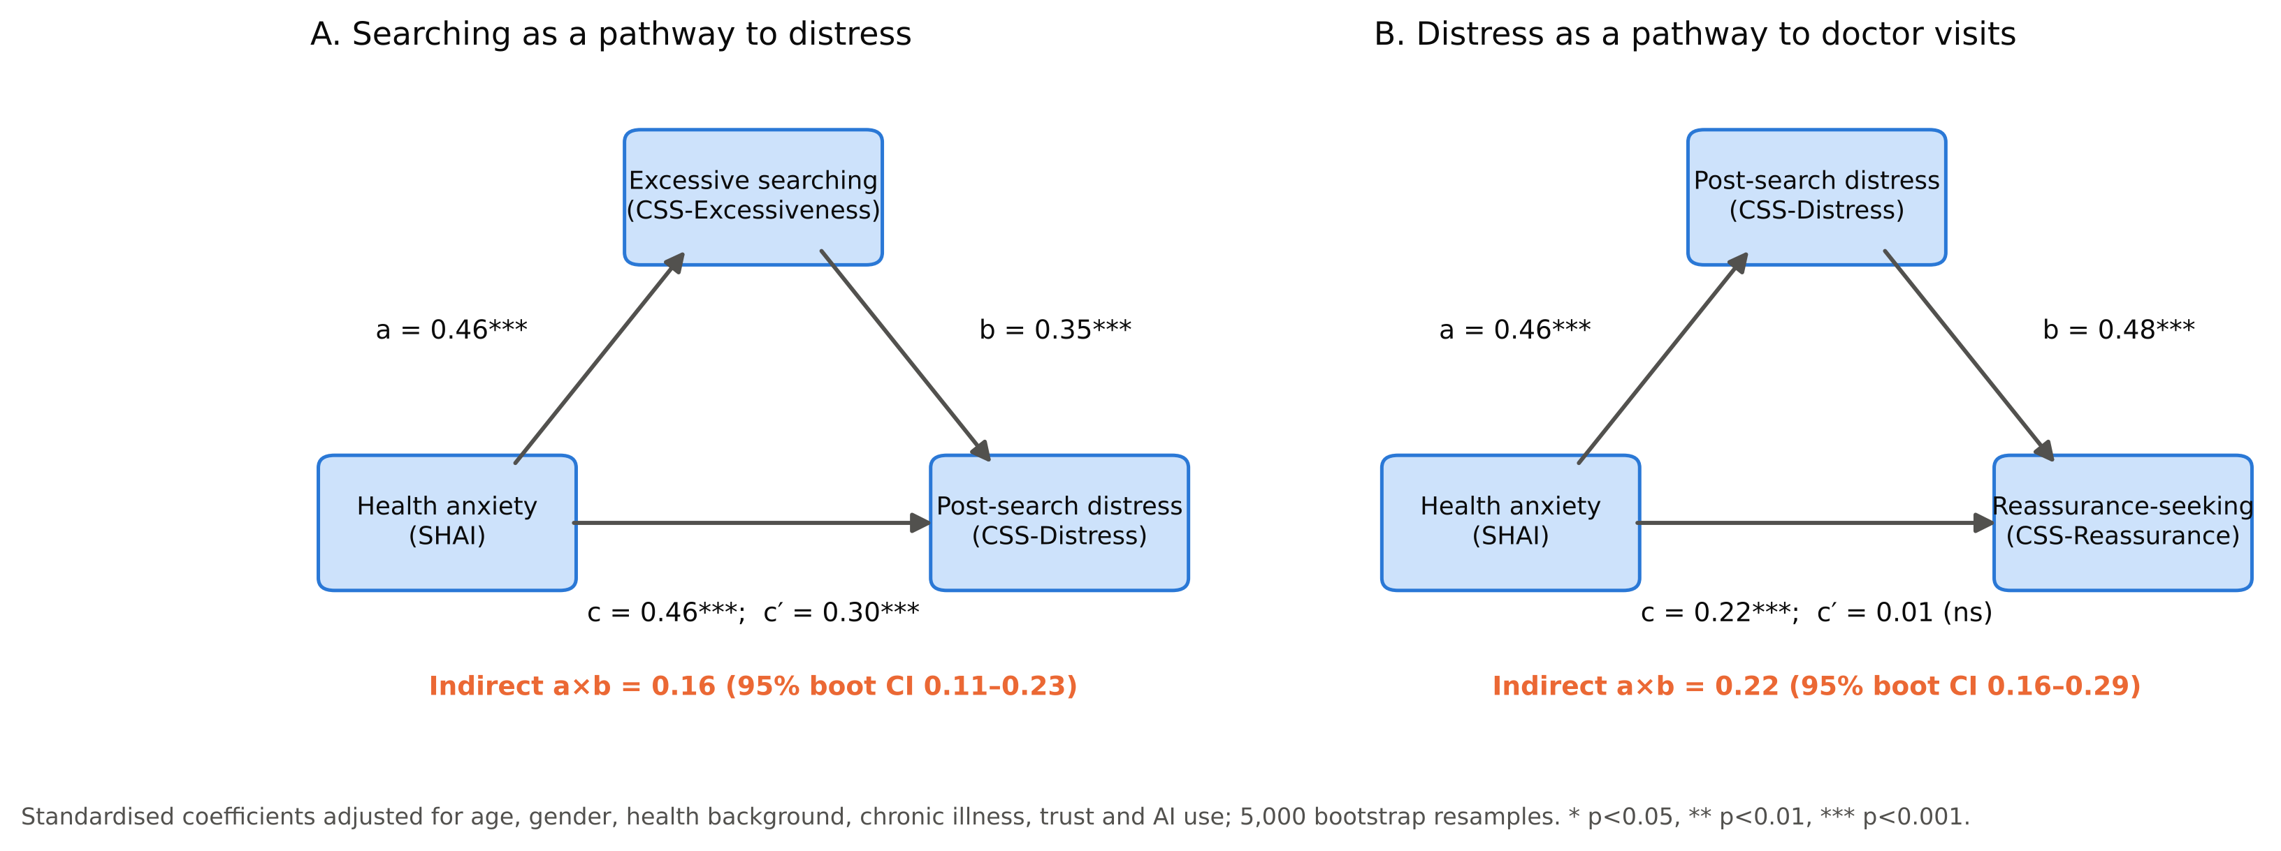
Pathways: Is There a Cycle?
Figure 7: Mediation models (standardised; 5000 bootstrap resamples)
Indirect via excessive searching 0.16 (CI 0.11–0.23) · via distress 0.22 (direct → 0.01) · reverse path also 0.15 → compatible with a cycle, not proof of direction
Notes:
[STUDENT 2 — Results]
Opening: Figure 7 shows the pathways. Main finding: in model A, part of the link from health anxiety to post-search distress runs through excessive searching, indirect effect 0.16, CI 0.11–0.23. In model B, post-search distress carries almost all of the link from health anxiety to reassurance-seeking visits: the direct effect drops to 0.01. But the reverse direction also fits, 0.15. Closing: our data are compatible with the cycle, but one survey at one time point cannot prove direction. Hypothesis 3 is supported statistically, not causally.

Slide 22
Behaviour Before the Consultation
34.7%
delay / skip care because reassured
31.7%
never tell their doctor (fear of judgement)
OR 0.57
higher cyberchondria → more disclosure (q = 0.012)
34.7%
say searching strained trust in doctors
Figure 3: Behaviour after searching (n = 300; multiple answers)
Notes:
[STUDENT 2 — Results]
Opening: Figure 3 shows what people do after searching. Main finding: the most common response is to delay or skip care because they feel reassured, 34.7%. Others escalate: urgent visits 22.0%, multiple doctors 25.3%. Only 27.0% always tell their doctor about their searches, and 31.7% never do, for fear of being judged. Higher cyberchondria was linked with more disclosure, odds ratio 0.57, and this survived FDR correction. 34.7% say searching complicated or reduced trust in their doctor. Closing: searching changes the consultation before it begins.

Slide 23
AI Chatbots: An Independent Effect?
Table: Adjusted difference in cyberchondria (CSS-12) for AI-chatbot users
Definition of AI user | B (CSS points) | 95% CI | p
Inclusive: ticked OR named a chatbot | +5.3 | 2.3–8.3 | < 0.001
Strict: ticked “AI chatbots” only | +1.5 | — | 0.31
32 respondents named a chatbot without ticking it (mean CSS 31.6 vs 24.0 in non-users); only 34 were non-users.
The classification decides it
Small comparison group
No moderation
32 “named but not ticked” respondents had the highest scores
Only 34 true non-users
AI use did not change the SHAI ↔ CSS link
Conclusion: no reliable evidence that AI use is linked to cyberchondria beyond health anxiety.
Notes:
[STUDENT 2 — Results]
Opening: finally, did AI chatbots themselves matter? Main finding: AI users scored 5.3 points higher on cyberchondria after adjustment, mainly excessiveness and reassurance. But 32 people named a chatbot without ticking the AI option. When we use the strict definition, only people who ticked it, the effect disappears: B = 1.5, p = 0.31. And only 34 people were true non-users. AI use also did not change the strength of the anxiety–cyberchondria link. Closing: no reliable independent effect of AI. Absence of evidence, not evidence of absence. I now hand over to my colleague for the discussion.

Slide 24

Discussion
Our main finding vs the world
Why weaker than meta-analyses?
AI chatbots
The consultation
Medical students
Limitations & future directions
So, is searching the problem, or the anxiety?
Notes:
[STUDENT 3 — Discussion & Conclusions]
Thank you. I will discuss what these results mean, how they compare with other studies, our limitations, and our conclusions.

Slide 25

To our knowledge, this is the first study to apply the CSS-12 in a Baghdad-based sample, and among the first to place AI chatbots alongside search engines as a source of health information before consulting a doctor.
Health anxiety and cyberchondria were moderately and robustly associated (r = 0.47), independent of all other measured factors.
n = 300 · r = 0.47
Notes:
[STUDENT 3 — Discussion & Conclusions]
To our knowledge, this is the first study to use the CSS-12 in Baghdad, and among the first anywhere to look at AI chatbots next to search engines before seeing a doctor. Our main finding, r = 0.47, supports our first two hypotheses: health anxiety and cyberchondria go together, independently of everything else we measured.

Slide 26
Comparison with Worldwide Results
Our study: r = 0.47
Meta-analyses (McMullan 2019; Schenkel 2021): r ≈ 0.62–0.63
Our r corrected for unreliability: ≈ 0.56
Correlation: health anxiety ↔ cyberchondria
Meta-analysis (2019)
0.62
Why weaker?
Meta-analysis (2021)
0.63
1
Measurement error: Corrected for reliability, r ≈ 0.56
Our study, corrected
2
Narrow range: Low health anxiety (mean SHAI 12.3) attenuates r
0.56
3
Who answered: Online recruitment favours confident, habitual users
Our study
0.47
4
Short form: Most earlier studies used the 33-item CSS
Notes:
[STUDENT 3 — Discussion & Conclusions]
How do we compare with the world? Our correlation of 0.47 is weaker than the pooled estimates of about 0.62 from meta-analyses. Several reasons: first, measurement error; corrected for reliability it would be about 0.56, close to the meta-analytic range. Second, our sample had low health anxiety, and a narrow range weakens correlations. Third, online recruitment may favour confident, habitual internet users. Fourth, most earlier studies used the full 33-item scale.

Slide 27
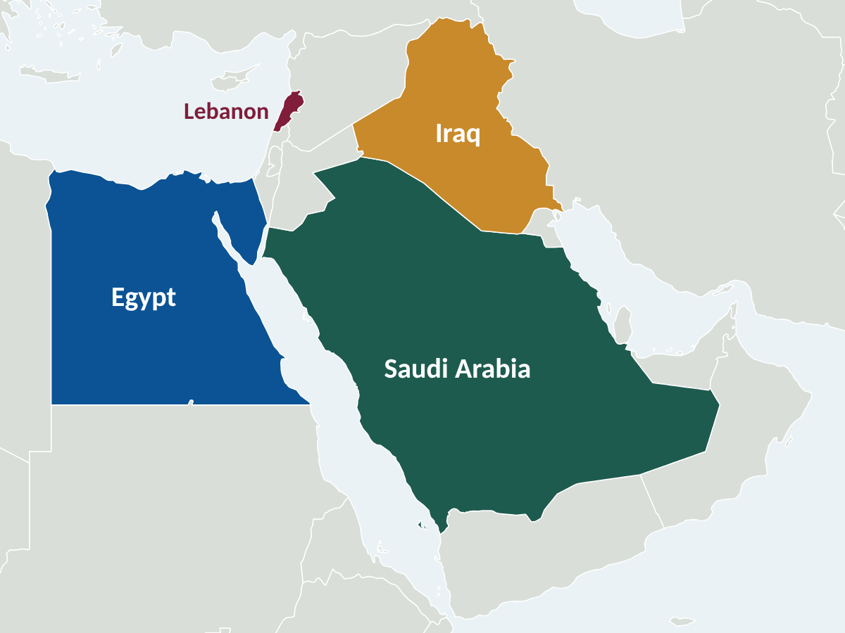
Comparison with Regional Studies
Saudi Arabia – Jeddah
Cyberchondria common, linked with smartphone addiction
Saudi Arabia – primary care
Cyberchondria linked with health anxiety
Lebanon
Arabic CSS-12: same four-factor structure as ours
Egypt – 1435 medical students
85.8% moderate cyberchondria; health worry predicted it
Our results are in line with emerging Arab-region data.
Notes:
[STUDENT 3 — Discussion & Conclusions]
Our findings agree with the Arab region. In Jeddah, cyberchondria was common and linked with smartphone addiction. In Saudi primary care, cyberchondria was linked with health anxiety. In Lebanon, the Arabic CSS-12 had the same structure as ours. And among 1435 Egyptian medical students, the group closest to ours, most had moderate cyberchondria.

Slide 28
AI Chatbots & the Consultation
AI chatbots
The consultation
Our use 78.0%–88.7% vs ~20% (US 2024) and 21% (2025 survey).
Young sample: AI use fell from 96% (18–19 y) to 72% (≥ 40 y).
Conversational AI may invite “one more question” (excessiveness, reassurance).
Higher trust → fewer multiple-doctor visits, but a trend to delay care (OR 1.33, p = 0.088).
Delay because reassured (34.7%): saves visits, but risks delayed diagnosis; seen at all anxiety levels.
31.7% never disclose searches (fear of judgement).
Higher cyberchondria → more disclosure (robust); health anxiety → concealment (exploratory).
H4 only partially supported.
Clinical message: ask every patient, without judgement, what they searched or asked an AI.
Notes:
[STUDENT 3 — Discussion & Conclusions]
AI use in our sample, 78.0% to 88.7%, is far higher than in a 2024 US survey, about 1 in 5, and a 2025 survey, 21%. Our sample is young; AI use fell from 96% at 18 to 19 years to 72% at 40 and above. On the consultation: delaying care because of reassurance can save visits for minor symptoms, but risks delayed diagnosis for serious ones, and it happened across all anxiety levels. About a third never tell their doctor what they searched. So doctors should ask.

Slide 29

44.0% of our sample were medical students, a distinct group:
Heightened medical awareness of rare and serious diseases.
High academic stress.
The popular idea of “medical student syndrome” (weak evidence).
Higher unadjusted health anxiety, but this disappeared after adjustment: it reflected their younger age.
Cyberchondria scores were identical to other participants’: medical knowledge did not protect against cyberchondria.
Notes:
[STUDENT 3 — Discussion & Conclusions]
44.0% of our sample were medical students, a distinct group: high medical awareness, academic stress, and exposure to descriptions of serious disease. They had higher unadjusted health anxiety, but this disappeared after adjustment, because they are younger, and age was the independent factor. Their cyberchondria scores were identical to everyone else's. So medical knowledge did not protect against cyberchondria.

Slide 30
Limitations
Cross-sectional design: Cannot establish direction; mediation is statistical, not causal
1
Online convenience sample: Young, 44.0% medical students; percentages not generalisable, associations consistent across subgroups
2
Arabic wording: Team translation without formal back-translation; but CSS-12 fully invariant and SHAI-14 metric invariant across languages, no item DIF
3
Single-item measures: Behaviour, disclosure and trust items not validated; labelled exploratory
4
Multiple testing & self-report: FDR correction applied; recall and social-desirability bias possible
5
Notes:
[STUDENT 3 — Discussion & Conclusions]
We have several limitations. First, the design is cross-sectional, so we cannot prove direction; the mediation is statistical, not causal. Second, the sample is online convenience and snowball, young, and heavy in medical students, so percentages cannot be generalised to all of Baghdad, although associations were consistent across subgroups. Third, the Arabic wording was ours, without formal back-translation, although reliability and means were the same in both languages. Fourth, behaviour items were single, non-validated questions. Fifth, many tests; we corrected with FDR.

Slide 31
Future Directions & Recommendations
Future research should prioritise:
Clinicians
Longitudinal / experience-sampling studies of the cycle.
Experiments: AI chatbot vs search-engine answers and anxiety.
Probability sampling of Baghdad adults, including older and less-educated people.
Formally adapted Arabic scales with invariance testing.
Intervention trials: only 9 cyberchondria studies on ClinicalTrials.gov, none in Iraq.
Ask, without judgement, what patients searched or asked an AI; screen with the SHAI
Ministry of Health
May consider Arabic digital and AI health-literacy campaigns; warn about false reassurance
AI developers
May consider anxiety-aware answers that do not escalate rare diagnoses
Notes:
[STUDENT 3 — Discussion & Conclusions]
For the future: longitudinal studies to test the cycle over time; experiments comparing AI chatbot and search-engine answers; probability sampling of all Baghdad adults; and formally adapted Arabic scales. ClinicalTrials.gov lists only nine cyberchondria studies and none in Iraq, so intervention trials are a clear gap. For practice: doctors should ask about searches; the Ministry may consider digital and AI health-literacy campaigns; and AI developers may consider anxiety-aware answers.

Slide 32
Conclusion
AI chatbots (mainly ChatGPT) are a leading source of health information: 78.0% ticked them (88.7% incl. named), more than search engines.
19% had elevated health anxiety (SHAI ≥ 18, a screening threshold); younger people and reassurance-seekers most affected.
Health anxiety and cyberchondria are moderately and robustly associated (r = 0.47), mainly through excessive searching and distress, compatible with a cycle.
No reliable independent effect of AI beyond health anxiety.
Searching shapes the consultation: 34.7% delay care when reassured, 31.7% never disclose searches.
Notes:
[STUDENT 3 — Discussion & Conclusions]
To conclude. AI chatbots, mainly ChatGPT, are now the main source of health information before seeing a doctor in our sample. About one in five has elevated health anxiety. Health anxiety and cyberchondria are moderately and robustly linked, r = 0.47, compatible with a cycle. We found no reliable independent effect of AI. And searching shapes the consultation: delays, non-disclosure and strained trust. Thank you.

Slide 33
r = 0.47
Health anxiety and cyberchondria travel together.
Thank you — questions are welcome
Notes:
[ALL] Leave this slide up during questions. Each student answers questions on their own part; Student 2 takes statistics questions.

