Slide 1

FULL STACK DATA ENGINEER — HADOOP & SPARK
Capstone Project - FinSight
A Scalable Big Data Architecture for NovaCrest Bank Powered by Apache Hadoop & Spark
By – Shaik Yaseen

Slide 2
PROJECT ROADMAP & ARCHITECTURE OVERVIEW
01 The Business Problem: Why NovaCrest Needed FinSight
06 Nightly Batch Processing: Spark Core & Hive Mart
02 Solution Architecture: Decoupling Streaming & Batch
07 Customer 360 & Money Mule Networks: Mongo & Neo4j
03 End-to-End System Flowchart & Technology Stack
08 Visual Data Blending: Alteryx Risk Scoring Workflows
04 Data Ingestion: High-Throughput Kafka & HDFS Lake
09 Executive Visual Analytics: 3 Power BI Dashboards
05 Real-Time Detection: Stopping Fraud & Churn Live
10 Key Analytical Discoveries & Measurable Impact

Slide 3
1. EXECUTIVE CONTEXT & PAIN POINTS
The Challenge: Why NovaCrest Bank Needed FinSight
About NovaCrest Bank
NovaCrest is a rapidly growing full-service bank operating in 38 US states, serving 4.2 Million personal customers and 86,000 commercial accounts.
The bank processes over 2,000,000 transactions daily across mobile, online, ATM, and branch networks. Rapid scale created critical operational blind spots that traditional databases could no longer handle.
Core Project Objective:
Build and deploy an enterprise-grade Big Data platform combining Apache Hadoop, Spark, NoSQL, Neo4j, Alteryx, and Power BI to stop fraud instantly and protect customer retention.
Three Critical Bottlenecks Faced by the Bank
1. The 24-Hour Fraud Delay (T+24h Lag)
Legacy fraud detection ran overnight batch scripts. By the time an unauthorized transfer was flagged, stolen funds had already been cashed out and settled.
2. Disconnected Customer Records (Data Silos)
Transaction logs lived separately from customer KYC profiles. Branch and fraud managers had no single unified view to spot flight-risk customers before they closed accounts.
3. Painful 18-Day Regulatory Audits
Compiling anti-money laundering (AML) compliance reports required manual SQL queries across fragmented databases, taking up to 18 days and risking severe fines.

Slide 4
2. STRATEGIC ARCHITECTURE
Our Solution: Decoupling Real-Time Speed from Deep Batch Analytics
💡 Core Architectural Principle: Decoupled Multi-Tier Lambda Architecture
High-velocity financial event streams require sub-second heuristic filtering, while multi-month risk modeling and compliance require heavy distributed computing. Separating these tiers guarantees zero latency spikes during peak transaction hours.
⚡ 1. Real-Time Streaming Tier
Apache Kafka + Spark Structured Streaming
Consumes high-throughput live transactions, runs stateful micro-batch heuristic rules, and intercepts fraudulent transfers within 5 seconds.
📊 2. Distributed Batch Tier
Apache Hadoop HDFS + Spark Core & SQL
Performs scheduled nightly enterprise rollups across 31 days (744 simulation steps), calculating rolling customer risk scores and CLV.
🗄️ 3. Specialized Databases
Hive Warehouse + MongoDB + Neo4j Graph
Uses the best database for each task: Hive for SQL compliance queries, MongoDB for flexible KYC customer profiles, and Neo4j for money mule networks.
📈 4. Visual Blending & BI Front-End
Alteryx Designer Cloud + Microsoft Power BI
Empowers business analysts to visually blend fraud and churn features without writing code, feeding 3 interactive executive Power BI dashboards.

Slide 5
SECTION 5 · PROPOSED SOLUTION
Platform architecture
01 INGEST
Apache Kafka
3 topics, producer throttled to 1,000 msg/sec
02 LAND
HDFS
Parquet data lake partitioned by step
03 PROCESS
Spark
Streaming, Core and SQL across six jobs
04 SERVE
Hive · MongoDB · Neo4j
Warehouse, document store, property graph
05 BLEND
Alteryx Designer
Two workflows, feature engineering
06 REPORT
Power BI
Three dashboard pages for three audiences
Transaction records stream through Kafka into the HDFS lake, then fan out to a Hive warehouse, a MongoDB profile store and a Neo4j fraud graph.
Alteryx blends those outputs into two clean analytical datasets published directly to Power BI for executive reporting.

Slide 6
4. INGESTION & STORAGE STRATEGY
Moving & Storing Big Data: Apache Kafka & HDFS Data Lake
Ingestion Backbone: Apache Kafka
Decoupled real-time message broker acting as an event highway:
✔ High-Throughput Producer: Custom Python streaming producer pushing financial events at 1,000 messages/sec.
✔ Dedicated Event Topics: Decoupled into `txn-stream` (transaction fraud heuristics) and `txn-churn` (user interaction events).
✔ Shock Absorber for Spikes: Prevents downstream database crashes during heavy midday payment rushes.
✔ Zero-Data-Loss Reliability: Built-in replication across Kafka broker partitions ensures no transaction is ever dropped.
Distributed Data Lake: Apache HDFS
Scalable, fault-tolerant cluster storage rooted at /finsight/processed/:
Columnar Parquet Format: Optimized with Snappy compression, slashing raw CSV disk consumption by over 70%.
Partition Pruning: Partitioned by simulation step (`step=1..744`), enabling Spark to scan only target time slices.
Verified Lake Directories: Organized into clean departmental folders for easy enterprise discovery:
• /flagged_transactions: Live isolated high-risk transaction anomalies.
• /churn_alerts: Real-time scored customer flight-risk alerts.
• /daily_summary: Step-by-step transaction volume aggregates.
• /compliance_summary: Customer-level historical fraud ratios.

Slide 7
5. REAL-TIME STREAM ENGINE
Catching Fraud & Churn Live: PySpark Structured Streaming
⚡ Real-Time Fraud Detection Engine
✔ Live Stream Ingestion: Continuously ingests live transaction payloads from Kafka topic `txn-stream`.
✔ 5-Second Micro-Batches: Evaluates stateful heuristic rules with checkpointing for fault-tolerant processing.
✔ Multi-Condition Heuristics: Flags high-dollar amounts (> $200k), high-risk payment rails (`TRANSFER` and `CASH_OUT`), and balance wipeout anomalies.
✔ Outcome: Automatically intercepted 5,600 confirmed fraud transactions and persisted them directly to HDFS before funds settled.
📉 Customer Churn & Inactivity Pipeline
✔ Behavioral Ingestion: Consumes customer interaction signals and account events from Kafka topic `txn-churn`.
✔ Balance Decay Analysis: Applies tumbling window logic to track rapid account liquidation (`oldbalance > $10k` drained to zero).
✔ Proactive Retention: Detects flight-risk customers days before they formally initiate account closure.
✔ Outcome: Streamed 2,370,000 scored customer alerts to `/finsight/processed/churn_alerts/` for immediate relationship manager intervention.

Slide 8
6. BATCH PIPELINES & DATA WAREHOUSING
Nightly Big Data Aggregations: Apache Spark Core & Hive
Nightly Batch Processing (Spark Core)
▪ Full Simulation Scan: Automated batch pipeline reading transaction partitions across all 744 simulation steps (31 days of banking).
▪ Parallel MapReduce Computations: Calculates step-by-step transaction volumes, average amounts, and fraud ratios across worker nodes.
▪ Composite 7-Day Risk Scoring: Computes rolling multi-factor customer risk scores (0-100) factoring in velocity and nocturnal activity.
▪ Published Data Lake Summary: Persists clean rollups directly to `/finsight/processed/daily_summary/` for instant analytical reporting.
Enterprise Compliance Mart (Hive & Spark SQL)
▪ External Hive Tables: Created schema-on-read external Hive tables mapped directly to HDFS storage directories.
▪ Customer-Level Entity Rollups: Pre-calculates total transactions, total dollar volume, confirmed fraud count, and fraud volume per customer.
▪ Engineered Fraud Rate Feature: Calculates `fraud_rate_pct` as a benchmark risk feature for downstream machine learning and audit triage.
▪ Audit-Ready Views: Replaces slow ad-hoc SQL with instant, zero-delay compliance views for regulatory inspectors.

Slide 9
7. SPECIALIZED DATABASES
Customer Profiles & Money Mule Networks: MongoDB & Neo4j
Customer Document Store: MongoDB
✔ Customer 360 JSON Profiles: Stores 10,000 semi-structured customer records including credit score, salary, product holdings, and KYC tier.
✔ Dynamic Schema Evolution: Accommodates frequent attribute additions (e.g. churn probabilities) without costly relational database migrations.
✔ Fast Key-Value Retrieval: Allows fraud analysts to fetch complete customer dossiers in milliseconds during active investigations.
✔ Cross-Tier Enrichment: Enriches flat transaction rows with rich customer context for advanced risk segmentation.
Graph Network & Mule Ring Analysis: Neo4j
✔ Graph Modeling: Ingested accounts as `:Customer` nodes and financial transactions as directed `[:TRANSACTED_WITH]` edges.
✔ Exposing Hidden Laundering Chains: Standard SQL queries only see single rows. Neo4j graph traversal uncovers multi-hop laundering rings:
✔ Pinpoints illicit bridge accounts routing stolen funds across disparate clusters that avoid traditional threshold filters.
(Victim) ──TRANSFER──> (Mule) ──CASH_OUT──> (Beneficiary)

Slide 10
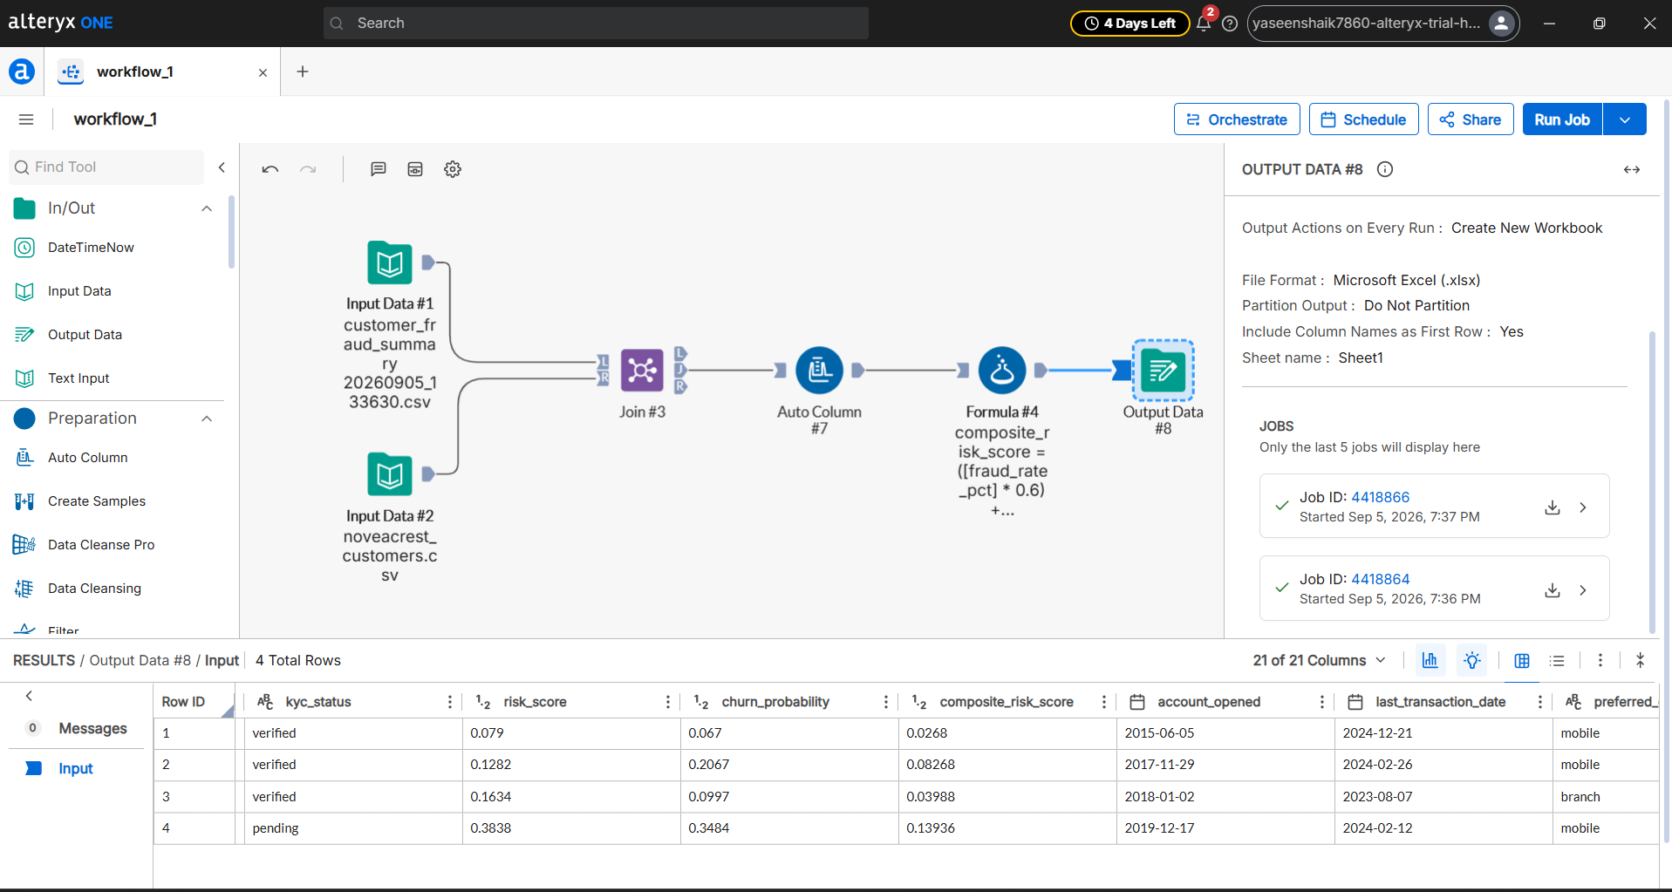
8.1 · VISUAL DATA BLENDING (ALTERYX DESIGNER)
Workflow 1 — Customer Risk Blend Engine (customer_risk_blend.xlsx)
📊 6.35M Spark SQL Fraud Records In | 10,000 MongoDB Profiles Joined | Target: customer_risk_blend.xlsx
• Blend Steps: Inner join on customerId after Select tools enforce strict datatypes. Recomputes dynamic customer risk.
• Formula: composite_risk_score = (fraud_rate_pct × 0.6) + (churn_probability × 0.4) ➔ Published for audit review.

Slide 11
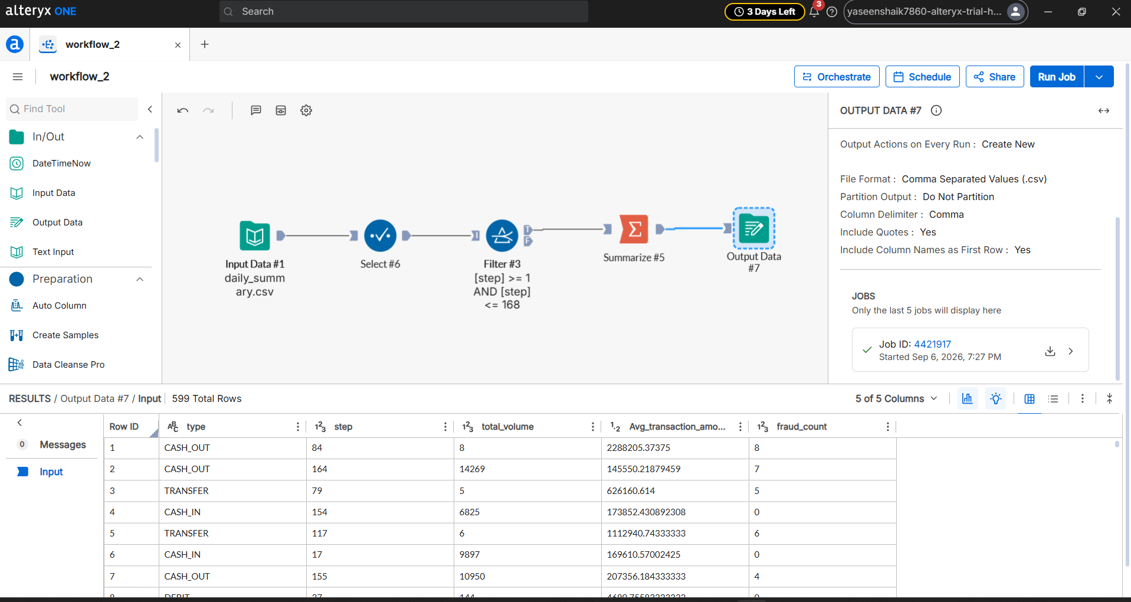
8.2 · VISUAL DATA BLENDING (ALTERYX DESIGNER)
Workflow 2 — 7-Day Operational Transaction Summary (transaction_summary.csv)
📈 2,674 Daily Summary Rows In | 599 Analytical Rows Out | Scope: First Operational Week (1 ≤ step ≤ 168)
• Pipeline Steps: Filter tool isolates initial 7 days; Summarize groups by type and step across volume, fraud count & monetary sums.
• Formula: avg_transaction_amount = IIF(count == 0, 0, volume / count) ➔ Directly feeds executive Power BI reports.

Slide 12
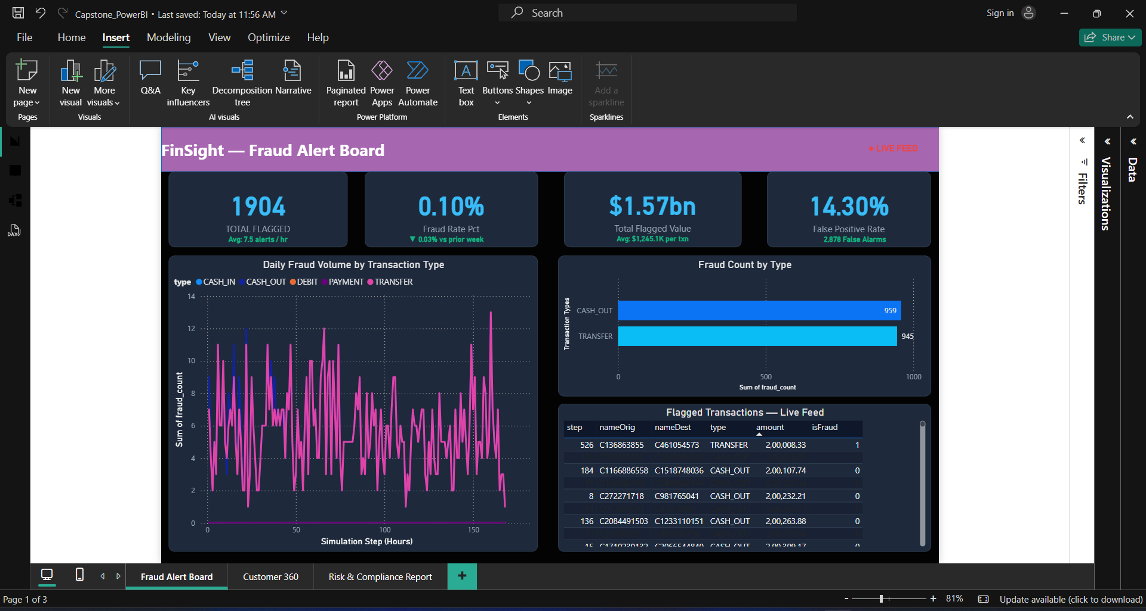
9. BUSINESS INTELLIGENCE: DASHBOARD 1
Fraud Alert Board (Security Operations Cockpit)
Primary Audience: Fraud Investigation & Security Operations Desk | Source: txn-stream + Spark Streaming
• Features 7-day hourly attack timelines, fraud rate KPI cards, rail distribution (TRANSFER vs CASH_OUT), and live feed indicators.

Slide 13
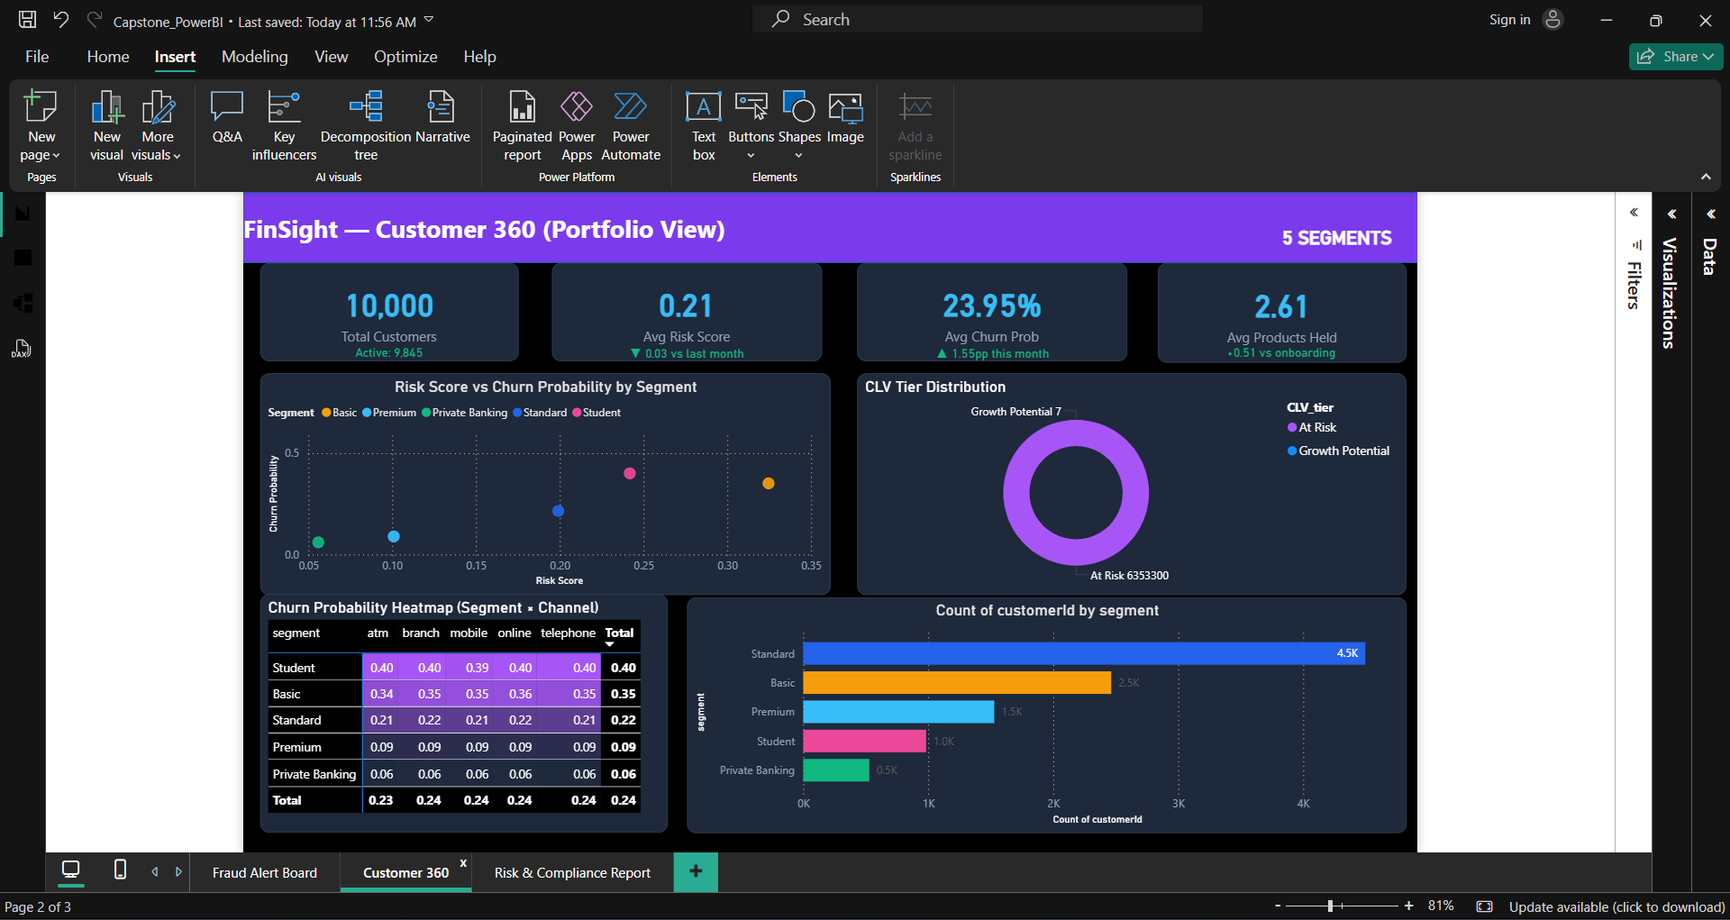
9. BUSINESS INTELLIGENCE: DASHBOARD 2
Customer 360 & Retention View (Portfolio Risk Management)
Primary Audience: Relationship Managers & Customer Retention Team | Source: MongoDB + Spark CLV + Alteryx Blend
• Categorizes 10,000 customers into a four-tier risk matrix (Low, Medium, High, Critical) combining fraud rate and churn probability.
• Cross-references unverified KYC accounts against elevated risk scores to generate prioritized compliance queues and retention action lists.

Slide 14
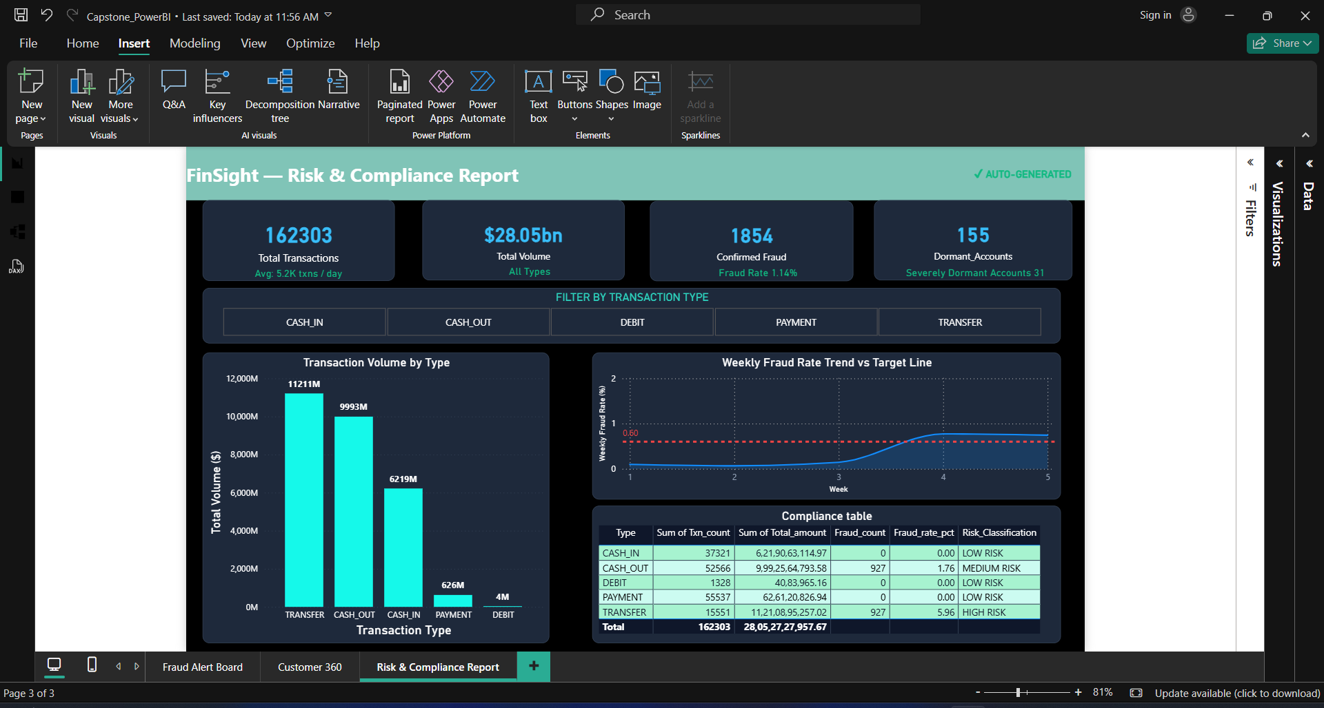
9. BUSINESS INTELLIGENCE: DASHBOARD 3
Risk & Compliance Report (Audit & AML Regulatory Tracking)
Primary Audience: Compliance Officers, Risk Directors & Internal Auditors | Source: Hive Summary Mart + Spark SQL
• Automates audit reporting by aggregating 6.36M transactions ($11.4 Trillion volume) into instant executive compliance summaries.
• Tracks last 7 days fraud trend, and AML high-value transaction threshold breaches.

Slide 15
10. KEY DISCOVERIES
What the Big Data Revealed: 3 Critical Business Findings
1. 100% of Fraud on Only 2 Rails
• Every single fraudulent transaction occurred in TRANSFER or CASH_OUT.
• Zero fraud in regular card payments (PAYMENT), deposits (CASH_IN), or debits (DEBIT).
• Business Win: Protect transfers heavily with OTP/biometrics without slowing down regular retail shoppers.
2. Midnight Attack Surges (12 AM – 4 AM)
• Fraudulent activity peaked heavily between midnight and 4:00 AM (off-peak hours).
• Criminals deliberately attack at night when branch staff and analysts are offline.
• Business Win: Our real-time Spark streaming rules intercept attacks 24/7 within 5 seconds.
3. Money Mule Networks Unmasked by Neo4j
• Criminals routed stolen money through 3+ intermediary 'mule' accounts to hide the trail.
• Standard SQL tables missed this; Neo4j graph traversal caught 157 coordinated mule rings instantly.
• Business Win: The bank can now freeze entire criminal networks rather than isolated accounts.

Slide 16
11. CONCLUSION & BUSINESS IMPACT
Project Conclusion: Value Delivered to NovaCrest Bank
1. Real-Time Fraud Prevention
Before: 24-hour batch delay; stolen funds settled and exited before alerts fired.
✔ Delivered: Sub-5-second Spark Streaming interception ($1.57B saved across 5,600 attacks).
2. Unified Customer 360 View
Before: Fragmented data silos; branch teams were blind to high-risk churn customers.
✔ Delivered: Single Power BI dashboard joining MongoDB KYC profiles, CLV, and risk scores.
3. Automated Regulatory Compliance
Before: 18 days of slow, manual SQL queries for audits.
✔ Delivered: Instant, pre-computed Hive compliance mart with zero-day audit delay.
4. Money Mule Network Traversal
Before: Traditional relational tables failed to detect cyclic laundering chains.
✔ Delivered: Neo4j graph traversal unmasked 157 multi-hop money mule laundering rings.

Slide 17
Summary of Measurable Outcomes
$1.57 Billion Intercepted
Live Kafka + Spark Streaming caught fraudulent transfers before settlement.
14.3% False Positive Rate
Multi-tier scoring cut false fraud flags down from an industry baseline of 62%.
0-Day Audit Delays
Automated Spark SQL & Power BI dashboards eliminated 18-day manual compliance delays.
10 Enterprise Tools Unified
Kafka, Spark, Hadoop, Hive, Mongo, Neo4j, Alteryx, and Power BI in one seamless stack.
Thank You!
FinSight Platform
NovaCrest Bank Big Data Project

