Slide 1

InstaHyre Job Analysis
The Project contains the analysis of Job openings available on InstaHyre.com job portal on the basis of location, fields, profiles, years of experience required, company size etc. The Project's objectives is to investigate accessibility of jobs and to help a person to find the most suitable jobs based on his/her eligibilities and preferences. Additionally, it compared the availability of jobs in different locations, profiles, fields, level of experience etc. Moreover, it aimed to reveal some of the dataset's hidden insights. The Web scrapping part was done with Python (Beautiful Soap, Selenium, Pandas), Data cleaning part was done with Python (Pandas) and Power Query (MS Excel), the Aggregation of Data and Formation of Tables in SQL and the Analysis of Data along with the Visualization in MS Excel. This project was completed under the supervision of the Instructional Associate for our batch at Masai School, Mr. Sushant Ranjan.

Slide 2

INTRODUCTION
The job market in India is constantly evolving, with new trends emerging and old ones fading away. In this project, the focus will be on analyzing the job trends in India, including the most in-demand skills, the states with the highest number of job openings, and other useful insights.
The project aims to provide a comprehensive overview of the job market in India, using data-driven analysis to identify the key trends and patterns that are driving the market. By understanding these trends, job seekers, employers, and policymakers can make informed decisions about their career paths, hiring strategies, and workforce development initiatives.
Through this project, we hope to shed light on the current state of the job market in India, as well as provide insights into how it is likely to evolve in the future. Ultimately, our goal is to help individuals and organizations make better, more informed decisions that will enable them to thrive in an ever-changing job market.
Problem Statement :
The objectives is to investigate accessibility of jobs and to help a person to find the most suitable jobs based on his/her eligibilities and preferences. Additionally, it compared the availability of jobs in different locations, profiles, fields, level of experience etc. Moreover, it aimed to reveal some of the dataset's hidden insights

Slide 3
Project’s Flow And The Tools Used:
Web Scrapping
Data Cleaning
Data Modelling
MS Excel
My SQL
Analysis
Dashboard Creation
Python (Selenium, Beautiful Soap)
MS Excel
Python (Pandas)

Slide 4



Division Of Project In 4 Phases:
Phase 1 | Phase 2 | Phase 3 | Phase 4
Web Scrapping | Data Cleaning | Data Modelling | Dashboard Creation & Analysis
Selenium Pandas | Pandas MS Excel: Power Query | MySQL MS Excel | MS Excel

Slide 5

Quick Start:
Started with scrapping of the data from InstaHyre's website with Python and saving it into CSV files, imported the CSV files into an Excel file. Learning new tools.
Did the Data cleaning part with the help of Pandas and Power Query (MS Excel), imported the CSVs into MySQL for further analysis. Presentation and communication skills.
Imported CSVs in MySQL, created tables using Group By, Join, Trim, Constraints etc. Multi tasking.
Exported all the tables from MySQL to MS Excel and created required tables to gain some insights.
Performed in depth analysis of the data in MS Excel using Pivot tables and charts.
Created different charts from the table for better understanding of the data.
Also Designed a Interactive Dashboard from the charts for better visualization.
Created some useful drop-downs for fetching the required Data like Standard Experience, Standard Role (Profiles) and Location.
Created a Power point presentation with all the insights and the conclusions listed with the in depth analysis.

Slide 6

Columns In Final Dataset:
1. Company_ID 9. Standard Experience
2. Job_ID 10. Details _ID
3. Establishment Year 11. Skills
4. Emoloyee Count (Company Size) 12. Role (Designation)
5. Location 13. Standard Role (Field of Job)
6. HR Name
7. Years of Experience
8. Standard Experience

Slide 7
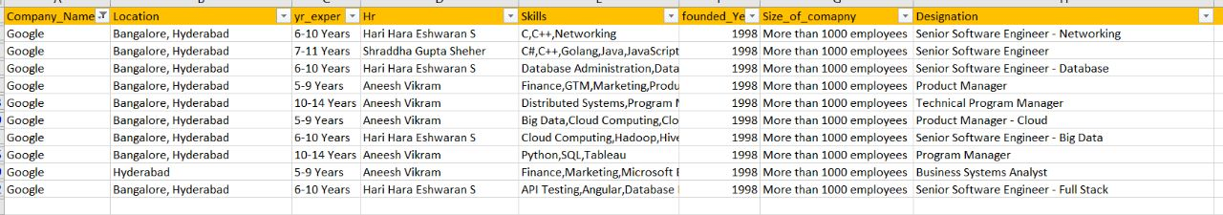
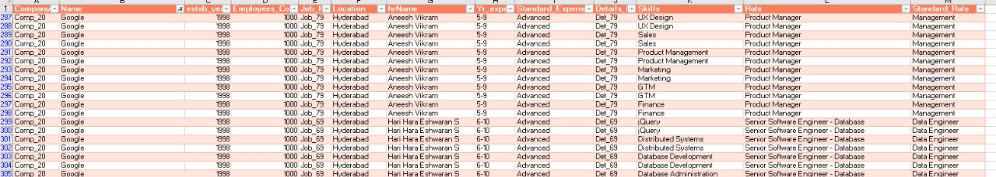
Data Preparation:
Raw Data
Cleaned Data

Slide 8
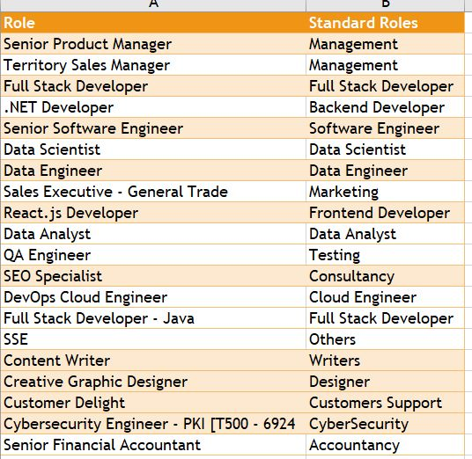
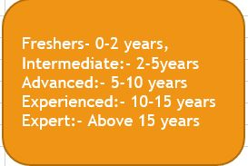
Cleaning Part:

Slide 9
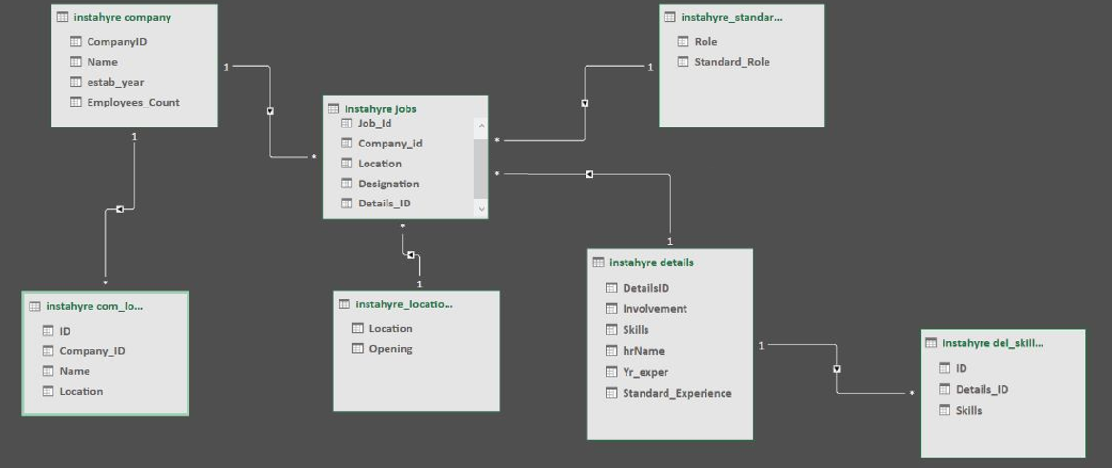
Data Modelling

Slide 10

Project Insights:
By analyzing the data, some of the important insights that have been drawn out are as follows:
The companies with Employee size of above 1000 employees and above 50 (under 200) employees have the highest number of Job openings, whereas companies having less than 10 employees have least number of job openings.
There are highest number of job openings in Job Profiles like Management, Marketing and Software Engineers, whereas Job Profiles like Accountancy, Designers and Writers have the least number of job openings.
Freshers (0-2 years of Experience) and Experts (above 15 years of Experience) are the least in demand segment of the job seekers, whereas Advanced (5-10 years of Experience) and Intermediate (between 2-5 years of Experience) are the highest in demand segment of the job seekers.
Programming languages like Python, Java and Java script are the most in demand skills.
Bangalore and Mumbai are the Cities with highest number of job openings.
Work From Home is surprisingly the 3rd highest segment in the location with highest number of jobs, indicating the increasing preference of the companies for WFH post pandemic period as it reduces the requirement of Infrastructure for the company, cost of operations and also remains employee friendly.
LTI Mindtree, Cashflo and Google in the companies have highest number of job openings, indicating that the Tech and the Finance sectors, especially the large companies in it are creating the highest number of employment in India.

Slide 11
Problems Encountered:
Web Scrapping | Others
Web Scrapping: It was something new to me. It was easy to scrap the smaller data but when I got the larger data set, I had encountered many errors, to over come it, a lot of research was needed. | Data Modelling: In MySQL, one can connect multiple tables but in MS Excel one can only create relation one to one, so I needed to do a lot of research to figure out the solution to build the schema and perform analysis with Pivot tables in MS Excel.
Time Constraint: Being a working professional, time constraint of 7 days was a challenge in which I had to learn Web scrapping from scratch and implement the same in a practical situation during the project. | Data Cleaning: The scrapped data contained columns with multiple values like skills, locations etc. I had shifted each value to a new row with common job id and other details.

Slide 12
Learning Outcome:
Project and time management.
Learning new tools and skills (Web Scrapping, Data Modelling).
Problem Solving and Research based improvement.
Presentation and communication skills.
Critical thinking.
Multi tasking.

Slide 13
Future Scope:
The aim of the Project is to:
Assist the people in finding the most suitable jobs based on their eligibilities and preferences.
Help the migratory work force in finding out the most suitable locations for their respective work fields.
To provide an idea of the employment situation in the country.
Helping out the freshers and the people lacking in information, in finding the easiest path to secure employment.
Helping the new Generation to plan their future with the information like most in demand skills, locations with highest number of job openings, most in demand job profiles etc.
Empowerment of common people with the relevant information that can help them to secure employment, reduce the accessibility gap between the companies and the job seekers and aid to the raising employment rate of the country.

Slide 14
THANK YOU
Please feel free to ask Open Ended Questions

