Slide 1
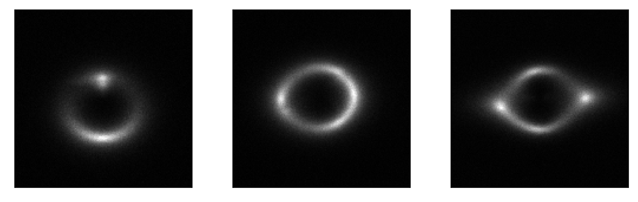
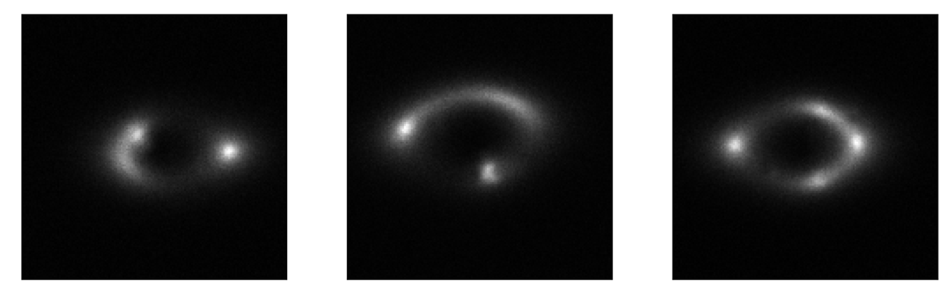
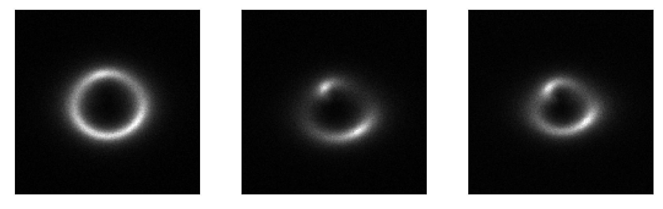
Strong Lensing Challenge Multi-Class Classification
Vortex substructure
Spherical substructure
No substructure
Code: https://github.com/Yash-10/ML4SCI2021-Strong-Lensing

Slide 2
Approach
Data Augmentation:
Random Rotation: θ ∊ [-90 deg, +90 deg]
Random Affine: -img_width * a < dx < img_width * a -img_height * b < dy < img_height * b (a = 0.3, b = 0.3)
Split: 90%-10% split => 27,000 training, 3,000 validation, and 7,500 testing instances Model and Hyperparameters: Resnet34, Adam optimizer, reduce LR on plateau lr_scheduler: factor=0.1, patience = 3 epochs, train for 40 epochs.

Slide 3
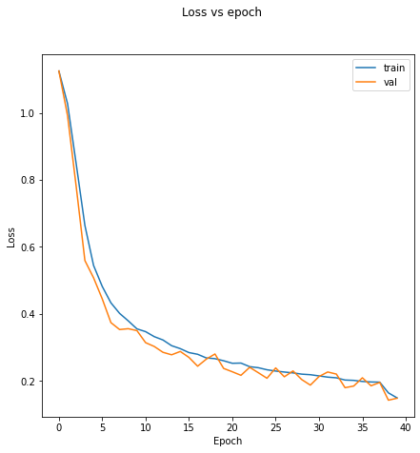
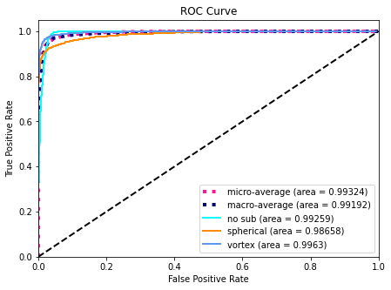
Results
Overall AUC score ~ 0.9918

Slide 4
References
Alexander, S., Gleyzer, S., McDonough, E., Toomey, M., & Usai, E. (2020). Deep Learning the Morphology of Dark Matter Substructure. The Astrophysical Journal, 893(1), 15. doi: 10.3847/1538-4357/ab7925

