Slide 1

Pimpri Chinchwad Education Trust (PCET) Pimpri Chinchwad College of Engineering An ISO 9001:2015 Certified Institute, NBA Accredited, Accredited by NAAC with ‘A’ grade
Department of Information Technology
Project Title (Times new roman 24)
Presented By
Name of Students (PRN No) (Times new roman 18)
Guided By
Name of Guide(Times new roman 18)

Slide 2
Contents (Bold ,Times new roman 44)
Problem Statement (Times new roman 24)
Motivation
Literature Survey
Objectives and Scope of the Project
System Architecture of project
Methodology Used
Hardware and software to be used
Project Plan
Advantages & Applications
Conclusion
References
2

Slide 3
Problem Statement (Bold, Times new roman 32)
Problem Statement (Bold Times new roman 32)
(Problem statement should contain answers of following questions ) (Times new roman 32)
What is the issue that you want to address?
Why it is need to address this issue?
How your project can solve this issue?
Who gets benefits from the project?
3

Slide 4
Motivation(Bold ,Times new roman 44)
(Follow following guidelines to write introduction)
Outline the problem you are working on. (Times new roman 32)
Why it is interesting and what are the challenges?
List your aims and goals.
Aim is something you intend to achieve.
Goal is something specific you expect to deliver.
4. Give an overview of how you carried out the project.
4

Slide 5
Literature Survey (Bold ,Times new roman 44)
(Follow following guidelines to write Literature Survey (Times new roman 32)
Identify the “big names or researchers” and best publications in your working area.
Collect the most recent books, most popular publications from IEEE Transactions, Elsevier, Springer. (papers or thesis will be most helpful for developing the project.)
The minimum number of the papers to be collected between Ten (10) to Twenty (20) papers.
Explain each paper in one paragraph include that should following points:
Summarize all the major points of your selected paper i.e. what kind of new work, results, its conclusion (Findings and conclusion)
Write the strengths and limitations of your selected paper. Cite this paper by numbering inside the square bracket [].
Make comparisons of the selected papers and give comments.
Summary of comparison is to be given in a tabulated form in the last page.
5

Slide 6
Literature Survey (Bold ,Times new roman 44)
Websites / Paper / Article ( Bold,Times new roman 34) | Reviews / Findings ( Bold,Times new roman 34)
Details of paper1 (Times new roman 32)
6

Slide 7
Objectives and Scope (Bold ,Times new roman 44)
To Provide Advance Search facility to user. (Times new roman 32)
To Reduce affords of user.
To Provide full satisfaction to user.
To Provide scope of the project

Slide 8
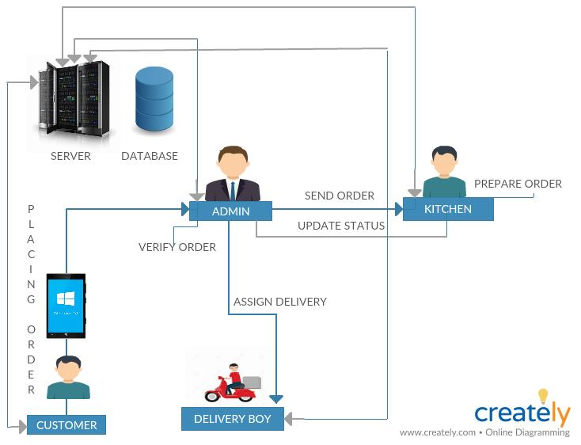
System Architecture (Bold ,Times new roman 44)

Slide 9
Methodology
Follow following guidelines to write Methodology used(Times new roman 32)
Method adopted to solve the problem.
Give an overview of how can you carry out the project.
Step-wise approach to the solution.

Slide 10
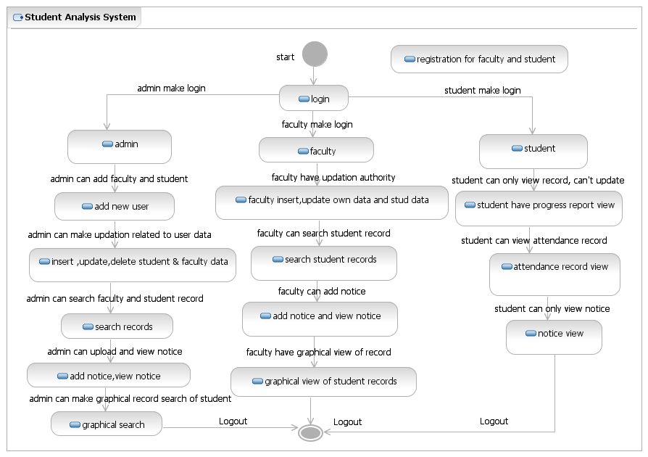
System Design: Flowchart (Bold ,Times new roman 44)
10

Slide 11
Project Plan
PROJECT SCHEDULE
Work Breakdown Structure among the members
Deliverables and Milestones (Timeline Chart required)

Slide 12
Technology Stack (Bold ,Times new roman 44)
Software Requirements
Front End:
Java, CSS, HTML
Back End
Include IDE,Libraries,Framework &
Hardware require for project.
12

Slide 13
Advantages & Applications
(Bold ,Times new roman 44)
13

Slide 14
Conclusion (Bold ,Times new roman 44)
Follow following guidelines to write conclusion
Summary of what the project has been achieved. (Times new roman 32)
Must include your quantitative results and logical analysis of the result presented in the project report.
S. B. Jain Institute of Technology Management and research
14

Slide 15
References (Bold ,Times new roman 44)
Follow following guidelines to write references
For a journal/conference paper, give the name(s) of authors, “title of paper”, name of journal/conference, volume and issue number (for journal), page numbers, month and year of publication.
Example:
A. D. Rahulkar and R. S. Holambe, “A New Class of triplet half-band filter bank based iris feature extraction and recognition using k-out- of-n:A post-classifier”, IEEE Transactions on Information forensic and security, vol. 7, No. 1, pp.230-240, February, 2012. (Times new roman 16)
For World Wide Web page, write the URL.
15

Slide 16
Thank You

