Slide 1

1 / 17
Strategies for Business Growth
Week 5 · Session 19
Growth Strategies: The Ansoff Matrix

Slide 2
Bridge
2 / 17
The Question This Whole Course Is Named For
Last session, we established that growth is a real choice, not a default. Today, if you've made that choice, you get a precise tool for deciding exactly how to grow.
Igor Ansoff published this matrix in a 1957 Harvard Business Review article. It is nearly 70 years old and is still the first framework any manager reaches for when asked “how do we grow?”
“India that is Bharat”

Slide 3
Core Concept
3 / 17
Two Questions, Four Answers
“India that is Bharat”

Slide 4
Core Concept
3 / 17
Two Questions, Four Answers
Are we selling an existing or a new product? To an existing or a new market? Two yes/no questions produce four growth strategies.
Market Penetration
Product Development
Market Development
Diversification
“India that is Bharat”

Slide 5
Core Concept
3 / 17
Two Questions, Four Answers
Are we selling an existing or a new product? To an existing or a new market? Two yes/no questions produce four growth strategies.
Market Penetration
Product Development
Existing product, existing market
New product, existing market
Market Development
Diversification
Existing product, new market
New product, new market
“India that is Bharat”

Slide 6
Quadrant 1 of 4
4 / 17
Market Penetration: Sell More, Here
“India that is Bharat”

Slide 7
Quadrant 1 of 4
4 / 17
Market Penetration: Sell More, Here
The safest growth strategy. Same product, same market, just capture more of it, through better pricing, more usage, or taking share from rivals.
Colgate, ongoing
Decades of campaigns encouraging Indians to brush twice a day rather than once. Same toothpaste, same customers, just more frequent use, a textbook penetration play.
For Boncho’s Momos: a loyalty stamp card so regulars buy more often, without changing the menu or opening anywhere new.
“India that is Bharat”

Slide 8
Quadrant 2 of 4
5 / 17
Market Development: Same Product, New Customers
“India that is Bharat”

Slide 9
Quadrant 2 of 4
5 / 17
Market Development: Same Product, New Customers
Take a product that already works and carry it to a market that hasn't seen it, a new city, a new state, a new country, or a new customer segment entirely.
Haldiram's, 1990s onward
A Bikaner sweets shop that carried the same bhujia and namkeen recipes first across North India, then nationally, then to Indian diaspora communities abroad, without changing the core product.
For Priya's Momos: opening a second stall in a college campus across town, same menu, new customer base.
“India that is Bharat”

Slide 10
Quadrant 3 of 4
6 / 17
Product Development: New Product, Same Customers
“India that is Bharat”

Slide 11
Quadrant 3 of 4
6 / 17
Product Development: New Product, Same Customers
Your existing customers already trust you. Give them a reason to spend more, with a genuinely new product built for the same relationship.
Maggi, ongoing
From one 2-minute noodle recipe to oats noodles, masala variants, and sauces, sold to the same households that already trusted the original brand.
For Boncho’s Momos: adding a frozen, take-home pack of momos for customers who already love the fresh ones.
“India that is Bharat”

Slide 12
Quadrant 4 of 4
7 / 17
Diversification: New Product, New Market

Slide 13
Quadrant 4 of 4
7 / 17
Diversification: New Product, New Market
The riskiest quadrant, and the only one where you have neither an existing product nor an existing customer base to fall back on. Next session goes deep on this one alone.
ITC, 1970s onward
A cigarette company that is today also India's hotels business, one of its largest packaged foods companies, and a major paperboard manufacturer. A new product, a new customer, almost every time.
For Boncho’s Momos: opening a completely unrelated business, say, a laundry service, with nothing shared but the founder.
“India that is Bharat”

Slide 14
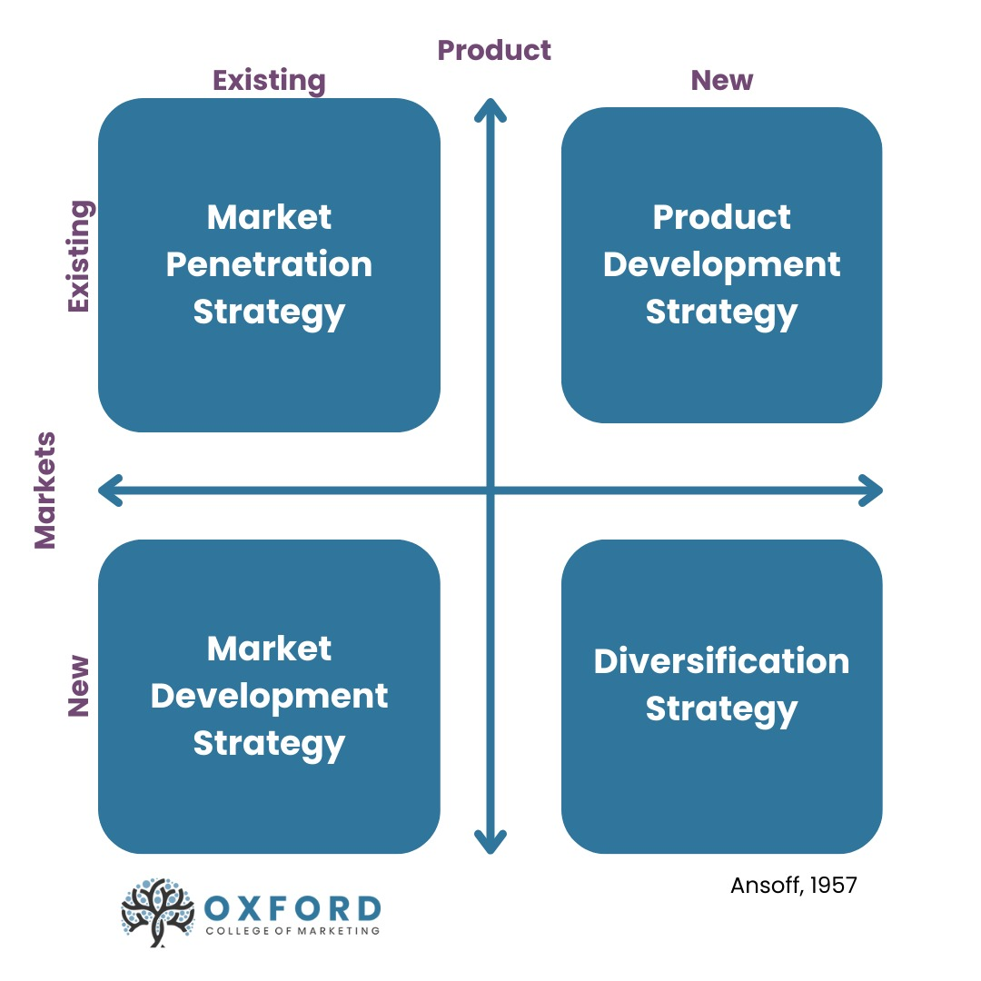
Ansoff Matrix
3 / 17
“India that is Bharat”

Slide 15
Core Concept
8 / 17
Rise in Risk

Slide 16
Core Concept
8 / 17
Risk Rises as You Move Away From What You Know
Market Penetration
(lowest risk)
Market Development
Product Development
Diversification
(highest risk)
→
→
→
Neither product nor market is a known quantity in diversification, which is exactly why it deserves its own full session.
“India that is Bharat”

Slide 17
From the Art of War
9 / 17
“Know the Ground on Which You Fight”
Sun Tzu, Chapter X, on terrain: a skilled general studies the ground before committing forces, because the same army can win easily on familiar terrain and be destroyed on unfamiliar terrain.
Market Penetration is fighting on home ground. Diversification is marching into terrain you've never seen. The Ansoff Matrix is, at heart, a map of how familiar your battlefield is.
“India that is Bharat”

Slide 18
Activity · Groups of 4–5 · 12 Minutes
10 / 17
Map Your Own Company
1
In your group, pick one real Indian company everyone knows well.
2
For each of the four quadrants, name one real or plausible move that company could make.
3
Circle the one move you think is the smartest bet for that company right now, and be ready to defend it in one sentence.
“India that is Bharat”

Slide 19
Debrief
12 / 17
What Did We Notice?
1
Which quadrant did most groups pick as the smartest bet, and why?
2
Did any group pick Diversification? What made it feel worth the risk?
3
For the companies discussed, which quadrant have they actually already tried, that you know of?
“India that is Bharat”

Slide 20
A Common Mistake
13 / 17
Chasing Diversification Too Soon
Diversification looks exciting on a slide. In practice, most companies that skip Market Penetration and Development, and jump straight to a brand-new product in a brand-new market, are trying to escape a problem in their core business rather than genuinely pursuing an opportunity. Fix or understand the core first.
“India that is Bharat”

Slide 21
Coming Next Session
14 / 17
Going Deep on Diversification
If diversification really is the right move, the next question is how. Related diversification, staying close to what you know, or unrelated diversification, going somewhere with no shared thread at all?
We'll use ITC's full journey, cigarettes to hotels to FMCG, as the running case, and get our first look at the BCG Matrix for managing a diversified portfolio.
“India that is Bharat”

Slide 22
Takeaways
15 / 17
Key Takeaways from Today
The Ansoff Matrix answers “how do we grow” with four options: Penetration, Development (market or product), and Diversification
Risk rises the further you move from your existing product and existing market
Market Penetration is the safest and usually the first move worth trying
Diversification is powerful but should follow real strategic logic, not be a way to avoid fixing a struggling core business
“India that is Bharat”

Slide 23
References & Next Class
16 / 17
Sources & What's Coming Up
Ansoff, H.I. — “Strategies for Diversification,” Harvard Business Review, 1957; Sun Tzu, The Art of War, Chapter X; public accounts of Haldiram's, Maggi, and ITC's business history.
Next: Session 20 — Diversification & Introduction to Portfolio Planning.
“India that is Bharat”

Slide 24
17 / 17
How you grow matters as much as whether you grow.
See you next class!

