Slide 1

1 / 15
Strategies for Business Growth
Week 5 · Session 20
Diversification & Introduction to Portfolio Planning

Slide 2
Core Concept
6 / 15
Why Most Diversification Actually Fails
1
2
3
4
“India that is Bharat”

Slide 3
Core Concept
6 / 15
Why Most Diversification Actually Fails
No real synergy, just a founder's personal interest in a new industry
1
Underestimating how different the new business's competitive dynamics really are
2
Starving the new business of resources, or starving the old one to fund it
3
No patience, expecting quick payback in a business that needs years to mature
4
“India that is Bharat”

Slide 4
Core Concept
3 / 15
Related vs. Unrelated Diversification
Related
Unrelated
.
“India that is Bharat”

Slide 5
Core Concept
3 / 15
Related vs. Unrelated Diversification
Related
Unrelated
The new business shares something real with the old one, a customer base, a distribution network, a brand, or a raw material. There is a genuine synergy to capture.
The new business shares nothing operational with the old one. The only connection is shared ownership and capital. Riskier, but sometimes the only real opportunity available.
“India that is Bharat”

Slide 6
Case Story · Part 1
4 / 15
ITC: From Tobacco to a Different Kind of Company
1910
Founded as the Imperial Tobacco Company. For decades, cigarettes are essentially the entire business, and a formidable, high-margin one.
1970s–1990s
Facing growing regulatory pressure on tobacco, ITC begins diversifying, hotels (leveraging real estate and hospitality skills adjacent to its existing operations), and paperboards (an input it already understood, since cigarette packaging needs paper).
Both of these are Related diversification, built on skills or inputs ITC already had a genuine claim to.
“India that is Bharat”

Slide 7
Case Story · Part 2
5 / 15
ITC: The FMCG Bet
2000s onward
ITC launches into packaged foods and personal care, Aashirvaad atta, Sunfeast biscuits, Bingo chips, Fiama and Engage personal care. A genuinely new customer relationship, daily household purchases, far from cigarettes.
The synergy here wasn't a shared product, it was ITC's existing distribution reach into Indian retail, and its financial strength from cigarettes funding years of FMCG losses before the business turned profitable.
“India that is Bharat”

Slide 8
The Next Problem
7 / 15
Once You've Diversified, a New Problem Appears
ITC today runs cigarettes, hotels, paperboards, FMCG, and agri-business, all at once. Each needs a different amount of cash, attention, and patience. How do you decide where to invest more, and where to stop investing? That's what portfolio planning tools exist to answer.
“India that is Bharat”

Slide 9
Core Concept
8 / 15
Introducing the BCG Matrix
“India that is Bharat”

Slide 10
Core Concept
8 / 15
Introducing the BCG Matrix
Developed by the Boston Consulting Group in 1970. It plots every business unit on two axes: how fast is this market growing, and how strong is our share within it?
Market growth up top, market share left to right, four resulting quadrants, each with a memorable name and a very different job to do for the company.
“India that is Bharat”

Slide 11
Core Concept
9 / 15
The Four Quadrants
Stars
Question Marks
Cash Cows
Dogs
“India that is Bharat”

Slide 12
Core Concept
9 / 15
The Four Quadrants
Stars
Question Marks
High growth, high share. Worth heavy investment.
High growth, low share. Expensive gambles, could become Stars or fail.
Cash Cows
Dogs
Low growth, high share. Fund everything else.
Low growth, low share. Usually candidates for retrenchment.
“India that is Bharat”

Slide 13
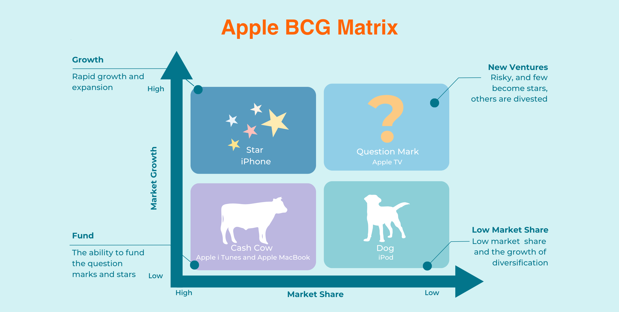
Core Concept
9 / 15

Slide 14
Applying It
10 / 15
Mapping ITC's Own Businesses
Cigarettes
FMCG (foods, personal care)
Hotels
“India that is Bharat”

Slide 15
Applying It
10 / 15
Mapping ITC's Own Businesses
Cigarettes
Cash Cow
Mature market, still ITC's dominant share, funds everything else
FMCG (foods, personal care)
Question Mark → Star
Growing fast; years of investment before turning genuinely profitable
Hotels
Question Mark
Cyclical, capital-heavy, real but uneven growth
“India that is Bharat”

Slide 16
From the Art of War
11 / 15
“The Treasury Runs Dry Near Home”
Sun Tzu warned that a state's treasury is drained not by the battle itself, but by supporting an army far from home for too long, transport, upkeep, and delay all bleed resources quietly.
A Question Mark business is exactly this: a campaign far from your home ground, that can quietly drain the Cash Cow funding it if you don't set a real limit on patience.
“India that is Bharat”

Slide 17
Activity · Pairs · 10 Minutes
12 / 15
Place Your Own Company
1
Take the same company you discussed for the Ansoff Matrix.
2
If it has more than one real business line, place each one into a BCG quadrant, Star, Question Mark, Cash Cow, or Dog.
3
If it only has one business, decide which single quadrant it sits in today, and where you think it's heading.
“India that is Bharat”

Slide 18
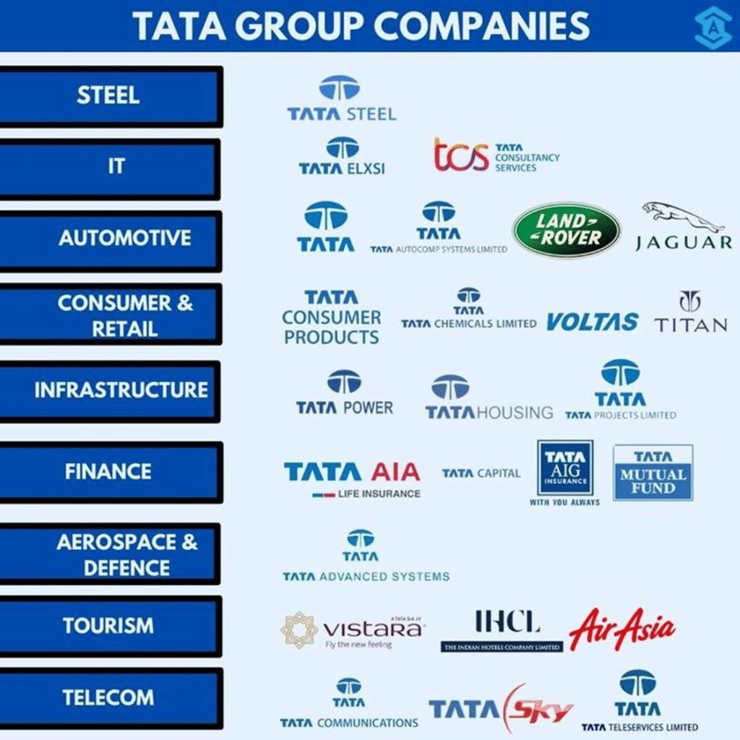
15 / 15

Slide 19
Tata Group
11 / 15
BCG Category | Tata Business/Company | Why?
⭐ Star | Tata Motors – EV business | High market growth in electric vehicles + Tata has a strong and growing position in India's EV market
🐄 Cash Cow | Tata Consumer Products – Tea | Mature tea market + strong brands such as Tata Tea generate steady cash flows
❓ Question Mark | Tata Digital / Tata Neu | Digital commerce is a high-growth market, but Tata Neu faces strong competition from established players
🐕 Dog | Tata Teleservices (consumer mobile business) | Operates in a highly competitive/mature telecom environment and has historically had a relatively weak position
“India that is Bharat”

Slide 20
Takeaways
13 / 15
Key Takeaways from Today
Related diversification shares a real synergy, customer base, distribution, or input; unrelated diversification shares only capital
ITC's journey shows both: hotels and paperboards were related moves, FMCG succeeded on distribution and financial synergy, not product overlap
Diversification usually fails from a lack of real synergy, underestimating the new business, or running out of patience
The BCG Matrix, Stars, Question Marks, Cash Cows, Dogs, is the next tool for managing everything a diversified company now owns
“India that is Bharat”

Slide 21
References & Next Class
14 / 15
Sources & What's Coming Up
Course pack, Unit 2, Diversification & Portfolio Planning; Henderson, B. — “The Product Portfolio,” BCG, 1970; Sun Tzu, The Art of War, Chapter II; public accounts of ITC's business history.
“India that is Bharat”

Slide 22
15 / 15
A diversified company is a portfolio, not a single bet.
See you next week!

