Slide 1
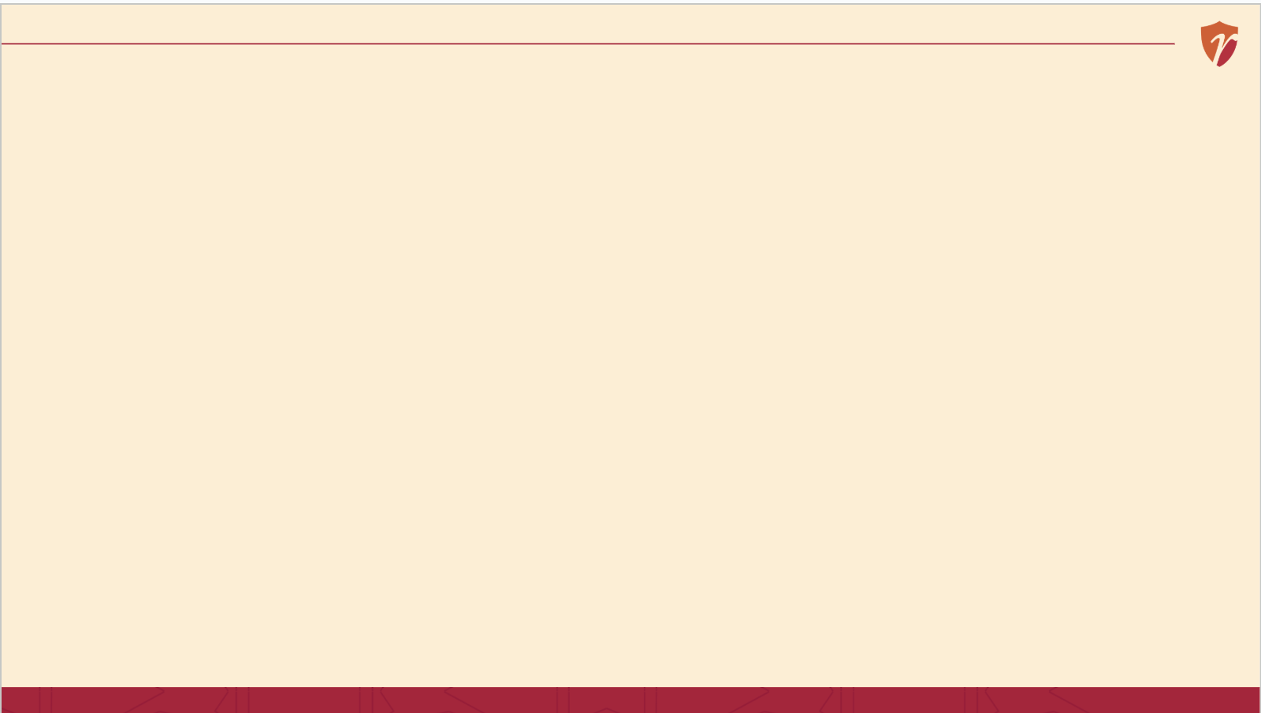
RECAP
Last Session

Slide 2
The TOWS Matrix.
The TOWS Matrix.

Slide 3
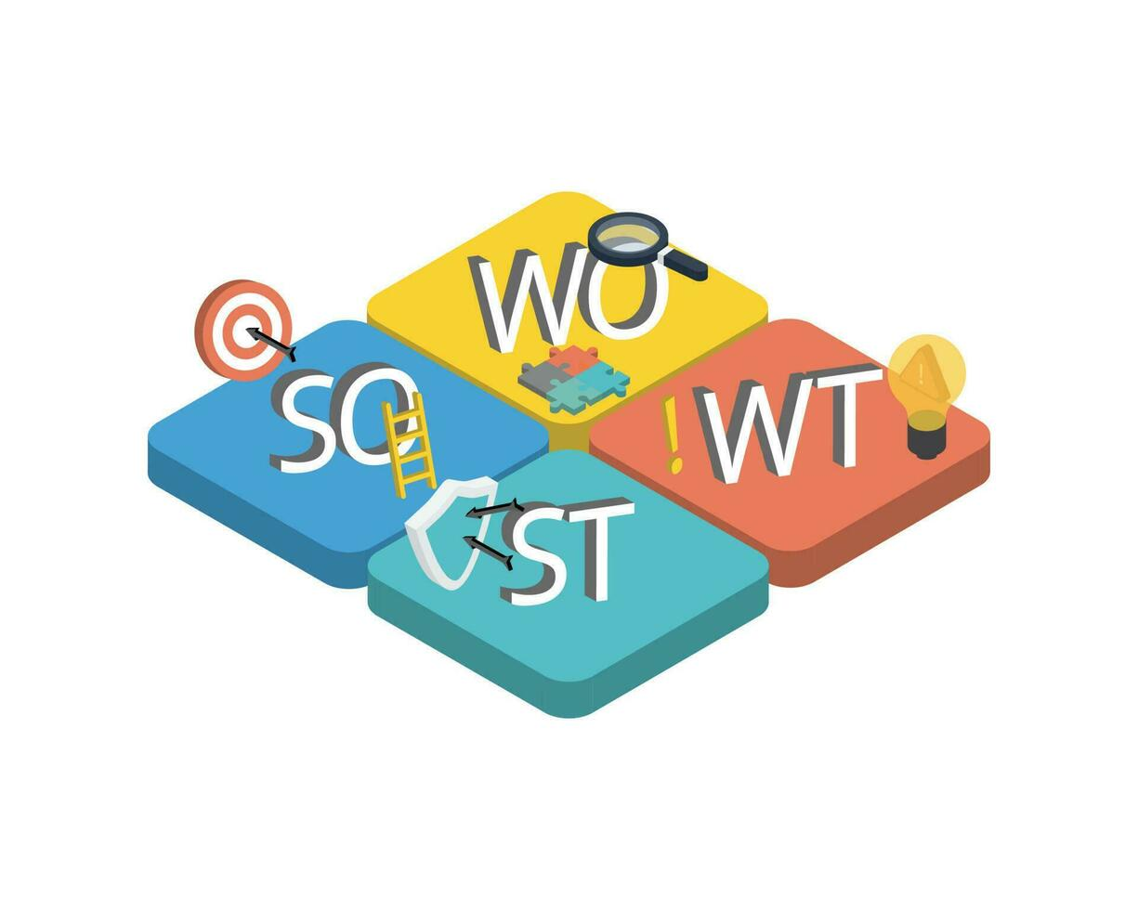
So, we have the Choices... But how to formulate the strategies for the choices?
The TOWS Matrix.

Slide 4
From SWOT to TOWS
SWOT tells you what's true about a business. It doesn't tell you what to do next.
The TOWS Matrix the tool that turns a SWOT list into actual, actionable strategies.
SWOT is the diagnosis. TOWS is the prescription.
2 / 18

Slide 5
COMPARISON
SWOT vs. TOWS — What Changed?
SWOT
TOWS
A list. Four boxes of facts about your business and its environment. Good for understanding a situation.
A matrix. Factors are paired into four strategy types. Good for deciding what to do next.
SWOT is the diagnosis. TOWS is the prescription.
4 / 18

Slide 6
DEFINITION
What Is the TOWS Matrix?
The TOWS matrix pairs each external factor (Threats, Opportunities) with each internal factor (Weaknesses, Strengths) to generate four distinct sets of strategic options.
Developed by Heinz Weihrich (1982) as a refinement of the classic SWOT framework.
The name deliberately flips the order — a reminder to start from the outside (T, O) before looking inside (W, S).
3 / 18

Slide 7
THE FRAMEWORK
The Four Strategy Types
SO — Maxi-Maxi
WO — Mini-Maxi
Use Strengths to capture Opportunities
Use Opportunities to overcome Weaknesses
ST — Maxi-Mini
WT — Mini-Mini
Use Strengths to avoid or reduce Threats
Minimize Weaknesses and avoid Threats
5 / 18

Slide 8
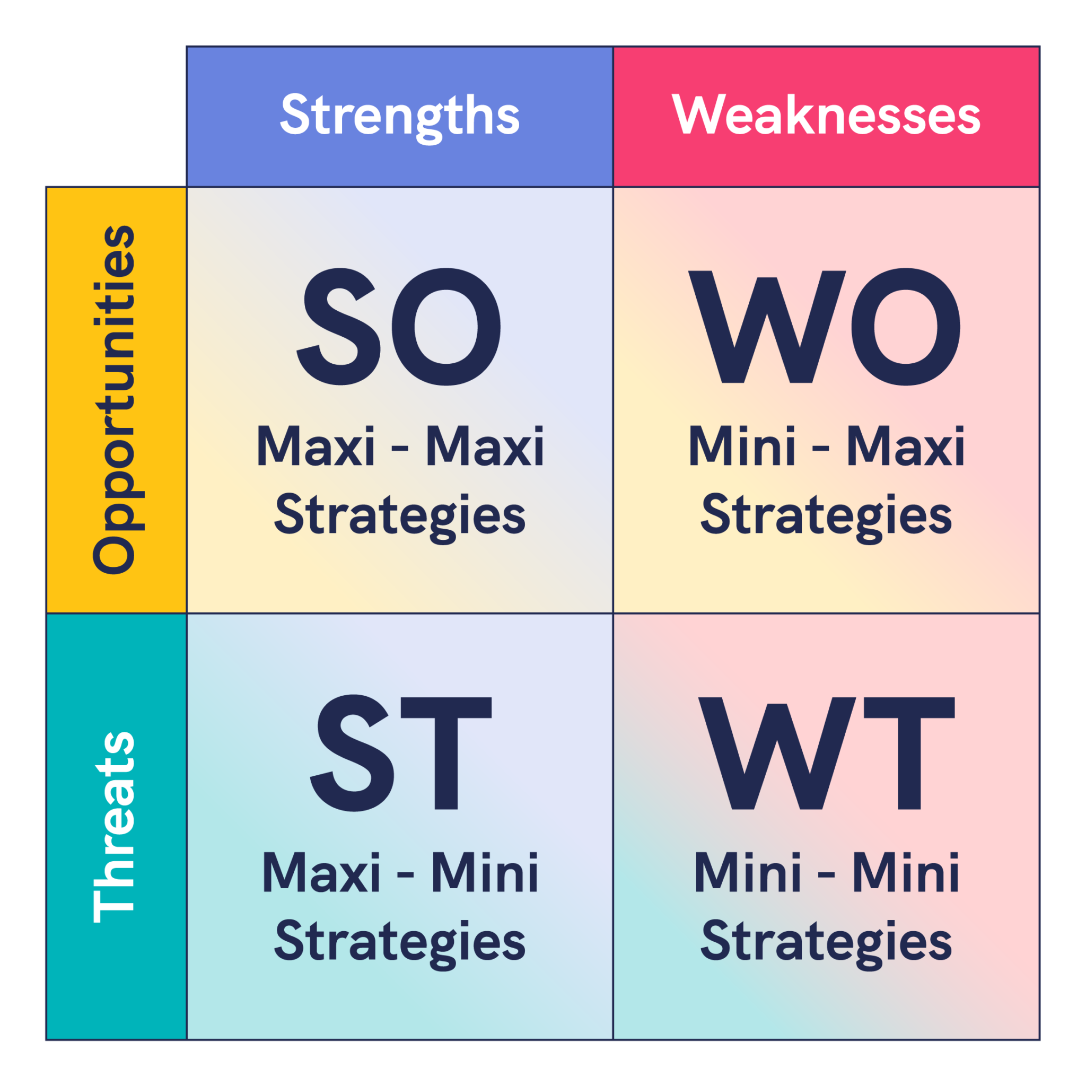
TOWS Matrix

Slide 9
SO STRATEGY
SO: Amul's Strength Meets Rising Demand
Strength
Opportunity
SO Strategy
6 / 18

Slide 10
SO STRATEGY
SO: Amul's Strength Meets Rising Demand
Strength
Amul's cooperative network of 3.6 million farmers gives it the largest, most reliable milk-procurement chain in India.
Opportunity
A fast-growing urban market for packaged dairy, ice cream, and value-added products.
SO Strategy
Amul aggressively expanded into ice cream, cheese, and chocolate — using the exact same cooperative supply chain that built its milk business.
6 / 18

Slide 11
WO STRATEGY
WO: Ola's EV Push Turns a Weakness Into a Fix
Weakness
Opportunity
WO Strategy
7 / 18

Slide 12
WO STRATEGY
WO: Ola's EV Push Turns a Weakness Into a Fix
Weakness
Ola's petrol-based cab fleet was expensive to fuel and hard to scale profitably at high volumes.
Opportunity
Government EV subsidies (FAME II) and falling battery costs opened a path to cheaper, cleaner mobility.
WO Strategy
Ola launched Ola Electric and pushed its fleet toward EVs — using the external opportunity to fix an internal cost weakness.
7 / 18

Slide 13
ST STRATEGY
ST: Indian IT Blunts an Offshoring Threat
Strength
A deep, English-speaking, cost-effective technical talent pool at firms like TCS, Infosys, and Wipro.
Threat
Rising anti-outsourcing political sentiment in the US and Europe threatens offshore contracts.
ST Strategy
Indian IT majors opened local delivery centres and hired directly in the US/UK — using their talent strength to blunt the threat, rather than retreating.
8 / 18

Slide 14
WT STRATEGY
WT: Jet Airways' Missing Prescription
Weakness
Threat
A WT strategy would have meant
9 / 18

Slide 15
WT STRATEGY
WT: Jet Airways' Missing Prescription
Weakness
High debt, an ageing fleet, and thin cash reserves.
Threat
Aggressive low-cost rivals (IndiGo) and rising fuel costs squeezed margins further.
A WT strategy would have meant
Selling non-core assets, cutting unprofitable routes, and finding a strategic partner early — defensive moves to survive, not grow. Jet delayed these too long and collapsed in 2019.
9 / 18

Slide 16
RUNNING EXAMPLE
Bonsho's Momos — His SWOT Recap
Strength
Weakness
Opportunity
Threat
11 / 18

Slide 17
RUNNING EXAMPLE
Bonsho's Momos — His SWOT Recap
Strength
Weakness
Loyal local customer base and a strong recipe reputation
No delivery app presence; only a single physical outlet
Opportunity
Threat
Rising demand for late-night food delivery in her city
A new cloud-kitchen chain entering her neighbourhood
11 / 18

Slide 18
RUNNING EXAMPLE
Bonsho's Momos — SO
Strength
Loyal local customer base and a strong recipe reputation
SO
Use his loyal following to launch a delivery-only late-night menu, backed by existing reputation
Opportunity
Rising demand for late-night food delivery in her city
Attack
11 / 18

Slide 19
RUNNING EXAMPLE
Bonsho's Momos — WO
Weakness
No personal delivery app; only a single physical outlet
WO
Partner with an aggregator (Swiggy/Zomato) for instant delivery reach without building her own app
Opportunity
Rising demand for late-night food delivery in her city
Fix & Grow
11 / 18

Slide 20
RUNNING EXAMPLE
Bonsho's Momos — ST
Strength
Loyal local customer base and a strong recipe reputation
ST
Lean on her recipe reputation and regulars' loyalty to hold customers against the new chain's pricing
Threat
A new cloud-kitchen chain entering her neighborhood
Defend
11 / 18

Slide 21
RUNNING EXAMPLE
Bonsho's Momos — WT
Weakness
No delivery app presence; only a single physical outlet
WT
Move to low-cost delivery options and tighten operations at her single outlet until the threat passes
Threat
A new cloud-kitchen chain entering her neighbourhood
Survive
11 / 18

Slide 22
APPLICATION
Which Cell Matters Most, and When? (Not a thumb rule)
Growing business, strong position → lean into
Growing business, weak position → prioritize
Strong business, hostile environment → prioritize
Weak business, hostile environment → prioritize

Slide 23
APPLICATION
Which Cell Matters Most, and When? (Not a thumb rule)
Growing business, strong position → lean into SO
Growing business, weak position → prioritize WO
Strong business, hostile environment → prioritize ST
Weak business, hostile environment → WT is about survival, not growth

Slide 24
CAUTION
Limitations of the TOWS Matrix
• It's only as good as the SWOT feeding it — garbage in, garbage out
• Highly subjective — two teams can pair the same SWOT into very different strategies
• Doesn't rank or prioritize strategies — that's a separate step, using tools like the BCG matrix
• A static snapshot — needs revisiting as internal and external factors shift
14 / 18

Slide 25
CAUTION
Common Pitfalls When Using TOWS
• Writing strategies that just restate a SWOT item, instead of a real pairing
• Filling all four cells equally instead of focusing where it matters most
• Skipping SO/ST (offense) because WO/WT (defense) feels safer — or the reverse
• Treating the matrix as a one-time exercise instead of revisiting it
15 / 18

Slide 26
QUICK EXERCISE · 5-7 MIN
Let’s build
Complete your SWOT list first — TOWS only works with a solid SWOT underneath it
1
Draw a 2×2 grid — Opportunities & Threats across the top, Strengths & Weaknesses down the side
2
Fill each of the 4 cells by asking one pairing question — e.g., "How can we use this strength to capture this opportunity?"
3
Pick the 2–3 strongest strategies per cell — don't try to act on all of them at once
4
10 / 18

Slide 27
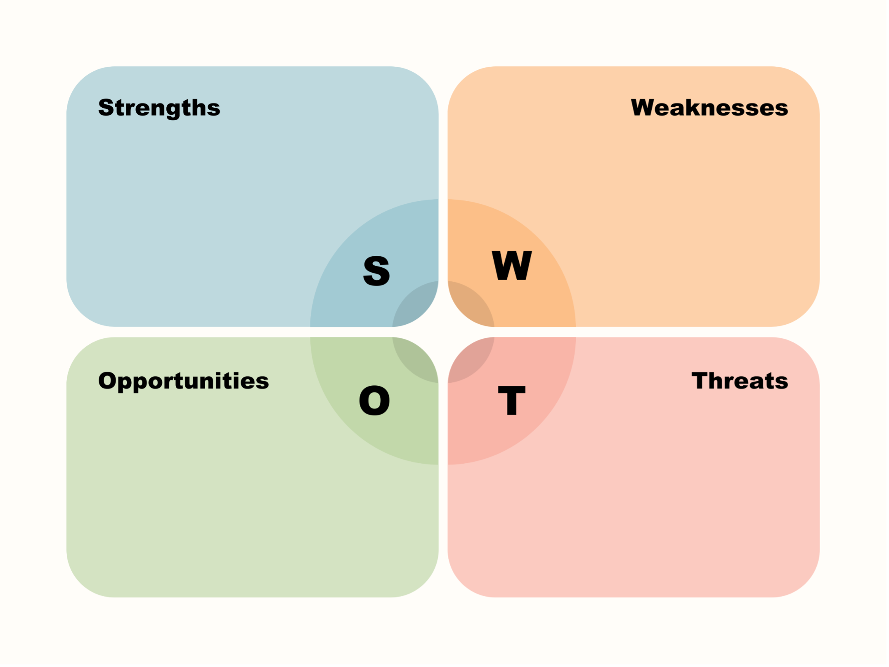
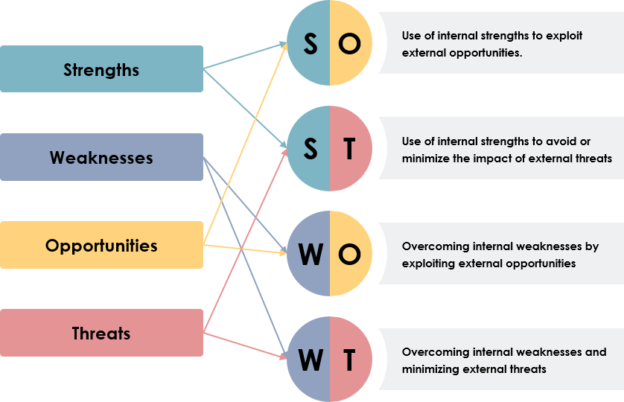
QUICK EXERCISE · 5-7 MIN

Slide 28
SUMMARY
Key Takeaways from Today
SWOT tells you what's true; TOWS tells you what to do about it
Four strategy types: SO (attack), WO (fix & grow), ST (defend), WT (survive)
Always build TOWS from a solid SWOT — pairing quality depends on SWOT quality
The matrix doesn't prioritize for you — that's your job as a strategist
Real companies live in specific cells: Amul in SO, Ola Electric in WO, Indian IT in ST, Jet Airways failed at WT

Slide 29

Term of the day
Potemkin Village

Slide 30
REFERENCES & NEXT SESSION
Sources & What's Coming Up
Required Reading
• Weihrich, H. (1982). "The TOWS Matrix — A Tool for Situational Analysis." Long Range Planning.
Case & History Sources
• Public accounts of Amul's cooperative model, Ola Electric's launch, Indian IT's global delivery model, and Jet Airways' 2019 collapse
18 / 18

