Slide 1
STRATEGIES FOR BUSINESS GROWTH
The Product Life Cycle
Week 6 · Session 22 · How Products Age

Slide 2
RECAP & BRIDGE
The Missing Dimension: Time
2 / 16

Slide 3
RECAP & BRIDGE
The Missing Dimension: Time
The BCG matrix gives you a snapshot — where a business sits right now.
But businesses move. A Question Mark can become a Star. A Star eventually becomes a Cash Cow. A Cash Cow can slide into a Dog.
The Product Life Cycle (PLC) explains exactly how and why that movement happens.
2 / 16

Slide 4
DEFINITION
What Is the Product Life Cycle?
3 / 16

Slide 5
DEFINITION
What Is the Product Life Cycle?
Every product moves through a predictable sequence of stages from launch to eventual decline — Introduction, Growth, Maturity, and Decline.
Sales and profit behave differently at each stage, and so should your strategy — pricing, marketing, and competitive response all need to shift as a product ages.
3 / 16

Slide 6
THE FOUR STAGES
Introduction, Growth, Maturity, Decline
1. Introduction
2. Growth
3. Maturity
4. Decline
4 / 16

Slide 7
THE FOUR STAGES
Introduction, Growth, Maturity, Decline
1. Introduction
2. Growth
Product just launched. Sales are low, costs are high, and awareness is still building.
Sales accelerate fast. Competitors start noticing and entering the market.
3. Maturity
4. Decline
Sales peak and flatten. The market is saturated; growth slows to near zero.
Sales fall as demand fades, tastes shift, or newer alternatives take over.
4 / 16

Slide 8
INTRODUCTION
Ola Electric Scooters: Just Getting Started
5 / 16

Slide 9
INTRODUCTION
Ola Electric Scooters: Just Getting Started
The stage
Ola launched its electric scooters into a market still forming, with low overall EV two-wheeler penetration in India.
What it looks like
Heavy marketing spend, aggressive pricing to build trial, and a focus on awareness over profit.
The strategic task
Get early adopters on board and prove the category works, even at a loss profit isn't the goal yet.
5 / 16

Slide 10
GROWTH
UPI Payments: The Growth Years
6 / 16

Slide 11
GROWTH
UPI Payments: The Growth Years
The stage
Between roughly 2018 and 2021, UPI transaction volumes grew explosively as PhonePe, Google Pay, and Paytm all raced for share.
What it looks like
Rapid adoption, new competitors entering monthly, and heavy feature-matching between rivals.
The strategic task
Grab share fast, because your growth-stage position often determines your maturity-stage position later.
6 / 16

Slide 12
MATURITY
Parle-G: Decades in Maturity
7 / 16

Slide 13
MATURITY
Parle-G: Decades in Maturity
The stage
Parle-G biscuits have held a stable, dominant position in India's glucose-biscuit category for decades.
What it looks like
Sales are large but roughly flat year over year; competition is about defending share, not growing the category.
The strategic task
Protect margins, defend distribution, and look for small line extensions rather than expecting big new growth.
7 / 16

Slide 14
DECLINE
Nokia Feature Phones: A Long, Slow Decline
8 / 16

Slide 15
DECLINE
Nokia Feature Phones: A Long, Slow Decline
The stage
Once dominant, Nokia's classic feature phones lost relevance as smartphones took over the market after 2010.
What it looks like
Falling sales, shrinking retailer interest, and shrinking investment in the product line.
The strategic task
Decide whether to milk remaining demand for cash, or exit the category entirely — Nokia largely exited.
8 / 16

Slide 16
CONNECTING THE DOTS
PLC and BCG, Side by Side
The two frameworks describe the same journey from different angles:
Introduction ≈ Growth ≈
Maturity ≈ Decline ≈
PLC explains the movement between BCG quadrants over time.
9 / 16

Slide 17
RUNNING EXAMPLE
Boncho’s Momos — Her Products on the PLC
Introduction
Growth
Maturity
Decline
10 / 16

Slide 18
RUNNING EXAMPLE
Boncho’s Momos — Her Products on the PLC
Introduction
Growth
Her new fusion-momos menu, launched just a few months ago.
Her catering-for-events line, picking up fast word-of-mouth demand.
Maturity
Decline
Her original steamed momos — steady, reliable, well-known locally.
The old snack item she's phasing out due to falling demand.
10 / 16

Slide 19
STRATEGIC RESPONSE
Extending the Life Cycle
11 / 16

Slide 20
STRATEGIC RESPONSE
Extending the Life Cycle
Maturity doesn't have to mean the end. Companies often extend a product's life through relaunches, new variants, or new uses.
Maggi has repeatedly added variants (Atta Noodles, Cuppa Noodles) to keep a decades-old product feeling fresh, rather than letting it slide into decline.
11 / 16

Slide 21
CAUTION
Limitations of the Product Life Cycle
12 / 16

Slide 22
CAUTION
Limitations of the Product Life Cycle
• Not every product follows a neat curve some skip stages or jump straight to decline
• It's easier to identify a stage in hindsight than to predict it in advance
• Category-level cycles don't always match individual brand performance within that category
• External shocks (a new technology, a pandemic) can override the natural curve entirely
12 / 16

Slide 23
STRATEGIC RESPONSE
Extending the Life Cycle
Pattern | Example
Introduction → Decline | Google Glass
Introduction → Growth (very rapidly) | ChatGPT
Growth → Decline | BlackBerry smartphones
Maturity → New Growth | LEGO
Decline → Revival | Nokia 3310
Long Maturity | Coca-Cola
Stage skipped / never achieved scale | 3D TV
Disrupted before maturity | DVD players
11 / 16

Slide 24
STRATEGIC RESPONSE
Extending the Life Cycle
Pattern | Example | What happened?
Introduction → Decline | Google Glass | Launched with huge expectations but failed to gain mainstream consumer acceptance and quickly declined.
Introduction → Growth (very rapidly) | ChatGPT | Adoption grew extraordinarily quickly after launch, with little conventional “slow introduction” phase.
Growth → Decline | BlackBerry smartphones | Strong growth and maturity, followed by a rapid decline when iPhone/Android changed the market.
Maturity → New Growth | LEGO | Faced decline/near-crisis, then revived through new product lines, partnerships and stronger customer engagement.
Decline → Revival | Nokia 3310 | The original product declined, but the brand revived the product concept with a redesigned version.
Long Maturity | Coca-Cola | Has remained a mature product for decades through continuous marketing, distribution and product variations.
Stage skipped / never achieved scale | 3D TV | Introduced with considerable industry interest but never achieved mass-market growth and moved toward decline.
Disrupted before maturity | DVD players | Digital streaming and smartphones accelerated decline before the product could enjoy a prolonged maturity period.
11 / 16

Slide 25
CAUTION
Common Pitfalls When Using the PLC
• Assuming maturity always means decline is coming soon some products stay mature for decades
• Applying growth-stage marketing spend to a product that's already mature
• Ignoring how competitors' stage differs from your own, even in the same category
• Forgetting that relaunches and line extensions can reset part of the curve
13 / 16

Slide 26
QUICK EXERCISE · 5-7 MIN
Live Build: Name the Stage
1
I'll name a real Indian product or category PLC stage
14 / 16

Slide 27
SUMMARY
Key Takeaways from Today
Every product moves through Introduction, Growth, Maturity, and Decline
Strategy needs to change at each stage what works in Growth can fail in Maturity
PLC and BCG describe the same journey: stages roughly map to quadrants
Products can be extended past Maturity through relaunches and new variants
15 / 16

Slide 28

Term of the day
Madman Theory

Slide 29

Term of the day
Madman Theory

Slide 30
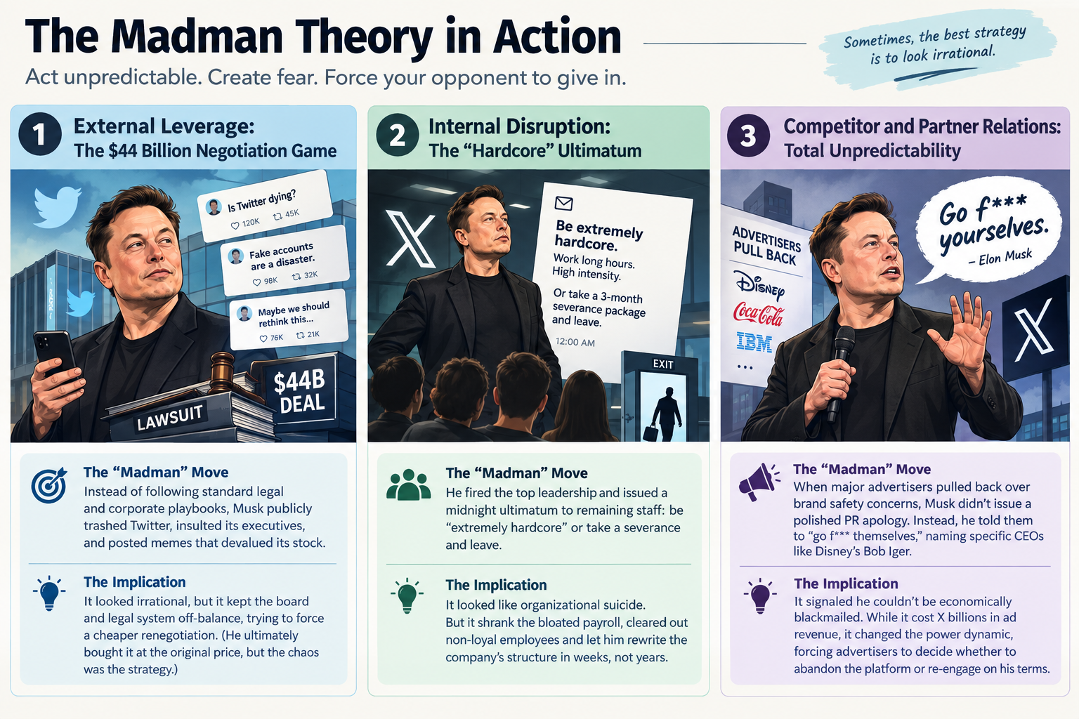
Term of the day
Madman Theory

Slide 31
REFERENCES & NEXT SESSION
Sources & What's Coming Up
Required Reading
Coming Up — Session 23
• Levitt, T. (1965). "Exploit the Product Life Cycle." Harvard Business Review.
GAP Analysis
Case & History Sources
We'll look at how to measure the distance between where a business is headed and where it wants to be — and how to close that gap.
• Public accounts of Ola Electric, UPI payment apps' growth phase, Parle-G, and Nokia's feature-phone decline
No prep needed — just come ready to build.
16 / 16

