Slide 1
STRATEGIES FOR BUSINESS GROWTH
GAP Analysis
Week 6 · Session 23 · How Much Growth Do You Actually Need?

Slide 2
RECAP & BRIDGE
From Direction to Distance
The Ansoff Matrix (Session 19) told you which direction to grow in. Diversification (Session 20) and BCG (Session 21) told you how to manage what you already have.
None of them answer one basic question: how much growth do you actually need? That's what GAP Analysis is for.
2 / 16

Slide 3
DEFINITION
What Is GAP Analysis?
GAP Analysis compares where a business is headed on its current path against where it wants to be — and measures the difference.
That difference, the "gap," is what strategy has to close.
3 / 16

Slide 4
THE CONCEPT
The Strategic Planning Gap
Picture two lines on a chart of revenue (or profit) over time:
The desired line — your growth objective, rising steadily.
The projected line — what happens if you simply continue current strategy, unchanged.
The widening space between those two lines is the gap you need a strategy to close.
4 / 16

Slide 5
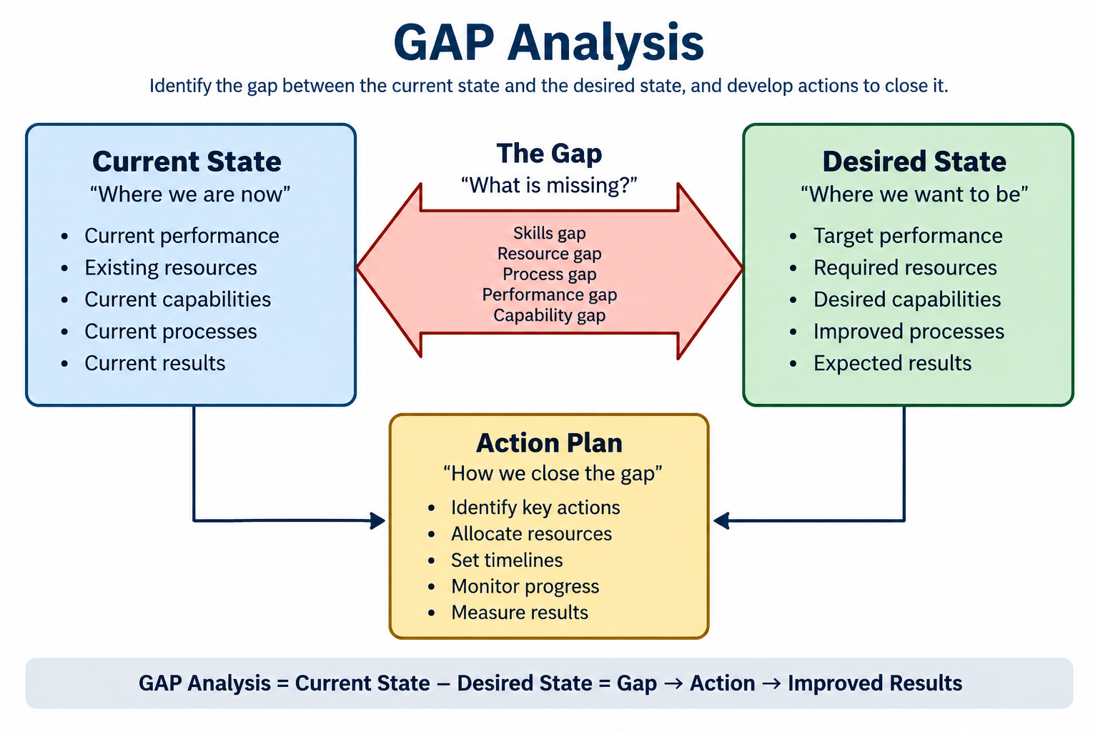
THE CONCEPT
The Strategic Planning Gap
4 / 16

Slide 6
TWO TYPES OF GAP
Operating Gap vs. Strategic Gap
Operating Gap
Strategic Gap
Can be closed by doing the current strategy better — improving efficiency, cutting costs, raising prices slightly, better execution.
Can't be closed by doing more of the same — it needs a genuinely new strategy: a new product, a new market, or a new business entirely.
Most real gaps are a mix of both — close the operating part first; it's faster and cheaper.
5 / 16

Slide 7
WAYS TO CLOSE THE GAP
Three Growth Routes (Recap: Ansoff)

Slide 8
WAYS TO CLOSE THE GAP
Three Growth Routes (Recap: Ansoff)
Intensive Growth
Integrative Growth
Do more with what you have — market penetration, market development, product development.
Grow by controlling more of the value chain — backward, forward, or horizontal integration.
Diversification
Combination
Grow into genuinely new businesses, related or unrelated to the current one.
Most real companies use more than one route at once, layered together.
6 / 16

Slide 9
CASE: INTENSIVE + DIVERSIFICATION
Airtel Closes the Gap After Jio's Disruption

Slide 10
CASE: INTENSIVE + DIVERSIFICATION
Airtel Closes the Gap After Jio's Disruption
The gap
Jio's 2016 entry crashed data prices industry-wide, blowing a hole in Airtel's projected revenue and profit trajectory.
Intensive growth response
Airtel matched aggressive data pricing and pushed hard on 4G network expansion to defend and grow its existing customer base.
Diversification response
Airtel built out Airtel Payments Bank and expanded its digital-services portfolio — genuinely new revenue lines to help close the gap.
7 / 16

Slide 11
CASE: HORIZONTAL INTEGRATION
Vodafone-Idea: Merging to Close a Survival Gap
The gap
Both Vodafone India and Idea Cellular were individually losing share and cash rapidly after Jio's price war began.
The response
The 2018 merger combined their subscriber bases and infrastructure — horizontal integration aimed at regaining the scale neither could reach alone.
The lesson
Not every gap gets closed by growth — sometimes closing it means merging just to survive.
8 / 16

Slide 12
RUNNING EXAMPLE
Boncho's Momos - Her Growth Gap
Boncho’s wants to double her monthly revenue within a year. But if she changes nothing, her single outlet's steady regulars will only grow revenue by a small amount that shortfall is her gap.
9 / 16

Slide 13
RUNNING EXAMPLE
Boncho’s Momos — Choosing Her Closing Strategy
Boncho’s gap is mostly strategic, not operating — her single outlet is already running efficiently, so trimming costs alone won't double her revenue.
Her best bet: combine product development (her fusion menu) with a delivery partnership (extending reach without owning logistics) — two routes at once, like Airtel did.
10 / 16

Slide 14
PROCESS
Building a GAP Analysis
1
Set a clear growth objective — a specific number, not a vague ambition
2
Forecast your current trajectory — what happens if nothing changes
3
Measure the gap — the difference between objective and projection
4
Choose one or more closing strategies — intensive, integrative, diversification, or combination
11 / 16

Slide 15
CAUTION
Limitations of GAP Analysis
• It depends entirely on how realistic your "projected" line actually is
• A large gap doesn't tell you which closing strategy will actually work
• It's a planning tool, not an execution plan — closing the gap still takes real strategic choices
• External shocks can move both lines unpredictably, making the gap a moving target
12 / 16

Slide 16
CAUTION
Common Pitfalls When Using GAP Analysis
• Setting an objective that's aspirational but has no real link to the business's capabilities
• Projecting the current trajectory too optimistically, which understates the real gap
• Picking a closing strategy because it's familiar, not because it fits the gap
• Treating the gap as closed once a plan exists, without tracking actual progress
13 / 16

Slide 17
SUMMARY
Key Takeaways from Today
GAP Analysis measures the distance between your growth objective and your current trajectory
The gap is what strategy actually has to close — not just "grow more"
Closing routes: intensive, integrative, diversification, or a combination of these
Real companies often close gaps with more than one route at once — as Airtel did after Jio
15 / 16

Slide 18
REFERENCES & NEXT SESSION
Sources & What's Coming Up
Required Reading
• Ansoff, H.I. (1965). "Corporate Strategy" — the origin of gap-based strategic planning.
Case & History Sources
• Public accounts of Airtel's response to Jio's market entry, and the Vodafone-Idea 2018 merger
16 / 16

Slide 19
1 / 20
The GE / McKinsey Nine-Cell Matrix

Slide 20
Bridge
2 / 20
BCG Was a Start, Not the Whole Story
The BCG Matrix uses two numbers, market growth and relative market share, to sort a portfolio into four boxes. Fast, simple, and honestly, a little crude.
General Electric, working with McKinsey in the early 1970s, built a richer version: instead of two numbers, it uses two composite judgments, industry attractiveness and business strength, each built from multiple real factors.
“India that is Bharat”

Slide 21
Why This Tool Exists
3 / 20
The Problem BCG Couldn't Solve
Two real businesses can have identical growth and share numbers, and still be nothing alike. A slow-growing category can still be genuinely attractive: high margins, few competitors, loyal customers, low regulatory risk.
BCG's two axes can't capture that nuance. GE's matrix was built specifically to let managers weigh in judgment, not just plug in two numbers.
“India that is Bharat”

Slide 22
Core Concept
4 / 20
Two Composite Axes, Not Two Numbers
Industry Attractiveness
Business Strength
Market size, market growth rate, competitive intensity, profit margins, technology requirements, regulatory environment
Market share, brand strength, cost position, distribution reach, technical capability, management quality
“India that is Bharat”

Slide 23
Core Concept
6 / 20
Nine Cells, Three Zones
Invest / Grow
Invest / Grow
Selective Growth
Invest / Grow
Selective Growth
Harvest / Divest
Selective Growth
Harvest / Divest
Harvest / Divest
“India that is Bharat”
Top-left = strong on both axes, invest heavily. Bottom-right = weak on both, harvest cash or exit.

Slide 24
Core Concept
4 / 20
Mckinsey
 | Strong Business | Average Business | Weak Business
High Industry Attractiveness | 🟢 Invest/Grow | 🟢 Selective Investment | 🟡 Build/Select
Medium Industry Attractiveness | 🟢 Selective Growth | 🟡 Hold | 🟠 Harvest
Low Industry Attractiveness | 🟡 Protect/Harvest | 🟠 Harvest | 🔴 Exit/Divest
“India that is Bharat”

Slide 25
Case Story · Part 1
7 / 20
Godrej Group: A Portfolio Worth Mapping

Slide 26
Case Story · Part 1
7 / 20
Godrej Group: A Portfolio Worth Mapping
Founded 1897
From locks and safes to one of India's most diversified conglomerates, spanning consumer products, real estate, agrochemicals, appliances, and more.
Three businesses worth examining
Godrej Consumer Products (soaps, hair colour, household insecticides), Godrej Properties (real estate development), and Godrej Agrovet (animal feed, agri-inputs).
“India that is Bharat”

Slide 27
Case Story · Part 2
8 / 20
Mapping the Group onto the Grid
Godrej Consumer Products
High attractiveness, high strength
Decades of brand trust and distribution reach in a steadily growing FMCG market
Godrej Properties
Medium attractiveness, medium strength
Cyclical, capital-intensive, strong brand but exposed to real-estate cycles
Godrej Agrovet
Medium attractiveness, building strength
A genuinely important sector, but still establishing scale relative to specialised agri players
“India that is Bharat”

Slide 28
So What Do You Do With This?
9 / 20
Each Zone Implies a Different Move
Invest / Grow
Fund aggressively, this is where the group's future is being built
Selective Growth
Invest carefully, fix specific weaknesses before committing more capital
Harvest / Divest
Minimise new investment, extract cash, or exit entirely
“India that is Bharat”

Slide 29
Comparing the Two Tools
10 / 20
GE Matrix vs. BCG Matrix
BCG
GE / McKinsey
Two hard numbers: growth rate, relative share. Fast, objective, easy to defend, but can miss real nuance.
Multiple weighted factors, judgment-based. Richer picture, but the weights and scores can be gamed or biased.
“India that is Bharat”

Slide 30

Term of the day
The Poison Pill Effect

Slide 31
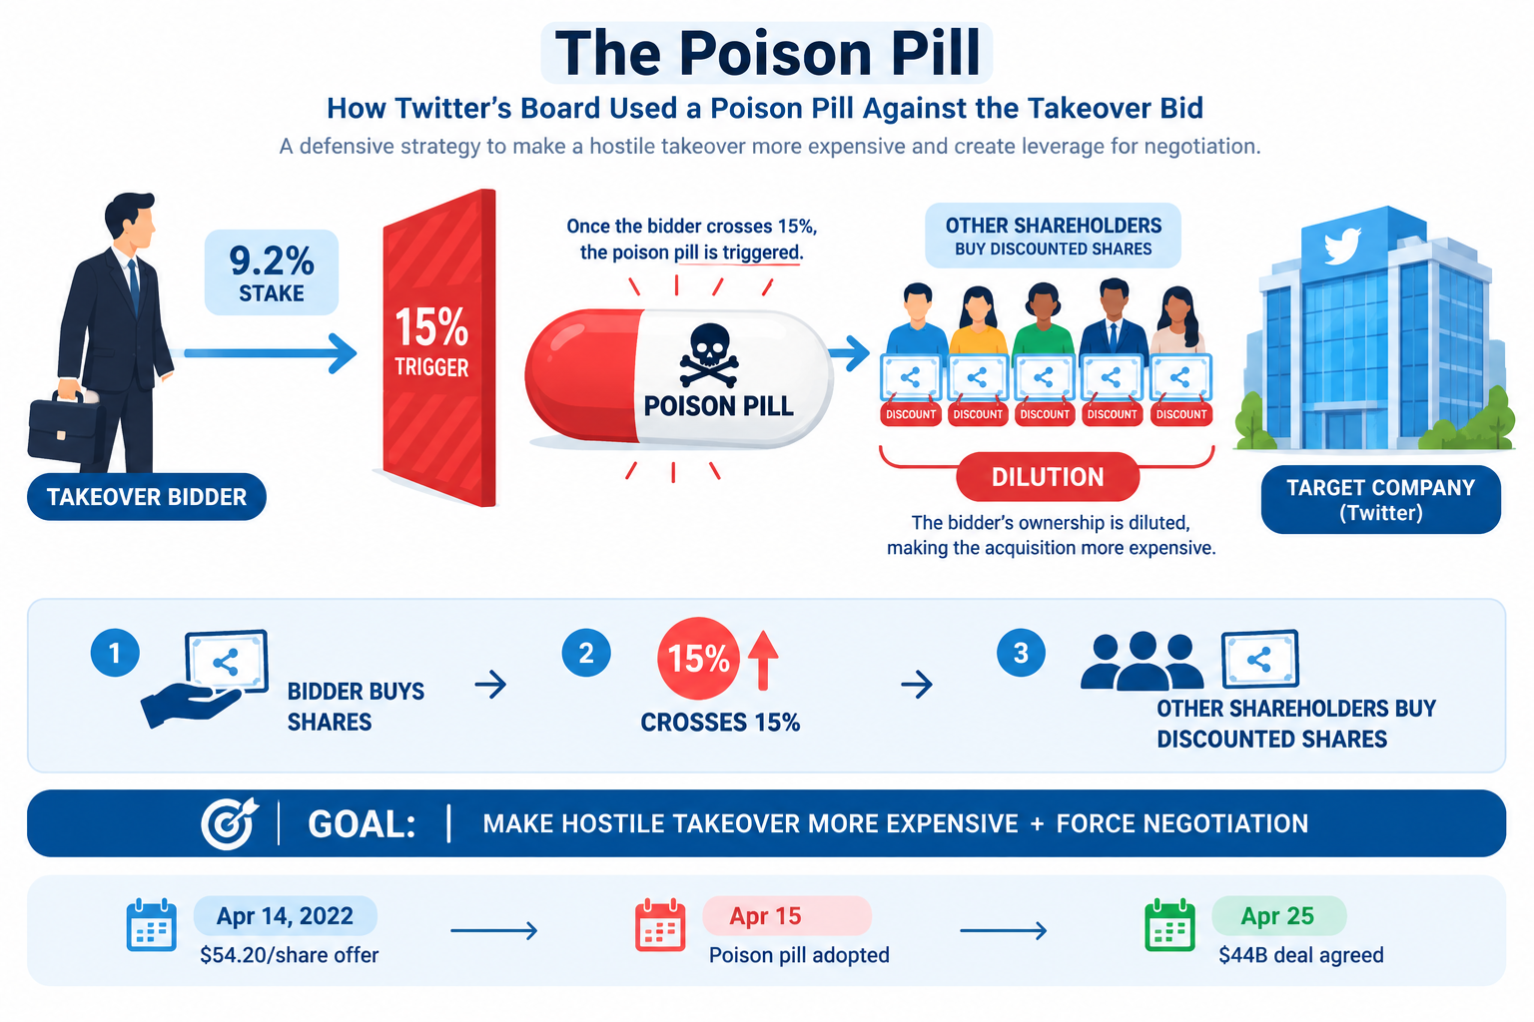
Term of the day
The Poison Pill Effect

Slide 32
References & Next Class
18 / 20
Sources & What's Coming Up
Course pack, Unit 2, Portfolio Planning Tools; Sun Tzu, The Art of War, Chapter III; public accounts of Godrej Group's business structure.
Term for next Session: The Empty Chair Strategy

