Slide 1
1 / 20
Strategies for Business Growth
Week 7 · Session 25
The GE / McKinsey Nine-Cell Matrix

Slide 2
Bridge
2 / 20
BCG Was a Start, Not the Whole Story
The BCG Matrix uses two numbers, market growth and relative market share, to sort a portfolio into four boxes. Fast, simple, and honestly, a little crude.
General Electric, working with McKinsey in the early 1970s, built a richer version: instead of two numbers, it uses two composite judgments, industry attractiveness and business strength, each built from multiple real factors.
“India that is Bharat”

Slide 3
Why This Tool Exists
3 / 20
The Problem BCG Couldn't Solve
Two real businesses can have identical growth and share numbers, and still be nothing alike. A slow-growing category can still be genuinely attractive: high margins, few competitors, loyal customers, low regulatory risk.
BCG's two axes can't capture that nuance. GE's matrix was built specifically to let managers weigh in judgment, not just plug in two numbers.
“India that is Bharat”

Slide 4
Core Concept
4 / 20
Two Composite Axes, Not Two Numbers
Industry Attractiveness
Business Strength
Market size, market growth rate, competitive intensity, profit margins, technology requirements, regulatory environment
Market share, brand strength, cost position, distribution reach, technical capability, management quality
“India that is Bharat”

Slide 5
Core Concept
6 / 20
Nine Cells, Three Zones
Invest / Grow
Invest / Grow
Selective Growth
Invest / Grow
Selective Growth
Harvest / Divest
Selective Growth
Harvest / Divest
Harvest / Divest
“India that is Bharat”
Top-left = strong on both axes, invest heavily. Bottom-right = weak on both, harvest cash or exit.

Slide 6
Core Concept
4 / 20
Mckinsey
 | Strong Business | Average Business | Weak Business
High Industry Attractiveness | 🟢 Invest/Grow | 🟢 Selective Investment | 🟡 Build/Select
Medium Industry Attractiveness | 🟢 Selective Growth | 🟡 Hold | 🟠 Harvest
Low Industry Attractiveness | 🟡 Protect/Harvest | 🟠 Harvest | 🔴 Exit/Divest
“India that is Bharat”

Slide 7
Case Story · Part 1
7 / 20
Godrej Group: A Portfolio Worth Mapping

Slide 8
Case Story · Part 1
7 / 20
Godrej Group: A Portfolio Worth Mapping
Founded 1897
From locks and safes to one of India's most diversified conglomerates, spanning consumer products, real estate, agrochemicals, appliances, and more.
Three businesses worth examining
Godrej Consumer Products (soaps, hair colour, household insecticides), Godrej Properties (real estate development), and Godrej Agrovet (animal feed, agri-inputs).
“India that is Bharat”

Slide 9
Case Story · Part 2
8 / 20
Mapping the Group onto the Grid
Godrej Consumer Products
High attractiveness, high strength
Decades of brand trust and distribution reach in a steadily growing FMCG market
Godrej Properties
Medium attractiveness, medium strength
Cyclical, capital-intensive, strong brand but exposed to real-estate cycles
Godrej Agrovet
Medium attractiveness, building strength
A genuinely important sector, but still establishing scale relative to specialised agri players
“India that is Bharat”

Slide 10
So What Do You Do With This?
9 / 20
Each Zone Implies a Different Move
Invest / Grow
Fund aggressively, this is where the group's future is being built
Selective Growth
Invest carefully, fix specific weaknesses before committing more capital
Harvest / Divest
Minimise new investment, extract cash, or exit entirely
“India that is Bharat”

Slide 11
Comparing the Two Tools
10 / 20
GE Matrix vs. BCG Matrix
BCG
GE / McKinsey
Two hard numbers: growth rate, relative share. Fast, objective, easy to defend, but can miss real nuance.
Multiple weighted factors, judgment-based. Richer picture, but the weights and scores can be gamed or biased.
“India that is Bharat”

Slide 12
A Common Mistake
11 / 20
The Weights Are Never Neutral
Whoever picks the factors and assigns the weights is making a strategic argument, whether they admit it or not. A manager defending a pet project can quietly weight the factors that make it look attractive. The tool is only as honest as the people scoring it.
“India that is Bharat”

Slide 13
From the Art of War
12 / 20
“Know the Enemy, Know Yourself”
Sun Tzu, Chapter III: “if you know the enemy and know yourself, you need not fear the result of a hundred battles.”
Industry attractiveness is knowing the enemy, the terrain. Business strength is knowing yourself. The GE Matrix simply forces both judgments to be made honestly, side by side.
“India that is Bharat”

Slide 14
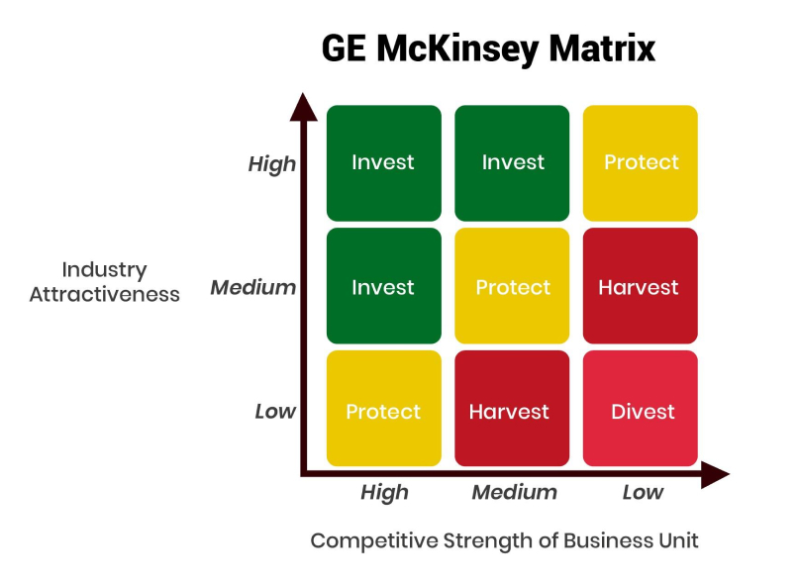
Core Concept
Nine Cells, Three Zones

Slide 15
Core Concept
4 / 20
Two Composite Axes, Not Two Numbers
Industry Attractiveness
Business Strength
“India that is Bharat”

Slide 16
Core Concept
4 / 20
Two Composite Axes, Not Two Numbers
Industry Attractiveness
Business Strength
Market size, market growth rate, competitive intensity, profit margins, technology requirements, regulatory environment
Market share, brand strength, cost position, distribution reach, technical capability, management quality
“India that is Bharat”

Slide 17
Core Concept
Nine Cells, Three Zones

Slide 18
How It's Actually Built
Step 1
Industry Attractiveness Factors | Weight | Business Strength Factors | Weight
Market Growth Rate | 40% | Relative Market Share | 35%
Industry Profit Margins | 30% | Brand Reputation | 30%
Market Size | 20% | Technological Capabilities | 20%
Barriers to Entry | 10% | Profit Margins | 15%
Total | 100% | Total | 100%

Slide 19
How It's Actually Built
5 / 20
Weighting and Scoring, Step by Step
List the factors that matter for each axis
1
Assign each factor a weight, all weights on one axis sum to 1.0
2
Score the business 1 (weak) to 5 (strong) on each factor
3
Multiply weight × score, sum for a final position on each axis
4

Slide 20
How It's Actually Built
Step 2
Score | Category
3.67 – 5.00 | High
2.34 – 3.66 | Medium
1.00 – 2.33 | Low
Scoring: Each factor is rated from 1 (Poor) to 5 (Excellent).
Weighted scores are then combined to obtain the final score for each SBU.
SBU | Industry Attractiveness Score | Category | Business Strength Score | Category | Strategic Position
🏎️ Electric Vehicles (EV) | 4.6 | High | 2.1 | Low | Selective Investment
📱 Smartphones | 3.5 | Medium | 4.2 | High | Protect / Hold
📷 Digital Cameras | 1.5 | Low | 1.8 | Low | Divest

Slide 21
Core Concept
Nine Cells, Three Zones

Slide 22
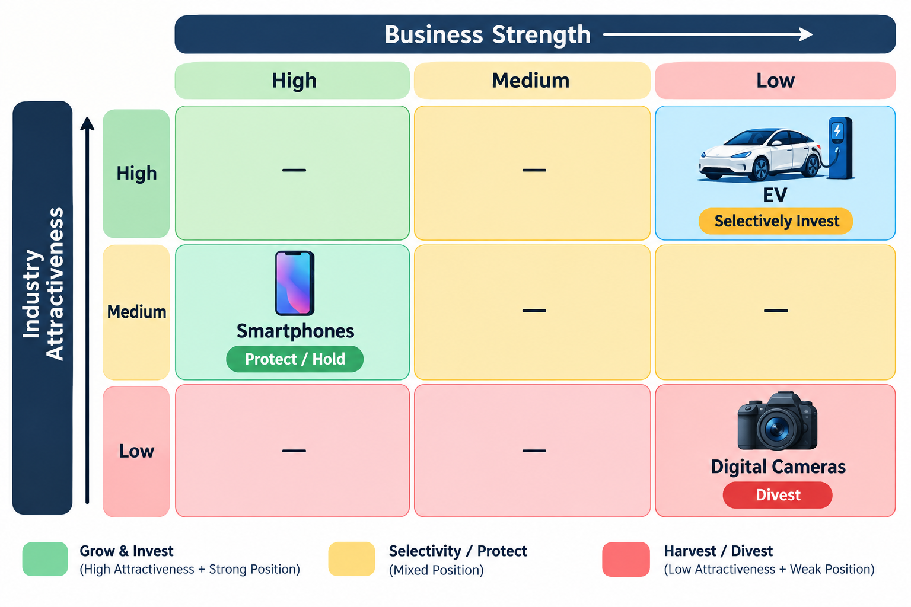
How It's Actually Built
Step 3

Slide 23
Term of the day
The Poison Pill Effect

Slide 24

Term of the day
The Poison Pill Effect

Slide 25
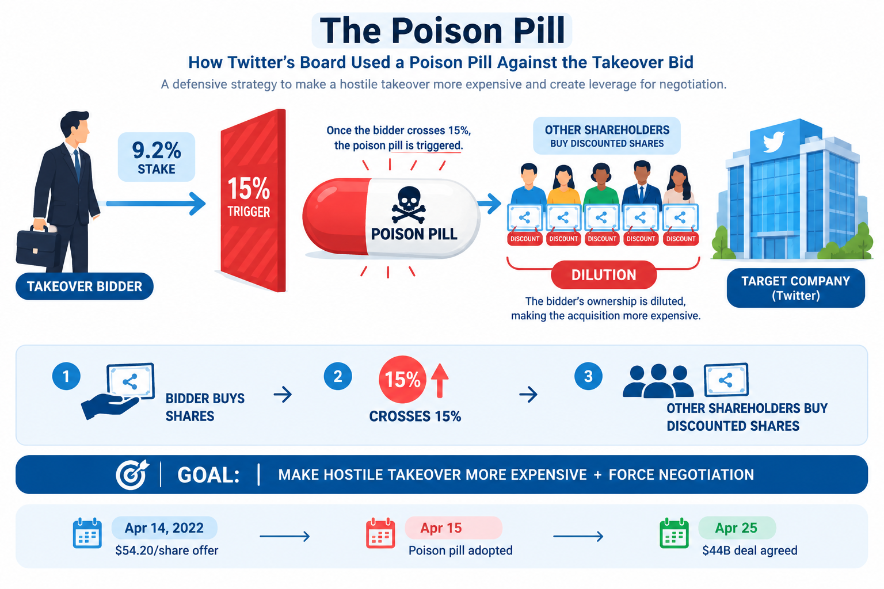
Term of the day
The Poison Pill Effect

Slide 26
Connecting Back
16 / 20
This Feeds Straight Back Into Week 5 and 6
The GE Matrix doesn't replace anything you've already learned, it organises it. A business landing in Invest/Grow is a strong candidate for the Growth strategies from Week 5. A business landing in Harvest/Divest is a strong candidate for Retrenchment.
The matrix tells you where to look. Ansoff and the four grand strategies tell you what to actually do once you're there.
“India that is Bharat”

Slide 27
Takeaways
17 / 20
Key Takeaways from Today
The GE / McKinsey Matrix uses two composite axes, Industry Attractiveness and Business Strength, built from multiple weighted factors, not just two numbers
It was built to capture nuance that BCG's simpler two-axis approach misses
The nine cells collapse into three zones: Invest/Grow, Selective Growth, and Harvest/Divest
Because weights and scores rely on judgment, the tool is only as honest as the people using it
“India that is Bharat”

