Slide 1
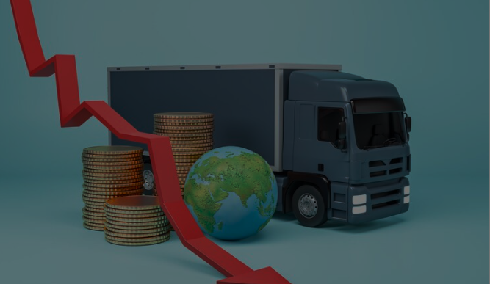


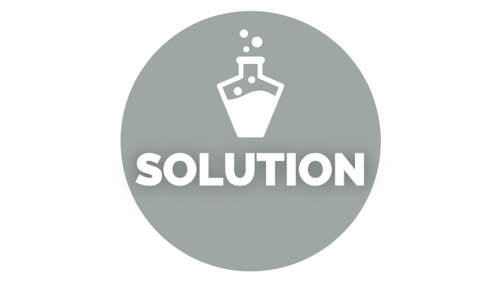


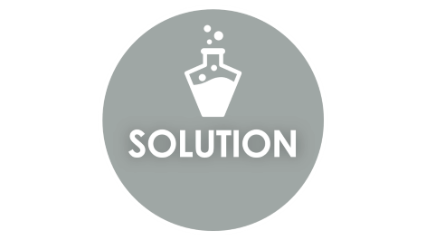
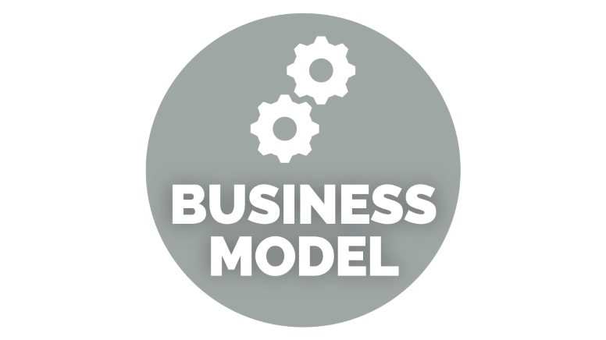
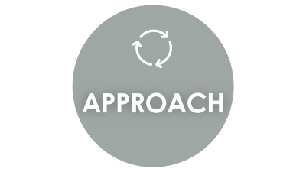
OPTIMIZING LOGISTICS
AND TRANSPORTATION
TEAM MEMBERS:
YASH V
ADITI AV

Slide 2

INTRODUCTION

Slide 3
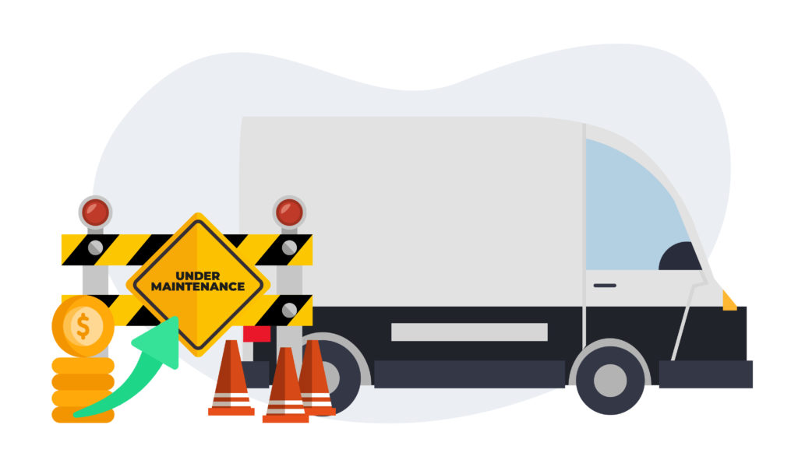
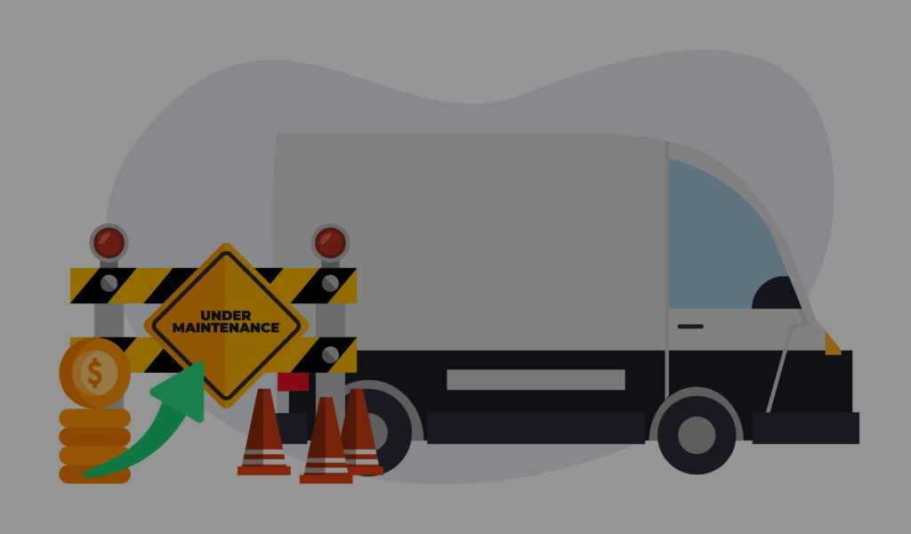
INTRODUCTION
PROBLEM STATEMENT – “ OPTIMIZING LOGISTICS AND TRANSPORTATION “ .
The goal of this project is to create a system that optimizes delivery truck routes, workforce management, and inventory control in real-time.
This optimization aims to minimize fuel consumption, reduce delivery times, lower operational costs and .
The need for smart optimization is because logistic companies face routing problems, there is lack of management in inventory control , no communication with the man power group which ultimately results in inefficient management of inventory.

Slide 4

APPROACH

Slide 5


APPROACH
OUR APPROACH: A HYBRID OPTMIZATION APPROACH
The approach includes data collection and preprocessing and hybrid algorithm approach .
The Hybrid Algorithm Approach integrates Dijkstra’s algorithm for shortest path calculation, a genetic algorithm for multi-variable optimization, and random forest for predictive traffic and weather analysis.
This random forest algorithm is also used for studying the patterns in the man power and inventory management for better optimization.

Slide 6

SOLUTION

Slide 7


SOLUTION
TOOLS AND PLATFORMS FOR PROTOTYPE EXECUTION
Organizations face challenges in optimizing operational systems, leading to inefficiencies. Effective manpower management is crucial to address these issues. The proposed solution integrates Dijkstra’s algorithm, genetic algorithms, and machine learning models for optimization and prediction. This system leverages real-time data collection and advanced algorithms to enhance efficiency, reduce costs, and improve productivity. Python, Pandas, and Scikit-Learn are used for implementation, with Google Maps API, Weather API, GPS devices, and cloud platforms like AWS and Google Cloud providing necessary data and support.

Slide 8

BENEFITS

Slide 9
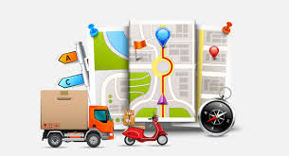
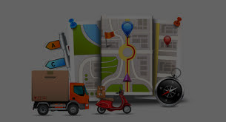
BENEFITS OF MODEL
BENEFITS AND CONCLUSION
The logistics optimization system offers significant benefits, including reduced fuel consumption, operational costs, and improved inventory management, ensuring better stock control and efficient manpower scheduling. It enhances reliability with predictable deliveries and consistent inventory availability.
This is done while reducing environmental impact through optimized routes and lower emissions.
Improved delivery reliability and inventory availability boost customer satisfaction.

