Slide 1
SUPPLY CHAIN RISK INTELLIGENCE
Supply Chain Disruption
Prediction System
Case Study: Semiconductor Industry — DRAM · NAND · HBM · GPU
Yash Aggarwal
Aditi Verma
Shashank Dimri
SAP ID 500125299
SAP ID 500123739
SAP ID 500124397
MENTOR
Mr. Abhishek Kumar

Slide 2
Problem Statement & Our Solution
!
The Problem
✓
Our Solution
Semiconductor supply chains (DRAM, NAND, HBM, GPU) face recurring tightening events — the 2021 chip shortage, 2023 memory glut, and 2024–25 HBM/GPU allocation squeezes.
Signals that precede these events — prices, news, filings — are scattered, unstructured, and read only in hindsight.
No unified, quantitative early-warning score exists that fuses price, news-severity, and supplier-concentration signals per resource.
A weekly pipeline ingests real public signals — producer prices (yfinance), news (GDELT + NewsAPI), and SEC filings — into a structured database.
An LLM turns unstructured news into a numeric severity score (1–10), making sentiment a real model feature.
10 engineered features per resource-week are benchmarked across 4 ML models on a chronological split, and explained with SHAP.
Delivered as a live Streamlit dashboard: a 0–1 risk score per resource, refreshed weekly.

Slide 3
Literature Review
Ivanov & Dolgui (2020)
Chen & Guestrin (2016) · Ke et al. (2017)
1
Viability of intertwined supply networks — framework for disruption propagation that motivates a quantitative early-warning score.
2
XGBoost and LightGBM — gradient-boosted trees remain state-of-the-art on small, mixed-signal tabular data.
Hollmann et al. (2023)
Gorishniy et al. (2021)
3
TabPFN — a transformer pretrained for in-context tabular inference, evaluated here as a modern no-training baseline.
4
FT-Transformer — attention-based deep learning for tabular data; benchmarked to test scaling limits at our data size.
Lundberg & Lee (2017)
LLM few-shot extraction
5
SHAP — a unified game-theoretic framework for feature attribution, used to keep every risk score explainable.
6
Large language models applied to convert unstructured news text into structured, numeric severity signals.

Slide 4
The Data We Use
Every weekly risk score is built from four real, independently-sourced data points per resource.
Producer Price Series (yfinance)
News Severity (LLM-scored, 1–10)
Resource | Date | Price (USD proxy)
DRAM | 2026-07-02 | 975.56
HBM | 2026-07-02 | 975.56
NAND | 2026-07-02 | 975.56
GPU | 2026-07-02 | 194.83
Resource | Severity | Source
GPU | 7.0 | thefastmode.com
GPU | — | baltimorestar.com
GPU | — | phoenixherald.com
Supplier Concentration (HHI index)
Weekly Tightening Labels
Resource | HHI | Top Producer
DRAM | 0.53 | South Korea 68%
NAND | 0.37 | South Korea 50%
HBM | 0.82 | South Korea 90%
GPU | 0.82 | United States 90%
Resource | Week | Label
DRAM | 2026-06-29 | 0 (No Risk)
GPU | 2026-06-29 | 0 (No Risk)
HBM | 2026-06-29 | 0 (No Risk)
NAND | 2026-06-29 | 0 (No Risk)
n = 1,112 labeled resource-weeks · 458 positive (tightening) · Jan 2023 – Jun 2026

Slide 5
The Pipeline
A layered weekly pipeline — real public signals become an explainable 0–1 risk score, all persisted in SQLite.
Data Ingestion
ingestion/
yfinance
Producer prices
GDELT + NewsAPI
Historical + live news
SEC EDGAR
Company filings
News Understanding
entity_resolution · clustering · llm_extraction
Entity Resolution
map stories → resources
Near-duplicate Clustering
dedupe news
LLM Severity Scoring
1–10 per story
Features & Labels
forecasting · labeling
Price Forecast
level + uncertainty
10 Weekly Features
price, trend, z, severity, HHI
Tightening Labels
0 / 1 per resource-week
Modeling & Explainability
modeling/
4-Model Benchmark
XGBoost · LightGBM · TabPFN · FT-Transformer
SHAP Attribution
global + per-resource
Delivery
risk_dashboard/
Streamlit Dashboard
Overview · Performance · Explainability · Cases
Risk Score 0–1
per resource, refreshed weekly

Slide 6
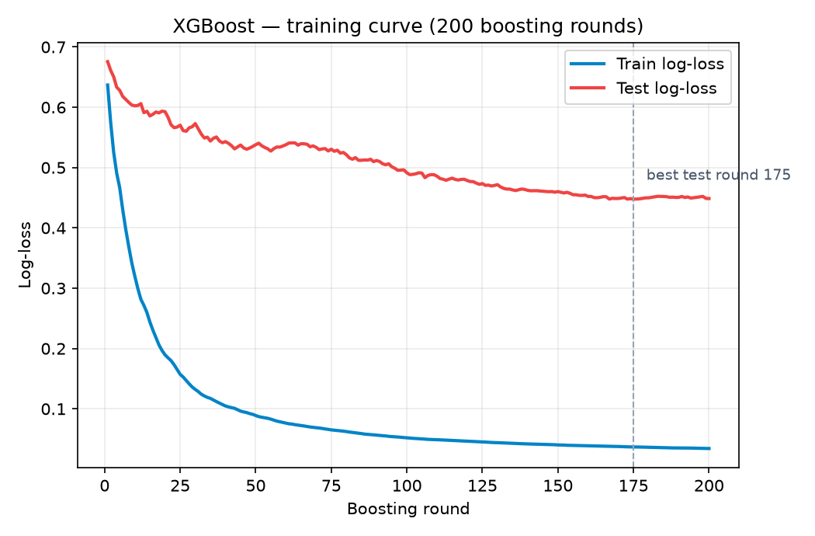
Model Deep Dive — XGBoost
Hyperparameters
n_estimators: 200 rounds
max_depth: 6
learning_rate: 0.1
subsample: 0.8
colsample_bytree: 0.8
scale_pos_weight: neg / pos ratio
eval_metric: logloss
random_state: 42
Train / test log-loss vs boosting round
Why chosen. The reference gradient-boosted-tree implementation and the natural fit for a small, mixed-signal tabular problem; it handles missing values natively and corrects class imbalance through scale_pos_weight. Training loss falls smoothly while test loss flattens near round 175 — a contained overfitting gap, and the best-generalising model in the benchmark.

Slide 7
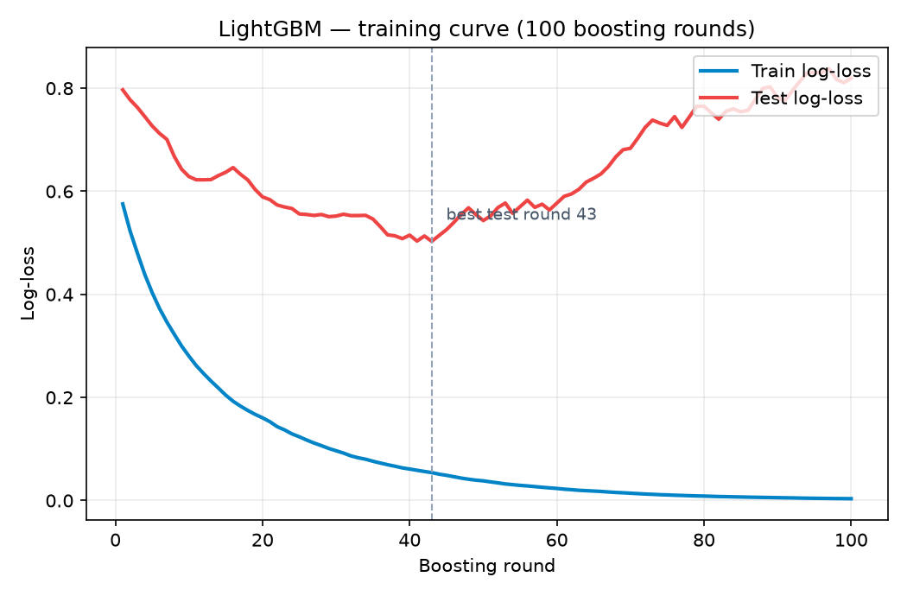
Model Deep Dive — LightGBM
Hyperparameters
n_estimators: 100 rounds
num_leaves: 31
max_depth: -1 (unlimited)
learning_rate: 0.1
eval_metric: binary_logloss
random_state: 42
Train / test log-loss vs boosting round (no early stopping)
Why chosen. A second, independent gradient-boosted-tree implementation, included as a cross-check on XGBoost; it grows trees leaf-wise with histogram splitting and trains far faster. With no early stopping, test loss bottoms out near round 43 and then rises — clear overfitting that shows up as high precision but low recall.

Slide 8
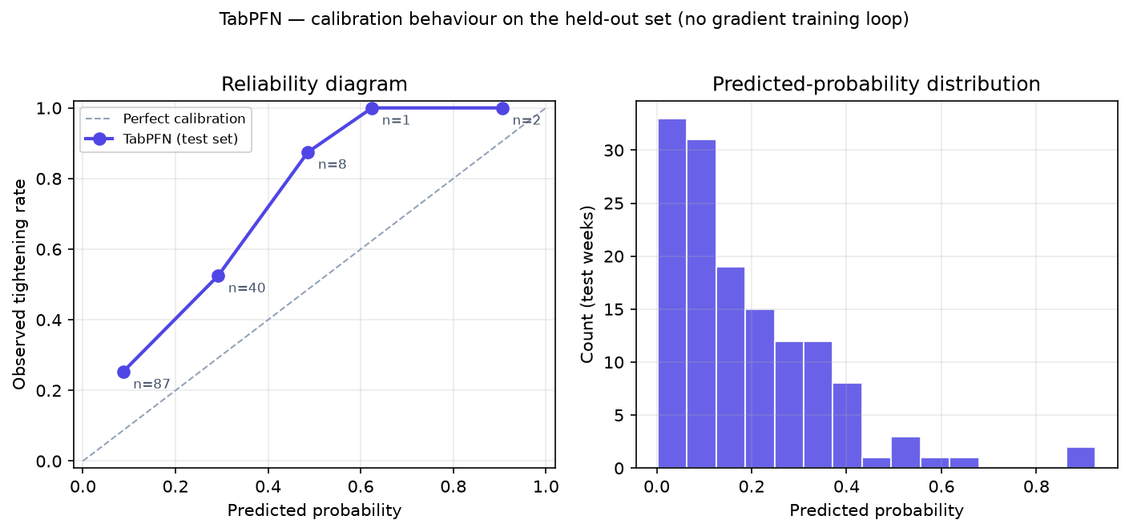
Model Deep Dive — TabPFN
Hyperparameters
Training: none — pretrained
Tunable params: none (library defaults)
Inference: hosted tabpfn-client
random_state: n/a (deterministic)
Reliability diagram & predicted-probability distribution
Why chosen. A transformer pre-trained to approximate Bayesian inference over small tabular datasets, applied in a single forward pass with no training or tuning. Its predicted probabilities are well-ordered but concentrated near zero, giving very high precision but very low recall — it rarely commits to a confident positive.

Slide 9
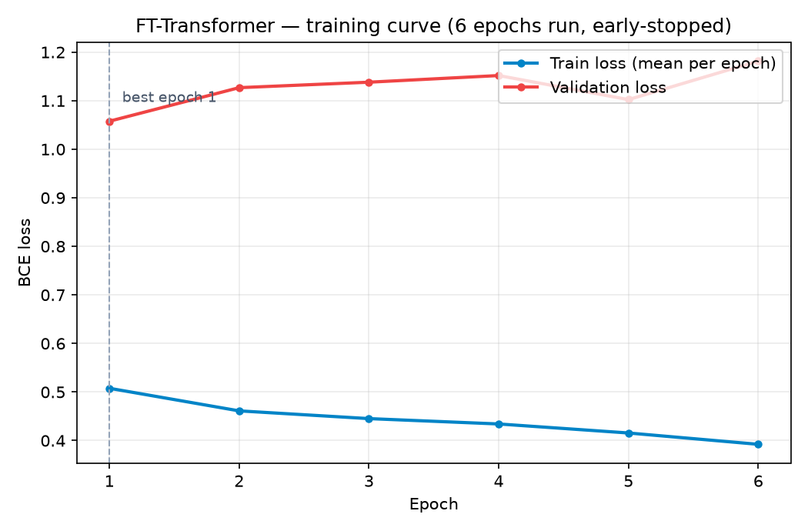
Model Deep Dive — FT-Transformer
Hyperparameters
dim: 32
depth: 4
heads: 4
attn / ff dropout: 0.1
epochs: 30 (max)
learning_rate: 1e-3
batch_size: 64
optimizer: Adam
loss: BCE-with-logits
early stopping: patience 5
Per-epoch train / validation loss (early-stopped)
Why chosen. The deep-learning baseline — it tokenizes every feature and applies self-attention across them. With only a few hundred training weeks it overfits almost immediately (early-stopped at epoch 6) and scores below chance, confirming the literature's small-data caveat for deep tabular models.

Slide 10
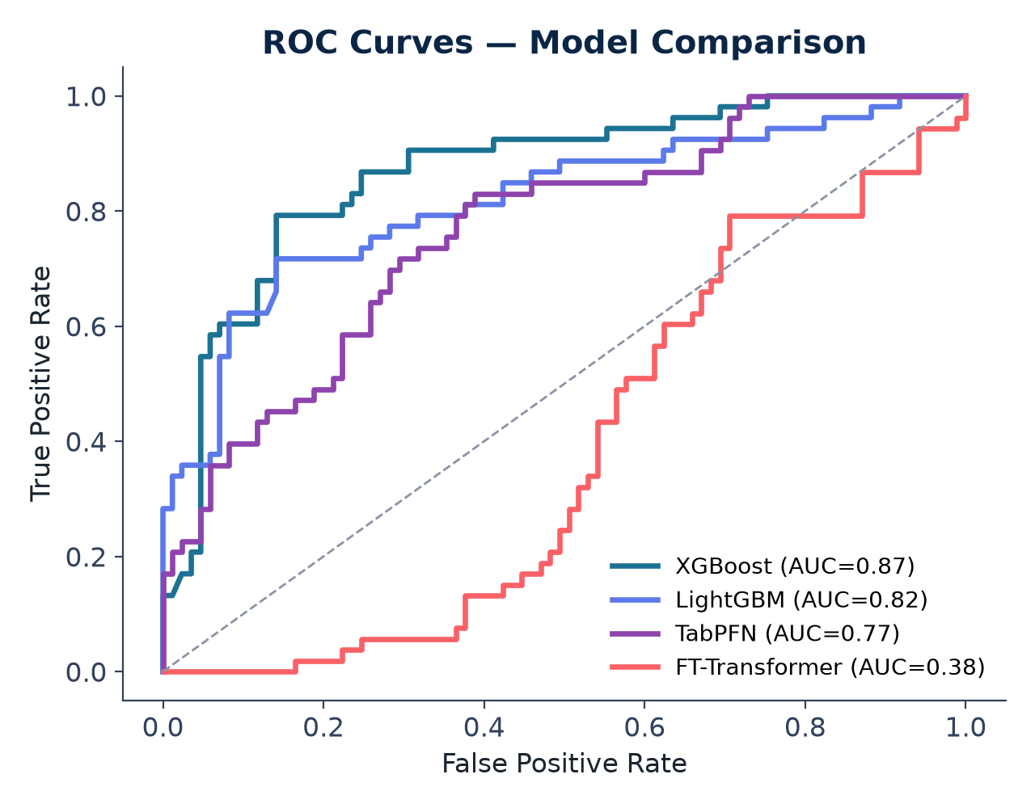
Results I — Model Benchmark
Model | Accuracy | Precision | Recall | F1 | ROC-AUC
XGBoost ★ | 0.790 | 0.750 | 0.679 | 0.713 | 0.867
LightGBM | 0.725 | 0.941 | 0.302 | 0.457 | 0.817
TabPFN | 0.667 | 1.000 | 0.132 | 0.233 | 0.765
FT-Transformer | 0.384 | 0.384 | 1.000 | 0.555 | 0.383
★ best F1. Ranked by F1 on the chronological (time-ordered) held-out test set.
Gradient-boosted trees win — the expected result for a small, tabular, mixed-signal problem.

Slide 11
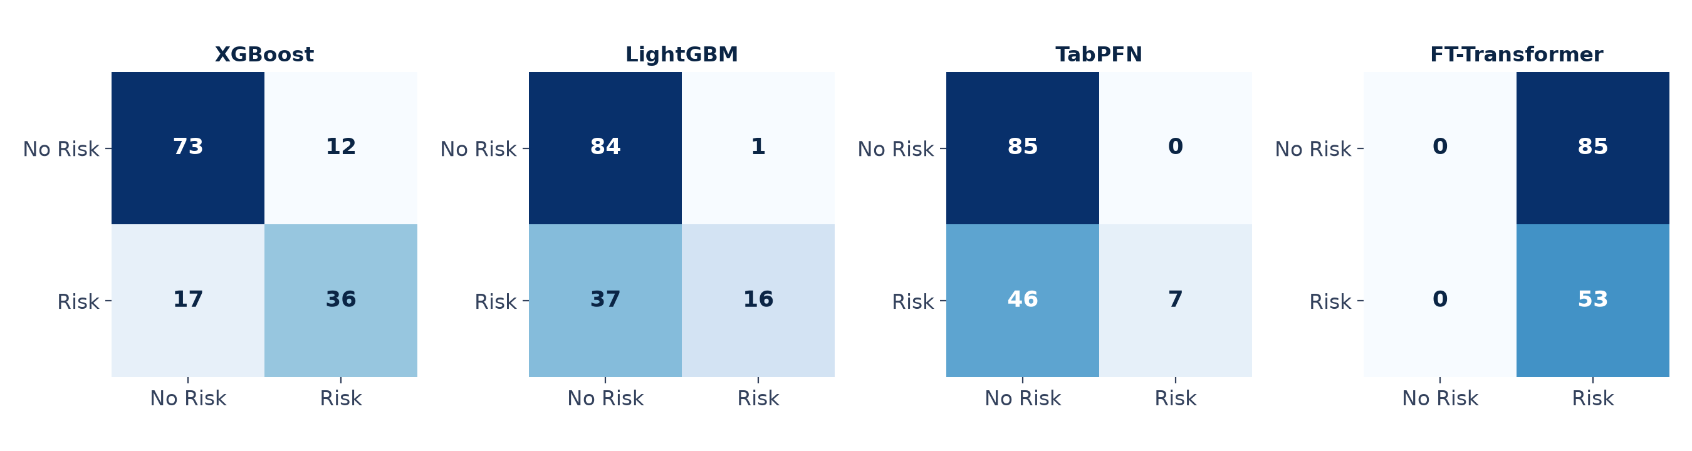
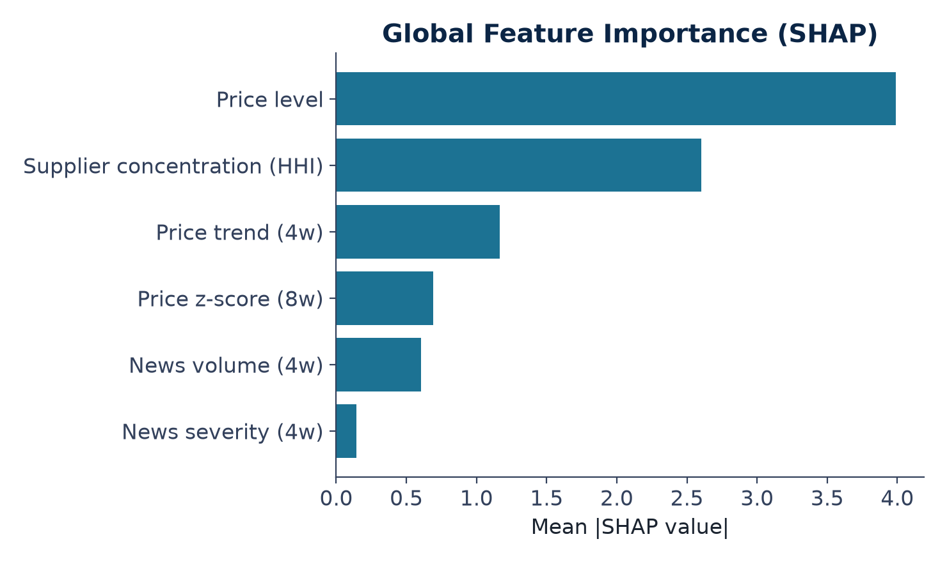
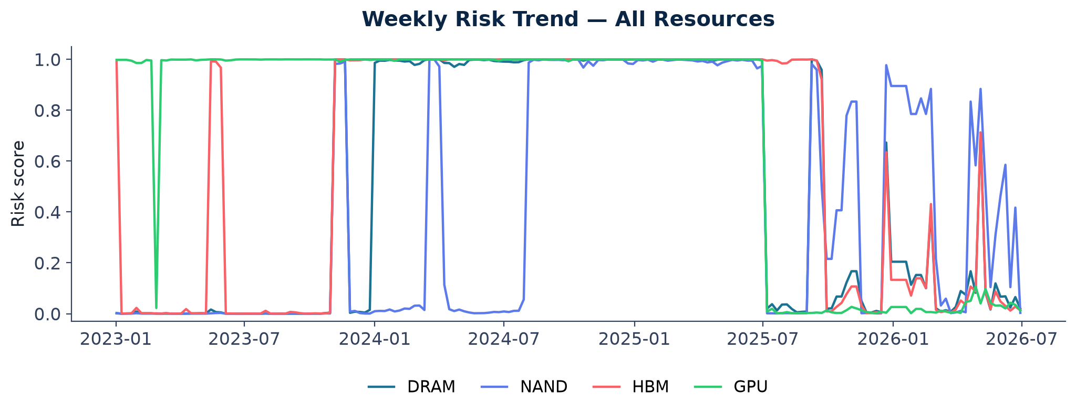
Results II — Explainability & Risk Trend

Slide 12
SWOT Analysis
✓
Strengths
!
Weaknesses
Built entirely on real public data — no synthetic or proprietary feeds required
Transparent 4-model benchmark with SHAP explainability at every prediction
Fully automated pipeline: ingestion → scoring → live dashboard, refreshed weekly
Negative examples cluster in the 2023 memory glut, partly confounding the time split
Risk score is uncalibrated and saturates near 0/1 — a resemblance signal, not a true probability
Small label set (n=1,112 weeks across 4 resources) limits generalization
↑
Opportunities
▲
Threats
Broaden negative examples across more periods, then calibrate the score
Extend to further resource categories — rare earths, silicon wafers, battery inputs
LLM-assisted label curation to reduce manual episode-tagging effort
News/price API rate limits or provider outages could interrupt weekly refresh
LLM provider drift or pricing changes could affect severity-scoring consistency
Public signals alone create blind spots around private contractual commitments

Slide 13
References
[1] D. Ivanov and A. Dolgui, “Viability of intertwined supply networks: extending the supply chain resilience angles towards survivability,” Int. J. Prod. Res., vol. 58, no. 10, pp. 2904–2915, 2020.
[2] T. Chen and C. Guestrin, “XGBoost: A scalable tree boosting system,” in Proc. 22nd ACM SIGKDD Int. Conf. Knowledge Discovery and Data Mining (KDD), San Francisco, CA, USA, 2016, pp. 785–794.
[3] G. Ke et al., “LightGBM: A highly efficient gradient boosting decision tree,” in Adv. Neural Inf. Process. Syst. (NeurIPS), vol. 30, 2017, pp. 3146–3154.
[4] N. Hollmann, S. Müller, K. Eggensperger, and F. Hutter, “TabPFN: A transformer that solves small tabular classification problems in a second,” in Proc. Int. Conf. Learning Representations (ICLR), 2023.
[5] Y. Gorishniy, I. Rubachev, V. Khrulkov, and A. Babenko, “Revisiting deep learning models for tabular data,” in Adv. Neural Inf. Process. Syst. (NeurIPS), vol. 34, 2021, pp. 18932–18943.
[6] S. M. Lundberg and S.-I. Lee, “A unified approach to interpreting model predictions,” in Adv. Neural Inf. Process. Syst. (NeurIPS), vol. 30, 2017, pp. 4765–4774.
[7] The GDELT Project, “Global Database of Events, Language, and Tone (GDELT),” 2013. [Online]. Available: https://www.gdeltproject.org/
[8] NewsAPI, “News API — Search worldwide news with code.” [Online]. Available: https://newsapi.org/
[9] U.S. Securities and Exchange Commission, “EDGAR full-text search system.” [Online]. Available: https://www.sec.gov/edgar
[10] R. Aroussi, “yfinance: Yahoo! Finance market data downloader.” [Online]. Available: https://github.com/ranaroussi/yfinance

Slide 14
Thank You
Questions & Discussion
Supply Chain Disruption Prediction System · Semiconductor Industry Case Study

