Slide 1

NOTEFY – Companion for your music
Arjun Talekar - 23107005 Shrikant Thakur - 23107045
Parth Pawar Ranjana Yadav
- 23107048
- 23107059
Project Guide
Ms. Dipali Gat

Slide 2
Outline
Introduction
Literature Survey of the existing systems Limitations of the existing systems Problem statement
System Design
Technologies and methodologies Implementation
Conclusion References

Slide 3
Sustainable Development Goals (SDG)Mapped
SDG 9: Industry, Innovation & Infrastructure:
Promotes Innovation – Uses AI to solve a unique problem in music: converting MP3 into sheet music and detecting instruments.
Strengthens Digital Infrastructure – Creates smart digital tools for music learning, performance, and creativity.
Bridges Technology & Art – Combines computer science with music, encouraging cross-domain innovation.
Supports Creative Industries – Helps musicians, educators, and learners with accessible technology.
Encourages Research & Development – Opens pathways for future projects in music AI and educational technology.
Global Reach – Can be used by anyone with a computer, making innovation accessible worldwide.

Slide 4
Introduction
Music is often available as audio (MP3) but not as readable sheet music.
Our project solves this problem by using ML and sound analysis (signal processing).
It can remove vocals, detect instruments, and extract their musical notes.
Users can choose instruments, change pitch/tune, and get output as sheet music or MIDI.
This makes learning, composing, and performing music easier and more interactive.

Slide 5
Introduction
Objectives:-
To separate vocals (lyrics) from instrumental tracks in audio files using signal processing or ML-based techniques.
To convert raw MP3 files into instrument-specific sheet music.
To let users convert or change the tune or pitch of the final output.
To Keep track of History for further references.

Slide 6
Literature Survey of the existing system
Sr. No. | Title | Author(s) | Year | Outcomes | Methodology | Result
1. | [1] Selected Features for Classifying Environmental Audio Data with Random Forest | Yan Zhang, Dan-jv Lv | 2015 | Identified key features useful for audio classification. | Extracted audio features Mel-Frequency Cepstral Coefficients, Code Excited Linear Prediction(MFCC, CELP) and classified them using Random Forest. | We applied this to classify instruments from MP3 audio using MFCC features.
2. | [2] Music Information Retrieval: Recent Developments and Applications | Markus Schedl, Emilia Gómez, Julián Urbano | 2014 | Explained the gap between low-level audio features and symbolic music (notes). | Reviewed different MIR (Music Information Retrieval) methods such as feature extraction, tagging, and recommendation systems. | We can use signal processing +ML methods to convert audio into sheet music and MIDI in our project.

Slide 7
Literature Survey of the existing system
Sr. No. | Title | Author(s) | Year | Outcomes | Methodology | Result
3. | [3] Independent Component Analysis: Recent Advances | Aapo Hyvärinen | 2013 | Demonstrated that ICA is a strong tool for blind source separation, successfully applied in audio, neuroscience, and speech analysis. | ICA separates mixed signals (like vocals + instruments) into independent components using statistical independence. | We used ICA to remove vocals (lyrics) from MP3 files, leaving only the clean instrumental part, which makes it easier to detect instruments and generate accurate sheet music.

Slide 8
Limitations of existing systems
From the literature review of existing systems, we find that:
The system does not include a dedicated History section, which limits users from tracking past activities or references.
It does not generate or provide sheet notes for specific instruments, restricting musicians who need instrument-wise notations.
The system does not offer pitch adjustment features, so users cannot modify or fine-tune the audio according to their preferences.

Slide 9
Problem statement
Existing systems mainly focus on classifying sounds, but they fail to provide complete sheet music generation.
Vocals and instruments are often not separated properly, which reduces transcription accuracy.
Models trained on limited datasets struggle with real-world mixed audio, leading to poor performance.
Current systems stop at audio feature extraction and do not convert them into readable notes or MIDI.
Users have little to no control to choose instruments or adjust pitch/tune in the final output.

Slide 10
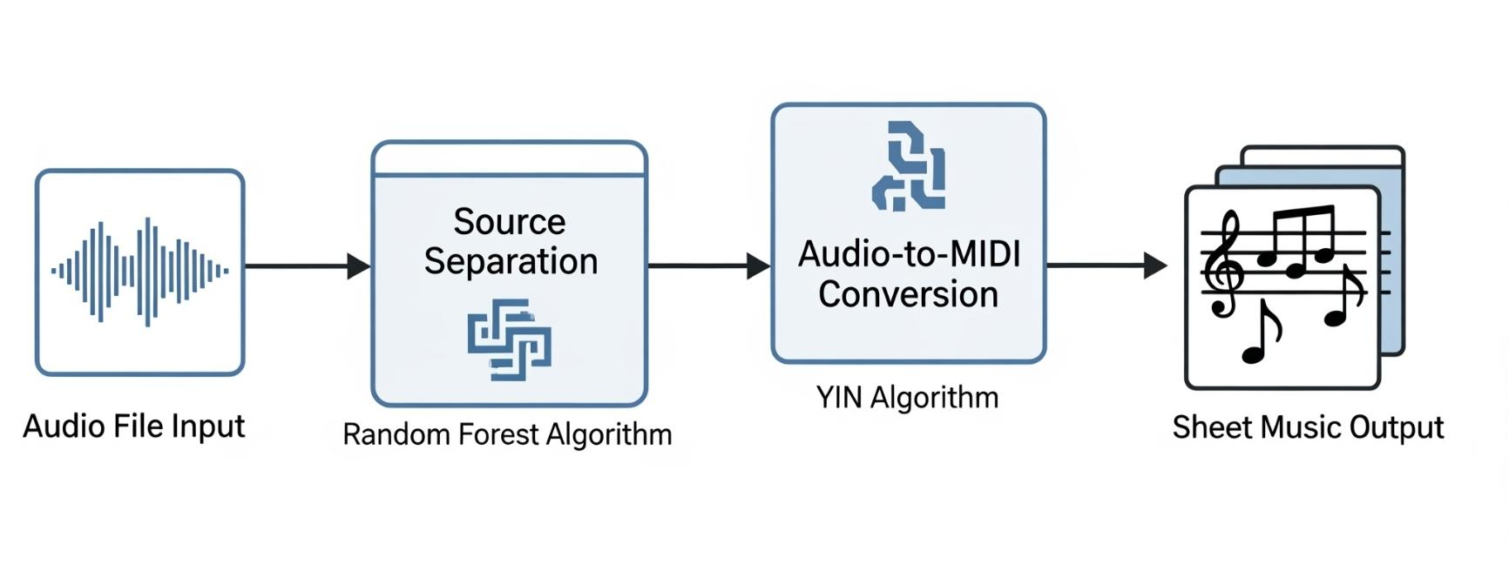
System Design

Slide 11
Technologies and methodologies
Technologies:
Frontend:
i. HTML, CSS
ii. JavaScript
Backend: Python 3.11.0, ML-based prediction integrated with APIs
Data Sources: IRMAS Dataset , Medley-solos-DB , NSynth Dataset
Database :Pickle Files (.pkl)JSON FilesMusicXML / PDF / MIDI Files
Data set:- https://www.upf.edu/web/mtg/irmas , https://colinraffel.com/projects/lmd/.
Dataset Size:
i. IRMAS Dataset → 6,705 × 55
ii. LMD-Clean Subset → 1,270 × 55
iii. Total Dataset → 7,975 × 55

Slide 12
Technologies and methodologies
Methodologies:
Machine Learning Model: Random Forest trained on IRMAS, Medley-solos, NSynth for instrument recognition.
Data Preprocessing: MP3 → WAV conversion, normalization, ICA vocal removal, HPSS separation.
Algorithms: Onset detection for timing, Pitch detection (YIN/Piptrack), Range- based assignment, Transpose handling, Random Forest, ICA
Feature Extraction : MFCCs ,Spectral Centroid, ZCR, and Pitch curves to capture tone and melody.
Algorithms used:
i. Random Forest
ii. YIN
iii. ICA

Slide 13

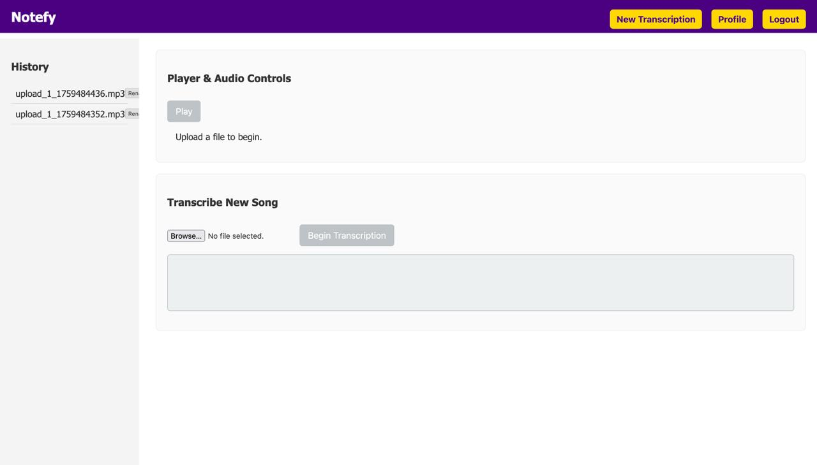


Implementation

Slide 14
Conclusion
The project provides a complete solution to convert raw music (MP3) into instrument-specific sheet music.
By combining signal processing and AI, we achieve vocal removal, instrument detection, and note transcription.
Users can choose instruments and change pitch/tune, making the system flexible and practical.
The final output can be exported as readable sheet music (PDF) or MIDI file, helping musicians, learners, and creators.
This makes music learning and performance more accessible, accurate, and user-friendly.

Slide 15
References
[1] Y. Zhang and D.-jv Lv, “Selected Features for Classifying Environmental Audio Data with Random Forest,” The Open Automation and Control Systems Journal, vol. 7, pp. 135–142, 2015.
URL:- https://benthamopen.com/contents/pdf/TOAUTOCJ/TOAUTOCJ-7-135.pdf
[2] M. Schedl, E. Gómez, and J. Urbano, “Music Information Retrieval: Recent Developments and Applications,” Foundations and Trends in Information Retrieval, vol. 8, no. 2–3, pp. 127–261, 2014.
URL:- https://www.nowpublishers.com/article/DownloadSummary/INR-042
[3] A. Hyvärinen, “Independent Component Analysis: Recent Advances,” Philosophical Transactions of the Royal Society A, vol. 371, 1984, p. 20110534, Feb. 2013.
URL:- https://pmc.ncbi.nlm.nih.gov/articles/PMC3538438/

Slide 16
Thank You...!!

