Slide 1



IoT Based Smart Home System
Using Esp32 Development Kit
Team:
P. Yaswanth (19A81A04A3)
P. Srinu (19A81A04A1)
V. N. V. Sushmanth (19A81A04B5)
R. Nithin (19A81A04A5)
U. Samuel (19A81A04B4)
Sri Vasavi Engineering College
(Autonomous)
Department Of ECE

Slide 2

Abstract:
This project is based on IoT Home Automation System. The aim of the project is to control all home appliances like fan, light, etc., using Mobile, Manual switches, IR Remote and Sensors. Improving technology is for making our lives easier, using smart home system helps our busy life more convenient and simpler. ESP32 is the core of the project which is made for IoT. ESP rainmaker is a cloud that provides free remote application and establish connections with voice assistance and it provides automation based on scheduling.

Slide 3
Introduction:
A smart home refers to a convenient home setup where appliances and devices can be automatically controlled remotely from anywhere with an internet connection using a mobile.
This Project is about to archive the smart home requirements and give the user most reliable life. The main moto of our project is making the home automation services available with low investment along with efficiency to every person. Even a non-technical person can be able to use these services without any hesitation.

Slide 4
Architecture:

Slide 5
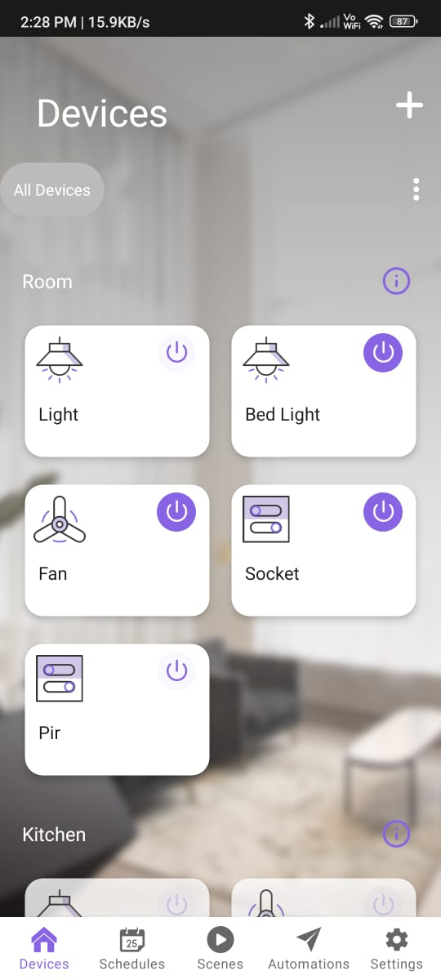
Working:
The system creates a QR code through serial communication onto the computer (save QR for future use). To connect the system and the mobile phone scan the QR with the ESP-Rainmaker application and provide the Wi-Fi credentials to the system from the mobile. Then the system can be controlled by mobile Application. It is possible to control these devices using voice assistance like Alexa and Google Home by linking these with Rainmaker.
PIR motion sensor turns ON devices when it detects the humans otherwise it turns OFF the devices. This action can be turned off if it was not necessary.
And also, all the devices can be controlled using manual switches and the IR-remote.
When the state of device changes by Manual switches or PIR sensor or IR-remote, these changes are reflected back to the mobile app.
It can also be possible to reset the system to connect with any other mobile or to change the Wi-Fi credentials of the system. To reset the system, press and hold the system reset button for ten seconds.
Rainmaker App

Slide 6
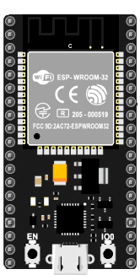
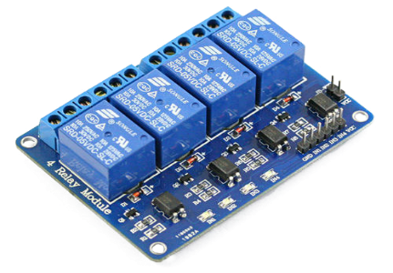
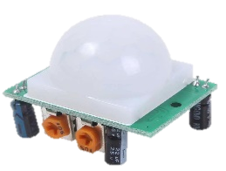
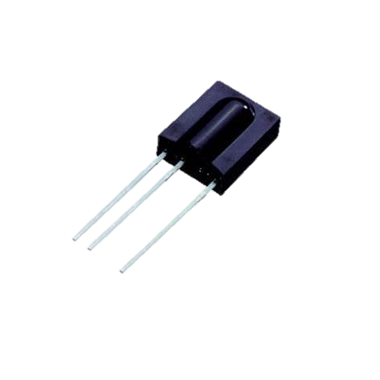
Components:
ESP32 Microcontroller
Relay Module
Passive Infrared Sensor
IR receiver – IR Remote
Push Buttons
Relay Module
ESP32
PIR Sensor
IR-Receiver

Slide 7

Conclusion:
The home automation system has been experimentally proven to work well by connecting sample appliances to it and the appliances were successfully controlled from a mobile device. In future this product has a potential demand in marketing and it may see in every house hold.

Slide 8
Thank You

