Slide 1
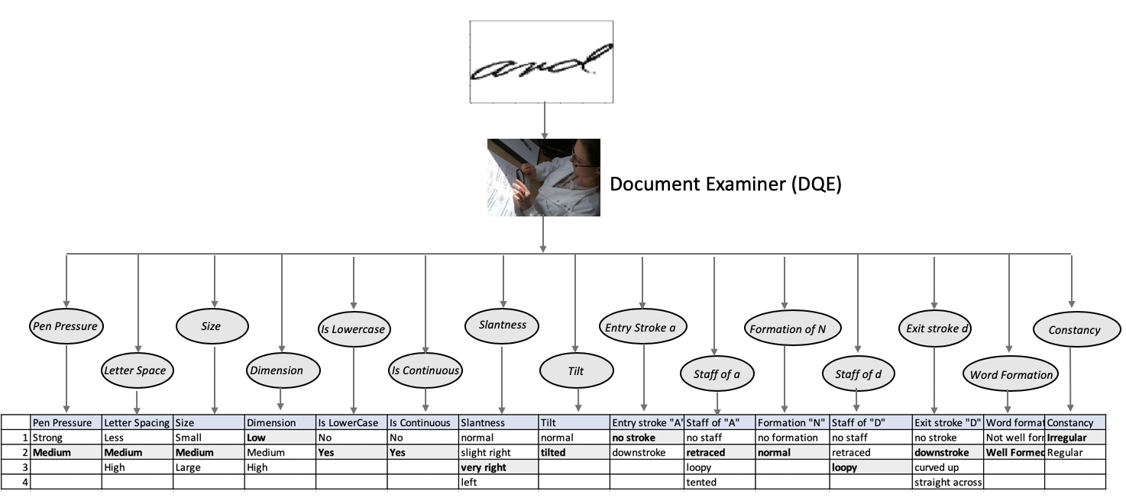
Writer Verification – Human Observed Dataset

Slide 2
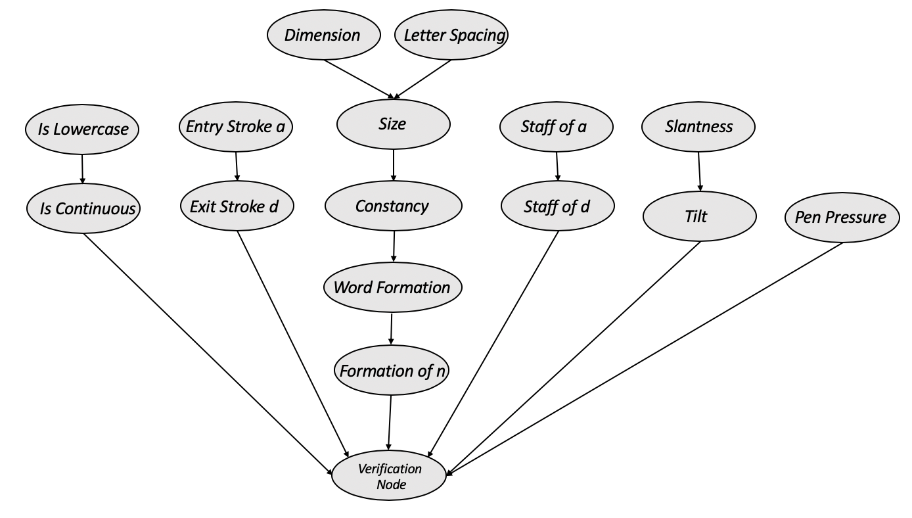
PGM for human observed ‘AND’ dataset

Slide 3
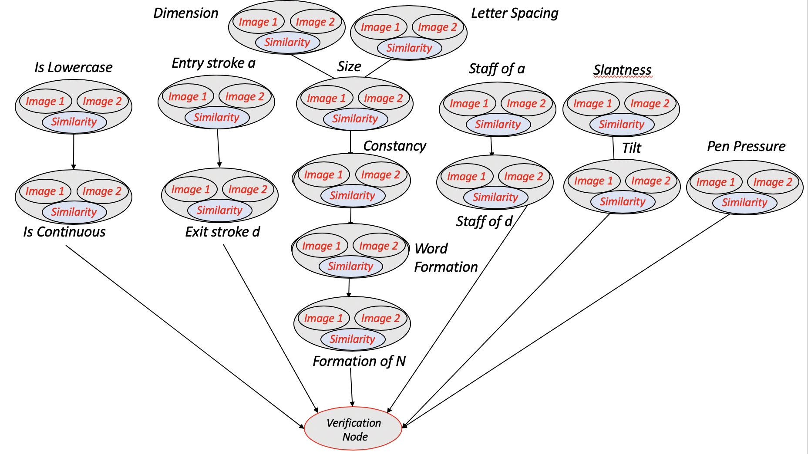
PGM for Writer Verification

Slide 4
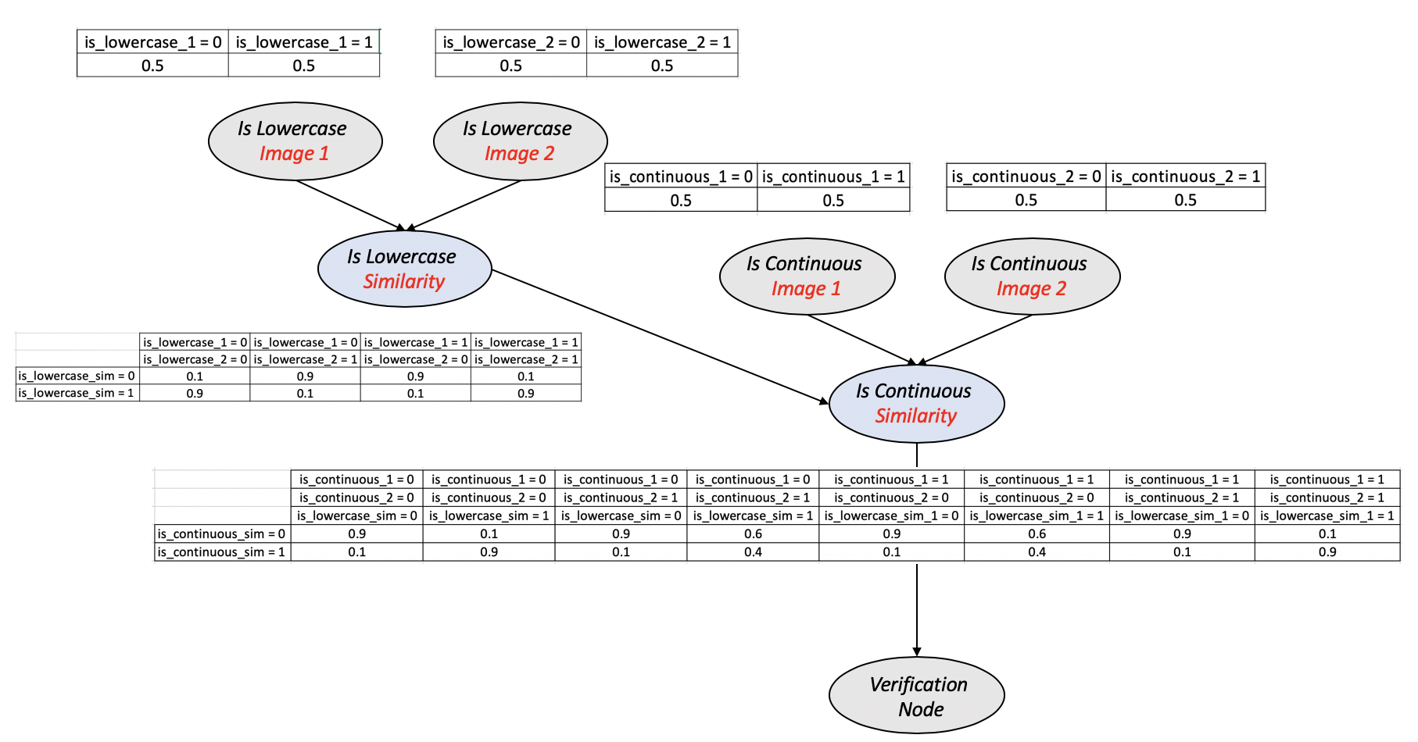
Example CPDs for Writer Verification PGM

Slide 5
PGM Results
Intra Class Type 1 Error
LLR: -0.3679
DQE
DQE
LLR: -0.6021
1x15
1x15
Metric | Accuracy
Intra Writer Accuracy (Type 1) | 85.67%
Inter Writer Accuracy (Type 2) | 87.36%
Overall Accuracy | 83.15%
PGM for Writer Verification
Inter Class Type 2 Error
LLR: +0.268
Performance Metrics based
on Overall similarity
LLR: +0.087
LLR

