Slide 1
Model View Controller
(MVC)

Slide 2
Need of MVC
Divide a project in three different layers.
To provide security.
To provide a structured way of programming.

Slide 3
Introduction
Model View Controller or MVC as it is popularly called, is a software design pattern for developing web application.
Model-View-Controller (MVC) is a software architecture pattern which seperates the representation of information from the user’s interaction with it.

Slide 4
Parts of MVC
A Model View Controller pattern is made up of following three parts:
Model
View
Controller

Slide 5
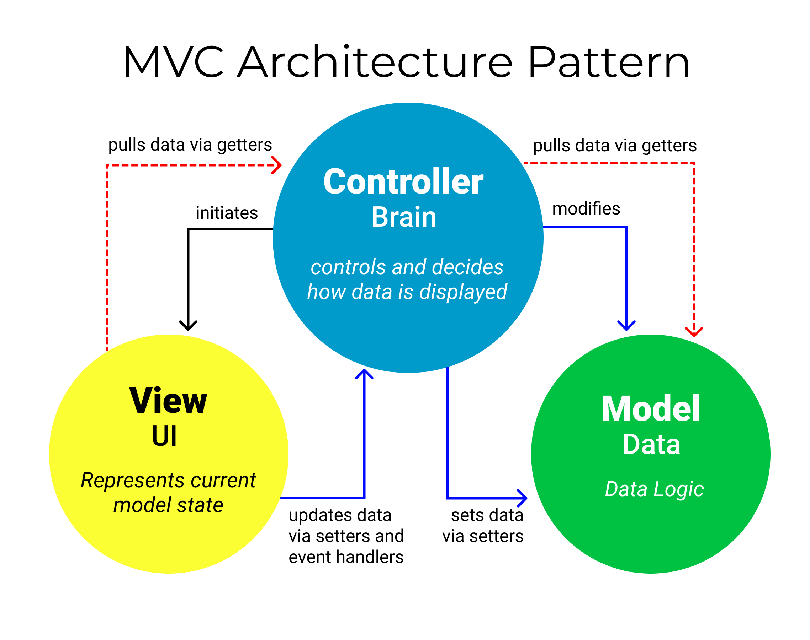

Slide 6
Model
The model is responsible for managing the data
of the application.
It responds to the request from the view and it
also responds to instructions from the controller
to update itself
It is the lowest level of the pattern which is
responsible for maintaining data.
The Model represents the application core (for
instancealist of database records).
It is also called the domain layer.

Slide 7
View
The View displays the data (the database records).
A view requests information from the model, that it needs to generate an output representation.
MVC is often seen in web applications, where the view is the HTML page.

Slide 8
Controller
The Controller is the part of the application that
handles user interaction.
Typically controllers read data fromaview, control user input, and send input data to the model.
It handles the input, typically user actions and may invoke changes on the model and view.

Slide 9
Workflow in MVC
Though MVC comes in different flavours,the control flow generally works as follows:
The user interacts with the user interface in some way(e.g.,user pressesabutton)
Acontroller handles the input event from the user interface,often viaaregistered handler or callback.
The controller accesses the model, possibly updating it inaway appropriate to the user's action(e.g.,controller updates user's shopping cart).

Slide 10
A view uses the model to generate an appropriate user interface (e.g., view producesascreen listing the shopping cart contents).
The view gets its own data from the model with the help of the controller. The model has no direct knowledge of the view.

Slide 11
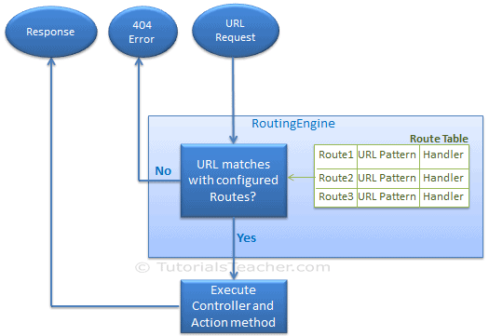
URL Representation

Slide 12
Advantages
Clear separation between presentation logic and business logic.
Each object in mvc have distinct responsibilities.
Parallel development.
Easy to maintain and future enhancements
All objects and classes are independent of each other.

Slide 13
Disadvantages
Increased complexity
Inefficiency of data access in view
Difficulty of using MVC with modern user interface too.
For parallel development there is a needed multiple programmers.
Knowledge on multiple technologies is required.

Slide 14
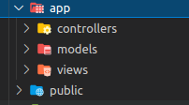
Basic Folder Structure of MVC

Slide 15
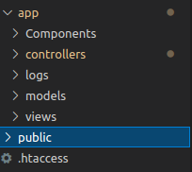
Additional Folder Structure of MVC

Slide 16
Thank You

