Slide 1
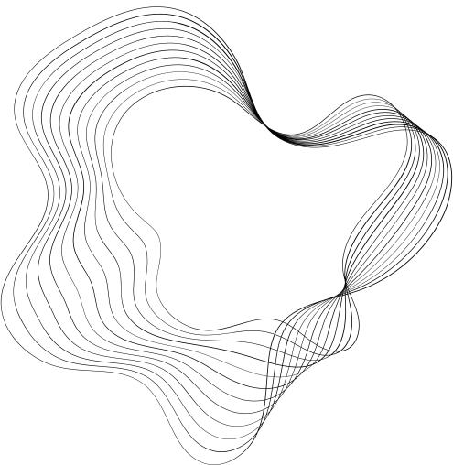

EE675A
STOCK TRADING USING DEEP REIGNFORCEMENT LEARNING
(end-term presentation)
JIGYASHU GARG YASH BARJATYA SATENDER KUMAR
200478
201138
200889
SOURCE CODE
PPT VIDEO
CODE DEMO VIDEO

Slide 2
PROBLEM STATEMENT
The problem is to predict the market and find the best moments to buy and sell to maximize profit using deep reinforcement learning

Slide 3
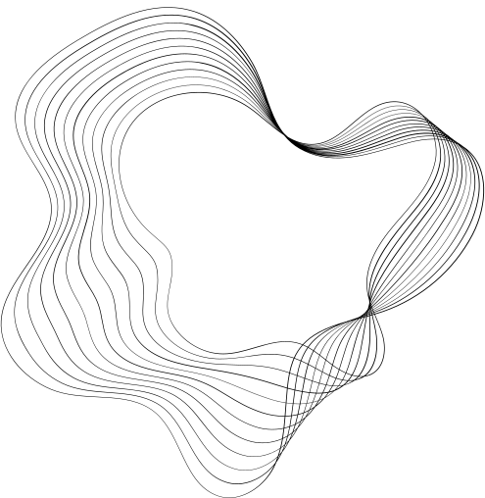
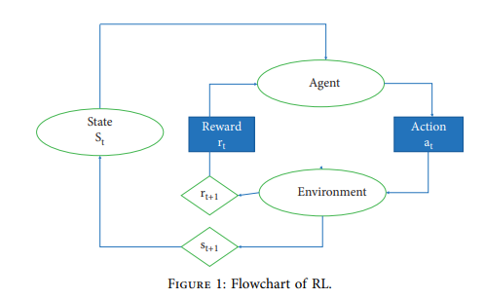
WHY DRL?
DRL in stock trading offers three key advantages:
Market-driven Intelligence:
DRL uses market data as input and outputs allocation vectors. It's a fully AI-driven method in trading, avoiding manual strategies. This approach continuously self-improves without relying on human-designed predictors of future stock prices.
Avoidance of Explicit Predictions:
Unlike traditional methods, DRL doesn't directly predict stock performance, a notoriously challenging task. This circumvents obstacles in reinforcement learning, leading to smoother performance improvements.
Neural Network Flexibility:
DRL approximates strategies or value functions with neural networks. This offers flexibility in designing network structures while overcoming the "curse of dimensionality." Consequently, it's effective for large-scale portfolio management.

Slide 4
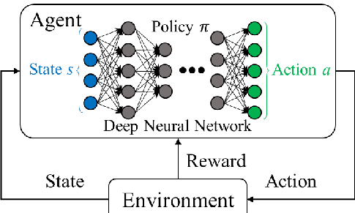
DRL SCHEMATIC STRUCTURE

Slide 5
WHY DQN AS AN AGENT?
Modeling Nonlinear Relationships:
DQN's deep neural network architecture effectively captures complex and nonlinear patterns in stock price movements, enhancing prediction accuracy.
Temporal Dependencies:
Stock prices exhibit time-series dependencies. DQN leverages historical data to learn from past price movements, making it adept at sequential decision-making tasks.
Memory Replay:
Incorporating experience replay, DQN stores and samples past experiences during training, stabilizing learning and preventing forgetting of crucial information.
Exploration-Exploitation Tradeoff:
DQN balances exploration and exploitation using an epsilon-greedy strategy, gradually shifting from exploration to exploitation as it learns, ensuring effective learning without overfitting.
Scalability:
DQN handles high-dimensional input spaces and large-scale datasets commonly encountered in stock trading

Slide 6
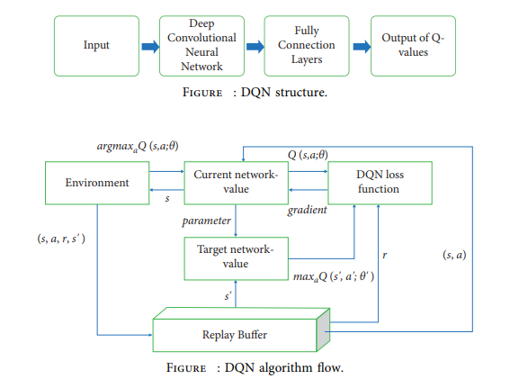
DQN FRAMEWORK

Slide 7
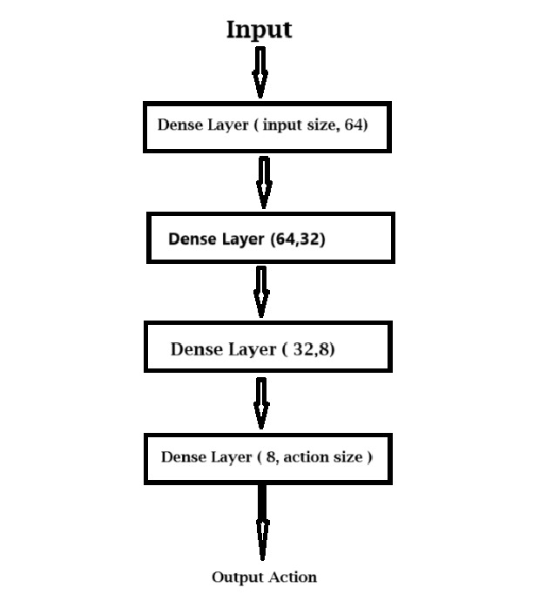
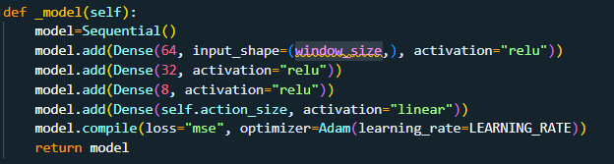
DQN NETWORK STRUCTURE

Slide 8
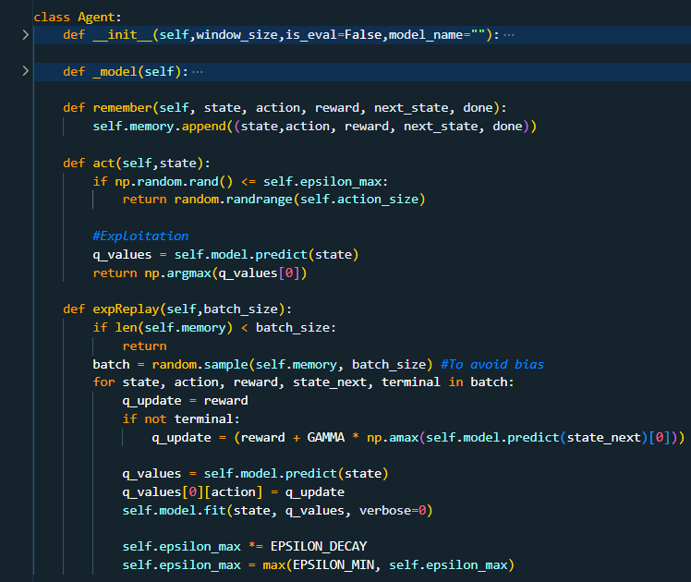
DQN AGENT

Slide 9
DATA OVERVIEW
Dataset Description:
The dataset comprises stock market data for various companies over different years.
Each dataset is stored in a CSV (Comma-Separated Values) format.
Each row represents a single trading day and includes the below data fields.
Data Fields:
Date: The date of the trading day.
Open: The opening price of the stock on that day.
High: The highest price the stock reached during the trading day.
Low: The lowest price the stock reached during the trading day.
Close: The closing price of the stock on that day.
Adj Close: The adjusted closing price of the stock, considering factors such as dividends and stock splits.
Volume: The total trading volume (number of shares traded) on that day.

Slide 10
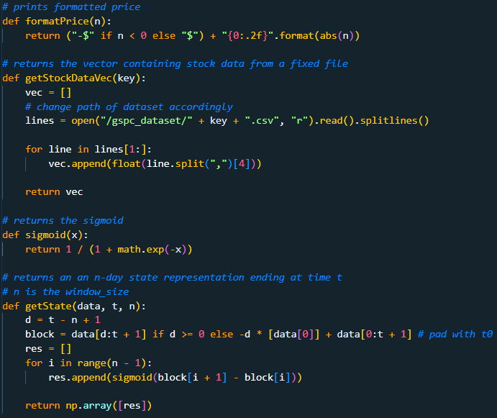
DATA PREPROCESSING

Slide 11
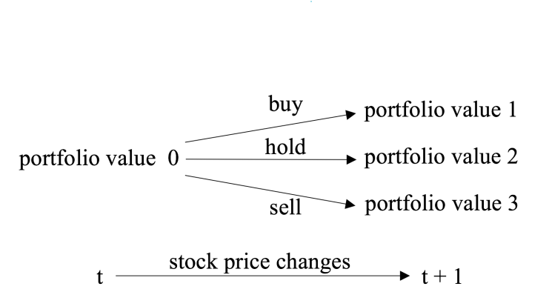
STOCK TRADING MODEL FORMULATION
Considering the stochastic and interactive nature of the trading market, we model the stock trading process as a Markov Decision Process (MDP) as shown in Fig. 1, which is specified in the following slides:

Slide 12
STOCK TRADING MODEL FORMULAITON
1) State (s):
The state represents the current situation or context in which the agent operates.
In this context, the state is created using historical stock market data.
It consists of a vector representing an n-day state ending at time t.
Each state includes information about the previous n days and stock prices of those days.

Slide 13
STOCK TRADING MODEL FORMULATION(contd.)
2) Action (a):
The action space consists of three actions: Hold (do nothing) , Buy, and Sell.
The agent decides on the action to take based on the current state and its learned policy.
Actions are chosen based on the output of the neural network model
The dynamics of the stock market is described as follows. We use t to denote time , and the available actions on stock d are :
Selling: k (k ∈ [1, h[d]], where d = 1, ..., D) shares can be sold from the current holdings, where k must be an integer. In this case, h(t+1) = h(t) − k
Holding: k = 0 and it leads to no change in h(t).
Buying: k shares can be bought and it leads to h(t+1) = ht + k. In this case at[d] = −k is a negative integer.

Slide 14
STOCK TRADING MODEL FORMULATION(contd.)
3) Reward r(s, a, s’):
The reward is the feedback provided to the agent after taking an action in a particular state.
The reward is calculated based on the change in portfolio value after taking an action.
It encourages the agent to take actions that maximize cumulative rewards over time.
In our model the reward is computed as the difference between the current portfolio value and the previous portfolio value.

Slide 15
STOCK TRADING MODEL FORMULATION(contd.)
4) Policy (π(s)):
The policy π(s) is implicitly defined by the action selection mechanism in the agent's behavior.
During training, the agent's policy is guided by the exploration-exploitation strategy, where it explores actions with a certain probability ε and exploits the learned policy with probability (1-ε).
During evaluation, the agent's policy is determined by the learned model without exploration.

Slide 16
STOCK TRADING MODEL FORMULATION(contd.)
5) Action-Value Function (Qπ(s, a)):
The action-value function Qπ(s, a) is estimated using the Deep Q-Network (DQN).
In the DQN architecture, the neural network approximates the action-value function, where the input is the state representation and the output is the estimated Q-values for each action.
The neural network model architecture and training process are defined in the DQN Agent class
The Q-values for each action are computed by the neural network during the action selection process

Slide 17
TRAINING
The training loop consisted of iterating through each episode and within each episode, iterating through each trading window.
At each time step, the agent observed the state, selected an action, executed the action in the market, received a reward, and updated its strategy.
The agent's decision-making process was influenced by the current state of the market and the agent's learned strategy.
Rewards were calculated based on the change in portfolio value between consecutive time steps.
Experience replay was employed to train the agent using past experiences stored in a memory buffer.
This technique helps stabilize the training process and improve the agent's policy over time.
The training progress was monitored by tracking portfolio returns across episodes.

Slide 18
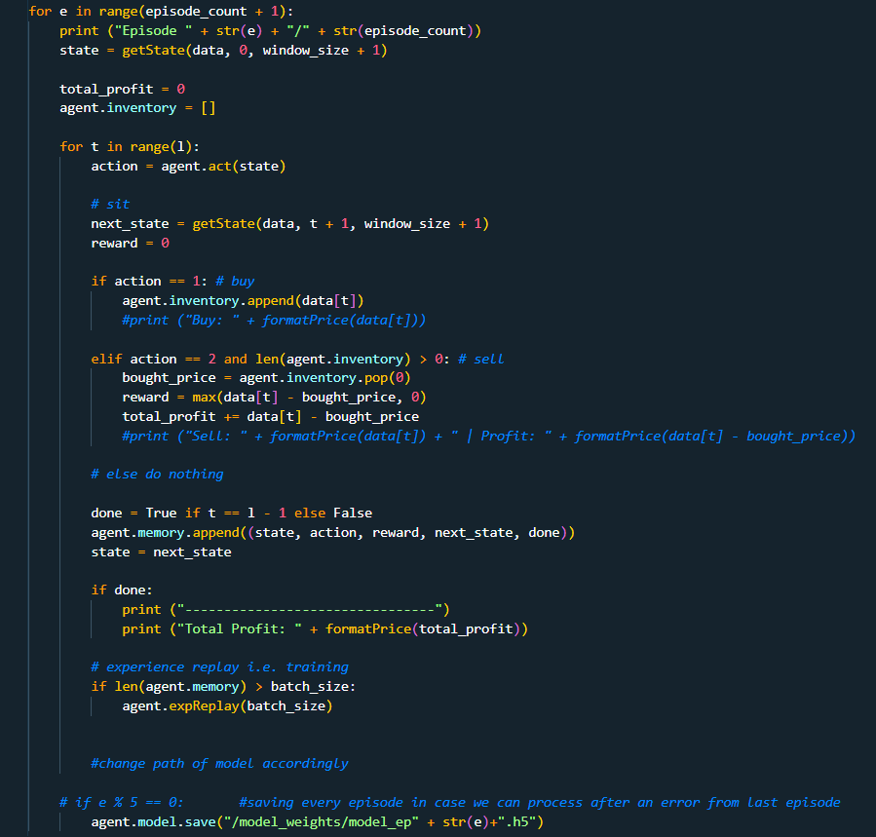
TRAINING AND BUILDING MODEL

Slide 19
EVALUATION PROCEDURE
The testing procedure involves simulating trading decisions based on the learned policy of the trained model.
At each time step, the model observes the current state of the market and selects an action (Hold, Buy, or Sell) accordingly.
Actions are executed in the market, and the portfolio's performance is tracked over the trading period.
The evaluation is based on how well the model's actions align with profitable trading strategies and the overall performance of the portfolio.

Slide 20
EVALUATION METRICS
Profit per Trade: This metric evaluates the profit earned or loss incurred for each individual trade made by the agent during the evaluation period.
Cumulative Profit: Cumulative profit measures the aggregated profit or loss over the entire evaluation period.
Sharpe Ratio: A measure of risk-adjusted return, calculated as the portfolio return divided by the standard deviation of returns.
Maximum Drawdown: The maximum loss experienced by the portfolio from a peak to a trough during the testing period.

Slide 21
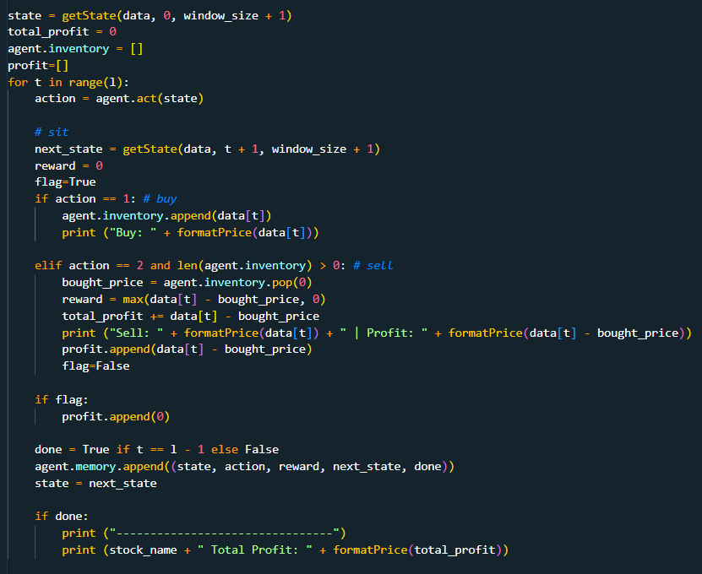
EVALUATION

Slide 22
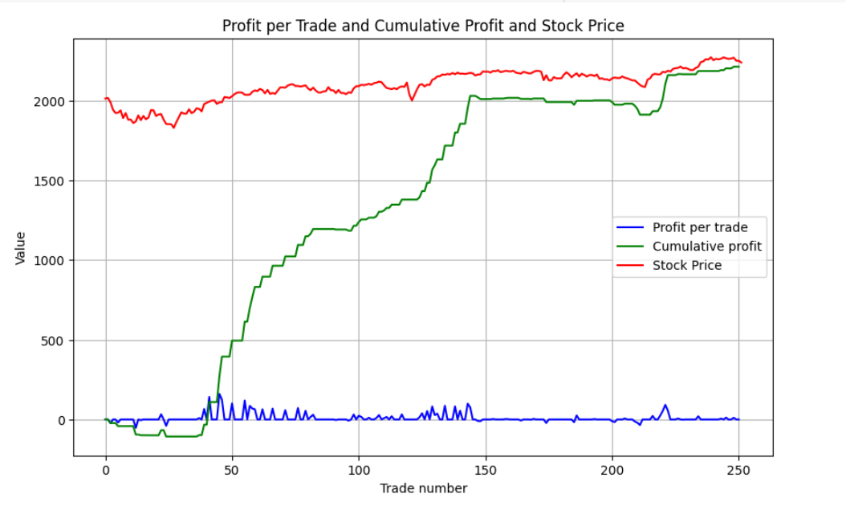
RESULTS

Slide 23
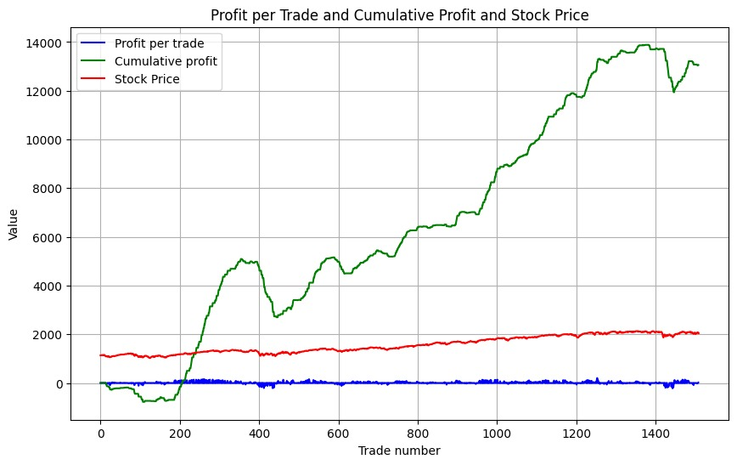
RESULTS
Fig : 2010-2015 data

Slide 24
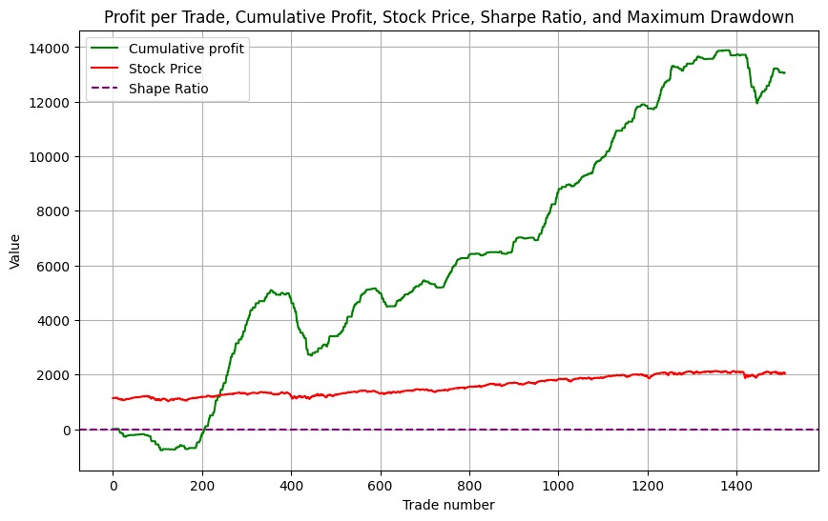
RESULTS
Fig : sharpe ratio test on 2010-2015

Slide 25
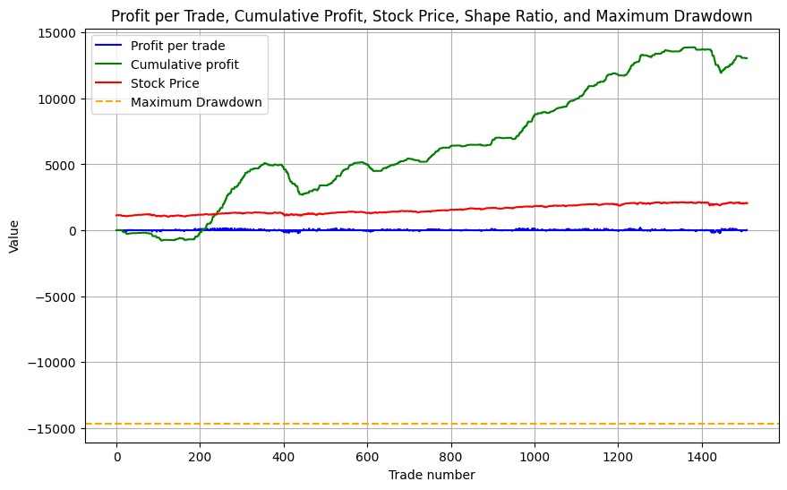
RESULTS
Fig : maximum drawdown for 2010-2015 data

Slide 26
CONCLUSION
A DQN based paradigm is proposed for stock price trend prediction and stock trading in this work. It shows that the deep learning architecture with CNN layers in policy network is capable of exploring and extracting the latent dependency in the stock data.The experiment also indicates that the DQN reduces overestimation and improves the stability of the model. It also shows that the method does well in pursuing high revenue via transaction strategy generated from DRL agent. It also reveals the difference between the DRL method and traditional machine learning methods through the comparison of the objective function, explaining why DQN could gain high revenue with relatively low hit rate.
Also, there are still some limitations in this work. It can be extended to the application of other reinforcement algorithms like DDPG
More stock data are supposed to be tested in the experiment; And it is advisable to compare the performances of models with different reward functions.

Slide 27
LIMITATIONS
Static Dataset: One significant limitation is the reliance on a static dataset. New data needs to be manually collected and incorporated into the dataset.
High Dimensionality and Feature Engineering: Stock market data typically involves a high-dimensional feature space, including various financial indicators, technical indicators, and market sentiment data.
Limited Generalization: DQL models trained on historical data may struggle to generalize well to unseen market conditions or unforeseen events.
Transaction Costs and Slippage: In real-world trading scenarios, transaction costs such as brokerage fees, taxes, and market impact costs can significantly impact the profitability of trading strategies.

Slide 28
Key Learnings
Understanding Market Dynamics: Developing a stock market prediction model provides valuable insights into the dynamics of financial markets
Importance of Data Preprocessing: Preprocessing and cleaning the dataset are critical steps in preparing the data for model training.
Reward Design and Reinforcement Learning: Designing appropriate reward functions is crucial in RL. In the context of stock market prediction, defining meaningful rewards that incentivize desirable behaviors (e.g., maximizing profit, minimising risk) is essential.
Data Augmentation and Feature Engineering: Data augmentation techniques can be beneficial in enhancing the diversity and richness of training data for DQL models.
Model Deployment and Real-world Considerations: Deploying RL models in real-world applications requires careful consideration of various factors, including computational resources, latency constraints, and regulatory compliance

Slide 29
REFERENCES
DEEP Q-LEARNING WITH KERAS AND GYM
DOUBLE DEEP Q NETWORKS
PRACTICAL DEEP REINFORCEMENT LEARNING APPROACH FOR STOCK TRADING
INTRODUCTION TO LEARNING TO TRADE WITH REINFORCEMENT LEARNING
A DEEP REINFORCEMENT LEARNING FRAMEWORK FOR THE FINANCIAL PORTFOLIO MANAGEMENT PROBLEM

Slide 30
THANK YOU

