Slide 1
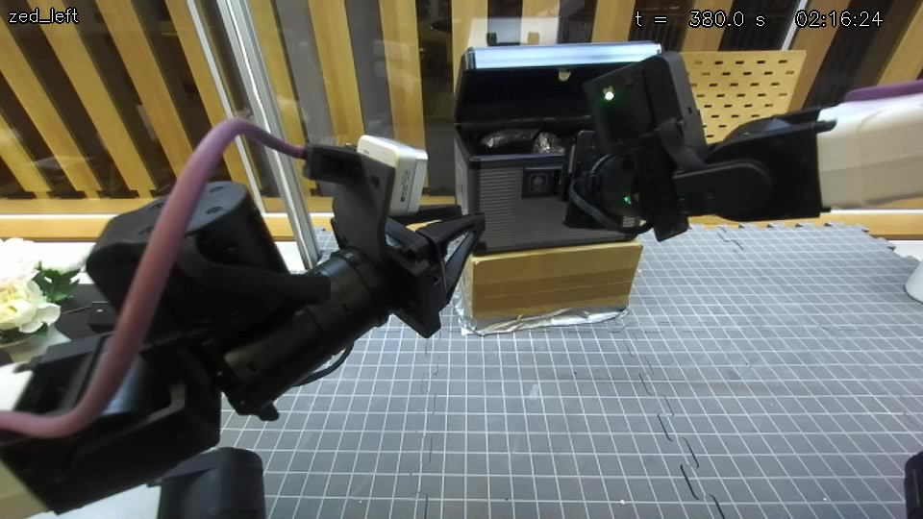
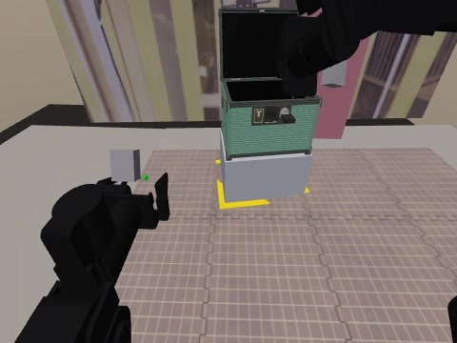
Opening the key box: sim to real with GaP
REAL · run_020911
SIM · current twin
Motion · Perception · Physics: what it took to turn a sim-only success into a real one
2026-10-27
Notes:
Hero frames: left, the real YAM cell after run_020911 (graph fix9): the lid is up. Right, the current MuJoCo twin after the privileged scripted solver.
The story: three things had to match between sim and real before a sim-trained graph could open the real box: motion (how the arm reaches and lands), perception (what the cameras really give) and physics (how the key, lock, tab and box behave).

Slide 2
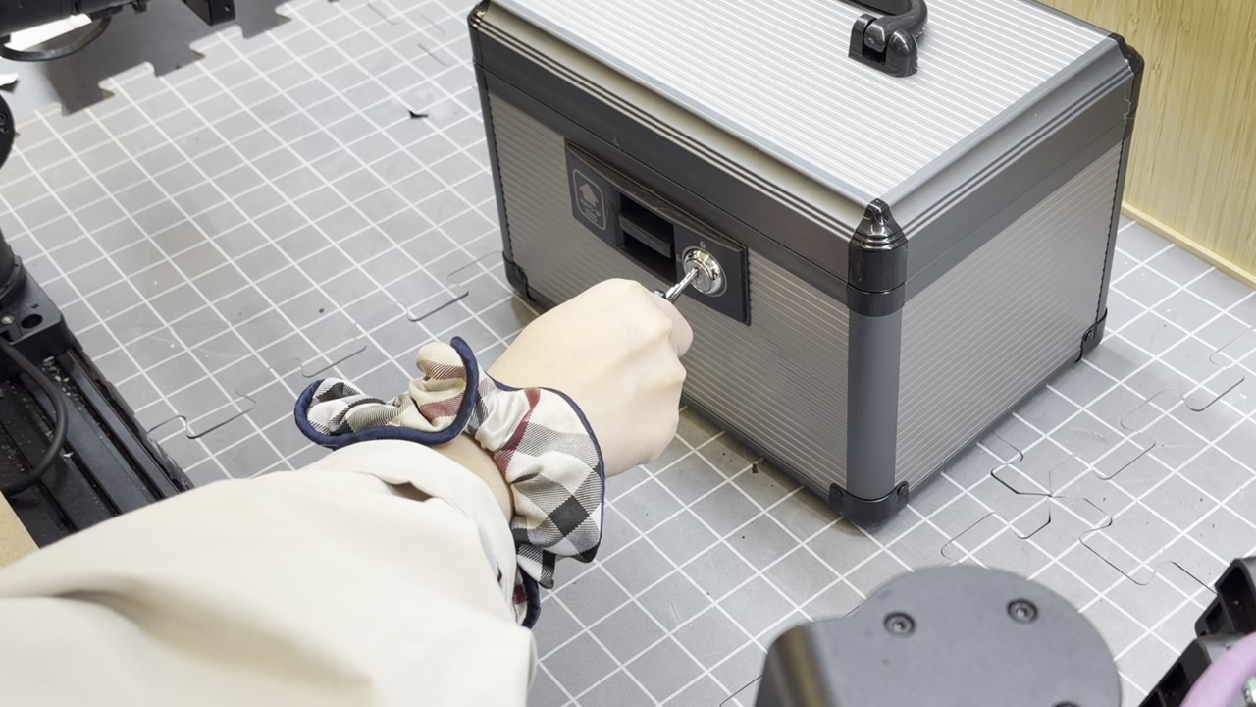
Self-learning pipeline solves many tasks. Can it solve the hardest one?
500/500
Latched toolbox
500/500
Tool hanging
500/500
Peg insertion
500/500
Wrench hanging
THE CHALLENGE
Key box
precise insertion · a turn · a hidden release tab
on a real YAM with no force sensing
493/500
Coffee machine
200/200
Scissor-hook (YAM)
98.8%
Siemens organizer
98.2%
Bike rotor
Solved in sim by the self-learning pipeline (held-out final tests; scissor-hook = dev)
Notes:
All numbers are from the self-learning / GaP pipeline in simulation; 'final' = held-out test seeds, 'dev' = development seeds.
Latched toolbox 500/500 final; tool hanging 500/500 final; peg insertion 500/500 final (best attempt); wrench hanging (vision) 500/500 final; coffee machine (vision) 493/500 final; YAM scissor-hook hanging 200/200 dev; Siemens organizer on the YAM twin 98.8% final; bike rotor (easy) 98.2% final.
The key box is the challenge: a precise insertion, a quarter turn and a hidden release tab, on a real YAM arm that has no force sensing.

Slide 3

The task: grasp the key, unlock, press the tab, the lid springs open
Notes:
The user's own phone clip (IMG_3520). The aluminium box is 254 × 174 mm. A key lies on the mat; the hand picks it up, inserts it, turns it a quarter turn, then presses the release tab inside the recess beside the lock; a torsion spring lifts the lid.

Slide 4
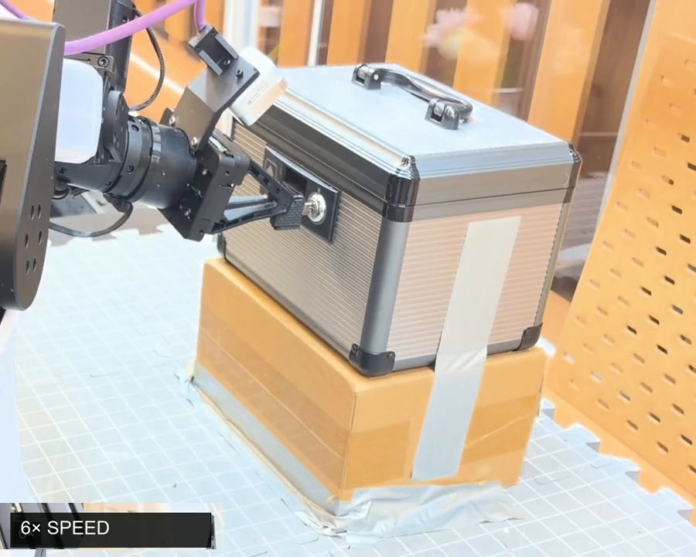
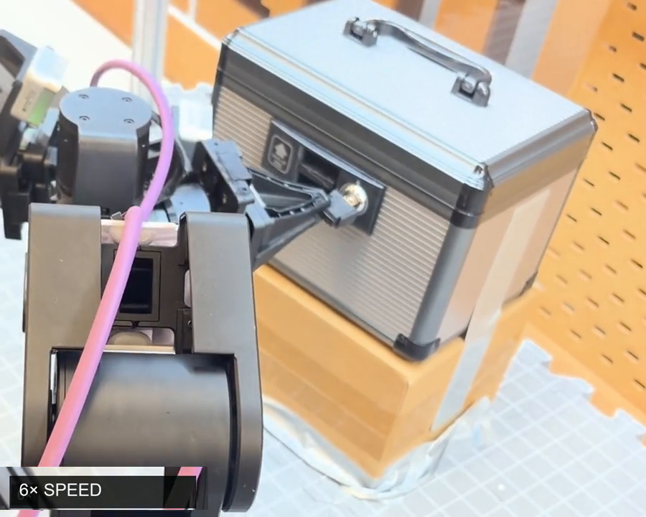
Robot doing the task
Rollout 1
Rollout 2
Notes:
The user's two recordings of the real YAM opening the box (successful_rollout_1_keybox.mp4, 40.3 s; successful_rollout_2_keybox.mp4, 48.5 s), shown at full length; the speed-ups are burned into the videos (6x, 12x, 16x, normal speed at the press).

Slide 5
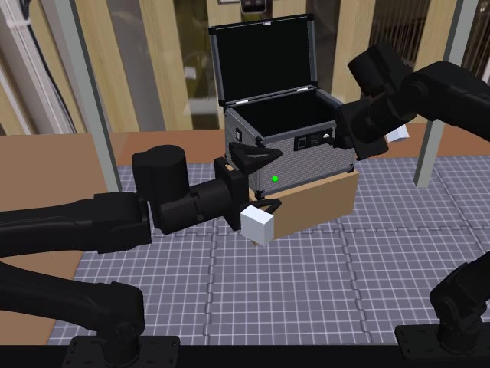
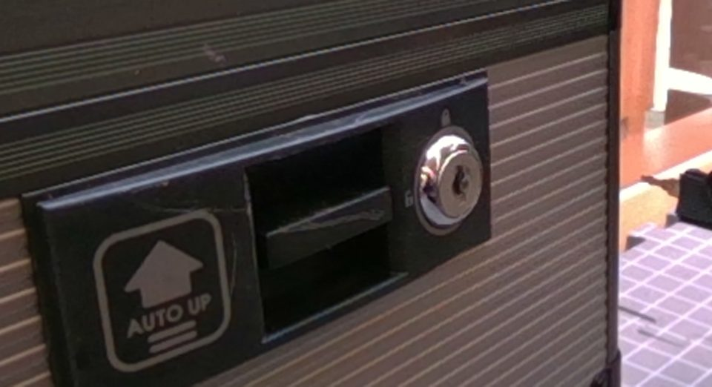
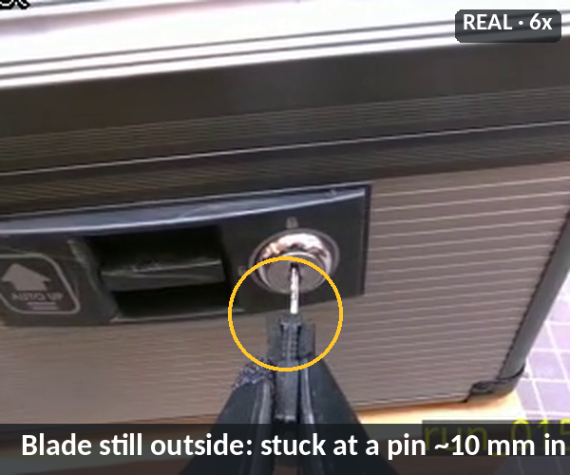
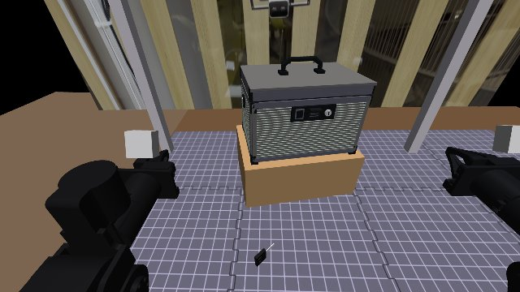
Why this task is hard for YAM
1
No demos
2
Very precise
0 demos at the start: agents had to find the strategy in sim
Keyway catches within 1.8 mm / 6°; the arm landed 2–10 mm off
3
Reach limits
4
No force sensor
Left arm: 0/100 scenes; the ~92° turn hits joint 4's limit
Can't feel a pin, a slip or the tab's stiff point
Notes:
(1) No demonstrations at the start: the strategy had to be found by agents in sim; the user recorded 4 teleop demos only later.
(2) Precision: the keyway catches the key only within 1.8 mm and 6°, while the real YAM arm landed 2-10 mm off before the controller work (now 0.43 mm median).
(3) Reachability: lock face, key and box sit near the arm's joint limits; the left arm could never insert and turn (0/100 scenes); the turn needs ~92° of wrist rotation and runs into joint 4's limit.
(4) No force sensor: the robot cannot feel the key stuck at a pin, slipping in its fingers, or the tab's stiff point; it infers contact from cameras and joint positions.

Slide 6
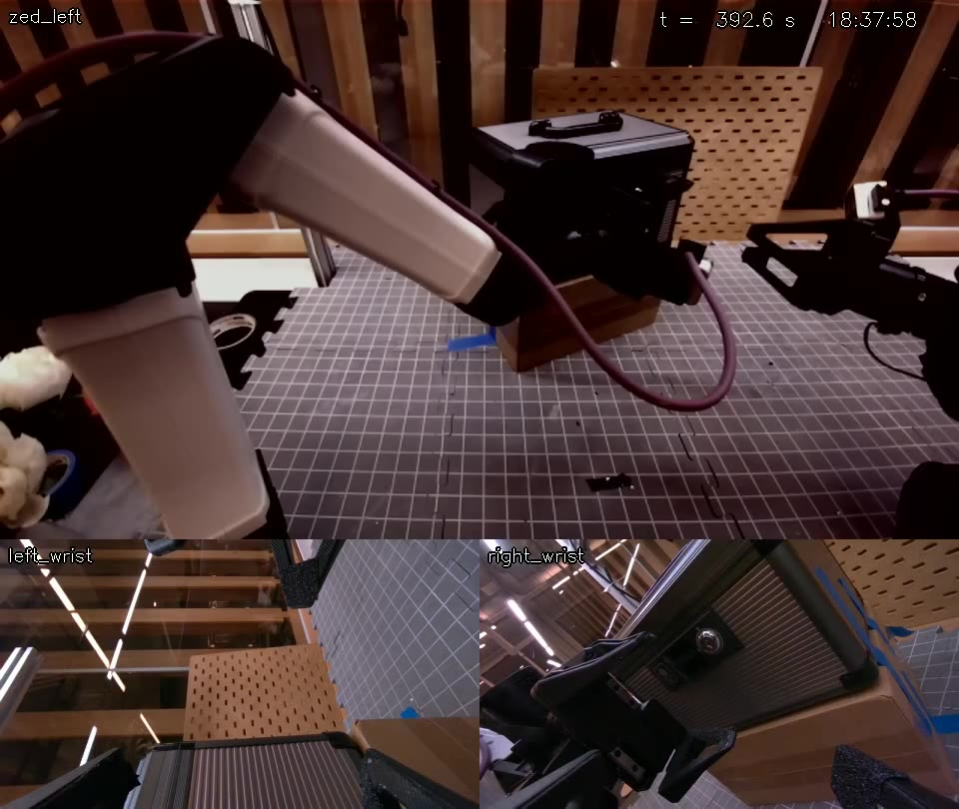
Success in sim, no progress on the real robot
SIM · first port, 2026-10-20
REAL · 22 Oct, key lost while lining up
496/500
vision graph final in sim (solver 197/200)
0
real runs that reached the key turn
Notes:
The box came as an RSS (RoboSimStudio) model and was first ported into the calibrated YAM MuJoCo twin on 2026-10-20. A scripted privileged solver did 197/200 there, and a vision agent graph reached dev 198/200 and final 496/500. Yet 34 real runs on 21-22 Oct never reached the key turn.

Slide 7
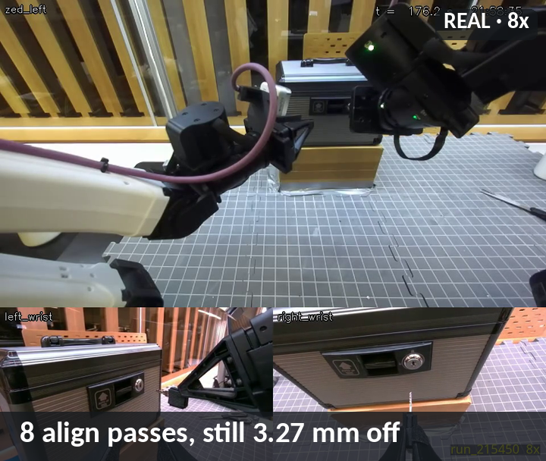
01 Motion
Reach the poses · land where commanded
Notes:
Motion: the arm could not reach many poses reliably, and where it went it landed off target (wrong gravity model, friction, gains).

Slide 8
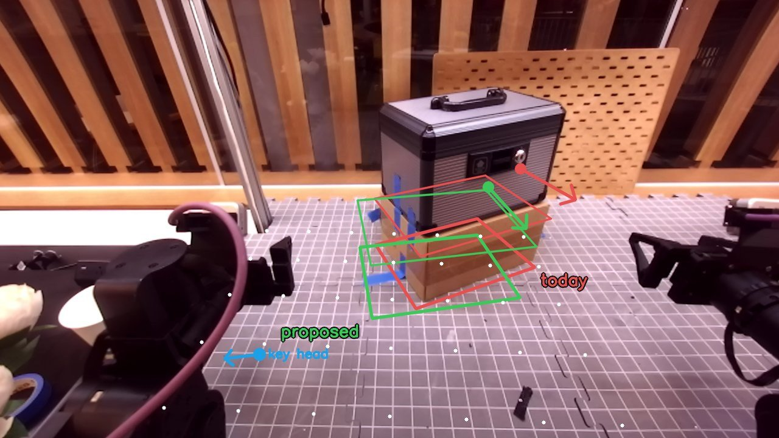
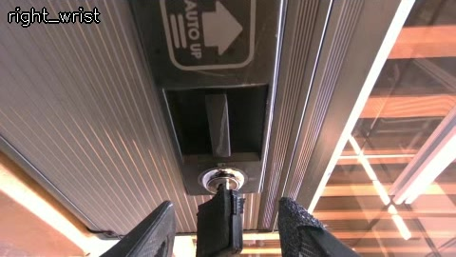
YAM Reachability
BEFORE (red) vs AFTER (green)
AFTER · right arm
REAL · turned −92°
0 → 100 of 100 scenes feasible after moving the box and giving the right arm the whole job
−92° turn: the real lock turns the other way; ~80° reach before joint 4's limit
Notes:
Before: in the old placement the left arm could insert and turn in 0/100 sampled scenes, and the old real4 setup was feasible in only 65/100 scenes; 34 real runs never reached the turn. After: box moved to 38/28 cm forward/right, turned 12° (was 43/33 cm, 25°); the key stands in front of the right arm, which picks, inserts, turns and presses; the left arm parks as an observer: 100/100 scenes feasible (worst/median joint margin 31/40°), no riser hits, left-arm gravity load 10.5 vs 13.5 Nm. Turn direction: the twin turned +, the real lock turns −; with the 18°-pitched grasp the hand reaches only ~80° before joint 4's limit, so the real graph turns −92° with a regrip-roll (first real insert + turn: run_004108).

Slide 9
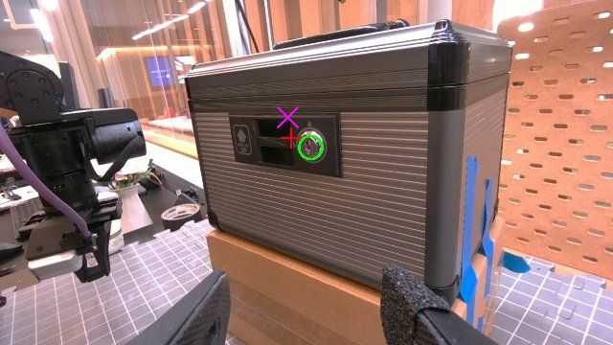
The offset came from gravity, friction and gains
REAL right wrist · run_123617
green real lock blue twin, same joints magenta old sag model
18.7 → 0.7 mm
gravity sag, right arm (left 16.6 → 2.0 mm)
1.1–1.2 Nm elbow static friction, now fed forward
Notes:
Median TCP error on the real right arm, one fix at a time: old i2rt gravity model 22.1 mm; fitted gravity 4.7 mm; runner feed-forward 2.7 mm; stiff PI 0.84 mm; PI + friction feed-forward 0.23 mm; chosen: normal springs + integral + friction ff + fitted gravity 0.43 mm (p90 0.83 mm, no vibration; the 0.23 mm option was much stiffer). Elbow static friction measured 1.1-1.2 Nm. Gravity fit RMS torque error: right arm 0.94 → 0.12 Nm (sag 18.7 → 0.7 mm at the align pose), left 0.73 → 0.17 Nm (16.6 → 2.0 mm). Image (real run_123617, right wrist): green circle = the real lock; blue cross = where the twin puts it at the same joint readings; magenta = the twin with the old sag model.

Slide 10
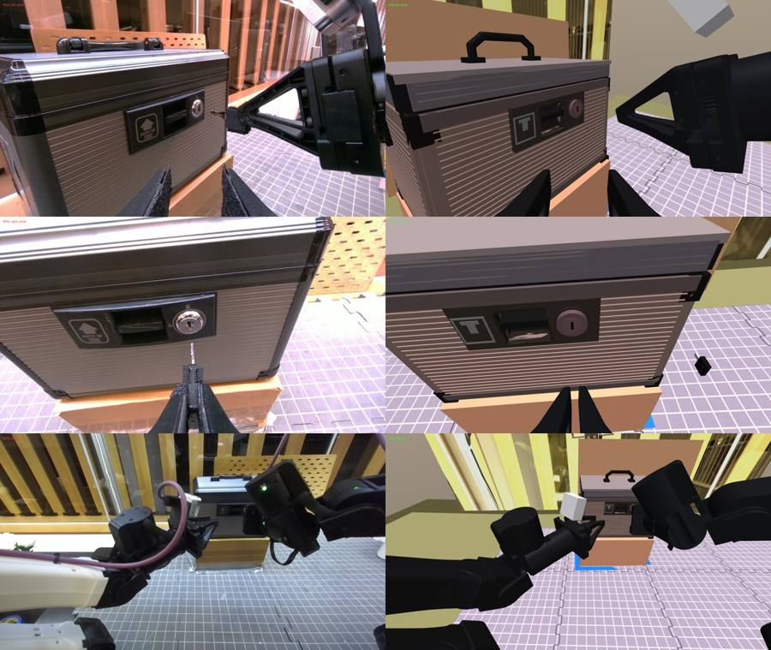
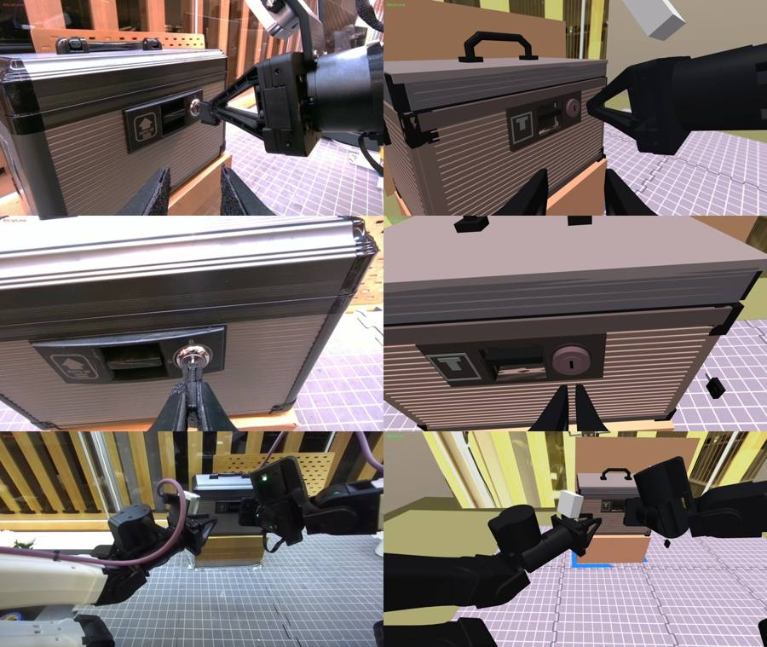
The sim now moves like the real arm
aligning: real | sim
pushing: real | sim
Springs 80/80/80/40/10/10 · capped integral · 0.15–0.4° landing error per joint · small sag
Notes:
The twin now models the real controller: joint springs 80/80/80/40/10/10, a capped integral term, a landing error of 0.15-0.4° per joint, and a small sag. Images: real (left of each pair) vs sim (right) at the same joint angles, while aligning the key and while pushing it in. Rows: left wrist, right wrist, ZED left.

Slide 11
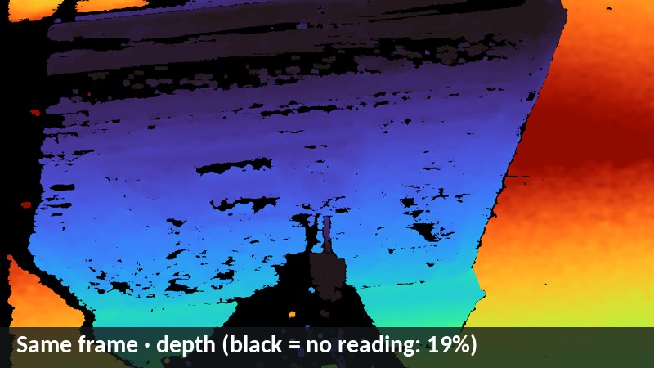
02 Perception
Depth: choose it · see where it fails · copy the failures · RGB looks
Notes:
Perception: choose the depth, see where the real cameras fail, and give the sim a camera at least as bad.

Slide 12
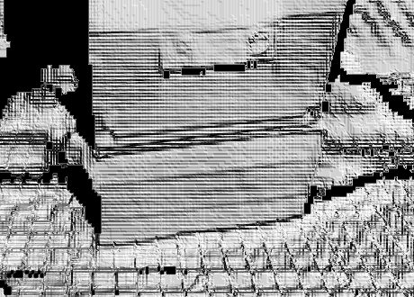
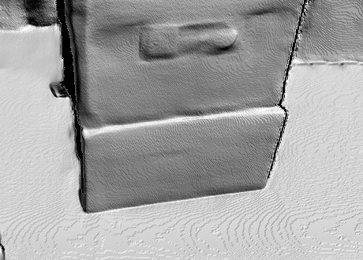
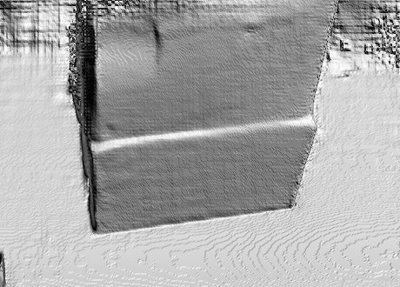
Depth chosen: ZED SDK neural depth, flat, square and fast
SDK Performance
SDK Neural · chosen
FoundationStereo
3.8 mm mat noise · 80° corner
5.7 ms per frame · 89.7° corner
0.49 mm flattest · 185 ms per frame
Notes:
Seven depth methods on the same 30 HD720 frames (page 12): SDK Performance / Neural Light / Neural / Neural Plus and Fast-FoundationStereo variants, shown as shaded relief of the box on its riser. SDK Neural Plus: 5.7 ms/frame, 0.63 mm mat roughness, box corner measured 89.7°. FoundationStereo is flattest (0.49 mm) but takes 185 ms per frame. SDK Performance: 3.8 mm mat noise, corner measured 80°. The runner uses the ZED SDK NEURAL depth mode; page 13 checked that the sim's ZED NEURAL depth model covers the real camera. Wrist D405s: on-camera depth (FoundationStereo would fill 100% vs 78% but costs 206 ms/frame and the right wrist is on USB 2.1).

Slide 13
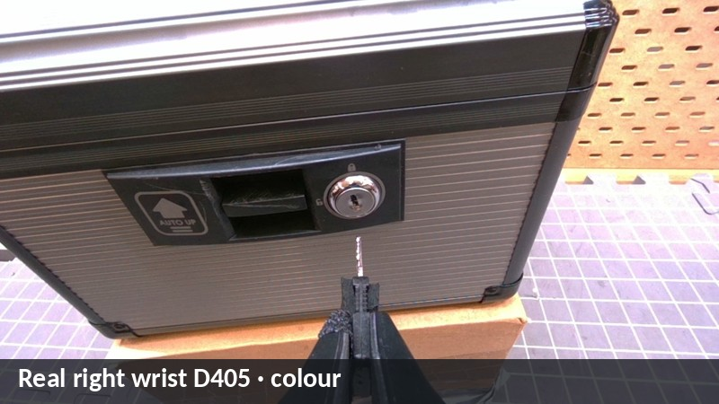
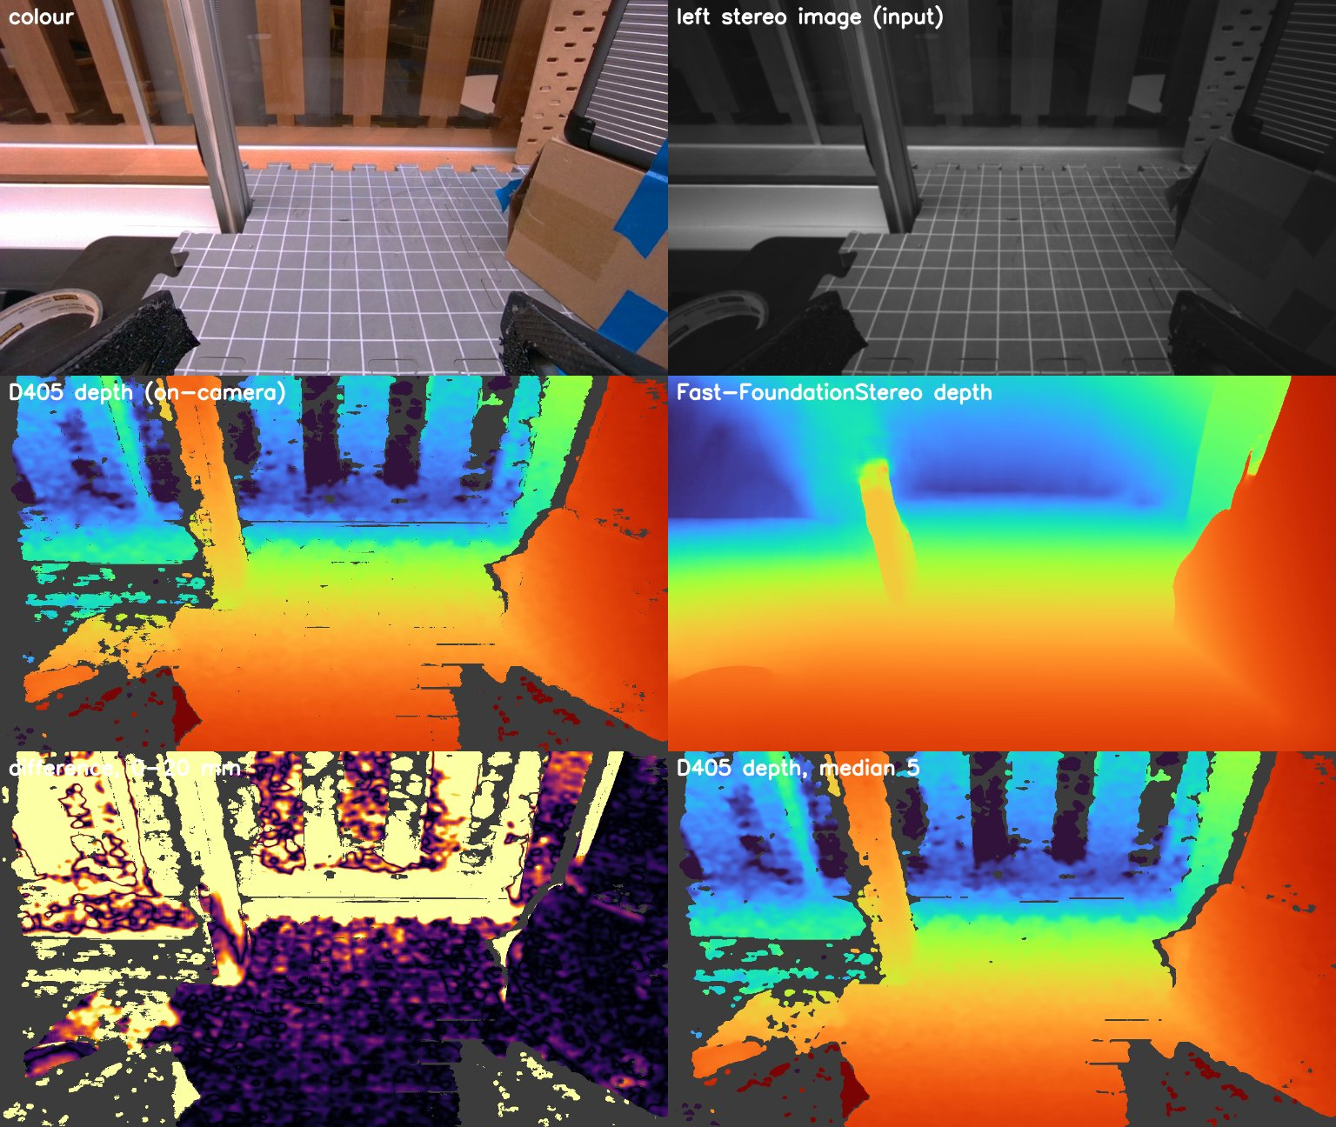
Shiny and dark surfaces read badly on the real cameras
REAL · right wrist colour
REAL · left wrist D405
19%
of wrist-depth pixels empty at the lock (black)
8–12 mm
off on the dark ribbed case face
REAL · same frame, depth
78%
fill of the on-camera D405 depth
Black = no reading. Streaks follow the ribs; the chrome lock gives holes. Middle: on-camera depth (left) vs FoundationStereo (right).
Notes:
Left pair: real run_020911, right wrist D405 at the lock (observation 0024, step 960): colour and the on-camera depth (colour = distance 0.11-0.49 m, black = no reading). 19% of the pixels have no depth; the holes run in streaks along the dark ribbed aluminium face and around the chrome lock. On the real D405s the dark ribbed case face also reads 8-12 mm off where it does read (pages 21/23), and the chrome lock cylinder gives holes and outliers. Right: left wrist D405 on-camera depth vs Fast-FoundationStereo (page 14): 78% vs 100% fill, median difference 4.8 mm where both read.

Slide 14
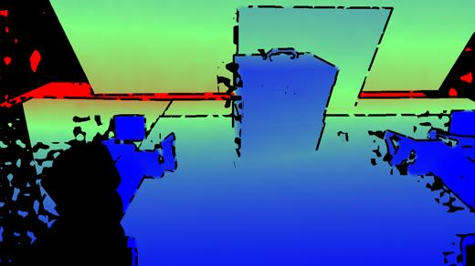
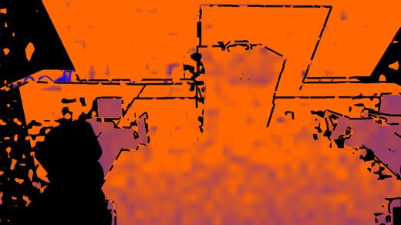
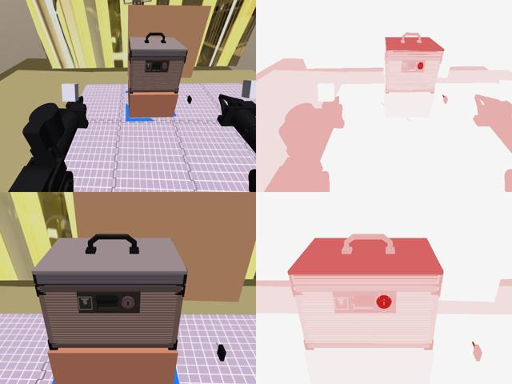
Sim depth: a camera at least as bad as the real one
SIM · depth as the graph gets it
SIM · depth error
SIM · extra noise per surface
Shiny surfaces: noise ×2.6 · 25% holes · 65% far-off readings
Dark surfaces: 20% holes
Distance: noise grows with range; holes at depth jumps and too near
Calibration ~2× real: fixed cams 0.6° / 4 mm · wrists 1.2° / 3 mm
red = more depth noise; the lock and case get the most
Notes:
The sim's camera model (real9; real errors are the floor, sim errors set at or above them): depth noise grows with distance; holes at depth jumps and when too near; ZED depth scale off by up to ±5%; per-surface rules from how the surface looks in that episode: the shinier a surface, the worse its depth ('shine': noise ×2.6, 25% holes, 65% of bad readings far off); dark surfaces: noise ×0.8 plus 20% holes. Calibration errors about 2× the real ones: fixed cameras up to 0.6° / 4 mm, wrists up to 1.2° / 3 mm. Left: seed 0 (the real cell), ZED and a close view, and the extra depth noise given to every surface (red = more). Right: depth as the graph gets it and its error (blue 0 → red ≥ 20 mm, black = no reading).

Slide 15
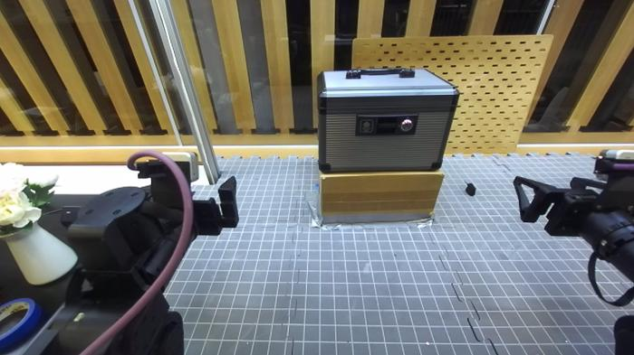
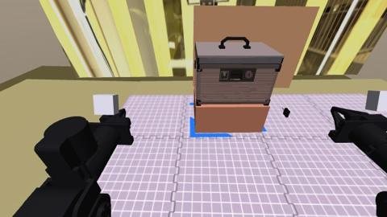
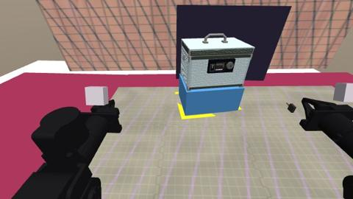
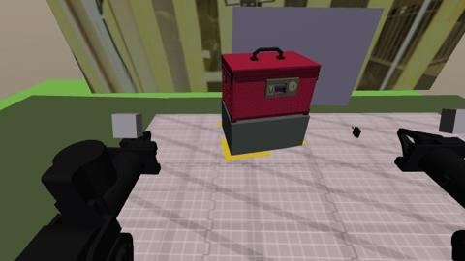
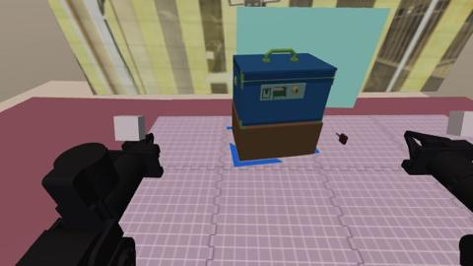
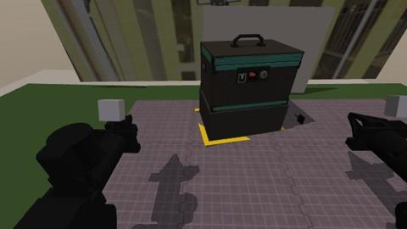
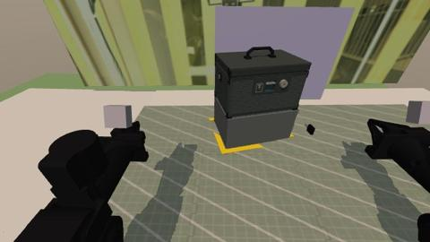
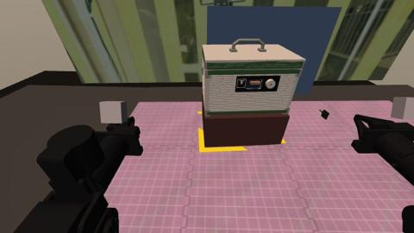
Sim RGB: every episode gets a new look
REAL · ZED
SIM · seed 0 = real look
seed 1
seed 2
seed 3
seed 4
seed 5
seed 6
Colours of case, bezel, tab, lock, riser, table, floor; flat to glossy
Patterns on mat and backdrop, mixed with the real ones
Key: any dark head; silver to brass metal
Lights: 35–90° up, 0.3–1.0, 3200–6500 K, shadows half the time
Camera: gain 0.93–1.07, brightness ±12, exposure ±6%, noise
Notes:
Look randomization per episode (seed 0 = the real cell's look): colours of the case, bezel, label, tab, lock metal, riser, table and floor can be any colour (case mostly near neutral, large surfaces mostly muted, metal for the lock); each part's finish from flat to glossy (metal satin to mirror). Mat and backdrop: patterned surfaces (plain, speckled, grained, striped, gridded) of any colour, mixed with the real ones. Key head: any dark colour; key metal silver to brass to dark. Lights: a key light from any direction 35-90° up, strength 0.3-1.0, warm to cool (3200-6500 K), shadows in half the episodes; fill light 0-0.6; ambient 0.1-0.5. Camera: colour gain 0.93-1.07 per channel (the real D405s render a little warm), brightness ±12, exposure changing up to 6% frame to frame, sensor noise. Images: real9 seeds as the ZED sees them (page 24).

Slide 16
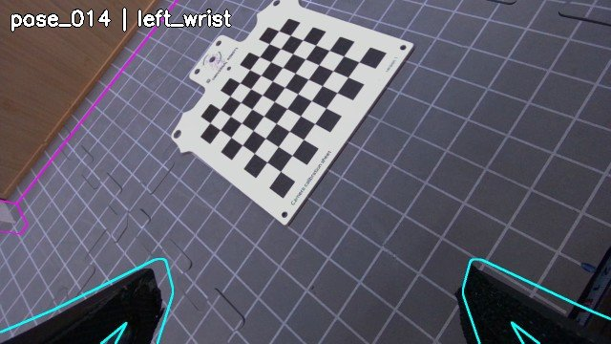

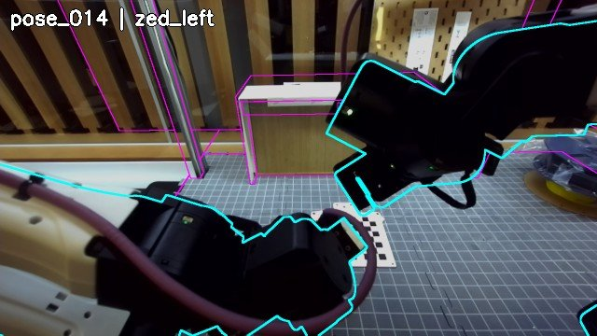

Robot-fit calibration beat the checkerboard
BEFORE · checkerboard
AFTER · robot-fit
0.62 → 0.75
finger IoU, left wrist
0.58 → 0.66
finger IoU, ZED grippers
BEFORE
AFTER
13.7 → 6.6
mm wrist-vs-wrist disagreement
Real errors: ZED 4.3 · left wrist 3.4 · right wrist 5.1 mm: sim errors set ≥ real
Notes:
Overlay (robot-fit) recalibration on 2026-10-21 vs the checkerboard calibration of 10-16, held-out pose 14. Twin outlines drawn on real images: finger IoU left wrist 0.62 → 0.75; ZED grippers 0.58 → 0.66; wrist-vs-wrist disagreement on the board 13.7 → 6.6 mm. Measured real camera errors after that: ZED vs left arm 4.3 mm, left wrist 3.4 mm, right wrist 5.1 mm. Rule: real errors are a floor, sim camera errors are set at or above them.

Slide 17
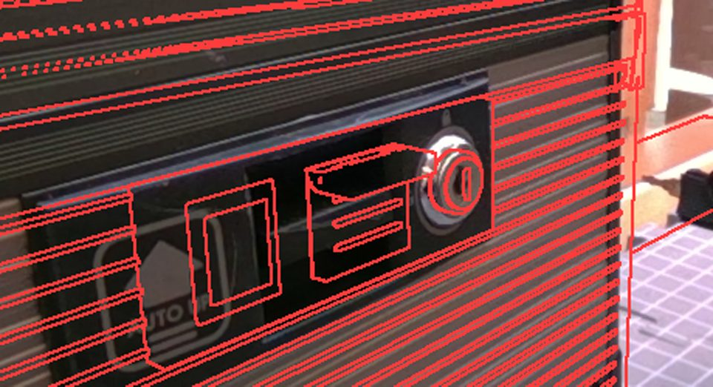
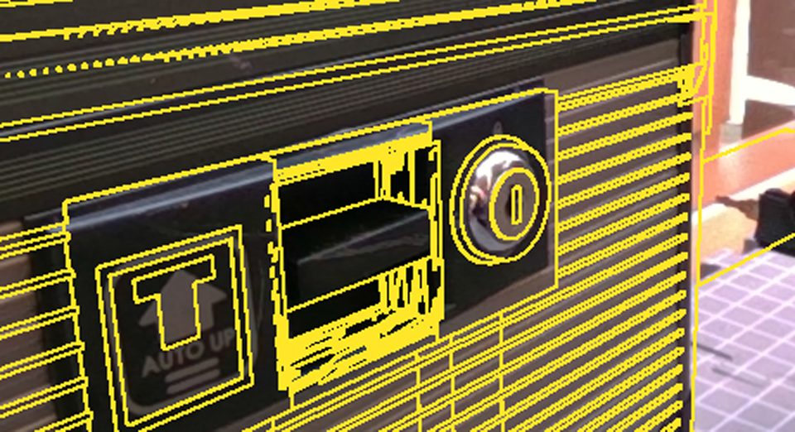
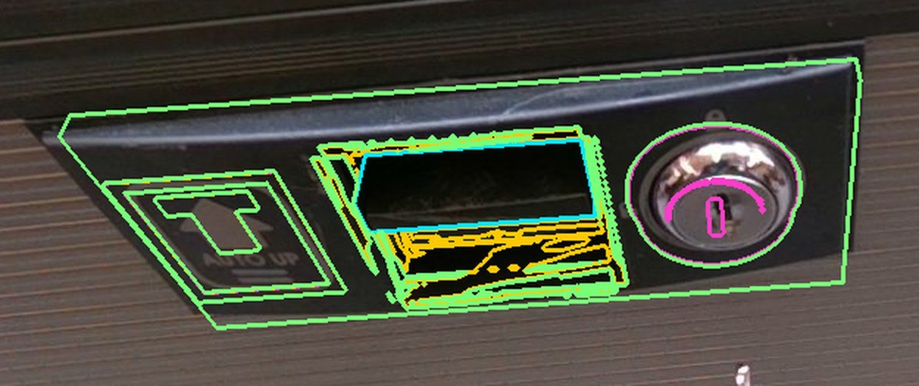
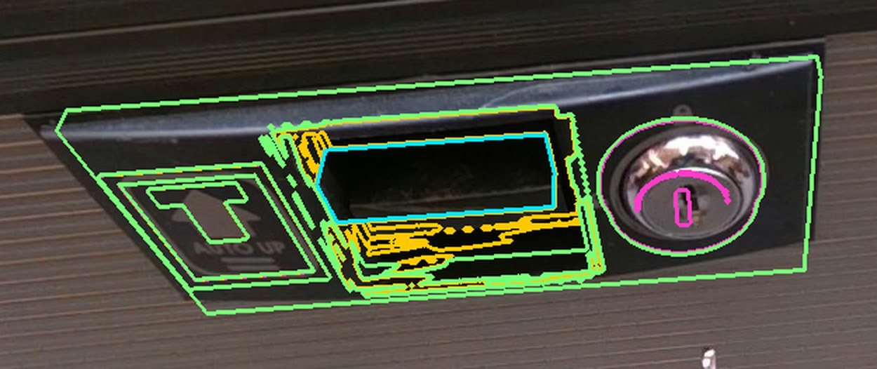
Aim from the right wrist; rebuild the lock face from the real one
BEFORE · old twin outlines
AFTER · rebuilt face
2–5 mm aim error: detector flipped 25 ↔ 32 mm
0.1–0.2 mm noise: right-wrist eye-in-hand look
1–3 mm outline fit; bezel 3.8 → 2.9 px, 4.9 → 3.7 px
BEFORE · tab drawn too high
AFTER · maker-photo fit
Notes:
Lock detection: the keyhole detector flipped between the chrome disk (~25 mm) and the disk + bezel (~32 mm), giving 2-5 mm aim errors, and the left camera saw the keyhole 11-14 mm too close. Fix: an eye-in-hand look from the right wrist (noise 0.1-0.2 mm). The real lock face was measured with the wrist cameras and rebuilt in the twin: new outlines land within 1-3 mm (the old twin had paddle and plate in the wrong place, no slot). The lock area was re-measured with the maker's photo: bezel edge error 3.8 → 2.9 px (left wrist), 4.9 → 3.7 px (right wrist); the tab is now a bar in the middle of the opening.

Slide 18
03 Physics
1
The key falls over
2
The key slips in the fingers
3
Insertion friction
Five problems, each before → after
4
The box is shoved off / flips
5
Pressing the tab
Notes:
Physics: five problems, each shown before and after its fix. Real clips show the real behaviour; sim clips are the same seed (9000101) with the old physics switched back on where it still reproduces.

Slide 19
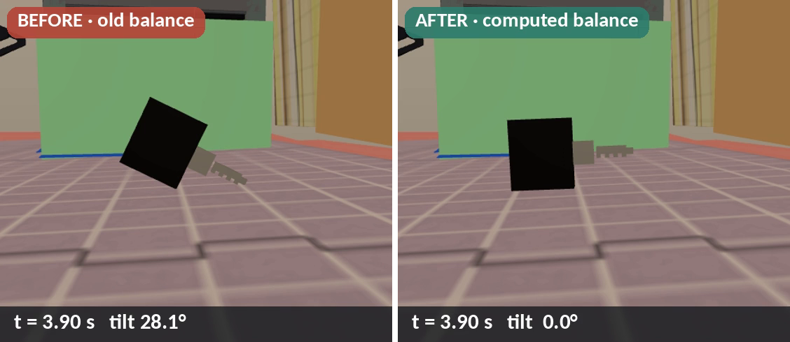
1 · The key fell over → now it stands on its head
28° → 0° how far the placed key tips (sim, same seed) · 7 of 20 real6b final failures were holders toppling at reset → holder shape capped
Notes:
Two tipping problems. (a) Real6b: randomized key holders that were too thin or too tall toppled at reset (7 of the 20 real6b final failures), so the holder aspect is now capped. (b) real9: a stale centre-of-mass constant (-8 mm) made the standing key tip onto its blade tip (blade pitch 25.8°, i.e. it tipped ~28° from where it was placed); the centre of mass is now computed from the key's parts and the key stays level. Video: same seed 9000102, the key as placed on the mat, the first 0.8 s at 0.3x speed (it falls in 0.25 s), then 0.6x.

Slide 20
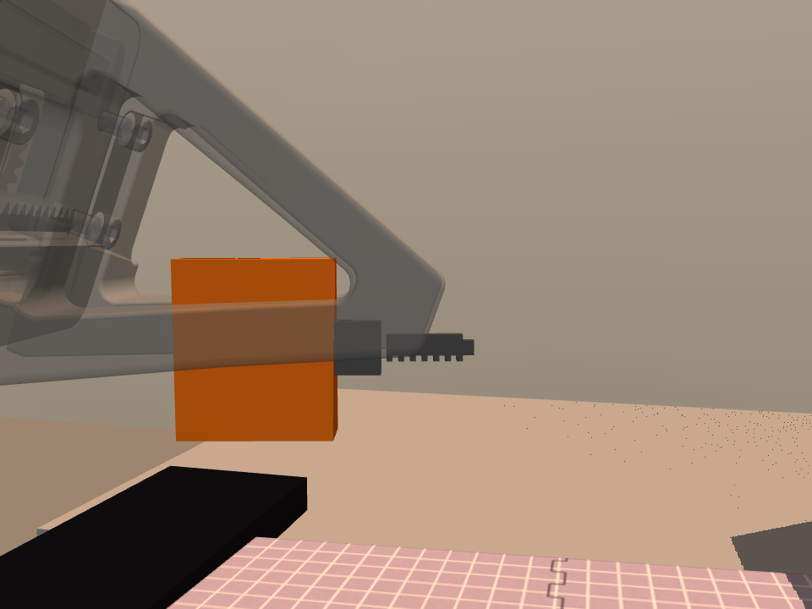
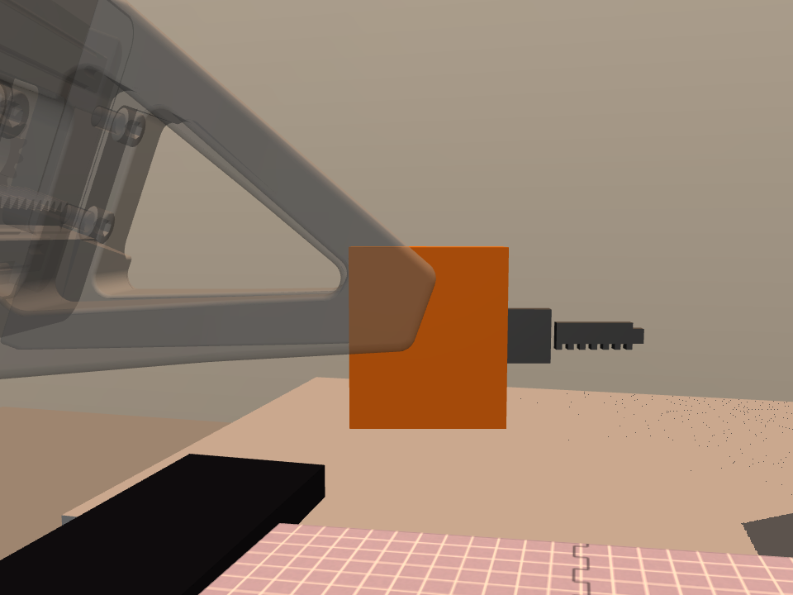
2 · The key slipped in the fingers → held firm now
BEFORE · old sim
AFTER · now
Before (sim): weak ~9 N squeeze, edgy fingertips: by the lock the key (orange) had slid 29 mm into the hand.
Now: flat pads, 35–40 N squeeze: the key stays at the fingertips (≤ 0.3 mm).
Notes:
Real (before): run_123617, right wrist at 2x: the key is in the fingertips at the keyhole and leaves the old edge pinch during the align servo; the fingers end empty. Fix on the real robot: the key now stands on its long edge and the right hand pinches it across its thickness. Sim: the gripper was a position servo that squeezed only ~9 N (4 N per side) and the fingertips were edgy convex mesh pieces, so the key rocked between their edges and walked 5-13 mm in the hand (up to 54 mm with the old lock-face teleport bug). Now: flat fingertip pads + a real 35-40 N squeeze; the key moves ≤ 0.3 mm between lift and insertion on all 19 seeds that lifted it. Note: with today's code the old grip settings no longer make this seed slip (the pads alone hold it), so the sim 'before' numbers come from the earlier runs, not a re-render.

Slide 21
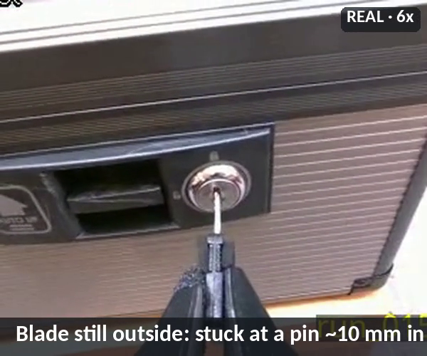
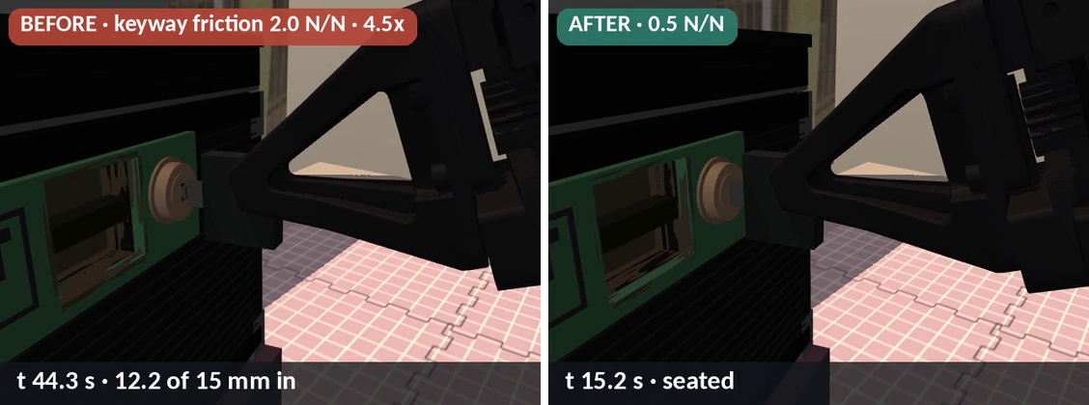
3 · Insertion friction: a little friction when the key is not aligned
REAL · run_015204, stuck
Edited so that when the key is not well aligned, a small friction holds it, which encourages wiggling.
Real: the key stuck at a pin ~10 mm in and was freed by rocking (teleop: stuck 7–28 s until rocked).
Notes:
Real: the key stuck at a pin ~10 mm in until rocked (run_015204 at 6x: blade still visible for the whole push). Teleop demos: aimed right at the face ~1 s, aimed wrong 3-11 s of sweeping, partly in 7-28 s until rocked free. Sim: the keyway catches the blade only within 1.8 mm / 6°; friction grows with side push and twist; pins at 25-85% depth hold the key until a 25-45 N push or a small wiggle. Old binding 2.0 N/N (BIND_SCALE=4) vs now 0.5 N/N, same seed 9000101, same scripted solver: the key took 47.6 s from the keyway to seated vs 15.2 s now (with the old grip the earlier runs jammed and never seated). Chart: key depth in the keyway vs time from catching it.

Slide 22
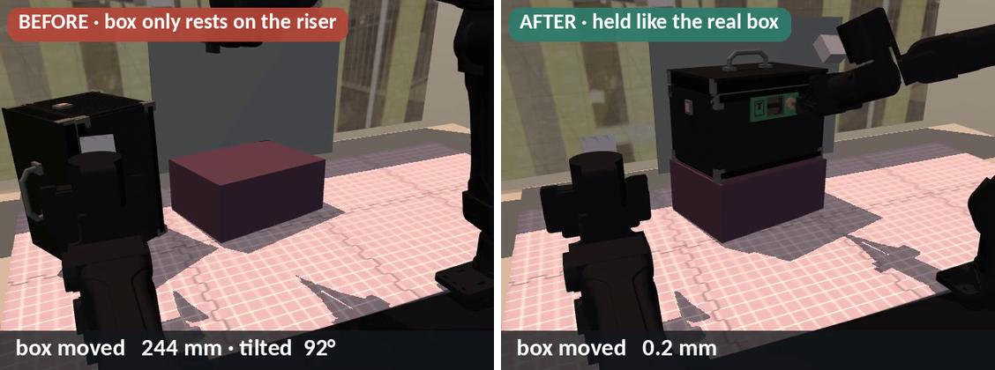
4 · The box was shoved off its riser and flipped → held now
244 mm, 92°
box shoved and flipped (before)
0.2 mm
box motion in a full episode (after)
Notes:
Sim, same seed 9000101, 2x: without a hold-down the right hand's approach shoved the box 244 mm and tipped it 92° onto its side off the riser (insertion IK then failed). The real box does not move; the box is now held firmly like the real one and moves 0.2-0.3 mm in a full episode. Collisions: the safety layer refuses arm-arm, arm-table and arm-riser contact (keep-out = riser + 2 cm, 5 mm above) and joint-limit moves; hand-box contact is ordinary solid contact.

Slide 23
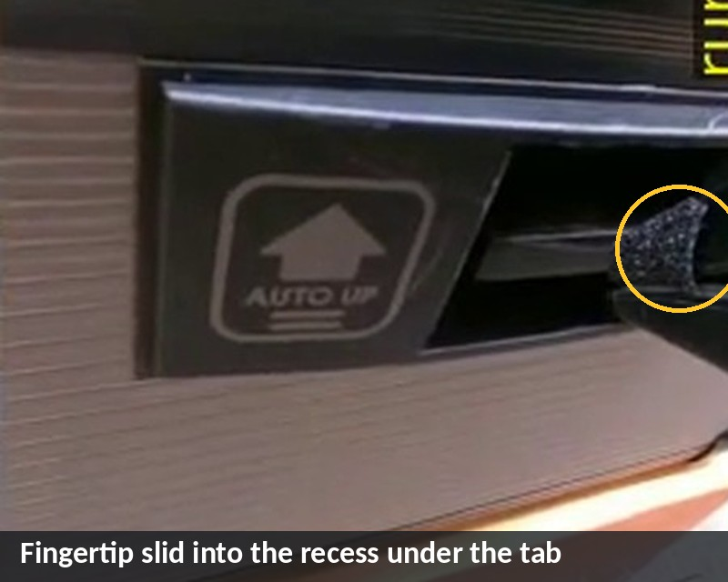
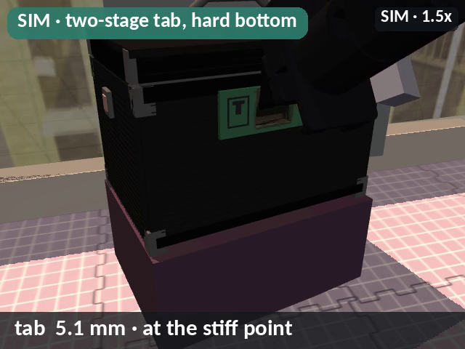
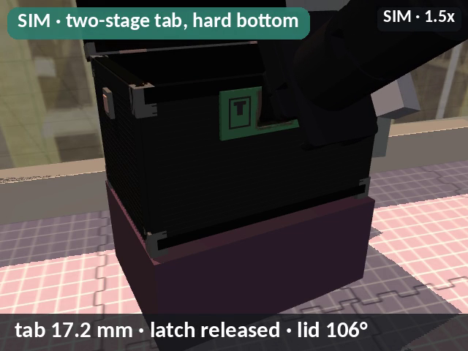
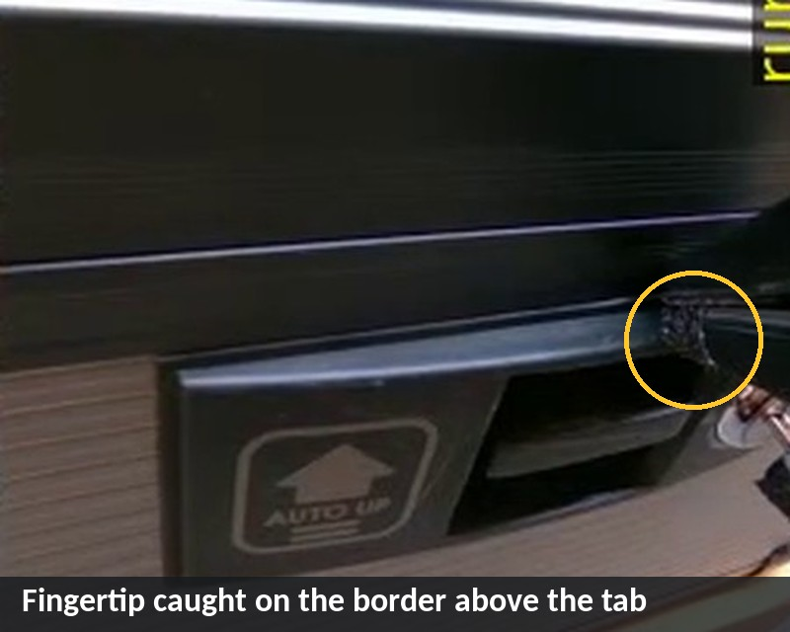
5 · Pressing the tab: a recessed tab with a stiff point
REAL · run_004108
REAL · run_012830
Before: 6 mm button, 700 N/m, a proud ledge the real box doesn't have
Now: stiff point at ~5 mm, ~17 mm travel to a hard bottom, latch at 95–98%
13 mm room above the real tab; real misses: border catch, recess slip
Notes:
Real: the tab sits in a recess and needs ~17 mm of travel past a stiff point (~5 mm down, ~10 N). The real fingertip caught on the border above it (run_012830) or slid into the recess under it (run_004108); the room above the tab measured 13 mm. Before (old twin): a 6 mm, 700 N/m button with a proud thumb ledge that does not exist on the real box, so any touch opened it. Now: two-stage spring with a hard bottom, latch at 95-98% travel. Sim video (seed 9000101, 1.5x) and chart: the fingertip holds the tab at the stiff point (5.1 mm) for ~8 s while the push builds, then it goes to the bottom (17.2 mm), the latch releases and the lid swings to 105°.

Slide 24
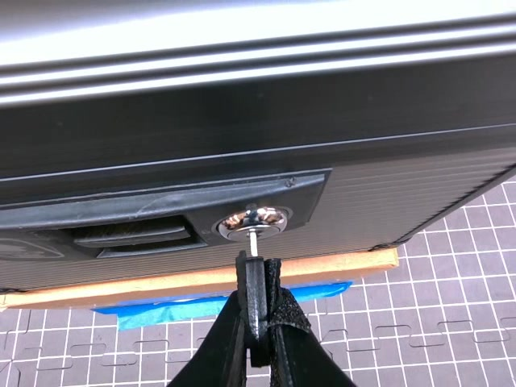

What helps ground the physics?
1
Robot runs
successes and failures
2
Human demos
teleop, 4 episodes
3
Language
facts a person tells the builder
“Inserting the key has large friction.”
“The button needs a bit of force.”
“The box doesn't move.”
“The key stands on its head without falling.”
Stuck at a pin → pin friction, wiggle
Border / recess → recessed tab, stiff point
run_020911 → the full working sequence
Strategy: right arm, grasp from behind, pitched 17–40°
Timings: aim right ~1 s · wrong 3–11 s · stuck 7–28 s until rocked
Notes:
(1) Robot runs, successful or failed: run_015204 (key stuck at a pin ~10 mm in, pads slid) and run_012830 / run_004108 (tab press caught the border / slid into the recess) told us about pin friction and the recessed tab with its stiff point; run_020911 showed the full working sequence. (2) Human demos: the user's 4 teleop demos (ep_172800 etc.) gave the strategy (right arm, grasp from behind pitched 17-40°) and the insertion timings: aimed right ~1 s at the face, aimed wrong 3-11 s of sweeping, partly in 7-28 s stuck until rocked. (3) Language: a person simply telling the sim builder facts; the quotes are paraphrases of what the user said during the build.

Slide 25

04 Results
Scripted solver · self-learning agents · the real robot
Notes:
Results in the fixed sim and on the real robot.

Slide 26
Robot doing the task
Rollout 1
Rollout 2
Notes:
The user's two recordings of the real YAM opening the box (successful_rollout_1_keybox.mp4, 40.3 s; successful_rollout_2_keybox.mp4, 48.5 s), shown at full length; the speed-ups are burned into the videos (6x, 12x, 16x, normal speed at the press).

Slide 27

Self-learning vision agents open the box in sim
SEEDED AGENT · 5x
Notes:
Two self-learning agents (real9 sim; stopped 2026-10-26 21:50) build vision graphs that see only the cameras (ZED view shown, 5x / 4x). Seeded agent: 7/8 on the demo seeds, best 81/100 dev. Scratch agent: 4/8, best 33/40 after the physics fixes. Full 200-seed dev before the fixes: 150/200 (seeded) and 130/200 (scratch). Neither has run the 500-seed final yet.

Slide 28


A general recipe for a new task
1
Physics priors first
2
Privileged agent solves it
3
Vision agent solves it
4
Zero-shot to real
friction · squeeze · stiff points · balance · what is held
true poses, no cameras: 0/20 → 17/20
sim cameras at least as bad as real
hopefully, as in run_020911
Next for the key box: re-run both agents on the fixed physics · 500-seed final · transfer the best graph
Notes:
(1) Give the sim the physics priors first: friction, grip squeeze, stiff points, masses and balance, what is held firmly; measured, or randomized around the best estimate. (2) Have a privileged agent solve it first (true poses, no cameras) to make sure the motion side works: reachability, controller, contacts. Here the scripted solver went 0/20 → 17/20 once the physics was right. (3) Then let the perception-based self-learning agent solve it with sim cameras at least as bad as the real ones. (4) Hopefully zero-shot sim-to-real (real run_020911).
What's left for the key box: re-run both self-learning agents on the fixed physics (key held to ≤ 0.3 mm); run the 500-seed final test; transfer the best graph to the real cell.

Slide 29



Next: new tasks for the same recipe
1
2
Hairbands into a zip bag
Protective film on a screen
open the pouch, put the scrunchies in, zip it
lay a thin film on a robot teach pendant
3
4
Other tasks?
Bike rotor (TRI)
Siemens: reel handling · parts organizer (98.8% final on the YAM twin)
already in the pipeline: easy 98.2%, tighten 97.6% final
Notes:
Upcoming tasks for the same recipe (physics priors → privileged solve → vision agent with bad-enough cameras → zero-shot to real). (1) Put hairbands into a zip bag: the user's clip IMG_3554 (two satin scrunchies and a butterfly zip pouch, opened, filled and zipped by hand). (2) Put a thin protective film on a screen: a Universal Robots teach-pendant screen. (3) Wheel / bike-rotor task for TRI: already in the pipeline as RSS real2sim; easy variant (seat the lockring tool) 98.2% final; tighten variant (place and spin the lockring snug) final 97.6%; video: scripted reference run, seed 4100003, 2x. (4) Sponsor tasks: Siemens reel handling and the parts organizer (organizer on the YAM twin 98.8% final); Robot Pizza Chef (a twin built 2026-10-26).

