Slide 1
ECE/CS 552: Introduction
Boone Severson
Lecture notes based in part on slides created by Joshua San Miguel, Mikko Lipasti, Mark Hill, David Wood, Guri Sohi, John Shen, and Jim Smith

Slide 2
What is Education?

Slide 3
What is Education?
Provides a set of fundamental axioms for producing and interpreting knowledge, which serves as an accessible bridge between the student learner and the infinite capabilities and complexities of the natural world.
everyday people
services
education
sciences
physical world

Slide 4
What is Computer Architecture?
Provides a set of fundamental axioms for producing and interpreting data, which serves as an accessible bridge between the digital programmers and the infinite capabilities and complexities of the analog hardware.
everyday people
software services (OS, apps)
computer architecture
hardware circuits
physical world

Slide 5
Computer Architecture
Instruction Set Architecture (IBM 360)
… the attributes of a [computing] system as seen by the programmer. I.e. the conceptual structure and functional behavior, as distinct from the organization of the data flows and controls, the logic design, and the physical implementation. -- Amdahl, Blaauw, & Brooks, 1964
Machine Organization (microarchitecture)
ALUs, Buses, Caches, Memories, etc.
Machine Implementation (realization)
Gates, cells, transistors, wires

Slide 6
552 In Context
Prerequisites
  252/352 – gates, logic, memory, organization
  252/354 – high-level language down to machine language interface or instruction set architecture (ISA)
This course – 552 – puts it all together
  Implement the logic that provides ISA interface
  Must do datapath and control, but no magic
  Manage tremendous complexity with abstraction
Follow-on courses explore trade-offs
  ECE 752, ECE 757

Slide 7
552 In Context
Application Program
CS302
Operating System
Compiler
CS536
CS537
Machine Language (ISA)
CS354
scope of this course
Digital Logic
ECE352
Electronic circuits
ECE340
Semiconductor devices
ECE335

Slide 8
Why Take 552?
To become a computer designer
  Alumni of this class helped design your computer
To learn what is under the hood of a computer
  Innate curiosity
  To better understand when things break
  To write better code/applications
  To write better system software (O/S, compiler, etc.)
Because it is intellectually fascinating!
  CPUs are arguably the most complex highly-integrated man-made devices

Slide 9
Computer Architecture
Exercise in engineering tradeoff analysis
  Find the fastest/cheapest/power-efficient/etc. solution
  Optimization problem with 100s of variables
All the variables are changing
  At non-uniform rates
  With inflection points
  Only one guarantee: Today’s right answer will be wrong tomorrow
Two high-level effects:
  Technology push
  Application pull

Slide 10
Technology Push
What do these two intervals have in common?
  1776-1999 (224 years)
  2000-2001 (2 years)

Slide 11
Technology Push
What do these two intervals have in common?
  1776-1999 (224 years)
  2000-2001 (2 years)
Answer: Equal progress in processor speed!
The power of exponential growth!
Driven by Moore’s Law
  Device per chips doubles every 18-24 months
Computer architects work to turn the additional resources into speed/power savings/functionality!

Slide 12
Performance Growth
Unmatched by any other industry !
[John Crawford, Intel]
Doubling every 18 months (1982-1996): 800x
  Cars travel at 44,000 mph and get 16,000 mpg
  Air travel: LA to NY in 22 seconds (MACH 800)
  Wheat yield: 80,000 bushels per acre

Slide 13
Application Pull
Corollary to Moore’s Law:
Cost halves every two years
  In a decade you can buy a computer for less than its sales tax today. –Jim Gray
Computers cost-effective for
  National security – weapons design
  Enterprise computing – banking
  Departmental computing – computer-aided design
  Personal computer – spreadsheets, email, web
  Mobile computing – smartphones

Slide 14
Application Pull
What about the future?
Must dream up applications that are not cost-effective today
  Virtual reality
  Telepresence
  Mobile applications
  Sensing, analyzing, actuating in real-world environments
This is your job!

Slide 15
Course Teaser

Slide 16
Course Teaser
How can we store our data?
Memory
  010101011010100101001110001
main memory

Slide 17
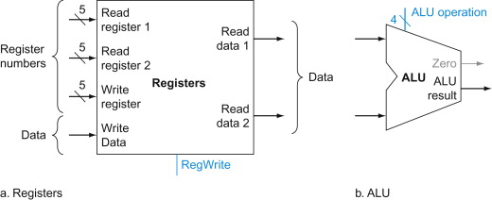
Course Teaser
How can we perform operations on our data?
Arithmetic Logic Units
  add, sub, or, nor, and, ...
main memory

Slide 18
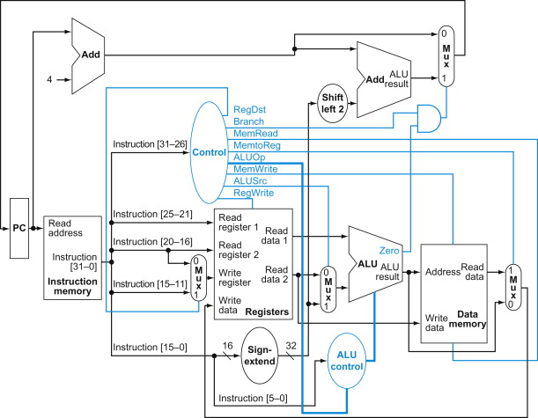
Course Teaser
How can we specify and execute a sequence of operations?
Instruction Set Architecture, Single-Cycle Processor
  add $t0, $t0, $s1
  or $t1, $t0, $s2
  and $t2, $t1, $s3
main memory
program instructions

Slide 19
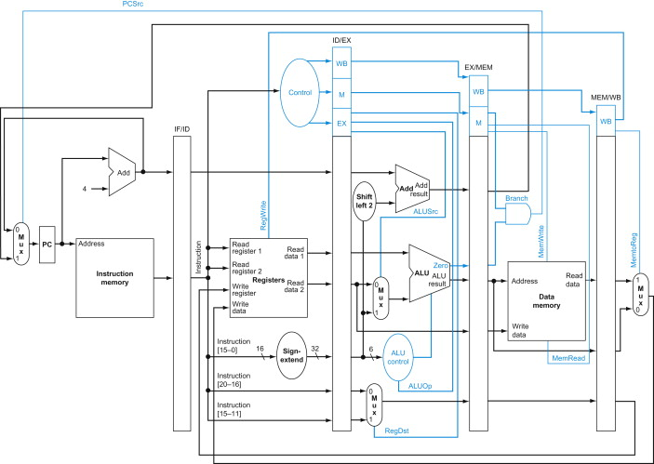
Course Teaser
How can we perform more operations at a time?
Pipelining
  add $t0, $t0, $s1
  or $t1, $t0, $s2
  and $t2, $t1, $s3
main memory
program instructions

Slide 20

Course Teaser
How can we perform even more operations at a time?
Superscalar, Out-of-order
  add $t0, $t0, $s1
  or $t1, $t0, $s2
  and $t2, $t1, $s3
main memory
program instructions

Slide 21
Course Teaser
How can we speed up memory loads and stores?
Caches
  add $t0, $t0, $s1
  or $t1, $t0, $s2
  and $t2, $t1, $s3
L1-I cache
L1-D cache
main memory
program instructions

Slide 22
Course Teaser
How can we run programs privately and in isolation?
Virtual Memory, TLBs
  add $t0, $t0, $s1
  or $t1, $t0, $s2
  and $t2, $t1, $s3
TLB
TLB
L1-I cache
L1-D cache
main memory
program instructions
page table

Slide 23
Course Teaser
How can we speed up parallel parts of our program?
Multiprocessors
  add $t0, $t0, $s1
  or $t1, $t0, $s2
  and $t2, $t1, $s3
  lw $t0, ($s0)
  nor $t3, $t0, $s1
  sub $t2, $t3, $s2
TLB
TLB
TLB
TLB
L1-I cache
L1-D cache
L1-I cache
L1-D cache
main memory
program instructions
page table

Slide 24
Course Teaser
How can we allow threads to safely share data?
Coherence, Consistency
  add $t0, $t0, $s1
  or $t1, $t0, $s2
  and $t2, $t1, $s3
  lw $t0, ($s0)
  nor $t3, $t0, $s1
  sub $t2, $t3, $s2
TLB
TLB
TLB
TLB
L1-I cache
L1-D cache
L1-I cache
L1-D cache
MSI, SC
MSI, SC
MSI, SC
MSI, SC
main memory
program instructions
page table

Slide 25
Course Teaser
How can we speed up non-parallel parts of our program?
Accelerators
  add $t0, $t0, $s1
  or $t1, $t0, $s2
  and $t2, $t1, $s3
  lw $t0, ($s0)
  nor $t3, $t0, $s1
  sub $t2, $t3, $s2
TLB
TLB
TLB
TLB
L1-I cache
L1-D cache
L1-I cache
L1-D cache
MSI, SC
MSI, SC
MSI, SC
MSI, SC
main memory
accelerator
program instructions
page table

Slide 26
Course Teaser
How can our processor interact with the user?
Disk, I/O
  add $t0, $t0, $s1
  or $t1, $t0, $s2
  and $t2, $t1, $s3
  lw $t0, ($s0)
  nor $t3, $t0, $s1
  sub $t2, $t3, $s2
TLB
TLB
TLB
TLB
L1-I cache
L1-D cache
L1-I cache
L1-D cache
MSI, SC
MSI, SC
MSI, SC
MSI, SC
main memory
accelerator
I/O
I/O
program instructions
page table

Slide 27
Course Teaser
…You’ve architected a modern computer
  add $t0, $t0, $s1
  or $t1, $t0, $s2
  and $t2, $t1, $s3
  lw $t0, ($s0)
  nor $t3, $t0, $s1
  sub $t2, $t3, $s2
TLB
TLB
TLB
TLB
L1-I cache
L1-D cache
L1-I cache
L1-D cache
MSI, SC
MSI, SC
MSI, SC
MSI, SC
main memory
accelerator
I/O
I/O
program instructions
page table

Slide 28
Future of Computer Architecture?
Mobile Computers
Graphics Processors
Intermittent Computing
Internet-Of-Things
Approximate Computing
Stochastic Computing
Ultra-Low-Power Processors
In-Memory Computing
Many-Core Processors
Cloud Computing
Reconfigurable Architectures
Quantum Computers
Energy-Harvesting Processors
Near-Threshold Computing
Warehouse-Scale Computers
Biodegradable Processors
AI Accelerators
Video Coding Unit

Slide 29
Abstraction
Difference between interface and implementation
  Interface: WHAT something does
  Implementation: HOW it does so

Slide 30
Abstraction, E.g.
2:1 Mux
Interface
Implementations
  Gates (fast or slow), pass transistors
X
Y
S | F
0 | X
1 | Y
S
Mux
F

Slide 31
What’s the Big Deal?
Firefox, MS Excel
Windows 11
Tower of abstraction
Complex interfaces implemented by layers below
Abstraction hides detail
Hundreds of engineers build one product
Complexity unmanageable otherwise
Visual C++
x86 Machine Primitives
Microarchitecture
Logic Gates & Memory
Transistors & Devices
Quantum Physics

Slide 32
Hardware Organization
In space:
Memory
Control
Output
Data Path
Input
Processor

Slide 33
Hardware Organization
In time:
  Fetch instruction from memory 001011001001
  Decode the instruction “add r1, r2, r3”
  Read input operands read [r2], [r3]
  Perform operation [r2] + [r3]
  Write results write to [r1]
  Determine the next instruction pc = pc + 4

Slide 34
Exercise
You have three international bank accounts: USD, EUR, JPY. You hire a foreign financial advisor to manage your accounts. But with your limited knowledge of the foreign language, you only know how to say one sentence:
“Please deduct from X account the current balance of Y account, and if the resulting balance is ≤ 0, ignore my next Z sentences.”
You also have a bunch of empty line of credit accounts (LOC1, LOC2, LOC3, ...) to facilitate transfers.
e.g., Now ask your financial advisor to perform a simple task:
Transfer all funds in your EUR account into your USD account.

Slide 35
Exercise
e.g., Transfer all funds in your EUR account into your USD account.
“Please deduct from X account the current balance of Y account, and if the resulting balance is ≤ 0, ignore my next Z sentences.”
[X] = [X] – [Y], then if [X] ≤ 0, skip next Z;
Shorthand: please X, Y, Z

Slide 36
Exercise
e.g., Transfer all funds in your EUR account into your USD account.
“Please deduct from X account the current balance of Y account, and if the resulting balance is ≤ 0, ignore my next Z sentences.”
[X] = [X] – [Y], then if [X] ≤ 0, skip next Z;
Shorthand: please X, Y, Z
Solution:
please LOC1, EUR, 0
please USD, LOC1, 0
please EUR, EUR, 0
please LOC1, LOC1, 0

Slide 37
Exercise
e.g., Transfer all funds in your EUR account into your USD account if USD funds > EUR funds.
[X] = [X] – [Y], then if [X] ≤ 0, skip next Z;
Shorthand: please X, Y, Z
Solution:
please LOC1, EUR, 0
please USD, LOC1, 0
please EUR, EUR, 0
please LOC1, LOC1, 0

Slide 38
Exercise
e.g., Transfer all funds in your EUR account into your USD account if USD funds > EUR funds.
[X] = [X] – [Y], then if [X] ≤ 0, skip next Z;
Shorthand: please X, Y, Z
Solution:
please LOC1, EUR, 0
please USD, EUR, 1
please USD, LOC1, 0
please USD, LOC1, 0
please EUR, EUR, 0
please LOC1, LOC1, 0

Slide 39
Exercise
e.g., Transfer all funds in your EUR account into your USD account if USD funds > EUR funds.
[X] = [X] – [Y], then if [X] ≤ 0, skip next Z;
Shorthand: please X, Y, Z
Solution:
please LOC1, EUR, 0
please USD, EUR, 1
please USD, LOC1, 0
please USD, LOC1, 0
please EUR, EUR, 0
please LOC1, LOC1, 0
skip if [USD] ≤ [EUR]
…but should skip too

Slide 40
Exercise
e.g., Transfer all funds in your EUR account into your USD account if USD funds > EUR funds.
[X] = [X] – [Y], then if [X] ≤ 0, skip next Z;
Shorthand: please X, Y, Z
Solution:
please LOC1, EUR, 0
please USD, EUR, 2
please USD, LOC1, 0
please EUR, EUR, 0
please USD, LOC1, 0
please EUR, EUR, 0
please LOC1, LOC1, 0
skip if [USD] ≤ [EUR]

Slide 41
Exercise
e.g., Transfer all funds in your EUR or JPY account, whichever is smaller, into your USD account.
Shorthand: please X, Y, Z
Solution:
please LOC1, EUR, 0
please USD, LOC1, 0
please LOC2, JPY, 0
please LOC2, LOC1, 3
please USD, LOC2, 0
please JPY, JPY, 0
please LOC3, LOC3, 1
please EUR, EUR, 0
please LOC1, LOC1, 0
please LOC2, LOC2, 0
[USD] += [EUR];
skip next if [JPY] ≥ [EUR]
if [JPY] < [EUR]:
[USD] += [JPY] – [EUR]; [JPY] = 0;
else:
[EUR] = 0;

Slide 42
Exercise Wrap-Up
Takeaways:
That was painful; we need abstraction!
Small finite instruction set -> Infinitely many possible programs
ISA building blocks:
please LOC1, EUR, 0
please USD, LOC1, 0
please LOC2, JPY, 0
please LOC2, LOC1, 3
please USD, LOC2, 0
please JPY, JPY, 0
please LOC3, LOC3, 1
please EUR, EUR, 0
please LOC1, LOC1, 0
please LOC2, LOC2, 0
registers
arithmetic
conditional branches
unconditional jumps

