Slide 1
ECE/CS 552: ISA Basics
Boone Severson
Lecture notes based in part on slides created by Joshua San Miguel, Mikko Lipasti, Mark Hill, David Wood, Guri Sohi, John Shen and Jim Smith

Slide 2
Instructions (252/354 Review)
Instructions are the “words” of a computer
Instruction set architecture (ISA) is its vocabulary
This defines most of the interface to the processor (not quite everything)
Implementations can and do vary
  e.g., Intel 486->Pentium->P6->Core Duo->Core i7

Slide 3
Instruction Sets
MIPS/MIPS-like ISA used in 552
  Simple, sensible, regular, easy to design CPU
Most common: x86 and ARM
  x86: Intel Core i7, AMD Ryzen, etc.
  ARM: cell phones, embedded systems, and even datacenter
Others:
  RISC-V (open source ISA w/reference implementation)
  IBM Power (mainframe servers)
  SPARC (Sun)

Slide 4
Forecast
Basics
Registers and ALU ops
Memory and load/store
Branches and jumps

Slide 5
MIPS Green Card
Familiarize yourself with the MIPS green card from the textbook

Slide 6
Basics
Opcode/Mnemonic: Specifies operation
C statement
  f = (g + h) – (i + j)
MIPS instructions
  add t0, g, h
  add t1, i, j
  sub f, t0, t1
Multiple instructions for one C statement
Operands: Input and
output data
Source
Destination

Slide 7
Registers
MIPS: Operands are registers, not variables
  add $t0, $s1, $s2
  add $t1, $s3, $s4
  sub $s0, $t0, $t1
MIPS has 32 word-size registers $0-$31
  1 word is 4 bytes
  $t0 ($8) and $t1 ($9) are temporaries
  e.g., $s0 ($16) is f, $s1 ($17) is g, $s2 ($18) is h, $s3 ($19) is i and $s4 ($20) is j
MIPS also allows one constant-value operand called an “immediate”
  Later we will see immediate is restricted to 16 bits

Slide 8
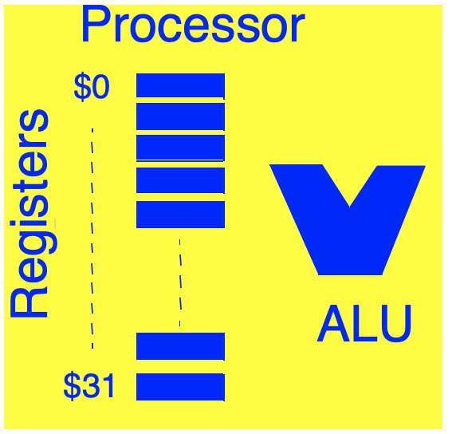
Registers and ALU

Slide 9
Arithmetic Logic Unit Ops
Some ALU ops:
  add, addi, addu, addiu (immediate, unsigned)
  sub …
  mul, div – wider result
    32b x 32b = 64b product
    32b / 32b = 32b quotient and 32b remainder
  and, andi
  or, ori
  sll, srl
Why a small set of (32) registers?
  Unique identifiers of registers are short: log₂(32) = 5 bits
But are registers enough?

Slide 10
Memory and Load/Store
Need more than 32 words of storage
e.g., array A[i]
Instructions for data movement:
  Load word to register from memory
  lw $t1, 0($s1) # where [$s1]=4008; get input g
  Store word from register to memory
  sw $t1, 0($s0) # where [$s0]=4004; save output f

Slide 11
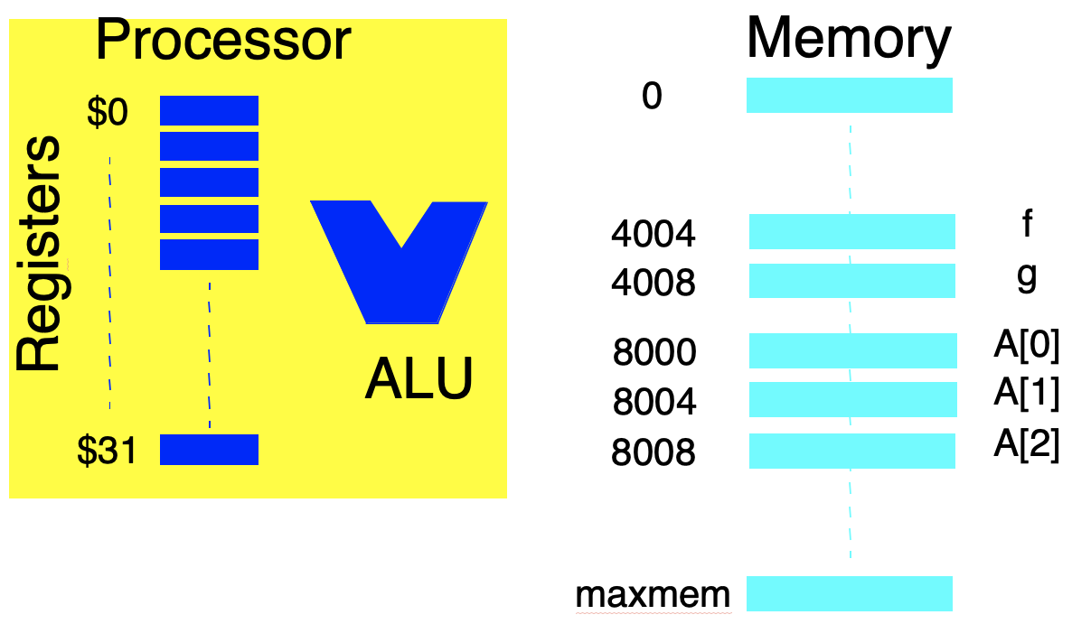
Memory and Load/Store

Slide 12
Memory and Load/Store
Important for arrays
  A[i] = A[i] + h
  # $t0 is temp, $s2 is h, $s5 is (i x 4)
  # A[] is integer array, and &A[0] = 8000
  lw $t0, 8000($s5)
  add $t0, $s2, $t0
  sw $t0, 8000($s5)
MIPS has other load/store for bytes and halfwords

Slide 13
Branches and Jumps
while ( i != j) {
j = j + i;
i = i + 1;
}

Slide 14
Branches and Jumps
while ( i != j) {
j = j + i;
i = i + 1;
}
# [$s1] is i, [$s2] is j
LOOP:
EXIT:

Slide 15
Branches and Jumps
while ( i != j) {
j = j + i;
i = i + 1;
}
# [$s1] is i, [$s2] is j
LOOP: beq $s1, $s2, EXIT
add $s2, $s2, $s1
addi $s1, $s1 , 1
j LOOP
EXIT:
Branch on equal (beq):
  Go to EXIT if $s1 == $s2
  Go to next instruction otherwise

Slide 16
Branches and Jumps
What does beq really do?
  Read $s1, read $s2, compare
  Set PC = PC + 4 or PC = Target
  Program counter (PC) specifies the address of the currently executing instruction
To do comparisons other than == or !=
  E.g.
  blt $s1, $s2, TARGET # pseudo-instruction
  Expands to:
  slt $t0, $s1, $s2 # set $t0 = ($s1 < $s2)
  bne $t0, $zero, TARGET # $zero ($0) is always 0

Slide 17
Branches and Jumps
MIPS branches
  beq $s1, $s2, imm # if ($s1==$s2) PC = PC + 4 + imm<< 2; else PC += 4;
  bne …
  slt, sle, sgt, sge
Unconditional jumps
  j addr # PC = addr
  jr $s3 # PC = $s3
  jal addr # $ra = PC + 8; PC = addr;
  (used for function calls; ret = jr $ra)

Slide 18
MIPS Green Card
Hint: Familiarize yourself with the MIPS green card from the textbook

Slide 19
Exercise – MIPS Assembly
What does this assembly code do?
  lw $t0, 0($s0)
  nor $t0, $t0, $zero
  addi $t0, $t0, 1
  sw $t0, 0($s0)

Slide 20
Exercise – MIPS Assembly
What does this assembly code do?
  lw $t0, 0($s0)
  nor $t0, $t0, $zero
  addi $t0, $t0, 1
  sw $t0, 0($s0)
Computes two’s complement of integer at ($s0).

Slide 21
Exercise – MIPS Assembly
What does this assembly code do?
  lw $t0, 0($s0)
  nor $t0, $t0, $zero
  addi $t0, $t0, 1
  sw $t0, 0($s0)
Computes two’s complement of integer at ($s0).
Reduce the number of instructions executed?

Slide 22
Exercise – MIPS Assembly
What does this assembly code do?
  lw $t0, 0($s0)
  sub $t0, $zero, $t0
  sw $t0, 0($s0)
Computes two’s complement of integer at ($s0).
Reduce the number of instructions executed?

Slide 23
Exercise – MIPS Assembly
What does this assembly code do?
  addi $t0, $zero, 4096
  lw $t1, 0($s0)
  slt $t2, $t1, $zero
  nor $t2, $zero, $t2
  slt $t3, $t1, $t0
  and $t4, $t2, $t3
  bne $t4, $zero, TARGET

Slide 24
Exercise – MIPS Assembly
What does this assembly code do?
  addi $t0, $zero, 4096
  lw $t1, 0($s0)
  slt $t2, $t1, $zero
  nor $t2, $zero, $t2
  slt $t3, $t1, $t0
  and $t4, $t2, $t3
  bne $t4, $zero, TARGET
Branches to TARGET if 0 ≤ ($s0) < 4096.

Slide 25
Exercise – MIPS Assembly
What does this assembly code do?
  addi $t0, $zero, 4096
  lw $t1, 0($s0)
  slt $t2, $t1, $zero
  nor $t2, $zero, $t2
  slt $t3, $t1, $t0
  and $t4, $t2, $t3
  bne $t4, $zero, TARGET
Branches to TARGET if 0 ≤ ($s0) < 4096.
Reduce the number of instructions executed?

Slide 26
Exercise – MIPS Assembly
What does this assembly code do?
  addi $t0, $zero, -4096 # binary: 1…1000000000000
  lw $t1, 0($s0)
  slt $t2, $t1, $zero
  nor $t2, $zero, $t2
  slt $t3, $t1, $t0
  and $t4, $t0, $t1
  beq $t4, $zero, TARGET
Branches to TARGET if 0 ≤ ($s0) < 4096.
Reduce the number of instructions executed?

Slide 27
Exercise – MIPS Assembly
What does this assembly code do?
  addi $t0, $zero, -4096
  lw $t1, 0($s0)
  and $t4, $t0, $t1
  beq $t4, $zero, TARGET
Branches to TARGET if 0 ≤ ($s0) < 4096.
Can reduce even more?

Slide 28
Exercise – MIPS Assembly
What does this assembly code do?
  addi $t0, $zero, -4096
  lw $t1, 0($s0)
  sltiu $t4, $t1, 4096
  bne $t4, $zero, TARGET
Branches to TARGET if 0 ≤ ($s0) < 4096.
Can reduce even more?

Slide 29
Exercise – MIPS Assembly
What does this assembly code do?
  lw $t1, 0($s0)
  sltiu $t4, $t1, 4096
  bne $t4, $zero, TARGET
Branches to TARGET if 0 ≤ ($s0) < 4096.
Can reduce even more?

