Slide 1
ECE/CS 552: ISA Basics
Boone Severson
Lecture notes based in part on slides created by Joshua San Miguel, Mikko Lipasti, Mark Hill, David Wood, Guri Sohi, John Shen and Jim Smith

Slide 2
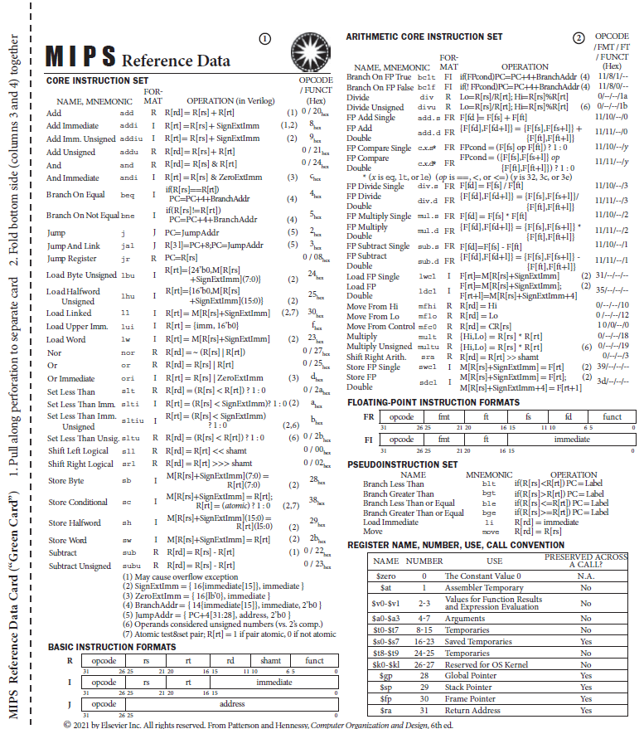
MIPS Green Card

Slide 3
MIPS ISA
Focus on core instruction set
  And ignore Load Linked and Store Conditional
Instructions and registers are 32-bit words
  Registers are referred by name ($t0) or number ($8)
  Register $zero ($0) always contains the value 0
Memory is byte-addressable
Only supports Branch on Equal or Not Equal
  Use Set Less Than instructions for other comparisons

Slide 4
MIPS ISA
Sample code:
  LOOP: addi $t0, $zero, 4096 # [$t0] = 4096
  lw $t1, 4($t0) # [$t1] = ($t0+4)
  slti $t2, $t1, 32 # [$t2] = [$t1] < 32 ? 1 : 0
  bne $t2, $zero, LOOP # branch to LOOP if [$t2] != 0
label
immediate
register

