Slide 1
ECE/CS 552: Performance Metrics
Boone Severson
Lecture notes based in part on slides created by Joshua San Miguel, Mikko Lipasti, Mark Hill, David Wood, Guri Sohi, John Shen and Jim Smith

Slide 2
Performance
Which of the following airplanes has the best performance?
Airplane Passengers Range (mi) Speed (mph)
Boeing 737-100 101 630 598
Boeing 747 470 4150 610
BAC/Sud Concorde 132 4000 1350
Douglas DC-8-50 146 8720 544
How much faster is the Concorde vs. the 747
How much bigger is the 747 vs. DC-8?

Slide 3
Performance
Which computer is fastest?
Not so simple
  Scientific simulation – FP performance
  Program development – Integer performance
  Database workload – Memory, I/O

Slide 4
Performance
Want to buy the fastest computer for what you want to do?
  Workload is all-important
  Correct measurement and analysis
Want to design the fastest computer for what the customer wants to pay?
  Cost is an important criterion

Slide 5
Forecast
Response time and throughput
Iron Law
Arithmetic and geometric mean
Amdahl’s Law

Slide 6
Defining Performance
What is important to whom?
Computer system user
  Minimize elapsed time for program:
    t_{resp} = t_{end} – t_{start}
  Called response time
Computer center manager
  Maximize completion rate = #jobs/second
  Called throughput

Slide 7
Response Time vs. Throughput
Is throughput = 1/avg. response time?
  Only if NO overlap
  Otherwise, throughput > 1/avg. response time
  e.g., Lunch buffet with 5 entrees
  Each person takes 2 minutes to add entrée to their plate => fill time = 10 minutes/plate
  But throughput = 5 plates filled/10 minutes
    Since 5 people simultaneously filling plates (overlapping pipeline)
    Without overlap, throughput = 1/10
plate 1
plate 2
plate 3
plate 4
plate 5
10 minutes

Slide 8
Improve Performance
Improve (a) response time or (b) throughput?
  Faster CPU
    Helps both (a) and (b)
  Add more CPUs
    Helps (b) and perhaps (a) due to less queueing
For computer architects
  Focus on CPU time = time spent running program

Slide 9
Performance Comparison
Machine A is n times faster than machine B if
time(B)/time(A) = n
Machine A is x% faster than machine B iff
  time(B)/time(A) = 1 + x/100%
E.g. time(A) = 10s, time(B) = 15s
  15/10 = 1.5 => A is 1.5 times faster than B
  15/10 = 1.5 => A is 50% faster than B

Slide 10
Breaking Down Performance
A program is broken into instructions
  Hardware is aware of instructions, not programs
At low level, hardware breaks instructions into cycles
  Lower level state machines change state every cycle
For example:
  1GHz Snapdragon runs 1000M cycles/sec, 1 cycle = 1ns
  4.4GHz Ryzen Zen5 runs 4.4B cycles/sec, 1 cycle = 0.227ns

Slide 11
Iron Law
Time
Processor Performance = ---------------
Program
=
Instructions
Cycles
Time
X
X
Program
Instruction
Cycle
(dynamic insns)
(CPI)
(cycle time)
Architecture --> Implementation --> Realization
Compiler Designer Processor Designer Chip Designer

Slide 12
Iron Law Example
Machine A: clock 1ns, CPI 2.0, for program x
Machine B: clock 2ns, CPI 1.2, for program x
Which is faster and how much?
  Time/Program = instr/program x cycles/instr x sec/cycle
  Time(A) = N x 2.0 x 1 = 2N
  Time(B) = N x 1.2 x 2 = 2.4N
  Compare: Time(B)/Time(A) = 2.4N/2N = 1.2
So, Machine A is 20% faster than Machine B for this program

Slide 13
Multiple Programs
 | Machine A | Machine B
Program 1 | 1 | 10
Program 2 | 1000 | 100
Total | 1001 | 110
One answer: for total execution time, how much faster is B?
1001 / 110 = 9.1x

Slide 14
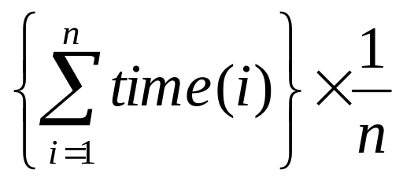
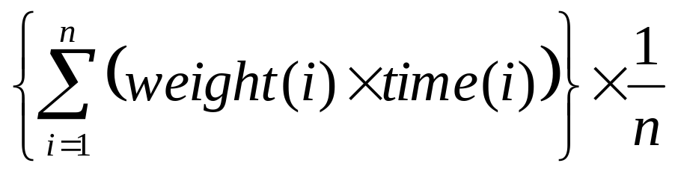
Arithmetic Mean
Another answer: arithmetic mean (same result)
Arithmetic mean of times:
AM(A) = 1001/2 = 500.5
AM(B) = 110/2 = 55
Speedup = 500.5/55 = 9.1x
Valid only if programs run equally often
  Otherwise, use weighted arithmetic mean:

Slide 15
Dealing with Ratios
 | Machine A | Machine B
Program 1 | 1 | 10
Program 2 | 1000 | 100
Total | 1001 | 110
If we take ratios with respect to machine A:
 | Machine A | Machine B
Program 1 | 1 | 10
Program 2 | 1 | 0.1
Arith. Mean | 1 | 5.05

Slide 16
Dealing with Ratios
 | Machine A | Machine B
Program 1 | 1 | 10
Program 2 | 1000 | 100
Total | 1001 | 110
But if we take ratios with respect to machine B:
Can’t both be true!
 | Machine A | Machine B
Program 1 | 0.1 | 1
Program 2 | 10 | 1
Arith. Mean | 5.05 | 1

Slide 17
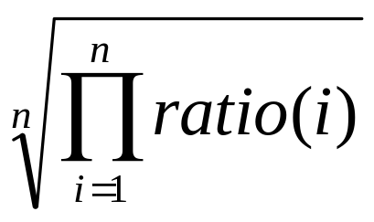
Geometric Mean
Use geometric mean for ratios
Independent of reference machine
In the example, GM(A) = 1 and GM(B) = 1
  Normalized with respect to either machine

Slide 18
Geometric Mean
 | Machine A | Machine B
Program 1 | 1 | 10
Program 2 | 1000 | 100
Total | 1001 | 110
But GM of ratios is not proportional to total time
Recall: in example, arithmetic mean says B is 9.1x faster
  But geometric mean says they are equal
If we took total execution time, A and B are equal only if
  Program 1 is run 100 times more often than Program 2

Slide 19
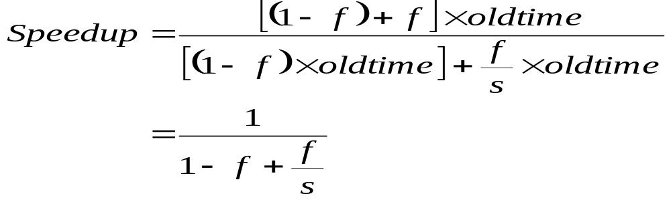
Amdahl’s Law
Motivation for optimizing the common case
Program speedup = old time / new time
Total program speedup when applying an optimization that accelerates a fraction f of time by a factor of s

Slide 20
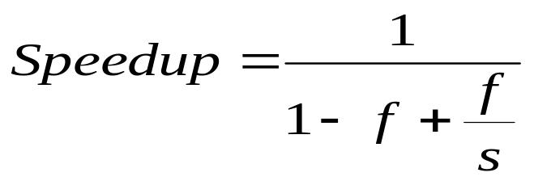
Amdahl’s Law Example
Your boss asks you to improve performance by either:
  Improving the ALU (used 95% of time) by 10%
  Improving the memory pipeline (used 5% of time) by 10x
f | s | Speedup
95% | 1.10 | 1.094
5% | 10 | 1.047

Slide 21
Amdahl’s Law Example
Your boss asks you to improve performance by either:
  Improving the ALU (used 95% of time) by 10%
  Improving the memory pipeline (used 5% of time) by 10x
f | s | Speedup
95% | 1.10 | 1.094
5% | 10 | 1.047
5% | ∞ | 1.052

