Slide 1
ECE/CS 552: Arithmetic Logic Units
Boone Severson
Lecture notes based in part on slides created by Joshua San Miguel, Mikko Lipasti, Mark Hill, David Wood, Guri Sohi, John Shen and Jim Smith

Slide 2
Basic Arithmetic and the ALU
Signed/unsigned integers
Addition/subtraction
ALUs
Overflow

Slide 3
Basic Arithmetic and the ALU
Covered later in the semester:
  Integer multiplication, division
  Floating point arithmetic
These are not crucial for the project

Slide 4
Background
32-bit word: b₃₁ b₃₀ … b₃ b₂ b₁ b₀
  Recall: n bits enables 2^{n} unique combinations
No inherent meaning
  In isolation, all bits in registers and memory are just arbitrary
  Instructions define datatypes by how they use the bits
For example:
If [$t0] = 10101101001010000000000000000000, then:
  $t0 may contain an integer value: -1389887488
  $t0 may contain an unsigned integer value: 2905079808
  $t0 may contain a memory address: 0xAD280000
  $t0 may contain a machine instruction: sw $t0, 0($t1)
    Aside: What MIPS instruction is 0x00000000?

Slide 5
Unsigned Integers
f(b₃₁…b₀) = b₃₁ x 2³¹ + … + b₁ x 2¹ + b₀ x 2⁰
Treat as normal binary number
  E.g. 0…011010101
  = 1 x 2⁷ + 1 x 2⁶ + 0 x 2⁵ + 1 x 2⁴ + 0 x 2³ + 1 x 2² + 0 x 2¹ + 1 x 2⁰
  = 128 + 64 + 16 + 4 + 1 = 213
Max f(111…11) = 2³² – 1 = 4,294,967,295
Min f(000…00) = 0
Range [0,2³²-1]

Slide 6
Signed Integers
2’s complement
  f(b₃₁…b₀) = -b₃₁ x 2³¹ + … b₁ x 2¹ + b₀ x 2⁰
Max f(0111…11) = 2³¹ – 1 = 2147483647
Min f(100…00) = -2³¹ = -2147483648 (asymmetric)
Range[-2³¹,2³¹-1]
Invert bits and add one: e.g. –6
  000…0110 => 111…1001 + 1 => 111…1010

Slide 7
Signed Integers
Consider a signed 8-bit number
  -b₇ x 2⁷ + … b₁ x 2¹ + b₀ x 2⁰
11110001
  -2⁷ + 2⁶ + 2⁵ + 2⁴ + 2⁰ = -128 + 64 + 32 + 16 + 1 = -15

Slide 8
Sign Extension
Convert signed 8-bit integer to 16-bit integer?
Copy MSB bit[7] to bits [15:8]
What does 11110001 become?
1111111111110001
How about 01110001?
0000000001110001
Why does sign extension work for negative numbers?

Slide 9
Sign Extension
Convert signed 4 bit to signed 5 bit
Copy the MSB: 1001 → 11001
1001 = -8 + 1 = -7
11001 = -16 + 8 + 1 = -7
-8
The old negative MSB becomes positive, and the new negative MSB offsets for zero sum

Slide 10
Why 2’s Complement
Why not use sign-magnitude?
  2’s complement makes hardware simpler
  Representation affects ease of calculation, not correctness of answer
2’s complement
sign-magnitude
000
000
111
001
111
0
001
-1
0
1
-3
1
110
-2
2
010
110
-2
2
010
-3
-1
3
-4
3
-0
101
011
101
011
100
100

Slide 11
Addition
4-bit unsigned example
4-bit signed example
0 | 0 | 1 | 1 |  | 3
1 | 0 | 1 | 0 |  | 10
1 | 1 | 0 | 1 |  | 13
+
0 | 0 | 1 | 1 |  | 3
1 | 0 | 1 | 0 |  | -6
1 | 1 | 0 | 1 |  | -3
+

Slide 12
Subtraction
A – B = A + -B = A + 2’s complement of B
e.g. 3 – 2 = 3 + -2 = 1
0 | 0 | 1 | 1 |  | 3
1 | 1 | 1 | 0 |  | -2
0 | 0 | 0 | 1 |  | 1
+

Slide 13
Full Adder
Full adder (a,b,c_{in}) => (c_{out}, s)
c_{out} = two or more of (a, b, c_{in})
s = exactly one or three of (a,b,c_{in})
a | b | c_{in} | c_{out} | s
0 | 0 | 0 | 0 | 0
0 | 0 | 1 | 0 | 1
0 | 1 | 0 | 0 | 1
0 | 1 | 1 | 1 | 0
1 | 0 | 0 | 0 | 1
1 | 0 | 1 | 1 | 0
1 | 1 | 0 | 1 | 0
1 | 1 | 1 | 1 | 1

Slide 14
Ripple-carry Adder
Just concatenate the full adders
c
in
Full
Full
Full
Full
Add
Add
Add
Add
er
er
er
er
C
out
a
0
b
a
1
b
a
2
b
a
31
b
0
1
2
31

Slide 15
Ripple-carry Subtractor
A – B = A + (-B) => invert B and set c_{in} to 1
Full
Full
Full
Full
Add
Add
Add
Add
C
out
1
er
er
er
er
a
0
b
a
1
b
a
2
b
a
3
b
0
1
2
3

Slide 16
Combined Ripple-carry Adder/Subtractor
Op = 1 => subtract
XOR B with control and set c_{in0} to Op
Full
Full
Full
Full
Add
Add
Add
Add
C
out
er
er
er
er
Op
b
0
b
1
b
2
b
31
a
0
a
1
a
2
a
31

Slide 17
Logical Operations
Bitwise AND, OR, XOR, NOR
  Implement w/ 32 gates in parallel
Shifts and rotates
  sll -> shift left logical (LSb := 0)
  srl -> shift right logical (MSb := 0)
  sra -> shift right arithmetic (new MSb := old MSb)
  rol => rotate left (LSb := MSb)
  ror => rotate right (MSb := LSb)

Slide 18
Shifter
x₇
x₆
x₅
x₄
x₃
x₂
x₁
x₀
s₀
Shift by 1
s₁
Shift by 2
s₂
Shift by 4
Right shift logic shown: missing inputs are 0
  Left shift logic similar
Rotate: wraparound instead of 0 inputs

Slide 19
Simple ALU
operation
invert
carry
in
a
x
result
u
M
b
x
u
Add
M

Slide 20
Overflow
With n bits, overflow occurs when result is beyond 2^{n} possible values
  Unsigned range [0, 2^{n}-1]
  2’s complement range [-2^{n-1}, 2^{n-1}-1]
e.g., 3-bit unsigned add
5 + 6 > max value (7): 101 + 110 => 1011
f(3:0) = a(2:0) + b(2:0) => f(3) is overflow
  Carry-out from most-significant bit signals overflow

Slide 21
Addition Overflow
More complicated for 2’s complement
  Can we just use the carry-out of MSb?
e.g., 3-bit signed add
-1 + -1 = -2:
111 + 111 = 1110
110 = -2 is correct, no overflow despite carry-out

Slide 22
Addition Overflow
When is overflow NOT possible?
  (p1, p2) > 0 and (n1, n2) < 0
  p1 + p2 maybe?
  p1 + n1 not possible
  n1 + p2 not possible
  n1 + n2 maybe?
Just checking signs of inputs is not sufficient

Slide 23
Addition Overflow
2 + 3 = 5 > 3: 010 + 011 = 101 (–3)
  Sum of two positive numbers should not be negative
    Conclude: overflow
-1 + -4 = -5 < -4: 111 + 100 = 011 (+3)
  Sum of two negative numbers should not be positive
    Conclude: overflow
Notes:
Let’s apply what we’ve learned with some signed 3-bit examples. Say we’re adding 2+3. We know the sum is 5, which would be 0101 with 4 bits, but signed 3 bit math results in 101 or negative 3. We have a new rule: if we sum 2 positive numbers and the result is negative, we know an overflow happened.
Let’s consider a similar, but opposite situation with -1 + -4. If we had 4-bits, the result should be 1011 but we only get the bottom 3 bits which is 011, or positive 3. Since the sum of 2 negative numbers resulted in a positive number, we can conclude that an overflow occurred.

Slide 24
Addition Overflow
Consider MSb full adder (a,b,c_{in}) => (c_{out}, s)
When does overflow happen?
a_{i} | b_{i} | c_{in} | c_{out} | s_{i}
0 | 0 | 0 | 0 | 0
0 | 0 | 1 | 0 | 1
0 | 1 | 0 | 0 | 1
0 | 1 | 1 | 1 | 0
1 | 0 | 0 | 0 | 1
1 | 0 | 1 | 1 | 0
1 | 1 | 0 | 1 | 0
1 | 1 | 1 | 1 | 1

Slide 25
Subtraction Overflow
No overflow on a – b if signs are the same
Neg – pos => neg; overflow otherwise
Pos – neg => pos; overflow otherwise

Slide 26
What to do on Overflow?
Ignore ! (C language semantics)
  What about Java? (try/catch?)
Flag – condition code
Sticky flag – e.g. for floating point
  Otherwise gets in the way of fast hardware
Trap – possibly maskable
  MIPS has e.g. add that traps, addu that does not
  Useful for extended precision in software

Slide 27
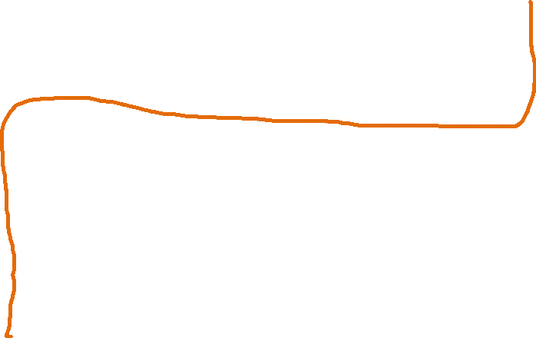
Combined Ripple-carry Adder/Subtractor
Full
Full
Full
Full
Add
Add
Add
Add
C
out
er
er
er
er
add/sub
b
0
b
1
b
2
b
31
a
0
a
1
a
2
a
31
Ripple-carry is too slow
  Gate delays = 32 * FA + XOR

Slide 28
Carry Lookahead
Theoretically, in parallel:
  Sum₀ = f(c_{in}, a₀, b₀)
  Sum_{i} = f(c_{in}, a_{i}…a_{0,}, b_{i}…b₀)
  Sum₃₁ = f(c_{in}, a₃₁…a₀, b₃₁…b₀)

Slide 29
Carry Lookahead
0101 0100
0011 0110
Need:
both 1s to generate carry
one or both 1s to propagate carry
Define: g_{i} = a_{i} * b_{i} ## carry generate
p_{i} = a_{i} + b_{i} ## carry propagate
Carryin: c_{i+1} = a_{i} * b_{i} + a_{i} * c_{i} + b_{i} * c_{i}
= a_{i} * b_{i} + (a_{i} + b_{i}) * c_{i}
= g_{i} + p_{i} * c_{i}

Slide 30
Carry Lookahead
Therefore:
c₁ = g₀ + p₀ * c₀
c₂ = g₁ + p₁ * c₁ = g₁ + p₁ * (g₀ + p₀ * c₀)
= g₁ + p₁ * g₀ + p₁ * p₀ * c₀
c₃ = g₂ + p₂ * g₁ + p₂ * p₁ * g₀ + p₂ * p₁ * p₀ * c₀
c₄ = g₃ + p₃*g₂ + p₃*p₂*g₁ + p₃*p₂*p₁*g₀ + p₃*p₂*p₁*p₀*c₀
1 gate delay (for g_{i}, p_{i}) + 2 gate delays (for c_{i+1})
But needs large i+1 fan-in for the OR and rightmost AND in c_{i}

Slide 31
4-bit Carry Lookahead Adder
c
0
c
4
Carry Lookahead Block
g
p
3
a
3
b
3
g
2
p
2
a
2
b
2
g
p
a
b
g
p
a
b
3
1
1
1
1
0
0
0
0
c
3
c
2
c
c
1
0
s
3
s
2
s
s
1
0

Slide 32
Hierarchical CLA for 16 bits
c
0
c
15
Carry Lookahead Block
G
P
a,b
12-15
G
P
a,b
8-11
G
P
a
b
G
P
a
b
4-7
4-7
0-3
0-3
c
12
c
8
c
c
4-bit CLA
4-bit CLA
4-bit CLA
4
4-bit CLA
0
s
12-15
s
8-11
s
s
4-7
0-3

Slide 33
Hierarchical CLA for 16 bits
Build 16-bit adder from four 4-bit adders
Figure out G and P for 4 bits together
G_{0,3} = g₃ + p₃ * g₂ + p₃ * p₂ * g₁ + p₃ * p₂ * p₁ * g₀
P_{0,3} = p₃ * p₂ * p₁ * p₀
G_{4,7} = g₇ + p₇ * g₆ + p₇ * p₆ * g₅ + p₇ * p₆ * p₅ * g₄
P_{4,7} = p₇ * p₆* p₅ * p₄
…
G_{12,15} = g₁₅ + p₁₅ * g₁₄ + p₁₅* p₁₄ * g₁₃ + p₁₅ * p₁₄ * p₁₃ * g₁₂
P_{12,15} = p₁₅ * p₁₄ * p₁₃ * p₁₂

Slide 34
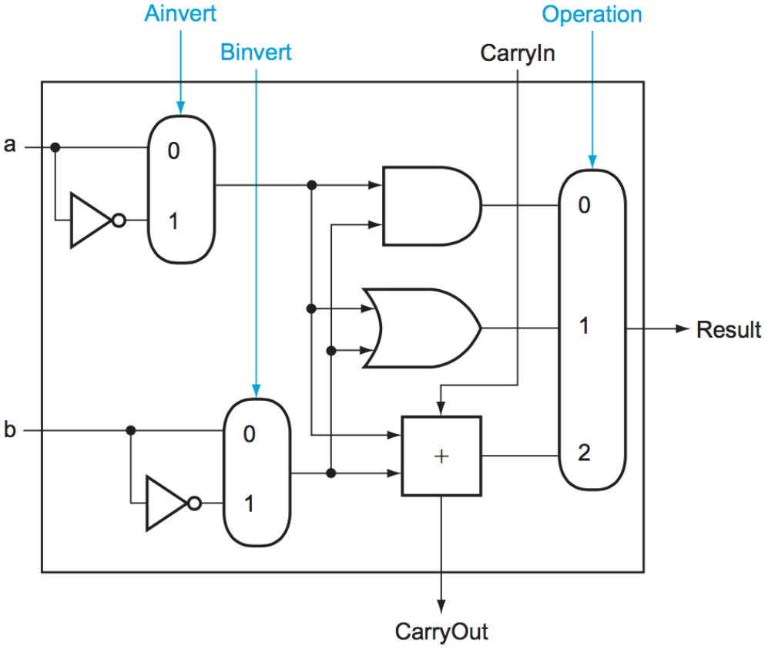
Exercise – ALU
1-bit 2-input ALU. Assume CarryIn=0.
  Operation = 0 (AND), 1 (OR), 2 (ADD)
  Can invert the two inputs

Slide 35
Exercise – ALU
1-bit 2-input ALU. Assume CarryIn=0. How to compute Result = NOR(a, b)?
  Ainvert = ?, Binvert = ?, Operation = ?

Slide 36
Exercise – ALU
1-bit 2-input ALU. Assume CarryIn=0. How to compute Result = NOR(a, b)?
  Ainvert = 1, Binvert = 1, Operation = 0

Slide 37
Exercise – ALU
1-bit 2-input ALU. Assume CarryIn=0. How to compute Result = XNOR(a, b)?
  Ainvert = ?, Binvert = ?, Operation = ?

Slide 38
Exercise – ALU
1-bit 2-input ALU. Assume CarryIn=0. How to compute Result = XNOR(a, b)?
  Ainvert = 1 (or 0), Binvert = 0 (or 1), Operation = 2

Slide 39
Exercise – SRL vs SRA
Modify the code below (using only the MIPS core instruction set) to perform arithmetic right-shift (sra) instead:
  srl $s1, $s0, 8

Slide 40
Exercise – SRL vs SRA
Modify the code below (using only the MIPS core instruction set) to perform arithmetic right-shift (sra) instead:
  srl $s1, $s0, 8
  srl $t0, $s0, 31
  beq $t0, $zero, SKIP
  addi $t0, $zero, -1
  sll $t0, $t0, 24
  or $s1, $t0, $s1
  SKIP:

Slide 41
Exercise – SRL vs SRA
Modify the code below (using only the MIPS core instruction set) to perform arithmetic right-shift (sra) instead:
  srl $s1, $s0, 8 # [$s1] = abs([$s0]) / 2⁸
  srl $t0, $s0, 31
  beq $t0, $zero, SKIP
  addi $t0, $zero, -1
  sll $t0, $t0, 24
  or $s1, $t0, $s1
  SKIP:

Slide 42
Exercise – SRL vs SRA
Modify the code below (using only the MIPS core instruction set) to perform arithmetic right-shift (sra) instead:
  srl $s1, $s0, 8 # [$s1] = abs([$s0]) / 2⁸
  srl $t0, $s0, 31 # [$t0] = sign([$s0])
  beq $t0, $zero, SKIP
  addi $t0, $zero, -1
  sll $t0, $t0, 24
  or $s1, $t0, $s1
  SKIP:

Slide 43
Exercise – SRL vs SRA
Modify the code below (using only the MIPS core instruction set) to perform arithmetic right-shift (sra) instead:
  srl $s1, $s0, 8 # [$s1] = abs([$s0]) / 2⁸
  srl $t0, $s0, 31 # [$t0] = sign([$s0])
  beq $t0, $zero, SKIP
  addi $t0, $zero, -1 # [$t0] = all 1s
  sll $t0, $t0, 24 # [$t0] = 8 leading 1s
  or $s1, $t0, $s1 # [$s1] |= 8 leading 1s
  SKIP:

Slide 44
Exercise – SRL vs SRA
Modify the code below (using only the MIPS core instruction set) to perform arithmetic right-shift (sra) instead:
  srl $s1, $s0, 8 # [$s1] = abs([$s0]) / 2⁸
  srl $t0, $s0, 31 # [$t0] = sign([$s0])
  sll $t0, $t0, 24 # [$t0] = sign * 2²⁴⁼³²⁻⁸
  sub $t0, $zero, $t0 # [$t0] = 8 leading signs
  or $s1, $t0, $s1 # [$s1] |= 8 leading signs
  Negating a power of two (00100) flips leading 0s (11100)

Slide 45
Exercise – SRL vs SRA
Modify the code below (using only the MIPS core instruction set) to perform arithmetic right-shift (sra) instead:
  srl $s1, $s0, 8 # [$s1] = abs([$s0]) / 2⁸
  srl $t0, $s0, 31 # [$t0] = sign([$s0])
  sll $t0, $t0, 24 # [$t0] = sign * 2²⁴⁼³²⁻⁸
  sub $t0, $zero, $t0 # [$t0] = 8 leading signs
  add $s1, $t0, $s1 # [$s1] += 8 leading signs

Slide 46
Exercise – SRL vs SRA
Modify the code below (using only the MIPS core instruction set) to perform arithmetic right-shift (sra) instead:
  srl $s1, $s0, 8 # [$s1] = abs([$s0]) / 2⁸
  srl $t0, $s0, 31 # [$t0] = sign([$s0])
  sll $t0, $t0, 24 # [$t0] = sign * 2²⁴⁼³²⁻⁸
  sub $s1, $s1, $t0 # [$s1] += 8 leading signs

