Slide 1
ECE/CS 552: Single-Cycle Data Path
Boone Severson
Lecture notes based in part on slides created by Joshua San Miguel, Mikko Lipasti, Mark Hill, David Wood, Guri Sohi, John Shen and Jim Smith

Slide 2
Forecast
Simple processor implementation
  Heart of 552
  Key to project
Forecast:
  Sequential logic design review
  Single-cycle data path (1 CPI)
    Fetch, ALU, load/store, branch, register file

Slide 3
Sequential Logic Review
Logic is combinational if output is solely a function of the inputs
  e.g., ALU in previous lecture
Logic is sequential or “has state” if output is a function of:
  Past and current inputs
  Past inputs remembered in “state”

Slide 4
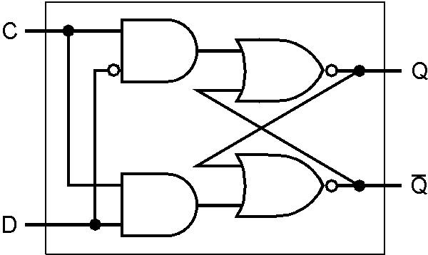

Sequential Logic Review
Level-sensitive D latch:
  Clock high: Q = D and ~Q = ~D, transparent
  Clock low: Q and ~Q remain unchanged

Slide 5
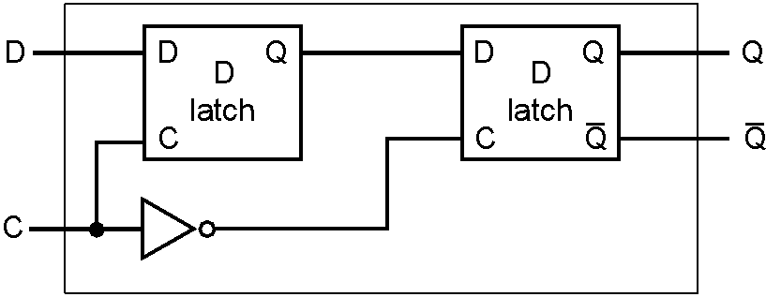
Sequential Logic Review
master
slave
Master-slave D flip-flop (DFF):
  Opaque except at falling (in example) clock edge
  Falling edge: Q_{M} stores D and Q_{S} passes it through
  Rising edge: Q_{M} propagates to Q_{S}, Q unchanged

Slide 6
Sequential Logic Review
D FF
+1
Why can this fail for a latch?
  Latch is transparent when clock is high
  Creates combinational loop
  Increments an indefinite number of times

Slide 7
Clocking Methodology
Use fully synchronous design in this course
  Motivation: simplifies design process
    Can guarantee timing correctness; design data and control without considering clock
  Only flip-flops, all with same clock and same edge
  All logic finishes within cycle

Slide 8
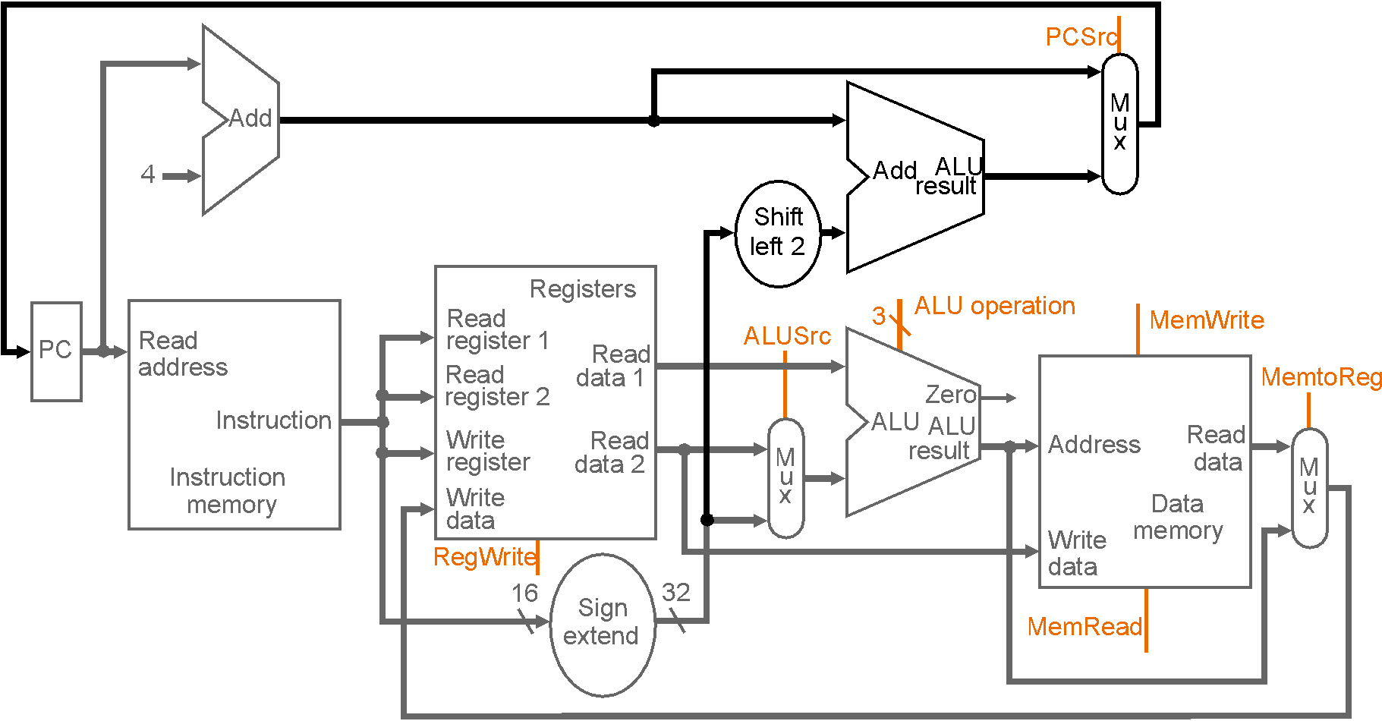
Single-Cycle Data Path

Slide 9
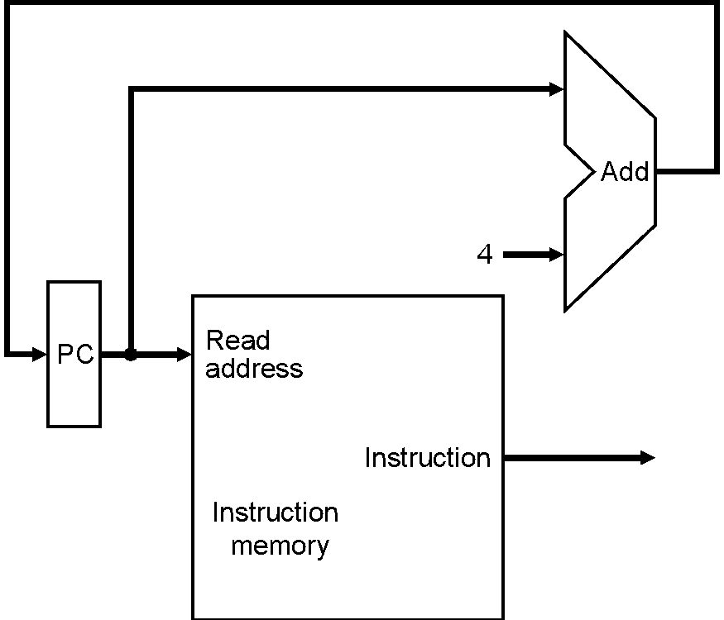
Fetch Instructions
Fetch instruction, then increment PC
  Same for all insns
Initially, let’s assume:
  PC updated every cycle
  No branches or jumps
After this instruction, fetch next one

Slide 10
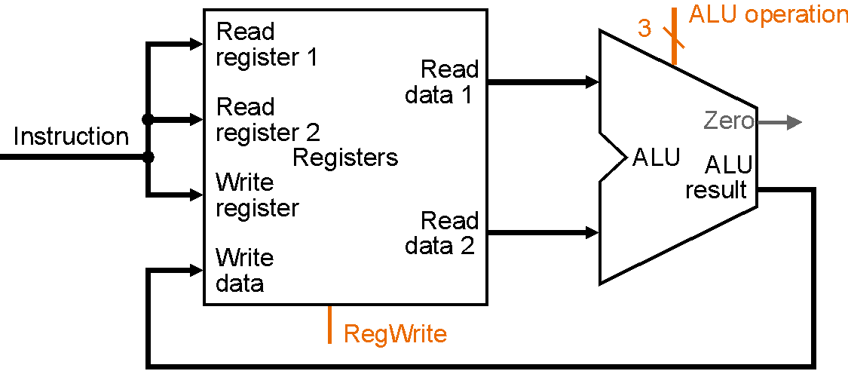
ALU Instructions
and $1, $2, $3 # [$1] = [$2] & [$3]
MIPS R-format
  opcode rs rt rd shamt function

Slide 11
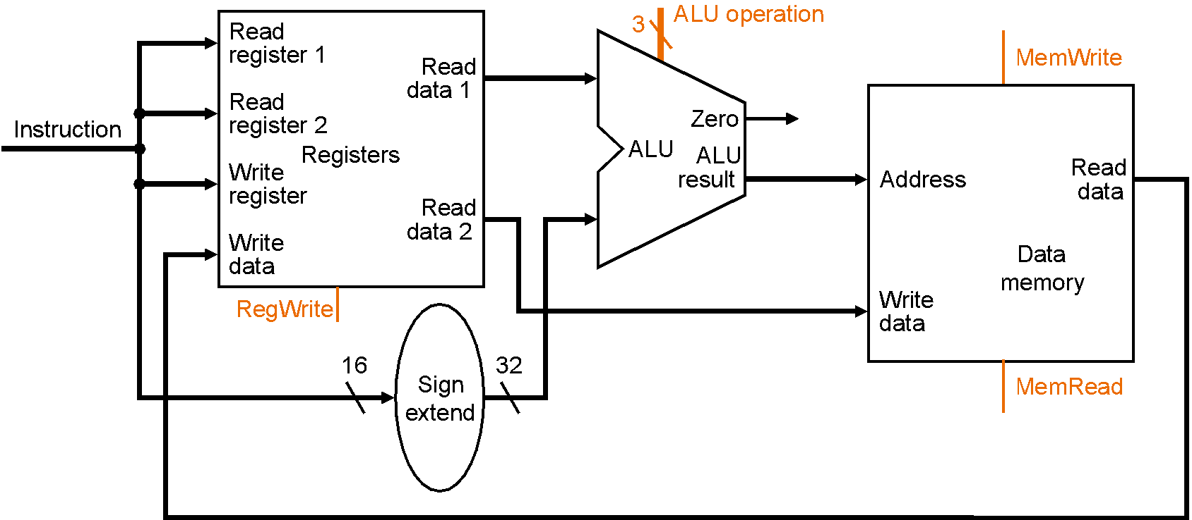
Load/Store Instructions
lw $1, immed($2) # [$1] = M[SE(immed)+[$2]]
MIPS I-format:
  opcode rs rt immed

Slide 12
Load/Store Instructions
lw $1, immed($2) # [$1] = M[SE(immed)+[$2]]
MIPS I-format:
  opcode rs rt immed

Slide 13
Load/Store Instructions
lw $1, immed($2) # [$1] = M[SE(immed)+[$2]]
MIPS I-format:
  opcode rs rt immed

Slide 14
Load/Store Instructions
lw $1, immed($2) # [$1] = M[SE(immed)+[$2]]
MIPS I-format:
  opcode rs rt immed

Slide 15
Branch Instructions
beq $1, $2, addr # if ($1==$2) [PC] = [PC] + 4 + addr<<2
Implementation:
  next = [PC] + 4
  target = next + SE(addr << 2)
  if (([$1] – [$2]) == 0)
    [PC] = target // branch taken
  else
    [PC] = next // branch not taken

Slide 16
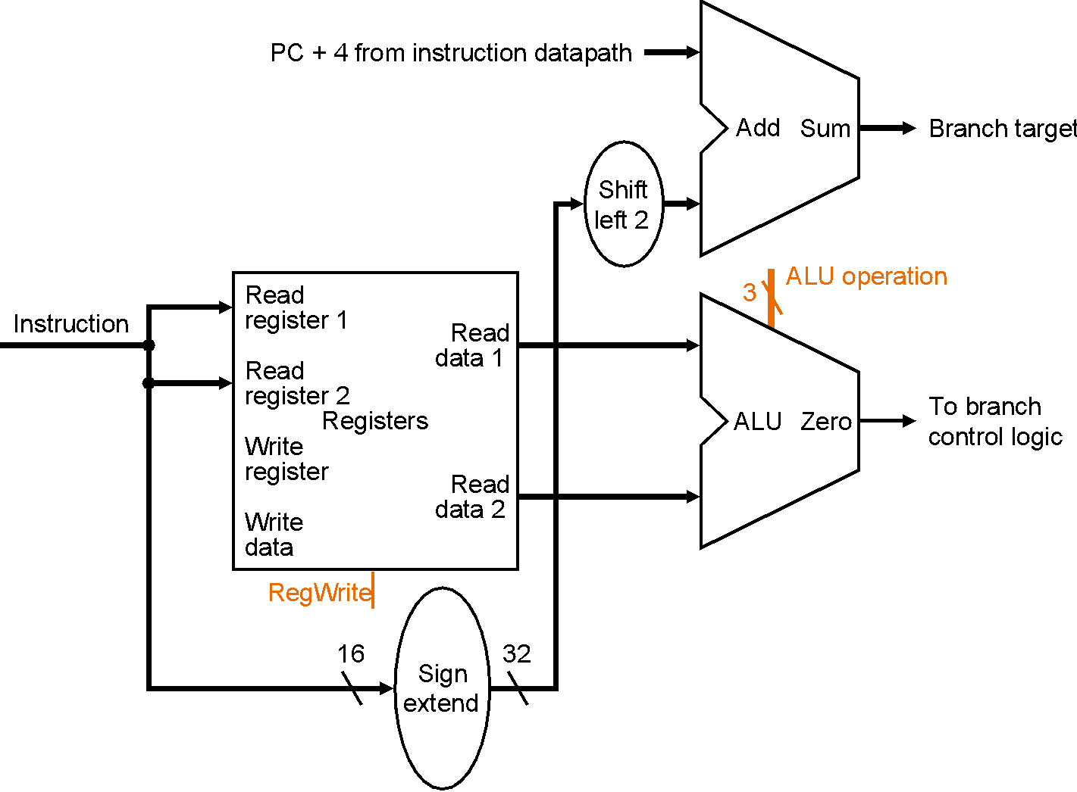
Branch Instructions

Slide 17
Register File
en
D
Q
2 read ports, 1 write port
r1
write data
bitline
one-hot
decoder
r2
write register
5
one-hot
decoder
31
0
read register 1
wordline
5
DFF
DFF
DFF
31
one-hot
decoder
read register 2
5
0
read data 1
bitline
read data 2
bitline

Slide 18
All Together

Slide 19
Exercise
If ALUSrc stuck at 1, add $t0, $t1, $t2 correct?
0
1

Slide 20
Exercise
If ALUSrc stuck at 1, add $t0, $t1, $t2 correct?
  No, would compute: [$t0] = [$t1] + 0x4020
0
1

Slide 21
Exercise
If ALUSrc stuck at 1, sw $t0, 8($t1) correct?
0
1

Slide 22
Exercise
If ALUSrc stuck at 1, sw $t0, 8($t1) correct?
  Yes
0
1

