Slide 1
ECE/CS 552: Single-Cycle Control Path
Boone Severson
Lecture notes based in part on slides created by Joshua San Miguel, Mikko Lipasti, Mark Hill, David Wood, Guri Sohi, John Shen and Jim Smith

Slide 2
Single-Cycle Processor
Data path:
  Combinational logic, I-mem, reg file, D-mem, PC reg
Control path:
  Just combinational logic
  Inputs into global control logic:
    Instruction word (output of I-mem)
  Outputs of global control logic:
    Select signals of muxes
    Read/write-enable signals of mem and regs
    ALU operation

Slide 3
Global Control
For fast control logic:
  Divide up logic on a “need to know” basis
  Logic with fewer inputs is faster

Slide 4
Global Control
R-format: opcode rs rt rd shamt function
    6 5 5 5 5 6
I-format: opcode rs rt address/immediate
    6 5 5 16
J-format: opcode address
    6 26
Inputs to register file:
  Read reg 1 = instruction[25:21]
  Read reg 2 = instruction[20:16]
  Write reg = I-format ? instruction[20:16] : instruction[15:11]
Instruction[31:26] (opcode) used for other control signals
Instruction[5:0] (function) used for ALU operation

Slide 5
Global Control

Slide 6
Global Control
RegDst:
0, if I-format
1, else

Slide 7
Global Control
RegWrite:
0, if store or branch
1, else

Slide 8
Global Control
MemRead:
1, if load
0, else

Slide 9
Global Control
MemWrite:
1, if store
0, else

Slide 10
Global Control
MemToReg:
1, if load
0, else

Slide 11
Global Control
PCSrc:
1, if branch taken
0, else

Slide 12
Global Control
ALUSrc:
0, if R-format or branch
1, else

Slide 13
Global Control
ALU control:
f(opcode, function)

Slide 14
ALU Control
Assume ALU control lines:
0000 | and
0001 | or
0010 | add
0110 | sub
0111 | slt (set less than)
… | ignore for now

Slide 15
ALU Control
ALU control lines = f(opcode, function)
Instruction | Operation | Opcode | Function
add | add | 000000 | 100000
sub | sub | 000000 | 100010
and | and | 000000 | 100100
or | or | 000000 | 100101
slt | slt | 000000 | 101010

Slide 16
ALU Control
ALU control lines = f(opcode, function)
4 bits
6 bits
6 bits
Instruction | Operation | Opcode | Function
add | add | 000000 | 100000
sub | sub | 000000 | 100010
and | and | 000000 | 100100
or | or | 000000 | 100101
slt | slt | 000000 | 101010
lw | add | 100011 | xxxxxx
sw | add | 101011 | xxxxxx
beq | sub | 000100 | xxxxxx
Simplify:
ALUOp = f(opcode)

Slide 17
ALU Control
ALU control lines = f(ALUOp, function)
4 bits
2 bits
6 bits
Instruction | Operation | ALUOp | Function
add | add | 10 | 100000
sub | sub | 10 | 100010
and | and | 10 | 100100
or | or | 10 | 100101
slt | slt | 10 | 101010
lw | add | 00 | xxxxxx
sw | add | 00 | xxxxxx
beq | sub | 01 | xxxxxx

Slide 18
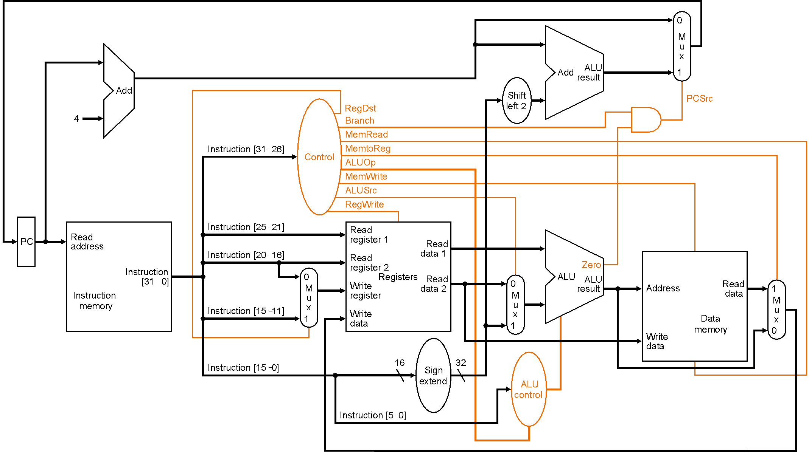
Global Control

Slide 19
Global Control
beq:
PCSrc = 1, if branch taken
PCSrc = Branch & Zero

Slide 20
Exercise
Assume only these instructions supported
  ALUSrc = ?
Instruction | Operation | Opcode
add | add | 000000
sub | sub | 000000
and | and | 000000
or | or | 000000
slt | slt | 000000
lw | add | 100011
sw | add | 101011
beq | sub | 000100

Slide 21
Exercise
Assume only these instructions supported
  ALUSrc = opcode[0] = instruction[26]
Instruction | Operation | Opcode
add | add | 000000
sub | sub | 000000
and | and | 000000
or | or | 000000
slt | slt | 000000
lw | add | 100011
sw | add | 101011
beq | sub | 000100

Slide 22
Exercise
Assume only these instructions supported
  RegWrite = ?
Instruction | Operation | Opcode
add | add | 000000
sub | sub | 000000
and | and | 000000
or | or | 000000
slt | slt | 000000
lw | add | 100011
sw | add | 101011
beq | sub | 000100

Slide 23
Exercise
Assume only these instructions supported
  RegWrite = ~opcode[2] & ~opcode[3]
Instruction | Operation | Opcode
add | add | 000000
sub | sub | 000000
and | and | 000000
or | or | 000000
slt | slt | 000000
lw | add | 100011
sw | add | 101011
beq | sub | 000100

Slide 24
Global Control
More complex with entire MIPS instruction set
  Need more systematic structure
  Want to share gates between control signals
Common solution: programmable logic array
  MIPS opcodes designed to minimize PLA inputs, minterms and outputs

Slide 25
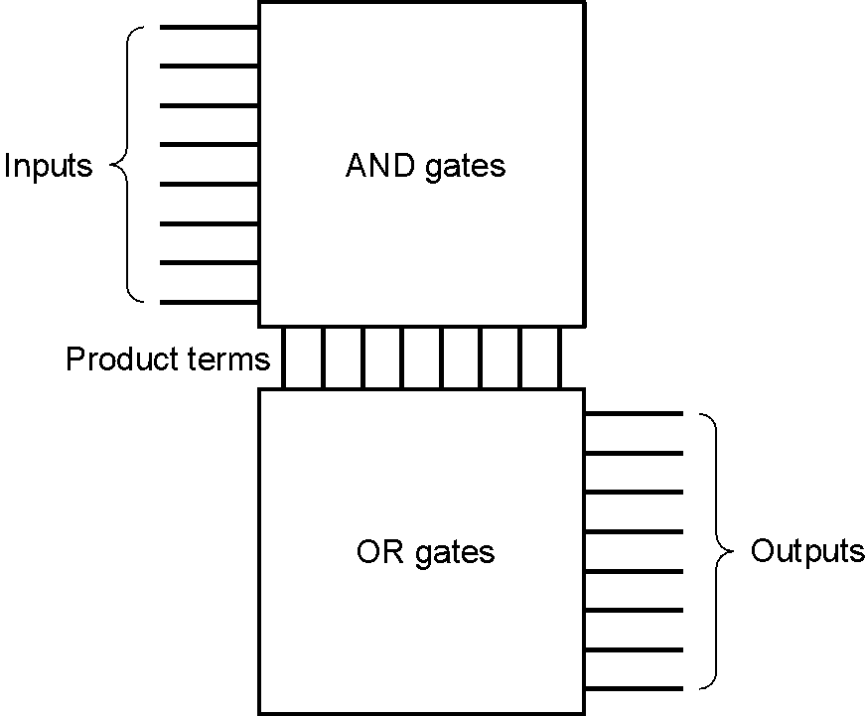
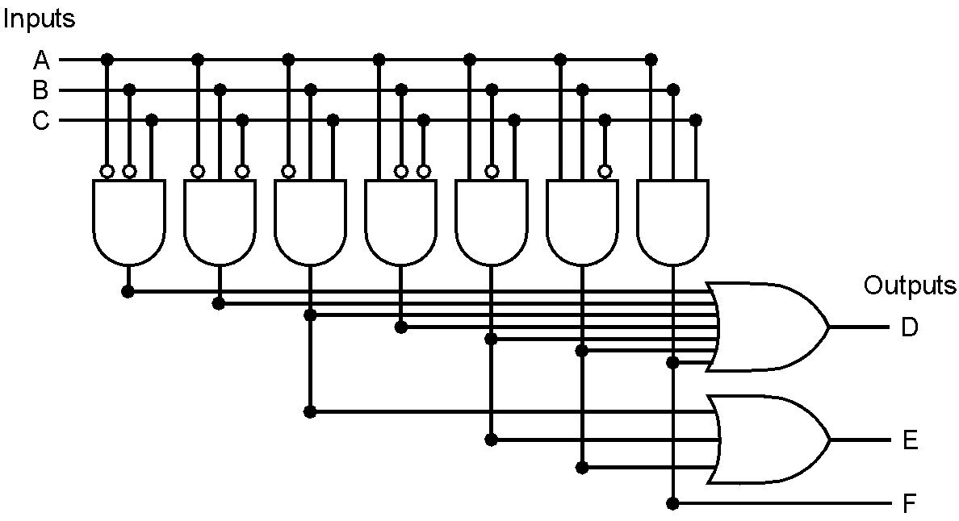
PLA
In AND-plane, AND selected inputs to get minterms
In OR-plane, OR selected minterms to get outputs
e.g.,

Slide 26
Global Control
Jump (j) instruction?

Slide 27
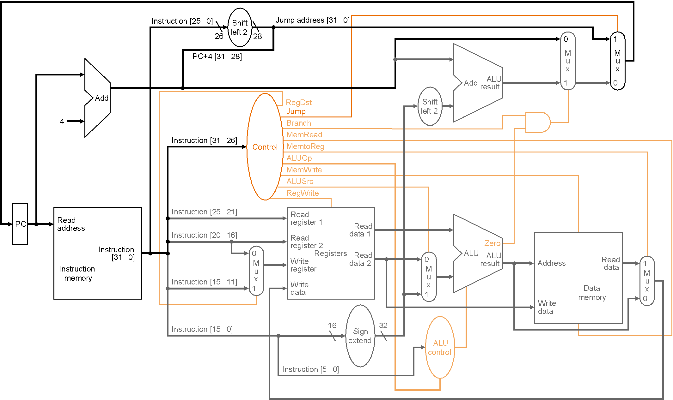
Global Control
Jump (j) instruction?
Jump:
1, if jump instruction
0, else

Slide 28
Single-Cycle Processor
Instructions
Cycles
Time
X
X
Program
Instruction
Cycle
(dyn insns)
(CPI)
(clock period)
worst-case
Critical path: probably load instruction
  I-mem, reg-read, ALU, D-mem, reg-write
Other common instructions are much faster
  e.g., R-format: skip D-mem
Problem: high instruction variation
  Much worse for full instruction set and real implementation
    e.g., floating-point arithmetic
    e.g., cache misses (later)

Slide 29
Single-Cycle Processor
Instructions
Cycles
Time
X
X
Program
Instruction
Cycle
(dyn insns)
(CPI)
(clock period)
Solution:
  Variable clock period per instruction?
    Too hard to control/build

Slide 30
Single-Cycle Processor
Instructions
Cycles
Time
X
X
Program
Instruction
Cycle
(dyn insns)
(CPI)
(clock period)
Solution:
  Variable clock period per instruction?
    Too hard to control/build
  Variable cycles per instruction
    Fixed short clock period
    Break data path into multicycle stages

Slide 31
Exercise
If RegDst stuck at 0, sub $t0, $t1, $t2 correct?

Slide 32
Exercise
If RegDst stuck at 0, sub $t0, $t1, $t2 correct?
  No, would compute: [$t2] = [$t1] - [$t2]

