Slide 1
ECE/CS 552: Pipelining
Boone Severson
Lecture notes based in part on slides created by Joshua San Miguel, Mikko Lipasti, Mark Hill and John Shen

Slide 2
Forecast
Multi-cycle implementation
Pipelining
  Data path
  Control

Slide 3
Multi-Cycle Processor

Slide 4
Multi-Cycle Processor
Stage | Actions
Fetch (IF or F) | Instr = MEM[PC] PC = PC + 4

Slide 5
Multi-Cycle Processor
Stage | Actions
Fetch (IF or F) | Instr = MEM[PC] PC = PC + 4
Decode (ID or D) | Rs = RegFile(Instr[25:21]) Rt = RegFile(Instr[20:16])

Slide 6
Multi-Cycle Processor
Stage | Actions
Fetch (IF or F) | Instr = MEM[PC] PC = PC + 4
Decode (ID or D) | Rs = RegFile(Instr[25:21]) Rt = RegFile(Instr[20:16])
Execute (EX or X) | ALUout = Rs op Rt # R-format = Rs op SE(Instr[15:0]) # I-format Target = PC + 4 + SE(Instr[15:0] << 2)

Slide 7
Multi-Cycle Processor
Stage | Actions
Fetch (IF or F) | Instr = MEM[PC] PC = PC + 4
Decode (ID or D) | Rs = RegFile(Instr[25:21]) Rt = RegFile(Instr[20:16])
Execute (EX or X) | ALUout = Rs op Rt # R-format = Rs op SE(Instr[15:0]) # I-format Target = PC + 4 + SE(Instr[15:0] << 2)
Memory (MEM or M) | MEMout = MEM[ALUout] # lw MEM[ALUout] = Rt # sw if (ALUout == 0) PC = Target # beq

Slide 8
Multi-Cycle Processor
Stage | Actions
Fetch (IF or F) | Instr = MEM[PC] PC = PC + 4
Decode (ID or D) | Rs = RegFile(Instr[25:21]) Rt = RegFile(Instr[20:16])
Execute (EX or X) | ALUout = Rs op Rt # R-format = Rs op SE(Instr[15:0]) # I-format Target = PC + 4 + SE(Instr[15:0] << 2)
Memory (MEM or M) | MEMout = MEM[ALUout] # lw MEM[ALUout] = Rt # sw if (ALUout == 0) PC = Target # beq
Writeback (WB or W) | RegFile(Instr[15:11]) = ALUout # R-format RegFile(Instr[20:16]) = ALUout # I-format RegFile(Instr[20:16]) = MEMout # lw

Slide 9
Multi-Cycle Processor
Single-cycle implementation:
  Clock period = T = T_{F} + T_{D} + T_{X} + T_{M} + T_{W}
Cycle Instruction | 1 |  |  |  |  | 2 |  |  |  |  | 3
lw $t0, 0($t1) | F | D | X | M | W
beq $t2, t3, DEST |  |  |  |  |  | F | D | X | M | W
sw $t4, 0($t5) |  |  |  |  |  |  |  |  |  |  | F | D | X | M | W
Multi-cycle implementation:
  Clock period = max{T_{F}, T_{D}, T_{X}, T_{M}, T_{W}} ≥ T/5
Cycle Instruction | 1 | 2 | 3 | 4 | 5 | 6 | 7 | 8 | 9 | 10 | 11 | 12 | 13 | 14 | 15
lw $t0, 0($t1) | F | D | X | M | W
beq $t2, t3, DEST |  |  |  |  |  | F | D | X | M
sw $t4, 0($t5) |  |  |  |  |  |  |  |  |  | F | D | X | M

Slide 10
Can We Do Better?
Multi-cycle implementation:
  Clock period = max{T_{F}, T_{D}, T_{X}, T_{M}, T_{W}} ≥ T/5
Cycle Instruction | 1 | 2 | 3 | 4 | 5 | 6 | 7 | 8 | 9 | 10 | 11 | 12 | 13 | 14 | 15
lw $t0, 0($t1) | F | D | X | M | W
beq $t2, t3, DEST |  |  |  |  |  | F | D | X | M
sw $t4, 0($t5) |  |  |  |  |  |  |  |  |  | F | D | X | M
Ideally we want:
  CPI of single-cycle implementation
  Clock period of multi-cycle implementation

Slide 11
Pipelining
Multi-cycle implementation:
  Clock period = max{T_{F}, T_{D}, T_{X}, T_{M}, T_{W}} ≥ T/5
Cycle Instruction | 1 | 2 | 3 | 4 | 5 | 6 | 7 | 8 | 9 | 10 | 11 | 12 | 13 | 14 | 15
lw $t0, 0($t1) | F | D | X | M | W
beq $t2, t3, DEST |  |  |  |  |  | F | D | X | M
sw $t4, 0($t5) |  |  |  |  |  |  |  |  |  | F | D | X | M
Pipelining:
  CPI of single-cycle implementation
  Clock period of multi-cycle implementation
Cycle Instruction | 1 | 2 | 3 | 4 | 5 | 6 | 7 | 8 | 9 | 10 | 11 | 12 | 13 | 14 | 15
lw $t0, 0($t1) | F | D | X | M | W
beq $t2, t3, DEST |  | F | D | X | M | W
sw $t4, 0($t5) |  |  | F | D | X | M | W

Slide 12

Pipelining
Multi-cycle implementation:

Slide 13
Pipelining
Pipelining:

Slide 14
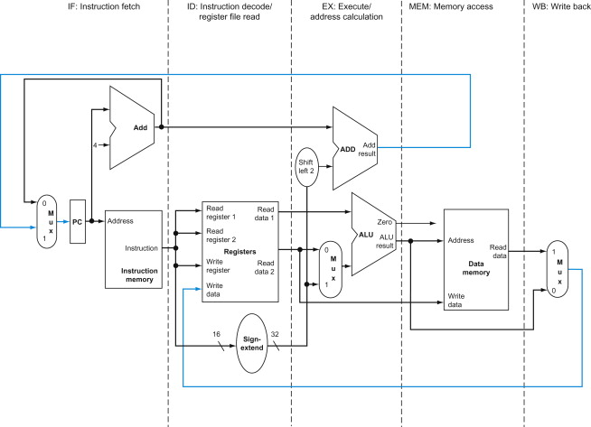
Pipelining
I1
I2
I3
I4
I5
I1
I2
I3
I4
I1
I2
I3
I1
I2
I1
I2
I3
I4
I5
I6
I3
I7
I4
I5
I6
I7
I8
I1
I2
I3
I4
I5
I6

Slide 15
Pipelining Idealisms
Uniform stages
  Break up into stages with equal delay
Identical computations
  Have all instructions do identical work to fill pipeline
Independent computations
  No dependences between instructions in different stages
  i.e., No pipeline hazards
Can we guarantee these conditions all the time?
  No, but can get close enough to get significant speedup

Slide 16
Pipelining Challenges
Data path:
  Support five instructions in-flight
Control:
  Remember control signals of multiple instructions
Instructions may have dependences:
  Data and control dependences
  May need to stall and wait
  Ignore for now; next lecture

Slide 17
Pipelined Data Path
Add pipeline registers between stages
  Retains values needed by current stage
    e.g., MEM/WB holds ALU and data memory outputs for WB stage
  Any values needed in later stage gets passed down
    e.g., Store value is passed from ID/EX to EX/MEM registers during EX stage

Slide 18
Pipelined Data Path
add

Slide 19
Pipelined Data Path
load

Slide 20
Pipelined Data Path
add
load

Slide 21
Pipelined Control
Decode instructions and pass control signals down via the pipeline registers

Slide 22
All Together

Slide 23
Exercise
250 us
150 us
100 us
350 us
150 us
Instructions per second with single-cycle implementation?
  clock period = 250 us + 150 us + 100 us + 350 us + 150 us = 1 ms
  IPC = 1
  instructions per sec = 1 / 1 ms = 1000 insns/s

Slide 24
Exercise
250 us
150 us
100 us
350 us
150 us
Instructions per second with pipelined implementation?
  clock period = max{IF,ID,EX,MEM,WB} = 350 us
  IPC = (# insns) / (# insns + 4) ≈ 1
  instructions per sec ≈ 1 / 350 us ≈ 2857 insns/s

