Slide 1
ECE/CS 552: Memory, ECC and I/O
Boone Severson
Lecture notes based in part on slides created by
Joshua San Miguel, Mikko Lipasti, Mark Hill, David Wood, Guri Sohi, John Shen and Jim Smith

Slide 2
Main Memory
Commodity DRAM chips
Design objectives:
  Minimizing cost, latency
  Maximizing bandwidth, capacity
Susceptible to soft errors
  Protect with error correction codes (ECC)
  ECC also widely used in on-chip memories/buses

Slide 3
Main Memory – DRAM
Data stored as charge in capacitor
Discharge on reads
Charge leaks over time
  Refresh periodically
  e.g., Every 64ms
Read entire row to row buffer
  Row address strobe (RAS), page open
Read word from row buffer
  Column address strobe (CAS)
Write row back
  Precharge, page close

Slide 4
Main Memory – Access
e.g., Main memory access for 4-word cache block:
Note that DRAM bus cycles are ~10x CPU cycle time
1) Read entire row into row buffer (RAS, page open)
  5 cycles to send row address and read row
2) Read each word from row buffer (CAS)
  1 cycle to send column address
  3 cycle DRAM internal access delay
  1 cycle to receive data word on bus
3) Precharge (page close)
  5 cycles to precharge

Slide 5

Main Memory – Access
L1-I cache
L1-D cache
unified I/D L2 cache
one-word-wide bus
main memory

Slide 6
Main Memory – Access
e.g., One word wide:
  r=row addr, c=col addr, d=DRAM delay, b=bus, p=precharge
  rrrrrcdddbcdddbcdddbcdddbppppp
  5 + 4 * (1 + 3 + 1) = 25 cycles to fetch data
  (then 5 cycles until next access allowed)
e.g., One word wide, burst mode (pipelined):
  rrrrrcdddb
  b
  b
  bppppp
  5 + 1 + 3 + 4 = 13 cycles (then 5 cycles until next access)

Slide 7
Main Memory – Access
L1-I cache
L1-D cache
unified I/D L2 cache
four-word-wide bus
main memory

Slide 8
Main Memory – Access
e.g., Four word wide:
  rrrrrcdddbppppp
  5 + 1 + 3 + 1 = 9 cycles (then 5 cycles until next access)

Slide 9
ECC
Main memory stores a huge number of bits
  Probability of bit-flip becomes significant
  Bit-flips (called soft errors) caused by
    Gamma rays and alpha particles
    Electrical interference
    etc.
  Getting worse with smaller feature sizes
Systems must be protected from soft errors via error correction codes (ECC)

Slide 10
ECC
Probability of bit errors in a single word:
  P(0 errors) > P(1 error) > P(2 errors) >> P(>2 errors)
Detection: signal a problem
Correction: restore data to correct value

Slide 11
No ECC
A single bit of data is stored as one bit in memory
Hamming Distance: how many bits must flip to convert a valid codeword to a different valid codeword?
Hamming Distance = 1
Data Word (1 bit) | Codeword in Memory (1 bit)
0 | 0
1 | 1

Slide 12
Single Error Detection (SED)
Store one extra bit of redundancy in memory
Hamming Distance = 2
Data Word (1 bit) | Codeword in Memory (2 bits)
0 | 00
1 | 11
if we observe invalid codeword, which bit flipped?
00
01
01
each edge is one bit-flip
10
11

Slide 13
Single Error Correction (SECSED)
Store two extra bits of redundancy in memory
Hamming Distance = 3
Data Word (1 bit) | Codeword in Memory (3 bits)
0 | 000
1 | 111
100
101
101
000
001
if we observe invalid codeword, assuming only one bit flipped, we know exactly which valid codeword we had previously
110
111
010
011

Slide 14
SED – Parity
For arbitrary n-bit data word (b_{n}…b₁), add one parity bit P to codeword
Hamming Distance = 2
P = b₁ ⊕ … ⊕ b_{n}
When reading codeword, check syndrome = P⊕b₁⊕…⊕b_{n}== 0?
Note: following discussions assume one-based indexing
Data Word (4 bits) | Codeword in Memory (4 bits + 1 parity bit)
0000 | 00000
0001 | 00011
0010 | 00101
0011 | 00110
0100 | 01001
0101 | 01010

Slide 15
SECSED – Hamming Code
For arbitrary n-bit data word (b_{n}…b₁), add k check bits (C_{k}…C₁) to codeword, where 2^{k} ≥ n+k+1
e.g., Hamming(7,4): n=4, k=3; Hamming Distance = 3

Slide 16
SECSED – Hamming(7,4)
Store a 4-bit data word (b₄b₃b₂b₁) as a 7-bit codeword (W₇W₆W₅W₄W₃W₂W₁) in memory. Whenever we read the codeword, generate a 3-bit syndrome (S₃S₂S₁) that specifies if any (and which) bit has flipped:
Syndrome | Bit flipped?
000 | none
001 | W₁
010 | W₂
011 | W₃
100 | W₄
101 | W₅
110 | W₆
111 | W₇

Slide 17
SECSED – Hamming(7,4)
Store a 4-bit data word (b₄b₃b₂b₁) as a 7-bit codeword (W₇W₆W₅W₄W₃W₂W₁) in memory. Whenever we read the codeword, generate a 3-bit syndrome (S₃S₂S₁) that specifies if any (and which) bit has flipped:
Syndrome | Bit flipped?
000 | none
001 | W₁
010 | W₂
011 | W₃
100 | W₄
101 | W₅
110 | W₆
111 | W₇
Syndrome | Bit flipped?
000 | none
001 | W₁
010 | W₂
011 | W₃
100 | W₄
101 | W₅
110 | W₆
111 | W₇
Syndrome | Bit flipped?
000 | none
001 | W₁
010 | W₂
011 | W₃
100 | W₄
101 | W₅
110 | W₆
111 | W₇
Syndrome | Bit flipped?
000 | none
001 | W₁
010 | W₂
011 | W₃
100 | W₄
101 | W₅
110 | W₆
111 | W₇
Syndrome
S₁
S₂
S₃
Syndrome
S₁ | W₁⊕W₃⊕W₅⊕W₇
S₂
S₃
Syndrome
S₁ | W₁⊕W₃⊕W₅⊕W₇
S₂ | W₂⊕W₃⊕W₆⊕W₇
S₃
Syndrome
S₁ | W₁⊕W₃⊕W₅⊕W₇
S₂ | W₂⊕W₃⊕W₆⊕W₇
S₃ | W₄⊕W₅⊕W₆⊕W₇

Slide 18
SECSED – Hamming(7,4)
Store a 4-bit data word (b₄b₃b₂b₁) as a 7-bit codeword (W₇W₆W₅W₄W₃W₂W₁) in memory. Whenever we read the codeword, generate a 3-bit syndrome (S₃S₂S₁) that specifies if any (and which) bit has flipped:
Syndrome | Bit flipped?
000 | none
001 | W₁
010 | W₂
011 | W₃
100 | W₄
101 | W₅
110 | W₆
111 | W₇
e.g., S₁ is 1 if any one of W₁, W₃, W₅ or W₇ flipped
Syndrome
S₁ | W₁⊕W₃⊕W₅⊕W₇
S₂ | W₂⊕W₃⊕W₆⊕W₇
S₃ | W₄⊕W₅⊕W₆⊕W₇
e.g., if both S₁ and S₃ are 1,
then W₅ must have flipped

Slide 19
SECSED – Hamming(7,4)
Store a 4-bit data word (b₄b₃b₂b₁) as a 7-bit codeword (W₇W₆W₅W₄W₃W₂W₁) in memory. Whenever we read the codeword, generate a 3-bit syndrome (S₃S₂S₁) that specifies if any (and which) bit has flipped:
Syndrome | Bit flipped?
000 | none
001 | W₁
010 | W₂
011 | W₃
100 | W₄
101 | W₅
110 | W₆
111 | W₇
Syndrome | Bit flipped?
000 | none
001 | W₁
010 | W₂
011 | W₃
100 | W₄
101 | W₅
110 | W₆
111 | W₇
Syndrome | Bit flipped?
000 | none
001 | W₁
010 | W₂
011 | W₃
100 | W₄
101 | W₅
110 | W₆
111 | W₇
Syndrome | Bit flipped?
000 | none
001 | W₁
010 | W₂
011 | W₃
100 | W₄
101 | W₅
110 | W₆
111 | W₇
Codeword
W₁
W₂
W₃
W₄
W₅
W₆
W₇
Codeword
W₁ | C₁=W₃⊕W₅⊕W₇
W₂ | C₂=W₃⊕W₆⊕W₇
W₃
W₄ | C₃=W₅⊕W₆⊕W₇
W₅
W₆
W₇
Codeword
W₁ | C₁=W₃⊕W₅⊕W₇
W₂ | C₂=W₃⊕W₆⊕W₇
W₃ | b₁
W₄ | C₃=W₅⊕W₆⊕W₇
W₅ | b₂
W₆ | b₃
W₇ | b₄
Codeword
W₁ | C₁ = b₁⊕b₂⊕b₄
W₂ | C₂ = b₁⊕b₃⊕b₄
W₃ | b₁
W₄ | C₃ = b₂⊕b₃⊕b₄
W₅ | b₂
W₆ | b₃
W₇ | b₄
Syndrome
S₁ | W₁⊕W₃⊕W₅⊕W₇
S₂ | W₂⊕W₃⊕W₆⊕W₇
S₃ | W₄⊕W₅⊕W₆⊕W₇
Syndrome
S₁ | W₁⊕W₃⊕W₅⊕W₇
S₂ | W₂⊕W₃⊕W₆⊕W₇
S₃ | W₄⊕W₅⊕W₆⊕W₇
Syndrome
S₁ | W₁⊕W₃⊕W₅⊕W₇
S₂ | W₂⊕W₃⊕W₆⊕W₇
S₃ | W₄⊕W₅⊕W₆⊕W₇
Syndrome
S₁ | W₁⊕W₃⊕W₅⊕W₇
S₂ | W₂⊕W₃⊕W₆⊕W₇
S₃ | W₄⊕W₅⊕W₆⊕W₇
use these as check bits (i.e., parity)

Slide 20
SECDED – Hamming(7,4) + Parity
Store a 4-bit data word (b₄b₃b₂b₁) as an 8-bit codeword (W₈W₇W₆W₅W₄W₃W₂W₁) in memory. Whenever we read the codeword, generate a 4-bit syndrome that includes a 1-bit parity (S₃S₂S₁, S_{P}):
Hamming Distance = 4
S₃S₂S₁, S_{P} | Bit flipped?
000, 0 | none
001, 1 | W₁
010, 1 | W₂
011, 1 | W₃
100, 1 | W₄
101, 1 | W₅
110, 1 | W₆
111, 1 | W₇
000, 1 | W₈
non-zero, 0 | double bit-flip

Slide 21
SECDED – Hamming(7,4) + Parity
Store a 4-bit data word (b₄b₃b₂b₁) as an 8-bit codeword (W₈W₇W₆W₅W₄W₃W₂W₁) in memory. Whenever we read the codeword, generate a 4-bit syndrome that includes a 1-bit parity (S₃S₂S₁, S_{P}):
Codeword
W₁ | C₁ = b₁⊕b₂⊕b₄
W₂ | C₂ = b₁⊕b₃⊕b₄
W₃ | b₁
W₄ | C₃ = b₂⊕b₃⊕b₄
W₅ | b₂
W₆ | b₃
W₇ | b₄
W₈
Codeword
W₁ | C₁ = b₁⊕b₂⊕b₄
W₂ | C₂ = b₁⊕b₃⊕b₄
W₃ | b₁
W₄ | C₃ = b₂⊕b₃⊕b₄
W₅ | b₂
W₆ | b₃
W₇ | b₄
W₈ | P = W₁⊕…⊕W₇
S₃S₂S₁, S_{P} | Bit flipped?
000, 0 | none
001, 1 | W₁
010, 1 | W₂
011, 1 | W₃
100, 1 | W₄
101, 1 | W₅
110, 1 | W₆
111, 1 | W₇
000, 1 | W₈
non-zero, 0 | double bit-flip
S₃S₂S₁, S_{P} | Bit flipped?
000, 0 | none
001, 1 | W₁
010, 1 | W₂
011, 1 | W₃
100, 1 | W₄
101, 1 | W₅
110, 1 | W₆
111, 1 | W₇
000, 1 | W₈
non-zero, 0 | double bit-flip
Syndrome, Parity
S₁ | W₁⊕W₃⊕W₅⊕W₇
S₂ | W₂⊕W₃⊕W₆⊕W₇
S₃ | W₄⊕W₅⊕W₆⊕W₇
S_{P}
Syndrome, Parity
S₁ | W₁⊕W₃⊕W₅⊕W₇
S₂ | W₂⊕W₃⊕W₆⊕W₇
S₃ | W₄⊕W₅⊕W₆⊕W₇
S_{P} | W₈⊕…⊕W₁
use this as parity bit of entire codeword

Slide 22
SECDED – Hamming(7,4) + Parity
e.g., Encode b₄b₃b₂b₁ = 0101 into an 8-bit codeword:
W₈W₇W₆W₅W₄W₃W₂W₁ = ____________
e.g., Encode b₄b₃b₂b₁ = 0101 into an 8-bit codeword:
W₈W₇W₆W₅W₄W₃W₂W₁ = 00101101
Codeword
W₁ | C₁ = b₁⊕b₂⊕b₄
W₂ | C₂ = b₁⊕b₃⊕b₄
W₃ | b₁
W₄ | C₃ = b₂⊕b₃⊕b₄
W₅ | b₂
W₆ | b₃
W₇ | b₄
W₈ | P = W₁⊕…⊕W₇
S₃S₂S₁, S_{P} | Bit flipped?
000, 0 | none
001, 1 | W₁
010, 1 | W₂
011, 1 | W₃
100, 1 | W₄
101, 1 | W₅
110, 1 | W₆
111, 1 | W₇
000, 1 | W₈
non-zero, 0 | double bit-flip
Syndrome, Parity
S₁ | W₁⊕W₃⊕W₅⊕W₇
S₂ | W₂⊕W₃⊕W₆⊕W₇
S₃ | W₄⊕W₅⊕W₆⊕W₇
S_{P} | W₈⊕…⊕W₁

Slide 23
SECDED – Hamming(7,4) + Parity
Compare this to simply storing the bits redundantly:
Hamming(7,4) + Parity (SECDED Codeword)
W₁ | C₁ = b₁⊕b₂⊕b₄
W₂ | C₂ = b₁⊕b₃⊕b₄
W₃ | b₁
W₄ | C₃ = b₂⊕b₃⊕b₄
W₅ | b₂
W₆ | b₃
W₇ | b₄
W₈ | P = W₁⊕…⊕W₇
1-Bit Redundancy (SED Codeword)
W₁ | b₁
W₂ | b₂
W₃ | b₃
W₄ | b₄
W₅ | b₁
W₆ | b₂
W₇ | b₃
W₈ | b₄
vs.

Slide 24
Input/Output
I/O necessary:
  To/from users (display, keyboard, mouse)
  To/from non-volatile media (disk)
  To/from other computers (networks)
L1-I cache
L1-D cache
unified I/D L2 cache
main memory
I/O
I/O
I/O

Slide 25
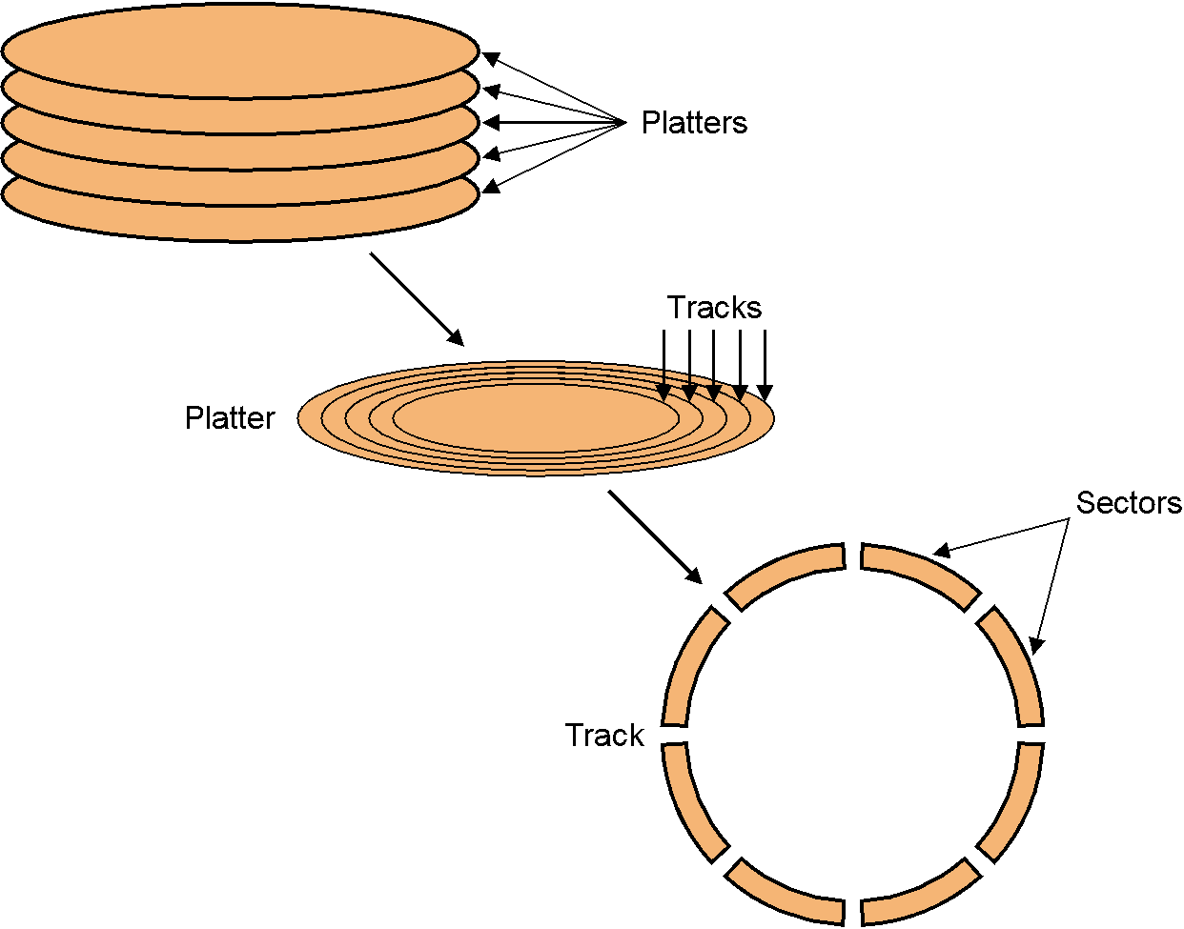
Disk
Stack of platters:
  Two surfaces per platter
  Multiple tracks per surface
    Surface head moves to select track
    Heads of all platters synchronized
  Multiple sectors per track
    Platters rotate to select sector

Slide 26
Disk – RAID
Redundant arrays of inexpensive disks (RAID):
  Handles disk failures
  e.g., Given a 100-disk system, if mean time to failure per disk is 5 years: over a long period of time, 1 disk fails every 18 days
Unlike memory ECC, we can tell when (and which) disks fail via diagnostics
  Just need to be able to recover the data

Slide 27
Disk – RAID
RAID 0:
  Block-level striping
  No failure protection
RAID 1:
  Block-level striping
  Store all data twice (mirroring)
RAID 3:
  Bit-interleaved parity
disk0 | disk1 | disk2
block0 | block1 | block2
block3 | block4 | block5
block6 | block7 | block8
block9 | block10 | block11
disk0 | disk1 | disk2 | disk3
bit0 | bit1 | bit2 | parity0-2
bit3 | bit4 | bit5 | parity3-5
bit6 | bit7 | bit8 | parity6-8
bit9 | bit10 | bit11 | parity9-11

Slide 28
Disk – RAID
RAID 4:
  Block-interleaved parity
RAID 5:
  Distributed block-interleaved parity
disk0 | disk1 | disk2 | disk3
block0 | block1 | block2 | parity0-2
block3 | block4 | block5 | parity3-5
block6 | block7 | block8 | parity6-8
block9 | block10 | block11 | parity9-11
disk0 | disk1 | disk2 | disk3
block0 | block1 | block2 | parity0-2
block3 | block4 | parity3-5 | block5
block6 | parity6-8 | block7 | block8
parity9-11 | block9 | block10 | block11

Slide 29
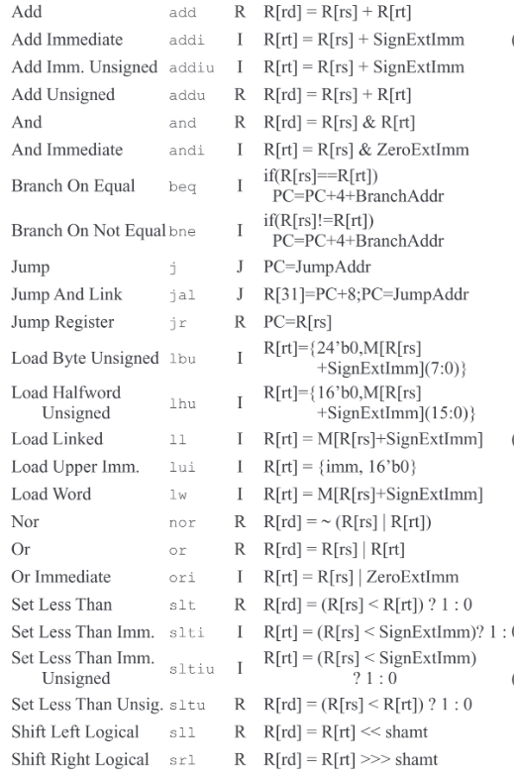
Input/Output
How to communicate from host processor to I/O device?
  Memory-mapped I/O vs. ISA commands for I/O
virtual address space
instruction set
memory-mapped I/O register
read/write I/O register

Slide 30
Input/Output
How to communicate from I/O device to host processor?
  Polling vs. interrupts
poll (read) I/O register
L1-I cache
L1-D cache
unified I/D L2 cache
interrupt processor
(similar to exceptions)
main memory
I/O
I/O
I/O

Slide 31
Buses

Slide 32
Buses
Bunch of wires:
  Arbitration
  Control
  Data
  Address

Slide 33
Buses
Synchronous bus: has clock
  Everyone watches clock and latches at appropriate phase
  Transactions take fixed or variable number of cycles
  Faster but clock limits bus length
  e.g., Processor-memory
Asynchronous bus: requires handshake
  More flexible
  e.g., I/O

Slide 34
Buses – Asynchronous
Req/Data
(1) Request sent
(3) Request deasserted
(6) Data response received
(2) Request received
(4) Ack deasserted
(5) Data response sent
(7) Data response deasserted

Slide 35
Input/Output – Caches
L1-I cache
L1-D cache
slows down loads/stores
unified I/D L2 cache
I/O
I/O
I/O
main memory

Slide 36
Input/Output – Caches
L1-I cache
L1-D cache
no access to up-to-date data in caches
unified I/D L2 cache
main memory
I/O
I/O
I/O

Slide 37
Exercise – SECDED
e.g., A single bit-flip has occurred. Recover original data:
W₈W₇W₆W₅W₄W₃W₂W₁ = 00101001
b₄b₃b₂b₁ = __________
e.g., A single bit-flip has occurred. Recover original data:
W₈W₇W₆W₅W₄W₃W₂W₁ = 00101001
b₄b₃b₂b₁ = __________
e.g., A single bit-flip has occurred. Recover original data:
W₈W₇W₆W₅W₄W₃W₂W₁ = 00101001
b₄b₃b₂b₁ = 0101
Codeword
W₁ | C₁ = b₁⊕b₂⊕b₄
W₂ | C₂ = b₁⊕b₃⊕b₄
W₃ | b₁
W₄ | C₃ = b₂⊕b₃⊕b₄
W₅ | b₂
W₆ | b₃
W₇ | b₄
W₈ | P = W₁⊕…⊕W₇
Codeword
W₁ | C₁ = b₁⊕b₂⊕b₄
W₂ | C₂ = b₁⊕b₃⊕b₄
W₃ | b₁
W₄ | C₃ = b₂⊕b₃⊕b₄
W₅ | b₂
W₆ | b₃
W₇ | b₄
W₈ | P = W₁⊕…⊕W₇
Codeword
W₁ | C₁ = b₁⊕b₂⊕b₄
W₂ | C₂ = b₁⊕b₃⊕b₄
W₃ | b₁
W₄ | C₃ = b₂⊕b₃⊕b₄
W₅ | b₂
W₆ | b₃
W₇ | b₄
W₈ | P = W₁⊕…⊕W₇
Codeword
W₁ | C₁ = b₁⊕b₂⊕b₄
W₂ | C₂ = b₁⊕b₃⊕b₄
W₃ | b₁
W₄ | C₃ = b₂⊕b₃⊕b₄
W₅ | b₂
W₆ | b₃
W₇ | b₄
W₈ | P = W₁⊕…⊕W₇
Codeword
W₁ | C₁ = b₁⊕b₂⊕b₄
W₂ | C₂ = b₁⊕b₃⊕b₄
W₃ | b₁
W₄ | C₃ = b₂⊕b₃⊕b₄
W₅ | b₂
W₆ | b₃
W₇ | b₄
W₈ | P = W₁⊕…⊕W₇
S₃S₂S₁, S_{P} | Bit flipped?
000, 0 | none
001, 1 | W₁
010, 1 | W₂
011, 1 | W₃
100, 1 | W₄
101, 1 | W₅
110, 1 | W₆
111, 1 | W₇
000, 1 | W₈
non-zero, 0 | double bit-flip
S₃S₂S₁, S_{P} | Bit flipped?
000, 0 | none
001, 1 | W₁
010, 1 | W₂
011, 1 | W₃
100, 1 | W₄
101, 1 | W₅
110, 1 | W₆
111, 1 | W₇
000, 1 | W₈
non-zero, 0 | double bit-flip
S₃S₂S₁, S_{P} | Bit flipped?
000, 0 | none
001, 1 | W₁
010, 1 | W₂
011, 1 | W₃
100, 1 | W₄
101, 1 | W₅
110, 1 | W₆
111, 1 | W₇
000, 1 | W₈
non-zero, 0 | double bit-flip
S₃S₂S₁, S_{P} | Bit flipped?
000, 0 | none
001, 1 | W₁
010, 1 | W₂
011, 1 | W₃
100, 1 | W₄
101, 1 | W₅
110, 1 | W₆
111, 1 | W₇
000, 1 | W₈
non-zero, 0 | double bit-flip
S₃S₂S₁, S_{P} | Bit flipped?
000, 0 | none
001, 1 | W₁
010, 1 | W₂
011, 1 | W₃
100, 1 | W₄
101, 1 | W₅
110, 1 | W₆
111, 1 | W₇
000, 1 | W₈
non-zero, 0 | double bit-flip
Syndrome, Parity
S₁ | W₁⊕W₃⊕W₅⊕W₇
S₂ | W₂⊕W₃⊕W₆⊕W₇
S₃ | W₄⊕W₅⊕W₆⊕W₇
S_{P} | W₈⊕…⊕W₁
Syndrome, Parity
S₁ | 1
S₂ | W₂⊕W₃⊕W₆⊕W₇
S₃ | W₄⊕W₅⊕W₆⊕W₇
S_{P} | W₈⊕…⊕W₁
Syndrome, Parity
S₁ | 1
S₂ | 1
S₃ | W₄⊕W₅⊕W₆⊕W₇
S_{P} | W₈⊕…⊕W₁
Syndrome, Parity
S₁ | 1
S₂ | 1
S₃ | 0
S_{P} | W₈⊕…⊕W₁
Syndrome, Parity
S₁ | 1
S₂ | 1
S₃ | 0
S_{P} | 1

