Slide 1
ECE/CS 552: Parallel Processors
Boone Severson
Lecture notes based in part on slides created by Joshua San Miguel, Mikko Lipasti, Mark Hill, David Wood, Guri Sohi, John Shen and Jim Smith

Slide 2
Forecast
Why multicore?
Parallelism
Multithreading

Slide 3

Why Multicore?
For years, transistor scaling:
  Processor dynamic power:
$$area A ∝ 1/X^{2}$$
$$voltage V ∝1/X$$
$$capacitance C ∝1/X$$
$$switching delay T ∝1/X$$
frequency
$$P_{D} ≈n ∙ \left( C ∙V^{2} \right)∙( α ∙f )$$
number of transistors
activity factor

Slide 4



Why Multicore?
For years, transistor scaling:
  Processor dynamic power:
$$area A ∝ 1/X^{2}$$
$$voltage V ∝1/X$$
$$capacitance C ∝1/X$$
$$switching delay T ∝1/X$$
$$P_{D} ≈n ∙ \left( C ∙V^{2} \right)∙( α ∙f )$$
similar dynamic power!
$$X^{2}$$
$$1/X^{3}$$
$$X$$

Slide 5
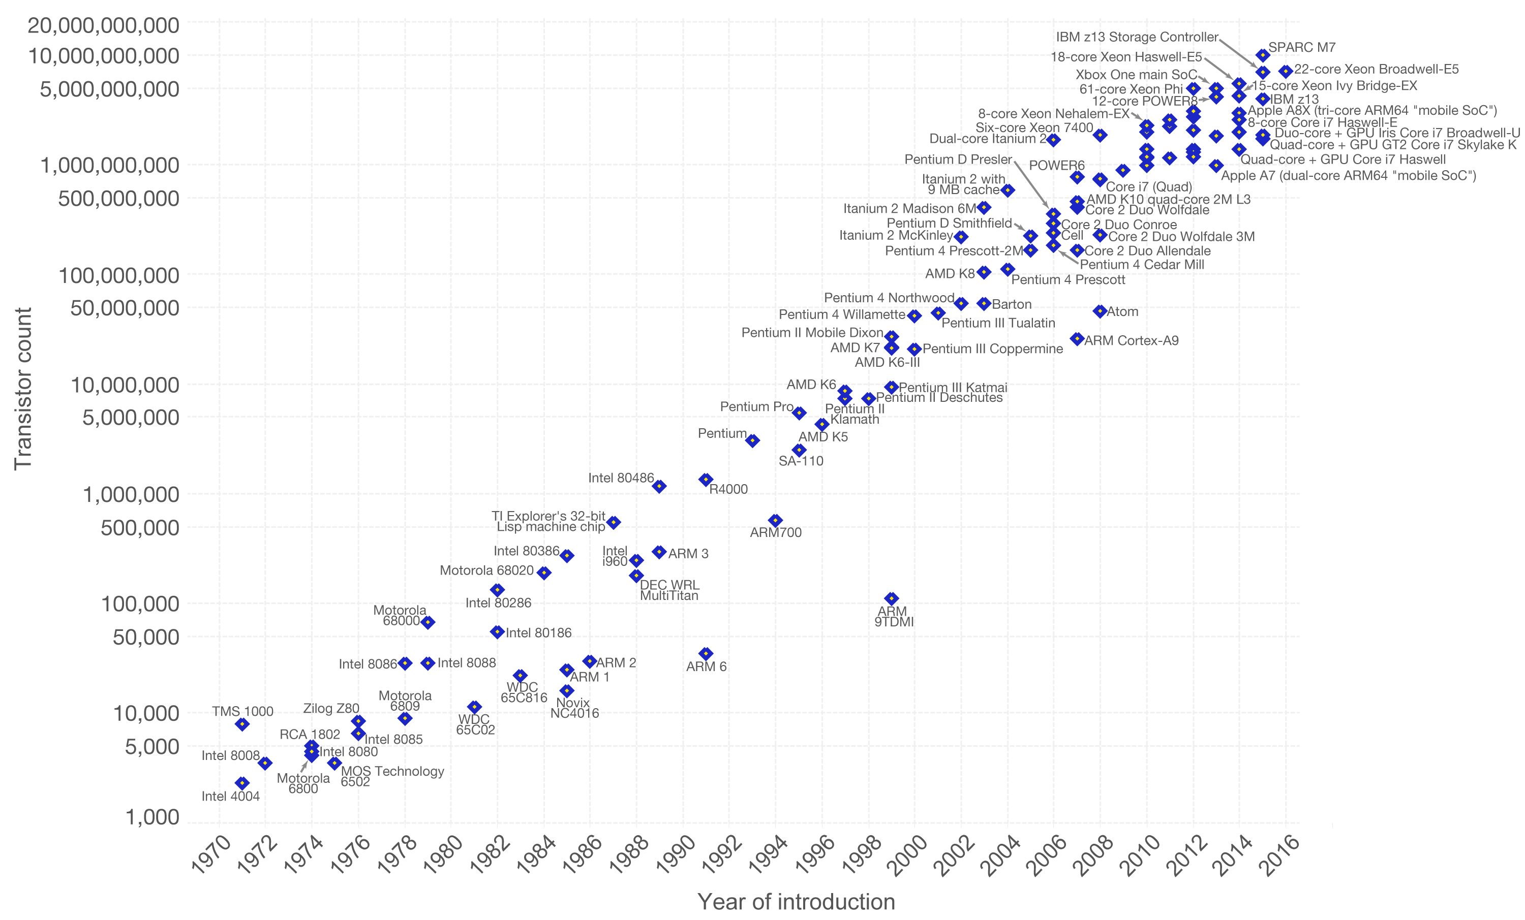
Why Multicore?
Moore’s Law: Transistor count per chip area doubles roughly every 18 months
source:wikipedia

Slide 6
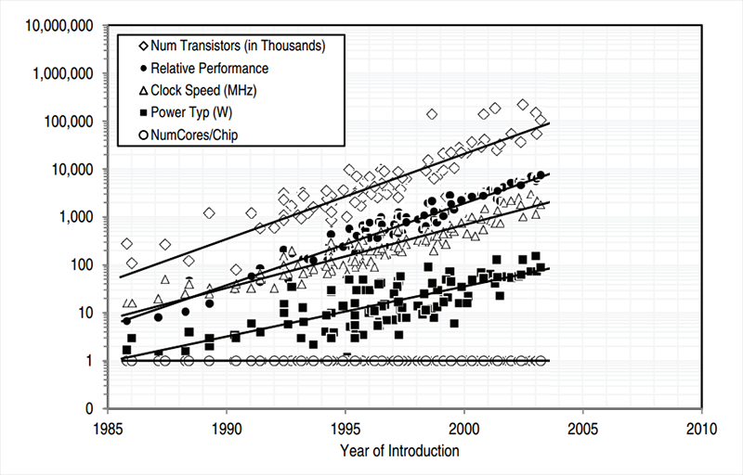
Why Multicore?
more transistors
+
higher frequency
source:The Future of Computing Performance, 2011

Slide 7
Why Multicore?
For years, transistor scaling:
  Processor dynamic power:
  Processor static (leakage) power:
$$area A ∝ 1/X^{2}$$
$$voltage V ∝1/X$$
$$capacitance C ∝1/X$$
$$switching delay T ∝1/X$$
$$P_{D} ≈n ∙ \left( C ∙V^{2} \right)∙( α ∙f )$$
threshold voltage
$$P_{S} ≈n ∙V∙e^{−V_{th}}$$

Slide 8
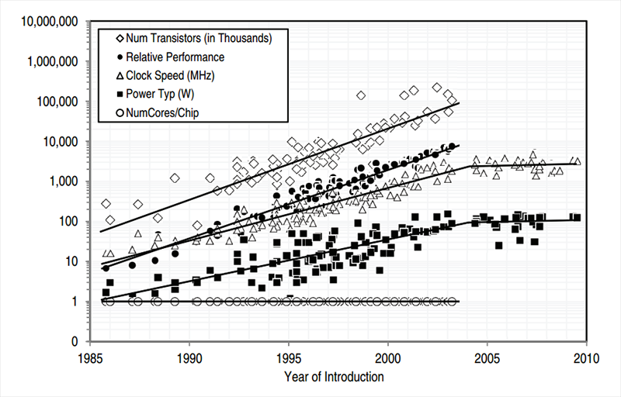
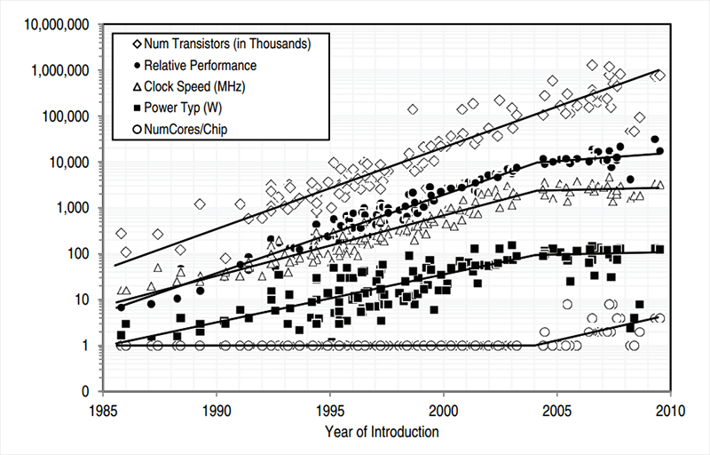
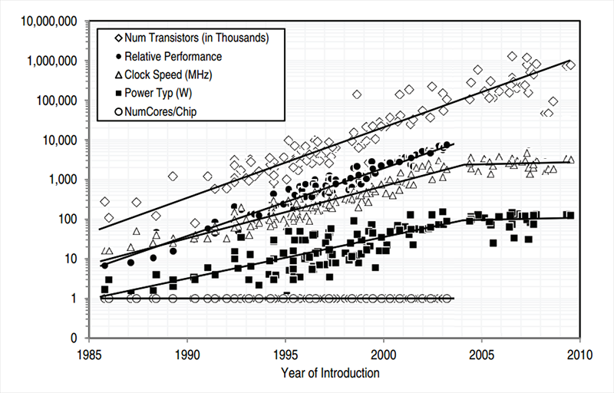
Why Multicore?
parallelize for performance
source:The Future of Computing Performance, 2011

Slide 9
Types of Parallelism
Compute-Level Parallelism:
Executing multiple computation streams simultaneously
Data-Level Parallelism:
Processing multiple data streams simultaneously

Slide 10
Concurrency and Parallelism
Concurrency:
Coexistence of multiple tasks/computations in progress
Logically doing multiple things at once
Typically algorithm/system-defined
Parallelism:
Execution of multiple tasks/computations simultaneously
Physically doing multiple things at once
Typically architecture-defined

Slide 11
Parallel Speedup
How to compute speedup due to parallelism?
  e.g., 3 processor cores
program
sequential
parallel
sequential

Slide 12
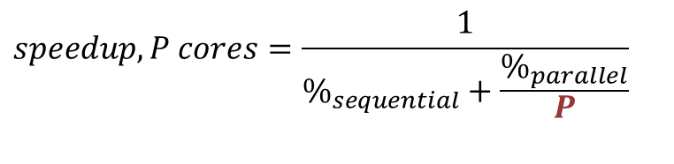
Amdahl’s Law
How to compute speedup due to parallelism?
  e.g., 3 processor cores
parallel
sequential
parallel
sequential
$$speedup, P cores=\frac{1}{\%_{sequential}+\frac{\%_{parallel}}{P}}$$
parallel

Slide 13
Amdahl’s Law – 75% Parallel

Slide 14
Amdahl’s Law – 98% Parallel
Even small percentage of sequential work can greatly limit speedup

Slide 15
Flynn’s Taxonomy
Michael J. Flynn, Very High-Speed Computing Systems, Proc. IEEE, 1966.
SISD (Single Instruction – Single Data)
One instruction operating on one data location
SIMD (Single Instruction – Multiple Data)
One instruction operating on multiple data locations
MISD (Multiple Instruction – Single Data)
Multiple instructions operating on one data location
MIMD (Multiple Instruction – Multiple Data)
Multiple instructions operating on multiple data locations

Slide 16
ILP vs. TLP
Instruction-Level Parallelism (ILP):
  Independent work within a single thread of program
  e.g., Superscalar
Thread-Level Parallelism (TLP):
  Independent work across multiple threads of program

Slide 17
Thread-Level Parallelism
pthreads: Popular library for explicitly creating and managing threads in a program
void *thread(void *vargp) {
printf("Hello, world!\n");
return NULL;
}
int main() {
pthread_t tid;
pthread_create(&tid, NULL, thread, NULL);
pthread_join(tid, NULL);
return 0;
}

Slide 18
MIMD
MIMD processors exploit thread-level parallelism
Motivated by time-sharing of single CPU
  Programs written to be multithreaded
Quickly led to adoption of multiple processor cores in a single system
  Enabled scalable product line from entry-level single-core systems to high-end multicore systems
  Same programs/OS run seamlessly
  Adding CPUs increases throughput (performance)

Slide 19
MIMD
Multiple hardware threads in a core:
Connected via microarchitecture
Simultaneous multithreading (SMT), hyperthreading
Multiple processor cores in a chip:
Connected via on-chip interconnect/memory hierarchy
Chip multiprocessors (CMPs)
Multiple CMPs in a cluster:
Connected via IO/internetworking
Datacenters, warehouse-scale computers

Slide 20
Instruction-Level Parallelism
in-order
scalar
in-order
superscalar
out-of-order
superscalar

Slide 21
Multithreading
context-switching
simultaneous multithreading
chip multiprocessor
parallelism/throughput
area/complexity

Slide 22




Multithreading
convoying
self-navigating
separate roads

Slide 23
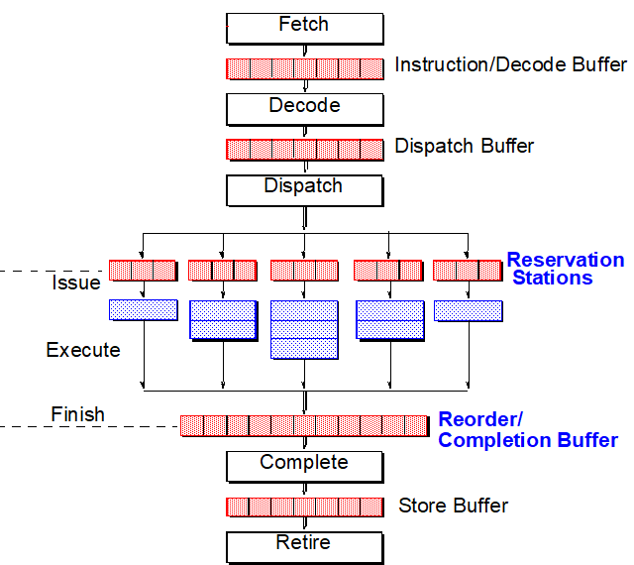
Simultaneous Multithreading
Fetch and execute instructions from different threads in parallel on the same superscalar processor
OoO engine is naturally well-suited to SMT

Slide 24
Simultaneous Multithreading
Partition the instruction/decode buffer, dispatch buffer, reorder buffer and map table
Pool the reservation stations, functional units and physical registers
Thread 1
Thread 2
Both threads 1 and 2
Thread 1
Thread 2

Slide 25
Simultaneous Multithreading
Partition the instruction/decode buffer, dispatch buffer, reorder buffer and map table
Pool the reservation stations, functional units and physical registers
partitioned
thread 1 map table
$t0 | P15 | rdy
$t1 | P9 | rdy
$s0 | P6 | !rdy
$s1 | P4 | rdy
$s2 | P0 | rdy
thread 2 map table
$t0 | P2 | !rdy
$t1 | P10 | rdy
$s0 | P3 | !rdy
$s1 | P11 | !rdy
$s2 | P7 | rdy
free list
P8, P1, P14, P12, P5, P13
pooled

Slide 26
Simultaneous Multithreading
Partition the instruction/decode buffer, dispatch buffer, reorder buffer and map table
Pool the reservation stations, functional units and physical registers
e.g., Intel Hyperthreading:
partitioned
pooled
[J. E. Smith]

Slide 27

Chip Multiprocessor
L1-I cache
L1-D cache
L1-I cache
L1-D cache
L1-I cache
L1-D cache
unified I/D
L2 cache
unified I/D
L2 cache
unified I/D
L2 cache
shared L3 cache
main memory

Slide 28
Exercise
Consider your program running on a parallel processor. If your program is 75% parallelizable, what would be the speedup of your entire program when executed on a five-core parallel processor?
speedup = 1 / (25% + 75%/5) = 2.5x

