Slide 1
ECE/CS 552: Consistency and SIMD
Boone Severson
Lecture notes based in part on slides created by Joshua San Miguel, Mikko Lipasti, Mark Hill, David Wood, Guri Sohi, John Shen and Jim Smith

Slide 2
Forecast
Sequential consistency
SIMD
MISD

Slide 3
Coherence and Consistency
Coherence: ordering of multiple cores’ reads and writes to one memory location.
Enforces that accesses to memory location are ordered as if they were performed in some sequential order
Consistency: ordering of multiple cores’ reads and writes to all memory locations.
Sequential consistency (SC) model: Enforces that accesses to all memory locations are ordered as if they were performed in some sequential order
Relaxed consistency models exist to improve performance

Slide 4
Sequential Consistency
To achieve sequential consistency, it should appear as if:
Intra-thread program order: Each individual core’s reads and writes occur in program order.
Inter-thread serialization: All memory reads and writes from all cores are globally serialized.
load X
load X
store X
store X
load Y
store Y
load Y
store Y

Slide 5
SC Example 1
Possible result with SC: (A=0, C=0)?
No
// init
*x = 0; *y = 0;
// P1
*x = 8;
A = *y;
// P2
B = *x * 2;
...
*y = 5;
C = *x * 2;

Slide 6
SC Example 1
Possible result with SC: (A=0, C=0)?
No
// init
*x = 0; *y = 0;
// P1
*x = 8;
A = *y;
// P2
B = *x * 2;
...
*y = 5;
C = *x * 2;
// P2
B = *x * 2;
...
*y = 5;
C = B;
compiler:
common subexpression elimination
(A=0, C=0)
SC violation!

Slide 7
SC Example 2
Possible result with SC: (A=B=C=2)?
No
// init
A = 0; B = 0; *x = 1; *y = 0;
// P1
A = *x;
B = *x;
if(A == B)
*y = 2;
// P2
C = *y;
*x = C;

Slide 8
SC Example 2
Possible result with SC: (A=B=C=2)?
No
// init
A = 0; B = 0; *x = 1; *y = 0;
// P1
A = *x;
B = *x;
if(A == B)
*y = 2;
// P1
A = *x;
B = A;
if(A == B)
*y = 2;
// P1
A = *x;
B = A;
*y = 2;
// P2
C = *y;
*x = C;
compiler:
common subexpression elimination
compiler:
static true

Slide 9
SC Example 2
Possible result with SC: (A=B=C=2)?
No
// init
A = 0; B = 0; *x = 1; *y = 0;
// P1
A = *x;
B = A;
*y = 2;
// P1
*y = 2;
A = *x;
B = A;
// P2
C = *y;
*x = C;
compiler:
independent of previous instructions
(A=B=C=2)
SC violation!

Slide 10
SC Example 3
Possible assertion fail with SC?
No
out-of-order execution
with branch prediction
// init
*x = 0; *y = 0;
// P1
*x = 1;
*y = 1;
// P2
if(*y != 0) {
A = *x;
assert(A != 0);
}
// P2
if(*y != 0) {
A = *x;
assert(A != 0);
}
(assertion fail)
SC violation!

Slide 11
SC Example 4
Possible result with SC: (A=7,B=0)?
No
// init
*x = 0; *y = 0; *z = 0;
// P0
*x = 7;
*y = 3;
// P1
while(*y == 0);
*z = 1;
A = *x;
// P5
while(*z == 0);
B = *y;

Slide 12
SC Example 4
Possible result with SC: (A=7,B=0)?
No
// init
*x = 0; *y = 0; *z = 0;
// P1
while(*y == 0);
*z = 1;
A = *x;
// P0
*x = 7;
*y = 3;
// P0
*x = 7;
*y = 3;
P0
P0
P1
P1
P2
7, 0, 0
0, 0, 0
7, 0, 0
0, 0, 0
// P5
while(*z == 0);
B = *y;
P3
P4
P5
P5
7, 0, 0
0, 0, 0

Slide 13
SC Example 4
Possible result with SC: (A=7,B=0)?
No
// init
*x = 0; *y = 0; *z = 0;
(A=7, B=0)
SC violation!
// P1
while(*y == 0);
*z = 1;
A = *x;
// P1
while(*y == 0);
*z = 1;
A = *x;
// P0
*x = 7;
*y = 3;
// P0
*x = 7;
*y = 3;
P0
P0
P0
P1
P1
P1
P2
7, 0, 0
7, 3, 0
7, 3, 1
7, 0, 0
7, 3, 0
7, 3, 1
// P5
while(*z == 0);
B = *y;
P3
P4
P5
P5
7, 0, 0
7, 0, 1
network congestion

Slide 14
Sequential Consistency
To achieve sequential consistency, it should appear as if:
Intra-thread program order: Each individual core’s reads and writes occur in program order.
Inter-thread serialization: All memory reads and writes from all cores are globally serialized.
  Tell compiler not to reorder loads/stores (volatile)
  Allow for out-of-order execution, but double-check loads at retire stage (replay)
  Stall younger memory operations (fences)
load X
load X
store X
store X
load Y
store Y
load Y
store Y
Inter-thread write atomicity: All memory writes are globally serialized and all cores agree on the order.
  If a core writes a new value, all cores must acknowledge the write before any core is allowed to read it (coherence acknowledgements)
only writes have to be serialized;
reads can happen in parallel

Slide 15
Volatile
Language declaration that allows the programmer to tell the compiler that an external entity (e.g., another thread, I/O device) may modify the memory location, so must be conservative and limit optimizations.
volatile int *x = ...;
*x = A;
...
B = *x;
compiler must assume that *x can be modified by someone else anytime

Slide 16
SC Example 2 – Fixed
Possible result with SC: (A=B=C=2)?
No
no more SC violation!
// init
A = 0; B = 0;
volatile *x = 1; volatile *y = 0;
// P1
A = *x;
B = *x;
if(A == B)
*y = 2;
// P2
C = *y;
*x = C;

Slide 17
Replay
MIPS R10K performs stores in-order at retire (R). Allow loads to be performed out-of-order at execute (X), but must replay them in-order at retire (R) to make sure their values have not changed since then. If the value has changed, flush and re-execute dependent instructions.
(2) perform load 0($s0)
insn \ cycle | 1 | 2 | 3 | 4 | 5 | 6 | 7 | 8 | 9 | 10 | 11 | 12
lw $t0, 0($s0) | F | De | Di | S | S | S | S | X | C | R
lw $t1, 0($s1) |  | F | De | Di | S | X | C | R | R | R | R
add $t2, $t1, $t0 |  |  | F | De | Di | S | S | S | S | X | C | R
(1) perform load 0($s1)
(3) replay load 0($s1)

Slide 18
SC Example 3 – Fixed
Possible assertion fail with SC?
No
out-of-order execution
with branch prediction
// init
*x = 0; *y = 0;
// P1
*x = 1;
*y = 1;
// P2
if(*y != 0) {
A = *x;
assert(A != 0);
}
replay load (A=1)
no more SC violation!

Slide 19
Memory Fences/Barriers
Special instructions to manually enforce intra-thread ordering of loads/stores, in case we do not want to change our OoO hardware implementation.
mfence: All prior loads and stores in this thread (in program order) must be globally acknowledged before proceeding.
lfence: All prior loads in this thread (in program order) must be globally acknowledged before proceeding.
sfence: All prior stores in this thread (in program order) must be globally acknowledged before proceeding.

Slide 20
SC Example 3 – Fences
Possible assertion fail with SC?
No
// init
*x = 0; *y = 0;
// P1
*x = 1;
sfence;
*y = 1;
// P2
if(*y != 0) {
lfence;
A = *x;
assert(A != 0);
}

Slide 21
Coherence Acknowledgements
When a core modifies a value and transitions to the modified (M) state, all other cores must first acknowledge that they have been invalidated before any of them are allowed to read the new value.
For snooping-based coherence, acknowledgements are implied since it is assumed that all cores are watching the common bus

Slide 22
SC Example 4 – Fixed
Possible result with SC: (A=7,B=0)?
No
// init
*x = 0; *y = 0; *z = 0;
// P1
while(*y == 0);
*z = 1;
A = *x;
stalls here until all cores have acknowledged the new value of y
// P0
*x = 7;
*y = 3;
P0
P1
P1
P2
7, 3, 0
7, 0, 0
7, 3, 0
// P5
while(*z == 0);
B = *y;
P3
P4
P5
P5
7, 0, 0
7, 3, 0

Slide 23
SC Example 4 – Fixed
Possible result with SC: (A=7,B=0)?
No
// init
*x = 0; *y = 0; *z = 0;
no more SC violation!
// P1
while(*y == 0);
*z = 1;
A = *x;
// P0
*x = 7;
*y = 3;
P0
P1
P2
7, 3, 1
7, 3, 1
// P5
while(*z == 0);
B = *y;
P3
P4
P5
7, 3, 1

Slide 24
Flynn’s Taxonomy
Michael J. Flynn, Very High-Speed Computing Systems, Proc. IEEE, 1966.
SISD (Single Instruction – Single Data)
One instruction operating on one data location
SIMD (Single Instruction – Multiple Data)
One instruction operating on multiple data locations
MISD (Multiple Instruction – Single Data)
Multiple instructions operating on one data location
MIMD (Multiple Instruction – Multiple Data)
Multiple instructions operating on multiple data locations

Slide 25
SIMD
Vector (Superword) Instructions:
conventional add r1, r2, r3
vector add vrA, vrB, vrC
r1 | = | r2 | + | r3
vrA.1 | = | vrB.1 | + | vrC.1
vrA.2 |  | vrB.2 |  | vrC.2
vrA.3 |  | vrB.3 |  | vrC.3
vrA.4 |  | vrB.4 |  | vrC.4

Slide 26
Vector (Superword) Instructions
Vector registers are typically composed of multiple smaller registers.
e.g., Intel 128-bit SSE:
70 different instructions/operations
8 128-bit registers that can be accessed as:
  Two 64-bit integers or double-precision floating-point
  Four 32-bit integers or single-precision floating-point
  Eight 16-bit short integers
  Sixteen 8-bit chars
r0 | r1 | r2 | r3 | vrA
r4 | r5 | r6 | r7 | vrB
r8 | r9 | r10 | r11 | vrC
r12 | r13 | r14 | r15
r16 | r17 | r18 | r19

Slide 27
Vector (Superword) Instructions
Loop unrolling:
for (i = 0; i < n; i += 4) {
a[i] = b[i] + c[i];
a[i+1] = b[i+1] + c[i+1];
a[i+2] = b[i+2] + c[i+2];
a[i+3] = b[i+3] + c[i+3];
}
for (i = 0; i < n; i += 1) {
a[i] = b[i] + c[i];
}
Loop fusion:
for (i = 0; i < n; i += 1)
a[i].x = b[i].x + c[i].x;
...
for (i = 0; i < n; i += 1)
a[i].y = b[i].y + c[i].y;
...
for (i = 0; i < n; i += 1)
a[i].z = b[i].z + c[i].z;
for (i = 0; i < n; i += 1) {
a[i].x = b[i].x + c[i].x;
a[i].y = b[i].y + c[i].y;
a[i].z = b[i].z + c[i].z;
}

Slide 28
Vector (Superword) Instructions
superword-level parallelism
instruction-level parallelism
SW1
I1
I2
I3
SW1: | a = b + c; d = e + f; g = h + i;
SW2: | j = a * l; k = d * m;
I1: I2: I3: | a = b + c; d = e + f; g = h + i;
I4: I5: | j = a * l; k = d * m;
VS
SW2
I4
I5
Needs register packing/unpacking
Less flexible (e.g., same operations)
More dynamic instructions fetched and executed
Superscalar cost for same performance

Slide 29
Vector (Superword) Instructions
superword-level parallelism
instruction-level parallelism
SW1
I1
I2
I3
SW1: | a = b + c; d = e + f; g = h + i;
SW2: | j = a * l; k = d * m;
I1: I2: I3: | a = b + c; d = e + f; g = h + i;
I4: I5: | j = a * l; k = d * m;
VS
SW2
I4
I5
More dynamic instructions issued
Superscalar cost for same performance
An analogy:
Buy-one-get-one-free (BOGO) deals vs. membership discount.
BOGO is less flexible (infrequent, same item), but getting membership is expensive and often underutilized.
Needs register packing/unpacking
Less flexible (e.g., same operations)

Slide 30
Single-Instruction Multiple-Threads (SIMT)
Graphics Processing Units (GPUs)
Shader cores that exploit compute-intensive, massive data parallelism
Devote more transistors to processing rather than caching and flow control
Being used for general-purpose use (GPGPUs) in high-performance computing applications
ALU
ALU
Control
ALU
ALU
CPU
GPU
Cache
DRAM
DRAM

Slide 31
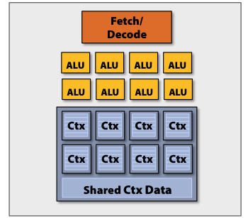
GPUs
Threads perform the same computations
  Unify the fetch and decode logic
[J. Hensley, AMD]

Slide 32
GPUs
There are many threads
  Stamp out many of these multiprocessors
[J. Hensley, AMD]

Slide 33
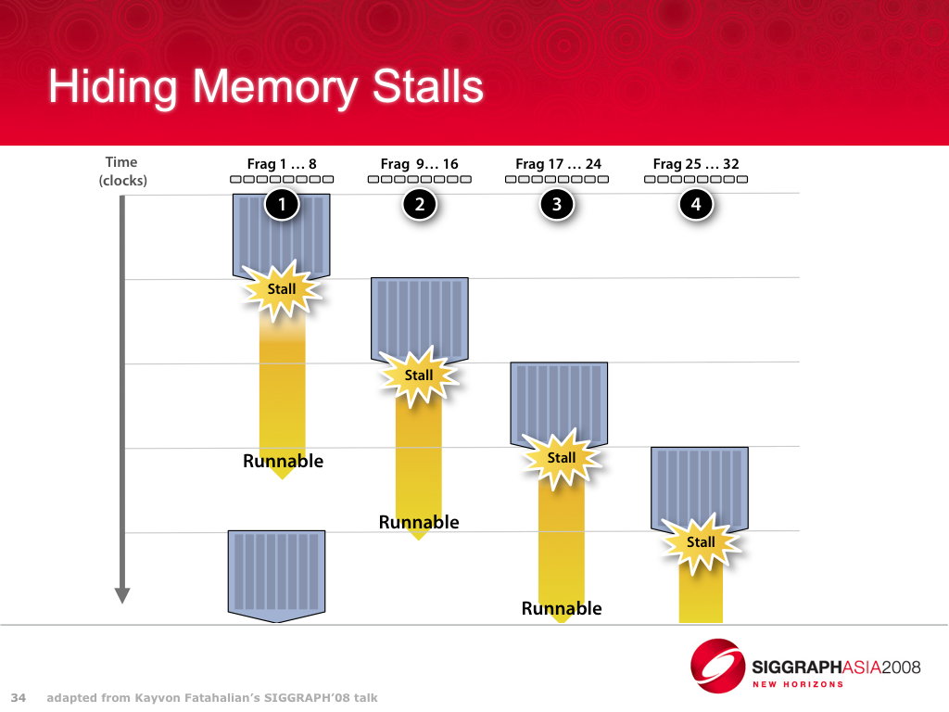
GPUs
There are many, many threads
  Lots of time-multiplexing
[J. Hensley, AMD]

Slide 34
MISD
Streaming Architectures:
e.g., Streaming big data analytics:
IBM stream computing
Apache Spark streaming

Slide 35
Exercise
Insert the minimum number of store fences and load fences to ensure SC:
Assume inter-thread write atomicity support
// init
*x = 0; *y = 0; *z = 0;
// P0
*x = 7;
*y = 3;
// P1
while(*y == 0);
*z = 1;
A = *x;
// P5
while(*z == 0);
B = *y;

Slide 36
Exercise
Insert the minimum number of store fences and load fences to ensure SC:
Assume inter-thread write atomicity support
// init
*x = 0; *y = 0; *z = 0;
// P0
*x = 7;
sfence;
*y = 3;
// P1
while(*y == 0);
lfence;
*z = 1;
A = *x;
// P5
while(*z == 0);
lfence;
B = *y;

