Slide 1
ECE/CS 552: Floating Point
Boone Severson
Lecture notes based in part on slides created by Joshua San Miguel, Mikko Lipasti, Mark Hill, David Wood, Guri Sohi, John Shen and Jim Smith

Slide 2
Forecast
Floating point representation
  Normalization
  Biased exponent
FP addition
FP multiplication
FP rounding

Slide 3
Floating Point
Why floating point representation?
  In many cases, we want to be able to represent a large range of values without needing much precision
e.g., Represent [3 … 1572864] in integer (i.e., fixed point):
  [000000000000000000011 … 110000000000000000000]
But really that’s just (in floating point):
  [1.1 x 2¹ … 1.1 x 2²⁰]
Like scientific notation:
  1.337 x 10⁻⁵

Slide 4
Floating Point
Floating point format:
  S: sign bit, E: exponent, F: fraction (mantissa)
  Value: (-1)^{S} x 1.F x 2E
  e.g., 9.25 in decimal = 1.00101 x 2³ in binary
  Fraction w/implicit 1 is called a Significand
S
E
F
S = sign | E = exp | F = fraction
0 | 0011 | 00101
usually biased
(discuss later)
normalized
(implicit/hidden leading 1)

Slide 5
Floating Point
IEEE754 floating-point standard:
 | E | F | Range*
Single (32-bit) precision | 8-bit | 23-bit | 2⁻¹²⁶→2⁺¹²⁷
Double (64-bit) precision | 11-bit | 52-bit | 2⁻¹⁰²²→2⁺¹⁰²³
*Normalized Numbers Only

Slide 6
Normalization
Why normalize?
  Otherwise, too many ways to represent 9.25:
    1001.01 x 2⁰
    100.101 x 2¹
    10.0101 x 2²
    1.00101 x 2³
  Standard: one leading 1 in front of binary point
    1.00101 x 2³
    No need to store leading 1; it is always assumed
      Sometimes called the “hidden bit”

Slide 7
Biased Exponent
E can be positive or negative
  Encoded in biased (or excess) notation
  Why? To simplify sorting, we want:
  ↑ unsigned exponent => ↑ floating-point value
e.g., 1-bit sign, 4-bit exponent (with bias 7), 5-bit fraction:
value = (-1)^{S} x 1.F x 2^{(E – 7)}
9.25 = 1.00101 x 2³
S = sign | E = exp | F = fraction
0 | 1010 | 00101

Slide 8
Biased Exponent
Exponent Value | 2’s Complement | E (with bias 127)
-127 | 1000 0001 | 0000 0000*
-126 | 1000 0010 | 0000 0001
… | … | …
+127 | 0111 1111 | 1111 1110
Value: (-1)^{S} x 1.F x 2^{(E-bias)}
  IEEE754 single precision: bias = 127
  IEEE754 double precision: bias = 1023
* 0 exponent is a subnormal number

Slide 9
IEEE754 Special Cases
Single Precision |  | Double Precision |  | Value
E | F | E | F
0 | 0 | 0 | 0 | zero
0 | nonzero | 0 | nonzero | denormalized
255 | 0 | 2047 | 0 | infinity
255 | nonzero | 2047 | nonzero | NaN (Not a Number)
Explore IEEE 754 @ https://www.h-schmidt.net/FloatConverter/IEEE754.html

Slide 10
FP Overflow/Underflow
FP overflow
  Analogous to integer overflow
  Result is too big to represent
  Means exponent is too big
FP underflow
  Result is too small to represent
  Means exponent is too small (or too negative)
Both can raise an exception under IEEE754 if enabled

Slide 11
FP Addition
Just like adding in scientific notation
  First, align points by shifting
  Then, add significands
  Finally, normalize and round
e.g., Decimal
9.997 x 10² | 9.997000 x 10²
4.631 x 10⁻¹ | 0.004631 x 10²
Sum | 10.001631 x 10²
Normalized | 1.0001631 x 10³
Round | 1.000 x 10³

Slide 12
FP Addition
Just like adding in scientific notation
  First, align points by shifting
  Then, add significands
  Finally, normalize and round
e.g., Binary
1.11001 x 2³⁼¹⁰⁻⁷ | 1.1100100 x 2³
1.10001 x 2¹⁼⁸⁻⁷ | 0.0110001 x 2³
Sum | 10.0010101 x 2³
Normalized | 1.00010101 x 2⁴⁼¹¹⁻⁷
Round | 1.00011 x 2⁴⁼¹¹⁻⁷
(-1)^{S} x 1.F x 2^{(E – 7)}

Slide 13
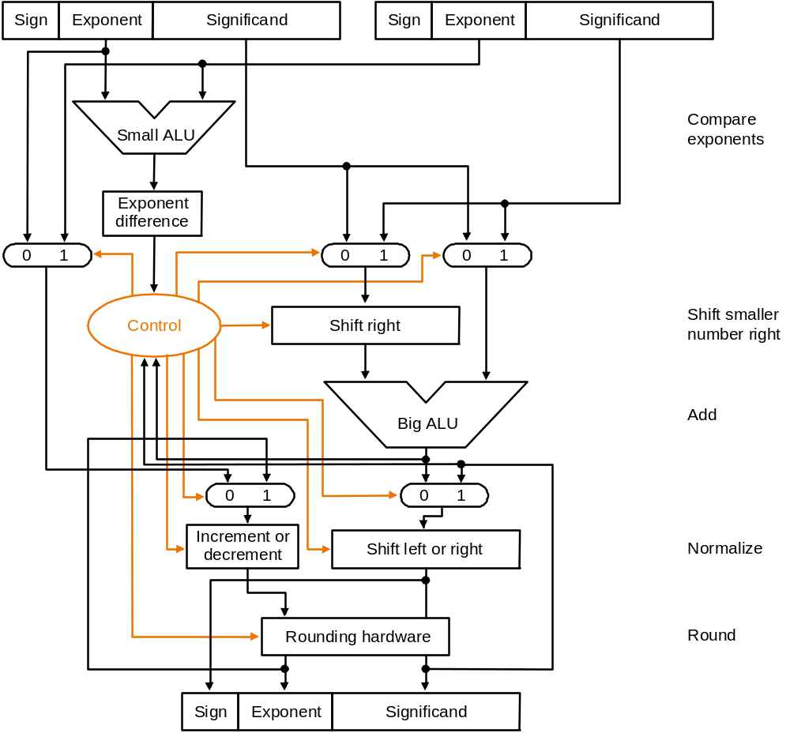
FP Adder
Fraction
Fraction
Fraction

Slide 14
FP Rounding
Rounding is important
  Small errors accumulate over billions of ops
e.g., Using 6-bit adder:
  (-1)^{S} x 1.F x 2^{(E – 7)}
1.11001 x 2³⁼¹⁰⁻⁷ | 1.1100100 x 2³
1.10001 x 2¹⁼⁸⁻⁷ | 0.0110001 x 2³
Sum | 10.0010101 x 2³
Normalized | 1.00010101 x 2⁴⁼¹¹⁻⁷
Round | 1.00010 x 2⁴⁼¹¹⁻⁷
rounding error!

Slide 15
FP Rounding
Introduce a guard bit
  Extra bit in significand beyond the least-significant bit
e.g., Using 7-bit adder:
  (-1)^{S} x 1.F x 2^{(E – 7)}
1.11001 x 2³⁼¹⁰⁻⁷ | 1.1100100 x 2³
1.10001 x 2¹⁼⁸⁻⁷ | 0.0110001 x 2³
Sum | 10.0010101 x 2³
Normalized | 1.00010101 x 2⁴⁼¹¹⁻⁷
Round | 1.00011 x 2⁴⁼¹¹⁻⁷

Slide 16
FP Multiplication
Product sign: S_{P} = S_{A} xor S_{B}
Product exponent: E_{P} = E_{A} + E_{B} – bias
  Must subtract the bias, since:
    A’s exponent = E_{A} – bias
    B’s exponent = E_{B} – bias
    E_{P} = (A’s exponent + B’s exponent) + bias = E_{A} + E_{B} – bias
Product significand: 1.F_{P} = 1.F_{A} x 1.F_{B}
  Standard integer multiplication
Then renormalize and round
  Adjust exponent and significand accordingly

Slide 17
FP Multiplication
Compute S_{P}, E_{P}, 1.F_{P}
Normalize incrementally
  Shift left/right by 1
Check for overflow/underflow
Round
If not normalized yet, back to Step 2

Slide 18
FP Multiplication
e.g., A = 1.11001 x 2³⁼¹⁰⁻⁷, B = 1.10010 x 2¹⁼⁸⁻⁷
  (-1)^{S} x 1.F x 2^{(E – 7)}
  Guard bit
A |  | B |  | A × B = P
significand | exponent | significand | exponent | significand | exponent
1.11001 | 2³⁼¹⁰⁻⁷ | 1.10010 | 2¹⁼⁸⁻⁷ | 10.1100100010 | 2⁴⁼¹¹⁻⁷
 |  |  | Normalize | 1.011001 | 2⁵⁼¹²⁻⁷
 |  |  | Round | 1.01101 | 2⁵⁼¹²⁻⁷

Slide 19
FP Multiplication
e.g., A = 1.01001 x 2³⁼¹⁰⁻⁷, B = 1.10001 x 2¹⁼⁸⁻⁷
  (-1)^{S} x 1.F x 2^{(E – 7)}
  Guard bit
A |  | B |  | A × B = P
significand | exponent | significand | exponent | significand | exponent
1.01001 | 2³⁼¹⁰⁻⁷ | 1.10001 | 2¹⁼⁸⁻⁷ | 01.1111011000 | 2⁴⁼¹¹⁻⁷
 |  |  | Normalize | 1.11110 | 2⁴⁼¹¹⁻⁷
 |  |  | Round | 1.11110 | 2⁴⁼¹¹⁻⁷
A |  | B |  | A × B = P
significand | exponent | significand | exponent | significand | exponent
1.01001 | 2³⁼¹⁰⁻⁷ | 1.10001 | 2¹⁼⁸⁻⁷ | 01.1111011000 | 2⁴⁼¹¹⁻⁷
 |  |  | Normalize | 1.11110 | 2⁴⁼¹¹⁻⁷
 |  |  | Round | 1.11110 | 2⁴⁼¹¹⁻⁷
rounding error! (no bits left to round with)

Slide 20
FP Rounding
Round bit: Extra guard bit for FP multiplication
  Multiplication of significands may result in a leading 0 bit
  Thus the guard bit can end up as the least significant bit of F_{P}
Sticky bit: Final guard bit
  Gets set to 1 if any bits that are shifted right during normalization are 1
  Effectively, logical OR of all dropped bits
  Differentiates between 1.1 and 1.100000000001

Slide 21
FP Rounding
e.g., A = 1.01001 x 2³⁼¹⁰⁻⁷, B = 1.10001 x 2¹⁼⁸⁻⁷
  (-1)^{S} x 1.F x 2^{(E – 7)}
  Guard bit, round bit, sticky bit
A |  | B |  | A × B = P
significand | exponent | significand | exponent | significand | exponent
1.01001 | 2³⁼¹⁰⁻⁷ | 1.10001 | 2¹⁼⁸⁻⁷ | 01.1111011000 | 2⁴⁼¹¹⁻⁷
 |  |  | Sticky bit | 01.1111011 | 2⁴⁼¹¹⁻⁷
 |  |  | Normalize | 1.1111011 | 2⁴⁼¹¹⁻⁷
 |  |  | Round | 1.11111 | 2⁴⁼¹¹⁻⁷

Slide 22
Exercise
e.g., A = 1.11001 x 2³⁼¹⁰⁻⁷, B = 1.10010 x 2¹⁼⁸⁻⁷
  (-1)^{S} x 1.F x 2^{(E – 7)}
  Guard bit, round bit, sticky bit
A |  | B |  | A × B = P
significand | exponent | significand | exponent | significand | exponent
1.11001 | 2³⁼¹⁰⁻⁷ | 1.10010 | 2¹⁼⁸⁻⁷
 |  |  | Sticky bit
 |  |  | Normalize
 |  |  | Round

Slide 23
Exercise
e.g., A = 1.11001 x 2³⁼¹⁰⁻⁷, B = 1.10010 x 2¹⁼⁸⁻⁷
  (-1)^{S} x 1.F x 2^{(E – 7)}
  Guard bit, round bit, sticky bit
A |  | B |  | A × B = P
significand | exponent | significand | exponent | significand | exponent
1.11001 | 2³⁼¹⁰⁻⁷ | 1.10010 | 2¹⁼⁸⁻⁷ | 10.1100100010 | 2⁴⁼¹¹⁻⁷
 |  |  | Sticky bit | 10.1100101 | 2⁴⁼¹¹⁻⁷
 |  |  | Normalize | 1.01100101 | 2⁵⁼¹²⁻⁷
 |  |  | Round | 1.01101 | 2⁵⁼¹²⁻⁷

