Slide 1
ECE/CS 552 testing
10/2/2024

Slide 2
Project phase 1 due Oct 21st
Shifter Implementation in next discussion session
  Use 3x1 MUX for Shifter implementation

Slide 3
Wire vs reg
LHS of continuous assignment -> wire
LHS of procedural assignment -> reg
Ports are by default wires unless otherwise specified
Input ports should always be wires
Output ports can be anything
Output ports should be connected to wires
Input ports can be connected to any
wire result;
assign result = s ? A : B;

Slide 4
Sequential vs combinational
Sequential
  Instantiate the provided DFF module; do not write your own sequential logic
Combinational
  Continuous assignment
  Procedural assignment
  Gate level/structural
dff d0 ( .q(flop_out), .d(flop_in), .rst(reset), .clk(clock) );
Note: Only case and casex go into always block; no module
instantiation or continuous assignment in always block!

Slide 5
Syntax checker
Run checker
No error
Error
java Vcheck <myfile.v>
End of file /tmp/foo.v. Hash = 377189683
Line 5: Expected '@' after 'always' Line 5: Always without case(x) End of file /tmp/foo.v. Hash = -994087497

Slide 6
Project testing flow
Use the test case programs provided on canvas; you can also write additional programs
Assemble the test program to create binary image (readme for WISC-assembler)
Load binary image into memory (readme for singlecycle-memory)
After reset, PC starts from 0; execution kicks off
Check register and memory values as program runs; check waveform and outputs (project-phase1-testbench.v)
Adapted from Sinclair, M. (no date) CS/ECE 552 spring 2022, CS/ECE 552 Spring 2022 Verification & simulation.

Slide 7
Verilog Code in Testbenches
Examples of verilog code that are ok in testbenches but not ok in hardware modules
  “#” delay statements are essential in testing modules and should never be in hardware (except for “clock to Q” delays in D FFs)
  “signed” regs and wires are extremely useful for printing 2’s complement signals
  “for” loops
  $write(“format”, var1, var2, …)
    // writes text to screen or file using the specified
    // format with optional variables. Example:
    // $write("in = %b, out1 = %b, ", in, out1);
    // $write("out2 = %b, out3 = %b", out2, out3);
    // $write("\n");
  $display(“format”, var1, var2, …)
    // same as $write except it adds a \n new line
    // automatically.

Slide 8
Verilog Code in Testbenches
@(posedge clock);
  // only for testbenches
@(negedge clock);
  // used as a standalone
  // statement that waits for the
  // next positive or negative
  // edge of “clock” in this case
repeat (50) @(posedge clk);
  // the “repeat” statement can
  // be very handy for
  // repeatedly executing a
  // statement (or a block of
  // statements)

Slide 9
Verilog Code in Testbenches
$stop;
  // Halts the simulation.
  // This is probably the better one to use
  // for Modelsim because $finish causes
  // Modelsim to ask if you really want to
  // quit the simulator which is probably
  // not what you want.
`timescale time_unit base / precision base
  // The first argument specifies “#1” delay. The
  // second argument specifies the precision with
  // which delays may be specified.
  // Base is {s,ms,us,ns,ps,fs}
  // Ex: `timescale 1ns/10ps

Slide 10
Verifying Hardware Correctness
A number of ways to verify designs:
  Eyeball text printouts and waveforms
    Quick and easy for some simple designs

Slide 11
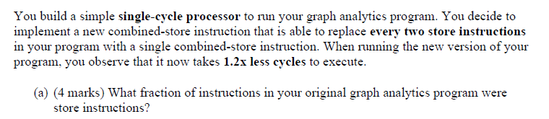
Practice Questions

Slide 12
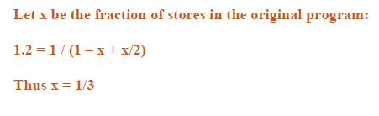
Practice Questions

Slide 13
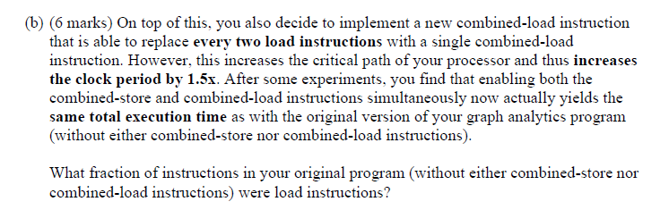
Practice Questions

Slide 14
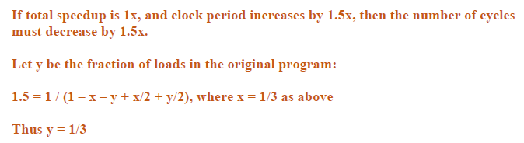
Practice Questions

Slide 15
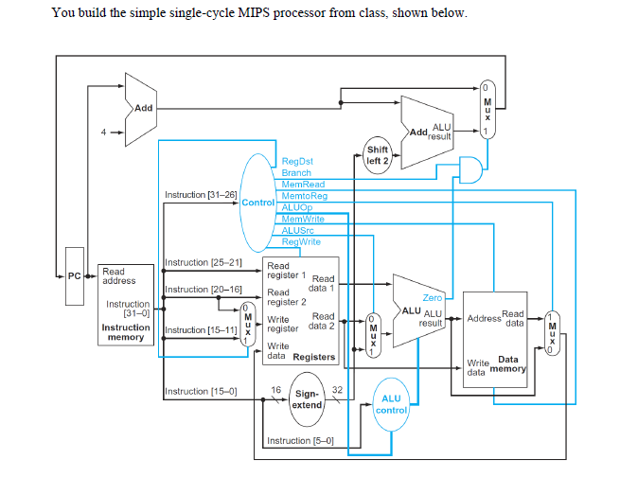
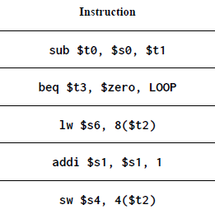

Practice Questions

Slide 16
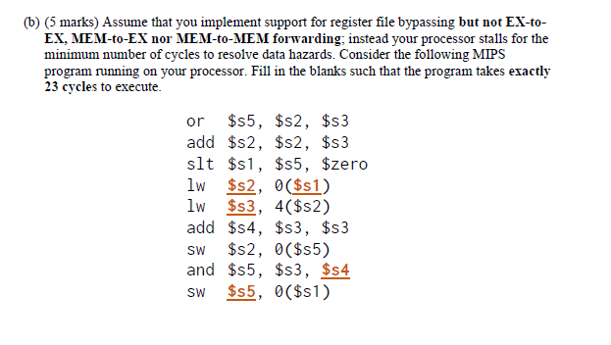
Practice Questions

