Slide 1
ECE/CS 552 project p1
9/25/2024

Slide 2
Due on Monday, October 21, 2024, 11:59pm on canvas
Submit your code as a zip file
One submission per group

Slide 3
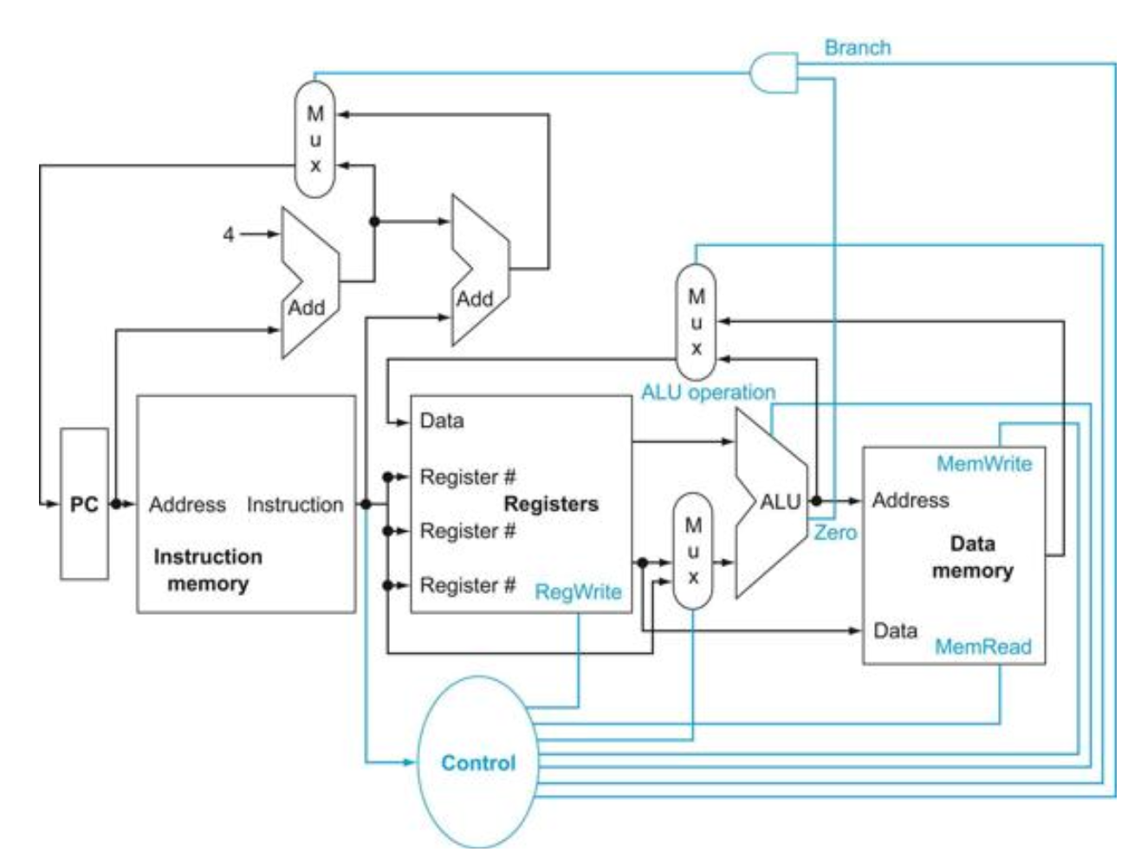
MIPS single-cycle CPU datapath
Fig. 4.2 in COD
“Single-cycle”: On every cycle, one instruction is completed.

Slide 4
MIPS single-cycle CPU datapath
- Fetching instruction
- Incrementing PC
Fig. 4.2 in COD

Slide 5
MIPS single-cycle CPU datapath
- R-type ALU operations
Fig. 4.2 in COD

Slide 6
MIPS single-cycle CPU datapath
Ld/st operations
Fig. 4.2 in COD

Slide 7
MIPS single-cycle CPU datapath
Branch target addr
Fig. 4.2 in COD

Slide 8
MIPS single-cycle CPU datapath
Control signal generation
Fig. 4.2 in COD

Slide 9
Key components
ALU (read 1.1 in phase 1 instruction)
  ADD, SUB, NAND, XOR in homework 2
  Parallel sub-word add (PADDSUB), shifter (SLL, SRA) in upcoming homework
  Extra logics e.g., reduction unit (RED), rotate shifter unit (ROR)
Register file in upcoming homework
Instruction/data memory use the provided model

Slide 10
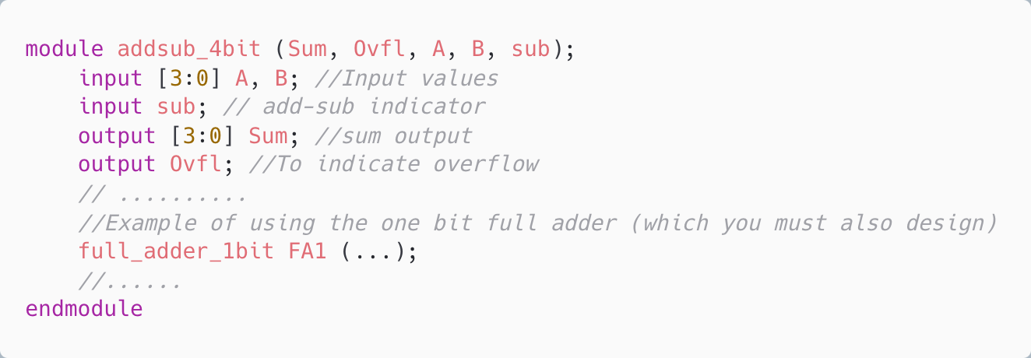
ALU (hw2)
ADD, SUB

Slide 11
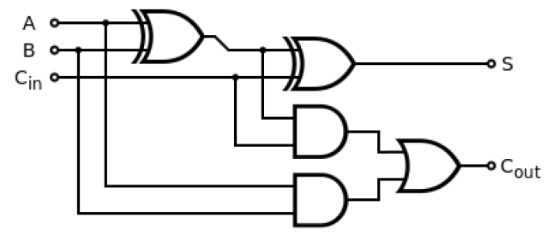
ALU (hw2)
ADD, SUB
1-bit full adder gate-level schematic

Slide 12
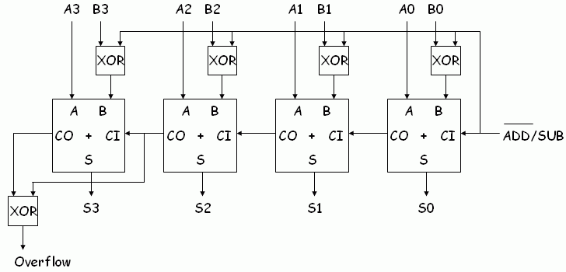
ALU (hw2)
ADD, SUB
1-bit full adder gate-level schematic
4-bit ripple carry adder/subtractor

Slide 13
ALU (hw2)
ADD, SUB
SUB is add/sub indicator
1-bit full adder gate-level schematic
4-bit ripple carry adder/subtractor
When SUB=1’b1: Cin=1’b1, ~B input to FA => subtraction
When SUB=1’b0: Cin=1’b0, B input to FA => addition

Slide 14
ALU (hw2)
ADD, SUB
Do not use +/- in design! You may use them in testbench
For project phase 1, you need 16 bit carry look-ahead (CLA) adder/subtractor

Slide 15
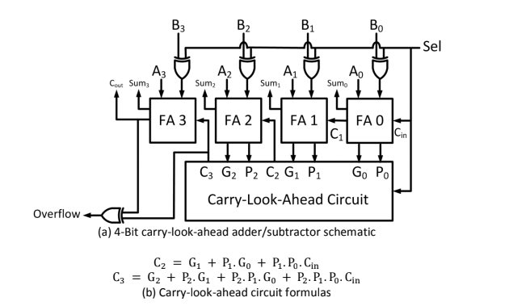
CLA
4-bit CLA with add/sub selection

Slide 16
ALU
RED
Byte 1
Byte 0
REG rs
aaaaaaaa
bbbbbbbb
REG rt
cccccccc
dddddddd
REG rd

Slide 17
ALU
RED
Byte 1
Byte 0
REG rs
aaaaaaaa
bbbbbbbb
REG rt
cccccccc
dddddddd
REG rd
Byte wise reduction (level 1)
4-bit CLA x2
4-bit CLA x2

Slide 18
ALU
RED
Byte 1
Byte 0
REG rs
aaaaaaaa
bbbbbbbb
REG rt
cccccccc
dddddddd
aaaaaaaa+
cccccccc
bbbbbbbb+
dddddddd
REG rd
9 bit
9 bit

Slide 19
ALU
RED
Byte 1
Byte 0
REG rs
aaaaaaaa
bbbbbbbb
REG rt
cccccccc
dddddddd
aaaaaaaa+
cccccccc
bbbbbbbb+
dddddddd
REG rd
+ (level 2)
4-bit CLA x3

Slide 20
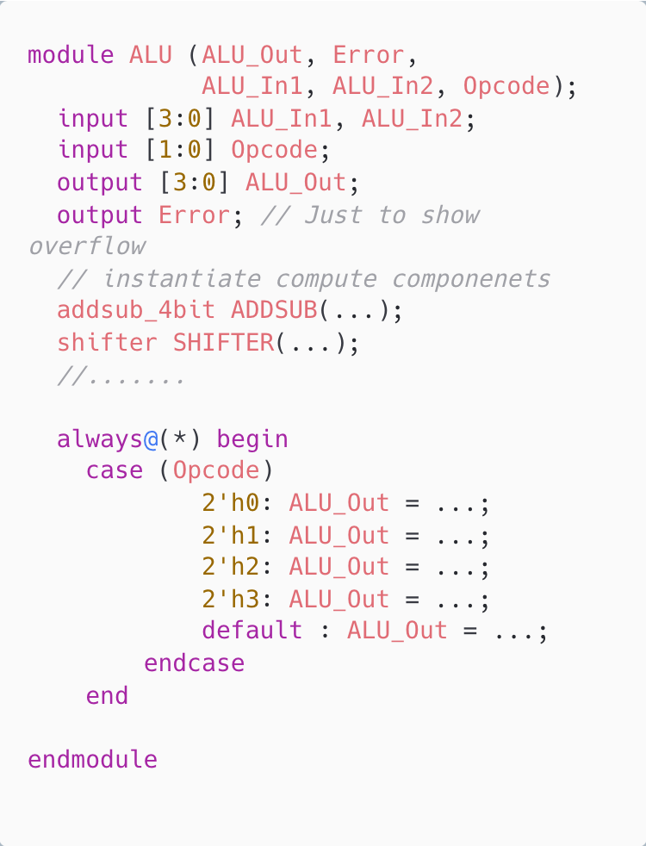
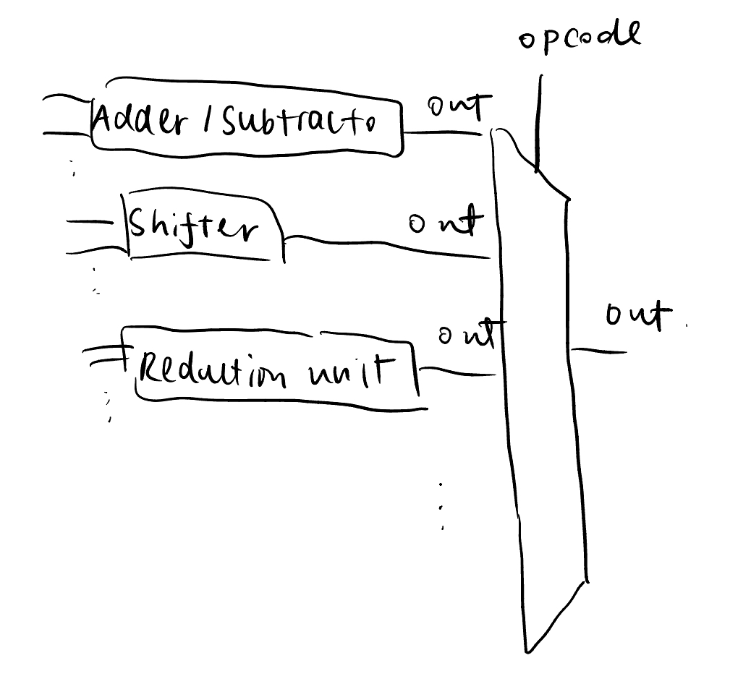
ALU
Top-level
ALU is effectively all compute subcomponent connected to a MUX; opcode is the selection signal
Sample ALU top level file

Slide 21
Keep your design modular
Test your modules
Draw block diagrams

