Slide 1
ECE/CS 552: Midterm Review
Boone Severson
Based on Notes from Joshua San Miguel

Slide 2
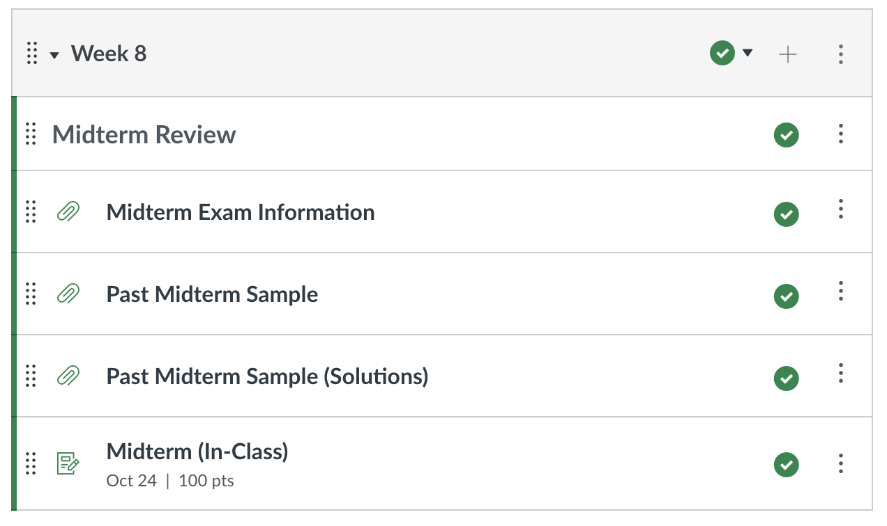
Midterm
Midterm this Thursday 10/24 during class, in this room
  Closed book, pen-and-paper exam
  One hand-written cheat sheet allowed
  MIPS green card will be provided for you

Slide 3
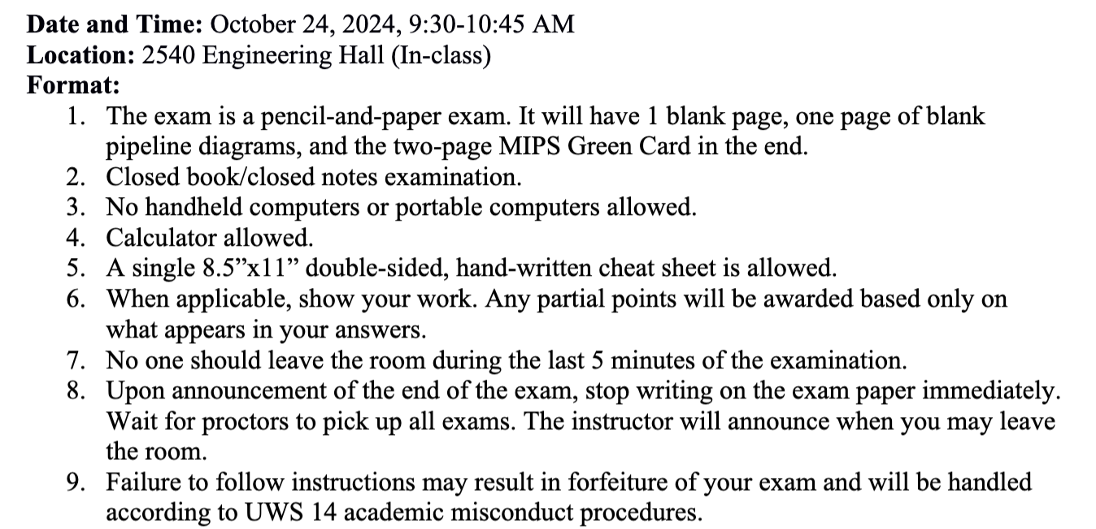
First Page of Midterm

Slide 4
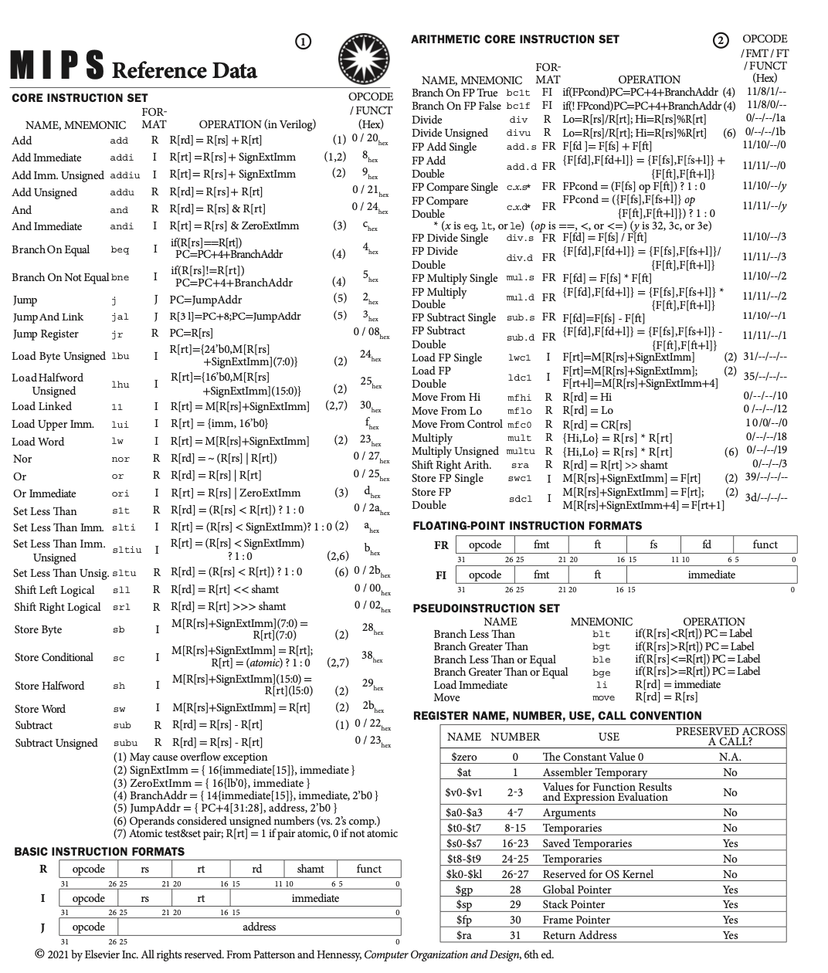
Core Instruction Set only
No Arithmetic Instructions
No Pseudoinstructions

Slide 5
Endianness
State the contents of register $t1 depending on the endianness of the machine, after executing the following instructions:
Little-endian:
Big-endian:
lui $t0, 258
ori $t0, $t0, 772 # [$t0] = 0x01020304
sw $t0, 0($s0)
lbu $t1, 1($s0)

Slide 6
Endianness
State the contents of register $t1 depending on the endianness of the machine, after executing the following instructions:
Little-endian:
  [$t1] = 0x3
Big-endian:
lui $t0, 258
ori $t0, $t0, 772 # [$t0] = 0x01020304
sw $t0, 0($s0)
lbu $t1, 1($s0)
Memory (little-endian)
([$s0] + 3) | 0x01
([$s0] + 2) | 0x02
([$s0] + 1) | 0x03
([$s0] + 0) | 0x04

Slide 7
Endianness
State the contents of register $t1 depending on the endianness of the machine, after executing the following instructions:
Little-endian:
  [$t1] = 0x3
Big-endian:
  [$t1] = 0x2
lui $t0, 258
ori $t0, $t0, 772 # [$t0] = 0x01020304
sw $t0, 0($s0)
lbu $t1, 1($s0)
Memory (little-endian)
([$s0] + 3) | 0x01
([$s0] + 2) | 0x02
([$s0] + 1) | 0x03
([$s0] + 0) | 0x04
Memory (big-endian)
([$s0] + 3) | 0x04
([$s0] + 2) | 0x03
([$s0] + 1) | 0x02
([$s0] + 0) | 0x01

Slide 8
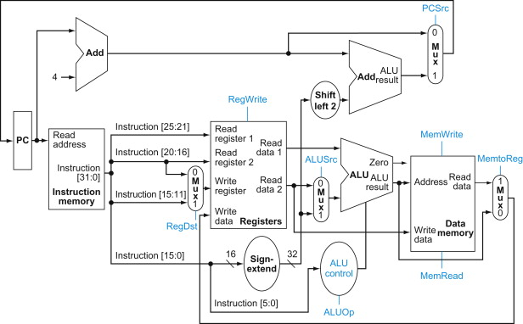
Processor Data Path
Modify the data path below such that all branch targets are computed as PC = PC + BranchAddr instead.

Slide 9
Processor Data Path
Modify the data path below such that all branch targets are computed as PC = PC + BranchAddr instead.

Slide 10
Data Dependences
List all register dependences in the following program:
L1: lw $t2, 4($t0)
L2: subi $t0, $t2, 72
L3: beq $t0, $t3, L1
L4: add $t0, $t2, $t3
RAW
$t2: L1 → L2
$t0: L2 → L3
WAR
$t0: L1 → L2
$t0: L3 → L4
WAW
$t0: L2 → L4

Slide 11

Data Forwarding
  lw $t0, 0($t1)
  lw $s1, 4($t0)
  add $t2, $t3, $s1
At which cycle(s) is this forwarding path enabled?
Assume forwarding to EX and RF bypassing.
insn\cycle | 1 | 2 | 3 | 4 | 5 | 6 | 7 | 8 | 9 | 10 | 11 | 12 | 13
lw $t0 | F | D | X | M | W
lw $s1 |  | F | D* | D | X | M | W
add |  |  | F* | F | D* | D | X | M | W

Slide 12
Data Forwarding
  lw $t0, 0($t1)
  lw $s1, 4($t0)
  add $t2, $t3, $s1
At which cycle(s) is this forwarding path enabled?
Assume forwarding to EX and RF bypassing.
insn\cycle | 1 | 2 | 3 | 4 | 5 | 6 | 7 | 8 | 9 | 10 | 11 | 12 | 13
lw $t0 | F | D | X | M | W
lw $s1 |  | F | D* | D | X | M | W
add |  |  | F* | F | D* | D | X | M | W
Cycle 7

Slide 13
Branch Prediction
Consider a branch predictor that uses a BHT with 8 entries, each containing a 1-bit prediction (1=taken). Assume the current state of the BHT as shown below. You encounter a branch instruction at address PC=0x10001014, and it is found to be not taken; specify the following:
BHT index of this branch:
  5
Prediction for this branch:
  taken
Updated BHT entry value:
  0
index PC[4:2] | 1-bit prediction (1=taken)
0 | 0
1 | 1
2 | 1
3 | 0
4 | 1
5 | 1
6 | 0
7 | 0

Slide 14
Branch Delay Slots
Which of the instructions below can individually be legally removed from its current position in the program and placed into the branch delay slot instead? Ignore potential exceptions.
L1: | addi | $s2, $zero, 16
L2: | and | $s4, $s4, $s1
L3: | slt | $s6, $s1, $s2
L4: | beq | $s6, $s0, L7
 | <branch delay slot>
L5: | or | $s3, $s4, $s6
L6: | add | $s1, $s1, $s3
L7: | slt | $s3, $s2, $s5
L2?
L3?
L5?

Slide 15
Branch Delay Slots
Which of the instructions below can individually be legally removed from its current position in the program and placed into the branch delay slot instead? Ignore potential exceptions.
L1: | addi | $s2, $zero, 16
L3: | slt | $s6, $s1, $s2
L4: | beq | $s6, $s0, L7
L2: | and | $s4, $s4, $s1
L5: | or | $s3, $s4, $s6
L6: | add | $s1, $s1, $s3
L7: | slt | $s3, $s2, $s5
L2?
L3?
L5?

Slide 16
Branch Delay Slots
Which of the instructions below can individually be legally removed from its current position in the program and placed into the branch delay slot instead? Ignore potential exceptions.
L1: | addi | $s2, $zero, 16
L3: | slt | $s6, $s1, $s2
L4: | beq | $s6, $s0, L7
L2: | and | $s4, $s4, $s1
L5: | or | $s3, $s4, $s6
L6: | add | $s1, $s1, $s3
L7: | slt | $s3, $s2, $s5
L2? Yes
L3?
L5?

Slide 17
Branch Delay Slots
Which of the instructions below can individually be legally removed from its current position in the program and placed into the branch delay slot instead? Ignore potential exceptions.
L1: | addi | $s2, $zero, 16
L2: | and | $s4, $s4, $s1
L4: | beq | $s6, $s0, L7
L3: | slt | $s6, $s1, $s2
L5: | or | $s3, $s4, $s6
L6: | add | $s1, $s1, $s3
L7: | slt | $s3, $s2, $s5
L2? Yes
L3?
L5?

Slide 18
Branch Delay Slots
Which of the instructions below can individually be legally removed from its current position in the program and placed into the branch delay slot instead? Ignore potential exceptions.
L1: | addi | $s2, $zero, 16
L2: | and | $s4, $s4, $s1
L4: | beq | $s6, $s0, L7
L3: | slt | $s6, $s1, $s2
L5: | or | $s3, $s4, $s6
L6: | add | $s1, $s1, $s3
L7: | slt | $s3, $s2, $s5
L2? Yes
L3? No
L5?

Slide 19
Branch Delay Slots
Which of the instructions below can individually be legally removed from its current position in the program and placed into the branch delay slot instead? Ignore potential exceptions.
L1: | addi | $s2, $zero, 16
L2: | and | $s4, $s4, $s1
L3: | slt | $s6, $s1, $s2
L4: | beq | $s6, $s0, L7
L5: | or | $s3, $s4, $s6
L6: | add | $s1, $s1, $s3
L7: | slt | $s3, $s2, $s5
L2? Yes
L3? No
L5?

Slide 20
Branch Delay Slots
Which of the instructions below can individually be legally removed from its current position in the program and placed into the branch delay slot instead? Ignore potential exceptions.
L1: | addi | $s2, $zero, 16
L2: | and | $s4, $s4, $s1
L3: | slt | $s6, $s1, $s2
L4: | beq | $s6, $s0, L7
L5: | or | $s3, $s4, $s6
L6: | add | $s1, $s1, $s3
L7: | slt | $s3, $s2, $s5
L2? Yes
L3? No
L5? Yes

Slide 21
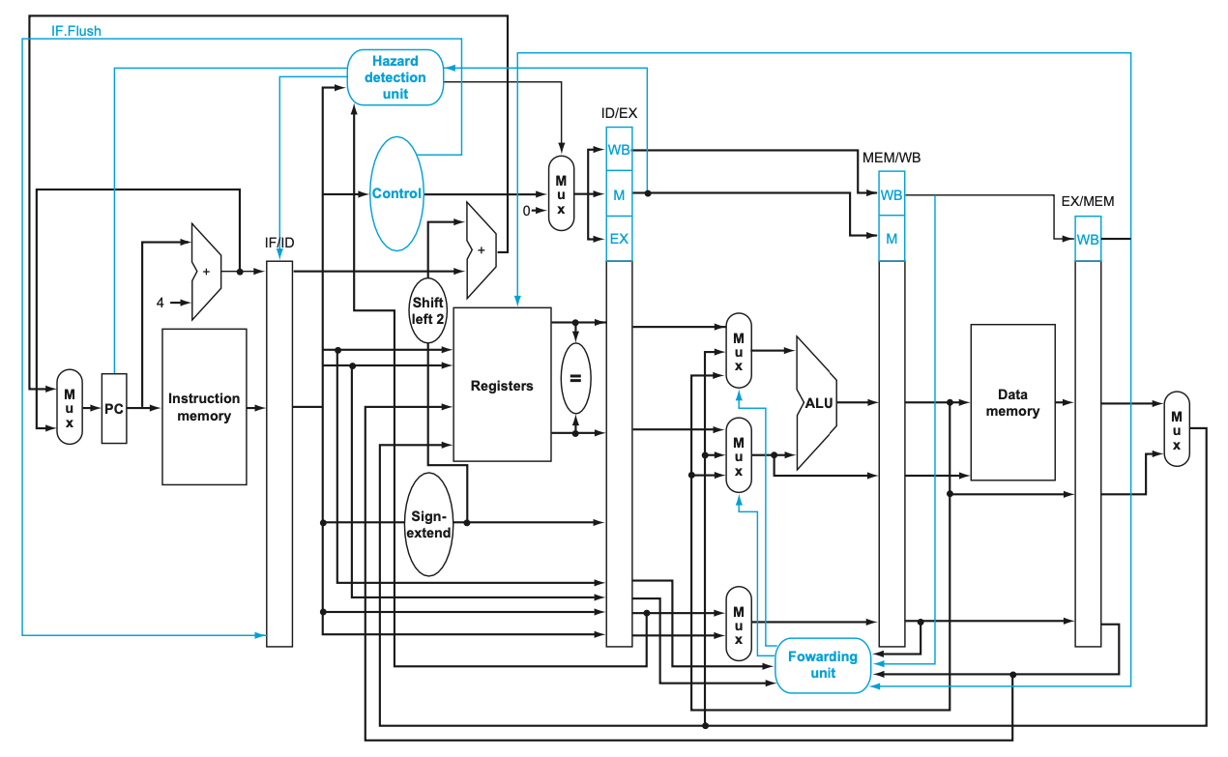
COD 4.65
Full Forwarding to EX
RF Bypass
Predict not taken
Where do Stalls originate?
Decode

Slide 22
COD 4.65 Pipeline Terminology
What is a Stall?
  A D* stall is when the results of D transformed to a NOP for the ID/EX pipeline registers
  F* is different; ID/EX.wen = 0 prevents ID/EX from updating, so D will re-execute on the next clock
When will F Stall (F*)?
  F* will stall only when D* originates a stall

Slide 23
COD 4.65
Full Forwarding to EX
RF Bypass
Predict not taken
+
<<2
=
Where are Branches decided?
Decode

Slide 24
COD 4.65 Pipeline Terminology
What is a Flush?
  A flush is when an instruction in F is transformed into a NOP by muxing in 0’s and registering them in IF/ID pipeline registers (=)
When does full-forwarding, RF bypass, predict not-taken CPU Flush?
  Branches are determined in Decode, and the younger instruction in Fetch will be flushed if the branch is taken

Slide 25
COD 4.65
Full Forwarding to EX
RF Bypass
Predict not taken
add $t0, $t1, $t2
addi $s0, $t0, $s0
Stall?
No. EX-to-EX Forwarding.

Slide 26
COD 4.65
Full Forwarding to EX
RF Bypass
Predict not taken
L1: add $t0, $s0, $s1
L2: addi $s0, $s0, 4
L3: addi $s1, $s1, -4
L4: beq $t0, $s2, L5
Stall?
No. $t0 result is in W, and will use
W→D RF bypass

Slide 27
COD 4.65
Full Forwarding to EX
RF Bypass
Predict not taken
L1: lw $s0, 0($t0)
L2: add $s1, $t1, $s0
L3: beq $s1, $zero, L5
Stall?
Yes. Once for load-to-use on $s0, then
twice for beq on $s1 (RF bypass).

Slide 28
Pipeline Diagrams
2 instructions cannot be in the same stage in the same clock
An instruction cannot stall after being executed
  e.g. D → D*
X, M, and W do not stall in COD 4.65 Full Forward, RF Bypass, Predict-not-taken CPU

Slide 29
Pipeline
Assume five-stage pipeline with forwarding to EX and RF bypassing support. Fill in the blanks such that the following sequence of instructions takes exactly 16 cycles to complete.
L1: sub $s4, $s2, $s3
L2: sw $s2, 8($s1)
L3: __w $s2, 0($s4)
L4: lw ___, 4(___)
L5: add $s1, $zero, $s5
L6: lw $s3, 0($s3)
L7: __w $s1, 0($s3)
L8: add $s2, $s1, $s2

Slide 30
Pipeline
L1: sub $s4, $s2, $s3
L2: sw $s2, 8($s1)
L3: __w $s2, 0($s4)
L4: lw ___, 4(___)
L5: add $s1, $zero, $s5
L6: lw $s3, 0($s3)
L7: __w $s1, 0($s3)
L8: add $s2, $s1, $s2
insn\cycle | 1 | 2 | 3 | 4 | 5 | 6 | 7 | 8 | 9 | 10 | 11 | 12 | 13 | 14 | 15 | 16

Slide 31
Pipeline
Assume five-stage pipeline with forwarding to EX and RF bypassing support. Fill in the blanks such that the following sequence of instructions takes exactly 16 cycles to complete.
L1: sub $s4, $s2, $s3
L2: sw $s2, 8($s1)
L3: lw $s2, 0($s4)
L4: lw $s5, 4($s2)
L5: add $s1, $zero, $s5
L6: lw $s3, 0($s3)
L7: lw $s1, 0($s3)
L8: add $s2, $s1, $s2

Slide 32
Pipeline
L1: sub $s4, $s2, $s3
L2: sw $s2, 8($s1)
L3: lw $s2, 0($s4)
L4: lw $s5, 4($s2)
L5: add $s1, $zero, $s5
L6: lw $s3, 0($s3)
L7: lw $s1, 0($s3)
L8: add $s2, $s1, $s2
insn\cycle | 1 | 2 | 3 | 4 | 5 | 6 | 7 | 8 | 9 | 10 | 11 | 12 | 13 | 14 | 15 | 16
L1 | F | D | X | M | W
L2 |  | F | D | X | M | W
L3 |  |  | F | D | X | M | W
L4 |  |  |  | F | D* | D | X | M | W
L5 |  |  |  |  | F* | F | D* | D | X | M | W
L6 |  |  |  |  |  |  | F* | F | D | X | M | W
L7 |  |  |  |  |  |  |  |  | F | D* | D | X | M | W
L8 |  |  |  |  |  |  |  |  |  | F* | F | D* | D | X | M | W

Slide 33
Happy Studying!
Piazza
E-mail
Wednesday Discussion
  3:30-4:30 PM in 209 Animal Science
Zoom (make an appointment!)

