Slide 1
InFormation and communication
Project
-> Aryaman Mahajan (2022102034)
-> Yash nitin Dusane (2022102078)
FUNDAMENTAL LIMITS OF CACHING

Slide 2
What is CACHING ?
Caching is a technique employed to reduce peak traffic rates by prefetching popular content into memories at the end users.
The frequently accessed data is stored in the local memory of the users, so that the rate of transmission of files from server to user is increased. Thus, this signifies a trade-off between memory and rate.

Slide 3
Examples of caching:
Basic Example :
Web browser:
In a web browser, the cache stores copies of web pages that have been recently visited. This allows the browser to deliver web pages to users faster. The amount of memory that the browser cache can store is a trade-off between the speed at which web pages can be delivered and the amount of memory that the browser uses.
Algorithmic computation , such as Fibonacci Series :
Caching can be employed. The basic idea is to store previously computed Fibonacci numbers in a cache (such as a dictionary or an array), so that they can be quickly retrieved when needed again. The cache keeps track of Fibonacci numbers that have already been calculated, avoiding redundant computations.

Slide 4

Why is caching required in information and communication ?
Main requirement is in :-
Reducing Signal Traffic by memory management algorithms during its ON-Peak and OFF-Peak hours.

Slide 5
Aim of the research paper:
The basic goal of this research paper is to introduce a new novel coded caching approach, which in addition to the ‘local caching gain’, is able to achieve a – ‘global caching gain’.
Adhering to the title, the authors show the upperbounds and lowerbounds on the rate, as well as the memory constraints of using this advanced coded caching approach.

Slide 6
The aim of this paper is to characterize the memory-rate tradeoff. In other words, the authors aim to find the minimum rate of communication over the shared client-server link at which all possible demand tuples of users from the server database can be satisfied.
Aim is also to show that this global caching gain is relevant if the aggregate global cache size is large enough compared to the total amount of content.

Slide 7
The model for the System assumed in the paper :
There exists a shared link between the users and the server, and the link is error-free.

Slide 8

Local Caching

Slide 9
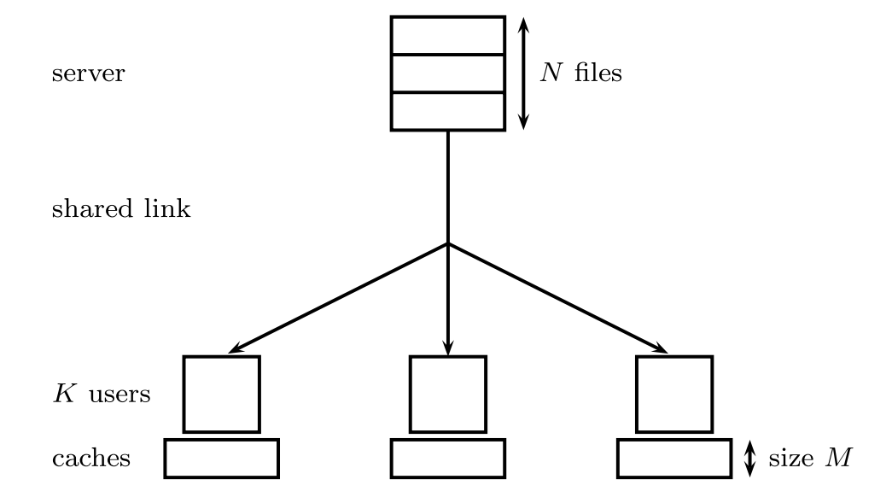
The client-server architecture set up, used in communication of information.

Slide 10
The expression K · (1 − M/N) represents the rate of conventional uncoded caching schemes in the delivery phase. The rate is a measure of the amount of data that needs to be transmitted over the shared link in order to satisfy all user requests.
In this expression, K is the number of users, M is the size of the file that each user caches, and N is the total number of files. The term (1 − M/N) is known as the local caching gain. It represents the fraction of the files that each user can satisfy from its own cache.
The rate of conventional uncoded caching schemes is simply the number of users multiplied by the local caching gain. This means that the rate is equal to the number of users that cannot satisfy their requests from their own cache and need to be served by the shared link.

Slide 11
Is local caching enough?
Lets find out →→

Slide 12
Global Caching

Slide 13
Global Caching Gain
The local caching gain being employed traditionally involves exploiting the historical statistics of the user demands.
However, in the global caching , gain derives from jointly optimizing both the placement and delivery phases, ensuring that in the delivery phase several different demands can be satisfied with a single coded multicast transmission.
This implies, even though we use the single coded multicast transmission, which involves sending the same data stream to all the recipients at the same time, we can still ensure to meet their demands of different data each.

Slide 14
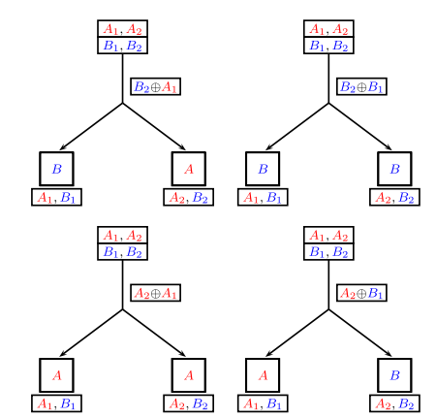
example

Slide 15
The expression K · (1 − M/N) · 1/(1 + KM/N) represents the rate of the coded caching scheme proposed in the paper. The rate is a measure of the amount of data that needs to be transmitted over the shared link in order to satisfy all user requests.
The expression has two terms. The first term, K · (1 − M/N), is the same as the rate of conventional uncoded caching schemes. This term represents the local caching gain. The second term, 1/(1 + KM/N), is known as the global caching gain. It represents the fraction of the files that can be satisfied by all users from the coded transmissions.
The global caching gain is a significant improvement over the local caching gain. For example, if there are 10 users, each of which caches 50% of the files, then the local caching gain is 0.5 and the global caching gain is 0.75. This means that the coded caching scheme can satisfy 75% of the user requests from the coded transmissions, which is a significant improvement over the 50% that can be satisfied from the user's own caches.

Slide 16
GAIN OBTAINED BY CACHING
Global gain
Local gain
The gain offered by this approach, which we term local caching gain, depends on the local cache size (i.e., the memory available at each individual user)
This gain depends on the aggregate global cache size (i.e., the cumulative memory available at all users), even though there is no cooperation among the users.

Slide 17
The global caching gain is achieved by exploiting the broadcast nature of the shared link. The coded transmissions are designed such that they can be decoded by multiple users. This allows the server to transmit less data overall, since it does not need to transmit the same data to multiple users.
This gain is relevant if the local cache memory is large enough such that a sizable fraction of the total (popular) content can be stored locally

Slide 18
The mathematics of global vs Local caching gain
The local caching gain animation is up next.

Slide 19


Slide 20


Main Results of the Paper:

Slide 22


